Slide 1
Date: 11.01.21
LO To be able to count to 10.
Subject: Maths

Slide 2
Pre-recorded Teaching
Access the online teaching video below that will support you to complete the work in this lesson. This video will act as a support but all of the work can still be successfully understood & completed using paper-based versions of this pack. If you need further support to understand / complete work then please contact school via e-mail or telephone.
Play Video

Slide 3
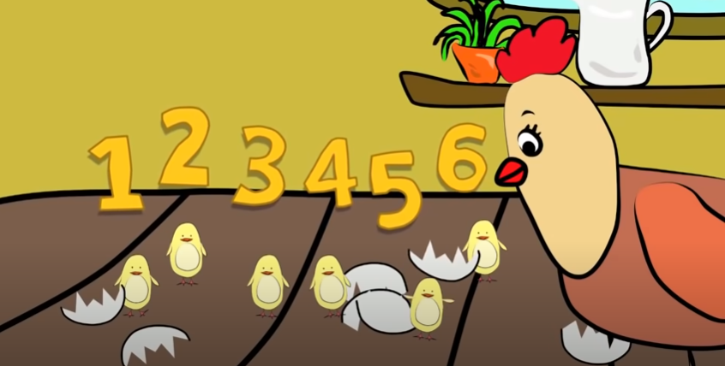
Watch this video. Can you join in and count to 10?
https://www.youtube.com/watch?v=DR-cfDsHCGA
Click the above link or copy and paste into the internet.
‘Counting 1-10 Song | Number Songs for Children | The Singing Walrus’ - YouTube

Slide 4
Counting to 10

Slide 5
Which number is missing?
Count from 1 until you find your missing number.
If you are working on a computer, insert a text box to type your answer.
Answer: _________

Slide 6
Which number is missing?
Count from 1 until you find your missing number.
If you are working on a computer, insert a text box to type your answer.
Answer: _________

Slide 7
Which number is missing?
Count from 1 until you find your missing number.
If you are working on a computer, insert a text box to type your answer.
Answer: _________

Slide 8
Which number is missing?
Count from 1 until you find your missing number.
If you are working on a computer, insert a text box to type your answer.
Answer: _________

Slide 9
Fill in the missing numbers …
1 2 ___ 4 ___ 6 ___ 8 ___ 10
1 ___ 3 ___ 5 ___ 7 ___ 9 ___
1 2 3 ___ ___ 6 ___ 8 ___ ____
If you are working on a computer, insert a text box to type your answer.

Slide 10
Date: 12.01.21
LO To be able to form numbers correctly.
Subject: Maths

Slide 11
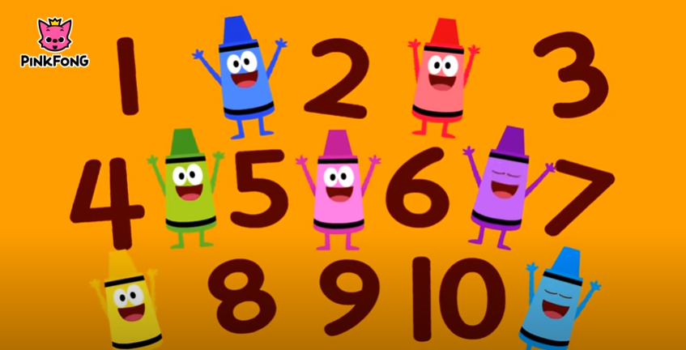
Watch this video. This will help you write your numbers today!
https://www.youtube.com/watch?v=DzKqCmjVXLI
Click the above link or copy and paste into the internet.
‘Writing Numbers | Number Songs | PINKFONG Songs for Children’ - YouTube

Slide 12
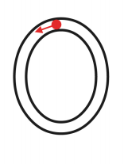
Zero
Practise writing the number 0 on some paper at home.
We would love it if your grown ups could take a picture of your super neat numbers and send it into school so we can see!

Slide 13
One
Practise writing the number 1 on some paper at home.
We would love it if your grown ups could take a picture of your super neat numbers and send it into school so we can see!
Watch the video and sing along to the rhyme to help you write the number 1.

Slide 14
Two
Practise writing the number 2 on some paper at home.
We would love it if your grown ups could take a picture of your super neat numbers and send it into school so we can see!
Watch the video and sing along to the rhyme to help you write the number 2.

Slide 15
Three
Practise writing the number 3 on some paper at home.
We would love it if your grown ups could take a picture of your super neat numbers and send it into school so we can see!
Watch the video and sing along to the rhyme to help you write the number 3.
If you’re in Miss McCartney’s class, you will be able to tell your grown ups our own rhyme to help us write number 3!
‘Around the tree, around the tree, that’s how you write the number three’.

Slide 16
Four
Practise writing the number 4 on some paper at home.
We would love it if your grown ups could take a picture of your super neat numbers and send it into school so we can see!
Watch the video and sing along to the rhyme to help you write the number 4.
If you’re in Miss McCartney’s class, you will be able to tell your grown ups our own rhyme to help us write number 4!
‘Down and across, down some more, that’s how you write the number four’.

Slide 17
Five
Practise writing the number 5 on some paper at home.
We would love it if your grown ups could take a picture of your super neat numbers and send it into school so we can see!
Watch the video and sing along to the rhyme to help you write the number 5.
If you’re in Miss McCartney’s class, you will be able to tell your grown ups our own rhyme to help us write number 5!
‘Make his hat, make his back, make his tummy round and fat’.

Slide 18
Six
Practise writing the number 6 on some paper at home.
We would love it if your grown ups could take a picture of your super neat numbers and send it into school so we can see!
Watch the video and sing along to the rhyme to help you write the number 6.

Slide 19
Seven
Practise writing the number 7 on some paper at home.
We would love it if your grown ups could take a picture of your super neat numbers and send it into school so we can see!
Watch the video and sing along to the rhyme to help you write the number 7.

Slide 20
Eight
Practise writing the number 8 on some paper at home.
We would love it if your grown ups could take a picture of your super neat numbers and send it into school so we can see!
Watch the video and sing along to the rhyme to help you write the number 8.
If you’re in Miss McCartney’s class, you will be able to tell your grown ups our own rhyme to help us write number 8!
‘There’s a snake, shut the gate, that’s how you make the number eight’.

Slide 21
Nine
Practise writing the number 9 on some paper at home.
We would love it if your grown ups could take a picture of your super neat numbers and send it into school so we can see!
Watch the video and sing along to the rhyme to help you write the number 9.
If you’re in Miss McCartney’s class, you will be able to tell your grown ups our own rhyme to help us write number 9!
‘Make a circle, make a line, that’s how you make the number nine’.

Slide 22
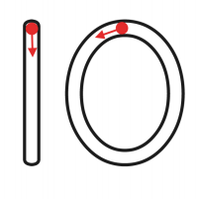
Ten
Practise writing the number 10 on some paper at home.
We would love it if your grown ups could take a picture of your super neat numbers and send it into school so we can see!
Watch the video and sing along to the rhyme to help you write the number 10.

Slide 23
Date: 13.01.21
LO To be able to count accurately.
Subject: Maths

Slide 24
Pre-recorded Teaching
Access the online teaching video below that will support you to complete the work in this lesson. This video will act as a support but all of the work can still be successfully understood & completed using paper-based versions of this pack. If you need further support to understand / complete work then please contact school via e-mail or telephone.
Play Video

Slide 25
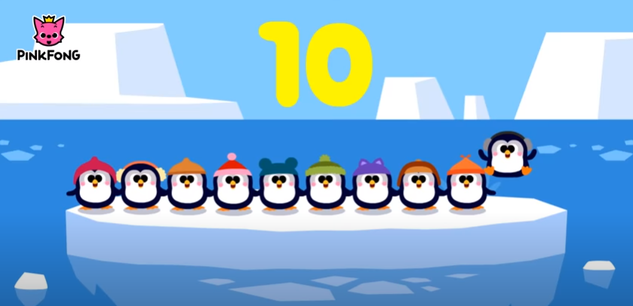
Watch this video. Can you join in with counting the penguins?
https://www.youtube.com/watch?v=Yt8GFgxlITs
Click the above link or copy and paste into the internet.
‘Counting 1 to 10 | Number Songs | PINKFONG Songs for Children’ - YouTube

Slide 26
Count the objects
Write the answer in the box next to the shapes.
Remember, use your finger and count every time you touch a new object.
1.
2.
3.

Slide 27
Count the objects
Write the answer in the box next to the shapes.
Remember, use your finger and count every time you touch a new object.
4.
5.
6.

Slide 28
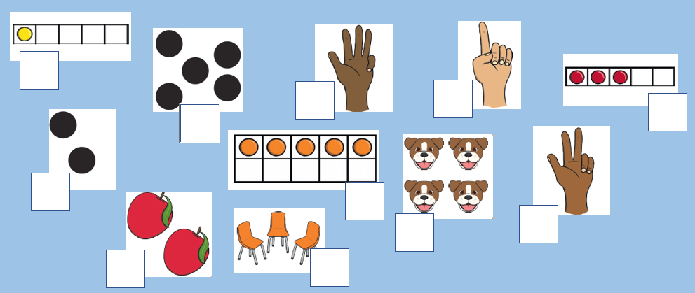
Count the objects and write the number in the box
1.
5.
8.
10.
3.
2.
6.
9.
11.
4.
7.
If you are working on a computer, insert a text box to type your answer.

Slide 29
Challenge!
Choose something you would like to draw.
I want you to draw 6 objects!
Make sure you keep counting so you draw the correct amount.

Slide 30
Date: 14.01.21
LO To be able to add within 10.
Subject: Maths

Slide 31
Pre-recorded Teaching
Access the online teaching video below that will support you to complete the work in this lesson. This video will act as a support but all of the work can still be successfully understood & completed using paper-based versions of this pack. If you need further support to understand / complete work then please contact school via e-mail or telephone.
Play Video

Slide 32
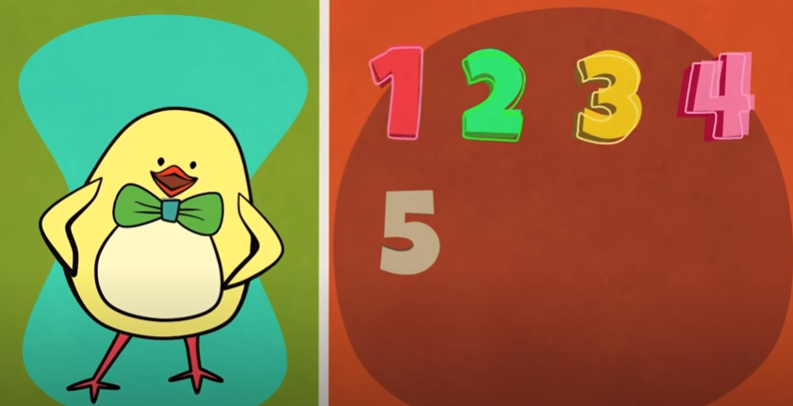
Warm your maths brain up by watching this video and singing along!
https://www.youtube.com/watch?v=HkkYaj0m6cg
Click the above link or copy and paste into the internet.
‘Funky Counting Song | Numbers 1-10 | The Singing Walrus’ - YouTube

Slide 33
Adding 1
My turn!
+
3 + 1 = 4
I counted the counters altogether to find the answer!

Slide 34
Adding 1
Your turn!
+
4 + 1 = ___
Use the counters to help you work out the answer.

Slide 35
Adding 1
Your turn!
+
5 + 1 = ___
Use the pictures to help you work out the answer.

Slide 36
Adding 1
Your turn!
+
2 + 1 = ___
Use the pictures to help you work out the answer.

Slide 37
Adding 1
Your turn!
3 + 1 = ___
6 + 1 = ___
7 + 1 = ___
4. 5 + 1 = ___
5. 8 + 1 = ___
6. 9 + 1 = ___
Use your fingers or draw counters to help you.

Slide 38
Date: 15.01.21
LO To be able to add within 10.
Subject: Maths

Slide 39
Pre-recorded Teaching
Access the online teaching video below that will support you to complete the work in this lesson. This video will act as a support but all of the work can still be successfully understood & completed using paper-based versions of this pack. If you need further support to understand / complete work then please contact school via e-mail or telephone.
Play Video

Slide 40
Warm your maths brain up by counting to 20 and working out!
https://www.youtube.com/watch?v=_MVzXKfr6e8&t=9s
Click the above link or copy and paste into the internet.
‘Count to 20 and Workout | Fun Counting Song for Kids | Count by 1's to 20 | Jack Hartmann’ - YouTube

Slide 41
Adding
My turn!
+
3 + 2 = 5
I counted the counters altogether to find the answer!

Slide 42
Adding
Your turn!
+
4 + 2 = ___
Use the counters to help you work out the answer.

Slide 43
Adding
Your turn!
+
3 + 3 = ___
Use the pictures to help you work out the answer.

Slide 44
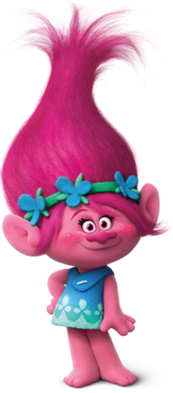
Adding
Your turn!
+
4 + 3 = ___
Use the pictures to help you work out the answer.

Slide 45
Adding 1
Your turn!
3 + 2 = ___
6 + 3 = ___
7 + 2 = ___
4. 5 + 3 = ___
5. 8 + 2 = ___
6. 9 + 1 = ___
Use your fingers or draw counters to help you.

Slide 46
Well done for your hard work this week!
Keep practising your counting and writing your numbers.
Could any completed work / photographic evidence of completed work please be sent to Pioneerspupils@gmail.com

