Slide 1
Subject: English
Pack: B

Slide 2
Date: Monday 1st February
LO To be able to follow instructions to make a ham and cheese sandwich.
Subject: English

Slide 3
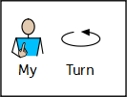
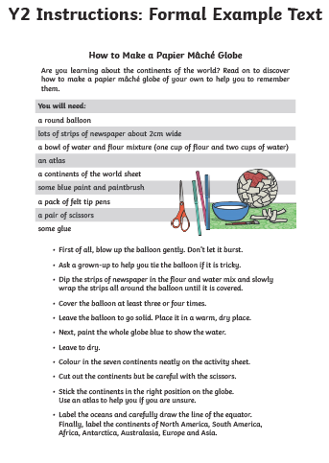
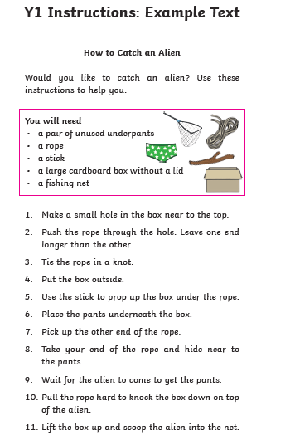
Instructions
This week we are going to be focusing on instructions!
What are instructions?
Instructions tell you how to make something step by step.
Here are some examples

Slide 4
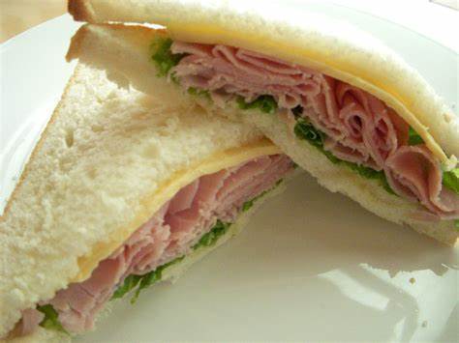
How to make a ham & cheese sandwich
Your job is to follow the instructions to make a delicious ham, cheese and lettuce sandwich.

Slide 5
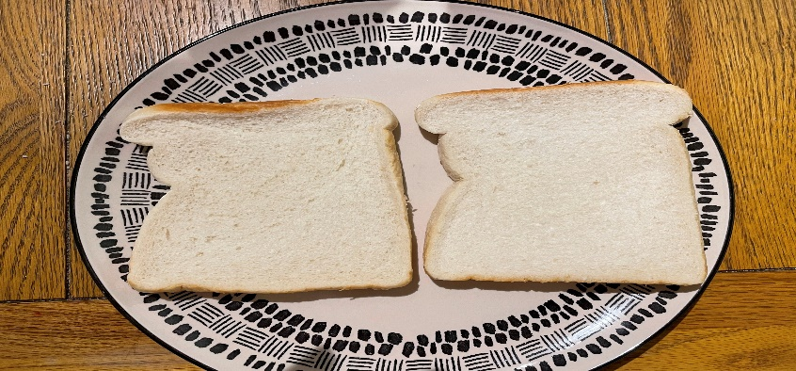
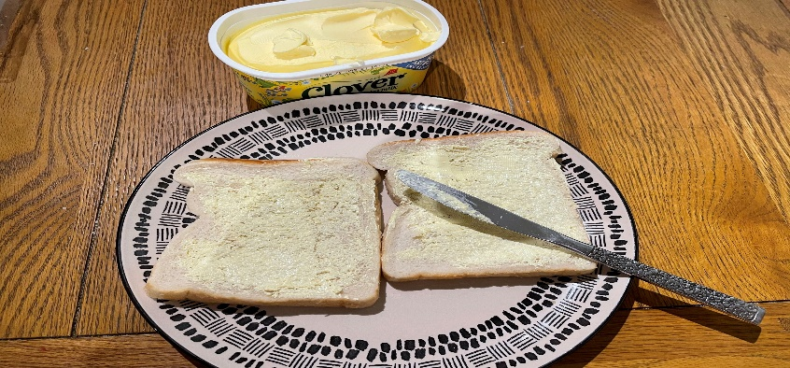
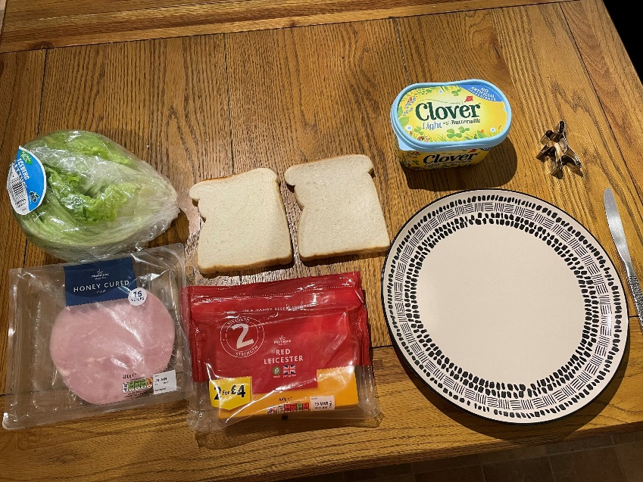
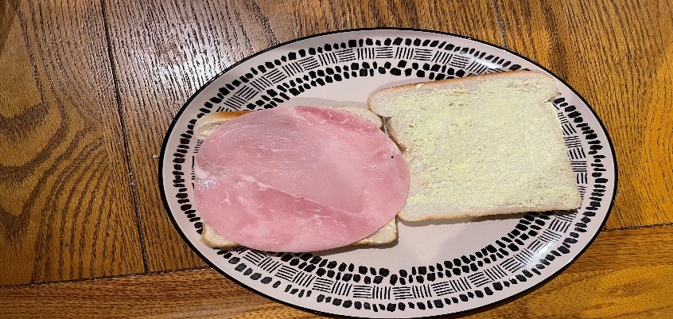
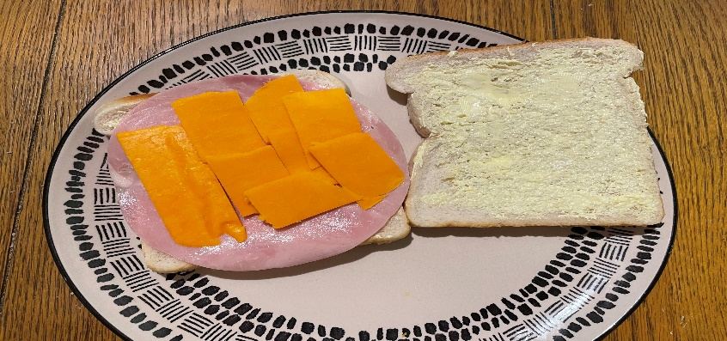
How to make a ham & cheese sandwich
First we need to read my instructions to find out what we will need and what we have to do.
1. Put your two slices of bread onto the plate.
You will need:
2 slices of bread
Butter or margarine
Ham
Cheese
Lettuce
1 plate
1 knife
Animal shaped cutter (Optional)
2. Spread the butter or margarine onto one side of each slice of bread.
3. Place one slice of ham onto the buttered side of one of the slices of bread.
4. Cut the cheese into four or five small slices and place the cheese on top of the ham.
Continued on the next slide

Slide 6
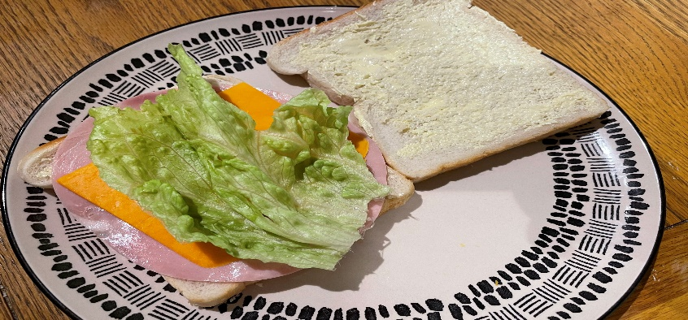
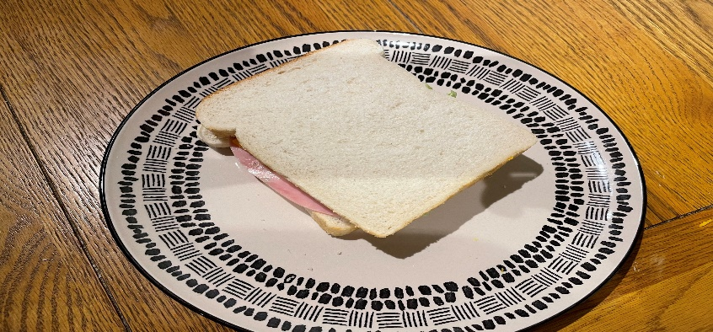
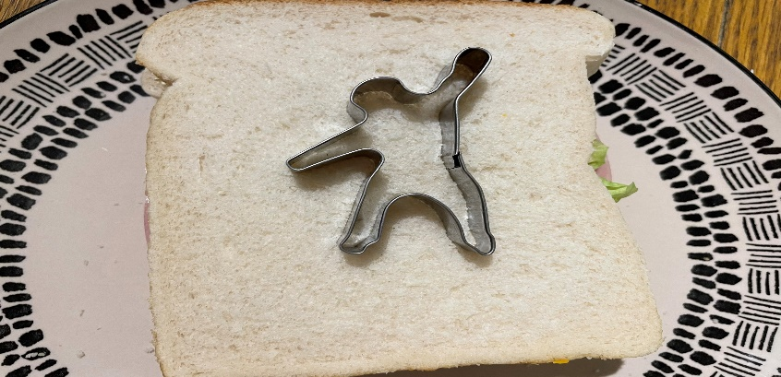
How to make a ham & cheese sandwich
5. Peel off one lettuce leaf and put the lettuce on top of the ham and cheese.
6. Place the other slice of bread on top of the sandwich with the buttered side on top of the lettuce.
7. *Optional – cut your sandwich into the shape of a rainforest animal using a special cutter or your knife.
8.Finally, enjoy your delicious ham and cheese sandwich.

Slide 7
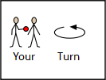
How to make a ham & cheese sandwich
Now it's your turn!
On the next two slides you will find another copy of the instructions. Make sure you follow the instructions carefully and tick off each step once you have completed the instruction.
You might find it useful to take photos of you doing each stage of the instructions. This will help with your writing later in the week.
If you don’t have any of the ingredients you can miss out that step or use an alternative filling. For example, if you don’t have ham you could just make a cheese sandwich. Or you could swap the ham to chicken.

Slide 8
How to make a ham & cheese sandwich
Follow the instructions and tick off each step once you have completed that instruction.
1. Put your two slices of bread onto the plate.
You will need:
2 slices of bread
Butter or margarine
Ham
Cheese
Lettuce
1 plate
1 knife
Animal shaped cutter (Optional)
2. Spread the butter or margarine onto one side of each slice of bread.
3. Place one slice of ham onto the buttered side of one of the slices of bread.
4. Cut the cheese into four or five small slices and place the cheese on top of the ham.
Continued on the next slide

Slide 9
How to make a ham & cheese sandwich
5. Peel off one lettuce leaf and put the lettuce on top of the ham and cheese.
6. Place the other slice of bread on top of the sandwich with the buttered side on top of the lettuce.
7. *Optional – cut your sandwich into the shape of a rainforest animal using a special cutter or your knife.
8.Finally, enjoy your delicious ham and cheese sandwich.

Slide 10
How to make a ham & cheese sandwich
Now for the best part – eating the sandwich! We hope you enjoy your delicious sandwich.
We would love to see photos of you making your sandwich and your finished product!

Slide 11
Well done for all of your hard work! We can’t wait to see your completed work.
Could any completed work / photographic evidence of completed work please be sent to pioneerspupils@gmail.com
Thank you!

Slide 12
Date: Tuesday 2nd February
LO To be able to identify features of instructions.
Subject: English

Slide 13
How to make a ham & cheese sandwich
Let's re read the instructions to get them back into our head!
1. Put your two slices of bread onto the plate.
You will need:
2 slices of bread
Butter or margarine
Ham
Cheese
Lettuce
1 plate
1 knife
Animal shaped cutter (Optional)
2. Spread the butter or margarine onto one side of each slice of bread.
3. Place one slice of ham onto the buttered side of one of the slices of bread.
4. Cut the cheese into four or five small slices and place the cheese on top of the ham.
Continued on the next slide

Slide 14
How to make a ham & cheese sandwich
5. Peel off one lettuce leaf and put the lettuce on top of the ham and cheese.
6. Place the other slice of bread on top of the sandwich with the buttered side on top of the lettuce.
7. *Optional – cut your sandwich into the shape of a rainforest animal using a special cutter or your knife.
8.Finally, enjoy your delicious ham and cheese sandwich.

Slide 15
Features of instructions …
Use the key below to help you find the features!
On the next two slides you will find my instructions on how to make a ham, cheese and lettuce sandwich. Use the key to highlight/underline the key features in the correct colour.
Key:
Title
Ordinal numbers
Imperative verbs
Pictures
Top Tips:
Imperative verbs are ‘bossy’ doing words.
Ordinal numbers are just numbers that count in order.

Slide 16
How to make a ham & cheese sandwich
Let's re read the instructions to get them back into our head!
1. Put your two slices of bread onto the plate.
You will need:
2 slices of bread
Butter or margarine
Ham
Cheese
Lettuce
1 plate
1 knife
Animal shaped cutter (Optional)
2. Spread the butter or margarine onto one side of each slice of bread.
3. Place one slice of ham onto the buttered side of one of the slices of bread.
4. Cut the cheese into four or five small slices and place the cheese on top of the ham.
Continued on the next slide

Slide 17
How to make a ham & cheese sandwich
Use the key to help you find the features!
5. Peel off one lettuce leaf and put the lettuce on top of the ham and cheese.
6. Place the other slice of bread on top of the sandwich with the buttered side on top of the lettuce.
7. *Optional – cut your sandwich into the shape of a rainforest animal using a special cutter or your knife.
8.Finally, enjoy your delicious ham and cheese sandwich.

Slide 18
Well done for all of your hard work! We can’t wait to see your completed work.
Could any completed work / photographic evidence of completed work please be sent to pioneerspupils@gmail.com
Thank you!

Slide 19
Date: Wednesday 3rd February
LO To be able to use imperative verbs.
Subject: English

Slide 20
Pre Recorded Teaching
On the school website you will find a pre recorded video that will support the teaching of todays lesson.

Slide 21
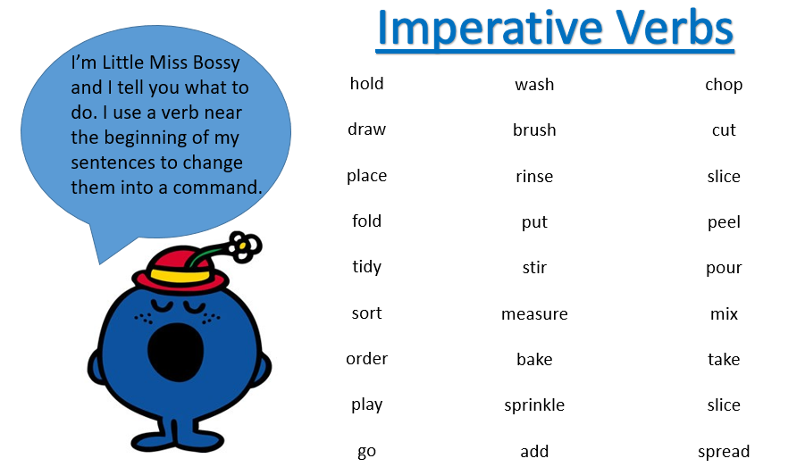
Imperative verbs
What are verbs?
Verbs are doing words – they are used to describe an action for example run, jump, cut or wipe.
What are imperative verbs?
Imperative verbs are still doing words but they are used to tell somebody else what to do.
Sometimes people call imperative verbs ‘bossy words’ because they tell people what to do!

Slide 22
Read the verbs
jump
eat
run
clap
draw
Verbs
paint
cut
sing
laugh
cry
These words are all actions that people can do.

Slide 23
Imperative verbs
Can you do the actions to represent these verbs?

Slide 24
Match the picture to the verb
jog
clap
jump
sing
wave

Slide 25
Match the picture to the verb - answers
jog
clap
jump
sing
wave

Slide 26
Imperative verbs
Lets look at some examples of verbs linked to cooking

Slide 27
Fill in the missing verbs
Choose from these verbs:

Slide 28
Fill in the missing verbs - answers
Spread
Choose from these verbs:
Put
Cut

Slide 29
Imperative verbs
Now it’s your turn!
Pick 3 of the verbs below and write 3 instructions on how to make a ham and cheese sandwich. Remember you can look back at mine if you need any help!
Each sentence should include a different verb.
Don’t forget:
Write your sentences neatly onto a piece of paper or type them on the lines below.

Slide 30
Well done for all of your hard work! We can’t wait to see your completed work.
Could any completed work / photographic evidence of completed work please be sent to pioneerspupils@gmail.com
Thank you!

Slide 31
Date: Thursday 4th February
LO To be able to write instruction on how to make a ham, cheese and lettuce sandwich.
Subject: English

Slide 32
How to make a ham & cheese sandwich
Let's Re read my instructions to get them back in our head!
1. Put your two slices of bread onto the plate.
You will need:
2 slices of bread
Butter or margarine
Ham
Cheese
Lettuce
1 plate
1 knife
Animal shaped cutter (Optional)
2. Spread the butter or margarine onto one side of each slice of bread.
3. Place one slice of ham onto the buttered side of one of the slices of bread.
4. Cut the cheese into four or five small slices and place the cheese on top of the ham.
Continued on the next slide

Slide 33
How to make a ham & cheese sandwich
5. Peel off one lettuce leaf and put the lettuce on top of the ham and cheese.
6. Place the other slice of bread on top of the sandwich with the buttered side on top of the lettuce.
7. *Optional – cut your sandwich into the shape of a rainforest animal using a special cutter or your knife.
8.Finally, enjoy your delicious ham and cheese sandwich.

Slide 34
Pre Recorded Teaching
On the school website you will find a pre-recorded video that will support the teaching of today's lesson. There is a video modelling today's writing to help you understand the task further.

Slide 35
Write your instructions
Today you are going to write instructions to tell people how to make a ham, cheese and lettuce sandwich.
Your instructions must include:
A title
Pictures (can be drawn or photos)
Ordinal numbers
Imperative verbs
At least 6 steps
Remember:
Ordinal numbers are numbers that count in order.
Imperative verbs are ‘bossy’ doing words.
You can use the template on the next slide to type your instructions or you can write them neatly on a piece of paper.
Don’t forget:
This piece of writing should take approximately 45 minutes
You will also find my pictures on slide 36 which you can cut and stick onto your instructions. Or you could draw your own.

Slide 38
Pictures to cut and stick onto your instructions
Don’t forget you can draw your own pictures or use photographs you took of your own sandwich!

Slide 39
Date: Friday 5th February
LO To be able to read and spell words with the ‘ee’ sound.
Subject: English

Slide 40
ee
The sound we are focusing on today is ee.
The ee sound is used at the end of words or in the middle of words.
Click on the links or copy and paste the links into your internet browser to watch the phonics videos.
Phonics Lesson - Set 2 'ee' sound for Reception and Year 1 - YouTube
'ee' Words | Blending Phonics Phase 3 – YouTube
Mr Thorne Does Phonics - Episode EE (20,000 Subs Edition) – YouTube

Slide 41
Read the ‘ee’ words
see
need
keep
bee
week
feet
deep
seek
feed
tree
glee
peek
Now write the words on a piece of paper and underline the ‘ee’ sound.

Slide 42
word | 1st try | 2nd try | 3rd try
bee
see
tree
need
week
feet
keep
deep
Practice writing the words on a piece of paper or type into the table on your computer.

Slide 43
Match the picture to the correct word
week
tree
feet
bee

Slide 44
Match the picture to the correct word - answers
week
tree
feet
bee

Slide 45
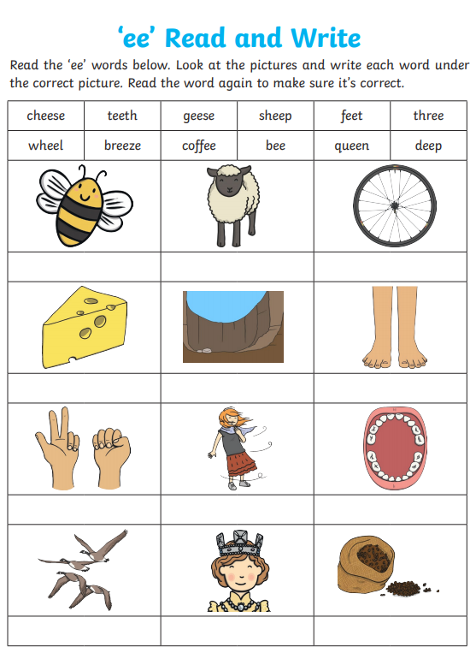
Read and write

Slide 46
‘ee’ sound
Now pick 3 ‘ee’ words and write a sentence including each word.
bee
tree
keep
need
see
deep
feet
week

Slide 47
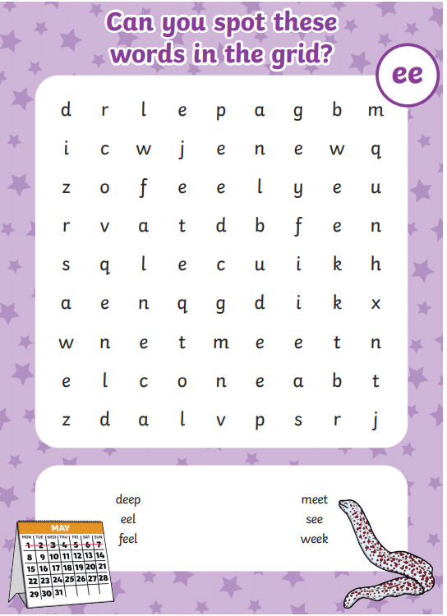
Word search

Slide 48
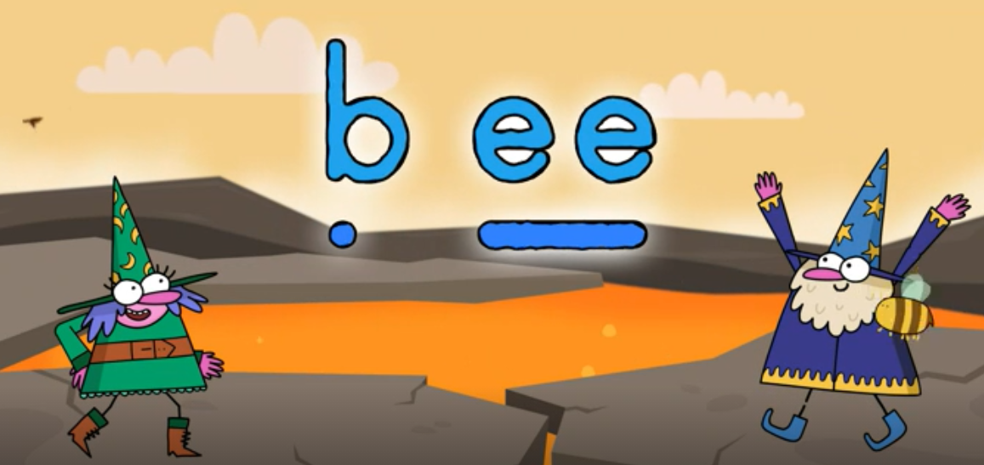
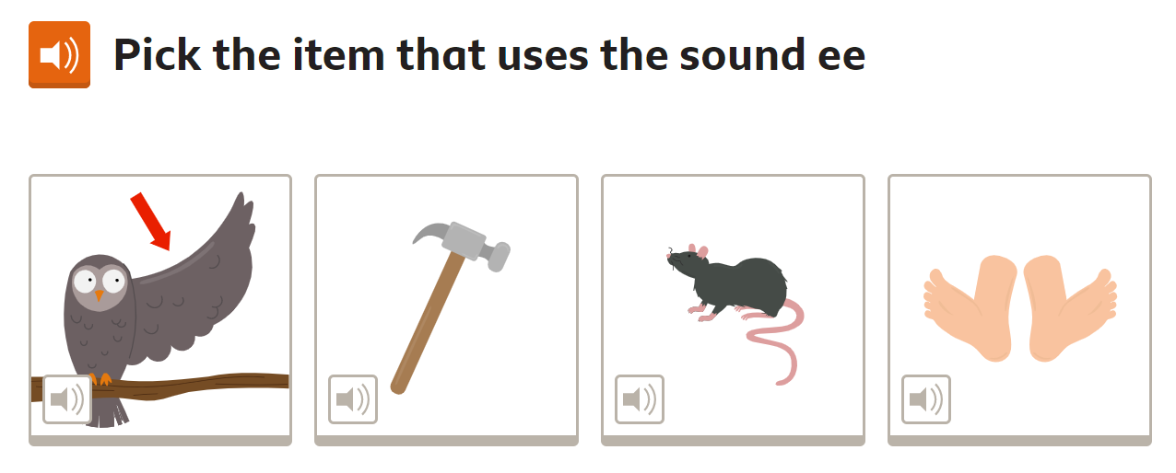
Spelling game!
Use the link to play the game and practice spelling the ‘ee’ words
The ee sound | Phase 3 Phonics | ee words - BBC Bitesize

Slide 49
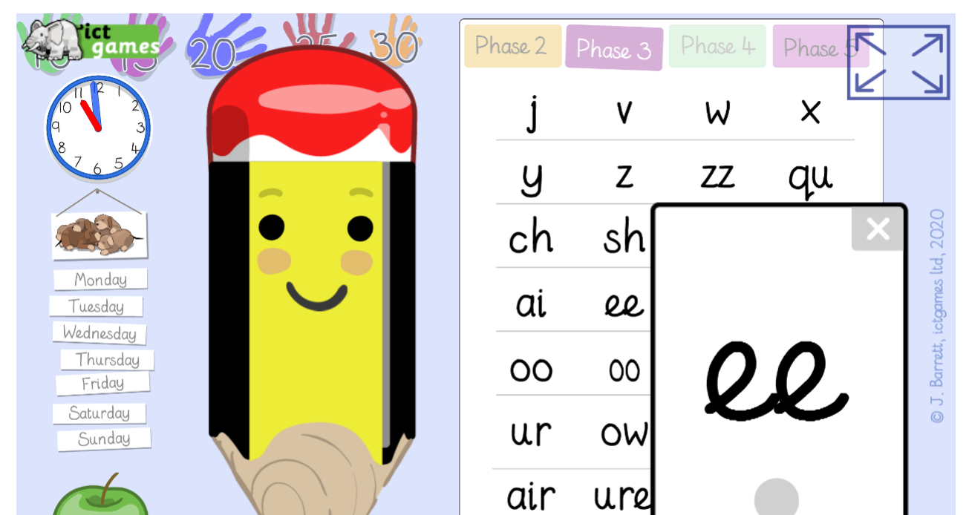
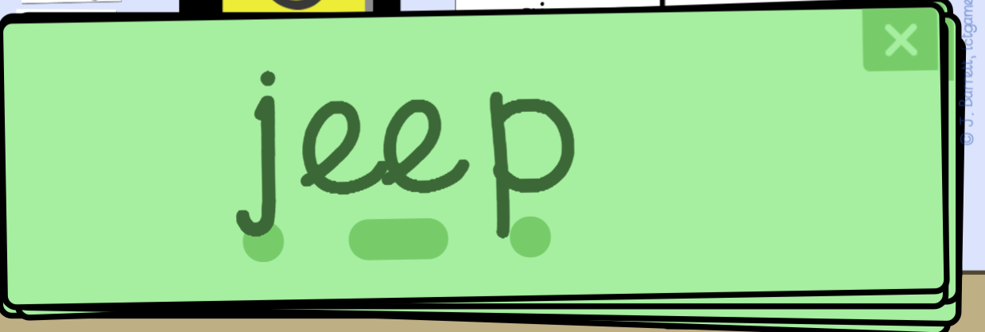
Spelling game!
Use the link to play the game and practice reading the ‘ee’ words
Sound Sayer (ictgames.com)

Slide 50
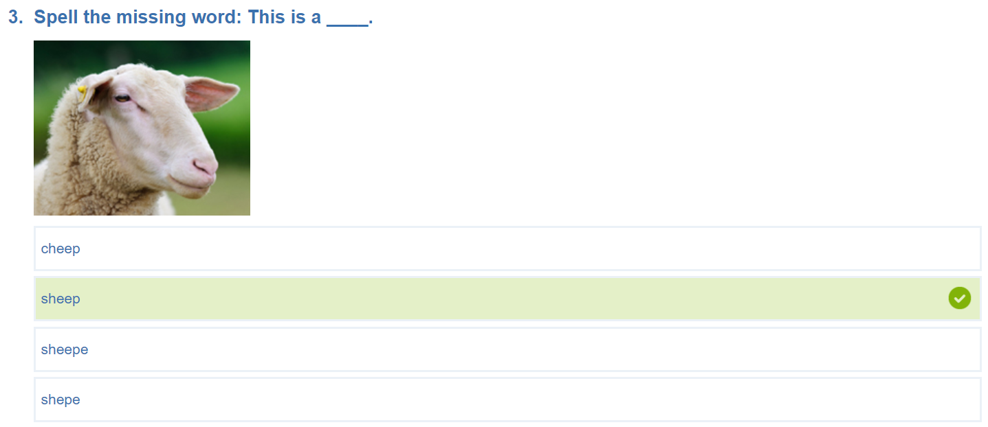
Spelling game!
Use the link to play the game and practice spelling the ‘ee’ words
KS1 Spelling | The Sound EE Quiz for Year 1 Children (educationquizzes.com)

Slide 51
Well done for all of your hard work! We can’t wait to see your completed work.
Could any completed work / photographic evidence of completed work please be sent to pioneerspupils@gmail.com
Thank you!

