Slide 1
Good day everyone, hope you are all fit and well and keeping safe. Danielle and I are missing you already, we hope you have had a lovely Christmas and Santa was good to you.
Here is a little bit of work to keep you busy and don’t forget to keep all of your work for your journals.
See you all soon ☺
Clare and Danielle
(any queries adults please don’t hesitate to contact school and ask for us)

Slide 2


Date: Tuesday 4th January
LO To be able to listen to a story and verbally retell it.
Subject: English

Slide 3
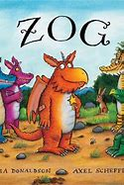
https://www.bbc.co.uk/iplayer/episode/b0bwdw8y/zog
Over the next few days we thought the children might like to learn and read the book Zog, there first lesson is to just watch and retell the story in their own words.
Here is a link for you to watch the short movie.
Task 1

Slide 4
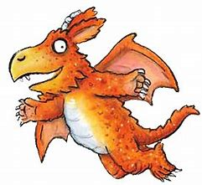
Pointy teeth
_____ wings
_____ ears
_____ mouth
_____ nails
_____ nose
_____ tummy
Now you have read/listened to the story can you now add some adjectives to our nouns to describe Zog, the main character.
Here is some adjectives to get you started, can you think of your own.
orange spiky bumpy sharp long pointy fluffy large white hairy bright wide

Slide 5
Date: Wednesday 5th January
LO To be able to write a short sentence using adjectives.
Subject: English

Slide 6
Can you now use your adjectives from yesterday and create your own short sentences .
EXAMPLE:
Zog has pointy teeth.
His wings are orange.
Task 1
Don’t forget to use your full stops, capital letters and finger spaces.
CHALLENGE
Now extended you sentence by using conjunctions for example and, but, because.
Here is a example to get you started.
Zog has pointy teeth and a green tongue.

Slide 7
Date: Thursday 6th January
LO To be able sequence the story
Subject: English

Slide 8
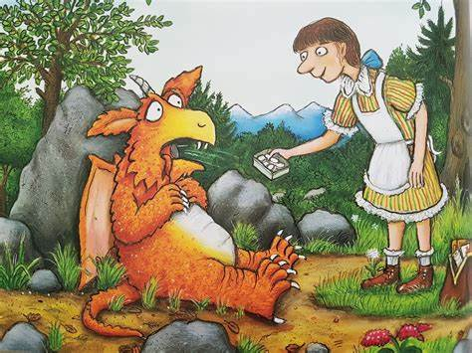
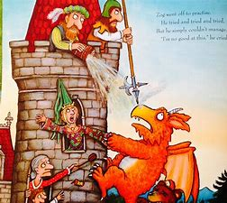
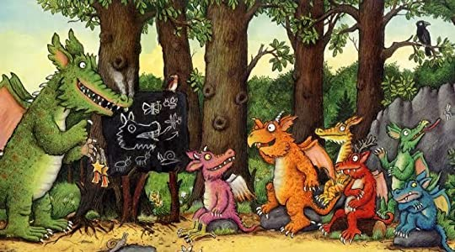
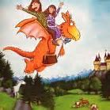
Can you watch the story again and sequence the with your family. Here is some pictures to help you out.
CHALLENGE
Now can you write a sentence for each picture describing what is happening

Slide 9
Date: Friday 7th January
LO To be able identify rhyming words.
Subject: English

Slide 10
Can you make a list of rhyming words from the book for example ago and know, far and star, fly and sky.
Task 1
Remember guys, rhyming words sound the same but does not always look the same for example flew and blue.
CHALLENGE
Now use your rhyming words in a sentence.
For example
“what a good idea” said Zog. Then up and off her flew.
The flying doctors waving as they zigzagged through the blue.
Here is a website to help support your task, its all about rhyming.
https://www.phonicsplay.co.uk/resources/phase/1/hickory-dickory-dock

