Slide 1
Date: Tuesday 5th January
LO To be able to identify adjectives to describe Winnie’s holiday.
Subject: English

Slide 2
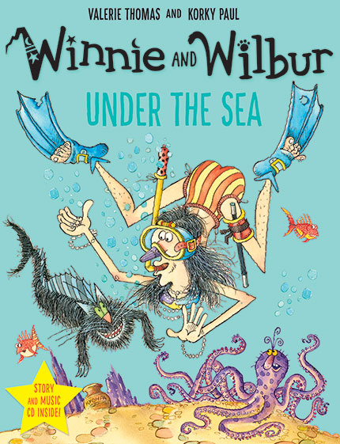
This is our story book for the next two weeks.
Hope you enjoy it!
https://www.youtube.com/watch?v=D5YE4rxQJhg
Click on the link or copy and paste into the internet to listen to the story being read.

Slide 3
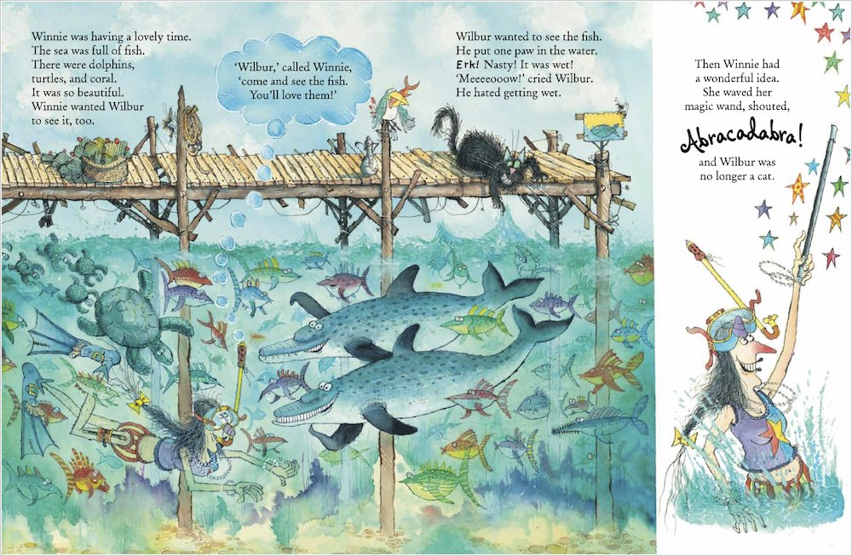

Slide 4
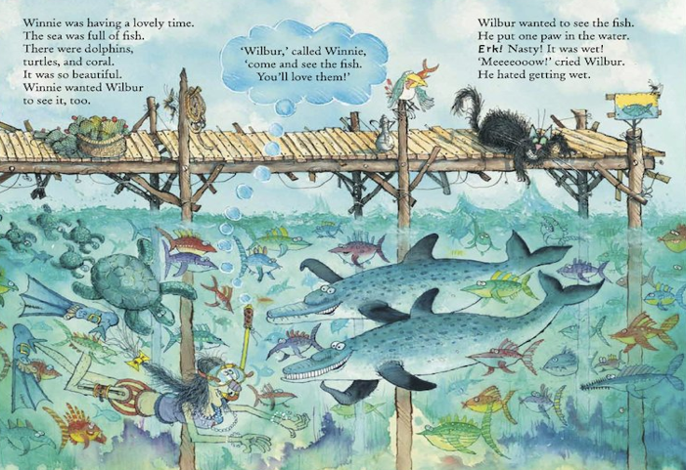
Example
Setting description
Read my description …
Look out for adjectives in red
Winnie swam down into the deep water. It was filled with colourful fish and slimy seaweed. On top of the water stood a brown jetty. Wilbur the mischievous cat tried to grab a delicious fish for his dinner. The sky was filled with grey clouds and the strong waves crashed against the wooden poles. Winnie explored the water through her red and yellow snorkel as the creatures floated around her. The small turtles darted after their green mother swimming elegantly above Winnie’s head.
Can you point to all of the capital letters and full stops?

Slide 5
Winnie swam down into the deep water. It was filled with colourful fish and slimy seaweed. On top of the water stood a brown jetty. Wilbur the mischievous cat tried to grab a delicious fish for his dinner. The sky was filled with grey clouds and the strong waves crashed against the wooden poles. Winnie explored the water through her red and yellow snorkel as the creatures floated around her. The small turtles darted after their green mother swimming elegantly above Winnie’s head.
What is an adjective?
A describing word!
‘the small turtles’
Read through the description again and highlight or colour in the adjectives.

Slide 6
Nouns are things.
clouds
sky
Wilbur
jetty
waves
turtles
Winnie
fish
seaweed
snorkel
water
Can you think of any others?

Slide 7
Date: Wednesday 6th January
LO To be able to write sentences using adjectives to describe the setting.
Subject: English

Slide 8
Setting

Slide 9
Nouns are things.
clouds
sky
Wilbur
jetty
waves
turtles
Winnie
fish
seaweed
snorkel
water
Can you think of any others?

Slide 10
Adjectives are describing words.
Complete the noun phrases by
adding 1 adjective before the noun.
deep water
colourful fish
_____________ jetty
_____________ seaweed
_____________ turtle
_______________ clouds
_____________ sky
_____________Wilbur

Slide 11
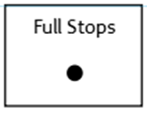
Sentences using adjectives…
Choose 4 of your noun phrases to
write into full sentences.
Don’t forget:
On top of the water stood a brown jetty.

Slide 12
Date: Thursday 7th January
LO To be able to use ‘and’ to extend sentences.
Subject: English

Slide 13
The word ‘and’ can be used as a conjunction. Conjunctions join two sentences together.
The ‘and’ in this sentence is not used correctly because it joins two words, not two sentences.
Wilbur is black and fluffy.
Example:
Wilbur sat on the jetty and watched the colourful fish swim past.
sentence
conjunction
sentence

Slide 14
Complete my sentences:
Wilbur sat on the jetty and _________________________________.
High above the jetty, the sky is blue and it _________________________________ .
Winnie swam through the cold water and __________________________________.
The word ‘and’ is a
…
Conjunction
Move the white box to see if you are correct!

Slide 15
Match the correct ending to the sentences
Sentence starters:
Endings:
Wilbur sat on the jetty and
swam with friendly sea turtles.
She dived into the deep water and
laughed as he ate it.
The hungry sharks searched for snacks and
chased small creatures away.
The greedy bird stole Winnie’s lunch and
watched the colourful fish swim past.

Slide 16
Challenge!
Use my adjectives or some of your own to make the sentences even better!
Your Sentences…
Write your own sentences to describe the setting using the conjunction ‘and’ to extend your sentences.
deep
colourful
mischievous
delicious
strong
wooden
small
slimy
Remember to use capital letters and full stops!

Slide 17
Date: Friday 8th January
LO To be able to write a setting description of the sea.
Subject: English

Slide 18
Read my description again to get it back in your head…
Winnie swam down into the deep water. It was filled with colourful fish and slimy seaweed. On top of the water stood a brown jetty. Wilbur the mischievous cat tried to grab a delicious fish for his dinner. The sky was filled with grey clouds and the strong waves crashed against the wooden poles. Winnie explored the water through her red and yellow snorkel as the creatures floated around her. The small turtles darted after their green mother swimming elegantly above Winnie’s head.
Can you point to all of the capital letters and full stops?

Slide 19
grey clouds
Write your own description of the setting…
wooden jetty
Use the noun phrases to help you!
brown jetty
clear water
black cat
slimy seaweed
colourful fish
I have started for you…
Remember to use ‘and’ to extend some of your sentences!
Don’t forget:
Winnie swam down into the clear water. It was filled with colourful fish and slimy seaweed.

