Slide 1


Date: Monday 18th January 2021
LO: To be able to apply the spelling rules for adding the suffixes –ible and –able.
Subject: Reading

Slide 2
They're both common spelling patterns for adjectives and usually sound the same.
When we add –ible or –able, we change a verb to an adjective.
They mean 'able to' or 'fit for' - acceptable, understandable, responsible

Slide 3
The following words mean 'able to be' -
available: able to be used or obtained
audible: able to be heard
breakable: able to be broken
visible: able to be seen

Slide 4
Which one is correct?
understandible or understandable
terrable or terrible
dependible or dependable

Slide 5
Which one is correct?
understandible or understandable
terrable or terrible
dependible or dependable

Slide 6
There are more words ending in -able (about 900)
There are far fewer ending in -ible
(less than 200).

Slide 7
A general rule is that if you take away the suffix (able) you are usually left with a root word:
understandable = understand + able
enjoyable = enjoy + able
comfortable = comfort + able
dependable = depend + able

Slide 8
What happens if they word ends with y?
Example: rely or justify
We ‘drop’ the y and add an i.
justify - justifiable
rely - reliable

Slide 9
If the root word ends in 'e' then usually we drop the ‘e‘.
value + able = valuable
desire + able = desirable
move + able = movable
believe + able = believable
excite + able = excitable

Slide 10
As a general rule we aren't left with a root word when we take away the ‘ible’
terrible = terr ×
horrible = horr ×
Visible = vis ×
But there are always exceptions - look at these:
corrupt +ible = corruptible
destruct + ible = destructible
convert + ible = convertible
digest + ible = digestible
access + ible accessible

Slide 11
We also drop the 'e' with ible:
collapse + ible = collapsible
response + ible = responsible
sense + ible = sensible
reduce + ible = reducible

Slide 12
Fill in the blanks using your knowledge of this week’s spelling rule.
1. That chair looks (comfort) _____________________.
2. The restaurant was (horr) _____________ and the service was (terror) ___________.
3. I went to see an (incred) ____________film last night.
4. I really had an (enjoy) _____________ evening.
5. The weather was so (change) ____________ yesterday.
6. I hope this isn't (imposs) _____________.
7. The job advert says you need to be (rely) __________, (sense) ___________, and (flex) ____________.
8. The pay is quite (reason) _____________.
9. I'm quite (knowledge) ____________ about spelling now.
10. Her new puppy is very (excite) _____________ and totally (adore) _____________.

Slide 13
Date: Tuesday 19th January 2021
LO: To be able to retrieve information and explain inferences.
Subject: Reading

Slide 14

The Dot
Peter H Reynolds

Slide 15
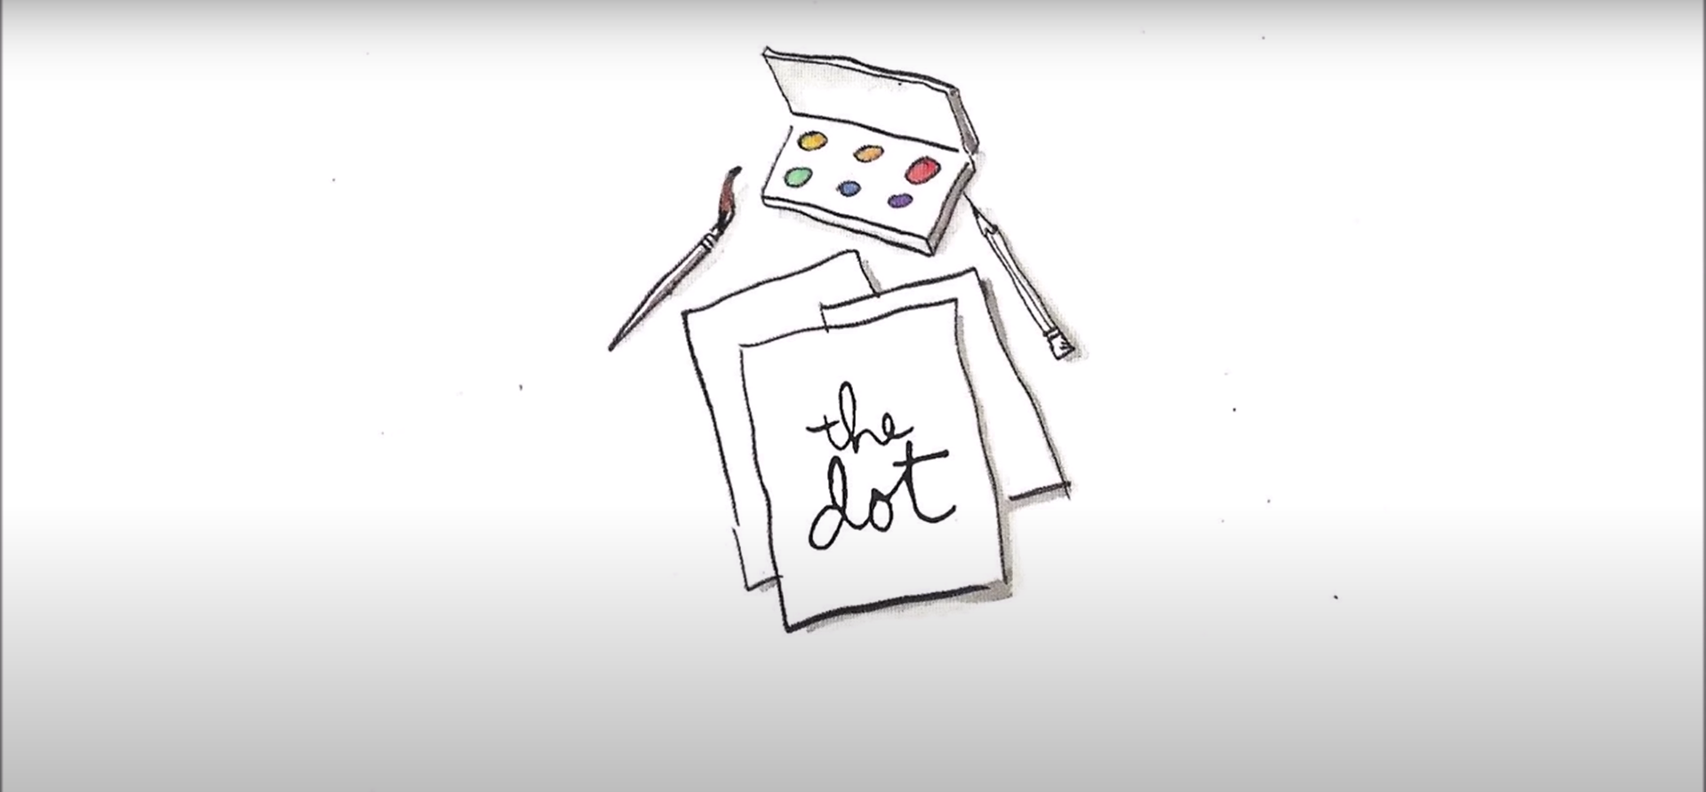

Slide 16
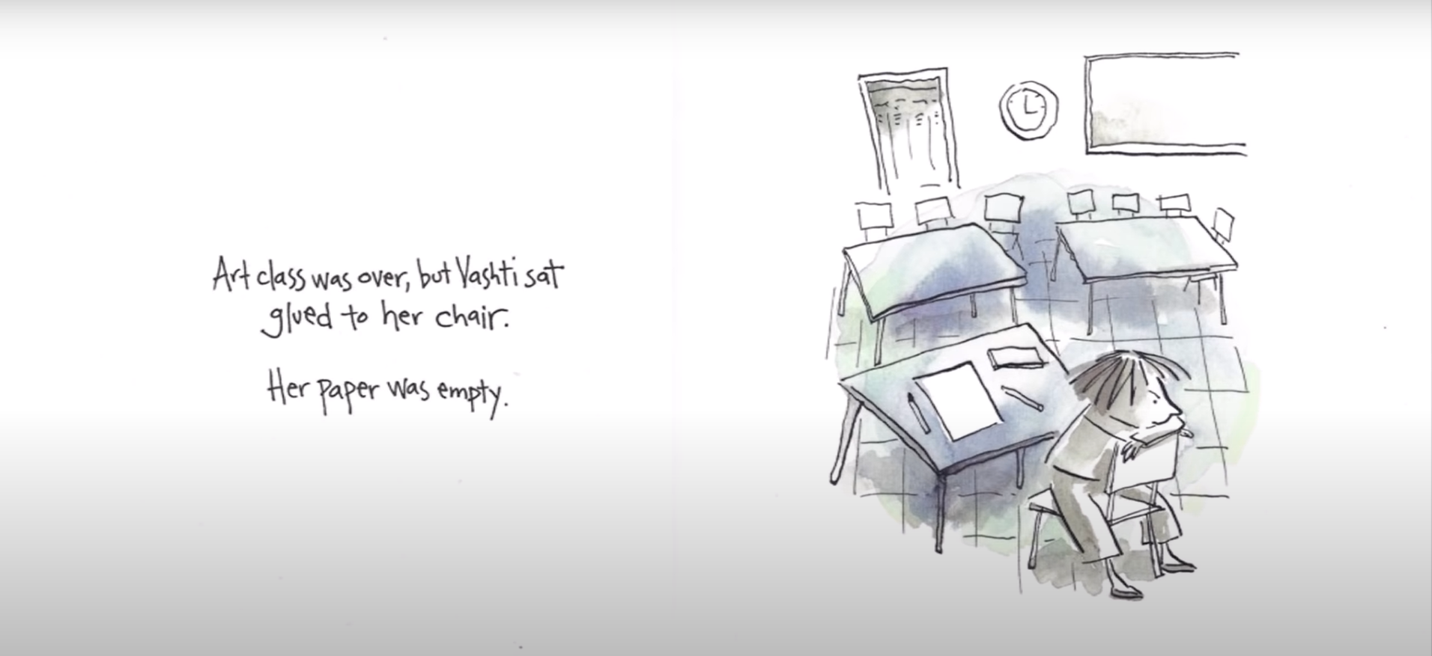

Slide 17
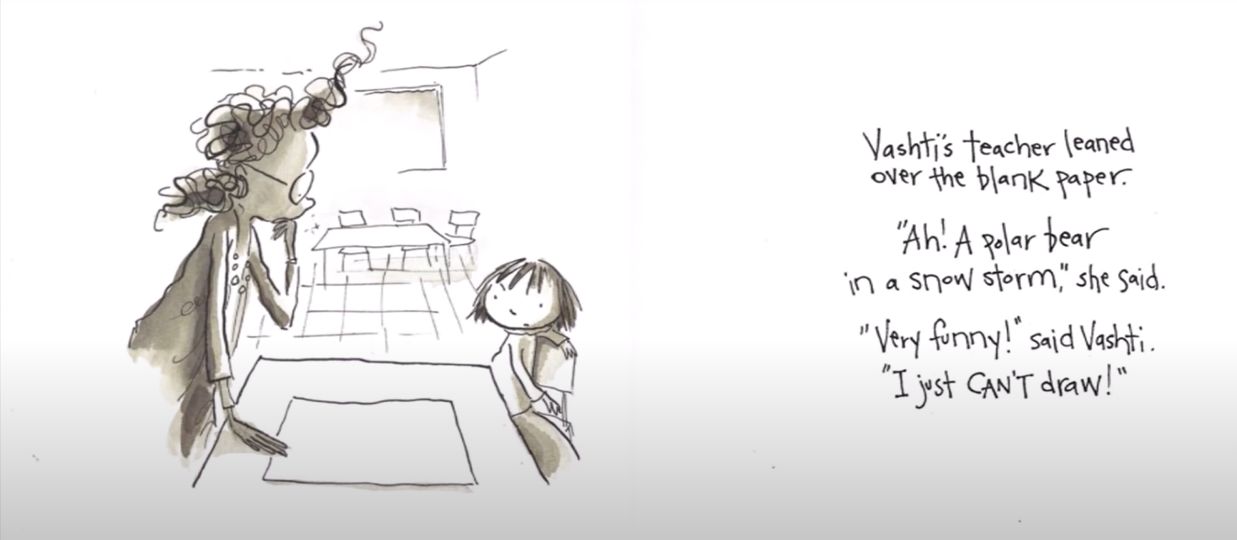

Slide 18
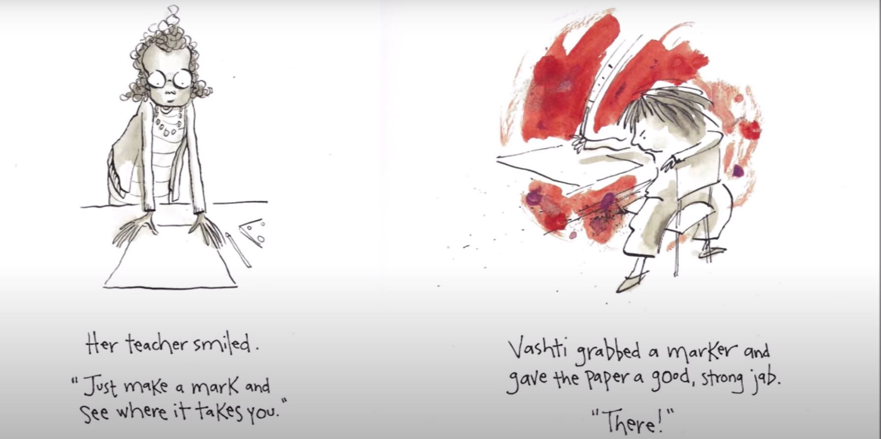

Slide 19
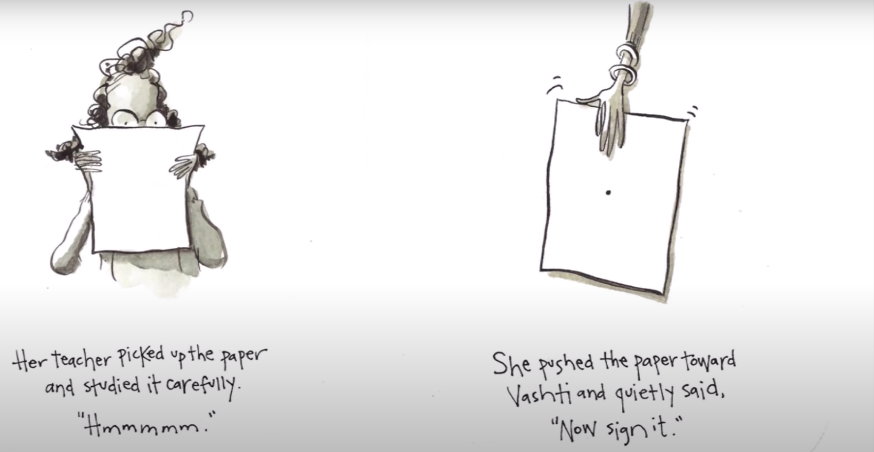

Slide 20
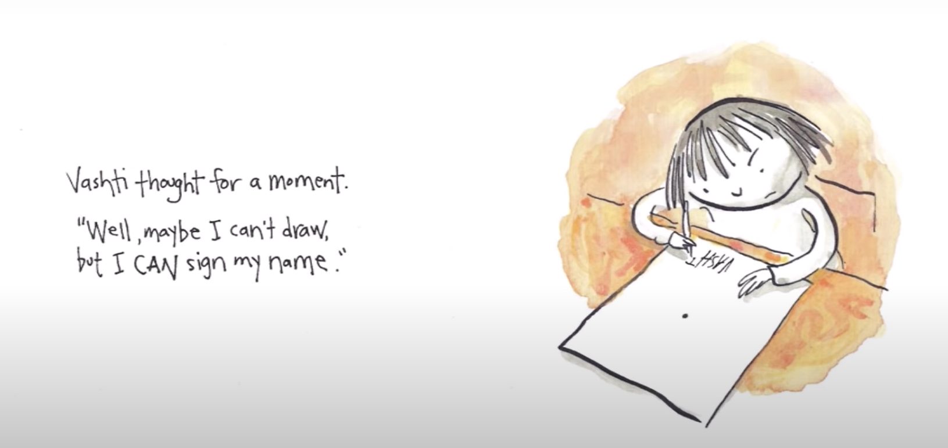

Slide 21
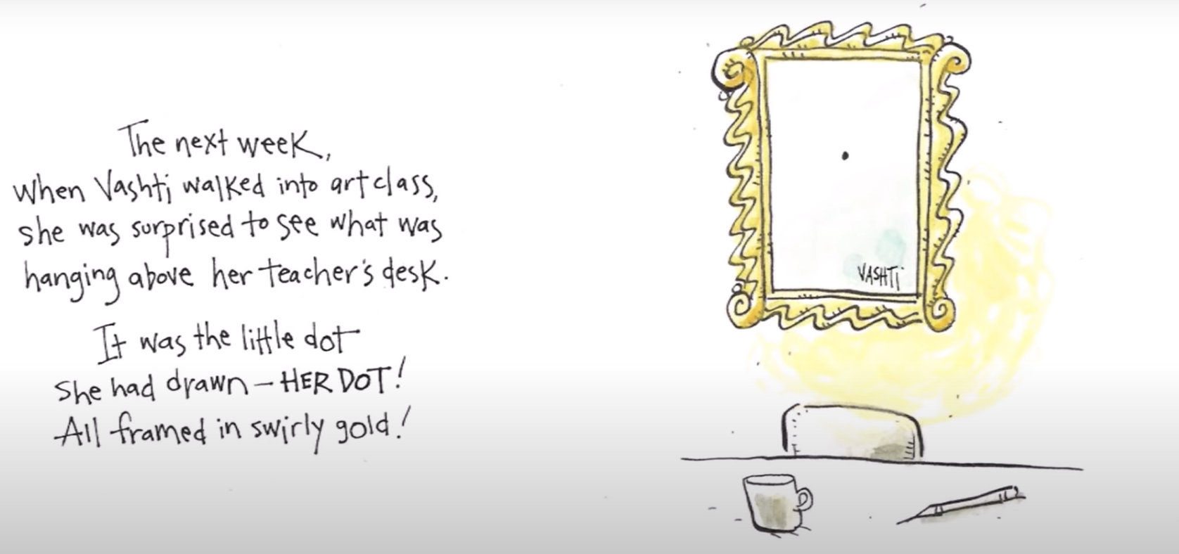

Slide 22
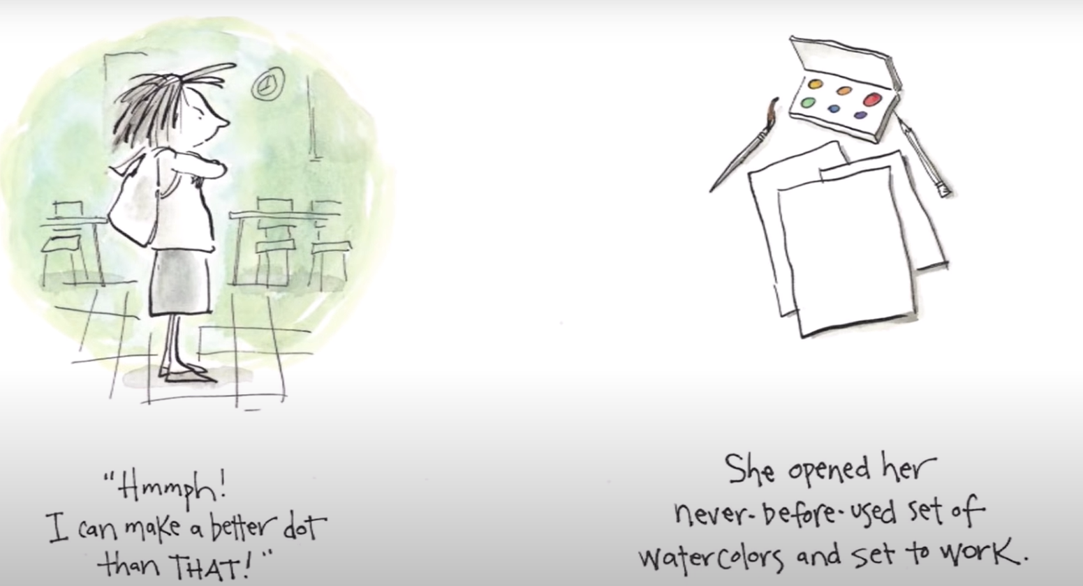

Slide 23
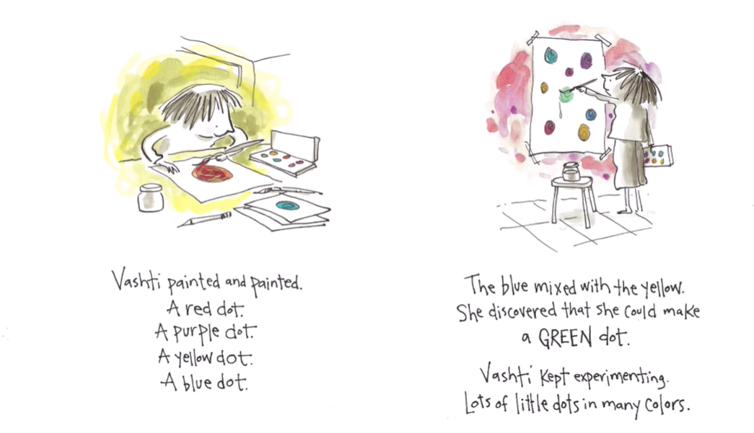

Slide 24
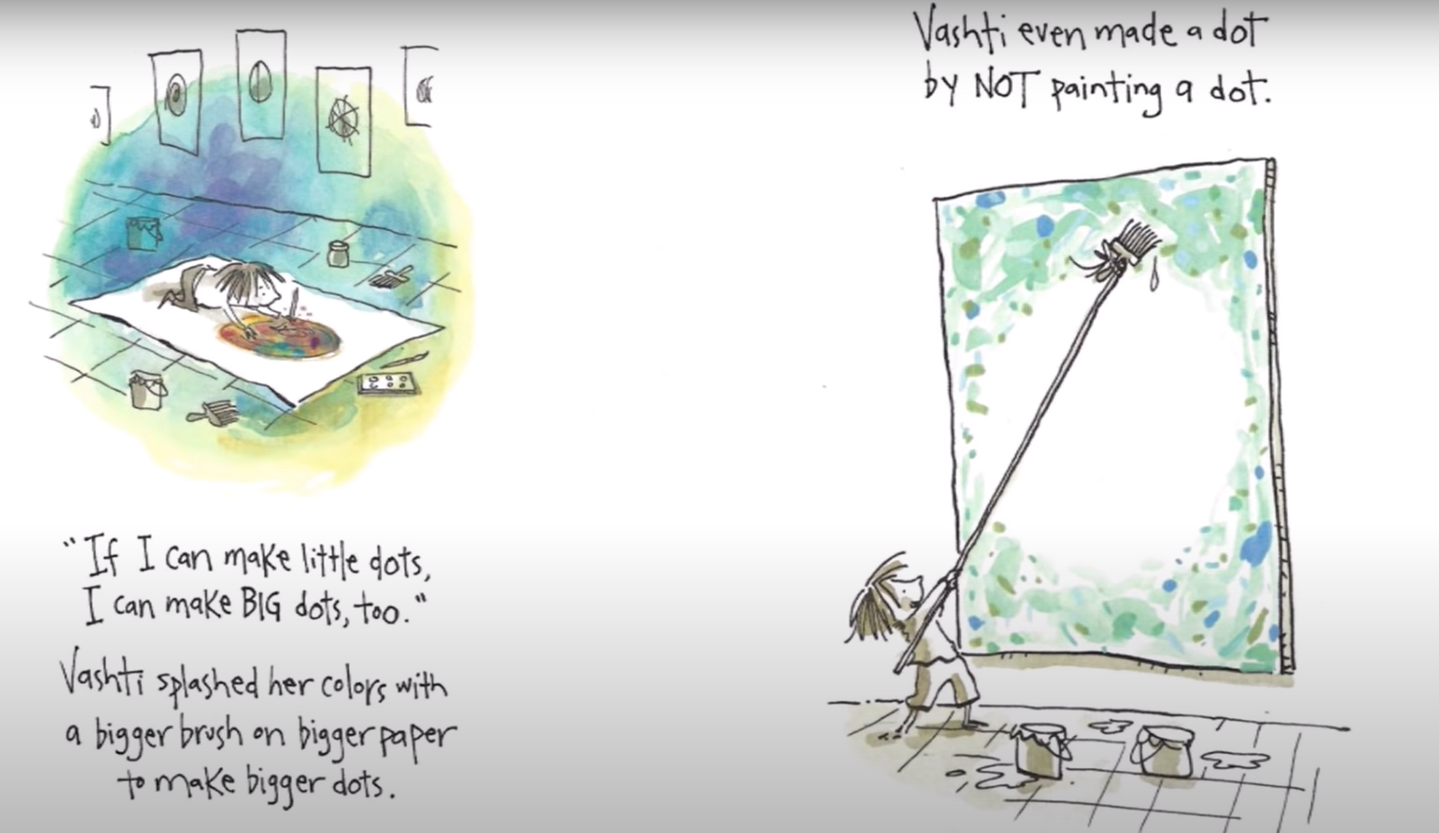

Slide 25
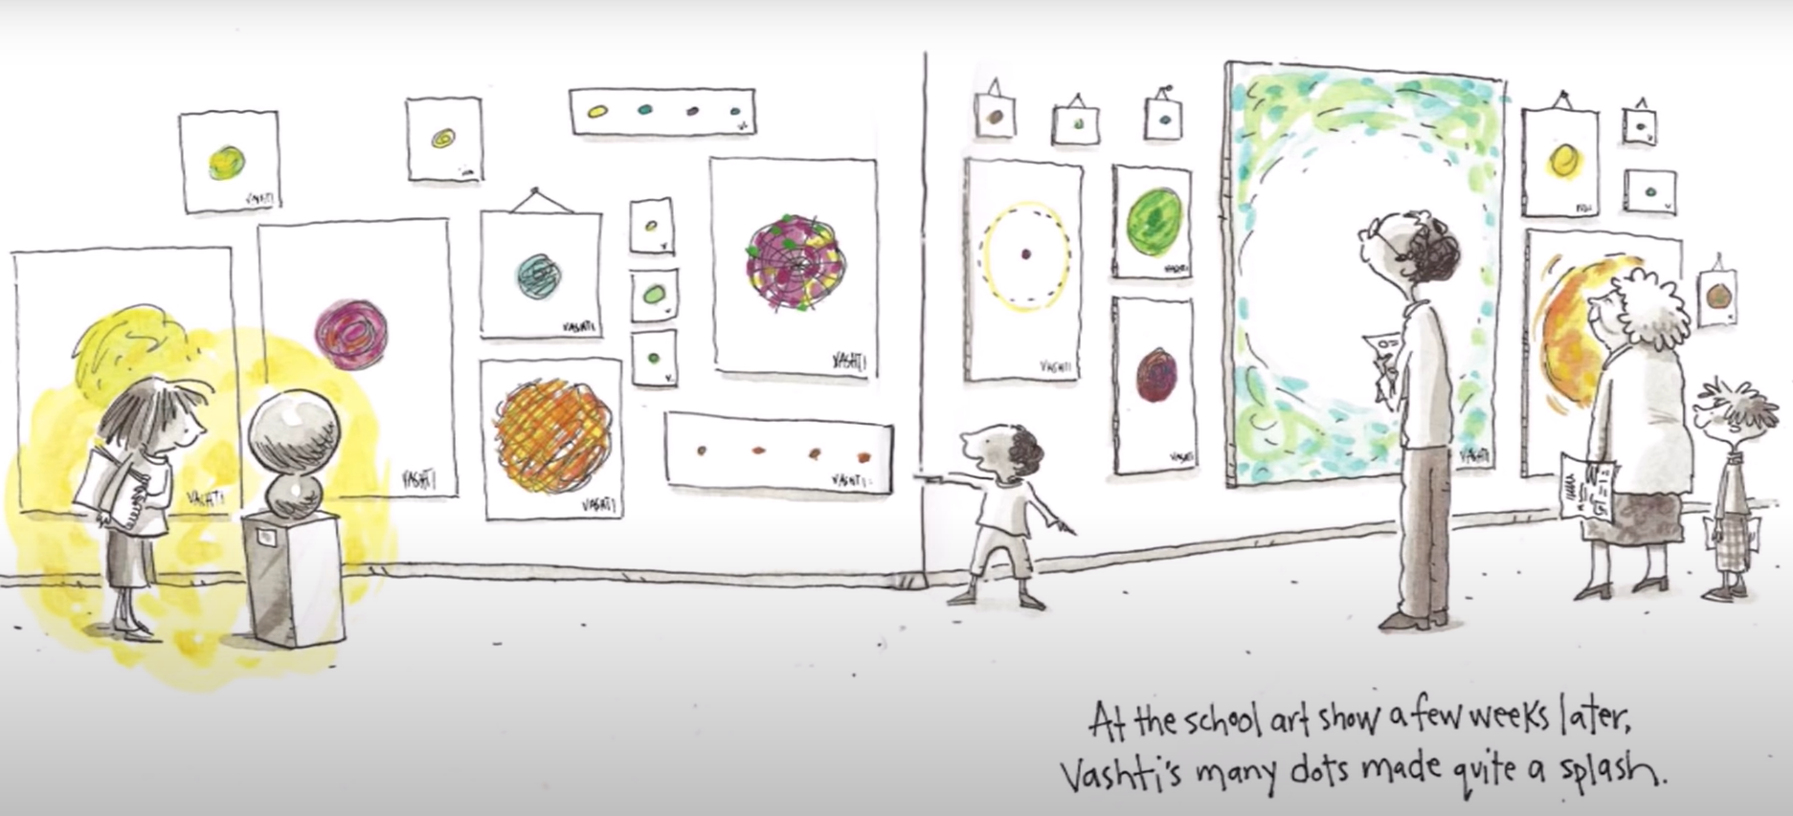

Slide 26
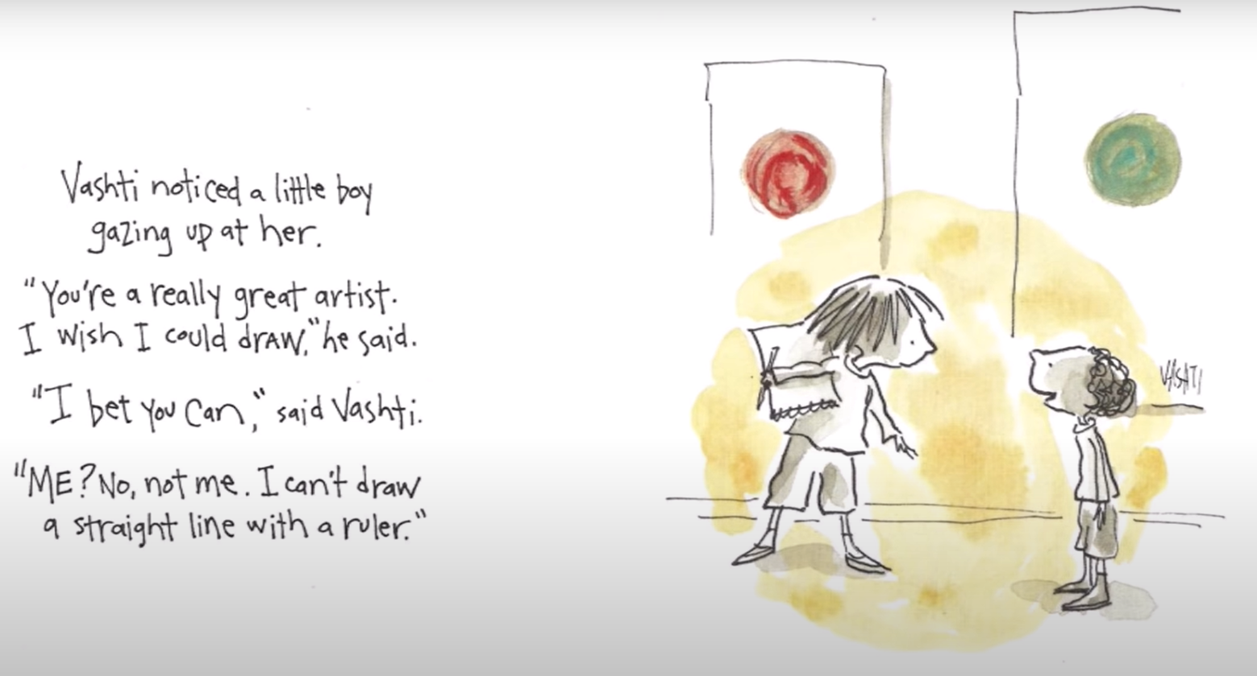

Slide 27
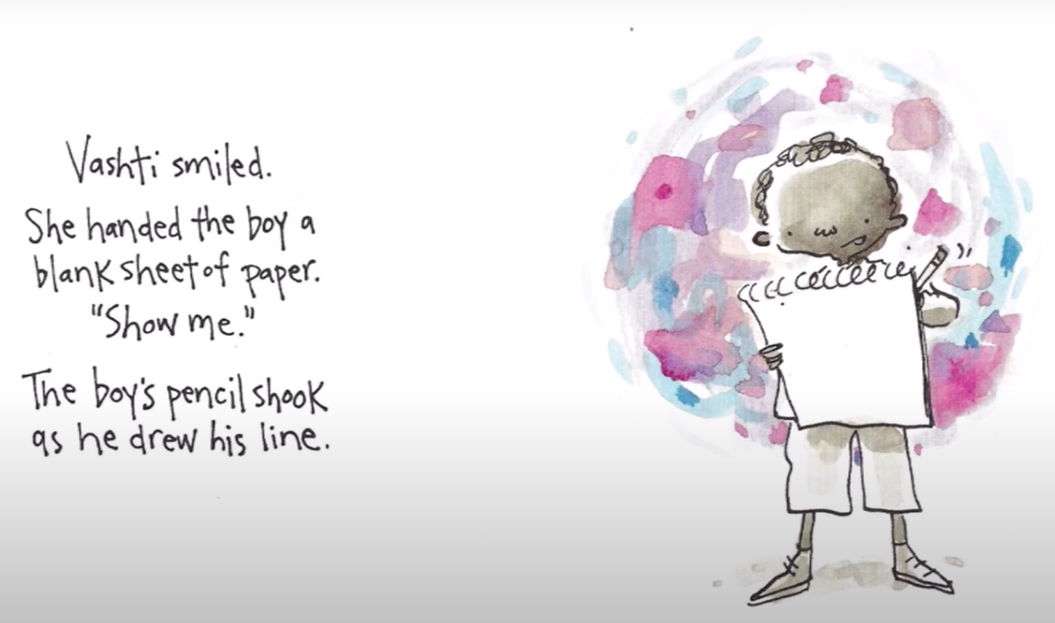

Slide 28
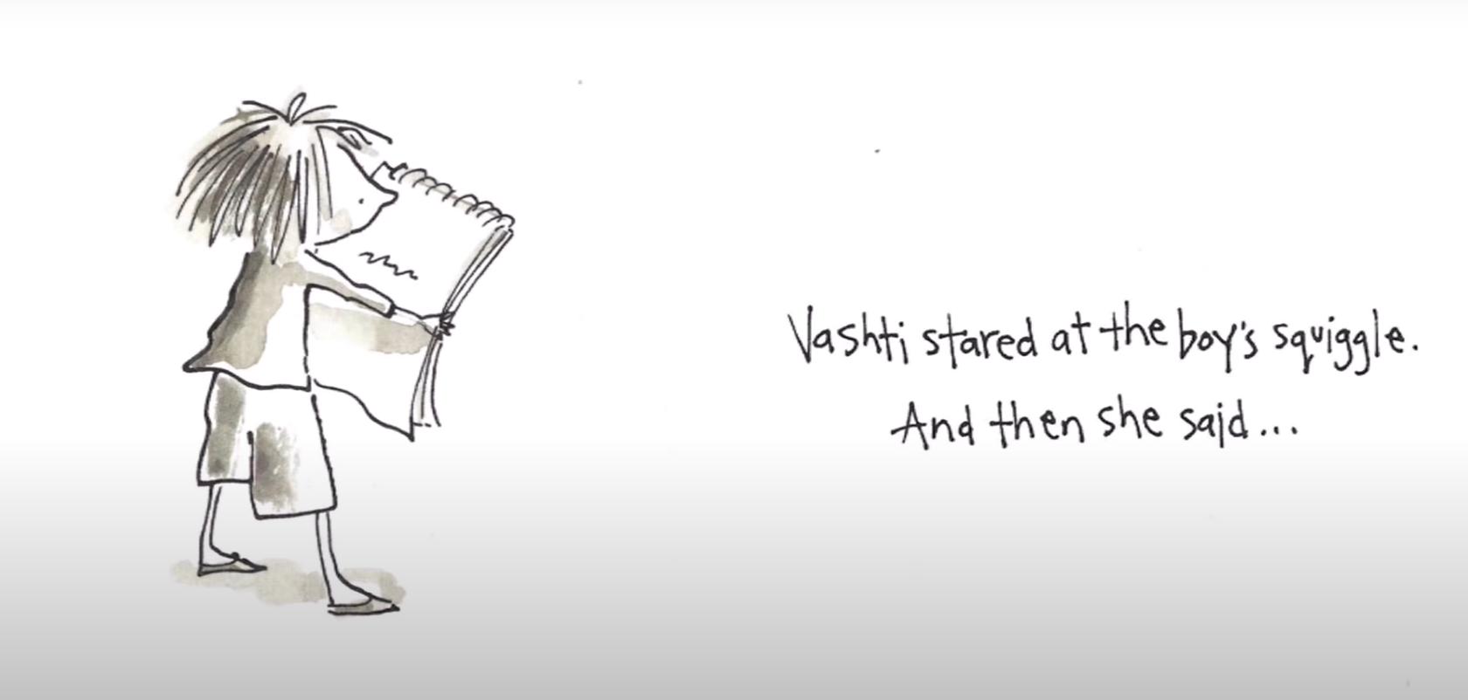

Slide 29
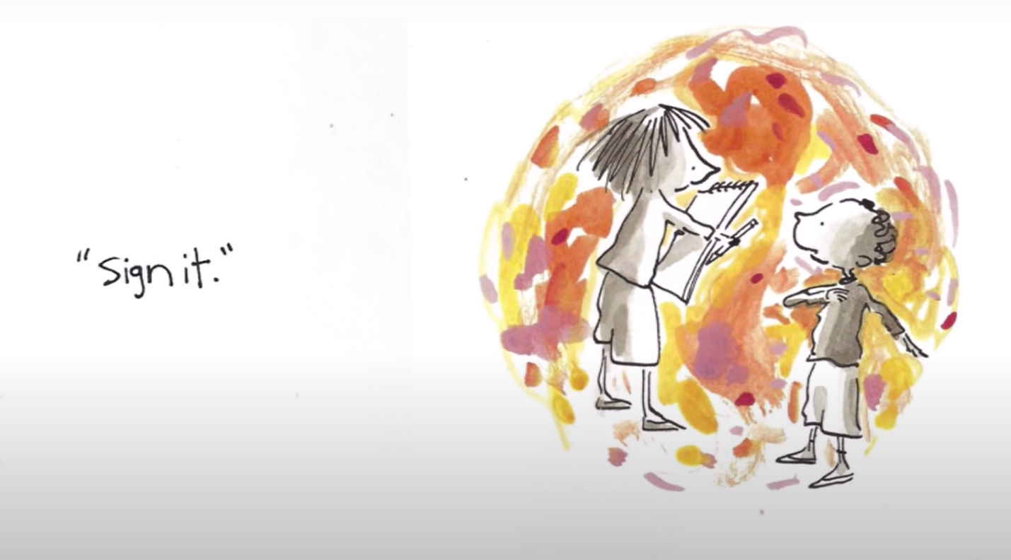

Slide 30
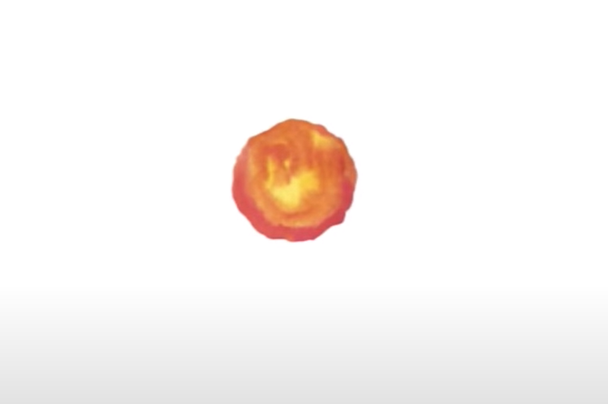

Slide 31
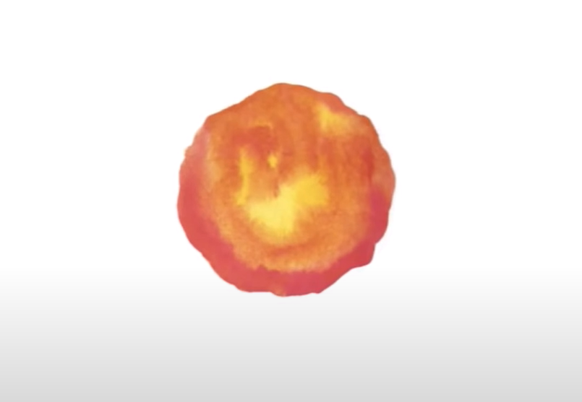

Slide 32
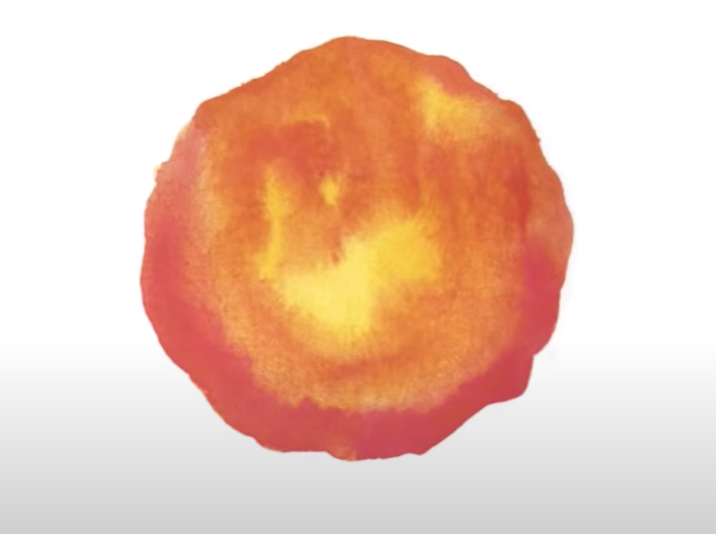

Slide 33
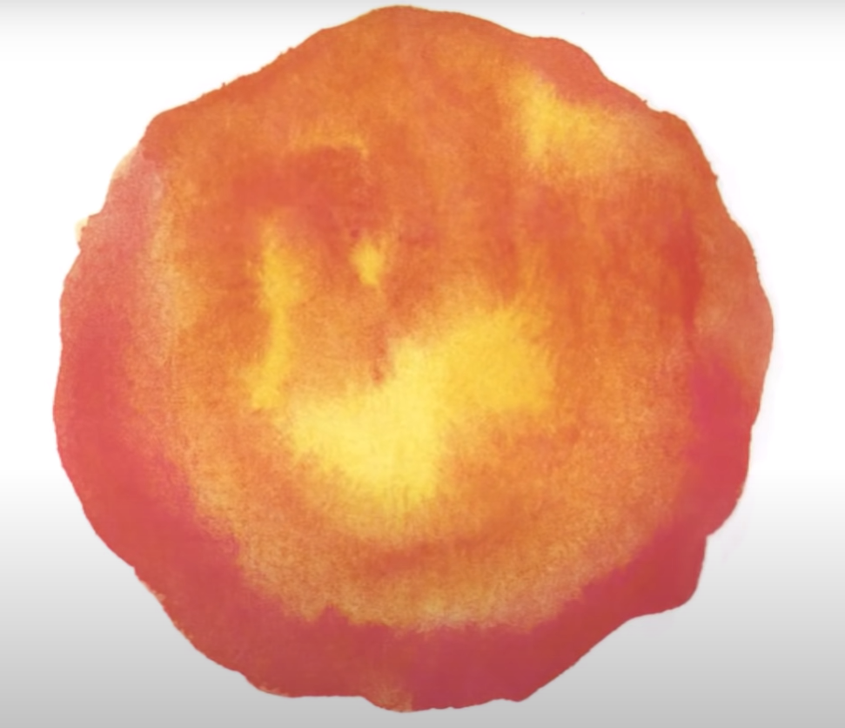

Slide 34
Retrieval
What was the girl’s name?
What did her teacher ask her to do to her piece of paper after she made a dot on it?
What did the teacher do with Vashti’s dot?
Where does Vashti exhibit her dots to the world?
What does Vashti say to the boy at the end of the book?

Slide 35
Explain
‘Ah! A polar bear in a snow storm,’ she said.
Explain this joke.

Slide 36

Explain
Vashti’s teacher then frames her artwork and puts it above her desk.
Why do you think she did this? Write an internal monologue, explaining what the teacher was thinking.

Slide 37
Explain
Why does Vashti keep painting dots?
What do you think we can learn from Vashti?

Slide 38
Predict
What might happen in a sequel to this book?
Come up with one likely scenario and one unlikely scenario and be prepared to present them back to the class. Justify each using the text.

Slide 39

Infer
What do you think is the moral of this story?
Why do you think this?

Slide 40
Date: Wednesday 20th January 2021
LO: To be able to retrieve information and explain inferences.
Subject: Reading

Slide 41
Drive
Incubus

Slide 42
https://www.youtube.com/watch?v=fgT9zGkiLig&ob=av2n
Drive, by Incubus – Lyrics
Sometimes
I feel the fear of
Uncertainty stinging clear
And I, can't help but ask myself how much I'll let the fear
Take the wheel and steer
It's driven me before and seems to have a vague
Haunting mass appeal
But lately I'm beginning to find that I
Should be the one behind the wheel
Whatever tomorrow brings I'll be there
With open arms and open eyes yeah
Whatever tomorrow brings
I'll be there, I'll be there
So, if I
Decide to waiver my
Chance to be one of
The hive
Will I choose water over wine
And hold my own and drive?
Aah ah ooo
It's driven me before and it seems to be the way
That everyone else gets around
But lately I'm beginning to find that when
I drive myself my light is found
Whatever tomorrow brings I'll be there
With open arms and open eyes yeah
Whatever tomorrow brings
I'll be there I'll be there
Would you choose water over wine?
Hold the wheel and drive
Whatever tomorrow brings I'll be there
With open arms and open eyes yeah
Whatever tomorrow brings
I'll be there I'll be there
Turutu turutu turututuru
No no no no no
Turutu turutu turututuru
No no no no no

Slide 43
Vocabulary Check
Sometimes, I feel the fear of the uncertainty
It seems to have a vague, haunting mass appeal
So if I decide to waiver my chance

Slide 44
Explain
‘Sometimes I feel the fear of uncertainty’
Explain this lyric.

Slide 45

Infer
I can’t help but ask myself how much I’ll let the fear, take the wheel and steer.
What do you think it means to ‘let the fear take the wheel and steer’?

Slide 46
Infer
‘It’s driven me before’
What insight does this give you into the lyricists life?

Slide 47
Infer
‘It seems to have a vague, haunting mass appeal’
What do you think the lyricist is saying about society in this line?

Slide 48
Infer
‘Will I choose water over wine?’
What do you think this lyric means? What would happen in each scenario?

Slide 49
Summarise
What do you think is the message of this song?

Slide 50
Explain
What similarities are there between ‘Drive’ and ‘The Dot’?

Slide 51
Date: Thursday 21st January 2021
LO: To be able to retrieve information and explain inferences.
Subject: Reading

Slide 52

You Are Awesome
Matthew Syed
Read to 7 pages of the LoveReading4Kids PDF
https://www.lovereading4kids.co.uk/extract/15248/You-Are-Awesome-by-Matthew-Syed.html

Slide 53
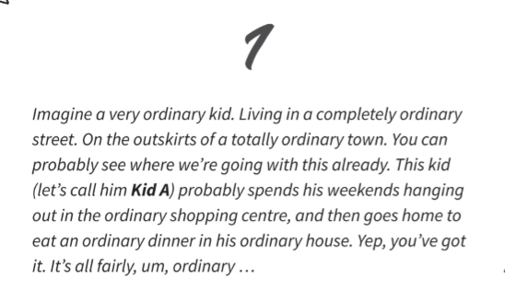
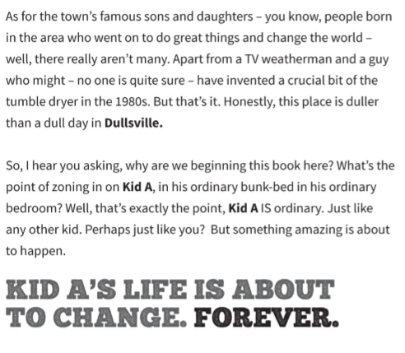

Slide 54

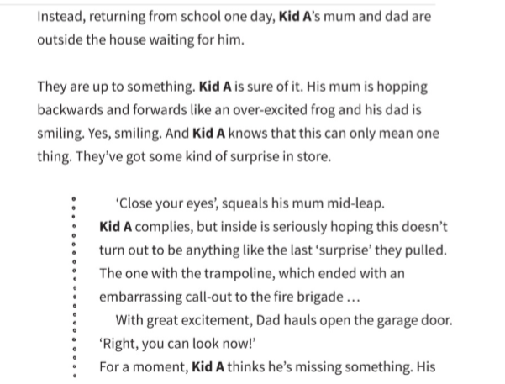

Slide 55
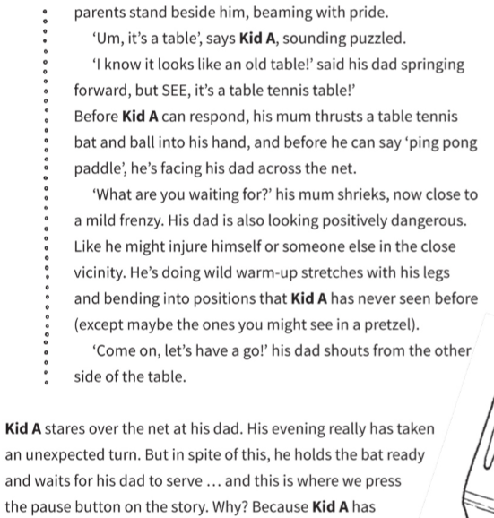
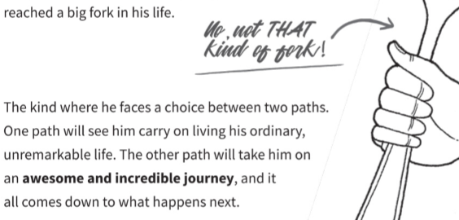
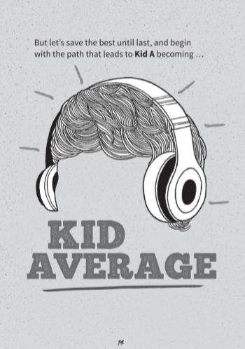

Slide 56
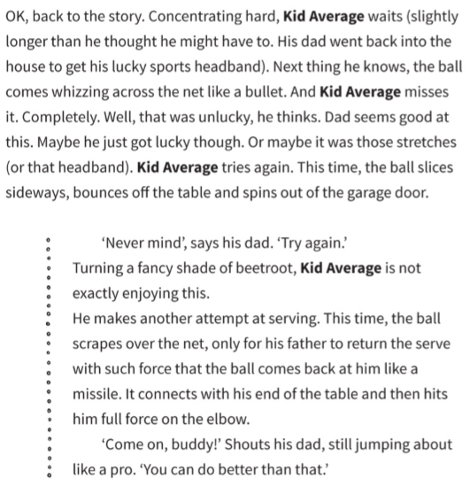
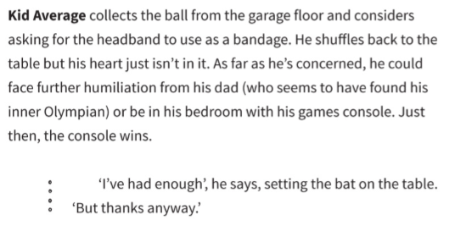

Slide 57
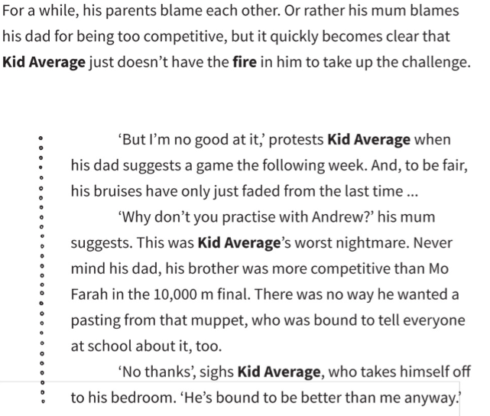
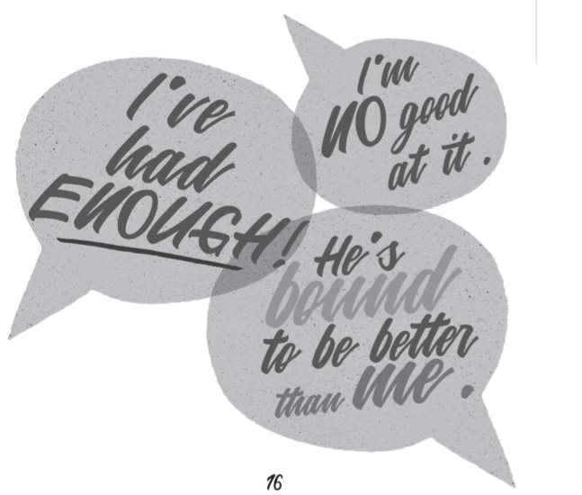

Slide 58
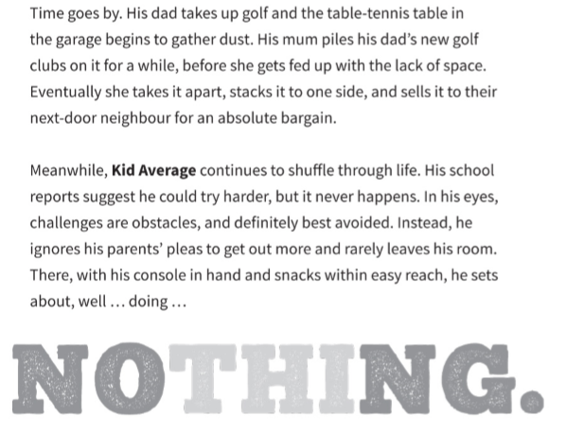
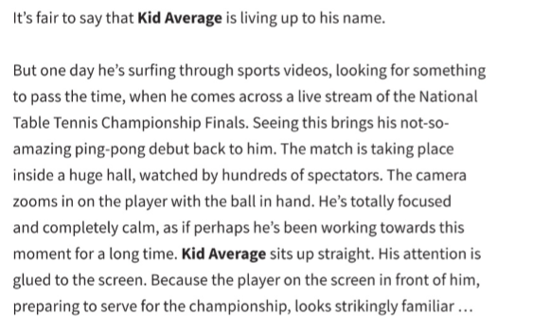

Slide 59

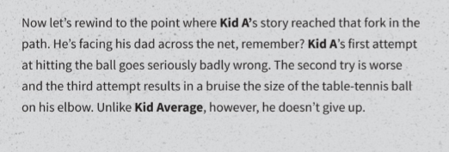

Slide 60
Vocabulary Check
fulfil potential
a crucial bit
Kid A complies
reached a big fork in his life

Slide 61
Retrieval
What will this book help you do?
If you start this book as Kid Average you will end it as Kid _____?
What have Kid A’s parents got for him?

Slide 62
Summarise
What is this text about? What do you think the purpose of writing it was? Who might it be for?

Slide 63
Retrieval
Look at Page 9.
Find and copy two ways the book pledges to help its reader.

Slide 64
Explain
‘totally ordinary’
Why do you think the author keeps repeating this?

Slide 65
Predict
Predict what the two forks would be.

