Slide 1


Subject: Phonics
Pack: A

Slide 2



Date: Monday 22nd February
LO To be able to practise phonics sounds.
Please practise phonics every day for 20 minutes.
Subject: Phonics

Slide 3

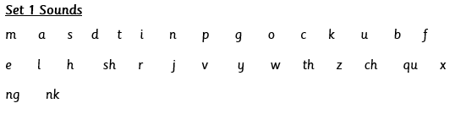

Each day we are going to focus on a different sound.
Please choose from set 1 or set 2. Each day, for phonics, there will be a video to watch and some words to read linked to the taught sound.
Here are the sounds which are in each set1 and set 2.
Please contact the school if you are not sure which set your child should be focusing on, or whether you’re unsure if your child does guided reading rather than phonics.
Then, play some phonics games!

Slide 4
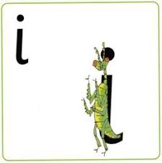
Set 1 Sounds
Skip this slide if your child is not focusing on this set.
Today’s sound:
Please click the link or copy the below link into the internet:
https://www.youtube.com/watch?v=5oQBK13yJaI&list=PLPVrkr0oJX1tBTpbocNce93WUH8G-um6A&index=6
Or copy the below into YouTube:
‘Phonic Lesson - Set 1 Sound - Learning to Read and Write “i" for Reception and Year 1’ – Early Years Learning is Fun
Scavenger Hunt!
What can you find in your house that begins with i?

Slide 5

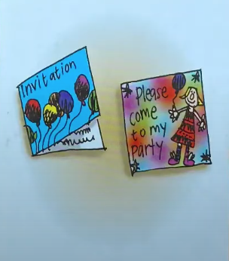
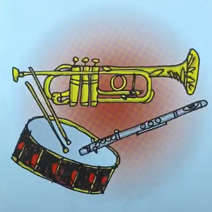
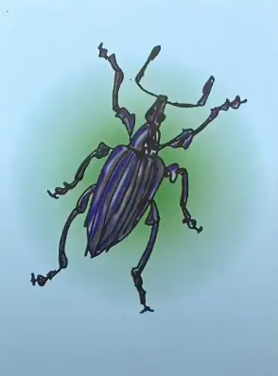
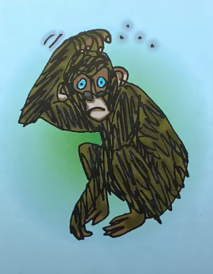
Today’s sound is i. Can you say i, i, i to your adult?
I have some pictures of things that begin with the sound i.
Try saying them out loud to your adult.
i i invitation
i i insect
i i itchy
i i instruments
Look at the picture on the left.
That is my insect.
Can you see the insect?
When you see this picture, as quick as you can say insect.
Hiding behind the insect is the grapheme i. Can you point to it and say i?
When you see this side of the card say i.

Slide 6

Below, I have given you some cards. Point to each one and say insect or i.
Now let’s have a go at writing the sound i. Use your finger and move it over the picture card saying, “Down the insect, dot for its head or i,i,i,i, until you have traced the whole grapheme.
Now have a turn on your own. Keep practising until you get it right.

Slide 7

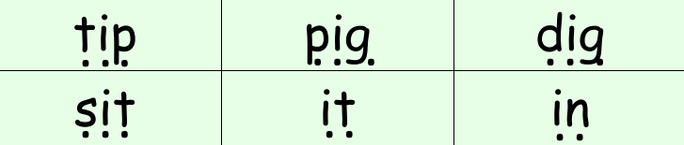
Set 1 Sounds
Now its time to Fred talk, read the word. Let me show you.
Here is my green word.
I am going to point to the button below each sound and say it out loud. This is Fred Talk.
d i g, after sounding out the word remember to read the word, dig. I have now read the word.
Now time to read some words beginning with ‘i’. You could even practise writing these words!

Slide 8
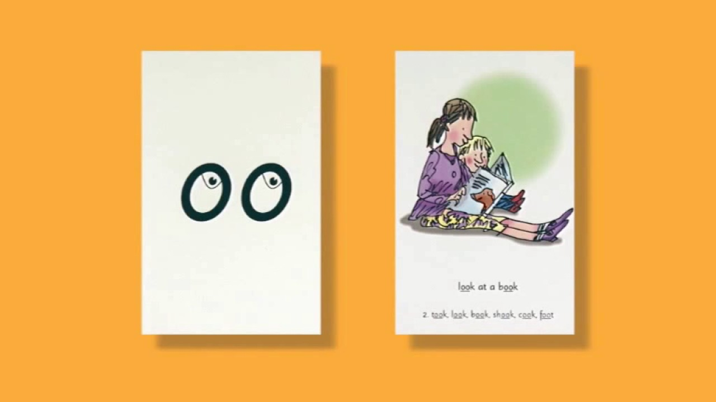
Set 2 Sounds
Skip this slide if your child is not focusing on this set.
Today’s sound:
Please click the link or copy the below link into the internet:
https://www.youtube.com/watch?v=c9U9y5XfJEs&list=PLPVrkr0oJX1sBGLJU2hNbPE2neuhezWSu&index=5
Or copy the below into YouTube:
‘Phonic Lesson - Set 2 ‘oo’ sound for Reception and Year 1’ – Early Years Learning is Fun
Can you think of any words with the ‘oo’ sound in it?

Slide 9
Today’s sound is ay. Can you say oo, oo, oo to your adult?
Look at the picture on your left. What can you see?
Can you see that the boy is looking at a book?
Yes that’s right they are going to,
“oo, look at a book”
Let’s Fred Talk some ‘oo’ words.
t oo k f oo t c oo k
On the other side of the card is the digraph, oo.
These letters are
special friends.
They are two letters that make one sound. When we see them we say,
oo.
When we see the picture side we say,
“oo,
Look at a book”

Slide 10
Below, I have given you some cards. Point to each one and say oo or look at a book.
Now let’s have a go at writing the sound oo. You already know how to form each letter. Now we simply put them together to write the sound oo.
Now have a turn on your own. Keep practising until you get it right.

Slide 11
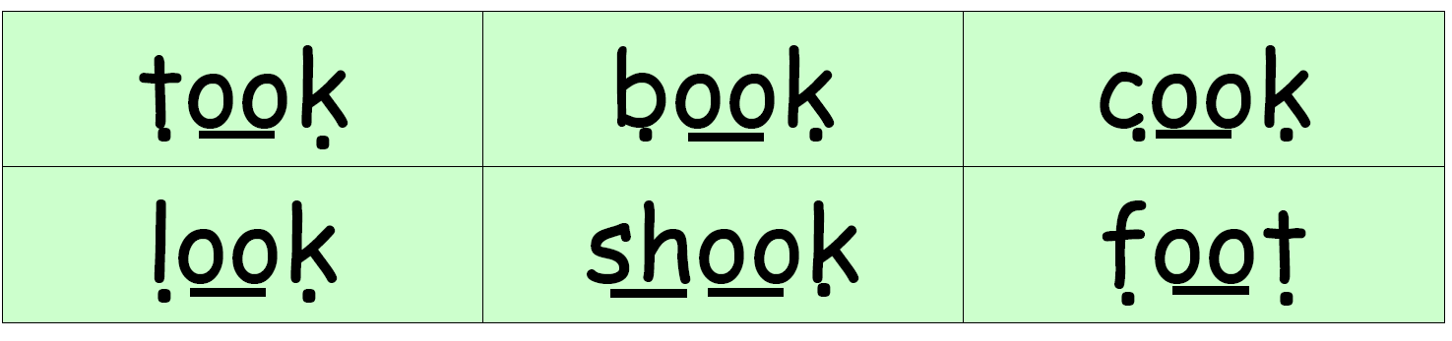
Set 2 Sounds
Now its time to Fred talk, read the word. Let me show you.
Here is my green word.
I am going to point to the button below each sound and say it out loud. This is Fred Talk.
t oo k, after sounding out the word remember to read the word, took.
I have now read the word.
Now it’s your turn. Fred talk, read the words below.

Slide 12
Date: Tuesday 23rd February
LO To be able to practise phonics sounds.
Please practise phonics every day for 20 minutes.
Subject: Phonics

Slide 13
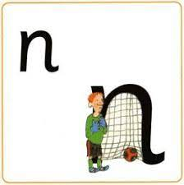
Set 1 Sounds
Skip this slide if your child is not focusing on this set.
Today’s sound:
Please click the link or copy the below link into the internet:
https://www.youtube.com/watch?v=gALB6ekaH0A&list=PLPVrkr0oJX1tBTpbocNce93WUH8G-um6A&index=7
Or copy the below into YouTube:
‘Phonic Lesson - Set 1 Sound - Learning to Read and Write “n" for Reception and Year 1’ – Early Years Learning is Fun
Scavenger Hunt!
What can you find in your house that begins with n?

Slide 14
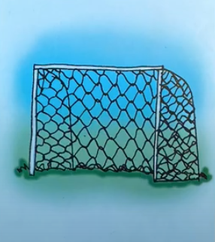
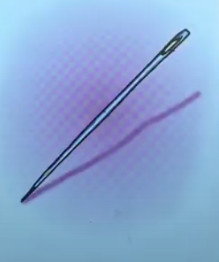
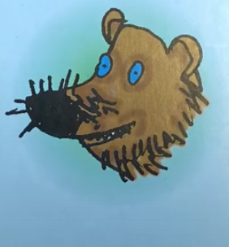
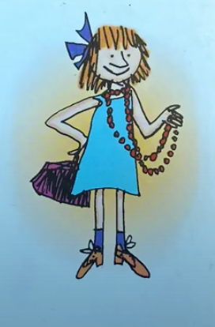
Today’s sound is m. Can you say n, n, n to your adult?
I have some pictures of things that begin with the sound n.
Try saying them out loud to your adult.
nnn net
nnn needle
nnn nose
nnn necklace
Look at the picture on the left.
That is my friend
nobbie.
Can you see the net next to him? When you see this picture, as quick as you can say nobbie.
Hiding behind the apple is the
grapheme n.
Can you point to it and say n?
When you see this side of the card say n.

Slide 15
Below, I have given you some cards. Point to each one and say nobbie or n.
Now let’s have a go at writing the sound n. Use your finger and move it over the picture card saying, “Down nobbie over the net” or nnnnn until you have traced the whole grapheme.
Now have a turn on your own. Keep practising until you get it right.

Slide 16




Set 1 Sounds
Now its time to Fred talk, read the word. Let me show you.
Here is my green word.
I am going to point to the button below each sound and say it out loud. This is Fred Talk.
p i n, after sounding out the word remember to read the word, pin.
I have now read the word.
Now time to read some words including ‘n’. You could even practise writing these words!

Slide 17

Set 2 Sounds
Skip this slide if your child is not focusing on this set.
Today’s sound:
Please click the link or copy the below link into the internet:
https://www.youtube.com/watch?v=5s5P-iSSJsU&list=PLPVrkr0oJX1sBGLJU2hNbPE2neuhezWSu&index=6
Or copy the below into YouTube:
‘Phonic Lesson - Set 2 ‘oo’ sound for Reception and Year 1’ – Early Years Learning is Fun
Can you think of any words with the ‘oo’ sound in it?

Slide 18
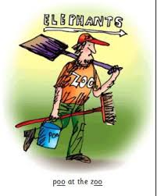
Today’s sound is oo. Can you say oo, oo, oo to your adult?
Look at the picture on your left. What can you see?
Can you see where the man is at? Yes that’s he’s at the zoo cleaning,
“oo, poo at the zoo”
Let’s Fred Talk some ‘oo’ words.
too food pool.
On the other side of the card is the digraph, oo.
These letters are
special friends.
They are two letters that make one sound. When we see them we say,
oo.
When we see the picture we say,
“oo,
Poo at the zoo”

Slide 19
Below, I have given you some cards. Point to each one and say oo or poo at the zoo.
Now let’s have a go at writing the sound oo. You already know how to form each letter. Now we simply put them together to write the sound oo.
Now have a turn on your own. Keep practising until you get it right.

Slide 20
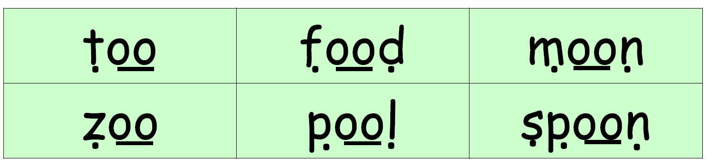
Set 2 Sounds
Now its time to Fred talk, read the word. Let me show you.
Here is my green word.
I am going to point to the button below each sound and say it out loud. This is Fred Talk.
t oo, after sounding out the word remember to read the word, too.
I have now read the word.
Now it’s your turn. Fred talk, read the words below.

Slide 21
Date: Wednesday 24th February
LO To be able to practise phonics sounds.
Please practise phonics every day for 20 minutes.
Subject: Phonics

Slide 22

Set 1 Sounds
Skip this slide if your child is not focusing on this set.
Today’s sound:
Please click the link or copy the below link into the internet:
https://www.youtube.com/watch?v=W-iXmHffIi8&list=PLPVrkr0oJX1tBTpbocNce93WUH8G-um6A&index=8
Or copy the below into YouTube:
‘Phonic Lesson - Set 1 Sound - Learning to Read and Write “p" for Reception and Year 1’ – Early Years Learning is Fun
Scavenger Hunt!
What can you find in your house that begins with p?

Slide 23
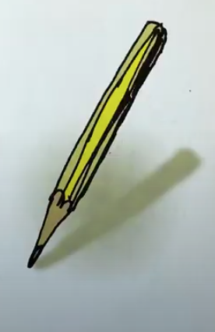
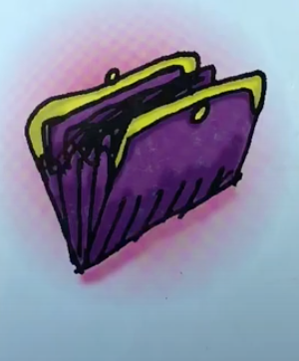
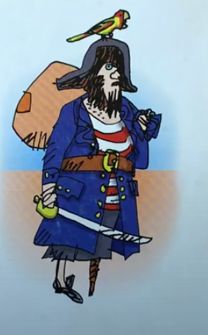
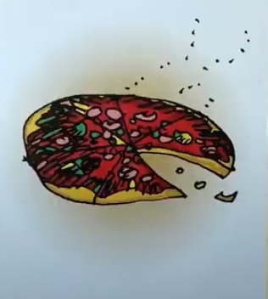
Today’s sound is p. Can you say p, p, p to your adult?
I have some pictures of things that begin with the sound p.
Try saying them out loud to your adult.
p p pencil
p p purse
p p pizza
p p pirate
Look at the picture on the left.
Can you see the pirate?
When you see this picture, as quick as you can say,
Down the pirates plait and around his face.
Hiding behind pirate is the grapheme p. Can you point to it and say p?
When you see this side of the card say p.

Slide 24
Below, I have given you some cards. Point to each one and say pirate or p.
Now let’s have a go at writing the sound p. Use your finger and move it over the picture card saying, “down the pirates plait and around his face or p, p, p, p until you have traced the whole grapheme.
Now have a turn on your own. Keep practising until you get it right.

Slide 25





Set 1 Sounds
Now its time to Fred talk, read the word. Let me show you.
Here is my green word.
I am going to point to the button below each sound and say it out loud. This is Fred Talk.
t, o, p, after sounding out the word remember to read the word, top.
I have now read the word.
Now time to read some words including ‘p’. You could even practise writing these words!

Slide 26
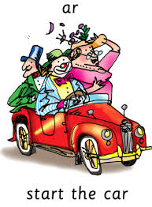
Set 2 Sounds
Skip this slide if your child is not focusing on this set.
Today’s sound:
Please click the link or copy the below link into the internet:
https://www.youtube.com/watch?v=7NPAgQhdKN4&list=PLPVrkr0oJX1sBGLJU2hNbPE2neuhezWSu&index=7
Or copy the below into YouTube:
‘Phonic Lesson - Set 2 ‘ar’ sound for Reception and Year 1’ – Early Years Learning is Fun
Can you think of any words with the ‘ar’ sound in it?

Slide 27
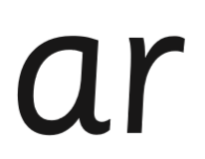
Today’s sound is ar.
Can you say ar, ar, ar to your adult?
Look at the picture on your left. What can you see?
Can you see that the clown is going to start the car?
Yes that’s right they are saying,
“ar, start the car”
Let’s Fred Talk some ‘ar’ words.
bar park smart.
On the other side of the card is the digraph, ar.
These letters are
special friends.
They are two letters that make one sound. When we see them we say,
ar.
When we see the picture we say,
“ar,
Start the car”

Slide 28
Below, I have given you some cards. Point to each one and say ar or start the car.
Now let’s have a go at writing the sound ar. You already know how to form each letter. Now we simply put them together to write the sound ar.
Now have a turn on your own. Keep practising until you get it right.

Slide 29
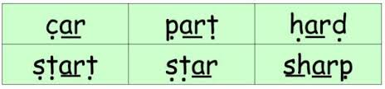
Set 2 Sounds
Now its time to Fred talk, read the word. Let me show you.
Here is my green word.
I am going to point to the button below each sound and say it out loud. This is Fred Talk.
c ar, after sounding out the word remember to read the word, car.
I have now read the word.
Now time to read some words including ‘ar’. You could even practise writing these words!

Slide 30
Date: Thursday 25th February
LO To be able to practise phonics sounds.
Please practise phonics every day for 20 minutes.
Subject: Phonics

Slide 31
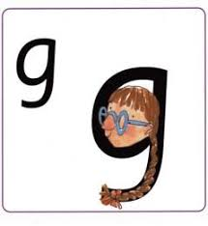
Set 1 Sounds
Skip this slide if your child is not focusing on this set.
Today’s sound:
Please click the link or copy the below link into the internet:
https://www.youtube.com/watch?v=_NID9A6Y4Yo&list=PLPVrkr0oJX1tBTpbocNce93WUH8G-um6A&index=9
Or copy the below into YouTube:
‘Phonic Lesson - Set 1 Sound - Learning to Read and Write “g" for Reception and Year 1’ – Early Years Learning is Fun
Scavenger Hunt!
What can you find in your house that begins with g?

Slide 32
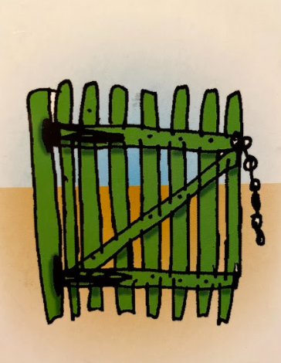
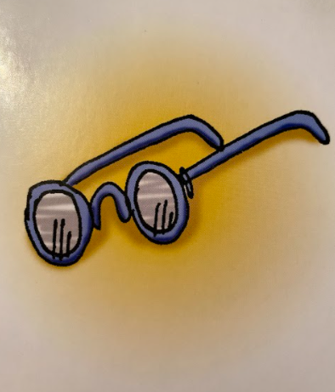
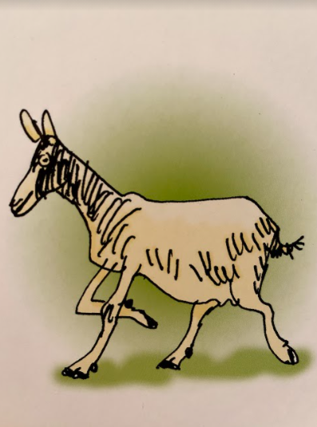
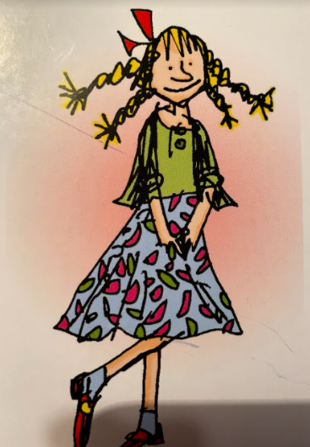
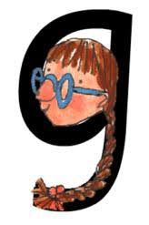

Today’s sound is g. Can you say g, g, g to your adult?
I have some pictures of things that begin with the sound g.
Try saying them out loud to your adult.
g g gate
g g glasses
g g goat
g g girl
Hiding behind the girl is the grapheme g. Can you point to it and say g?
When you see this side of the card say g.
Look at the picture on the left.
That is a
girl.
When you see this picture, as quick as you can say girl.

Slide 33
Below, I have given you some cards. Point to each one and say girl or g.
Now let’s have a go at writing the sound g. Use your finger and move it over the picture card saying, “Round her face, down her hair and give her a curl” or g g g g until you have traced the whole grapheme.
Now have a turn on your own. Keep practising until you get it right.

Slide 34






Set 1 Sounds
Now its time to Fred talk, read the word. Let me show you.
Here is my green word.
I am going to point to the button below each sound and say it out loud. This is Fred Talk.
g a p, after sounding out the word remember to read the word, gap. I have now read the word.
Now time to read some words including ‘g’. You could even practise writing these words!

Slide 35
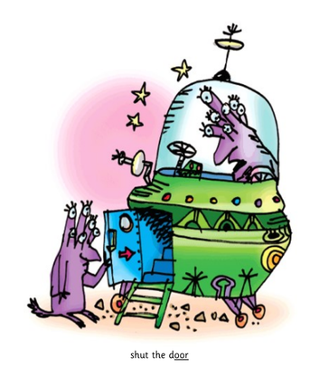
Set 2 Sounds
Skip this slide if your child is not focusing on this set.
Today’s sound:
Please click the link or copy the below link into the internet:
https://www.youtube.com/watch?v=Mape-qC0W54&list=PLPVrkr0oJX1sBGLJU2hNbPE2neuhezWSu&index=8
Or copy the below into YouTube:
‘Phonic Lesson - Set 2 ‘or’ sound for Reception and Year 1’ – Early Years Learning is Fun
Can you think of any words with the ‘or’ sound in it?

Slide 36
Today’s sound is or.
Can you say or, or, or to your adult?
Look at the picture on your left. What can you see?
Can you see the alien shutting the door?
Yes that’s right they are saying,
“or, shut the door”
Let’s Fred Talk some ‘or’ words.
door fork sport.
On the other side of the card is the digraph, or.
These letters are
special friends.
They are two letters that make one sound. When we see them we say,
or.
When we see the picture
we say,
“or,
shut the door”
or

Slide 37
Below, I have given you some cards. Point to each one and say or or shut the door.
or
or
or
Now let’s have a go at writing the sound or. You already know how to form each letter. Now we simply put them together to write the sound or.
Now have a turn on your own. Keep practising until you get it right.

Slide 38
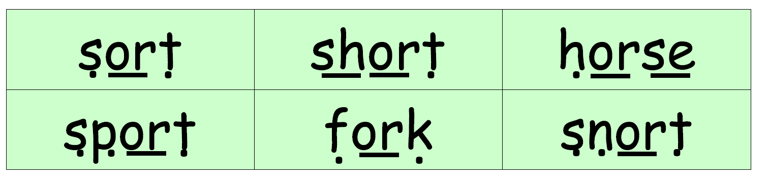
Set 2 Sounds
Now its time to Fred talk, read the word. Let me show you.
Here is my green word.
I am going to point to the button below each sound and say it out loud. This is Fred Talk.
s or t, after sounding out the word remember to read the word, sort.
I have now read the word.
Now time to read some words including ‘or’. You could even practise writing these words!

Slide 39
Date: Friday 26th February
LO To be able to practise reading and writing tricky words.
Please practise phonics every day for 20 minutes.
Subject: Phonics

Slide 40

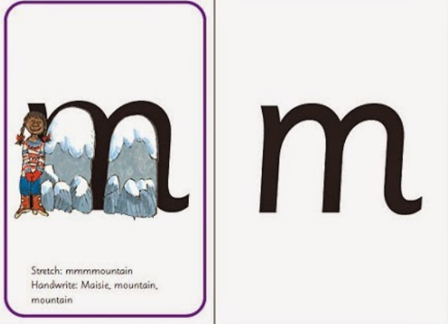
Today we are going to revisit what we have learned this week.
We have learned the sounds
i,n,p,g
Below I have placed some of the flashcards we have used this week. Can you point to each one and say the picture word or the letter sound.
insect
m

Slide 41
Today we are going to revisit what we have learned this week.
I have jumbled up some of the words we read this week. Here is a recap of how to read them.
Here is my green word.
I am going to point to the button below each sound and say it out loud. This is Fred Talk.
p, a, t, after sounding out the word remember to read the word, pat.
Now it’s your turn. Can you Fred talk, read the words?

Slide 42
Today we are going to revisit what we have learned this week.
We learned how to form the letters i,n,p,g. Let’s practice writing them again.
Don’t forget to sit straight, hold your pencil the right way and say the sound as you write it.
i___________________________
n____________________________
p____________________________
g____________________________

Slide 43
Today we are going to revisit what we have learned this week.
We have learned the sounds
oo, oo, ar, or
Below I have placed some of the flashcards we have used this week. Can you point to each one and say the picture word or the letter sound.
Set 2 Sounds
oo, look at a book
or
or
or

Slide 44
Today we are going to revisit what we have learned this week.
I have jumbled up some of the words we read this week. Here is a recap of how to read them.
Here is my green word.
I am going to point to the button below each sound and say it out loud. This is Fred Talk.
c, ar, after sounding out the word remember to read the word, car.
Now it’s your turn. Can you Fred talk, read the words?

Slide 45
Today we are going to revisit what we have learned this week.
We learned how to write the special friends sounds oo, oo, ar, or.
Let’s practice writing them again.
Don’t forget to sit straight, hold your pencil the right way and say the sound as you write it.
oo___________________________
oo___________________________
ar__________________________
or___________________________

