Slide 1


Subject: English
Pack: A

Slide 2


Date: Monday 8th February
LO To be able to write sentences using expanded noun phrases.
Subject: English

Slide 3

This is the story we are going to be focusing on this week.
Hope you enjoy it!
There's a Rang-Tan in my Bedroom - YouTube
Click on the link or copy and paste into the internet to listen to the story being read.
If you are unable to watch the video you will find pictures of each page of the book over the next two slides.

Slide 4
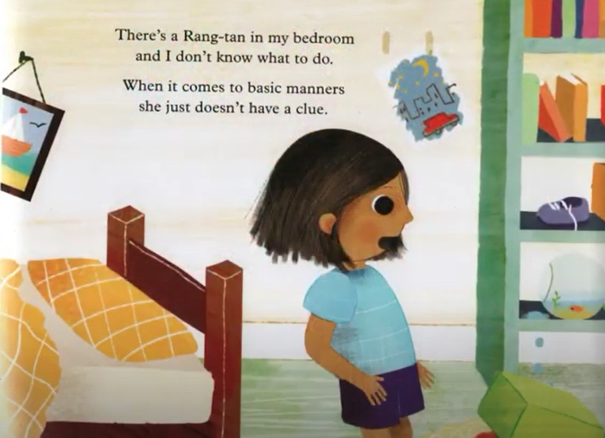
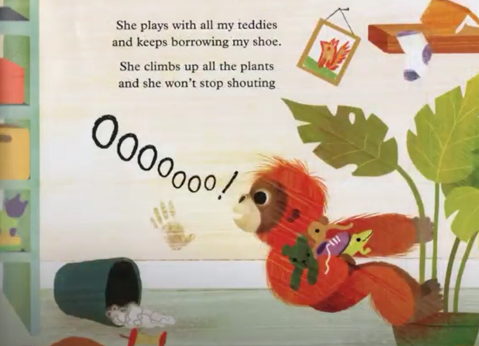
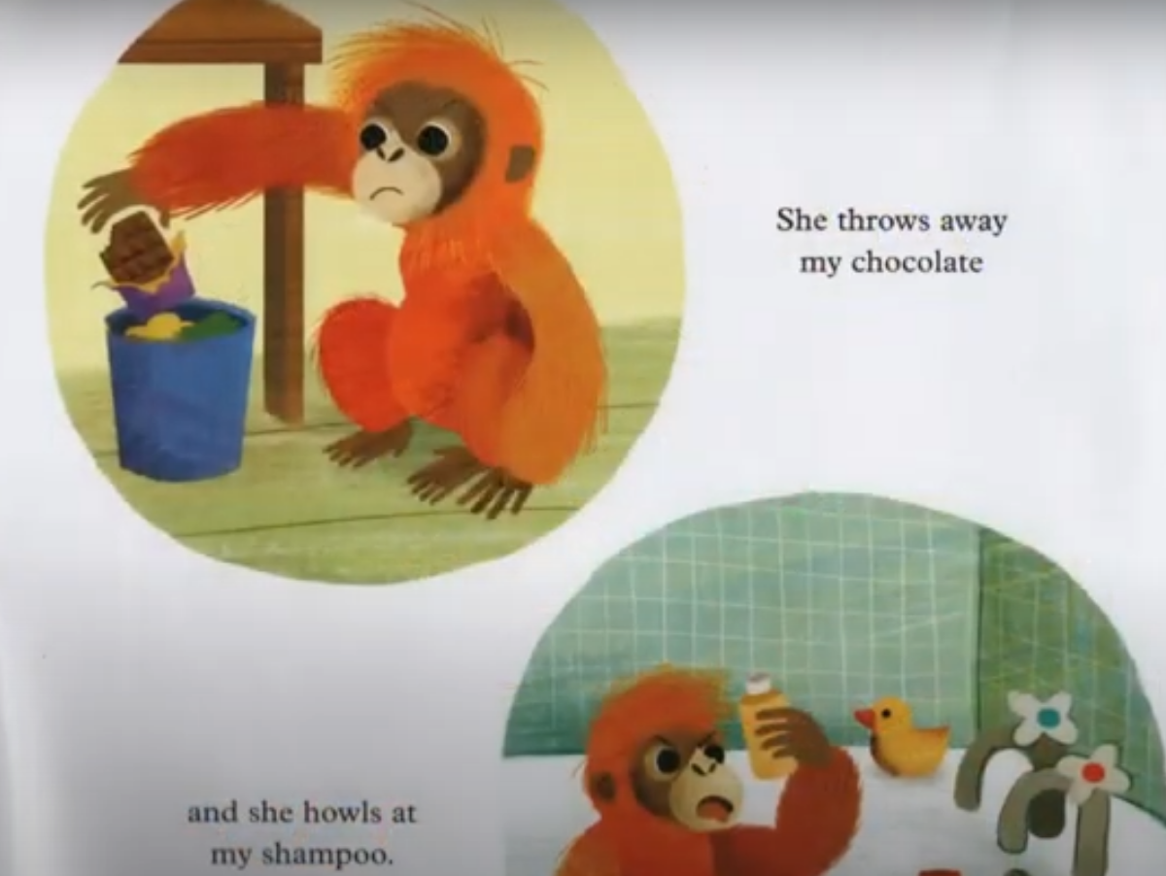
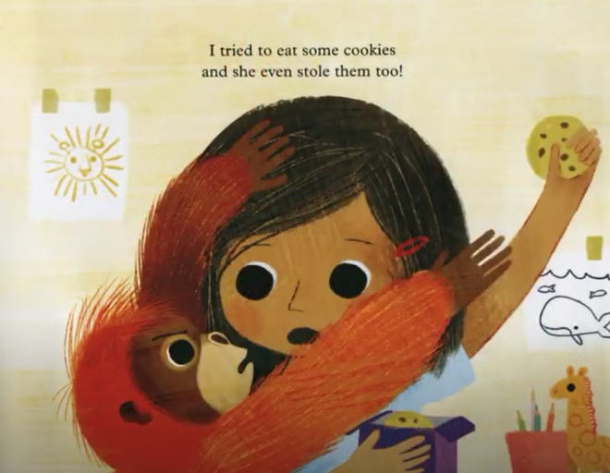
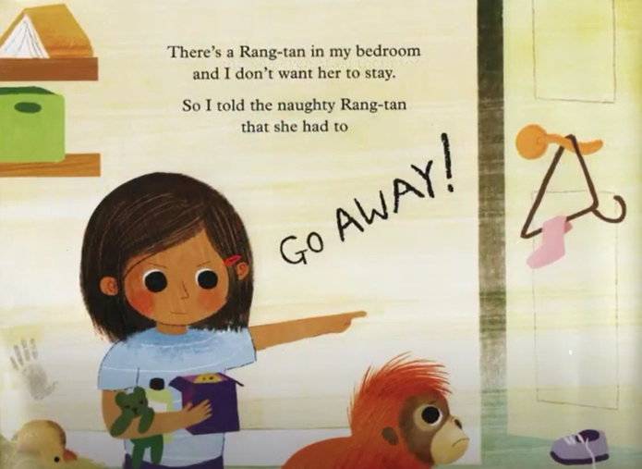
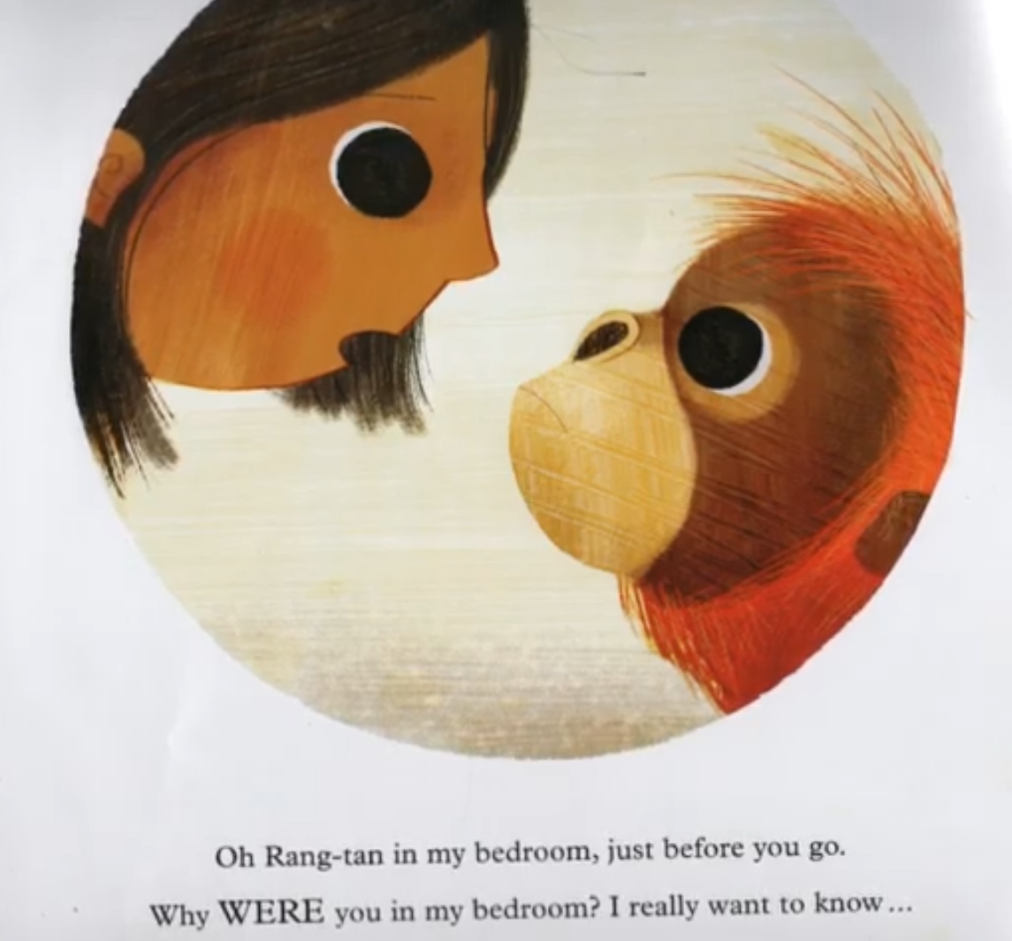
There’s a Rang-Tan in my bedroom …
Continued on the next slide

Slide 5
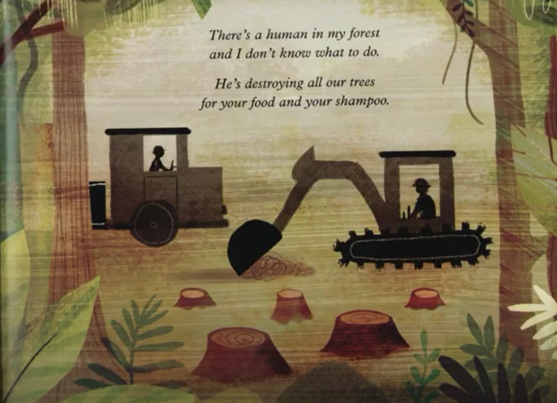
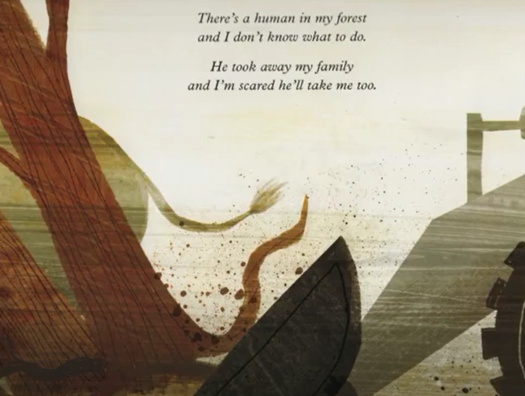
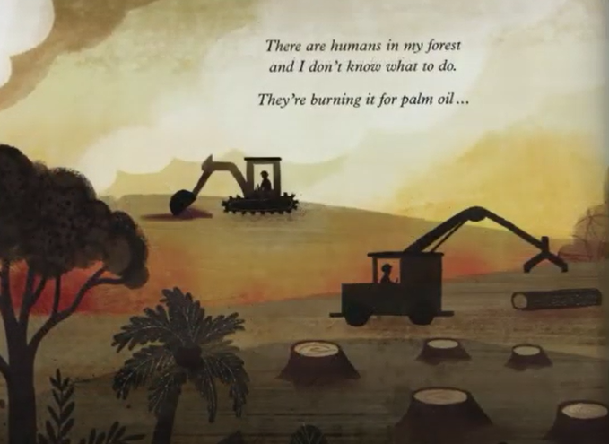
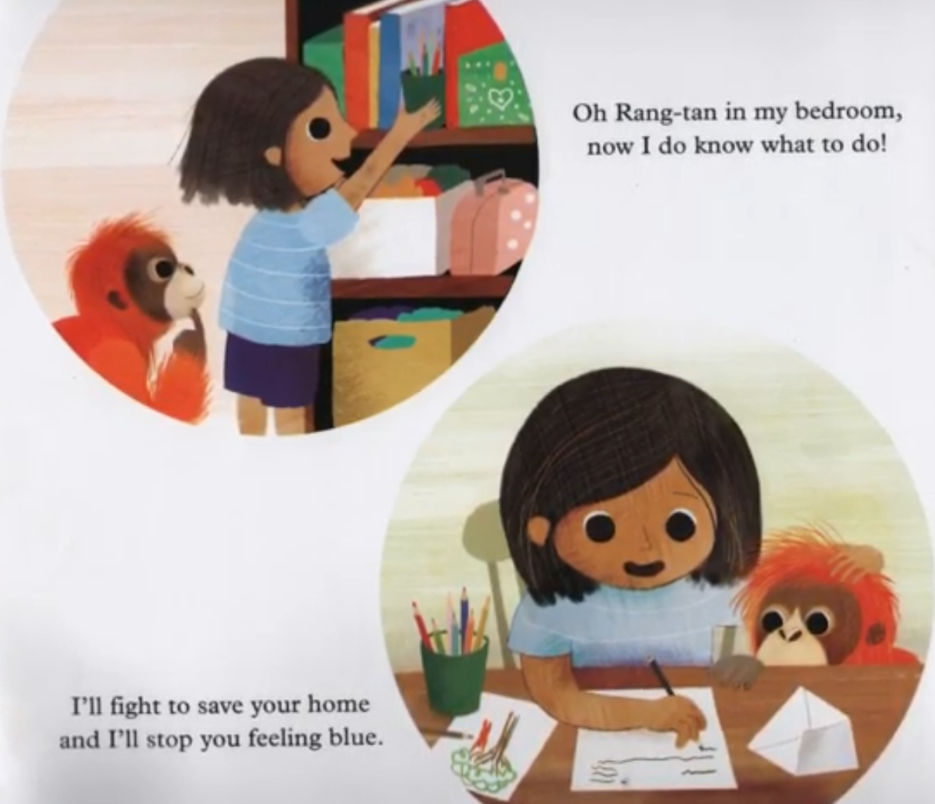
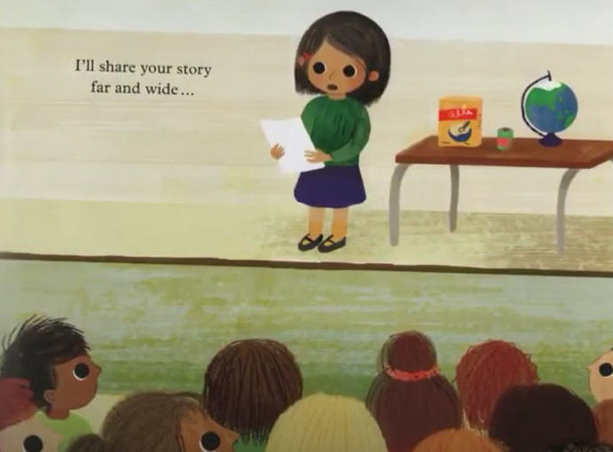
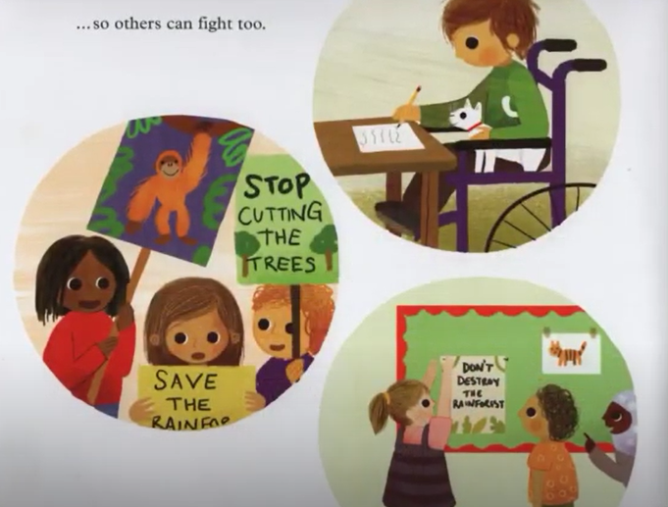
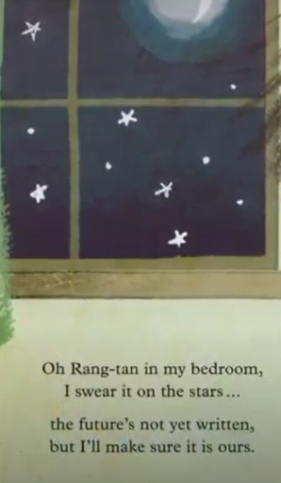
There’s a Rang - Tan in my bedroom …

Slide 6
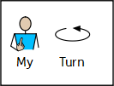
Nouns are things…
Recap on expanded noun phrases
An expanded noun phrase is adjective , adjective noun
Adjectives are describing words…

Slide 7

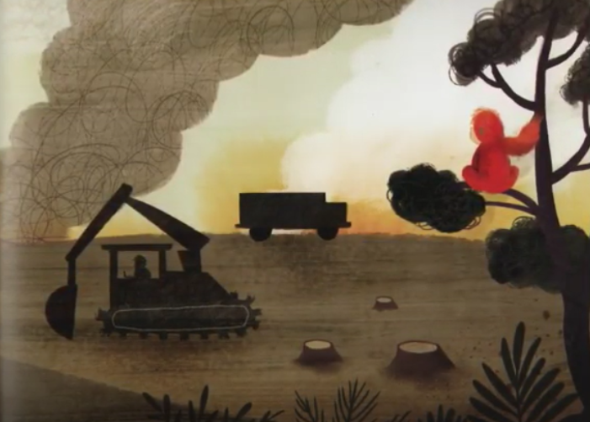
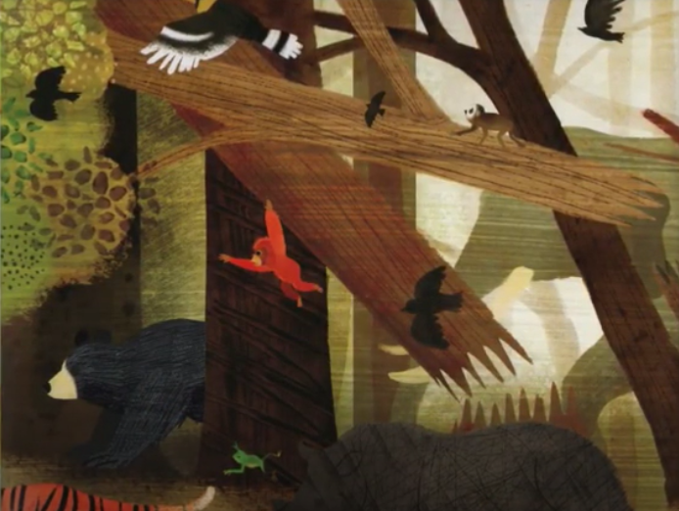
Nouns are things…
leaves
bird
orangutan
smoke
branch
digger
mud
Tree stump
bear
Can you think of any others?

Slide 8
Adjectives are describing words…
Complete the expanded noun phrases by
adding 2 adjectives before the noun.
thick , grey smoke
furry , orange orangutan
_____________ _____________ digger
_____________ _____________ tree
______________ _____________ branch
_____________ _______________ bird
______________ _____________ leaves
______________ _____________ tree stumps
Don’t forget! Have you put a comma between your two describing words?

Slide 9
Example
Setting description
Read my description …
A scared, furry orangutan was clinging onto a tall, burning tree. The sky was filled with clouds of thick, grey smoke. A loud, powerful digger chopped down the trees one by one. The beautiful, green canopy started to disappear and turn into small, round tree stumps. The ground was covered in broken, burnt branches and dried, dead leaves. The small, terrified animals squawked and howled as they searched franticly for a safe, new home.

Slide 10
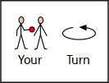
Read through the description again and highlight/underline the expanded noun phrases.
What is an expanded noun phrase?
adjective , adjective noun
A scared, furry orangutan was clinging onto a tall, burning tree. The sky was filled with clouds of thick, grey smoke. A loud, powerful digger chopped down the trees one by one. The beautiful, green canopy started to disappear and turn into small, round tree stumps. The ground was covered in broken, burnt branches and dried, dead leaves. The small, terrified animals squawked and howled as they searched franticly for a safe, new home.

Slide 11




Sentences using expanded noun phrases…
Choose 4 of your expanded noun phrases and turn them into full sentences.
Don’t forget:
The sky was filled with thick, grey smoke.

Slide 12

Well done for all of your hard work! We can’t wait to see your completed work.
Could any completed work / photographic evidence of completed work please be sent to pioneerspupils@gmail.com
Thank you!

Slide 13
Date: Tuesday 9th February
LO To be able to write a setting description of the rainforest.
Subject: English

Slide 14
Lets re read my description to get it back in our head.
A scared, furry orangutan was clinging onto a tall, burning tree. The sky was filled with clouds of thick, grey smoke. A loud, powerful digger chopped down the trees one by one. The beautiful, green canopy started to disappear and turn into small, round tree stumps. The ground was covered in broken, burnt branches and dried, dead leaves. The small, terrified animals squawked and howled as they searched franticly for a safe, new home.

Slide 15


Write a setting description
Today you are going to write a setting description of the rainforest after people have cut down the trees.
Your description must include:
At least 8 sentences
5 expanded noun phrases
You can use the blank lines on the next slide to type your description or you can write your description on paper.
Don’t forget an expanded noun phrase is
adjective , adjective
This piece of writing should take approximately 45 minutes

Slide 17
Well done for all of your hard work! We can’t wait to see your completed work.
Could any completed work / photographic evidence of completed work please be sent to pioneerspupils@gmail.com
Thank you!

Slide 18
27th January
Date: Wednesday 11th February
LO To be able to extend sentences using ‘but’.
Subject: English

Slide 19
but
We are going to use the word but to extend our sentences.
Can you say the word but?
Can you spell it out loud b u t?
Now can you practise writing the word but on a piece of paper?

Slide 20
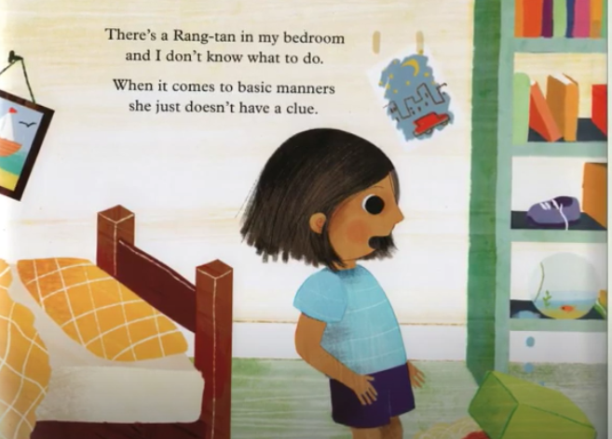
The word ‘but’ is a conjunction.
Conjunctions join two sentences together …
Example
There’s a Rang-Tan in my bedroom but I don’t know what to do.
Notes:
20

Slide 21
Match the correct ending to the sentences
Sentence starters:
Ending:
There’s a Rang-Tan in my bedroom but
keeps borrowing my shoes.
She plays with all my teddies but
I don’t know what to do.
She throws away my chocolate but
I’m scared he’ll take me too.
He took away my family but
likes to howl at my shampoo.

Slide 22
Match the correct ending to the sentences – answers
Sentence starters:
Ending:
There’s a Rang-Tan in my bedroom but
keeps borrowing my shoes.
She plays with all my teddies but
I don’t know what to do.
She thrown away my chocolate but
I’m scared he’ll take me too.
He took away my family but
likes to howl at my shampoo.
Notes:
22

Slide 23
because or but?
A few weeks ago we looked at using ‘because ’ to extend sentences. Lets see what you can remember read the sentences below and decide if the missing conjunction is ‘because’ or ‘but’.
She climbs up all the plants ____________ she won’t stop shouting oooooo!
2. Why were you in my bedroom ____________ I really want to know?
3. There’s a Rang-Tan in my bedroom ____________ I don’t want her to stay.
4. I’m scared ____________he’s destroying all our trees.
5. There’s a human in my forest ____________I don’t know what to do.

Slide 24
because or but? Answers
A few weeks ago we looked at using ‘because’ to extend sentences. Lets see what you can remember read the sentences below and decide if the missing conjunction is ‘because’ or ‘but’.
She climbs up all the plants but she won’t stop shouting oooooo!
2. Why were you in my bedroom because I really want to know?
3. There’s a Rang-Tan in my bedroom but I don’t want her to stay.
4. I’m scared because he’s destroying all our trees.
5. There’s a human in my forest but I don’t know what to do.

Slide 25
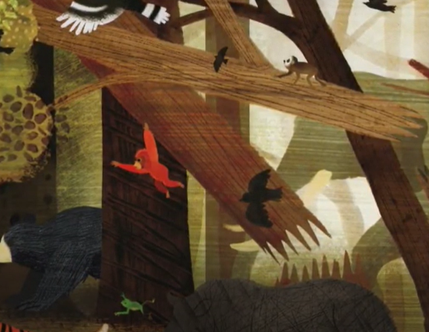
Complete my sentences:
I tried to eat some cookies but ___________________________________________.
There’s a human in my forest but ___________________________________________.
He took away my family but ___________________________________________.
The word ‘but’ is a …
Conjunction
Conjunction

Slide 26
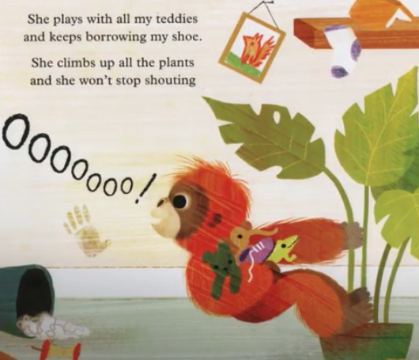
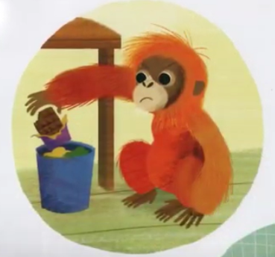
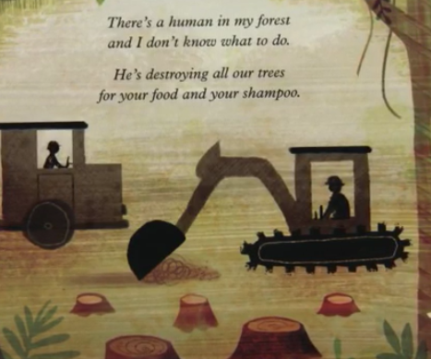
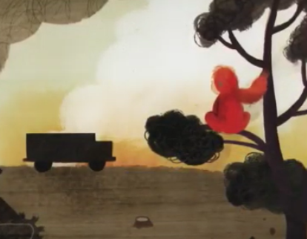
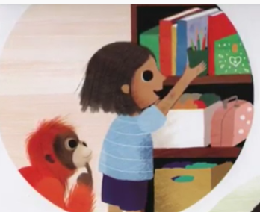

Your Sentences…
Write your own sentences about the story using the conjunction ‘but’ to extend your sentences
Don’t forget:
Use the pictures to help

Slide 27
Well done for all of your hard work! We can’t wait to see your completed work.
Could any completed work / photographic evidence of completed work please be sent to pioneerspupils@gmail.com
Thank you!

Slide 28
Date: Thursday 4th February
LO To be able to retell the story ‘There's a Rang-Tan in my bedroom’.
Subject: English

Slide 29
Lets read my version of the story
Retell of the story …
Many years ago, the world had beautiful rainforests filled with huge trees, gorgeous flowers and animals. Sadly humans started to destroy the rainforests using big, powerful diggers to chop down the trees for palm oil. One day a furry, orange orangutan was swinging through the trees when she heard a huge BANG! She thought it was thunder but she was wrong, very wrong.
Suddenly, she spotted thick, grey clouds of smoke and fire spreading across the forest floor. She could see humans cutting viciously through the burning tree trunks and piling the remaining logs onto a massive lorry. The sound of animals squawking and howling with fear echoed through the rainforest. Rangtan wanted to stop the humans but she didn’t know how.
Rang - Tan was terrified. Her home had been destroyed, her favourite banana tree had been chopped down and she couldn’t find her family. Rang - Tan knew she needed to find a new home but she didn’t know where to go. Rang - Tan loved the rainforest and didn’t want to leave but her cosy, safe and warm house was gone and not safe anymore!
One day, Rang - Tan searched for a new home but all the trees were gone. She couldn’t find anywhere to live. Giant tears started to roll down her soft, furry face. Then all of a sudden, in the distance, Rang - Tan spotted a house made from big, brown bricks. She saw a friendly, young girl with a room filled with toys and thought it would be good to live with her.
Rang - Tan played with the teddies and climbed up all the plants but somethings in the house made her feel quite mad. Rang - Tan didn’t like the chocolate, shampoo or the cookies because they all have palm oil in. Rang - Tan loved her new friend but wished she could go back to the rainforest with her family.

Slide 30
Now find the features
Retell of the story …
Many years ago, the world had beautiful rainforests filled with huge trees, gorgeous flowers and animals. Sadly humans started to destroy the rainforests using big, powerful diggers to chop down the trees for palm oil. One day a furry, orange orangutan was swinging through the trees when she heard a huge BANG! She thought it was thunder but she was wrong, very wrong.
Suddenly, she spotted thick, grey clouds of smoke and fire spreading across the forest floor. She could see humans cutting viciously through the burning tree trunks and piling the remaining logs onto a massive lorry. The sound of animals squawking and howling with fear echoed through the rainforest. Rang - Tan wanted to stop the humans but she didn’t know how.
Rang - Tan was terrified. Her home had been destroyed, her favourite banana tree had been chopped down and she couldn’t find her family. Rang - Tan knew she needed to find a new home but she didn’t know where to go. Rang - Tan loved the rainforest and didn’t want to leave but her cosy, safe warm house was gone and not safe anymore!
One day, Rang - Tan searched for a new home but all the trees were gone. She couldn’t find anywhere to live. Giant tears started to roll down her soft, fury face. Then all of a sudden, in the distance, Rang - Tan spotted a house made from big, brown bricks. She saw a friendly, young girl with a room filled with toys and thought it would be good to live with her.
Rang - Tan played with the teddies and climbed up all the plants but somethings in the house made her feel quite mad. Rang - Tan didn’t like the chocolate, shampoo or the cookies because they all have palm oil in. Rang - Tan loved her new friend but wished she could go back to the rainforest with her family.
Use the key to highlight/ underline the key features in the correct colour
Capital letters
but
Remember an expanded noun phrase is: adjective , adjective noun
Exclamation marks
Full stops
Expanded noun phrases

Slide 31
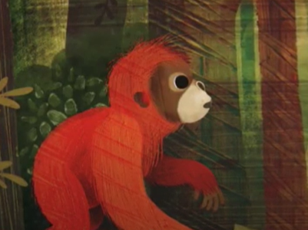
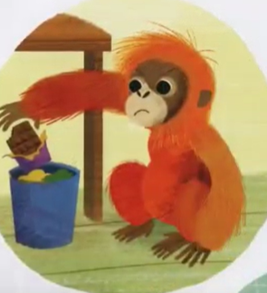
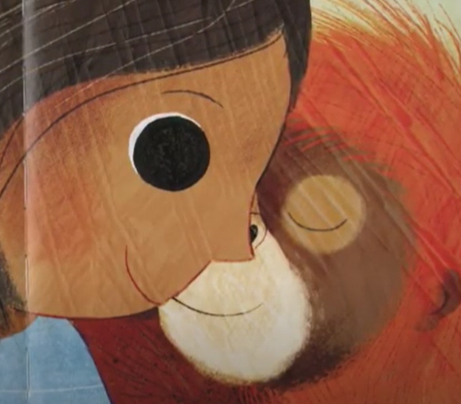
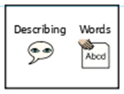
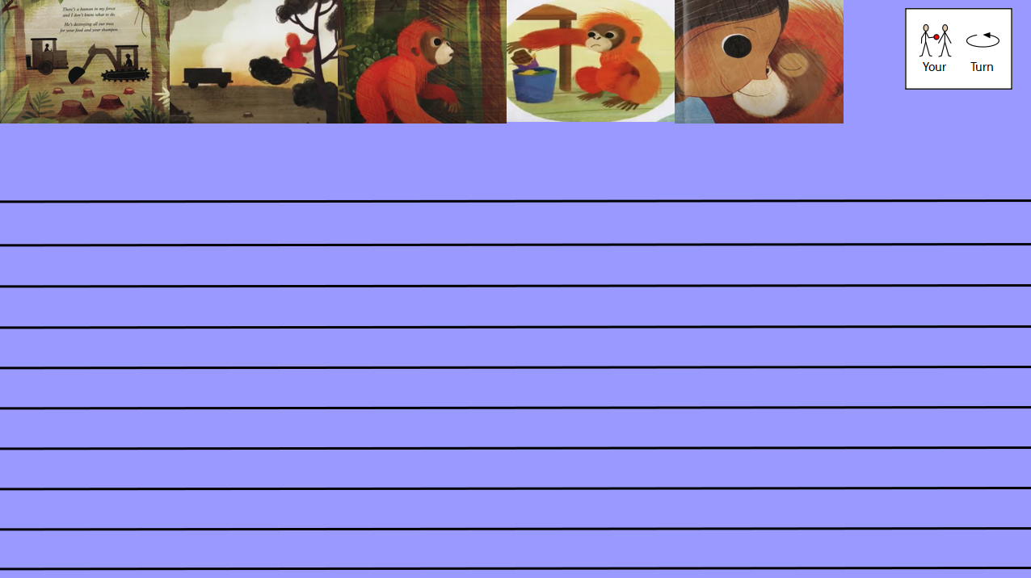
Retell of the story …
Today you are going to retell the story ‘There’s a Rang – Tan in my bedroom’.
Your story must include:
At least 2 paragraphs
Expanded noun phrases (At least 6)
The conjunction ‘but’ to extended sentences (used at least 3 times)
Use the pictures to help you
You can use the blank lines on the next slide to type your story or you can write your story on paper.
This piece of writing should take approximately 45 minutes

Slide 33
Well done for all of your hard work! We can’t wait to see your completed work.
Could any completed work / photographic evidence of completed work please be sent to pioneerspupils@gmail.com
Thank you!

Slide 34
Date: Friday 5th February
LO To be able to read and spell words with the ‘l’ sound spelt ‘le’.
Subject: English

Slide 35
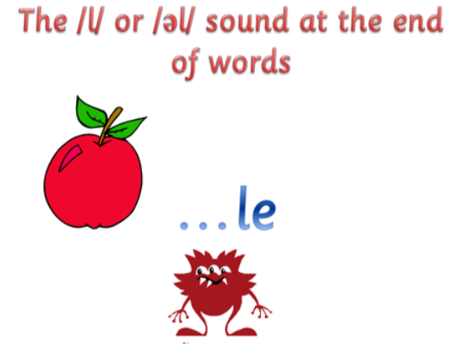
‘l’ – sound spelt as ‘le’
The spelling rule we are focusing on today is ‘l’ but it is spelt ‘le’.
The ‘l’ sound spelt ‘le’ is used at the end of words.
Click on the links or copy and paste the links into your internet browser to watch the spelling videos.
le | Fun Phonics | How to Read | Made by Kids vs Phonics - YouTube
Episode 11: Consonant LE – YouTube
Geraldine the Giraffe learns /-le/ - YouTube

Slide 36
Read the words
able
mile
mole
sale
pole
rule
apple
table
scale
whale
cycle
smile
eagle
Now write the words on a piece of paper and underline the ‘le’ sound which sounds like ‘l’ .

Slide 37

Real or Alien words?
Read the words and decide if they are real words or alien words.
Real words
able
Alien words
gable
sale
qule
eagle
yugle
pole
mile
itrle
apple
table
Remember alien words are made up words!

Slide 38





Match the picture to the correct word
table
smile
whale
mole
apple

Slide 39
Match the picture to the correct word
table
smile
whale
mole
apple

Slide 40



Write the word under the picture

Slide 41

word | 1st try | 2nd try | 3rd try
mole
pole
apple
table
whale
smile
eagle
cycle
Practice writing the words on a piece of paper or type into the table on your computer.

Slide 42
‘le’ sound
Now pick 3 ‘le’ words and write a sentence including each word.
mole
apple
whale
eagle
scale
pole
table
smile
cycle

Slide 43
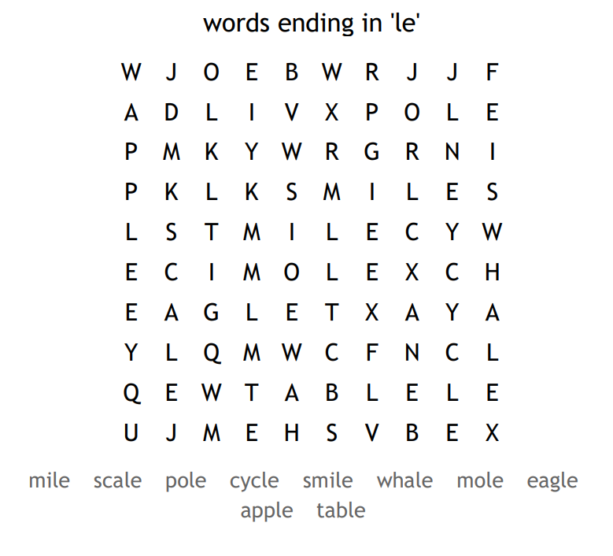
Word search

Slide 44
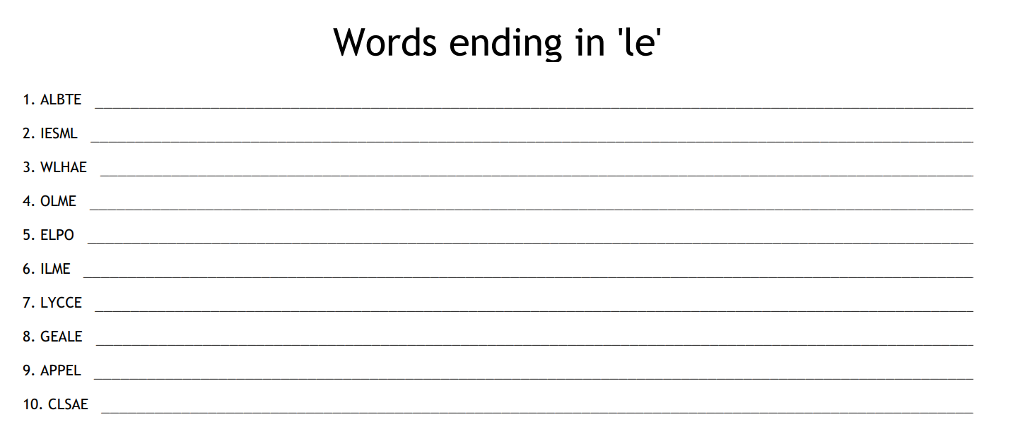
Unscramble the words ending in le

Slide 45
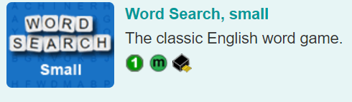
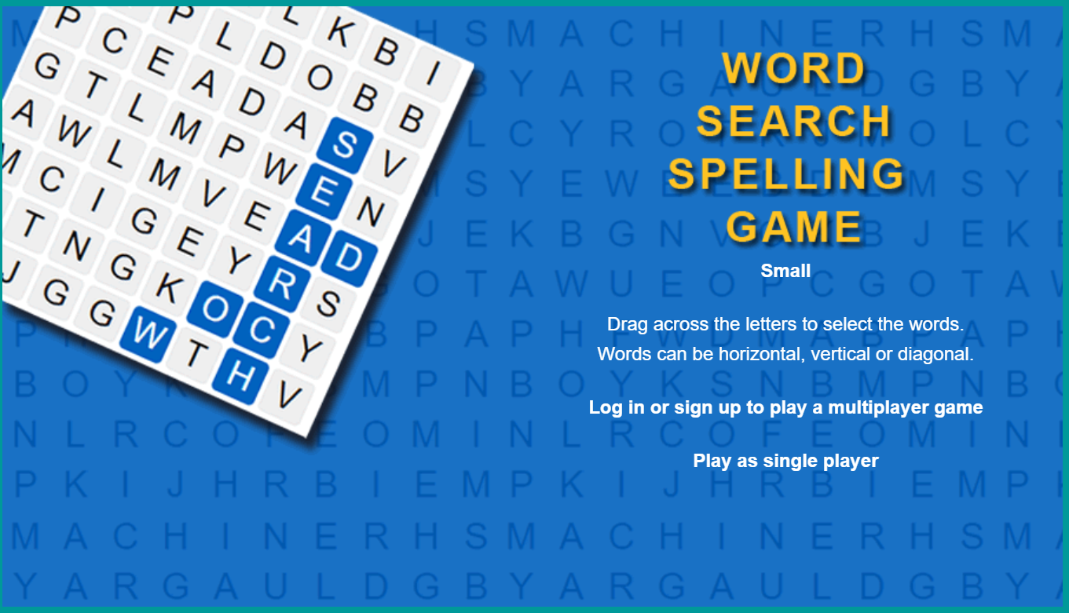
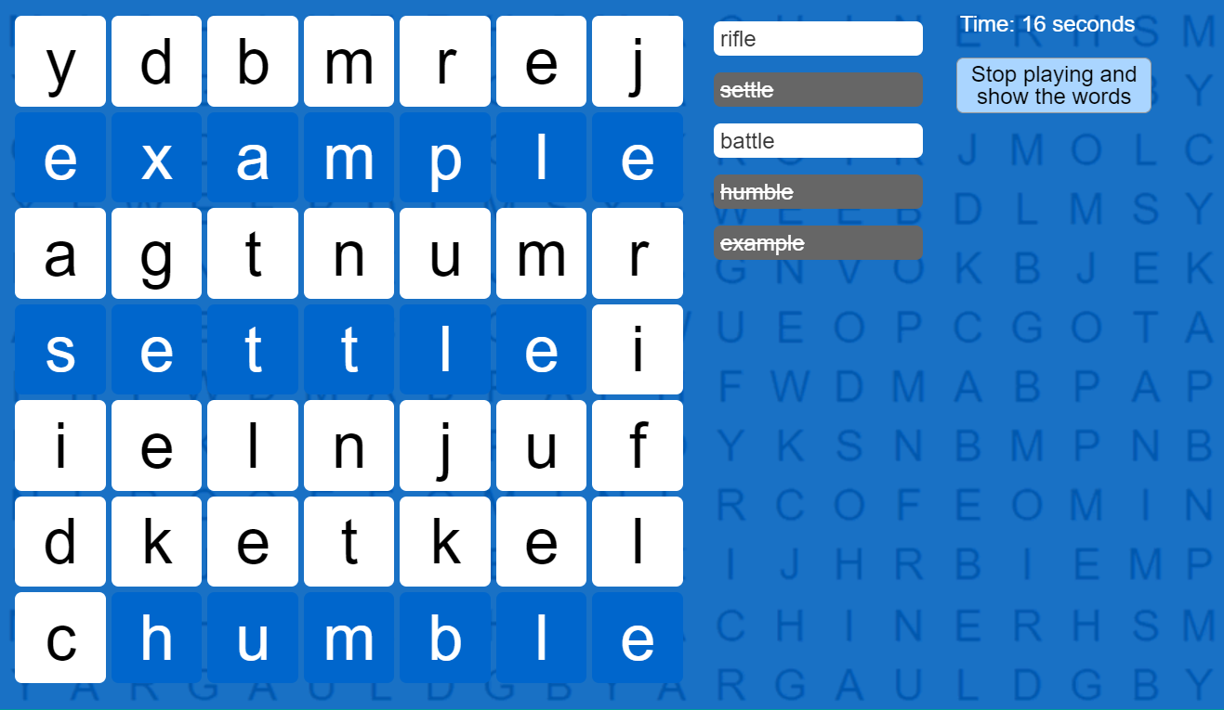
Spelling game!
Use the link to play the game and practice spelling the ‘le’ words
Spelling games: Words ending in LE (spellzone.com)

Slide 46
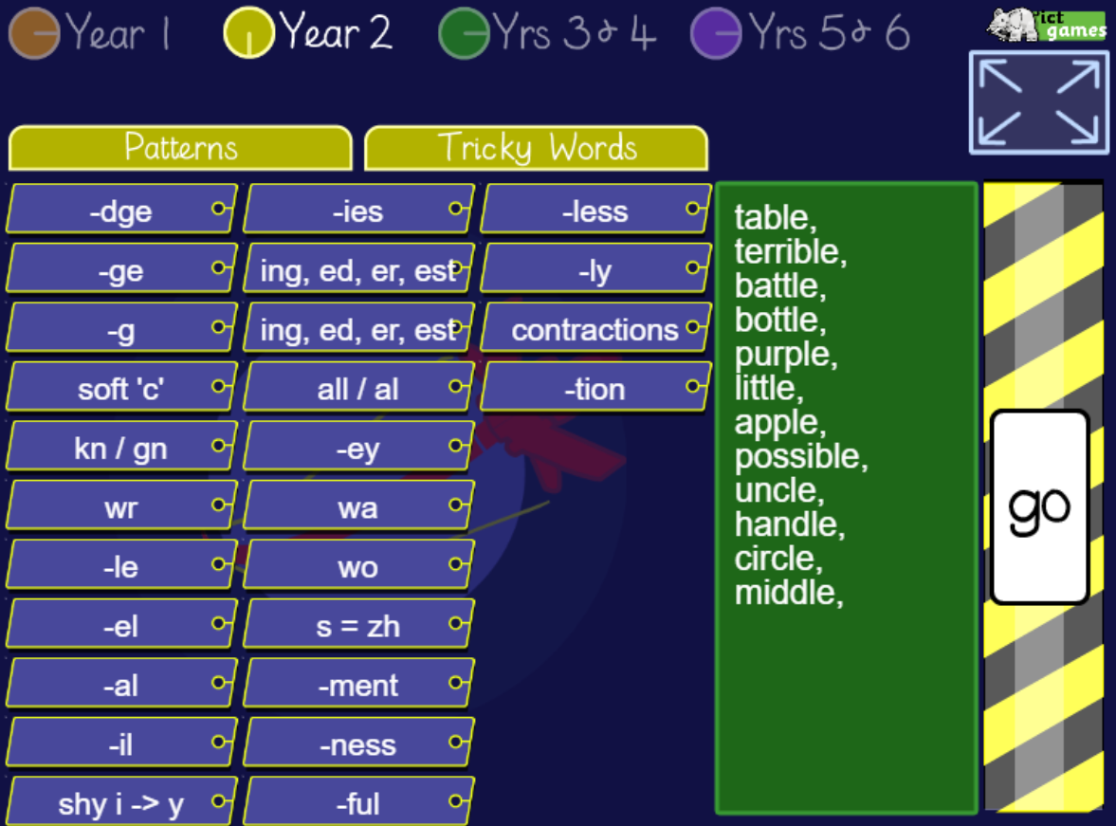
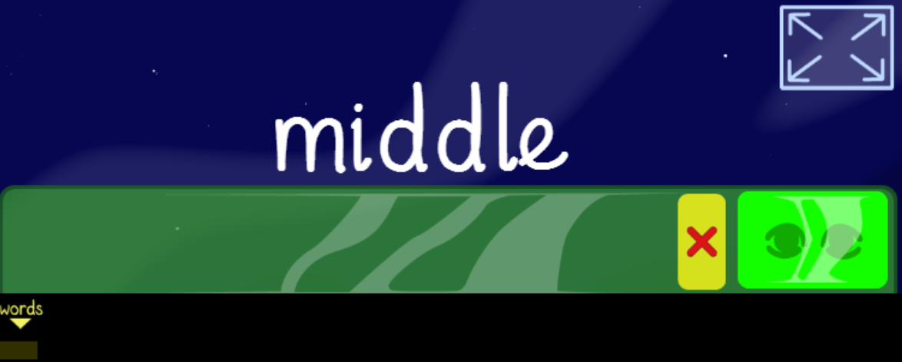
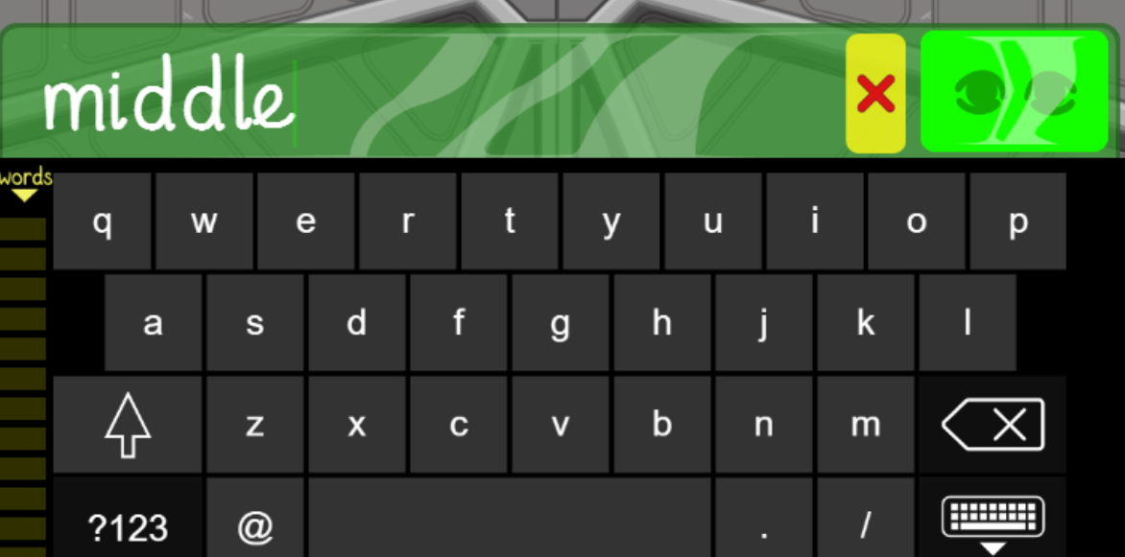
Spelling game!
Use the link to play the game and practice spelling the ‘le’ words
Look, Cover, Write, Check- mobile friendly (ictgames.com)

Slide 47
Well done for all of your hard work! We can’t wait to see your completed work.
Could any completed work / photographic evidence of completed work please be sent to pioneerspupils@gmail.com
Thank you!

