Slide 1


Subject: English
Pack: A

Slide 2



Date: Monday 1st February 2021
LO. To be able to identify rhyming words.
Subject: English

Slide 3

Pre-recorded Teaching
Access the online teaching video below that will support you to complete the work in this lesson. This video will act as a support but all of the work can still be successfully understood & completed using paper-based versions of this pack. If you need further support to understand / complete work then please contact school via e-mail or telephone.
Play Video
You can also copy and paste this link if you would prefer:
https://classroom.thenational.academy/lessons/word-reading-rhyming-words-6xk32c?activity=video&step=1
When you click on the link make sure you use google chrome to access the full 10 minutes video.

Slide 4
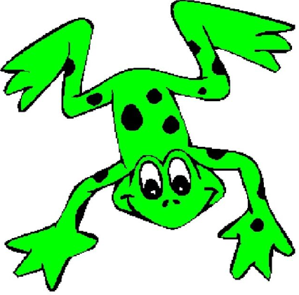

Rhyming words
Words that rhyme are words that look and sound the same.
A way to spot words that rhyme is by looking at the end sounds of the word.
For example 'hat' and 'bat' both look and sound the same at the end.
Below we have coloured the rhyming parts in the two words. Can you spot they both have 'at' at the end :
hat and bat
Both of these words are green words.
Let's Fred talk, read the words. Remember to push each sound button as you Fred talk the word.
h a t b a t

Slide 5

Remember rhyming words look and sound the same.
Let us have a look at some more examples of words that rhyme together.
pig and wig
'pig and 'wig' look and sound the same. They are rhyming words.
log and dog
'log' and 'dog' also look and sound the same. They are rhyming words as well.

Slide 6

Let’s do the next one together.​
Don't forget to listen out for the same sounds that both words have.​
First lets Fred talk, read the word.​ Do they sound the same at the end?
​f o x b o x
​​
Do 'fox' and 'box' look the same? ​​Colour in the letters that are the same.
​​f o x b o x
Did you colour in the same sounds as I did?
fox box
Well done! You are getting really good at this.

Slide 7
Now we are going to learn how to choose the correct rhyming word when there is more than one option.
The first word is 'jog', let’s sound this out together. Fred talk, read the word.
j o g
We now have two words that could rhyme with jog. The words are rat and fog.
Look at the words. Which word has the og sound on the end? Does it sound the same when you say it?
  rat
  jog
  fog
I have done the first one for you. They both end in og.
They look and sound the same. The words jog and fog rhyme.

Slide 8
Let’s have a try together.
The first word is ‘bat', let’s sound this out together. Fred talk, read the word.
b a t
Now look at the two words on the other side 'lip' and 'cat'.
Can you spot the one that has the letters 'at' at the end?
Draw a line to match the two words together that rhyme.
  cat
  bat
  lip
Super! 'bat' and 'cat' rhyme as they both have the letters 'at' at the end.

Slide 9

Now it is your turn
The first word is fish. Fred talk, read the word.
f i sh
Now look at the two words on the other side 'dish' and 'mud'.
Sound out both words and see which sounds the same. Then look closely to see which one looks the same.
Draw a line to match the two words together that rhyme.
  dish
  fish
  mud

Slide 10
The first word is mat. Fred talk, read the word.
m a t
Now look at the two words on the other side ‘pat' and ‘wish'.
Sound out both words and see which sounds the same. Then look closely to see which one looks the same.
Draw a line to match the two words together that rhyme.
  pat
  mat
  wish

Slide 11

The first word is bin. Fred talk, read the word.
b i n
Now look at the two words on the other side ‘lid' and ‘tin'.
Sound out both words and see which sounds the same. Then look closely to see which one looks the same.
Draw a line to match the two words together that rhyme.
  lid
  bin
  tin
Well done. You have identified all of the rhyming words.

Slide 12
Date: Tuesday 2th February 2021
LO. To be able to identify rhyming words.
Subject: English

Slide 13
Pre-recorded Teaching
Access the online teaching video below that will support you to complete the work in this lesson. This video will act as a support but all of the work can still be successfully understood & completed using paper-based versions of this pack. If you need further support to understand / complete work then please contact school via e-mail or telephone.
Play Video
You can also copy and paste this link if you would prefer:
https://classroom.thenational.academy/lessons/how-to-find-words-that-rhyme-c8vk8r?activity=video&step=1

Slide 14
Think back to yesterday’s lesson.
Can you remember the two things we look for when words rhyme?
Rhyming words look and sound the same on the end. Here are some pairs of rhyming words.
dog and log
pot and hot
nip and zip
Can you have a think of another word that rhymes with each of these words. Write them below.
og
dog
log
ot
pot
hot
ip
nip
zip

Slide 15
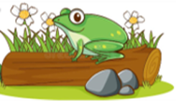
Now we are going to look at rhyming words in a sentence.
Lets read the sentence.
The frog is on a log.
Miss Bentley has found the two words that rhyme in the sentence.
She looked for words that sounded the same on the end.
She also looked for words that looked the same on the end.
I have put the tricky word in red. Your adult can help you with this. You can Fred talk, read the word for the rest of the sentence.
The frog was on a log.
Miss Bentley drew a circle around each of the rhyming words.
Frog and log rhyme.

Slide 16
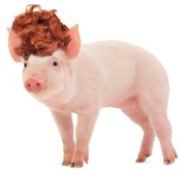
Now let’s do one together.
Let’s read the sentence.
Now let’s find two words that rhyme in the sentence.
Look for words that sound the same on the end.
Spot words that look the same on the end.
We have picked out the first word for you. Drag and drop or draw a circle around the word that rhymes with pig.
Can you think of any other words that rhyme with pig? Write your favourite one in the box.
The pig with a wig.
The pig with a wig.

Slide 17
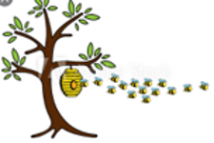
Now it is your turn.
Read the sentence and identify the two words that rhyme.
Remember the words that rhyme will look and sound the same at the end.
Circle the two words that rhyme by drawing a circle around them or moving the ones provided.
The bee in a tree.

Slide 18
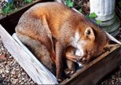
Read the sentence and identify the two words that rhyme.
Remember the words that rhyme will look and sound the same at the end.
Circle the two words that rhyme by drawing a circle around them or moving the ones provided.
The fox in a box.

Slide 19
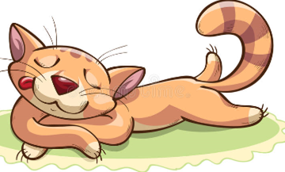
Now it’s time for a little challenge.
Read the sentence below and see if you can spot the three words that rhyme.
Talk to your adult about what other words that rhyme with cat, sat, mat. Write them down on the list below.
cat
sat
mat
The cat is sat on a mat.

Slide 20
Date: Wednesday 3rd February 2021
LO. To be able to order a simple sentence.
Subject: English

Slide 21

Pre-recorded Teaching
Access the online teaching video below that will support you to complete the work in this lesson. This video will act as a support but all of the work can still be successfully understood & completed using paper-based versions of this pack. If you need further support to understand / complete work then please contact school via e-mail or telephone.
Play Video
You can also copy and paste this link if you would prefer:
https://www.youtube.com/watch?v=qTkbVYgN1FE

Slide 22

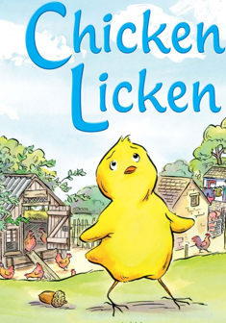
One day, Chicken Licken was sitting underneath the little nut tree when a nut fell on his head. OW!
Now, Chicken Licken was a very silly chicken and when the nut fell on his head, he said, “The sun! The sun fell on my head. What if the moon, stars and sky fall down to? I better go ask Hen Len what to do.”
So, Chicken Licken went to find his friend, Hen Len.
Hen Len was sitting in the straw with her little chicks. One, two, three and four.
“Hen Len! Hen Len! The sun fell on my head,” cried Chicken Licken.
The sun Chicken Licken?
The sun Hen Len.
And the little chicks cried, “The sun! The sun! The sun! The sun!”

Slide 23
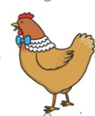
The sun little chicks.
The sun! What if the moon, stars and sky fall down to? We best go ask Cock Lock what to do.
So, Chicken Licken, Hen Len and the little chicks, one, two, three and four went to find Cock Lock.
Cock Lock was sitting on the hay whiling the afternoon away.
Cock Lock! Cock Lock! The sun fell on my head.
“Cock-a-doodle-doo”
The sun Chicken Licken.
The sun Cock Lock.
The sun Hen Len.
The sun Cock Lock.
The sun little chicks.

Slide 24
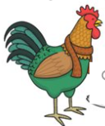
The sun! The sun! The sun! The sun!
The sun! What if the moon, stars and sky falls down to. We better go and ask Duck Luck what to do.
So, Chicken Licken, Hen Len and the little chicken, one, two, three and four went to find Duck Luck.
Duck Luck was splashing in the pool, dip double driving and keeping cool.
Duck Luck! Duck Luck! The sun fell on my head.
“Quack! Quack!”
The sun Chicken Licken.
The sun Duck Luck.
The sun Cock Lock.
The sun Duck Luck.
The sun Hen Len.
The sun Duck Luck.

Slide 25

The sun little chicks.
The sun! The sun! The sun! The sun!
“The sun! Wait a minute” said Duck Luck. Chicken Licken where were you when the sun fell on your head?
I was underneath the little nut tree. Come with me and I’ll show you.
So Chicken Licken, Duck Luck, Cock Lock, Hen Len and the little chicks, one, two, three and four.
All went to the little nut tree.
“Look up” said Duck Luck.
“What do you see?”
A nut fell on you.

Slide 26
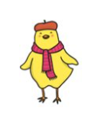
A nut Duck Luck.
A nut Chicken Licken.
A nut Duck Luck.
A nut Cock Lock.
A nut Duck Luck.
A nut Hen Len.
A nut! A nut! A nut! A nut!
A nut little chicks.
A nut everyone. A nut fell down and not the sun.
So, Chicken Licken, Duck Luck, Cock Lock, Hen Len and the little chicks, one, two, three, four all went back to what they were doing before.

Slide 27
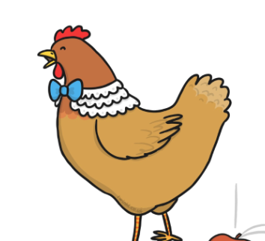
Did you notice that all of the characters have names that rhyme?
Lets look at one characters name.
Hen len
I can see that both words end in en.
I can hear that both words sound the same on the end.
I know that these words rhyme.
Mrs Simpson has muddled up the animals names. Can you help her to sort them out by joining the rhyming words together with a line. I have done one for you.
Chicken luck
Duck licken
Cock len
hen lock

Slide 28



Today we are going to look at some sentences from the story.
They are jumbled up and don’t make any sense. We are going to read the words and put them into the correct order.
Let me show you.
four chicks. Hen Len had
Here are some things to look for.
Does one have a capital letter? A capital letter always comes at the beginning of the sentence. Yes, Hen Len has a capital letter that must go first.
Does one have a full stop? A full stop always goes at the end of a sentence. Yes, four chicks has a full stop I will put that at the end.
Where does the last word go? It must go in the middle.
Lets read our sentence to check it makes sense. I will Fred Talk read, read the words to help me.
Yes, my sentence is correct
had
had

Slide 29


Let’s do one together now.
had a nut. Chicken Licken
I know that the middle word is had, Can you finish the sentence?
Does one have a capital letter?
Yes, Chicken Licken has a capital letter. Can you put if first?
Does one have a full stop? Yes, a nut has a full stop. Can you put that at the end.
Lets read the sentence to check it makes sense. Remember to Fred Talk read, read the words to help you.
had
had

Slide 30


Now it’s your turn.
Here is your jumbled sentence.
had Duck Luck a pool.
Can you change the sentence so it makes sense.
Remember to ask yourself about capital letters and full stops. This will help you.
Always read your sentence back to check it makes sense. Use Fred talk read the word to help you.
Lets read the sentence to check it makes sense. Remember to Fred Talk read, read the words to help you.
Once you have correctly sequenced the sentence write it down in the box below.
had

Slide 31
Date: Thursday 4rd February 2021
LO. To write a simple sentence.
Subject: English

Slide 32


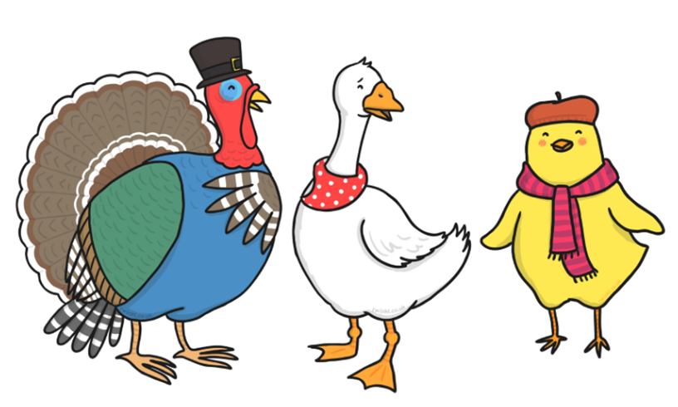
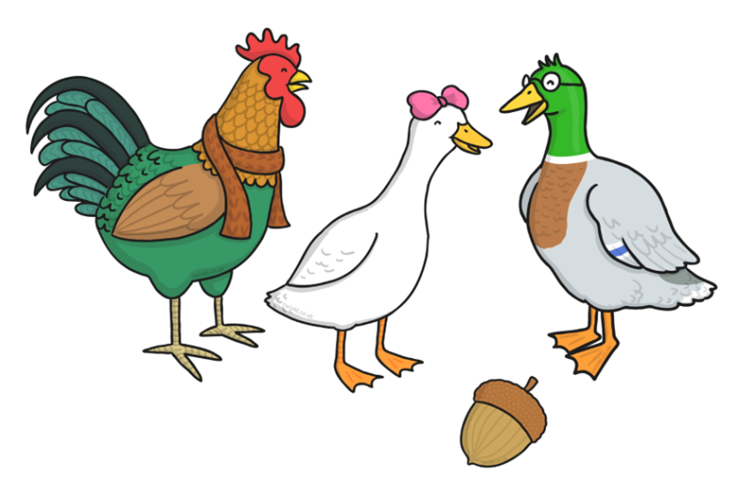
Let’s talk about who we met in the story.
We met:
Chicken Licken Hen Len Duck luck Cock lock

Slide 33



Now we are going to look at what the animals were doing when we met them in the story. Feel free to listen again if you need a quick recap.

Slide 34





Now we are going to look at where the animals were when we met them in the story. Feel free to listen again if you need a quick recap.
Read the sentences below.
Let’s add this to what we already know.

Slide 35
If I put all of this information together, I can make some who, doing what, where sentences.
Who? | Doing what? | Where?
Chicken Licken | was sitting | under the tree
Hen Len | was sitting | in the straw
Duck Luck | was splashing | In the pool
Cock Lock | was sitting | on the hay
Let’s have some fun on the next page and see if we can make some sentences together on the next page.

Slide 36






To make my sentence I am going to chose one character from the who column, one option from the doing column and one option from the where column. Let me show you. I have chosen Duck Luck as the who in my story. I have decided for the action, he will be sitting and where he will be is under a tree.
My sentence says, Duck Luck was sitting under a tree.

Slide 37









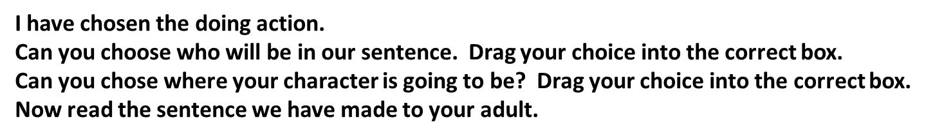
Now let’s try one together.

Slide 38
Now it’s your turn.
Choose WHO will be in your sentence.
Choose what they will be DOING.
Choose WHERE they will be in your sentence.
Experiment making lots of different sentences and write your favourite one below.

Slide 39
Date: Friday 5th February 2021
LO. To be able to write sounds in words.
Subject: English

Slide 40

As we do every Friday, today, we are going to have a word time lesson. Boys and girls, you will have to show your parents how to use Fred fingers.
Let’s do an example together.
Let’s write the word ‘dog’.
Show your adult three Fred fingers, split up the sounds from the word ‘dog’ onto each finger.
Remember to pinch each finger as you say the sound.
Then just like we do at school sound out the word three times before trying to write it down.
Ask your adult to check that you have written the word correctly.
1. d o g
d o g

Slide 41
1.
2.
3.
4.
5.
6.
Here are today’s words.
Ask your adult to read the word then hide it from you while you write it down.
nut
hen
duck
lock
tree
chicken
Don’t forget to check your sounds with an adult. If you weren’t quite right just correct your mistake.

