Slide 1



Date: 25.2.21
L.O: To be able to identify right angles.
Subject: Maths

Slide 2




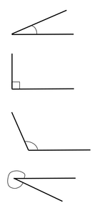


Slide 3

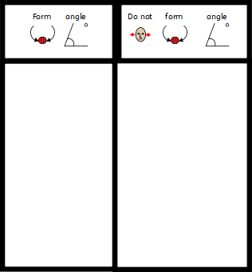
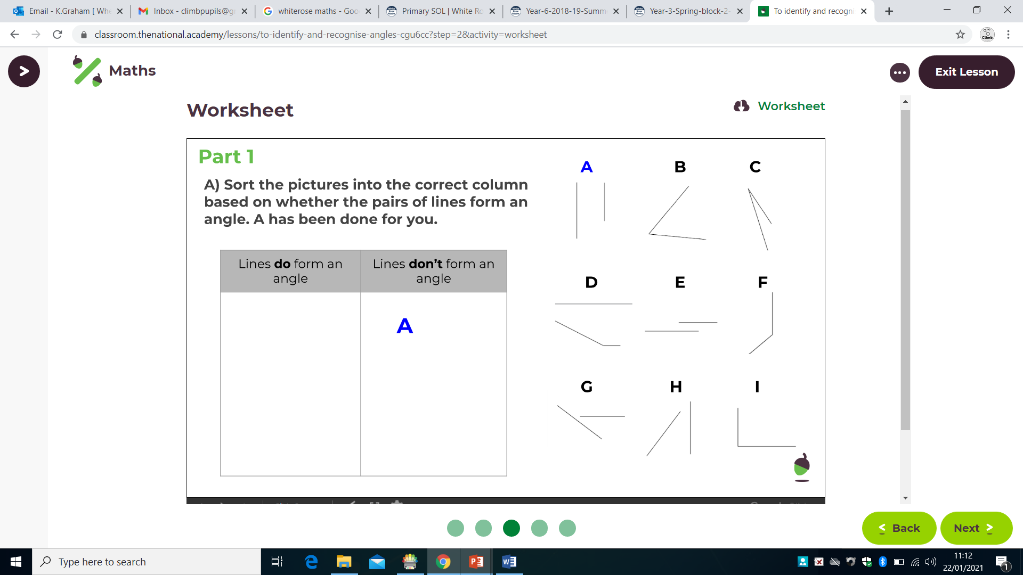

Slide 4


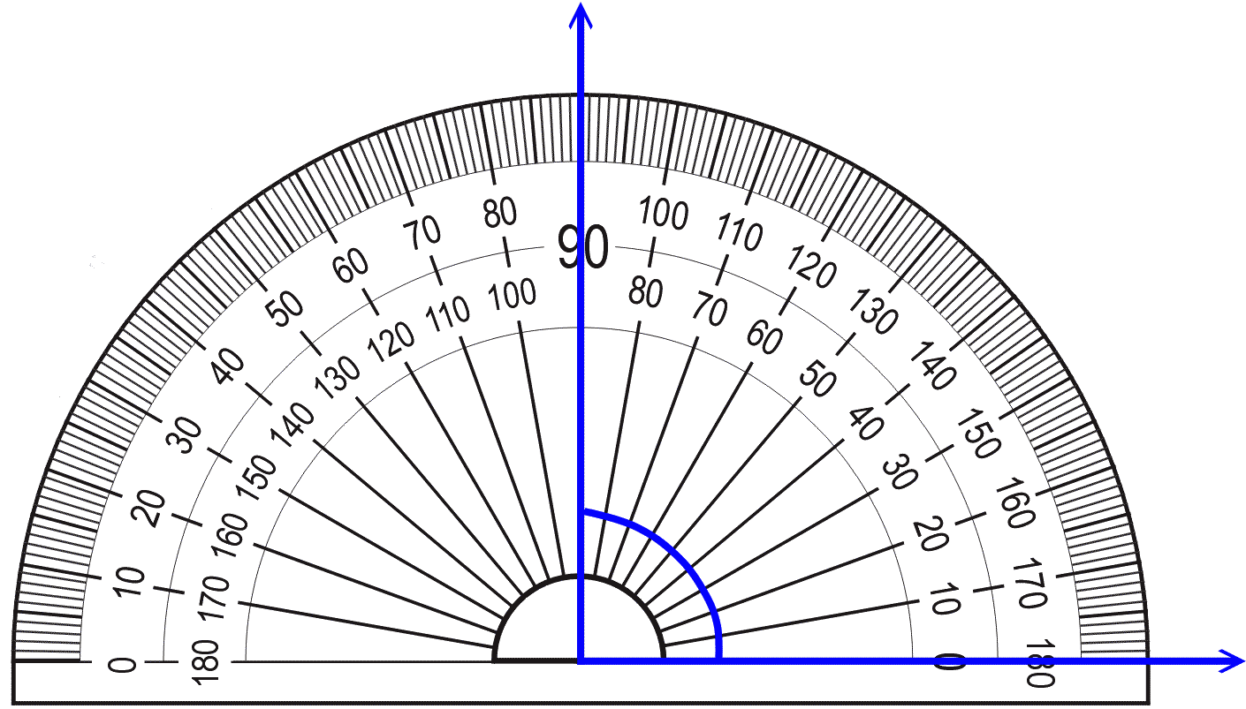
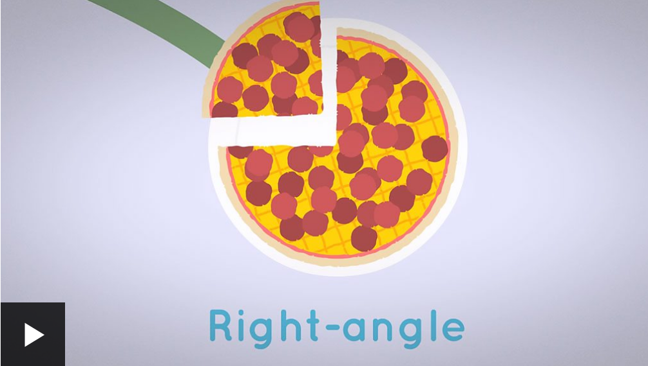
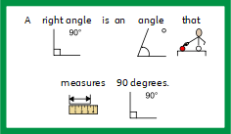
https://www.bbc.co.uk/bitesize/topics/zb6tyrd/articles/zg68k7h

Slide 5

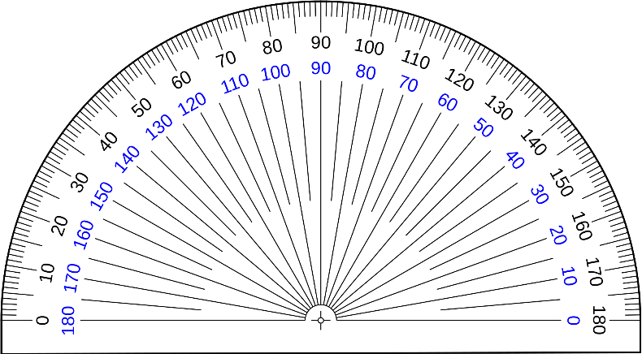

Slide 6
Date: 27.2.21
L.O: To be able to identify obtuse and acute angles.
Subject: Maths

Slide 7
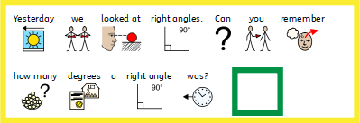
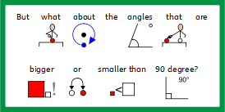




Slide 8



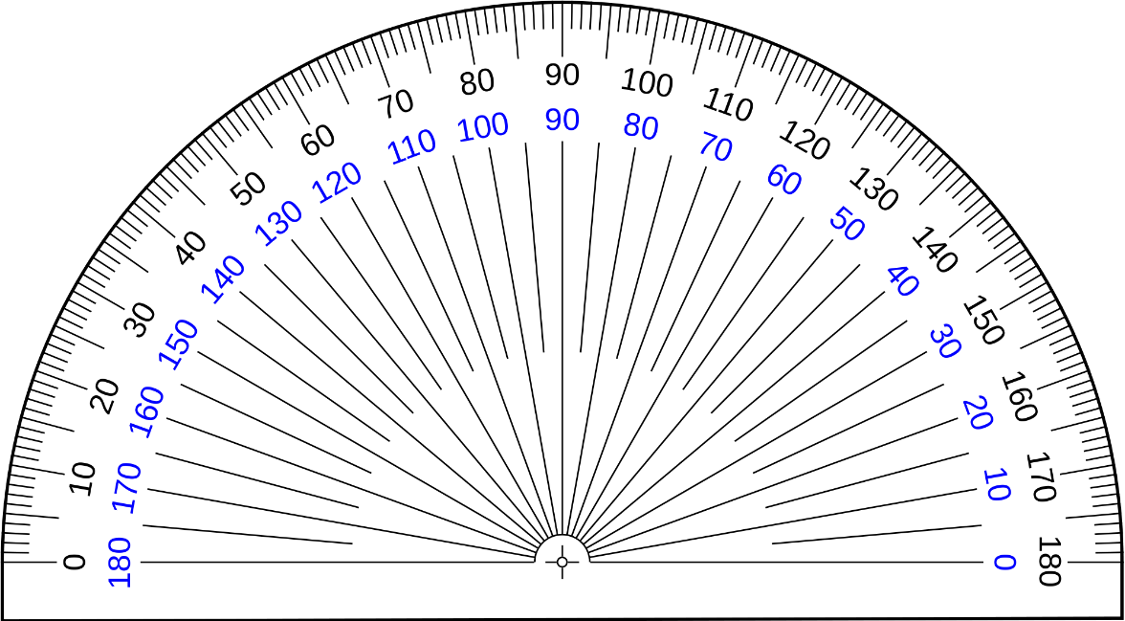


Slide 9




Slide 10




Slide 11
Date: 26.2.21
L.O: To be able to identify angles in everyday objects.
Subject: Maths

Slide 12


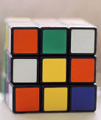

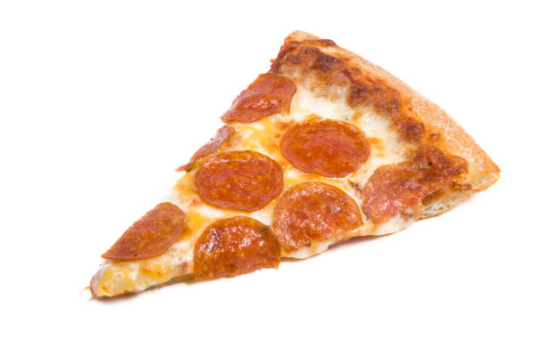

Slide 13


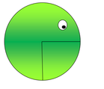

Slide 14
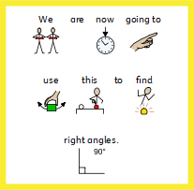
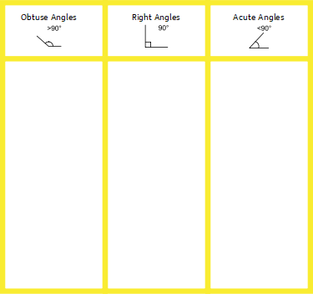

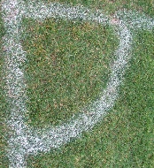
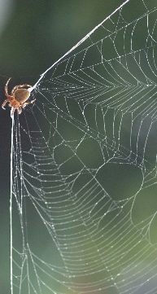


Slide 15
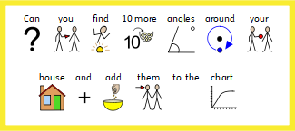

Slide 16
Date: 28.2.21
L.O: To be able to identify angles in shapes.
Subject: Maths

Slide 17


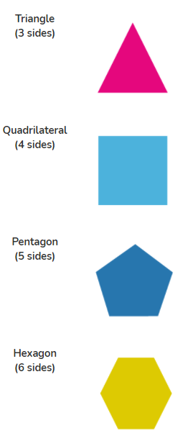
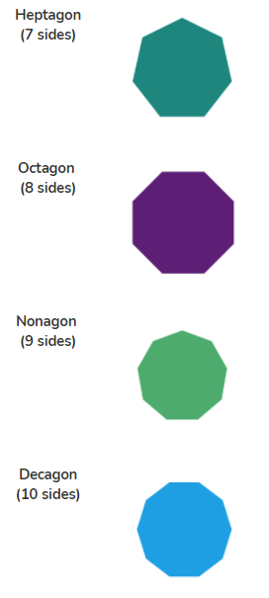


Slide 18


Slide 19

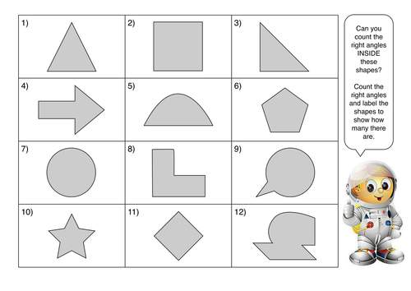

Slide 20

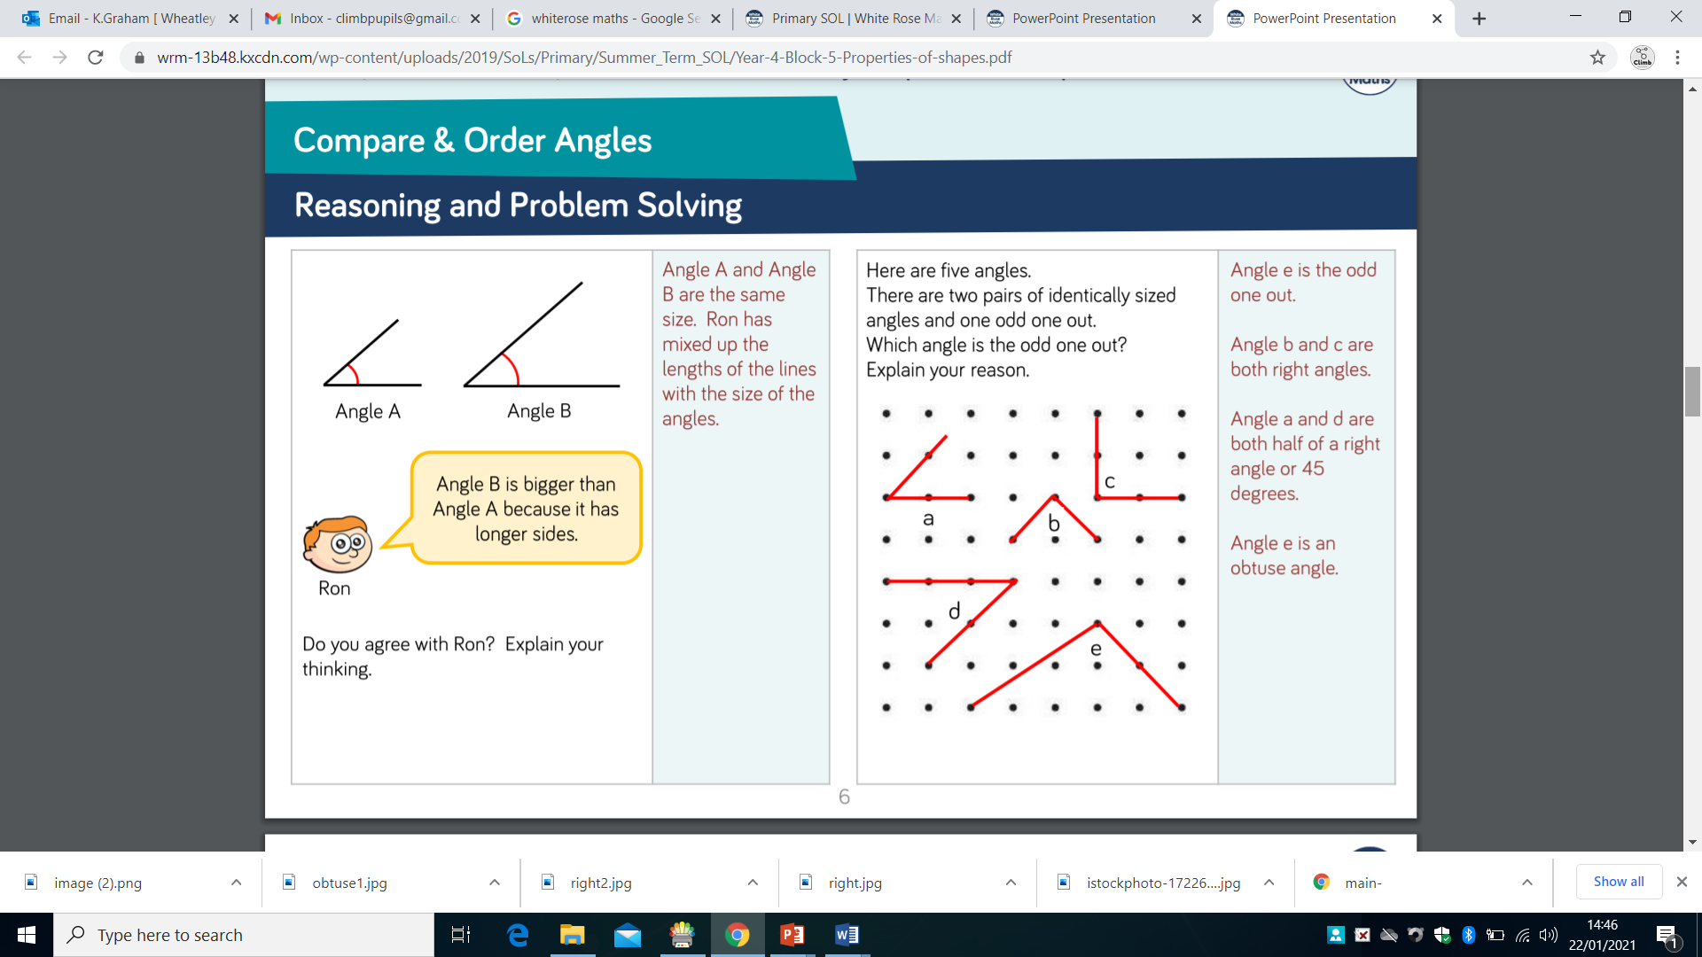


Slide 21


Slide 22
Date: 29.2.21
L.O: To be able to use the column addition method.
Subject: Maths intervention.

Slide 23


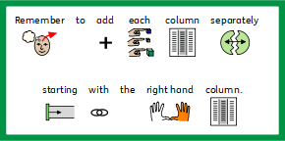
 | Th | H | T | O
 | 3 | 4 | 6 | 7
+ | 1 | 0 | 6 | 8
 | 4 | 5 | 3 | 5
 |  | 1 | 1

Slide 24

562+239=
283+685=
223+369=
526+239=
485+752=
3258+1204=
5167+2381=
4349+2920=
7641+1282=
4078+2246=
5479+3530=
3662+2409=
6654+2553=
1156+6644=
3684+6258=

