Slide 1
18.01.2021
LO To be able to use the column method to add three digit numbers.
Go to Times Tables Rock Stars to warm up your number brain before you start your maths activity.
Subject: Maths

Slide 2
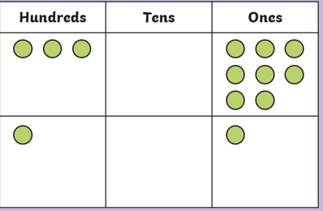
Look at the place value grid below and use the counters to help you work out the calculation – remember to always start with the ones
308+101=
+

Slide 3
How did you do?
308+101= 409
+

Slide 4
Can you use the place value counters in the grid to work out the answer and write the calculation? Remember to start with the ones
+

Slide 5
How did you do?
H T O
2 4 2
2 1 3
4 5 5
+
+
242+213=455

Slide 6
Remember to always set out the numbers correctly in column addition
H T O
7 2 1
2 3 5
H T O
7 2 1
2 3 5
9 5 6
H T O
4 2 1
3 4 8
H T O
4 2 1
3 4 8
7 6 9
+

Slide 7
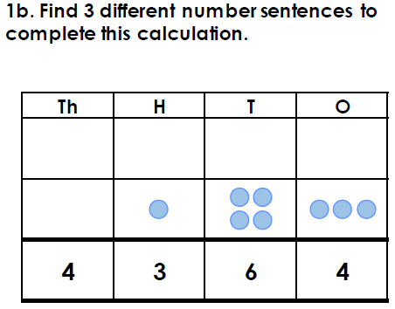
Using column addition complete the calculations
327+141=
214+547=
144+522=
314+659=
415+243=
7.
114+825=

Slide 8
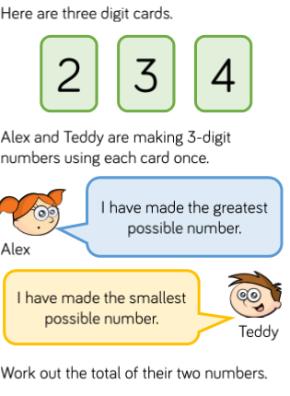
8.

Slide 9
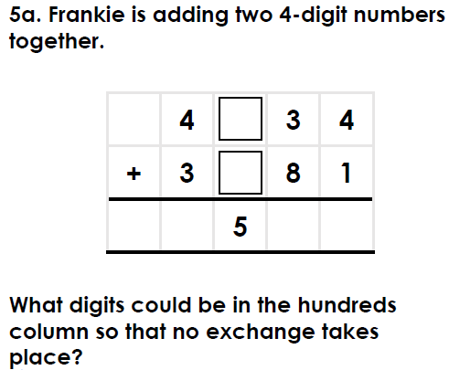
Try this challenge
+
5

Slide 10
19.01.2021
LO To be able to use the column method to add three digit numbers with exchanges.
Go to Times Tables Rock Stars to warm up your number brain before you start your maths activity.
Subject: Maths

Slide 11
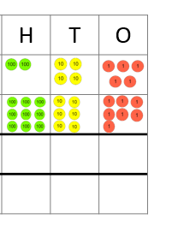
When we use the written method of column addition, we use our understanding of place value to line up the thousands, hundreds, tens and ones into columns.
+
+

Slide 12
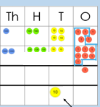
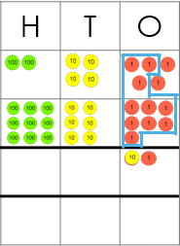
Now that we have lined up the digits of each number, we need to find the total. Remember to always start with the ones. We write the total of each column in the answer box.. In the ones, column there are 12 ones altogether so w need to exchange 10 ones into 1 ten.
1
5 7 2
Remember to add the extra 10
You can watch this video to help you https://www.youtube.com/watch?v=hwxyheQNXBU

Slide 13
Have a try at this calculation – you will need to exchange in the tens column.
526
293
+

Slide 14
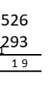
Have a try at this calculation – you will need to exchange in the tens column.
526
293
There are now 11 tens so we need to exchange 10 tens for one hundred and then add them together – remember to add the one you have exchanged also
+
+
+
1
9
1
8

Slide 15
Using the column addition method solve these calculations.
542+249=
524+128=
204+159=
115+194=
272+191=
6. 274+5441=
7. 126+ 735=

Slide 16
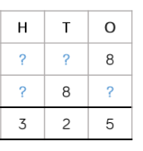
Try this challenge

Slide 17
20.01.2021
LO To be able to use the column method to subtract four digit numbers.
Go to Times Tables Rock Stars to warm up your number brain before you start your maths activity.
Subject: Maths

Slide 18
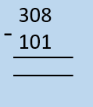
Look at the place value grid below and use the counters to help you work out the calculation – remember to always start with the ones
308
101
-
2 0 7

Slide 19
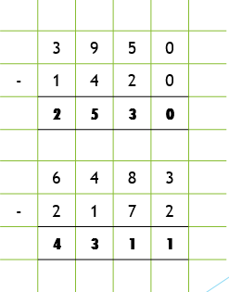
Starting with the ones column work out the calculations
-
-

Slide 20
Check your answers
-
-

Slide 21
Using column subtraction complete the calculations
523-412=
6598-355=
775-613=
968-744=
598-582=
547-436=

Slide 22
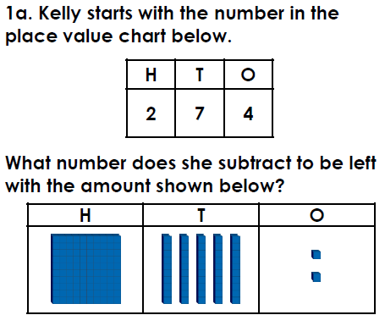
7.
8.

Slide 23
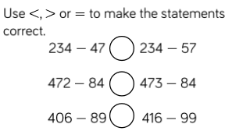
Try this challenge

Slide 24
21.01.2021
LO To be able to use the column method to subtract four digit numbers with exchanges.
Go to Times Tables Rock Stars to warm up your number brain before you start your maths activity.
Subject: Maths

Slide 25
When we do column subtraction its really important to write the calculation the correct way around so that the smaller number goes on the bottom
422-218=
218
422
422
214
-
-
This is incorrect as the smaller number always goes on the bottom
This is how it should be set out

Slide 26
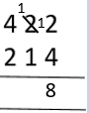
Always start with the ones. Look carefully though! There aren’t enough ones to subtract from so we need to exchange one 10 for ten 1s. So instead of 2-4 I changes to 12-4
-
-
-
2 0 8
Can 4 ones be taken away from 2 ones?
It can’t so we need to exchange one 10 for ten 1s.
The rest of the calculation can now be completed.
Always remember that you cannot subtract a lager number from a smaller number. You need to exchange!
You can watch this video to help you https://www.youtube.com/watch?v=t347YcQBGf8

Slide 27
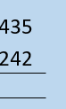
Have a try of this calculation
-

Slide 28
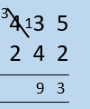
Have a try at this calculation. You will need to exchange in the hundreds column.
3
4 3 5
2 4 2
435
242
1
-
9 3
1
You can’t subtract 4 from 3 so you need to exchange from the hundreds column.

Slide 29
Complete the calculations
589-392=
632-523=
532-513=
578-492=
256-137=
548-364=

Slide 30
Try this challenge
-

Slide 31
22.01.2021
LO To be able to solve addition and subtraction problems.
Go to Times Tables Rock Stars to warm up your number brain before you start your maths activity.
Subject: Maths

Slide 32
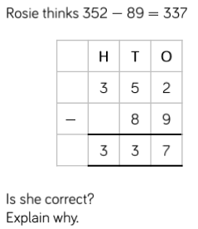
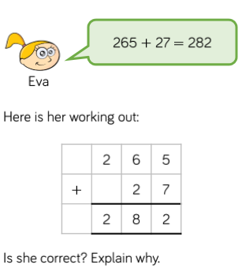
Solve the word problems

Slide 33
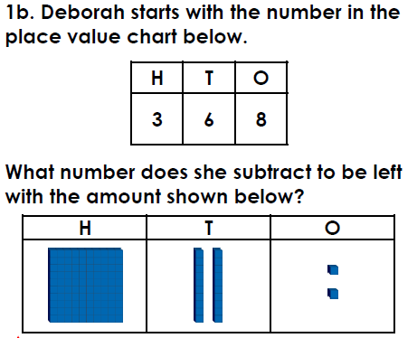
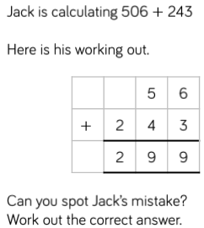
Solve the word problems

Slide 34
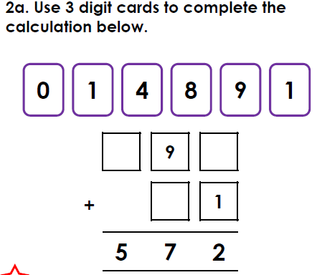
Solve the word problems

Slide 35
Try this challenge
Jenny is adding a 3-digit number and a 2-digit number.
The 3-digit number has a 5 in the tens column and
a 4 in the ones column.
The 2-digit number has a 7 in the tens column and
a 6 in the ones column.
Zara thinks the answer will have a 2 in the tens column and a 0 in the ones column.
Is she correct? Explain your answer.

