Slide 1


Subject: English
Pack: A

Slide 2



Date: Monday 22nd February 2021
LO. To be able to demonstrate an understanding of text.
Subject: English

Slide 3

Pre-recorded Teaching
Access the online teaching video below that will support you to complete the work in this lesson. This video will act as a support but all of the work can still be successfully understood & completed using paper-based versions of this pack. If you need further support to understand / complete work then please contact school via e-mail or telephone.
Play Video
You can also copy and paste this link if you would prefer:
https://classroom.thenational.academy/lessons/to-listen-and-join-in-with-a-story-6muk6c?activity=video&step=1
When you click on the link make sure you use google chrome to access the full 18 minute video.

Slide 5
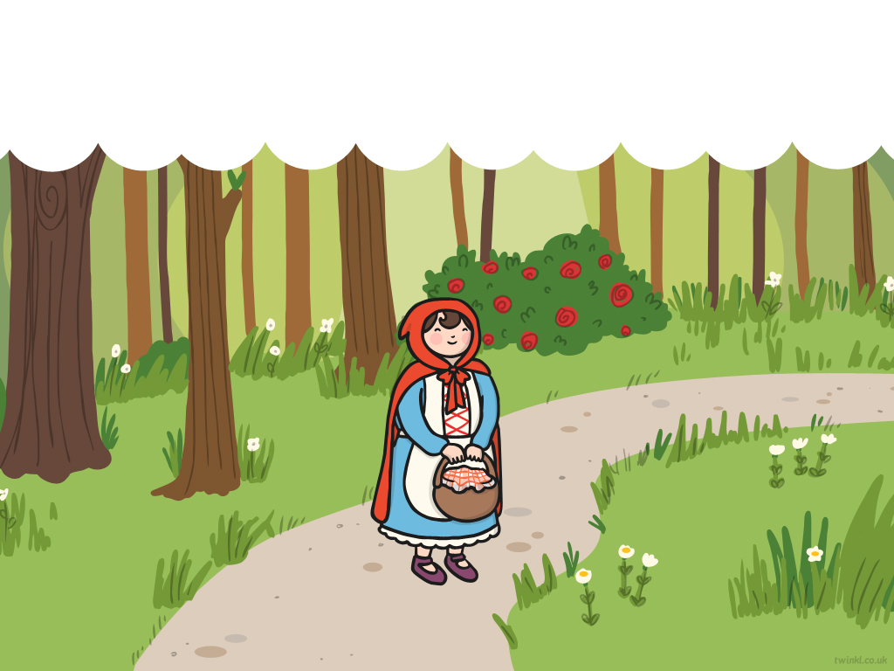
Once upon a time there was a girl called Little Red Riding Hood. She lived with her mother in a village near a forest.

Slide 6
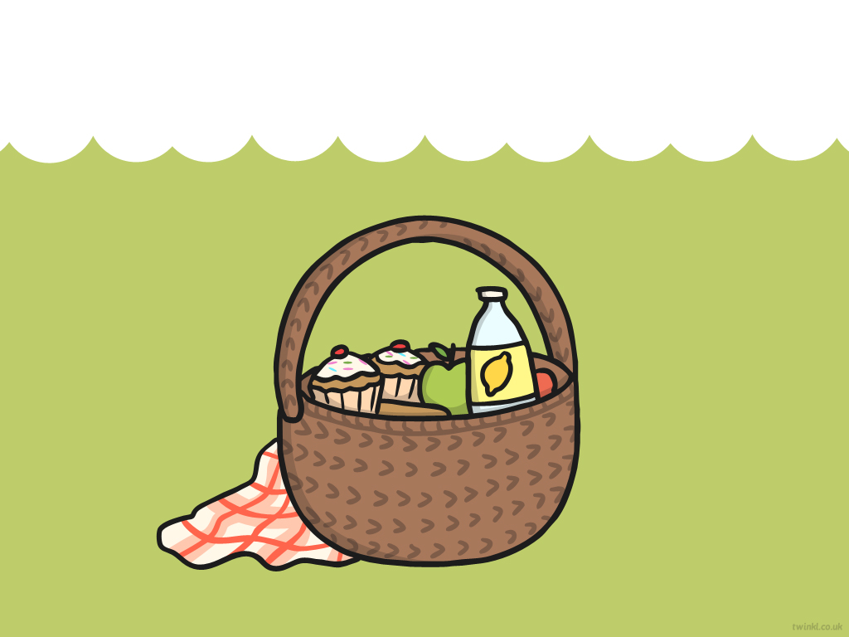
One day, Little Red Riding Hood went to visit her grandmother. She took a basket of food with her.

Slide 7
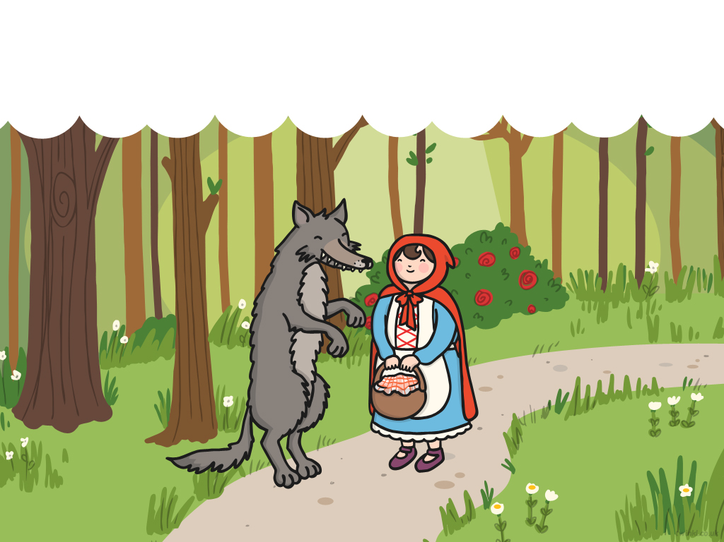
On her way, Little Red Riding Hood met a wolf. “Hello,” said the wolf. “Where are you going?” “I’m going to visit my grandmother who lives in the forest,” explained Little Red Riding Hood.

Slide 8
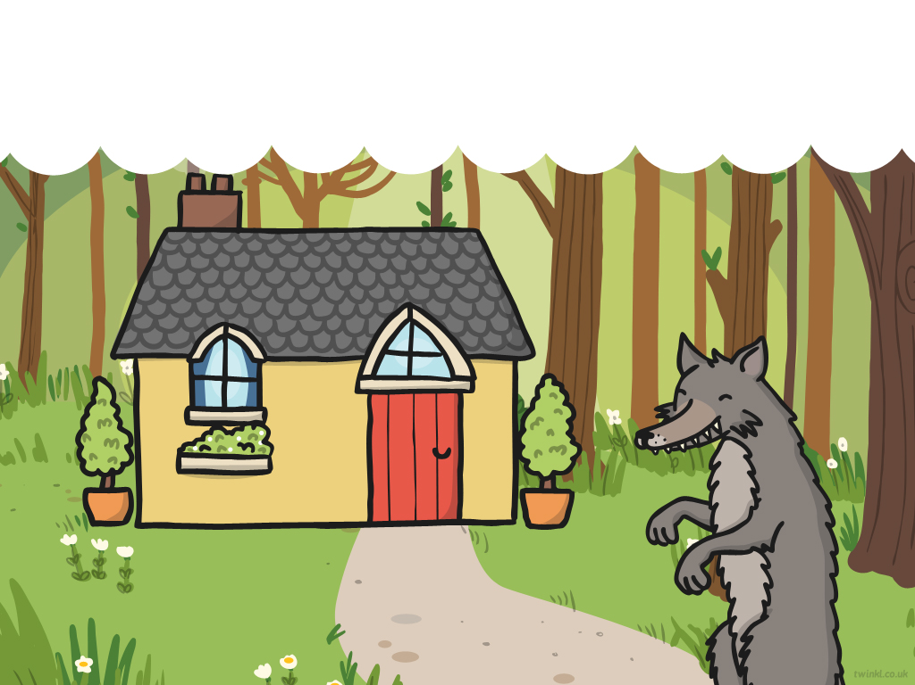
The wolf ran to her grandmother’s house. He went inside and locked her in the wardrobe! He put on her nightgown and got into her bed.

Slide 9
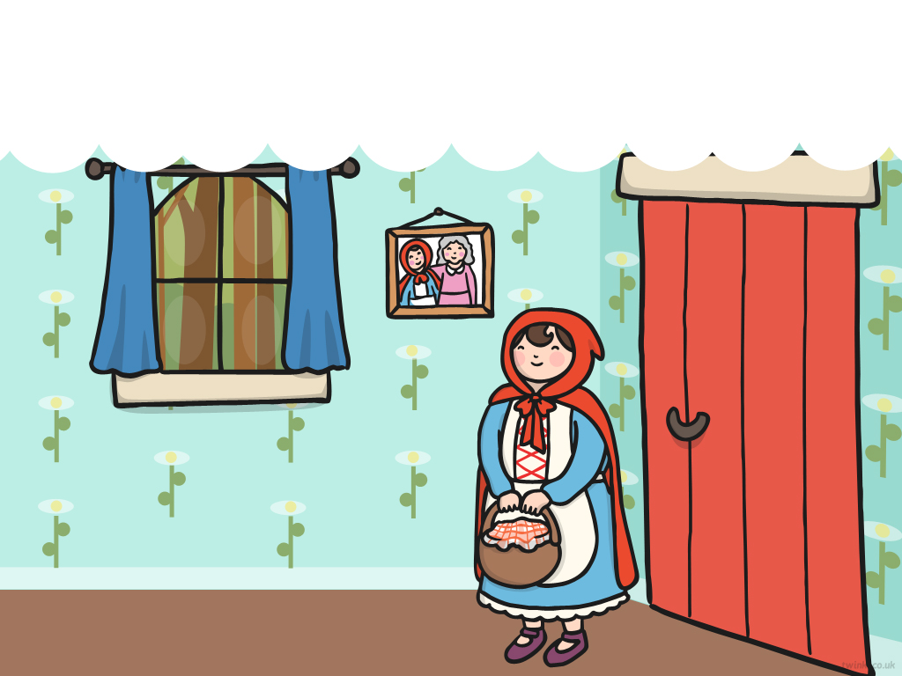
A little later, Little Red Riding Hood came to the house. She knocked on the door, then went inside.

Slide 10
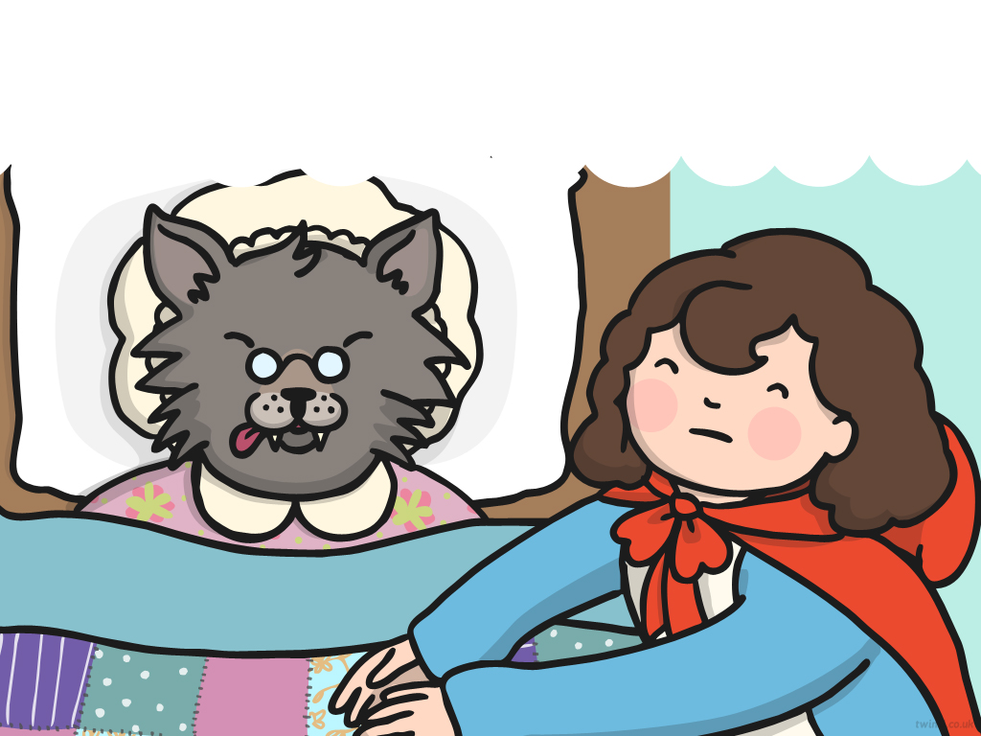
Little Red Riding Hood went over to Grandmother’s bed. “Oh Granny, what big ears you have,” she said.
“All the better to hear you with,” answered the wolf.

Slide 11
“Oh Granny, what big eyes you have,” said Little Red Riding Hood.
“All the better to see you with,” replied the wolf.

Slide 12
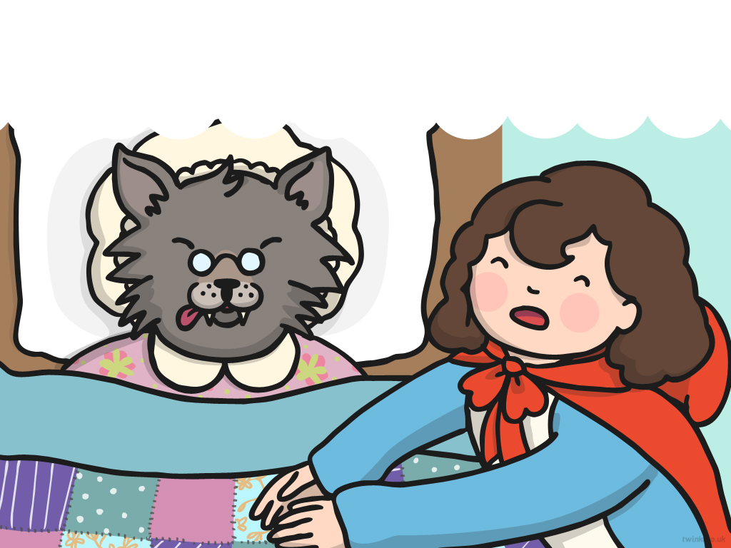
“Oh Granny, what big teeth you have,” said Little Red Riding Hood.
“All the better to eat you with,” said the wolf.

Slide 13
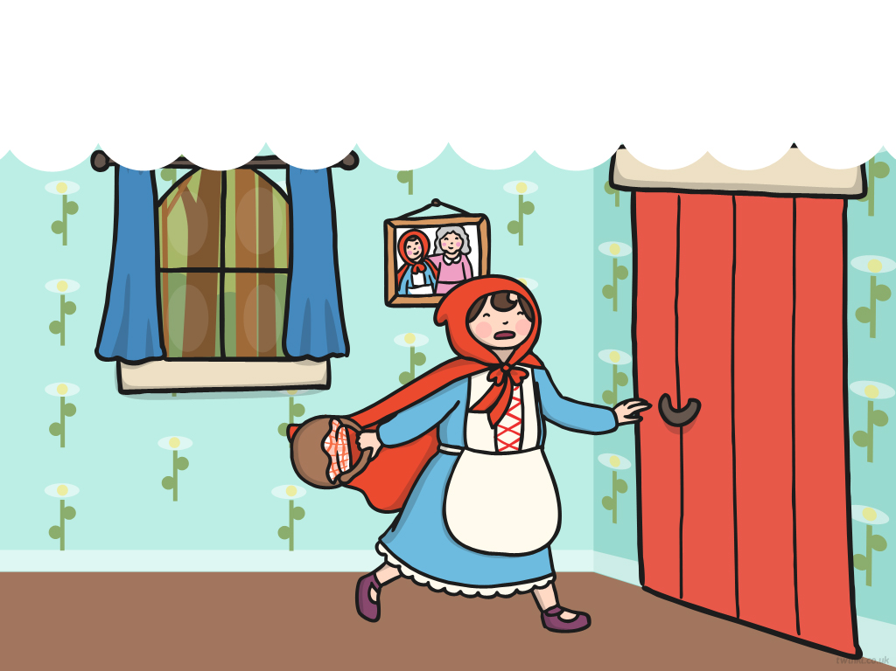
“Help!” shouted Little Red Riding Hood as she realised that there was a wolf in her grandmother’s bed.
She ran out of the house.

Slide 14
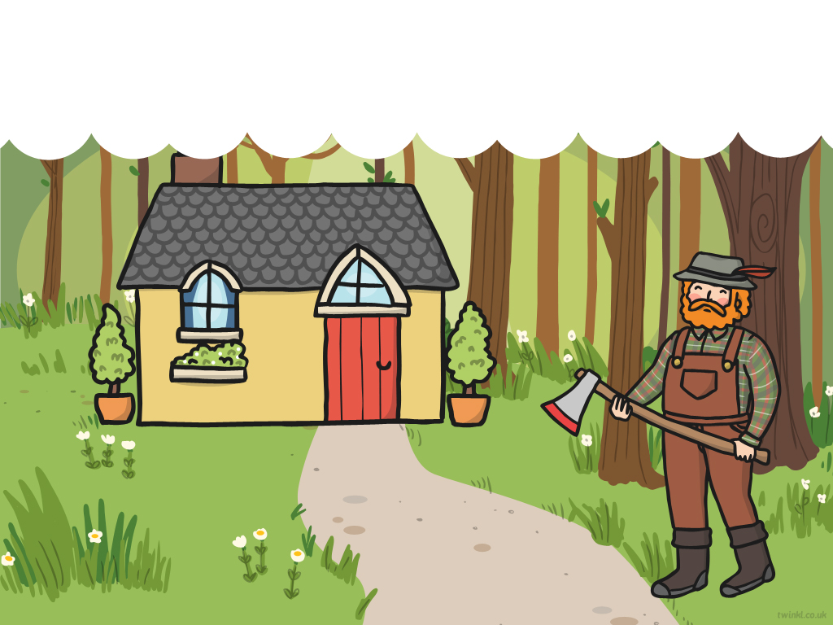
A woodcutter was nearby. He heard Little Red Riding Hood’s scream and ran to the house.

Slide 15
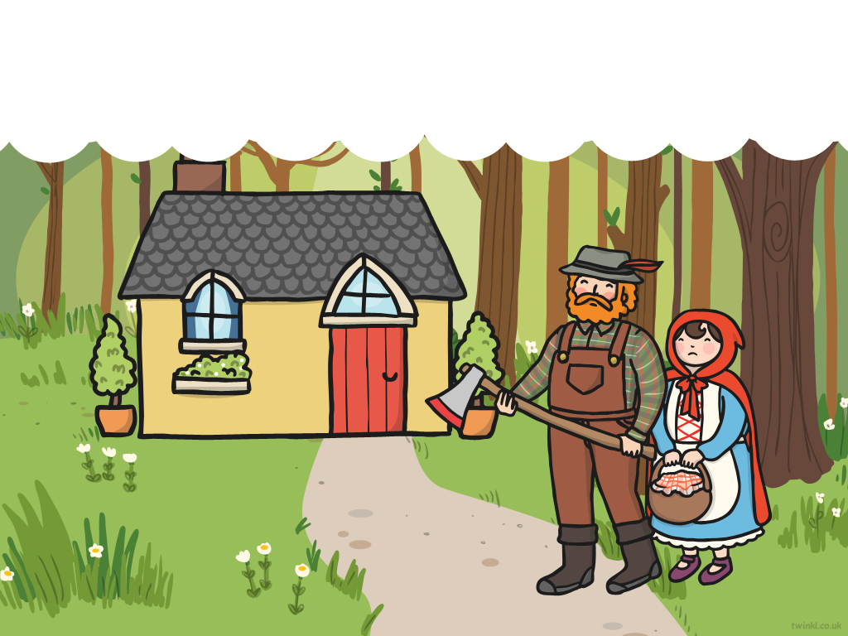
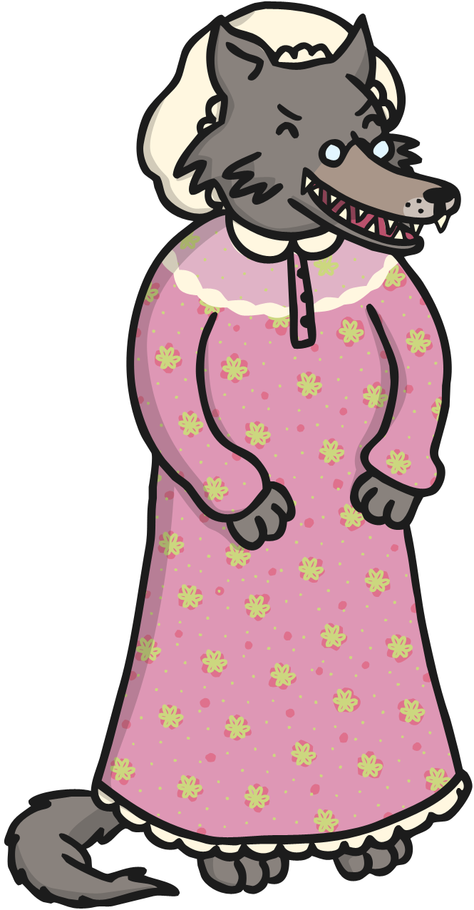
The woodcutter hit the wolf over the head. The wolf ran away and Little Red Riding Hood never saw him again.

Slide 17
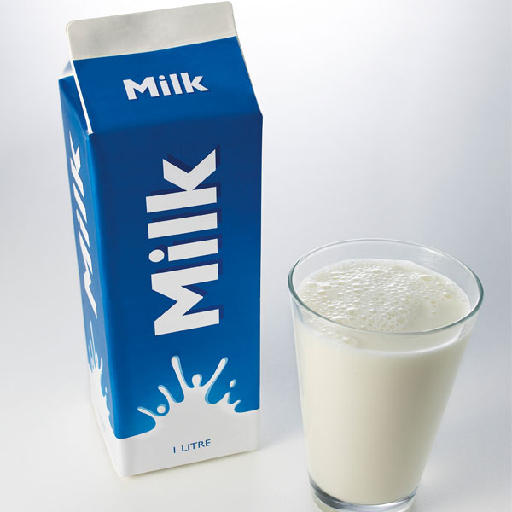
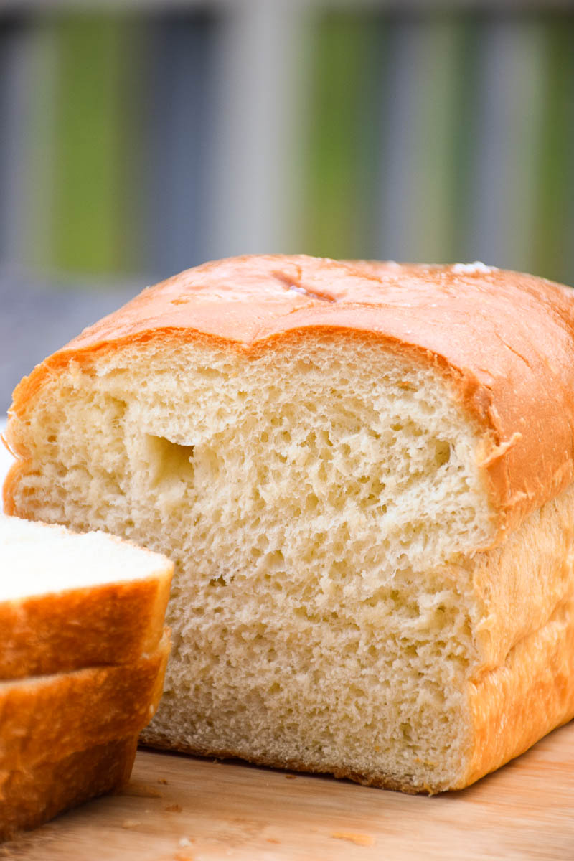
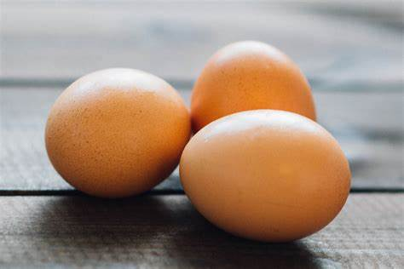
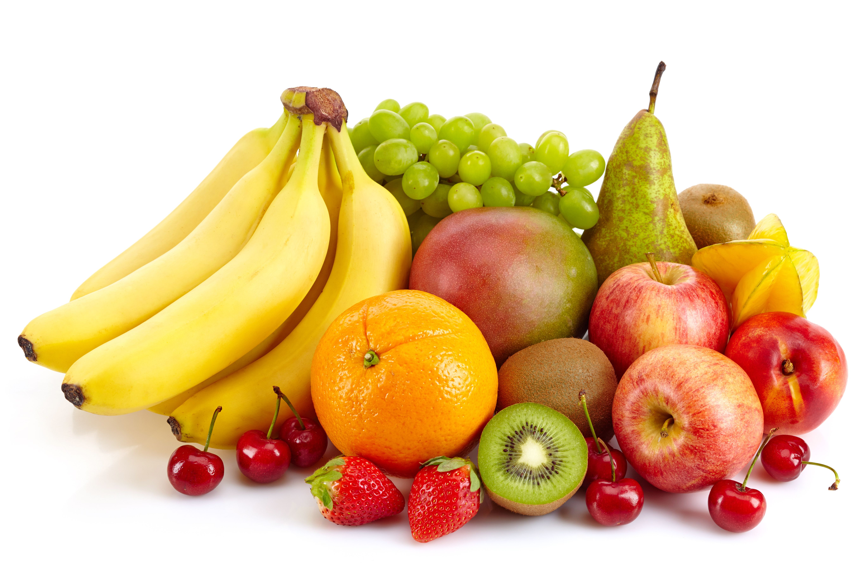

When you go somewhere sometimes you need to take a list with you. Here is a list I take with me when I go to the shop.
My shopping List
Bread
Milk
Eggs
Fruit
Tea bags

Slide 18
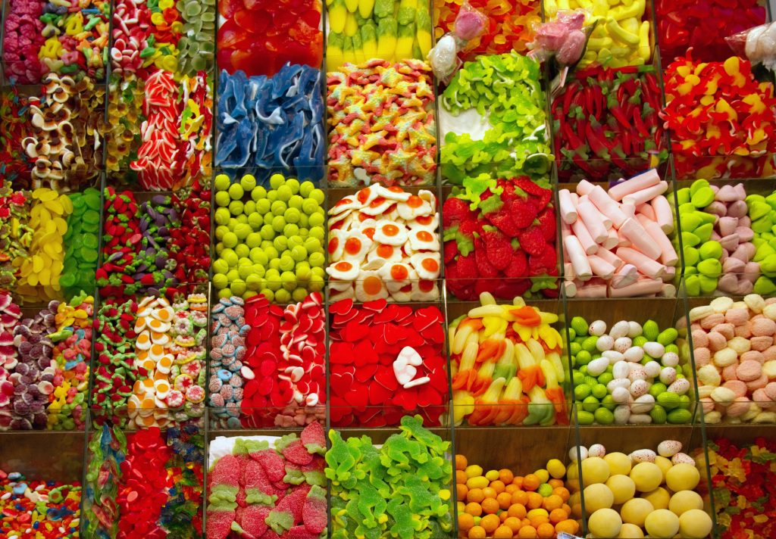
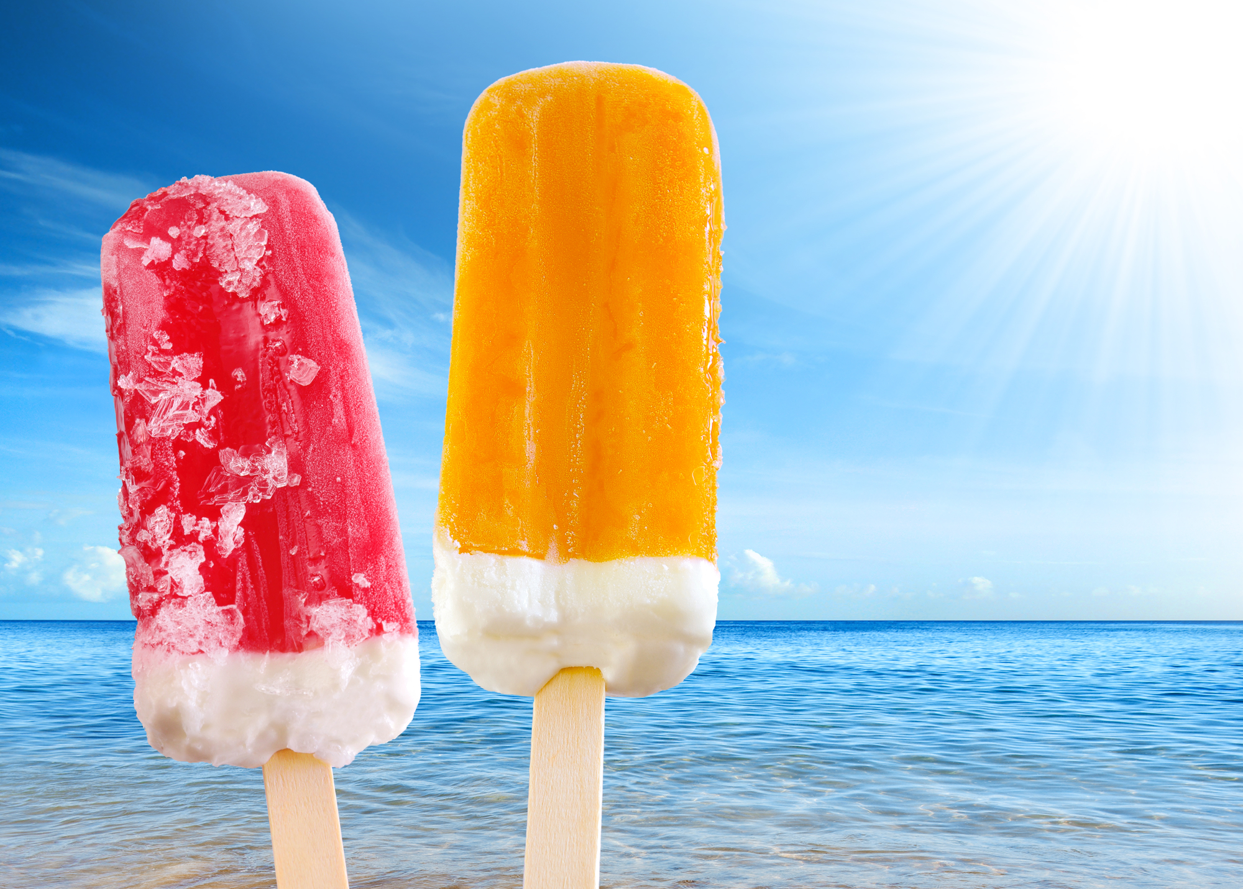
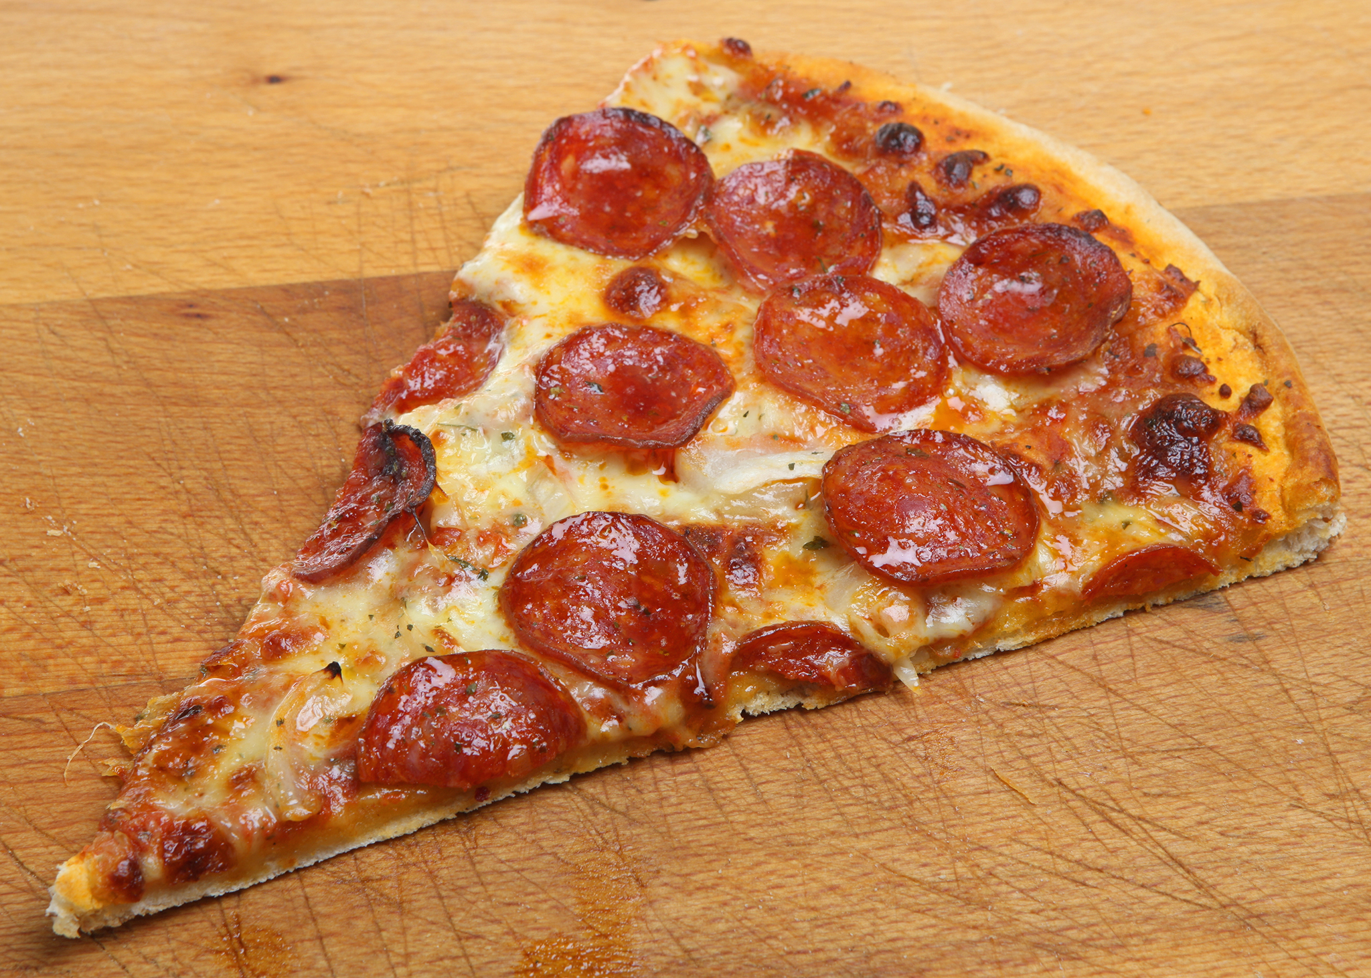

Here is Mrs Levington’s shopping list. Can you help her finish the shopping list with some items she could buy from the shop.
My shopping List
Bread
Milk

Slide 19
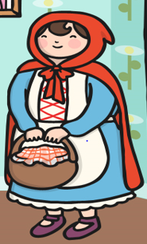

In the story why is Little Red Riding Hood going to visit her Grandma? Tell your adult.
Yeah that’s right!
She is taking her Grandma some goodies. Can you write a list of what goodies you would put in your basket to take Grandma.
My basket for Grandma

Slide 20
Date: Tuesday 23rd February 2021
LO. To be able to retell narratives in the correct sequence using a story map.
Subject: English

Slide 21
Pre-recorded Teaching
Access the online teaching video below that will support you to complete the work in this lesson. This video will act as a support but all of the work can still be successfully understood & completed using paper-based versions of this pack. If you need further support to understand / complete work then please contact school via e-mail or telephone.
Play Video
You can also copy and paste this link if you would prefer:
https://classroom.thenational.academy/lessons/to-map-and-speak-the-story-cngk2r?activity=video&step=1
When you click on the link make sure you use google chrome to access the full 18 minute video.

Slide 22
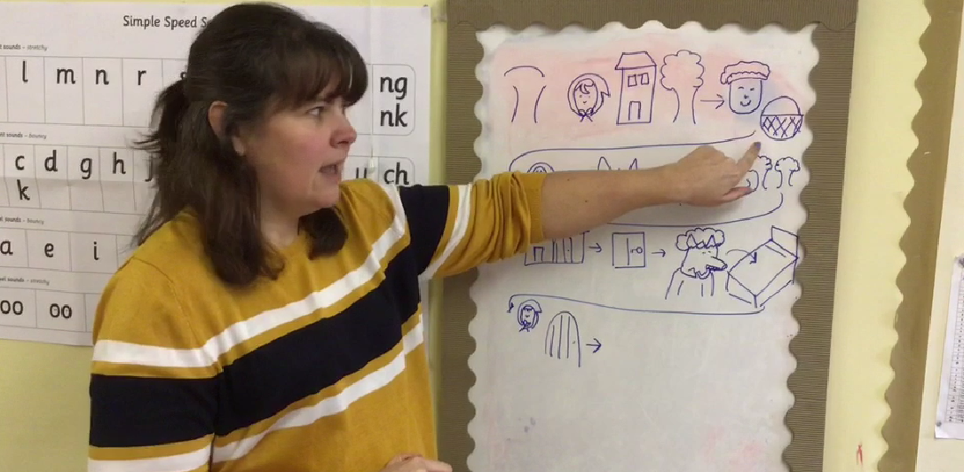
Mrs Simpson loved reading the story Little Red Riding Hood yesterday. Today she is going to tell you the story again by drawing her own story map.
Access the video by Mrs Simpson on the school website – Little Red Riding Hood Story Map

Slide 23
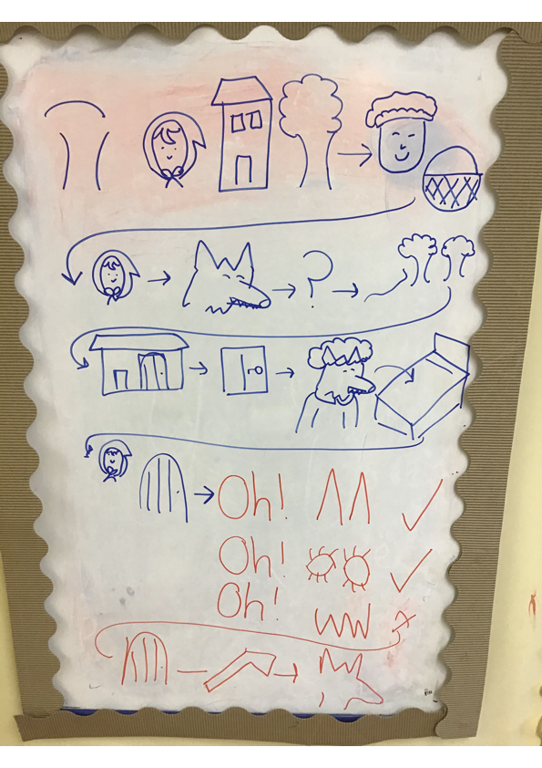
Aww no, what has happened below? It looks like Mrs Simpson has lost some parts of her story map!
Can you help Mrs Simpson by drawing the missing parts of her story map. Read the story map from the beginning to make sure you get the story in the correct order.
I think Little Red Riding Hood might meet someone here? Who could it be?

Slide 24
Now it’s your turn to draw your own story map for Little Red Riding Hood. If you need to remember what happens you can watch the video from yesterday's lesson, or you can re watch Mrs Simpsons story map from today.
Once you have finished drawing your story map you could take a video of you reading it and send it to us.

Slide 25
Date: Wednesday 24th February 2021
LO. To be able to retell a narrative in the correct sequence.
Subject: English

Slide 26
Today we are going to sequence the little red riding hood story. This means we are going to put the pictures in the correct order to tell the story correctly.
First let’s remind ourselves of the story by reading the story map Mrs Simpson made yesterday.
Can you read the story to your adult?

Slide 27
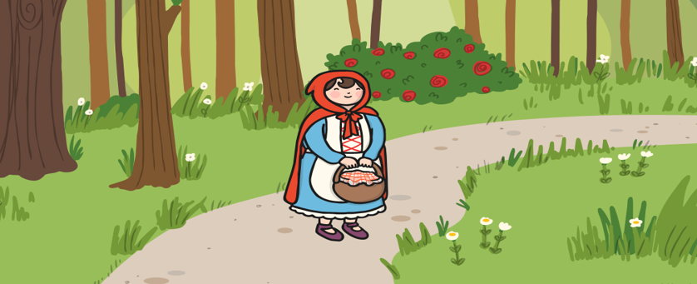
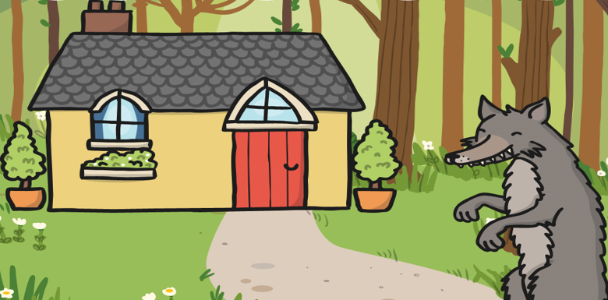
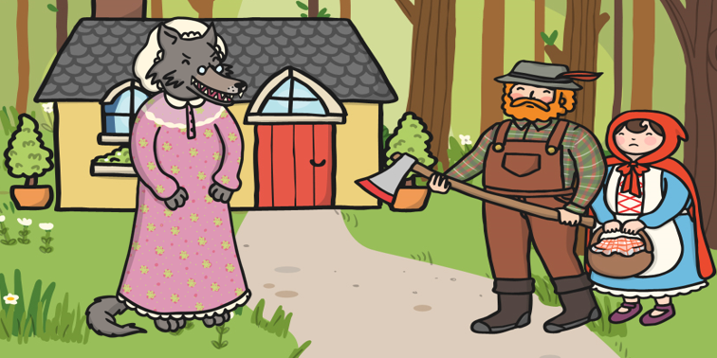
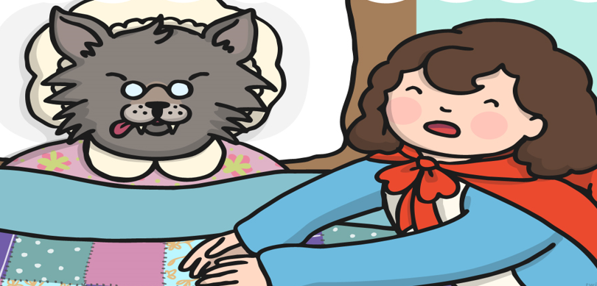
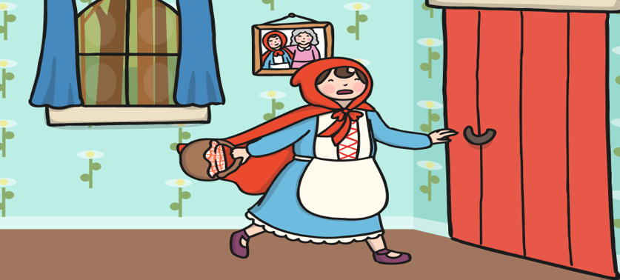
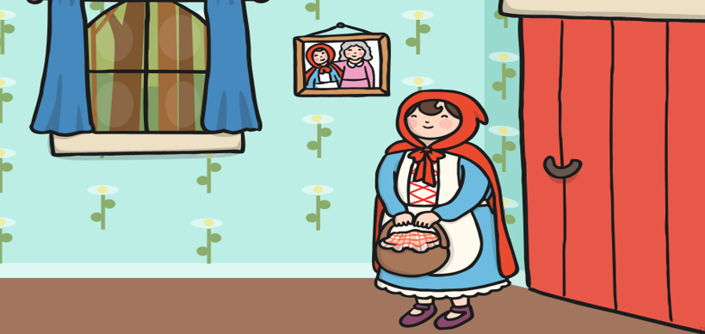
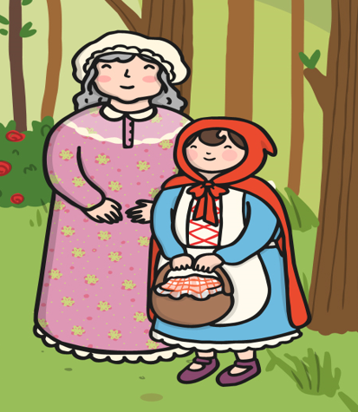
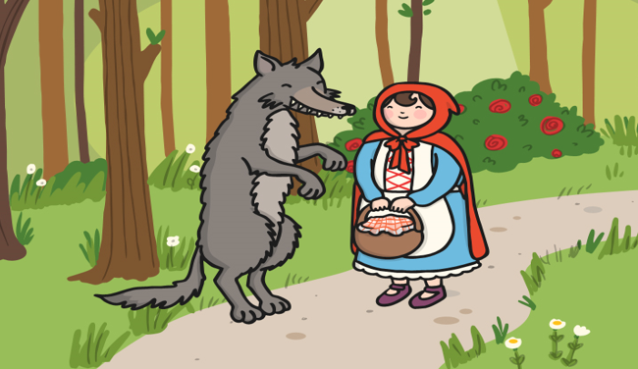
Mr Pennal is going to sequence out the story so we can read it in the correct order.
He is going to add the missing pictures into the correct part of the story.

Slide 28
He has thought about what the first missing picture is in our story.
We can see Little Red Riding Hood walking through the forest. Mr Pennal thinks the first missing picture is Little Red Riding Hood meeting the Wolf in the forest.
He has put this picture into the first box.
Lets read on…

Slide 29
Let’s try the next one together.
After Little Red Riding Hood meets the wolf, the wolf sneaks into Grandmas house. But what comes next?
Mr Pennal thinks Little Red Riding Hood arrives at the house to see her Grandma. Do you think he is right? Can you put the correct picture into our story?
Lets read on…

Slide 30
Super job. That’s right Little Red Riding Hood arrives at Grandmas house. She finds the Wolf in Grandmas bed and then she runs away scared.
This leave’s us with one more picture to put in our story. Let’s see if it makes sense together. Can you put the picture in the correct place in our story?
Lets read on…

Slide 31
When Little Red Riding Hood runs away she finds the axe man outside who saves her from the wolf. They then find Grandma and Little Red Riding Hood gives her the basket of food.

Slide 32
Now it’s your turn, have a look at the story and decide what pictures go in each empty box.
Talk about each picture with your adult and talk about what you think is happening.

Slide 33
Great job, your story is now complete can you read the story to your adult using the pictures to help you. Why not record it and send your own versions to us!

Slide 34
Your last English job for today is to choose one of our photos from the story and write a short sentence to explain what is happening in the picture you have chosen.
Mr Pennal has given you an example.
I have remembered my capital letter, finger spaces and full stop.
Mr Pennal has moved the picture he is going to write about into the box.
Little Red Riding Hood arrives
at her Grandmas house.

Slide 35
Take a look at the three pictures below.
The wolf went to Grandmas.
capital letter
finger spaces
full stop
Miss Bentley has written a sentence to match one of the pictures above.
Can you read the sentence and draw a line to match it to the correct picture above.

Slide 36
It’s time to write your sentence. First choose which picture you are going to write about. Then write your sentence of what that picture is showing on the lines.
Remember your capital letter, finger spaces and full stop. Use your Fred fingers to sound out the words.
2. Write your sentence.
1. Move your picture to the box.

Slide 37
Date: Thursday 25th February 2021
LO. To be able to write in short sentences.
Subject: English

Slide 38
Today we are going to have a think about how the characters could be feeling. Let’s start by reminding ourselves of the characters in the story.
We have…
Little Red Riding Hood
Wolf
Grandma

Slide 39
First I am going to think about how Grandma could have been feeling. I know that Grandma got locked in the cupboard by the wolf, I thought about how this would make Grandma feel and wrote these feelings inside the box.
worried
scared
shocked
lonely
alone
frightened

Slide 40
Let’s do this one together.
We know that the wolf locked Grandma in the cupboard and the wolf tricked Little Red Riding Hood by getting into Grandmas bed. The wolf did this because he wanted to eat the food Little Red Riding Hood had made for Grandma.
Let’s have a think about how the wolf could have been feeling in the story. I’ve helped you by writing some ideas into the box. Can you think of some more feelings for the wolf.
successful
sneaky
scary

Slide 41
Now it’s your turn.
Have a think about how Little Red Riding Hood could have been feeling during the story. Write your ideas in the box below.
Think about the different parts of the story as Little Red Riding Hood’s feelings will change in different parts of the story.

Slide 42

Let’s talk about who is in the story.
We met:
Little Red Riding Hood
Wolf
Grandma

Slide 43

Now we are going to look at the emotions of some of the characters.
Each character has different emotions in the story.
Little Red Riding Hood
The Grandma
The wolf
is excited.
is hungry.
is lonely.
is worried.
is successful.
is scared.
is brave.
is proud.
is shocked.
is scared.
is excited.
is worried.

Slide 44
If I put all of this information together, I can make some who, what emotion sentences.
Who? | What emotion?
Little Red Riding Hood | is scared
Grandma | is lonely
The wolf | is hungry
Let’s have some fun on the next page and see if we can make some sentences together on the next page.

Slide 45














To make my sentence I am going to chose one character from the who column and one option from the what emotion column.
Let me show you. I have chosen The Grandma as the who in my story. I have decided for the what emotion, she will be feeling scared.
My sentence says, The Grandma is scared.

Slide 46
Now let’s try one together.
I have chosen the what emotion.
Can you choose who will be in our sentence. Drag your choice into the correct box.
Now read the sentence we have made to your adult and make sure it makes sense.

Slide 47
Now it’s your turn.
You are going to write 3 sentences. One for each ‘who’.
Choose WHO will be in your sentence.
Choose WHAT EMOTION they will be feeling.
Once you have made your first sentence, write it on the line below.

Slide 48
It’s your turn to write your second sentence.
Make sure you choose a different ‘who’ from your last sentence.
Choose WHO will be in your sentence.
Choose WHAT EMOTION they will be feeling.
Once you have made your sentence, write
it on the line below.

Slide 49
It’s your turn to write your final sentence.
There’s one ‘who’ that you have written about yet.
Choose WHO will be in your sentence.
Choose WHAT EMOTION they will be feeling.
Once you have made your sentence, write
it on the line below.

Slide 50
Date: Friday 26th February 2021
LO. To be able to write sounds in words.
Subject: English

Slide 51
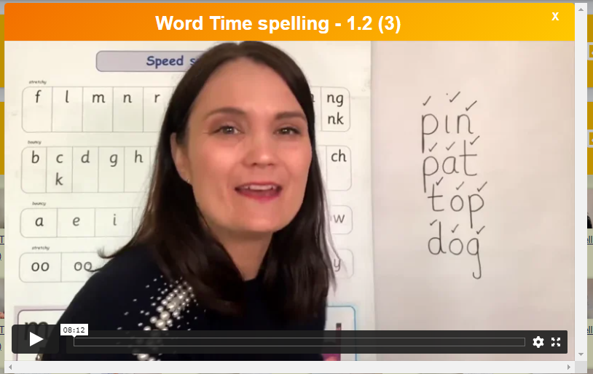
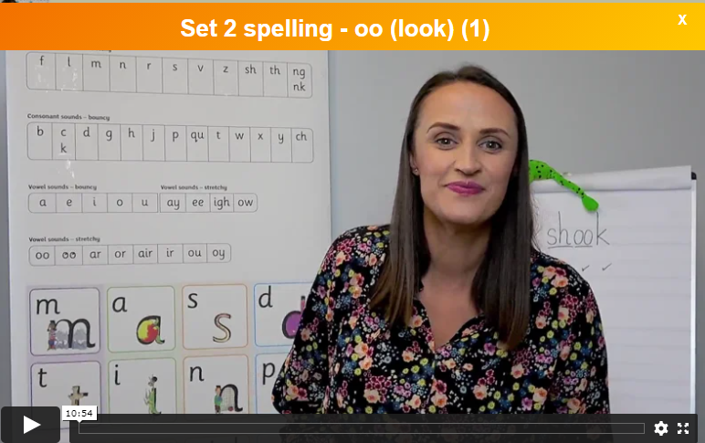
Pre-recorded Teaching
Access the online teaching video below that will support you to complete the work in this lesson. This video will act as a support but all of the work can still be successfully understood & completed using paper-based versions of this pack. If you need further support to understand / complete work then please contact school via e-mail or telephone.
Click on a link to choose one video – either set 1 or set 2
Set 1 sound spelling
Set 2 sound spelling
https://schools.ruthmiskin.com/training/view/h5nxPxwG/kWYab61b
https://schools.ruthmiskin.com/training/view/ypAf8a1E/nrovVg95
Paper version on next slide.

Slide 52


As we do every Friday, today, we are going to have a word time lesson. Boys and girls, you will have to show your parents how to use Fred fingers.
Let’s do an example together.
Let’s write the word ‘jam’.
Show your adult three Fred fingers, split up the sounds from the word ‘jam’ onto each finger.
Remember to pinch each finger as you say the sound.
Then just like we do at school sound out the word three times before trying to write it down.
Ask your adult to check that you have written the word correctly.
1. j a m
j a m

Slide 53
Here are today’s words using the sounds we practiced in phonics this week. Choose either set 1 or set 2 list.
Set 1 Set 2
1.
2.
3.
4.
5.
6.
pin
pat
top
dog
in
an
shook
book
cook
look
Took
Look at a book
Ask your adult to read the word then hide it from you while you write it down.
Say the word, Fred fingers, pinch the sounds, write the word.
Don’t forget to check your sounds with an adult. If you weren’t quite right just correct your mistake.

