Slide 1


Subject: Maths
Pack: A

Slide 2



Date: 01.02.21
LO To be able to measure in CMs.
Subject: Maths

Slide 3
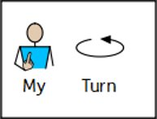
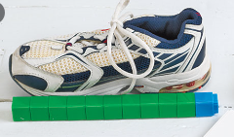

Measuring length
Length is how long something is.
We can use different objects to measure the length of something in non-standard units.
For example, we could use cubes to measure the length of a shoe or paper clips to measure the length of a pencil.

Slide 4
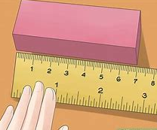
Measuring length
Length is how long something is.
We can use a ruler to measure in standard units.
For example, we could use a ruler to measure how long a block is.
The block is 7cm.
0
The start of the shape must be lined up with the 0.

Slide 5
CM
Length is how long something is.
We measure length in centimeters.
Because centimeters is a long word, we can write CM for short.
The block is 7cm.
0
The start of the shape must be lined up with the 0.

Slide 6
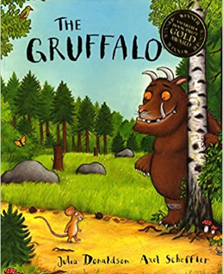

Incorrect Measuring
Length is how long something is.
If the end of your object isn’t lined up with the 0cm on your ruler, you will not measure the length of your object accurately.
This isn’t correct because the ruler isn’t lined straight against the book.
This isn’t correct because it’s lined up with the end of the ruler rather than the 0.

Slide 7


Pre-recorded Teaching
Access the online teaching video below that will support you to complete the work in this lesson. This video will act as a support but all of the work can still be successfully understood & completed using paper-based versions of this pack. If you need further support to understand / complete work then please contact school via e-mail or telephone.
Play Video

Slide 8
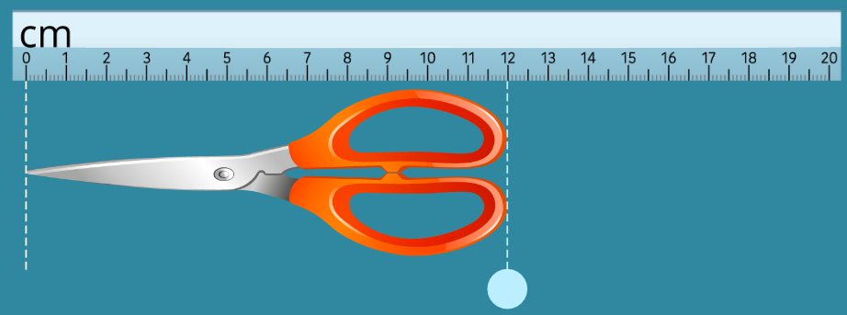
Measuring Length
The start of the shape must be lined up with the 0.
The end of the object shows us how long it is.
The scissors are 12cm long because the point is lined up with the 0 and the end of handles are in line with the 12.
Circle the correct length of the scissors in cm:
10cm
20cm
12cm
0cm

Slide 9
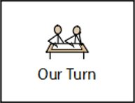
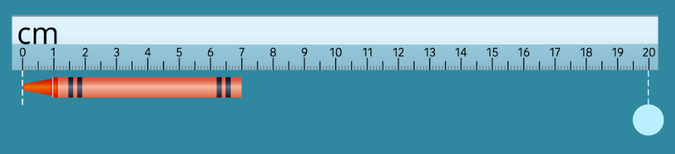
Measuring Length
This time, have a go yourself!
The start of the shape must be lined up with the 0.
The end of the object shows us how long it is.
Circle the correct length of the scissors in cm:
7cm
6cm
2cm
9cm

Slide 10
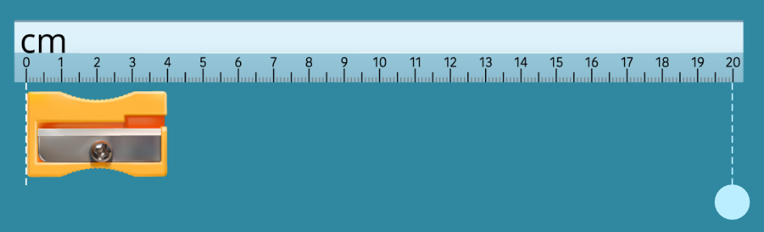
Measuring Length
This time, have a go yourself!
The start of the shape must be lined up with the 0.
The end of the object shows us how long it is.
Circle the correct length of the scissors in cm:
2cm
6cm
3cm
4cm

Slide 11
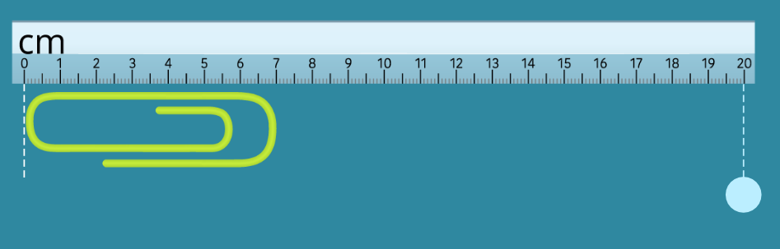
Measuring Length
This time, have a go yourself!
The start of the shape must be lined up with the 0.
The end of the object shows us how long it is.
Circle the correct length of the scissors in cm:
6cm
7cm
5cm
8cm

Slide 12
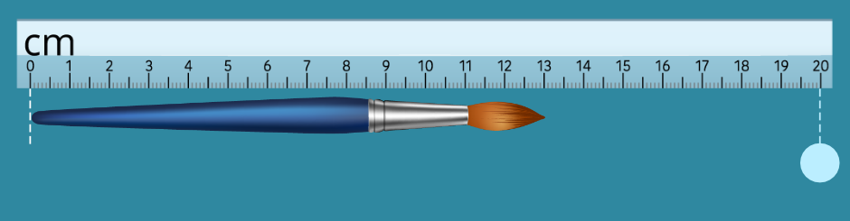
Measuring Length
This time, have a go yourself!
The start of the shape must be lined up with the 0.
The end of the object shows us how long it is.
Circle the correct length of the scissors in cm:
13cm
9cm
11cm
12cm

Slide 13
Longer than / Shorter than
Choose some objects/items in your house that you can measure with a ruler.
Objects that are longer than 10cm | Objects that are shorter than 10cm
Paintbrush (13cm) | Paperclip (7cm)
Chopping knife (21cm) | 20p Coin (2cm)
Cushion (18cm) | Rubber (4cm)
Book (27cm) | Dolls t-shirt (5cm)
TV Remote (14cm) | Lego block (3cm)
The paper clip is only 7cm so this is shorter than 10cm.
The paintbrush measures 13cm so this is longer than 10cm.

Slide 14
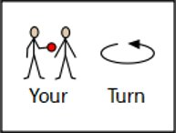
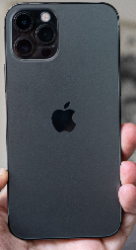

Practical Task
Choose some objects/items in your house that you can measure with a ruler.
Objects that are longer than 10cm | Objects that are shorter than 10cm
Measure the objects around your house and write them in the columns.
There is a ruler on the next slide that you can cut out if you don’t have one at home.
Alternatively, you can contact school if you’d like to borrow a ruler from school!
Email a photo of you completing this task to:
pioneerspupils@gmail.com so that you can be in our weekly Facebook post!

Slide 15

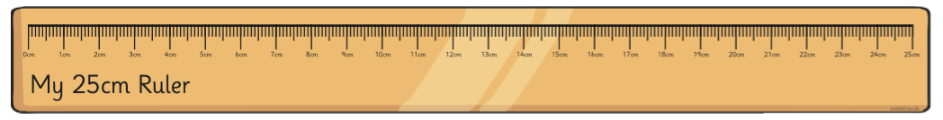
Ruler
- - - - - - - - - - - - -
You can cut out this ruler if you don’t have one to use at home!

Slide 16

Challenge!
Have a go at these problems…

Slide 17
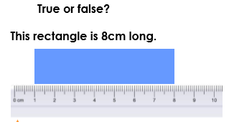
Challenge
Explain why…

Slide 18
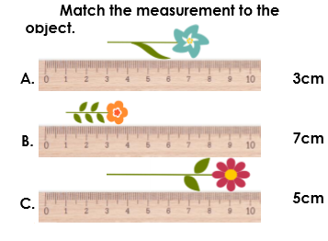
Tricky Challenge
Even though the flowers aren’t measured from 0, we can still work out how long they are by counting on or subtracting.

Slide 19


Well done for all of your hard work this lesson!
Please send any completed work/photographed evidence of completed work (practical activities) to pioneerspupils@gmail.com or deliver it to the dropbox outside of school on a Friday.

Slide 20
Date: 02.02.21
LO To be able to estimate and measure in CMs.
Subject: Maths

Slide 21
Recap - CM
Length is how long something is.
We measure length in centimeters.
Because centimeters is a long word, we can write CM for short.
This is how we measure accurately with a ruler.
The block is 7cm.
0
The start of the shape must be lined up with the 0.

Slide 22
Recap - Incorrect Measuring
Length is how long something is.
If the end of your object isn’t lined up with the 0cm on your ruler, you will not measure the length of your object accurately.
This isn’t correct because the ruler isn’t lined straight against the book.
This isn’t correct because it’s lined up with the end of the ruler rather than the 0.

Slide 23

30cm Ruler
Normally, the rulers we use in school are 30cm long.
If it looks shorter than a ruler it must be less than 30cm.
If it looks longer than a ruler it must be more than 30cm.
I use the fact that I know a ruler is 30cm to help when I am estimating the length of something.

Slide 24
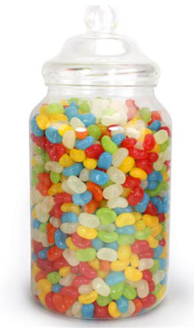
Estimating
Estimating how long something is means roughly judging how long something is, without using a ruler to measure accurately.
How many sweets are there in the jar?
Estimating means roughly judging how many sweets you think there are.
I estimate that there are around 250 sweets in the jar.
I don’t want to count all the sweets when I am estimating.

Slide 25
Pre-recorded Teaching
Access the online teaching video below that will support you to complete the work in this lesson. This video will act as a support but all of the work can still be successfully understood & completed using paper-based versions of this pack. If you need further support to understand / complete work then please contact school via e-mail or telephone.
Play Video

Slide 26
Metre
A metre is the same as 100cm.
When we are measuring something large that is over 30cm, it is not very easy to measure it with a ruler.
We can use a metre stick as this is 100cm long.
0
100
1m = 100cm
Metre can be written as ‘m’.

Slide 27
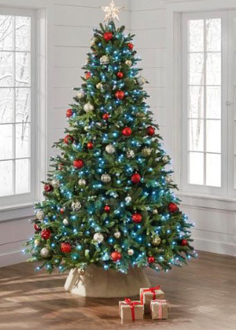
Estimating Unit of Measure
Would I measure these items in metres (m) or centimetres (cm) ?
Circle the correct unit of measure…
Centimetres (cm)
Metres (m)
We would measure the Christmas tree in metres because it is much bigger than a meter stick.
Christmas Tree

Slide 28
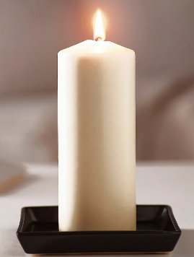
Estimating Unit of Measure
Would I measure these items in metres (m) or centimetres (cm) ?
A candle isn't as big as a ruler so we would measure it in...
Circle the correct unit of measure…
Centimetres (cm)
Metres (m)
Candle

Slide 29
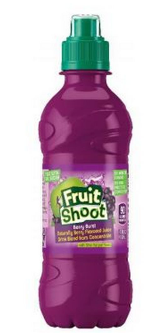
Estimating Unit of Measure
Would I measure these items in metres (m) or centimetres (cm) ?
Circle the correct unit of measure…
Centimetres (cm)
Metres (m)
Juice Bottle

Slide 30
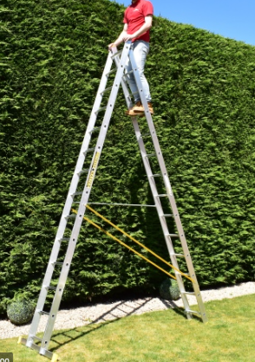
Estimating Unit of Measure
Would I measure these items in metres (m) or centimetres (cm) ?
Circle the correct unit of measure…
Centimetres (cm)
Metres (m)
Ladder

Slide 31
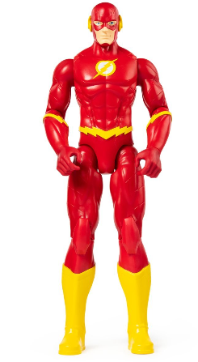
Estimating Unit of Measure
Would I measure these items in metres (m) or centimetres (cm) ?
Circle the correct unit of measure…
Centimetres (cm)
Metres (m)
Action Figure Toy

Slide 32
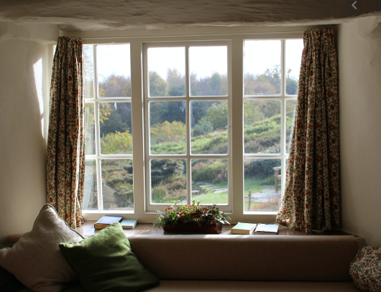
Estimating Unit of Measure
Would I measure these items in metres (m) or centimetres (cm) ?
Circle the correct unit of measure…
Centimetres (cm)
Metres (m)
Window

Slide 33
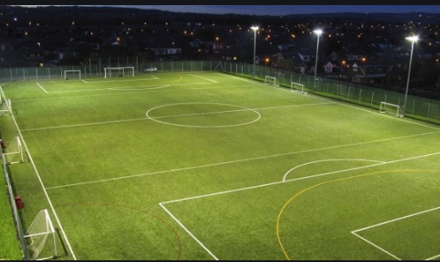
Estimating Unit of Measure
Would I measure these items in metres (m) or centimetres (cm) ?
Circle the correct unit of measure…
Centimetres (cm)
Metres (m)
Football Pitch

Slide 34
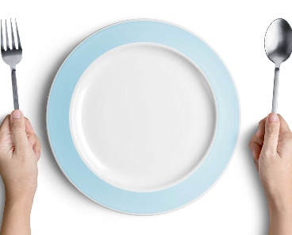
Estimating Unit of Measure
Would I measure these items in metres (m) or centimetres (cm) ?
Circle the correct unit of measure…
Centimetres (cm)
Metres (m)
Plate

Slide 35
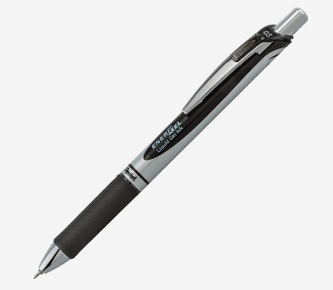
Estimating in CMs
Now that you can identify if something would be measured in metres or centimetres, we are going to look at estimating an approximate length of a range of different objects in your home.
Pen
I know that a pen is shorter than a ruler so I know its length is less than 30cm.
I think my pen is less than a ruler but bigger than half a ruler – so I’m going to estimate that my pen is 21cm.
I always think of a ruler when I am trying to estimate length in cm’s because if I think it’s shorter than a ruler, I know it’s less than 30cm.
Estimate length = 21cm.

Slide 36
Estimating in CMs
I am now going to record my estimate in the table below. Remember an estimate is just roughly judging how many CMs you think something is so it doesn’t have to be exactly right like when we measure with a ruler.
Object | Estimate (CM) | Accurate Measurement (CM)
Pen | 21cm
I always think of a ruler when I am trying to estimate length in cm’s because if I think it’s shorter than a ruler, I know it’s less than 30cm.
Finally, I accurately measured the pen using a ruler. I made sure the tip of the pen was lined up with the 0, read off the measurement and recorded it in my table.

Slide 37
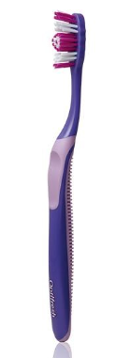
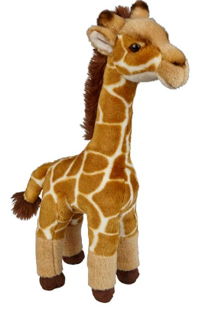
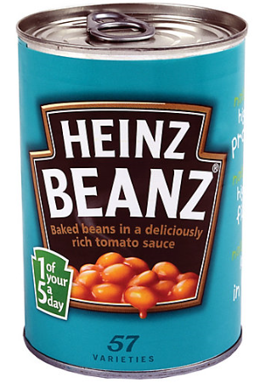
Practical Task
Choose 7 objects from around your house. First, estimate how my CMs long they are and then measure them accurately with a ruler to see how close you were. Record your results in the table below.
Object | Estimate (CM) | Accurate Measurement (CM)
Here are some ideas of things you could measure.
Remember an estimate is just roughly judging how many CMs you think something is so it doesn’t have to be exactly correct like when we measure with a ruler.
Email a photo of you completing this task to:
pioneerspupils@gmail.com so that you can be in our weekly Facebook post!

Slide 38
Challenge!
Have a go at these problems…

Slide 39
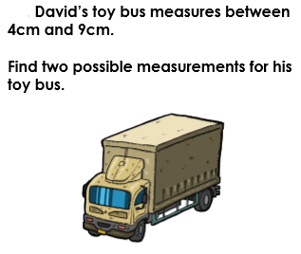
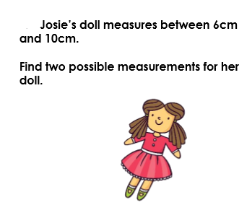
Challenge
Write your two possible measurements for each question on the lines.

Slide 40
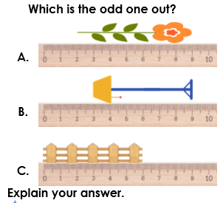
Tricky Challenge!
Write why it is the odd one out on the lines below.

Slide 41
Well done for all of your hard work this lesson!
Please send any completed work/photographed evidence of completed work (practical activities) to pioneerspupils@gmail.com or deliver it to the dropbox outside of school on a Friday.

Slide 42
Date: 03.02.21
LO To be able to add lengths in CMs.
Subject: Maths

Slide 43
Recap - CM
Length is how long something is.
We measure length in centimeters.
Because centimeters is a long word, we can write CM for short.
This is how we measure accurately with a ruler.
The block is 7cm.
0
The start of the shape must be lined up with the 0.

Slide 44
Recap - Incorrect Measuring
Length is how long something is.
If the end of your object isn’t lined up with the 0cm on your ruler, you will not measure the length of your object accurately.
This isn’t correct because the ruler isn’t lined straight against the book.
This isn’t correct because it’s lined up with the end of the ruler rather than the 0.

Slide 45
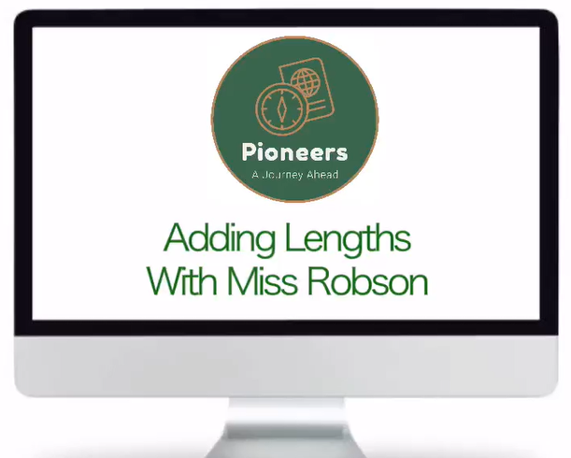
Pre-recorded Teaching
Access the online teaching video by Miss Robson on the school website that will support you to complete the work in this lesson.
This video will act as a support but all of the work can still be successfully understood & completed using paper-based versions of this pack.
If you need further support to understand / complete work then please contact school via e-mail or telephone.

Slide 46


Adding Lengths
A pen is 10cm long and a rubber is 5cm long. How long are the two items together?
10cm
5cm
1. We need to add the two lengths together to find the total length.
+
1
1
= 15cm
10
1
1
1
3. Finally, write the total – don’t forget you need ‘cm’ to tell it is centimetres.
2. Then we need to count up the tens and ones to find the total.

Slide 47
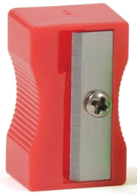
Adding Lengths
A pen is 10cm long and a sharpener is 3cm long. How long are the two items together?
Don’t forget ‘cm’ !
10cm
3cm
1. We need to add the two lengths together to find the total length.
+
1
1
= ______
10
1
3. Write your total here.
2. Then we need to count up the tens and ones to find the total.

Slide 48
Adding Lengths
A book is 20cm long and a rubber is 5cm long. How long are the two items together?
Don’t forget ‘cm’ !
20cm
5cm
1. We need to add the two lengths together to find the total length.
+
= ______
10
10
3. Write your total here.
2. Draw your ones and then count up the tens and ones to find your total.

Slide 49
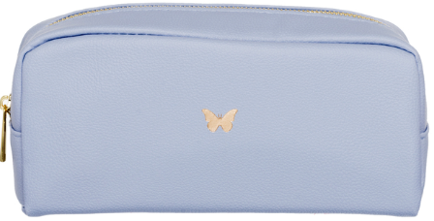
Adding Lengths
A pencil case is 24cm long and a sharpener is 3cm long. How long are the two items together?
Don’t forget ‘cm’ !
24cm
3cm
1. Draw your tens and ones to represent the pencil case.
+
= ______
3. Count up your tens and ones and write your total here.
2. Draw your ones to represent the sharpener.

Slide 50
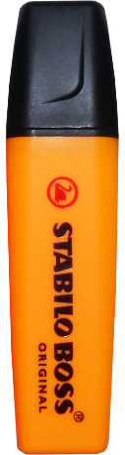

Key
Pen 10cm
Rubber 5cm
Sharpener 3cm
Book 20cm
Pencil Case 24cm
Highlighter 7cm
Pencil 13cm
Your Turn
Using the key to know the lengths, find the total length of the different objects.
You can draw your tens and ones to help you …
Book and a sharpener =
Pencil case and a rubber =
Pencil and a pen =
Highlighter and a book =
5. Highlighter, sharpener and a pen =
6. Pencil case and a book =
7. 3 sharpeners and a pen =
8. 2 books and a pencil =

Slide 51
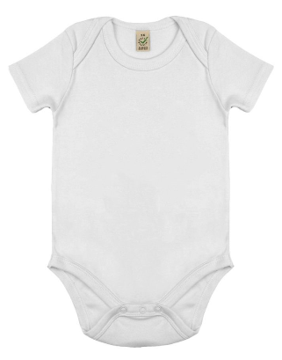
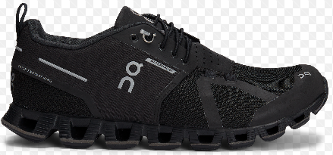

Practical Task
Choose 6 things in your house that you can measure in cm’s. Measure them accurately with a ruler and record (write down) how long they are.
For example:
Add some of your objects together to find their total length, e.g.
Create 6 addition sums to find different total lengths…
You can draw your tens and ones to help you …
+
=
Email a photo of you completing this task to:
pioneerspupils@gmail.com so that you can be in our weekly Facebook post!

Slide 52
Challenge!
Have a go at these problems…

Slide 53
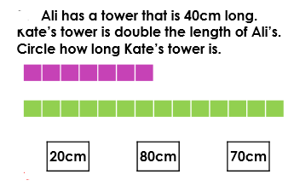
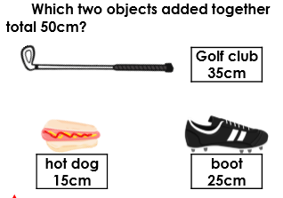
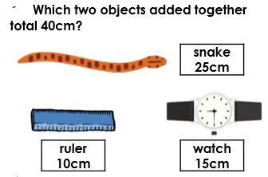
Challenge

Slide 54
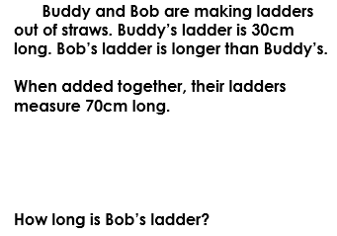
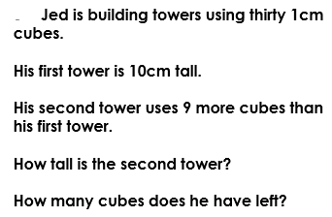
Tricky Challenge
____________________________
____________________________________________________________________________________
____________________________
____________________________________________________________________________________

Slide 55
Well done for all of your hard work this lesson!
Please send any completed work/photographed evidence of completed work (practical activities) to pioneerspupils@gmail.com or deliver it to the dropbox outside of school on a Friday.

Slide 56
Date: 04.02.21
LO To be able to measure curved and straight lines.
Subject: Maths

Slide 57
Recap - CM
Length is how long something is.
We measure length in centimeters.
Because centimeters is a long word, we can write CM for short.
This is how we measure accurately with a ruler.
The block is 7cm.
0
The start of the shape must be lined up with the 0.

Slide 58
Recap - Incorrect Measuring
Length is how long something is.
If the end of your object isn’t lined up with the 0cm on your ruler, you will not measure the length of your object accurately.
This isn’t correct because the ruler isn’t lined straight against the book.
This isn’t correct because it’s lined up with the end of the ruler rather than the 0.

Slide 59
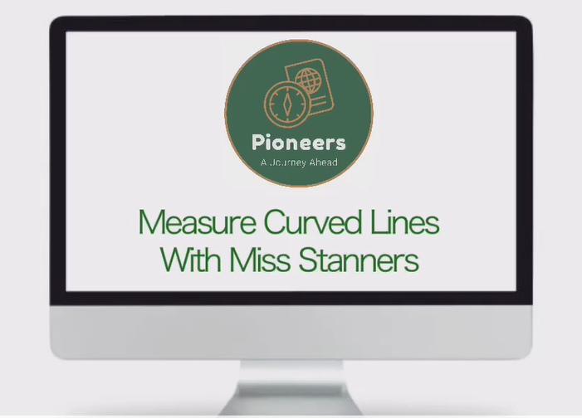
Pre-recorded Teaching
Access the online teaching video by Miss Stanners on the school website that will support you to complete the work in this lesson.
This video will act as a support but all of the work can still be successfully understood & completed using paper-based versions of this pack.
If you need further support to understand / complete work then please contact school via e-mail or telephone.

Slide 60
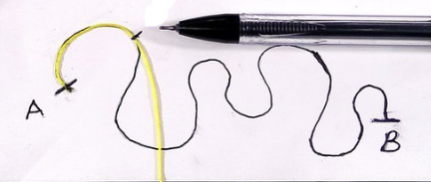
Curved Lines
What is a curved line?
A curved line is one that is bent / it is not straight.

Slide 61
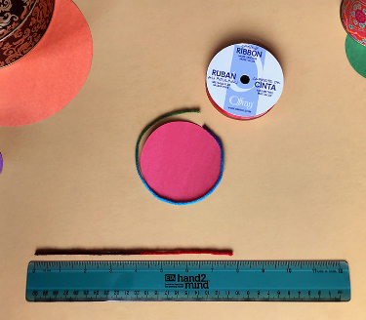
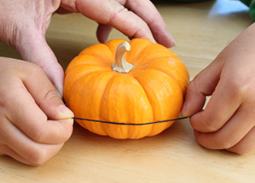
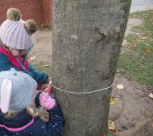
Measuring Curved Lines
When we need to measure curved lines, we can’t use a ruler as it doesn’t bend enough to follow the lines exactly.
Instead we can use string because it is flexible and it can bend to a curved shape/curved line.

Slide 62
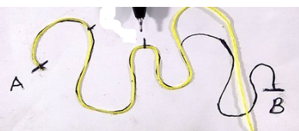
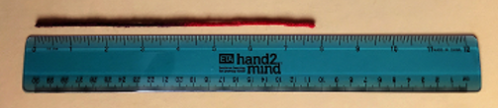
Measuring Curved Lines
When we need to measure curved lines, we can’t use a ruler as it doesn’t bend enough to follow the lines exactly.
Instead we can use string because it is flexible and it can bend to a curved shape/curved line.
If we mark the string when it reaches the end of the curved line, we can then measure this out flat with a ruler.

Slide 63
Your task!
Measuring Curved Lines
Draw 4 curved lines on a piece of paper.
25cm
Using some string, wool or something similar you have in the house, measure the length of your lines following the instructions in the video.
Then use a ruler to measure your string and write your measure, in cm’s, next to each line.
Email a photo of you completing this task to:
pioneerspupils@gmail.com so that you can be in our weekly Facebook post!

Slide 64
Challenge!
Have a go at these problems…

Slide 65
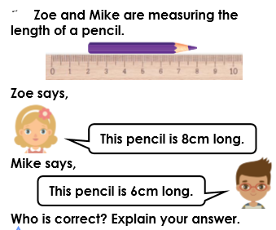
Challenge
Explain why __________ is correct on the lines below…

Slide 66

Tricky Challenge

Slide 67
Well done for all of your hard work this lesson!
Please send any completed work/photographed evidence of completed work (practical activities) to pioneerspupils@gmail.com or deliver it to the dropbox outside of school on a Friday.

Slide 68
Date: 05.02.21
LO: To be able to draw lines with specified lengths.
Subject: Maths

Slide 69
Pre-recorded Teaching
Access the online teaching video below that will support you to complete the work in this lesson. This video will act as a support but all of the work can still be successfully understood & completed using paper-based versions of this pack. If you need further support to understand / complete work then please contact school via e-mail or telephone.
Play Video

Slide 70


What do we use to measure a line?
Pencil
Ruler
When we measure the length of a line we use a ruler which measures in centimetres (CM).

Slide 71
Using a ruler
- - - - - - - - - - - - -
Carefully cut this ruler out OR use and move this ruler to measure the lengths of the lines in today’s tasks.
You will be able to access this ruler on each slide where you are required to measure the length of a line.

Slide 72

How do we measure the length of a line?
CM
To measure a line, place your ruler flat and directly below the line that you are measuring. Make sure you match it up with the beginning of the line (0cm) on your ruler.
0cm

Slide 73
Let’s practice!
Using the ruler below, measure the different length lines. Drag the ruler to move it into place.
__________ cm
__________ cm
When moving the ruler around the slide to measure the lengths of the lines, be careful not to resize the ruler.

Slide 74




Measuring different objects
There will be lots of different objects around your house that you can measure in centimetres (CM). Using your ruler, find some objects and measure their length and note this down on a piece of paper or type your measurements below.
Here are some examples and ideas of some objects you may be able to find and measure in your house:
Pencil
Door handle
Spoon
______________________
______________________
______________________
Notebook
Take a photo of yourself measuring your objects. Send it to us at pioneerspupils@gmail.com
If you are using the ruler that has been provided (on screen), measure the lengths of the objects in the next slide.

Slide 75

Use the ruler provided to measure the lengths of the objects in centimetres below:
The length of the pencil is ________ cm
The length of the door is _________ cm
When moving the ruler around the slide to measure your objects, be careful not to resize the ruler.

Slide 76
Your turn!
Use your ruler to measure the following lines:
_________ cm
_________ cm
_________ cm

Slide 77
Your turn!
If my line is already 10cm and I add an extra 5cm, what is the total length of my line?
___________ cm
10cm
5cm
If I then add an extra 2cm to my line, what is the total length?
___________ cm
10cm
5cm
2cm

Slide 78
Create your own lines
Get a piece of paper and using a pencil and ruler draw the following lengths OR use the line tool and your on screen ruler to create your different length lines on the next slide!
14cm
20cm
Take a photo of yourself drawing your lines. Send it to us at pioneerspupils@gmail.com
5cm
22cm

Slide 79
Move and use this ruler to measure and draw your lines.
Use the line tool to draw your lines or use a pencil and a ruler.

Slide 80
Challenge!
Have a go at these problems…

Slide 81

Challenge

Slide 82

Tricky Challenge

Slide 83
Well done for all of your hard work this lesson!
Please send any completed work/photographed evidence of completed work (practical activities) to pioneerspupils@gmail.com or deliver it to the dropbox outside of school on a Friday.

