Slide 1




Date:
Monday 8th February 2021
L.O.
To be able identify the first set of speed sounds.
Subject: English

Slide 2
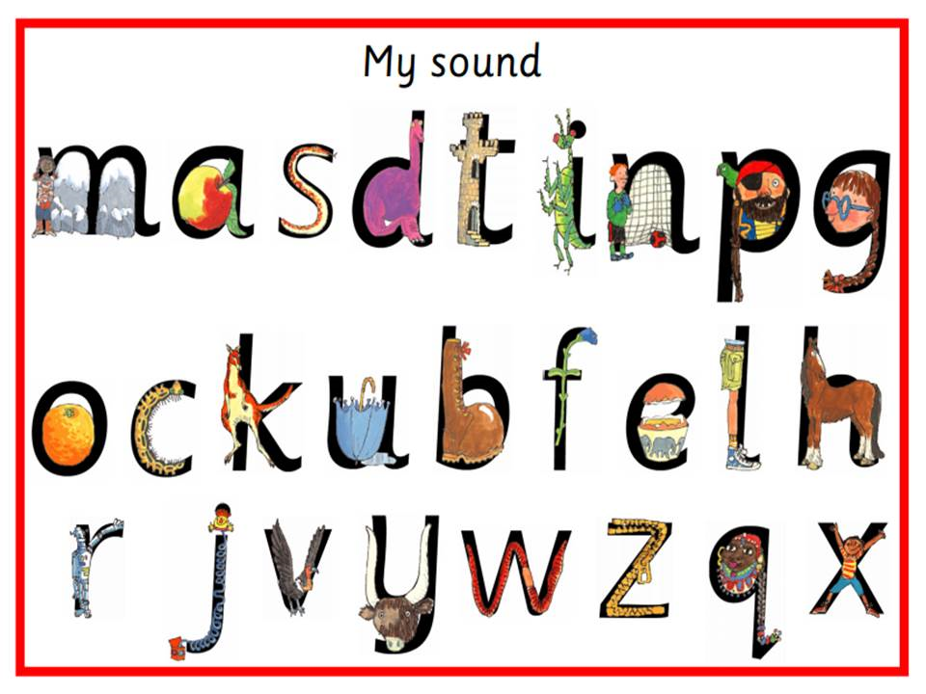

This week in our phonics lesson we are going to continue to look at set 1 sounds, including all the sounds we have explored already.
Can you remember all of the sounds below?

Slide 3
Recap: Using the letter sounds we already know, can you try blending the following words:
i-t it
a-n an
a-n-d and
p-i-n pin
p-a-t pat
g-o-t got
d-o-g dog
s-i-t sit
t-i-p tip
p-a-n pan
g-a-p gap
d-i-g dig
Point to each letter as you say its sound and say it faster to blend it together to make each word!

Slide 4


Now we are going to look at some new letters and sounds. They are the sounds e, l, b and h.

Slide 5



Slide 6
I am going to use the sounds we have just learnt to spell out some words.
bed
b
e
d

Slide 7
lap
l
a
p

Slide 8
b – e - t | bet
h – a - m | ham
l – i - t | lit
d- e - n | den
p - e - n | pen
b – a - t | bat
h – a - t | hat
Let’s try to make some more words using our new sounds. Point to each letter as you say its sound and say it faster to blend it together to make each word!

Slide 9
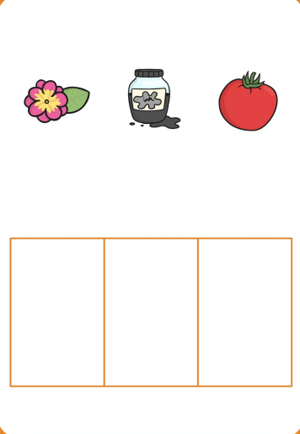
I am going to use the sounds I know to complete the secret words below. Each letter of the secret word is the initial letter sound from the word in each picture.
ink
flower
tomato
f
i
t

Slide 10
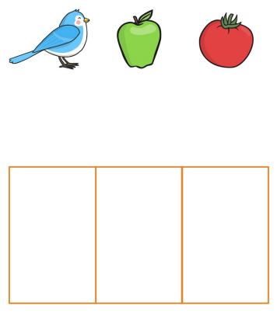
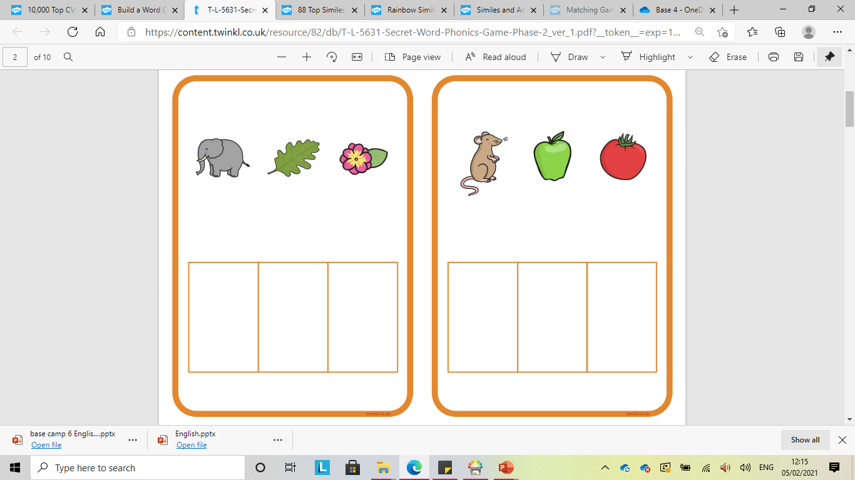

Slide 11
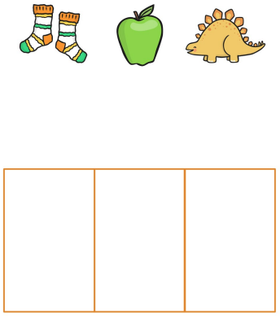
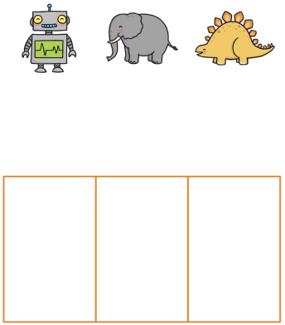
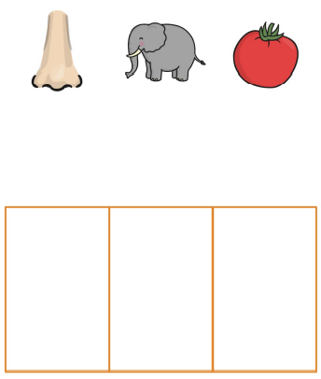

Slide 12
If you need help to write or struggle to write the letters, there are letters below which you can cut and stick into the correct place to help you to spell out the secret words.
s
a
d
r
e
d
n
e
t
b
a
t
e
l
f
m
a
t

Slide 13

Challenge time!
Now we have learnt our new letters and sounds can you sign them?

Slide 14
Date:
Tuesday 9th February 2021
L.O.
To be able to explore similes and the effects they have on the reader.
Subject: English

Slide 15

Listen to the song below. Listen careful to how the animals move and
join in with the actions, how do they make you feel?
Busy Feet 'It's Warm Up Time' – YouTube

Slide 16

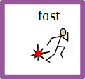

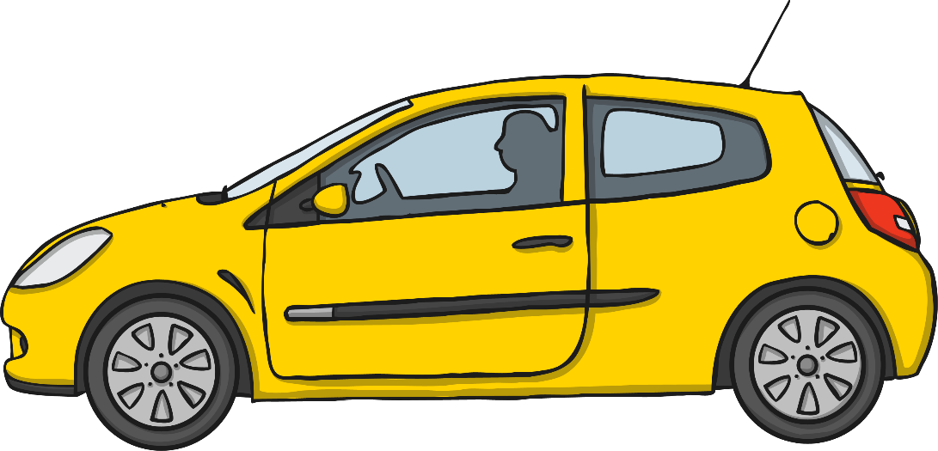

This week we are going to explore similes. A simile is a way of describing something by comparing it to something else using the words ‘like’ or ‘as.’
Here is an example of a simile:
The is as as a .

Slide 17
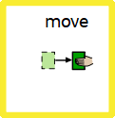

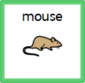
Here is another example of a simile. See if you can move like the animal the simile below is describing. How does it make you feel?
I as as a .

Slide 18

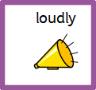



Here I have completed the simile below by choosing a noun (in this case an animals) from underneath the sentence. Can you stop as loudly as an elephant?
I as as an .

Slide 19


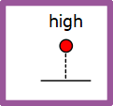
Can you complete the similes using the symbols below? Cut out the correct noun to complete the sentence.
I as as a .

Slide 20

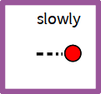
After listening to the song, can you complete the similes using the symbols below? Cut out the correct noun to complete the sentence.
I as as a .

Slide 21
Date:
Wednesday 10th February 2021
L.O.
To be able to make new similes.
Subject: English

Slide 22
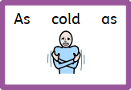

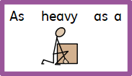
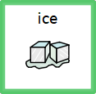
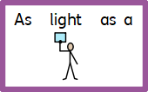

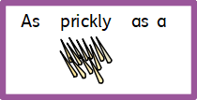

Last lesson we started to explore similes and completed some too. This lesson we are going to make our own. But first, let’s practice matching adjectives (describing words) to nouns (object or living thing) to make some similes.

Slide 23

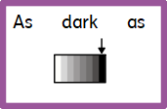

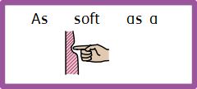



Draw a line between the adjectives (describing words) to nouns (object or living thing) to make some similes.

Slide 24

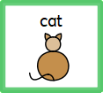
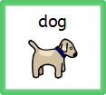

Now that we have reminded ourselves of what similes are, I’m going to make a simile of my own! I am going to use the symbols underneath to help to give me some ideas.
As as a .
I have chosen ‘cat’ but I could have chosen any of the nouns as they are all soft! Can you think of anything else that is soft?

Slide 25
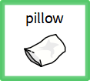
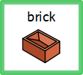
Use the symbols of nouns (objects or living things) below to help create your own simile. Look carefully to make sure the noun you are choosing matches its adjective! (descriptive word).
As as a .
Can you think of anything else that is soft?

Slide 26

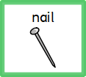
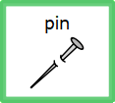
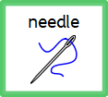
Use the symbols of nouns (objects or living things) below to help create your own simile. Look carefully to make sure the noun you are choosing matches its adjective! (descriptive word).
As as a .
Can you think of anything else that is sharp?

Slide 27


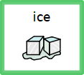
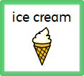
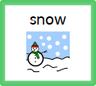
Use the symbols of nouns (objects or living things) below to help create your own simile. Look carefully to make sure the noun you are choosing matches its adjective! (descriptive word).
As as .
Can you think of anything else that is cold?

Slide 28

Challenge: Can you think of your own noun (object or living thing) to make a simile? Write the noun to complete the simile- an adult can help you to spell the word you want.
As as .
Can you think of anything else that is squashy?

Slide 29
Date:
Thursday 11th February 2021
L.O.
To be able to write a list poem using similes.
Subject: English

Slide 30
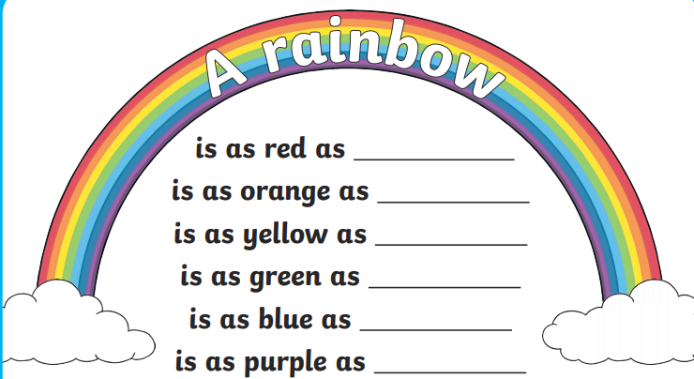
Last lesson we had a go at making our own similes. Now that we are familiar with what similes are we are going to use them to make a list poem. A list poem is a simple list of words or phrases following a ‘starter’ sentence. Our starter sentence for our list poem is going to be ‘ A rainbow is…’
Here is an example of my list poem about a rainbow. Can you find the similes in my poem?
a tomato
a sun
a sunflower
a leaf
a blueberry
a grape

Slide 31
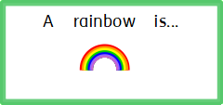

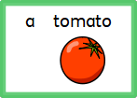

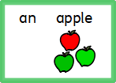
I have used the symbols of nouns (objects or living things) below to help create my own simile for a line of the list poem.
As as .
Can you think of anything else that is red?

Slide 32
Use the symbols of nouns (objects or living things) below to help create your own similes for a list poem. If you think of your own, you could use that instead and write it with an adult’s help.
As as .
Can you think of anything else that is red?

Slide 33

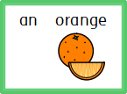
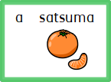
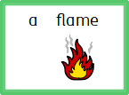
Use the symbols of nouns (objects or living things) below to help create your own similes for a list poem. If you think of your own, you could use that instead and write it with an adult’s help.
As as .
Can you think of anything else that is orange?

Slide 34

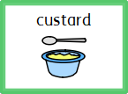
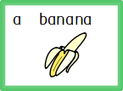
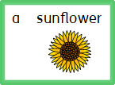
Use the symbols of nouns (objects or living things) below to help create your own similes for a list poem. If you think of your own, you could use that instead and write it with an adult’s help.
As as .
Can you think of anything else that is yellow?

Slide 35

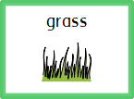
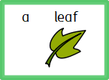
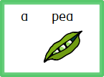
Use the symbols of nouns (objects or living things) below to help create your own similes for a list poem. If you think of your own, you could use that instead and write it with an adult’s help.
As as .
Can you think of anything else that is green?

Slide 36

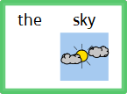
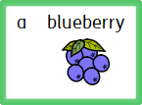
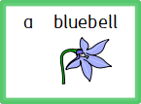
Use the symbols of nouns (objects or living things) below to help create your own similes for a list poem. If you think of your own, you could use that instead and write it with an adult’s help.
As as .
Can you think of anything else that is blue?

Slide 37

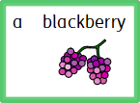
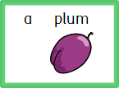
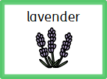
Use the symbols of nouns (objects or living things) below to help create your own similes for a list poem. If you think of your own, you could use that instead and write it with an adult’s help.
As as .
Can you think of anything else that is purple?

Slide 38
Date:
Friday 12th January 2021
L.O.
To be able write our new phonics sounds and CVC words.
Subject: English

Slide 39

Can you remember our new speed sounds we looked at the beginning of the week?
Today, we are going to try writing them.
Down the long leg.
Down the laces, over the shoe and touch the heel.
Down the horses head to its hooves and over its back.
Slice the egg, go over the top then under the egg.

Slide 40


Use flour or shaving foam to write the following letters:
You can also recap on these letters too:
m a s d t i n p g
O

Slide 41
Try writing the following CVC words using the sounds we have learnt this week in the foam or flour.
b – e - t | bet
h – a - m | ham
l – i - t | lit
d- e - n | den
p - e - n | pen
b – a - t | bat
h – a - t | hat

Slide 42

Challenge: Can you write and spell five of them into your book?
lit
den
pen
bat
hat

