Slide 1

Subject: Maths
Pack: B

Slide 2

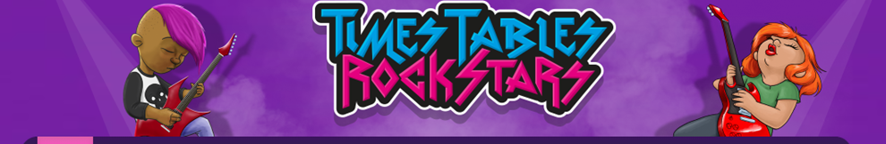

28.6.21
This lesson was also included in the first week'spowerpoint so you may have completed it if you were ahead
L.O. To be able to count in multiples
Go to Times Tables Rock Stars to warm up your number brain before you start your maths activity.
Subject: Maths

Slide 3
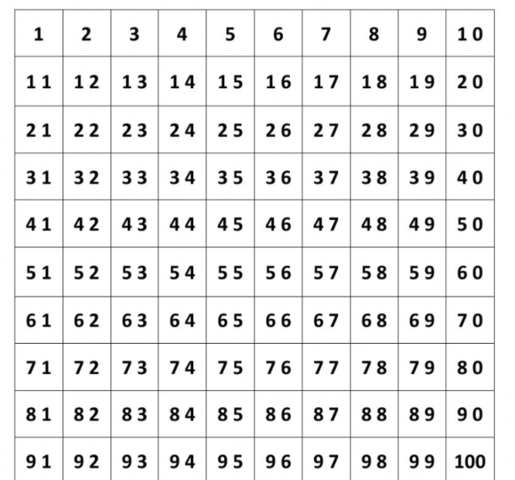

When we count in multiples we need to start at zero and count in equal steps
Use the number square and colour in all the multiples of 4.
Can you do the same using a different colour to identify the multiples of 8?

Slide 4
Complete the number sequences by counting on in jumps of 8 or 4.
1. ______ 8 12 _______ ________
2. 8 ______ _______ 20 ______
3. _______ _______ 60 _______ _______
4. 24 _______ 16 ______ ______ ______
5. 48 ________ 32 ______ ______ ______
6. 96 ______ 80 ______ ______ ______
7. 72 ______ ______ 48 _______
8. 48 ______ 40______ _______
9. 72 ______ 56 ______ ______ ______
10. 88 ______ 72 ______ ______ ______
Tip: Count on or back from the last number. Use the number square on the last page to help.
Subject: Maths

Slide 5
Can you use your knowledge of counting in multiples to complete the calculations
6 x _____ = 48 6. _____x _____ = 80
5 x _____ = 20 7. _____x _____ = 48
7 x _____ = 56 8. _____x _____ = 96
9 x _____ = 36 9. _____x _____ = 28
2 x _____ = 16 10. _____x _____ = 64

Slide 6
29.6.21
L.O. To be able to order numbers
Go to Times Tables Rock Stars to warm up your number brain before you start your maths activity.
Subject: Maths

Slide 7
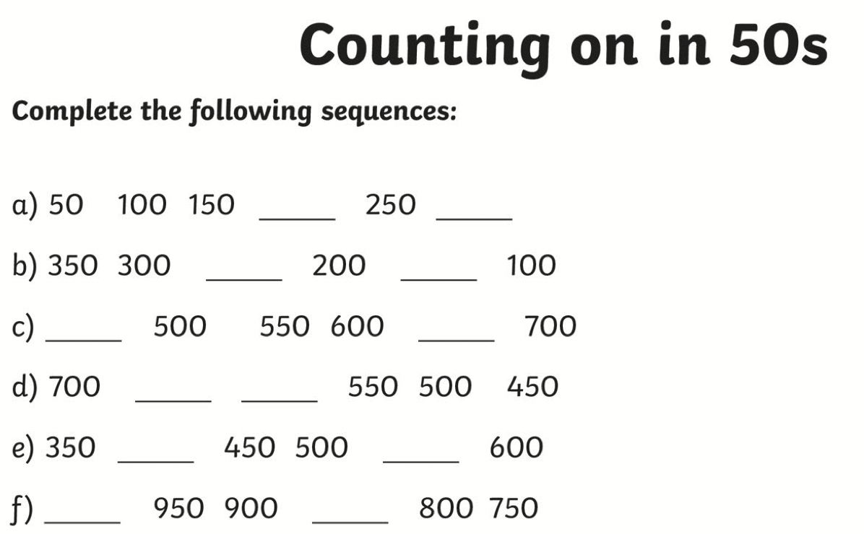

Starter

Slide 8
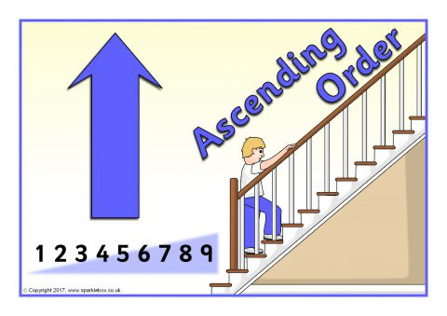
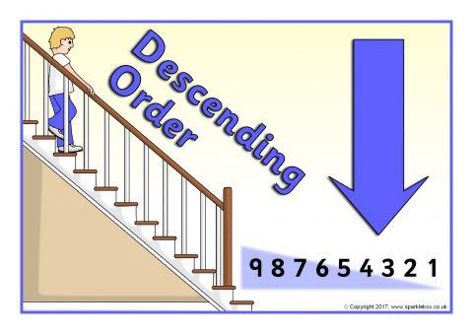
We can order numbers in ascending and descending order
Example-
Ascending - 321, 367, 402
Decending- 402, 367, 321

Slide 9
Order these numbers in ascending order -
1. 218, 421, 123, 204, 105
_____ , _____ , _____ , _____ , _____
2. 246, 521, 321, 464, 442
_____ , _____ , _____ , _____ , _____
3. 795, 701, 765, 762, 703
_____ , _____ , _____ , _____ , _____
4. 432, 423, 322, 332, 422
_____ , _____ , _____ , _____ , _____
HINT-
Think of place value, look at H first, then Ts and ones :)

Slide 10
Order these numbers in decending order -
1. 353, 311, 544, 504. 340
_____ , _____ , _____ , _____ , _____
2. 211, 789, 922, 336, 207
_____ , _____ , _____ , _____ , _____
3. 422, 490, 435, 418, 486
_____ , _____ , _____ , _____ , _____
4. 892, 982, 882, 998, 989
_____ , _____ , _____ , _____ , _____
HINT-
Think of place value, look at H first, then Ts and ones :)

Slide 11
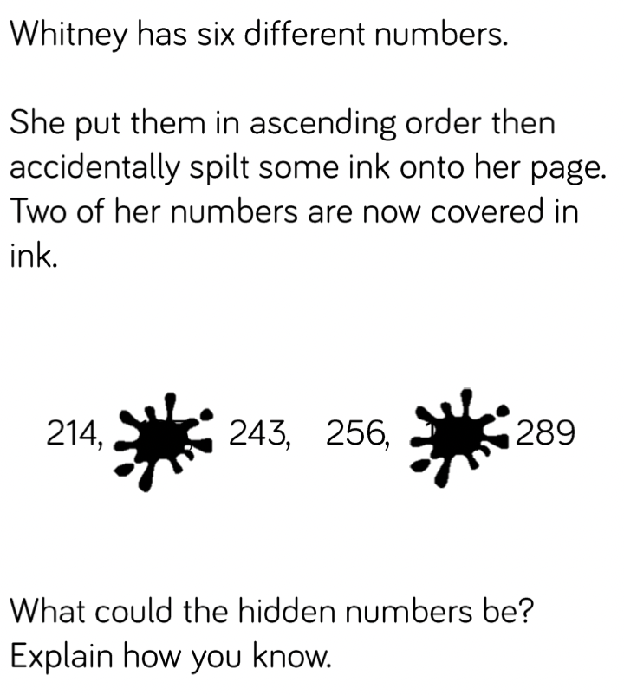
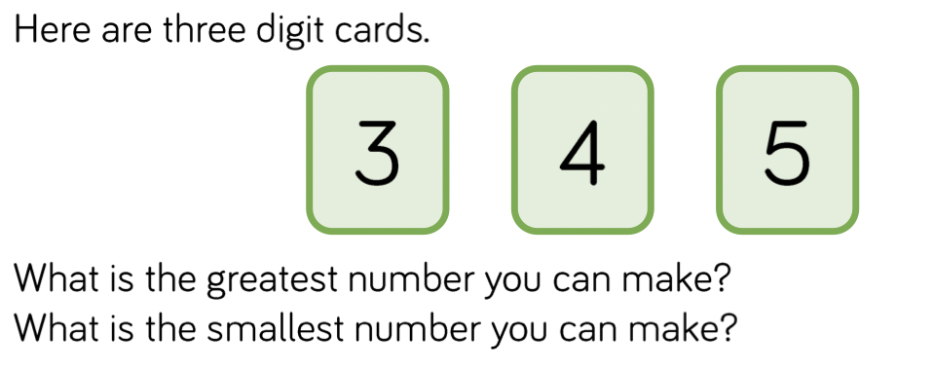
Grey box challenge

Slide 12
30.6.21
L.O. To be able to compare numbers
Go to Times Tables Rock Stars to warm up your number brain before you start your maths activity.
Subject: Maths

Slide 13
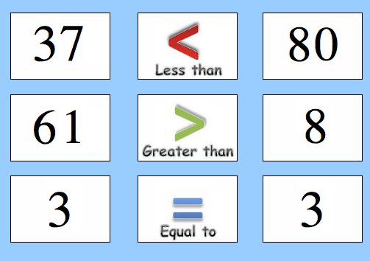
Comparing numbers
e.g.
1. 421 ____ 422
2. 310 ____ 301
3. 326 ____ 378
4. 532 ____ 522
5. 402 ___ 309
6. 336 ____ 326

Slide 14
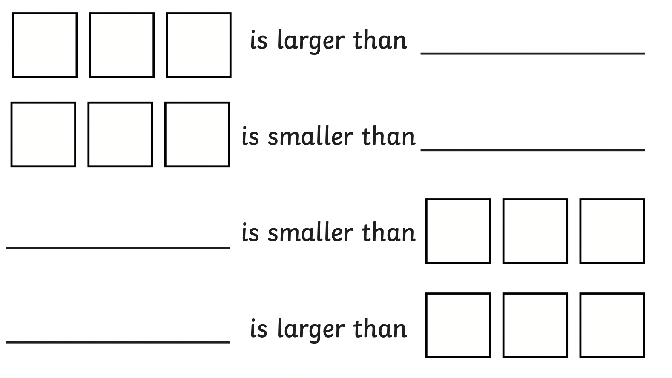
Add your own numbers to make these sentences correct. You could even roll a dice if you have one :)

Slide 15
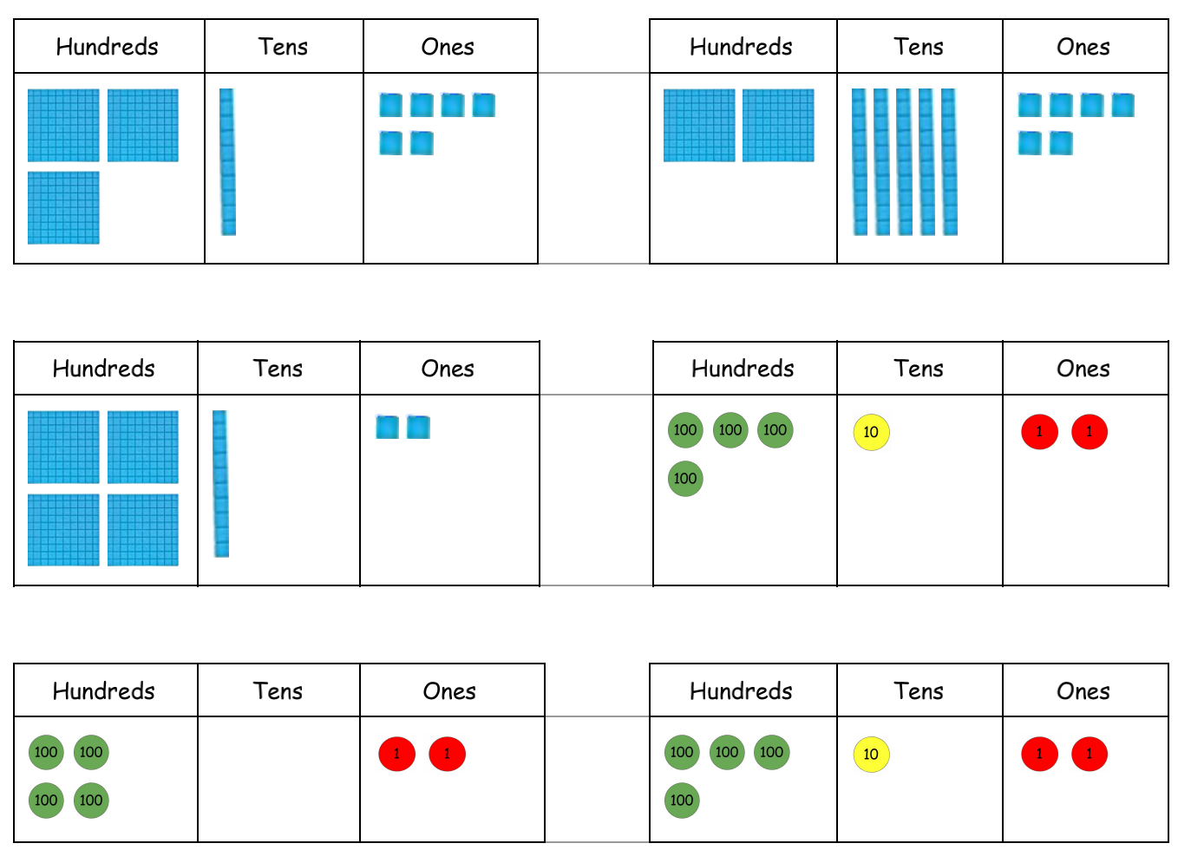
Now see what numbers are shown in the place value charts and add the correct symbol

Slide 16
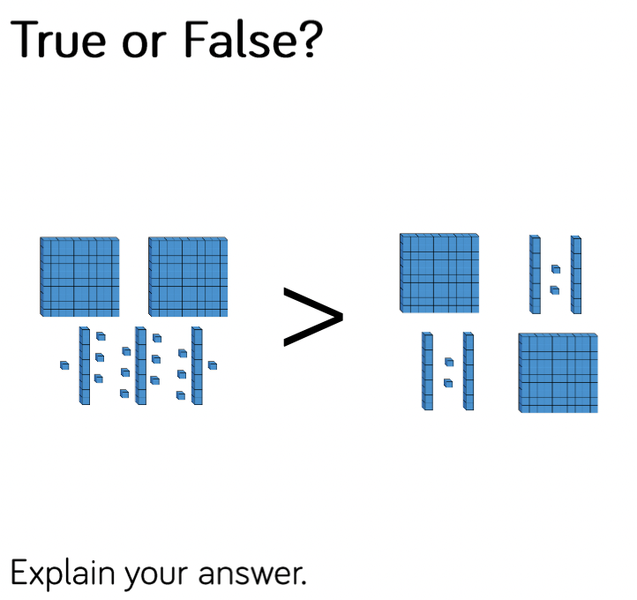
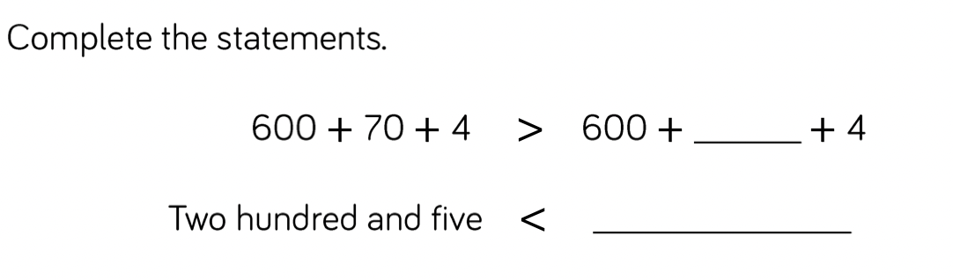
Grey box challenge

Slide 17
1.7.21
L.O To be able to recognise pounds and pence
Go to Times Tables Rock Stars to warm up your number brain before you start your maths activity.
Subject: Maths

Slide 18
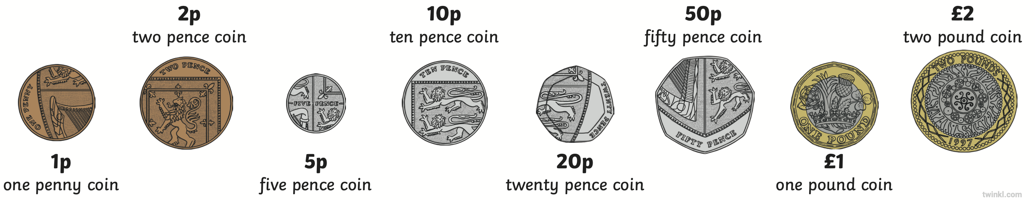
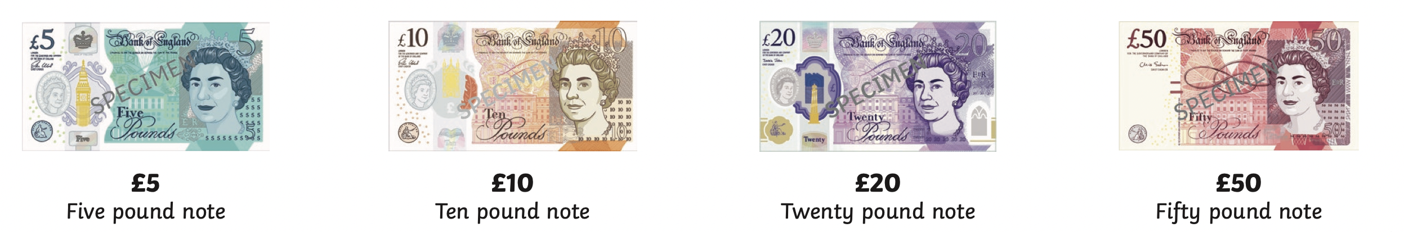
Here are all the coins and notes that we use -

Slide 19
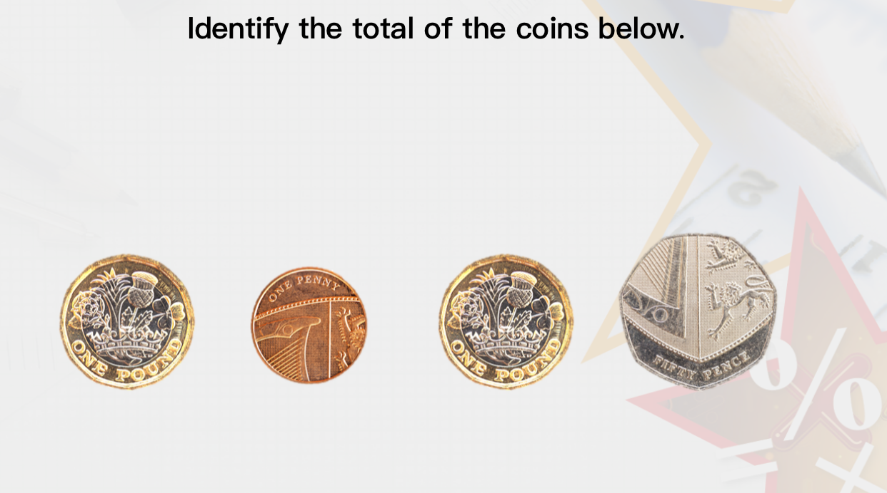
When finding the total of coins, start with the largest amount
Here I would add the 2 £1 together
then the 50 p and 1 p
Total = £2 and 51p

Slide 20
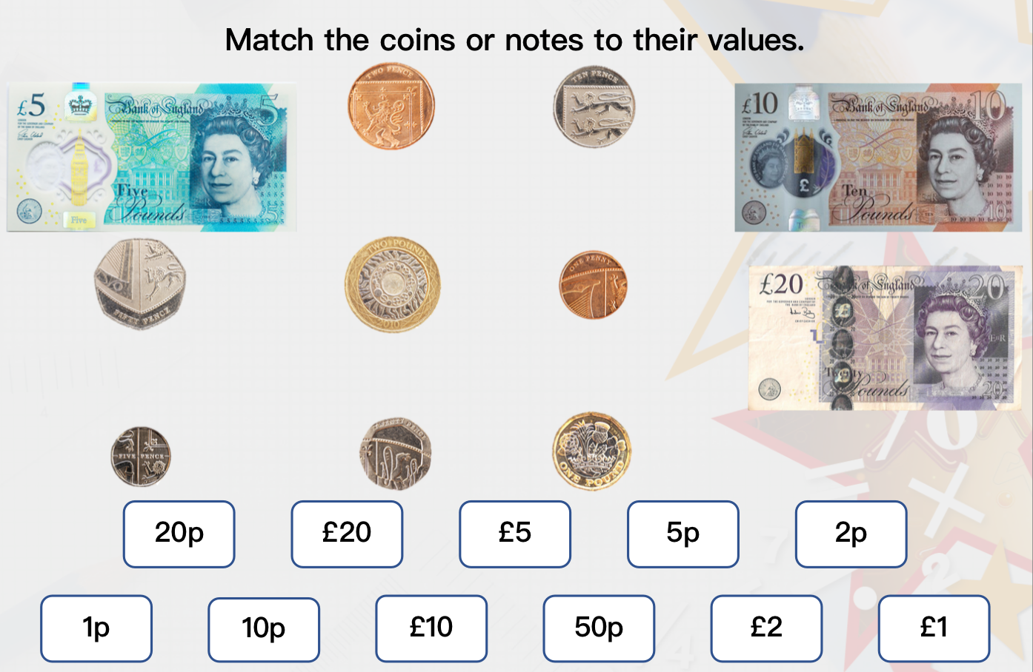

Slide 21
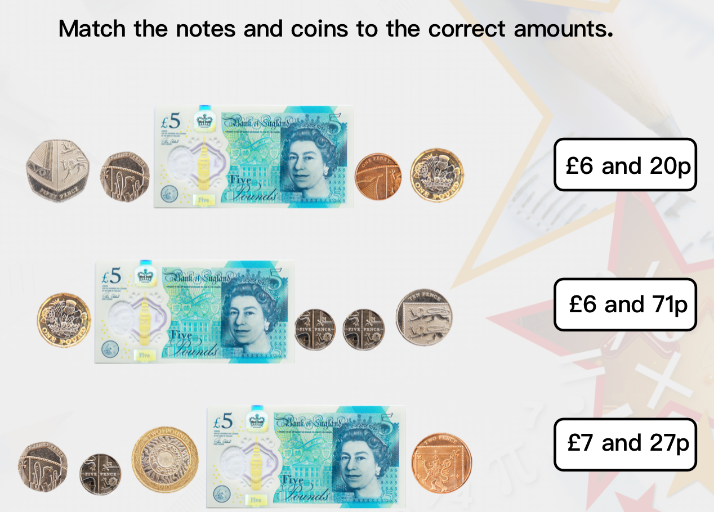

Slide 22
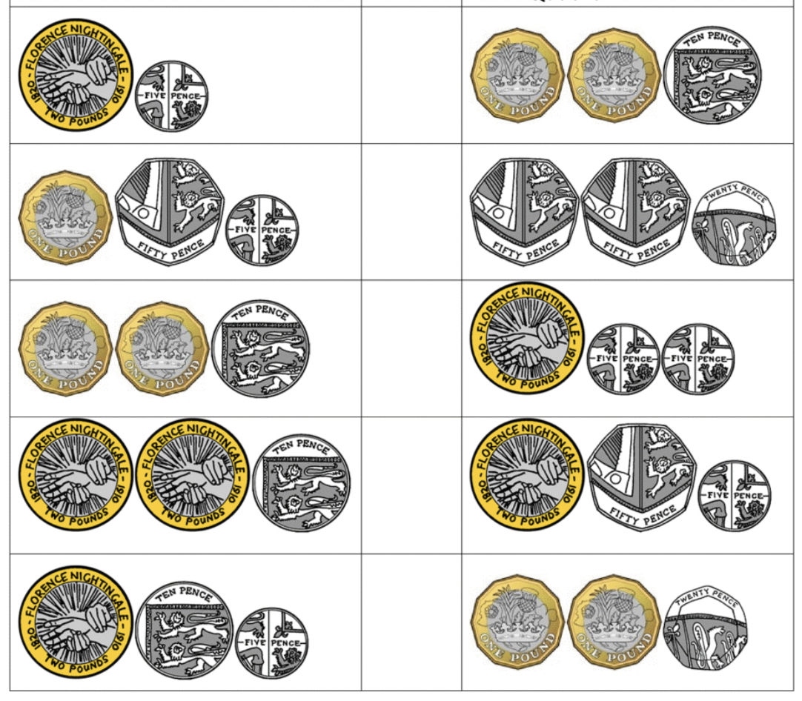
Add the the coins together and add the greater / less than sign
£ ____ and ____ p
_________________
_________________
_________________
_________________
£ ____ and ____ p
_________________
_________________
_________________
_________________

Slide 23
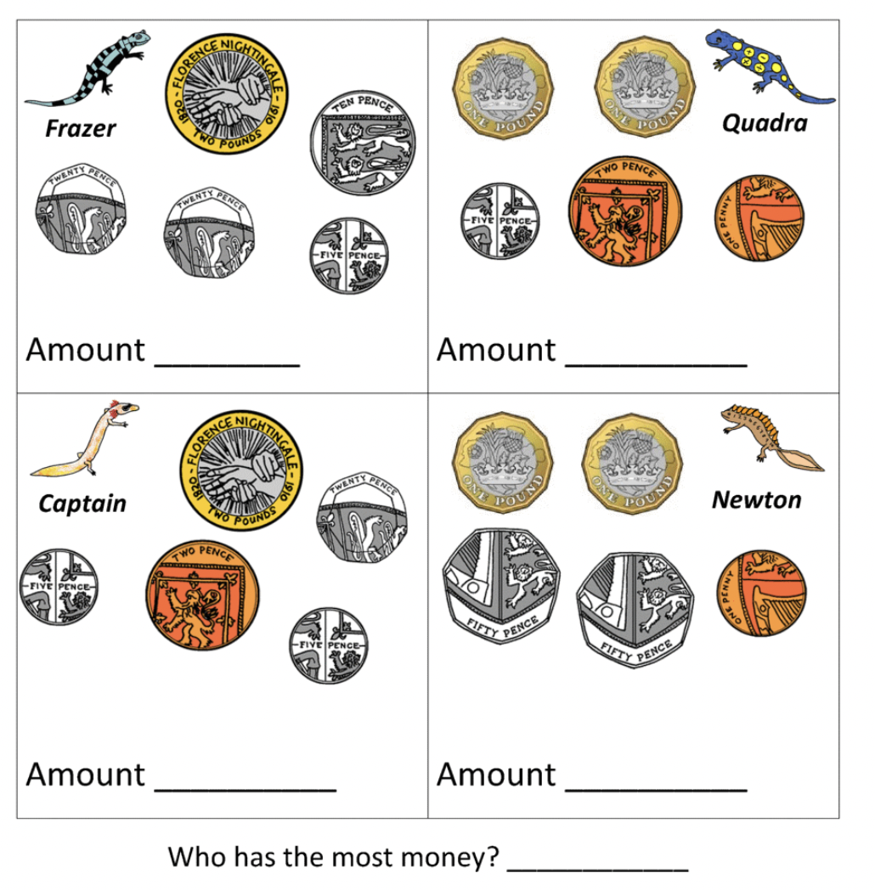
1
2
3
4

Slide 24
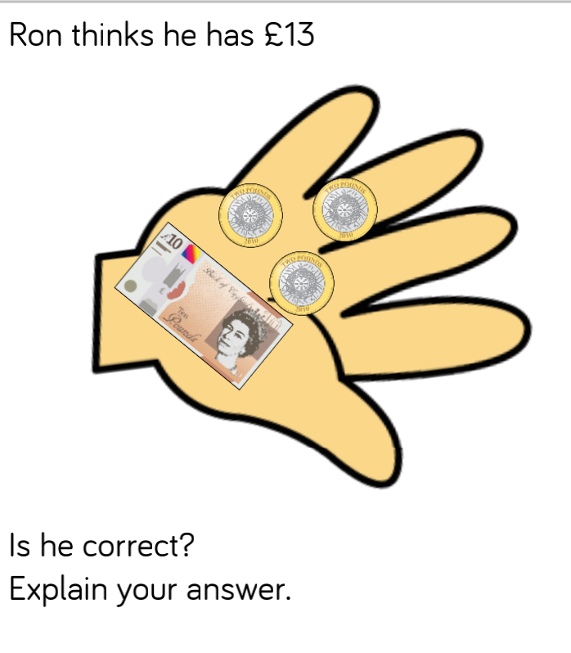
Grey box challenge

Slide 25
2.7.21
L.O To be able to identify fractions
Go to Times Tables Rock Stars to warm up your number brain before you start your maths activity.
Subject: Maths

Slide 26
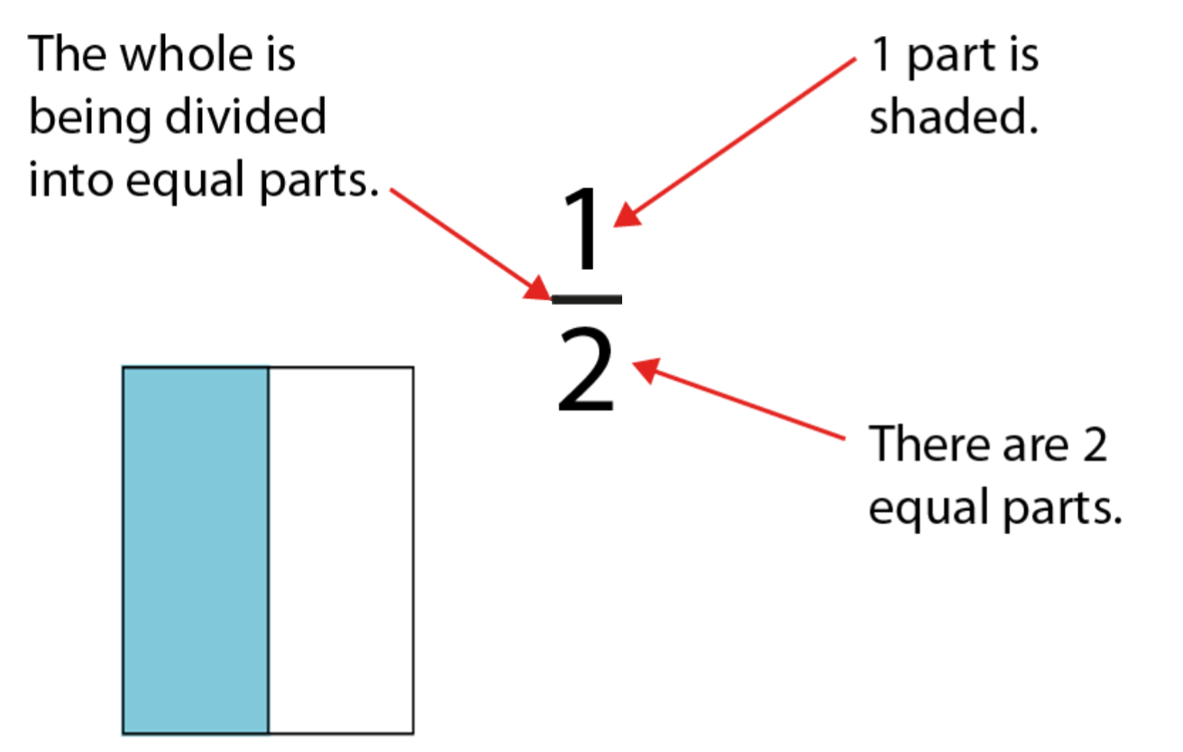
A fraction represents a part of a whole
Numerator
Denominator

Slide 27
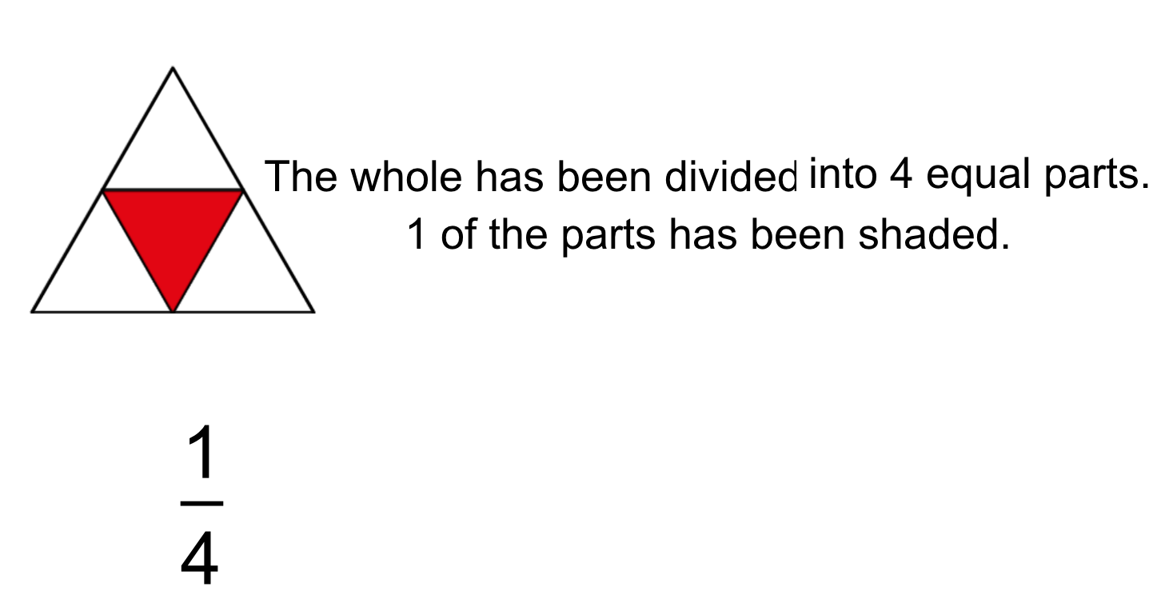

Slide 28
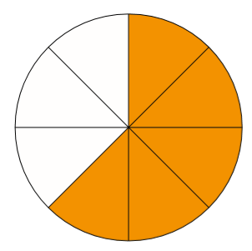
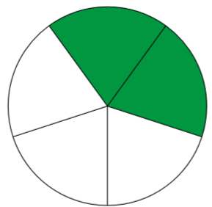


Slide 29
Lets do this one together

Slide 30

Fractions can be represented in different ways

Slide 31
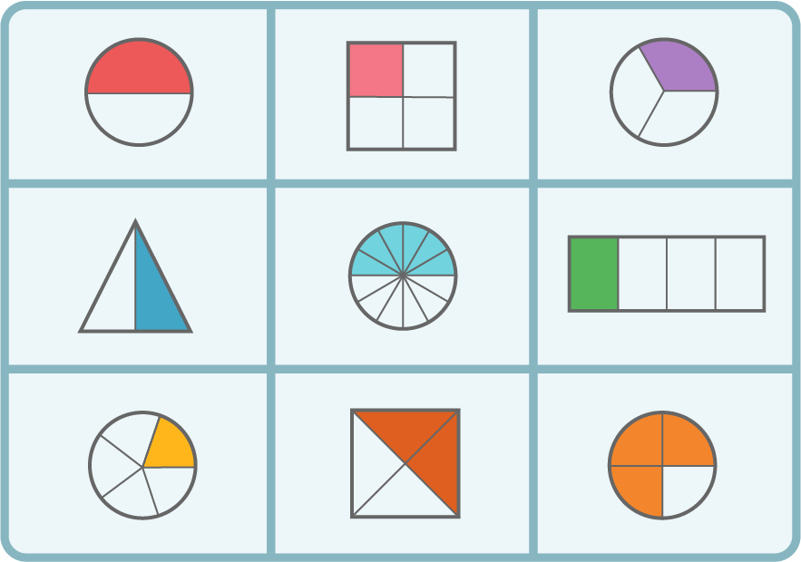
Write the correct fraction for each picture.
1.
2.
3.
4.
5.
6.
7.
8.
9.
1. 2. 3.
4. 5. 6.
7. 8. 9.

Slide 32
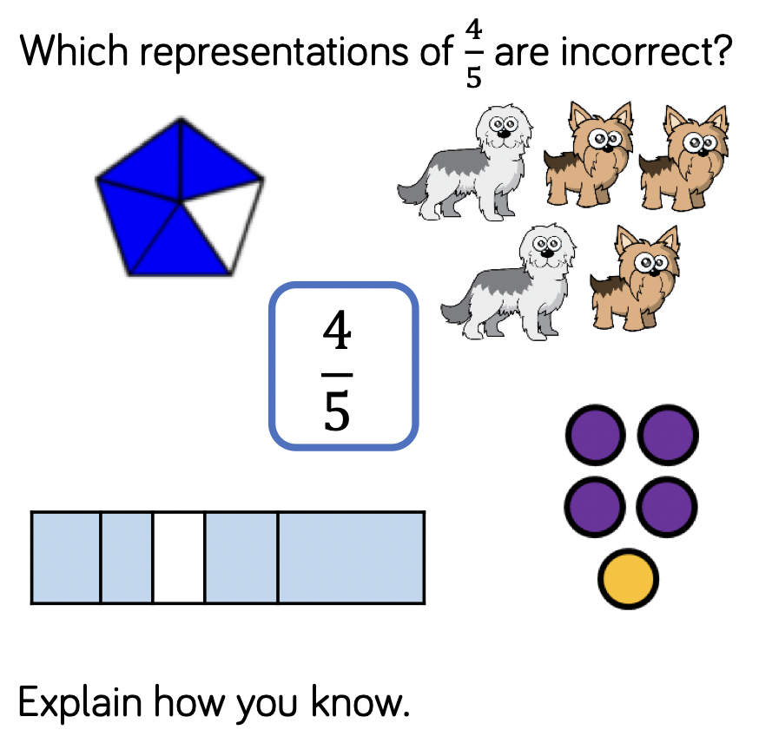
Grey box challenge

