Slide 1

Subject: English
Pack: A

Slide 2

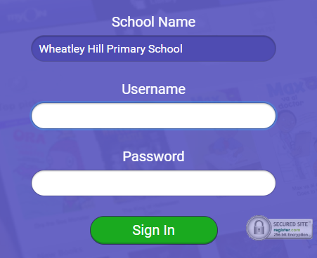
https://www.myon.co.uk/index.html
Remember to use myon for online reading
Example login -
Username
DavidW
Password
password1

Slide 3
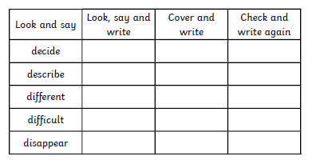
Monday 1st February 2021
L.O To be able to spell words from the Y3/4 word list

Slide 4


Monday 1st February 2021
L.O To be able to answer questions based on a text
Subject: English

Slide 5
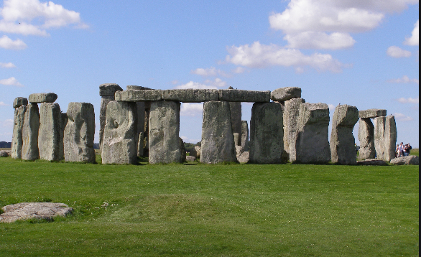
Today we are going to learn about Stonehenge

Slide 6
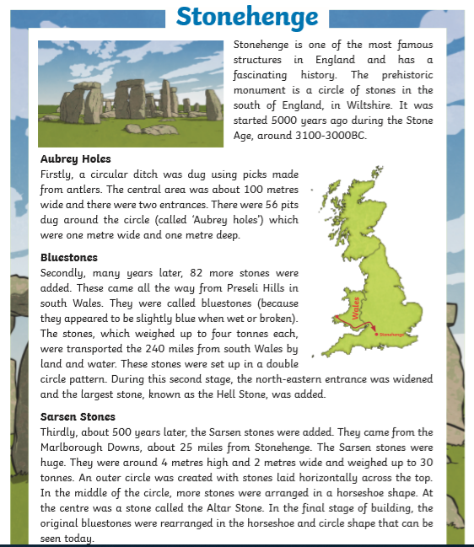
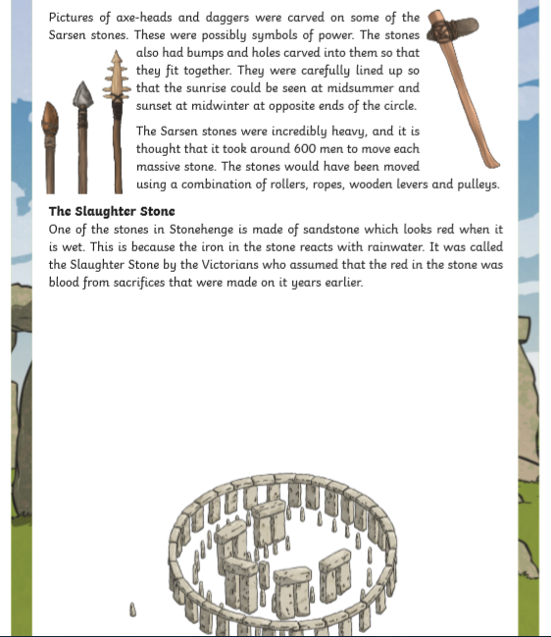
Read through the information on this page

Slide 7
Answer the questions in full sentences, e.g. Stonehenge is located in …….
1. Where in England is Stonehenge? ___________________________________________________________________________________________________________________________________________________
2. What were the 56 pits that were dug around the circle in the first stage called?
___________________________________________________________________________________________________________________________________________________
3. At what time of year could the sunrise be seen from Stonehenge?
___________________________________________________________________________________________________________________________________________________
4. How were the Sarsen stones moved? _______________________________________________________________________
5. Explain how the Slaughter Stone got its name. ____________________________________________________________________________________________________________________________________________________

Slide 8

End of lesson

Slide 9
Tuesday 2nd February 2021
L.O To be able to write expanded noun phrases
Subject: English

Slide 10

Pre-recorded Teaching
Access the online teaching video below that will support you to complete the work in this lesson. This video will act as a support but all of the work can still be successfully understood & completed using paper-based versions of this pack. If you need further support to understand / complete work then please contact school via e-mail or telephone.
Play Video
You can also copy and paste this link if you would prefer: https://teachers.thenational.academy/lessons/to-explore-expanded-noun-phrases-6hh36c?from_query=expanded

Slide 11
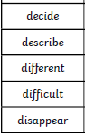
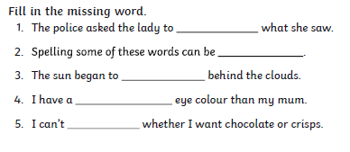
Tuesday 2nd February 2021
L.O To be able to spell words from the Y3/4 word list

Slide 12
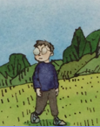
What is an expanded noun phrase?
An expanded noun phrase tells you more about the noun using two adjectives.
Example
Noun – boy
Adjectives – tall, pale
Expanded noun phrase
The tall, pale boy.
Adjective Adjective noun
Always remember the two adjectives must be separated by a comma

Slide 13
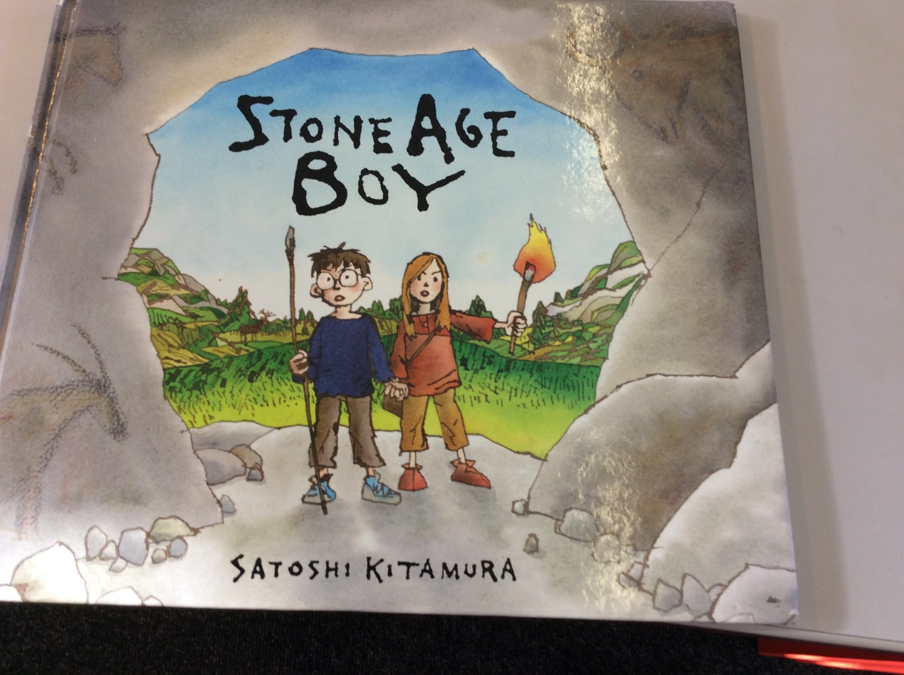
Write a list of adjectives to describe the boy and girl
______________________________________
______________________________________
______________________________________
______________________________________
______________________________________
______________________________________
______________________________________
______________________________________

Slide 14
What did you come up with?
Pale
Tired
Adventurous
Supportive
Fearless
Short
Brown haired
Curious
Inquisitive
Messy

Slide 15
Using some of the adjectives you have came up with lets try and write some descriptive sentences about the characters
The curious, strange boy stared inquisitively into the cave.
Staring curiously, the fearless, strong girl held the boys hand.
Both of these sentences have two adjectives in to add more description to the characters.

Slide 16

Fill in the missing gaps to complete the sentences
The ________, ________ girl was very friendly to the strange boy.
The boy had ________, ________ hair on top of his head.
The ________, ________ children danced together at the feast.

Slide 17

Your task
Using the adjectives you have came up with and the ones I have given you on the PowerPoint, write six sentences describing the two characters
Example - The curious, strange boy stared inquisitively into the cave.
___________________________________________________________________
___________________________________________________________________
___________________________________________________________________
___________________________________________________________________
___________________________________________________________________
___________________________________________________________________
___________________________________________________________________
___________________________________________________________________
Examples of adjectives:
Skinny, pale, brown haired, short, tall, scruffy

Slide 18
End of lesson

Slide 19
Wednesday 3rd February 2021
L.O To be able to use a range of sentence openers
Subject: English

Slide 20
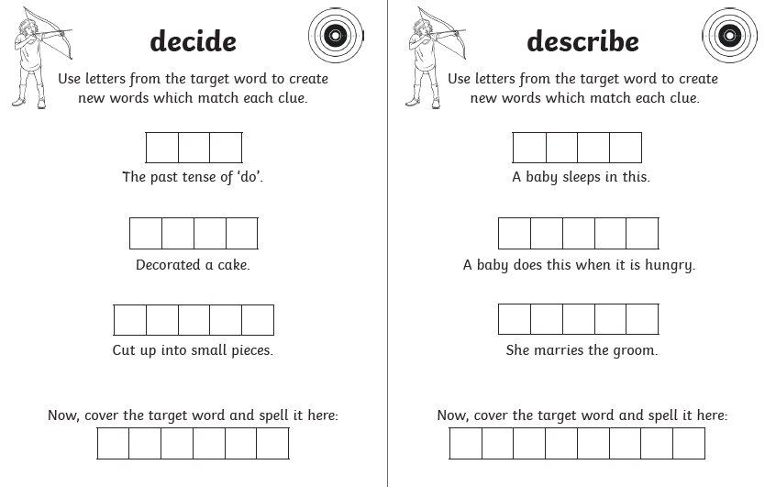
Wednesday 3rd February 2021
L.O To be able to spell words from the Y3/4 word list

Slide 21

Today we are going to read the next part of the Stone Age boy

Slide 22
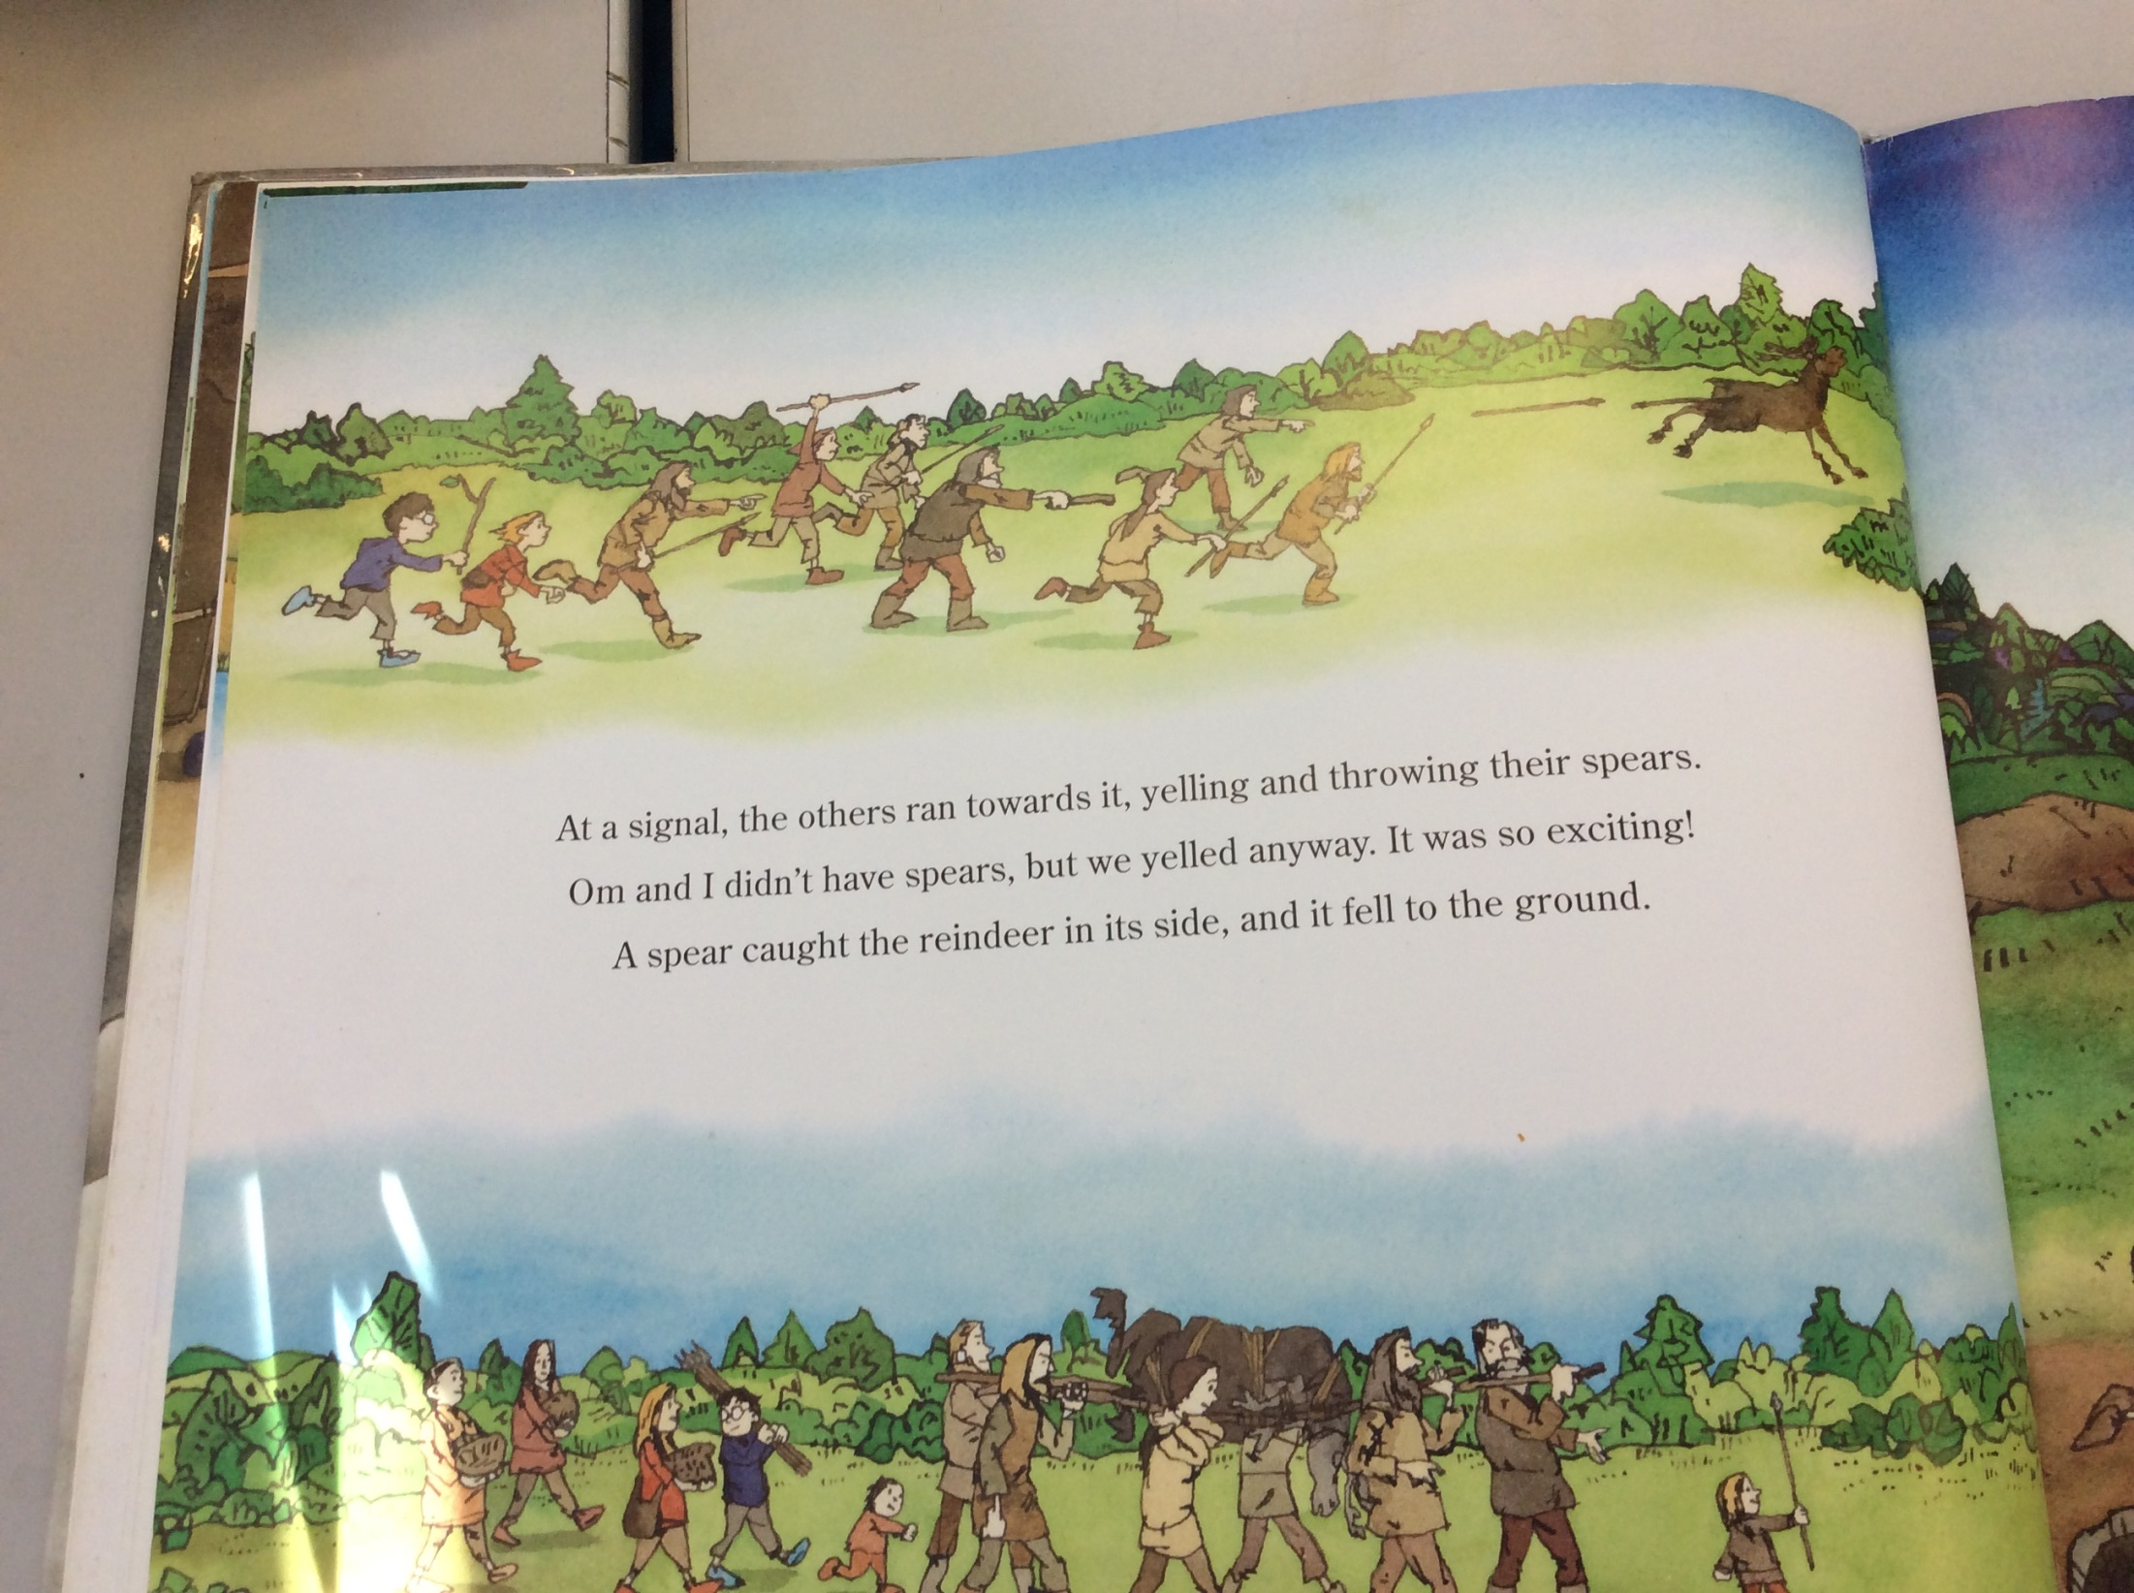

Slide 23
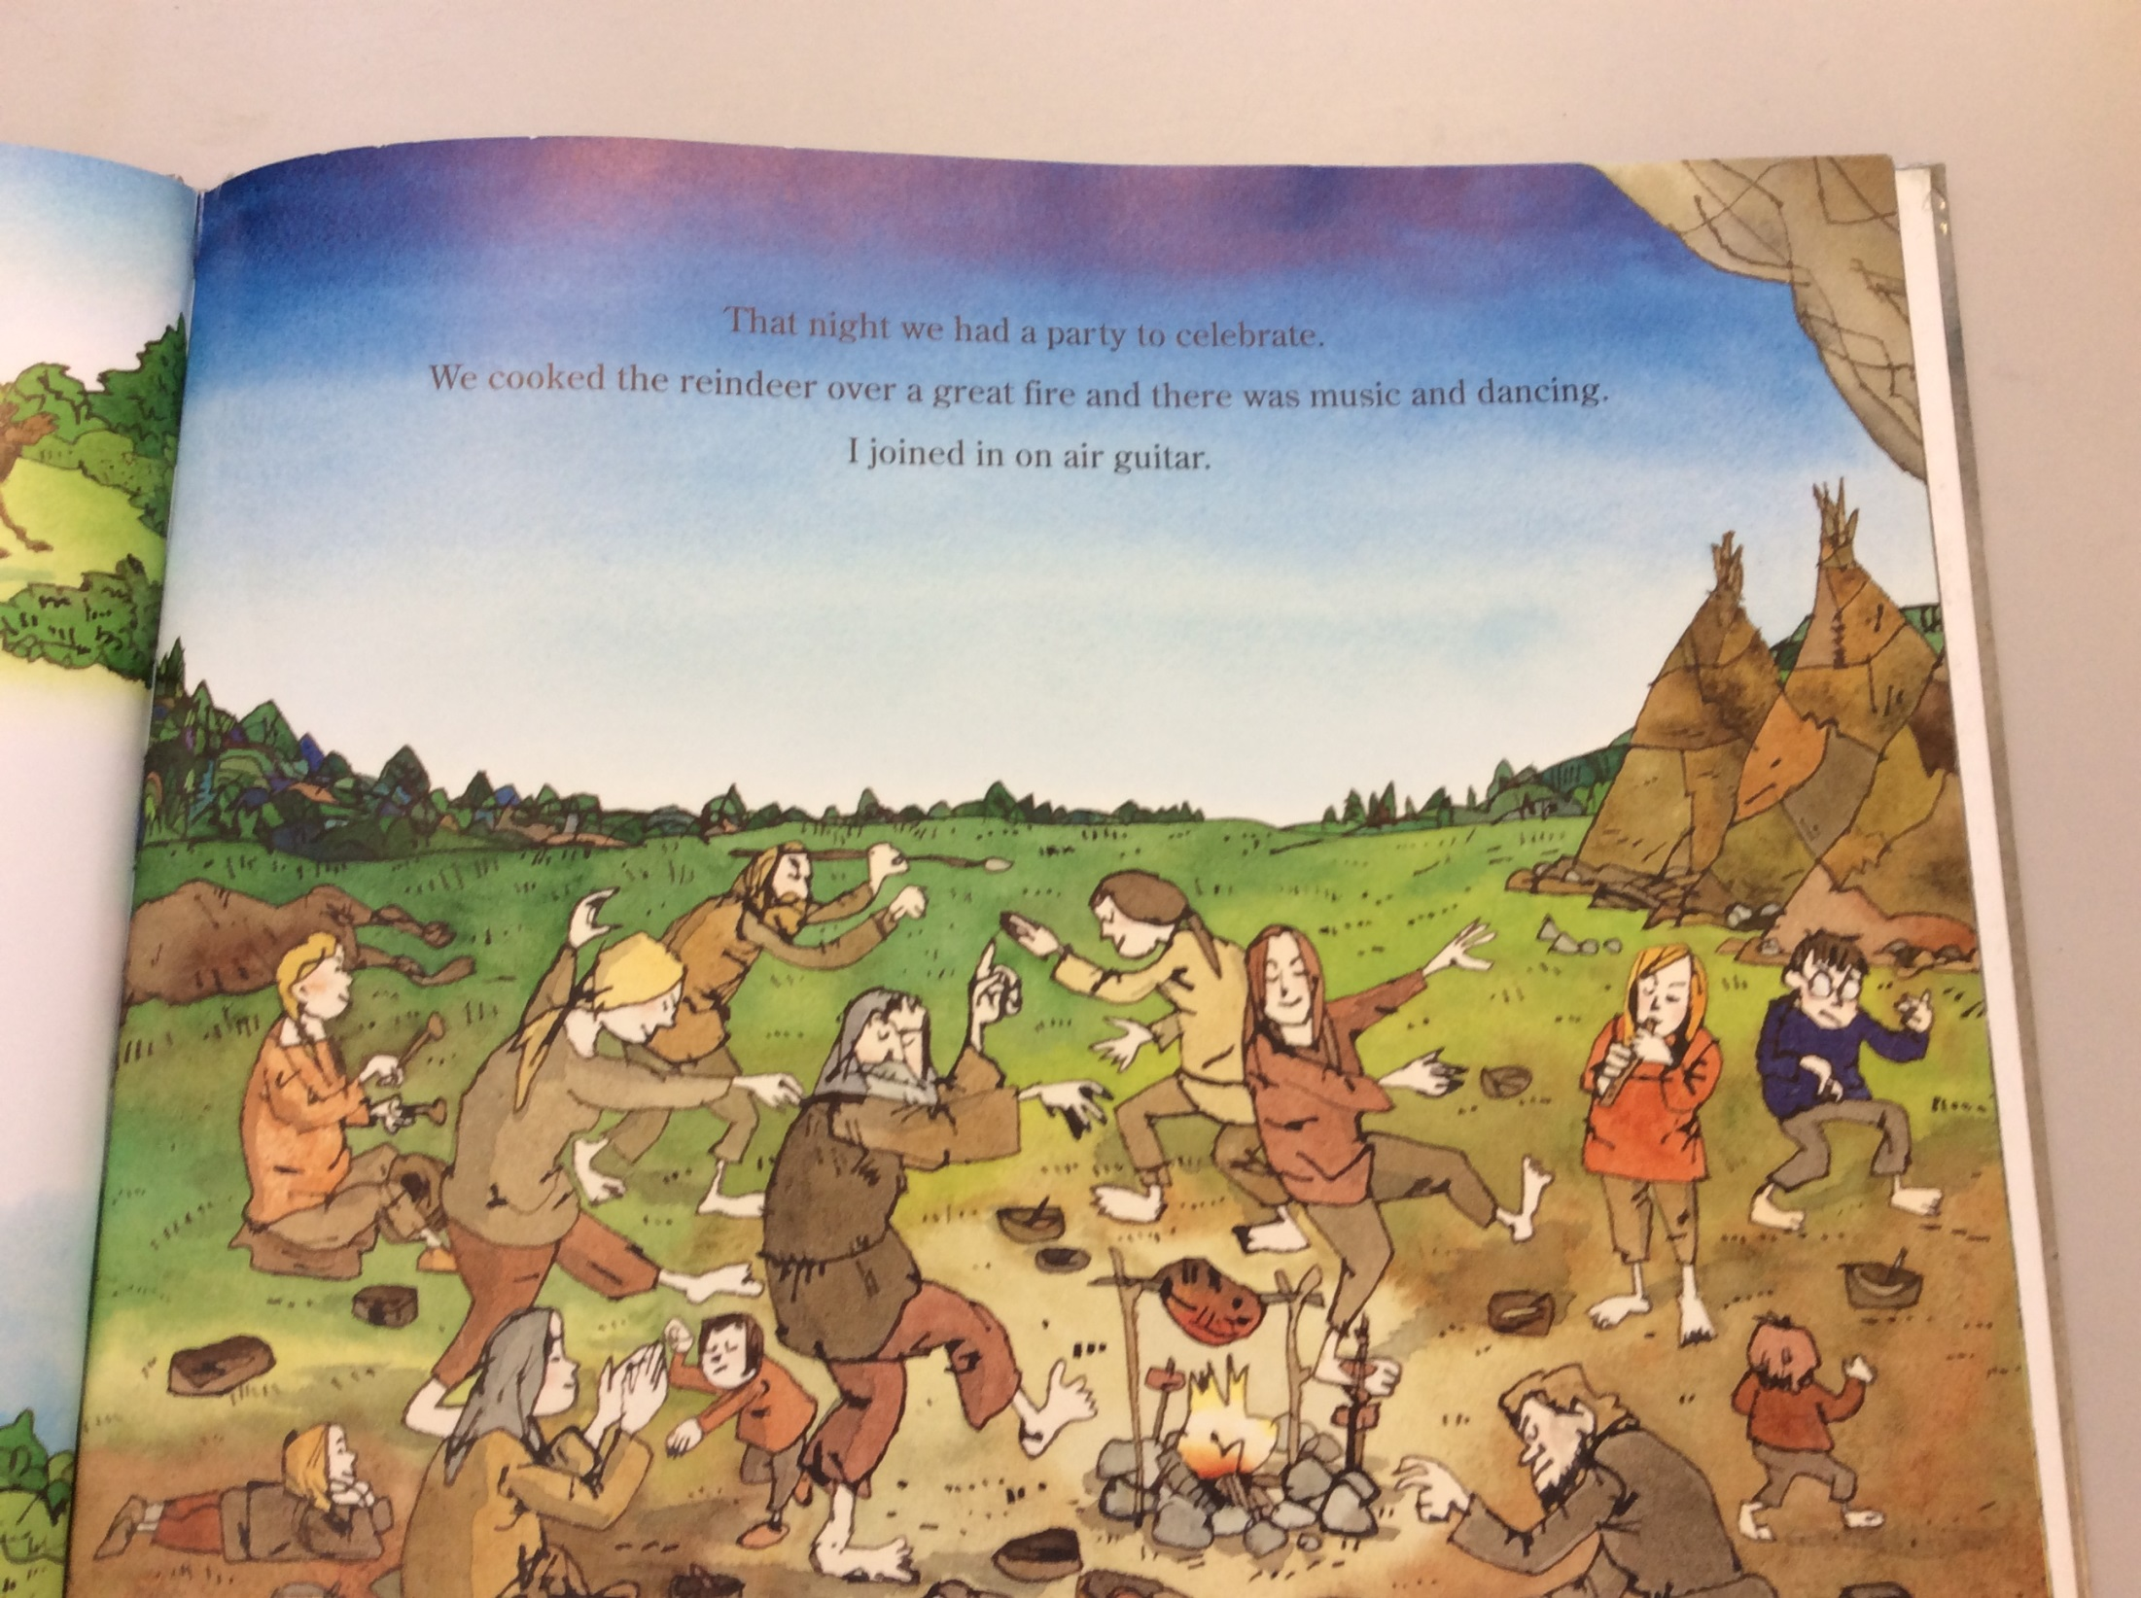

Slide 24
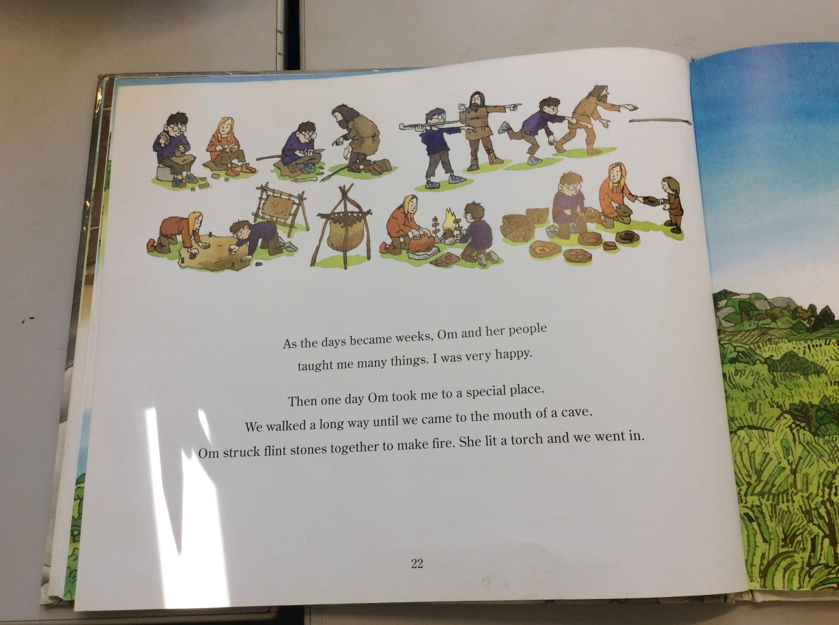

Slide 25
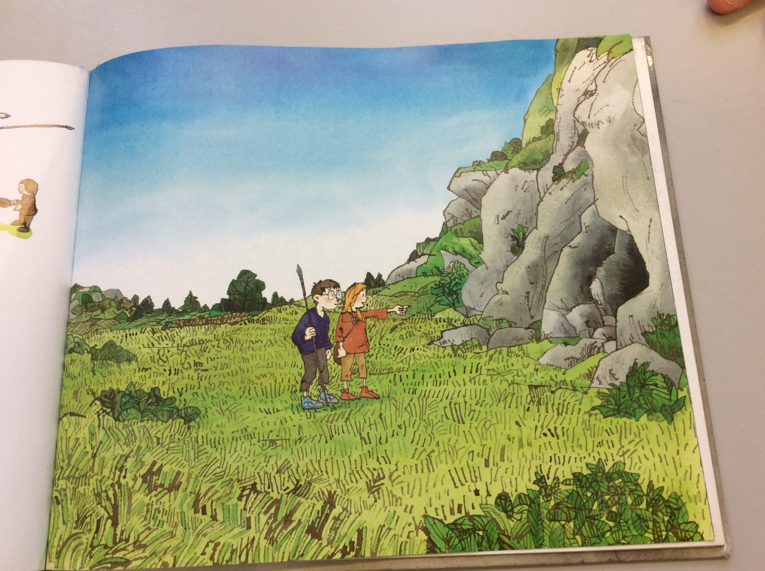

Slide 26
It’s important to use a range of sentence openers to keep our writing interesting
Time openers tell us when something happens.
Examples:
Before, after, without warning, next, just at that moment, in the end, eventually, while, just then, later and meanwhile.
Are there anymore you can think of that I have missed?

Slide 27

I’m going to use some of the time openers to write some sentences about the characters so far.
The moment the boy woke up, he realised he was in a strange place.
The comma goes after the opener and before the main clause.
The sentence opener doesn't make sense on its own and that is why is followed by main clause which is part of the sentence that makes sense on its own.
As soon as the boy met Om, he knew she was different to him.
Comma after the opener main clause

Slide 28
Preposition openers
Preposition openers tells us where something is
Example:
Standing on top of the hill, facing the cave, against the wall, below the sky, next to the child, in front of the animals, below the water, sitting by the fire.
Are there anymore you can think of that I have missed?

Slide 29
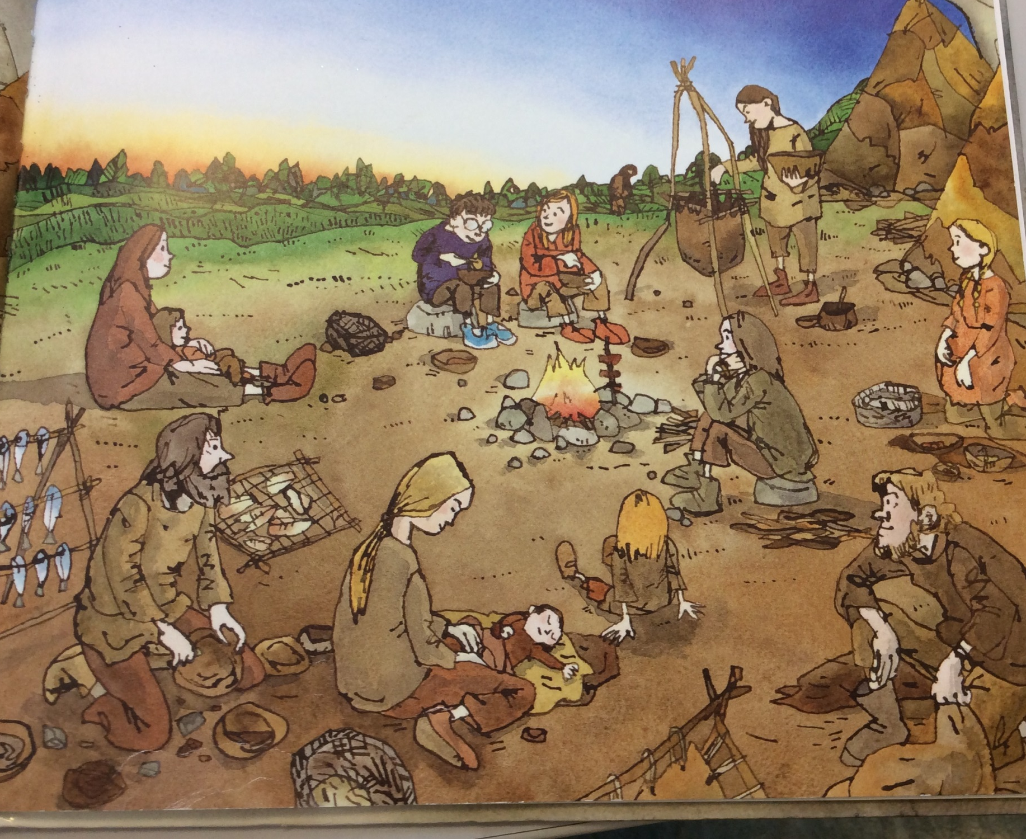
I’m going to use some of the preposition openers to write some sentences about the characters so far
Sitting by the fire, the boy was looking around at the strange people.
Underneath the stars, the strange people sat together to cook their food.
The comma goes after the opener and before the main clause.
The main clause is part of the sentence that makes sense on its own.

Slide 30
LY openers
LY openers often tell you how something is done.
Example
Quickly, wearily, anxiously walking through the field, silently creeping up on the animal, thoughtfully, suddenly.
Are there anymore you can think of that I have missed?

Slide 31
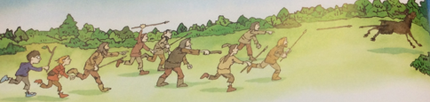
I’m going to use some of the LY openers to write some sentences about the characters so far
Quickly, both children ran to catch up with the group to hunt the animal.
Anxiously chasing after the animal, the Stone Age boy was determined to catch it.
The comma goes after the opener and before the main clause.
The main clause is part of the sentence that makes sense on its own.

Slide 32
Complete the sentences by filling in the missing words?
Time opener
_________________, the boy and Om sat by the fire with her tribe.
Prepositional opener
_________________, the boy felt scared because he wasn’t sure if they would be able to catch the animal.
LY Opener
_________________, the Stone Age boy started into the cave and wondered what was inside.

Slide 33
Your task is to write 6 sentences using different openers to describe what the characters are doing.
Two time openers
________________________________________________________
_________________________________________________________
Two prepositional openers
_________________________________________________________
_________________________________________________________
Two LY openers
_________________________________________________________
_________________________________________________________

Slide 34
End of lesson

Slide 35
Thursday 4th February 2021
L.O To be able to write similes
Subject: English

Slide 36
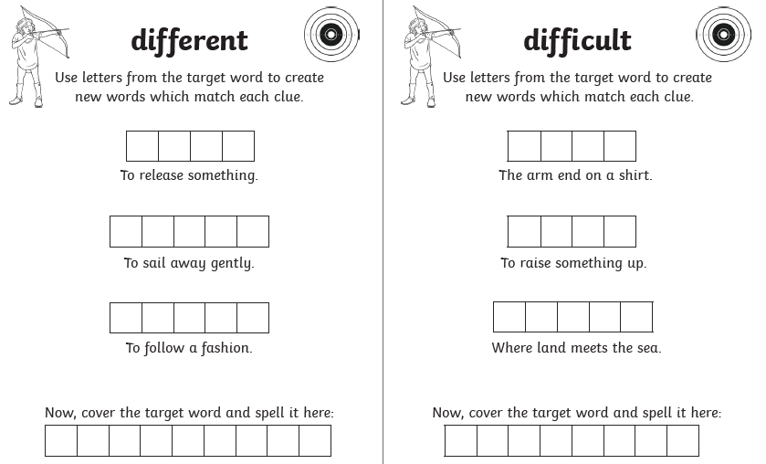
L.O To be able to spell words from the Y3/4 word list

Slide 37
What are similes?
A simile compares two things using like or as
Example
The teacher was as wise as an owl
We use similes to give the reader more information and help them to build a picture in their mind

Slide 38
Similes
The boy was as fierce as a lion.
The man was as strong as an Ox.
I walk to school as slow as a snail.
All of these similes are describing nouns (things)
(As big as a house)
Describes the things

Slide 39
Similes
Sometimes we use a simile to describe a verb (doing word)
Example
He swims like a fish
Doing word describes how he is swimming

Slide 40
Similes
He acts like a clown.
He smells like a dog.
She runs like the wind.
The boy jumped like a kangaroo.
Click this link to see more examples of similes https://www.bbc.co.uk/bitesize/topics/zfkk7ty/articles/z9tkxfr

Slide 41
Today were going to think about the Stone Age boy and use some similes to describe him
Example
He runs like the wind.
The Stone Age boy is as quick as lightening.
His clothes are as dirty as mud.

Slide 42
Complete the sentences using a simile
The boy was as ____________________
He felt like _______________ when he was chasing the animal.
Sitting by the fire, the Stone Age boy felt as hungry as __________________ when he was waiting for his dinner.

Slide 43
Write six sentences of your own to Describe the Stone Age boy, using similes.
_____________________________________________________________
_____________________________________________________________
_____________________________________________________________
_____________________________________________________________
_____________________________________________________________
_____________________________________________________________

Slide 44
End of lesson

Slide 45
Friday 5th February 2021
L.O To be able to write a character description
Subject: English

Slide 46
L.O To be able to spell words from the Y3/4 word list
Write your own sentences using these words
________________________________________________________________________________________________________________________________________________________________________________________________________________________________________________________________________________________________________________________

Slide 47
Re-read the story of the Stone Age boy so far to refresh your memory

Slide 48
Today we are going to write a character description about the Stone Age boy
We are going to try and include all the skills we have practised this week into our character description including…
Expanded noun phrases – the curious, small boy was wondering where he was.
LY opener – Quickly, the boy ran as fast as he could to get the animal.
Preposition opener – Sitting by the fire, the Stone Age boy felt very tired.
Time opener – As soon as he woke up, he knew he was lost.
Simile - The boy was as brave as a lion when he ran towards the beast.

Slide 49
Here is the start of my character description. Can you fill in the missing words?
The Stone Age boy is a __________, ___________ child who has woke up to find himself back in the Stone Age. As soon as he wakes up, he is very curious about the place he is in and meets another child named OM. Standing in the cave, the __________,__________ boy looks curiously at the girl because he realises that she is not like him. __________, he finds himself exploring his new surroundings and ____________________________________________________________________________________________________.

Slide 50
Your task today is to finish off the character description of the Stone Age boy.
Think about…
how he might be feeling
What he looks like
What he was doing
Where he went

Slide 51
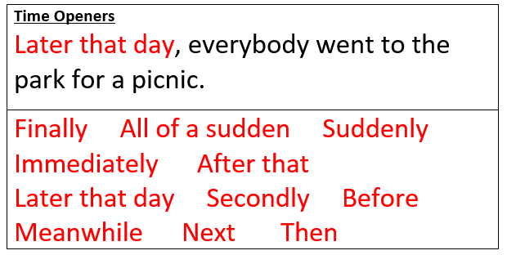
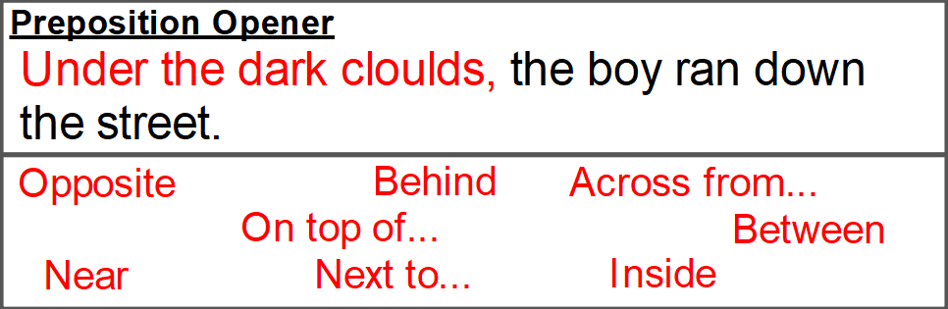
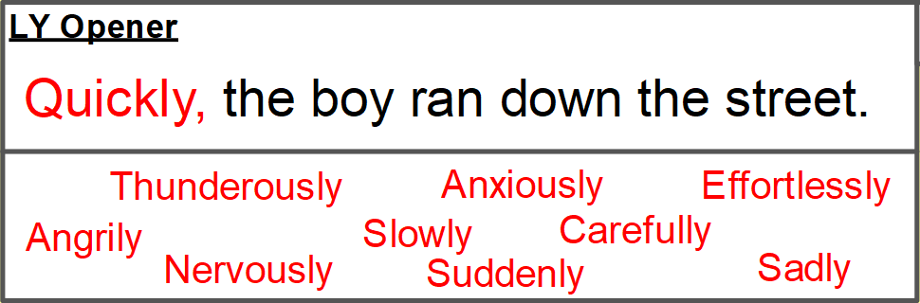
______________________________________________________________________________________________
______________________________________________________________________________________________
______________________________________________________________________________________________
______________________________________________________________________________________________
______________________________________________________________________________________________
______________________________________________________________________________________________
______________________________________________________________________________________________
______________________________________________________________________________________________
______________________________________________________________________________________________

Slide 52
End of lesson

