Slide 1



Date: Monday 25th January 2021
L.O. To explore Roman numerals
Subject: Maths

Slide 2
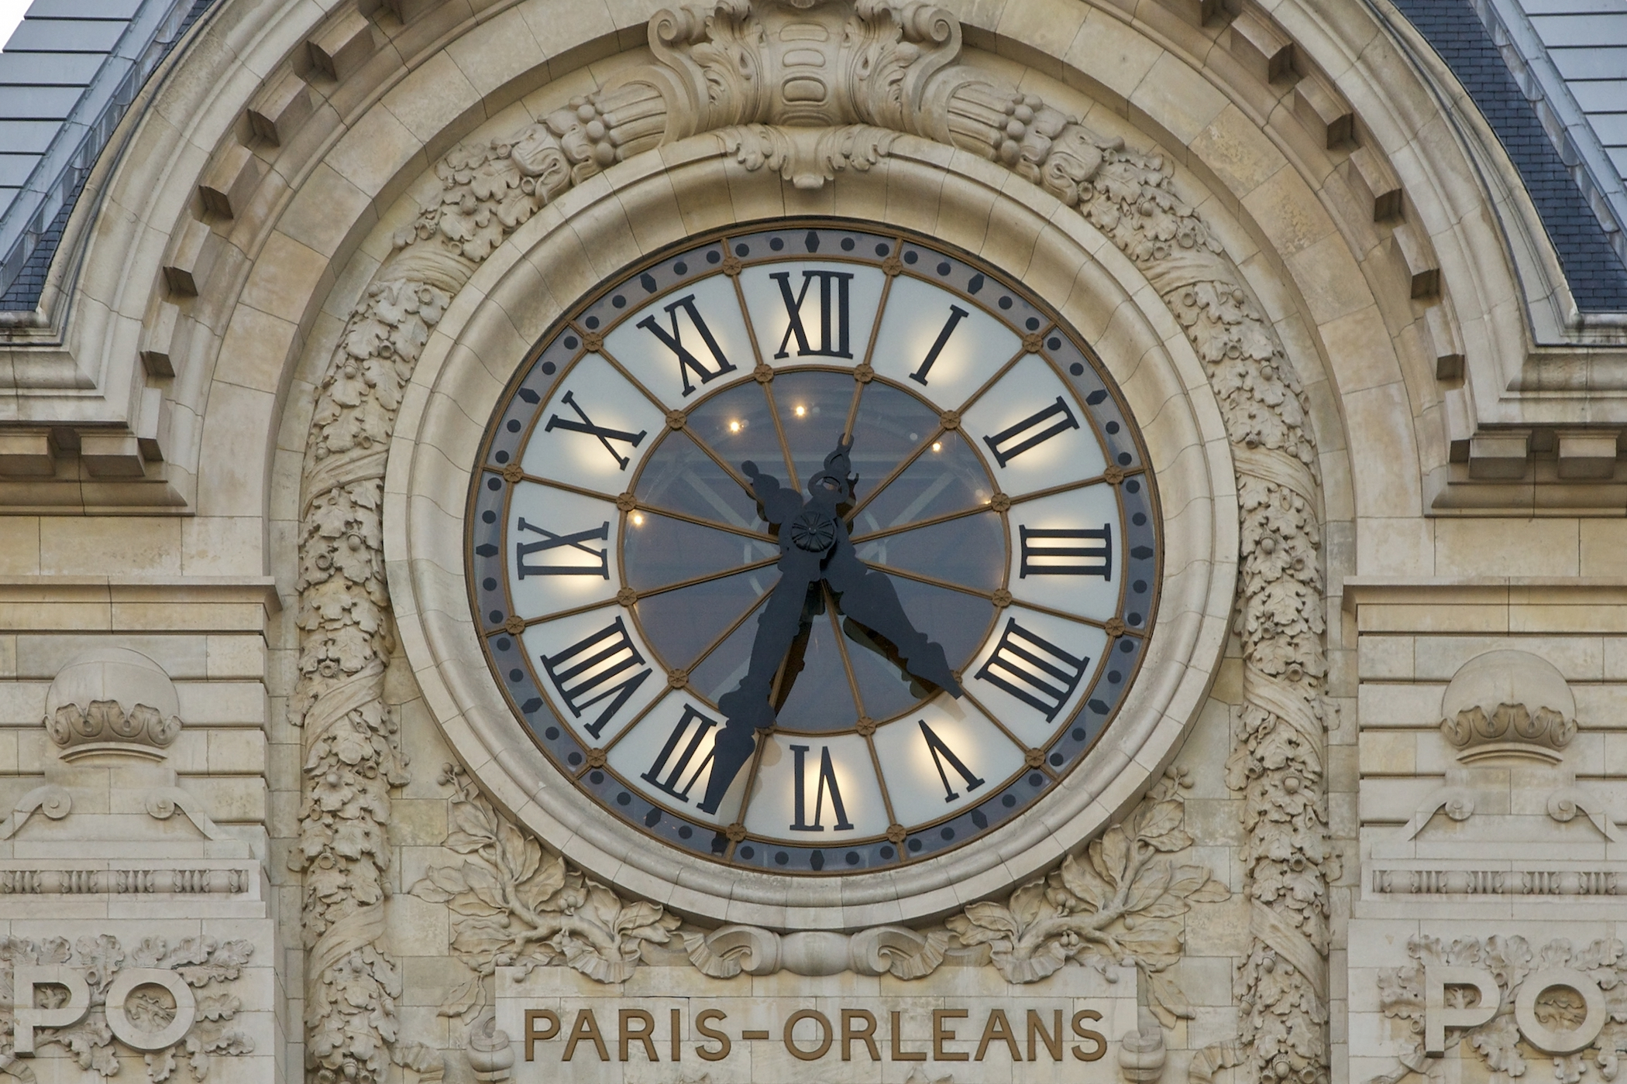

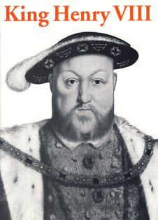
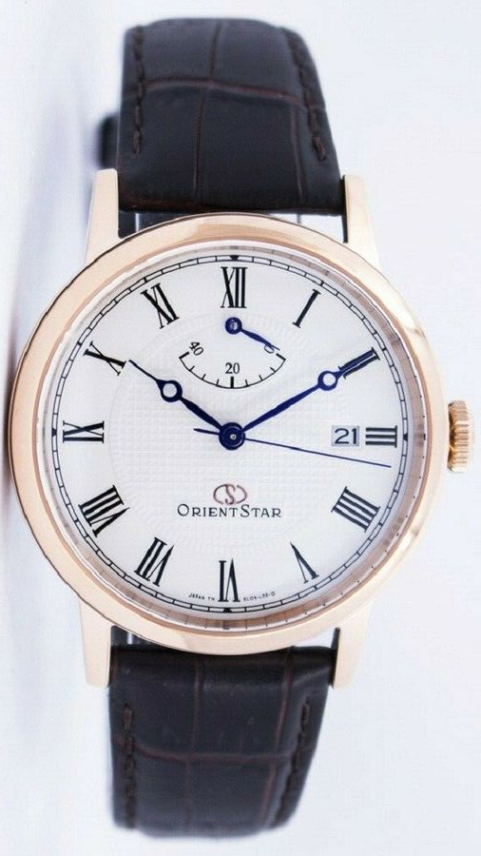
What are Roman numerals?
Roman numerals are a number system that originated in Ancient Rome. They have been around for thousands of years and are still used today.
They can be found on clocks, watches, film dates, book chapters, as bullet points and as the titles of Kings and Queens!

Slide 3
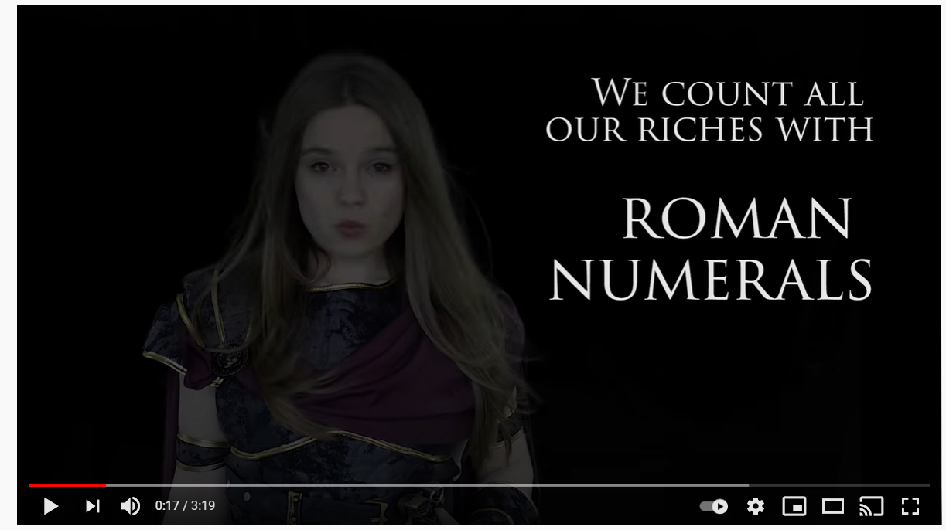

What film is this?
What do you think the Roman numeral I converts to in numbers?
Click here and watch the video to find out all about Roman numerals

Slide 4
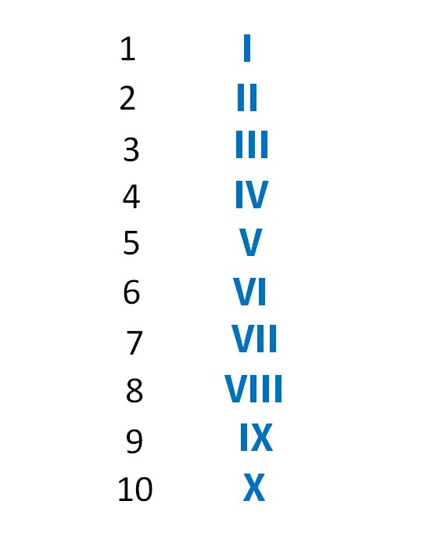
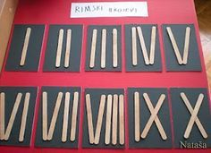
Task 1: using lollipop sticks, can you make Roman numerals and order them from 1 to 10?
Roman numerals to 10

Slide 5
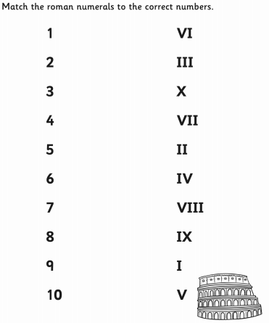
Task 2: can you match the Roman numeral to the correct number? I have done the first one for you! ☺

Slide 6
Date: Tuesday 26th January 2021
L.O. To identify Roman numerals up to 100
Subject: Maths

Slide 7

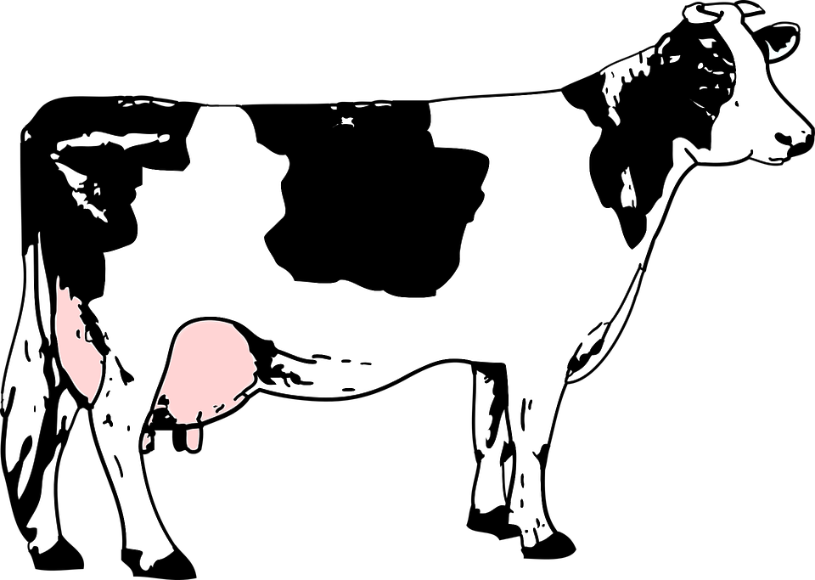
There are 7 letters used for Roman numerals…
I = 1
V = 5
X = 10
L = 50
C = 100
D = 500
M = 1,000
How can we remember them?
‘I Value Xylophones Like Cows Do Milk’
Can you think of your own way to remember them?

Slide 8

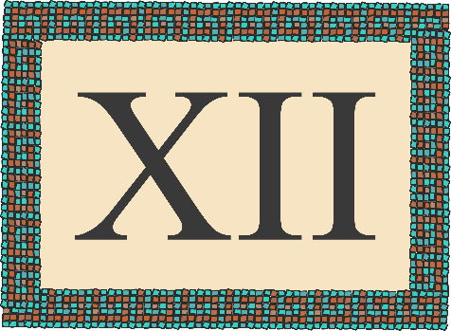



Roman Numerals Quiz...

Slide 9
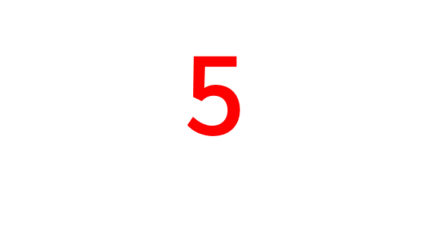







What is the Roman numeral for the number…
V
IIII
VI
NEXT

Slide 10


What is the Roman numeral for the number…
50
L
LC
XXXXVV
NEXT

Slide 11

What is the Roman numeral for the number…
100
LL
C
LCL
NEXT

Slide 12
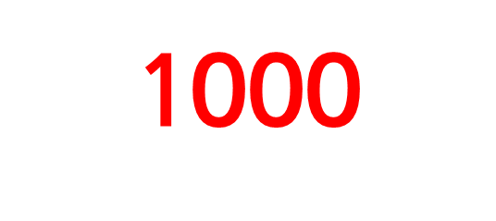
What is the Roman numeral for the number…
1000
CXC
M
CM
NEXT

Slide 13
Date: Wednesday 27th January
L.O. To convert Roman numerals into numbers
Subject: Maths

Slide 14
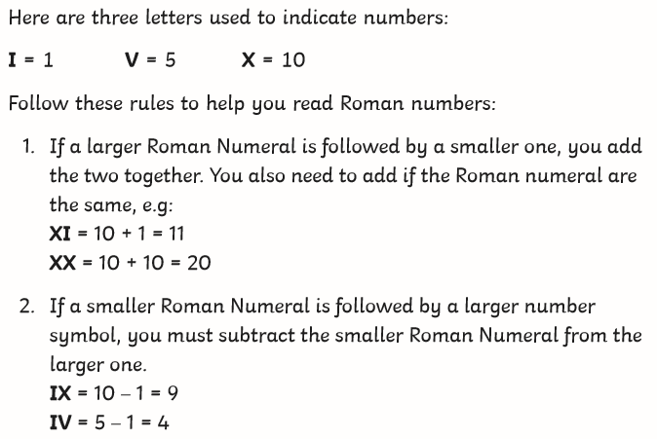
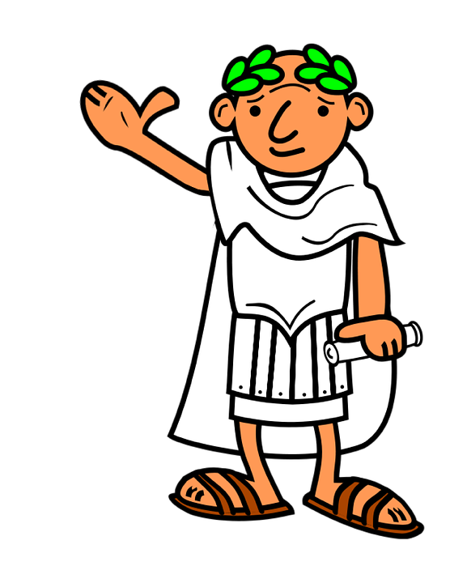
How to read Roman numerals…

Slide 15
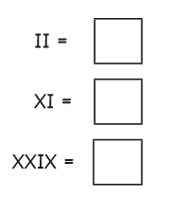
Let’s do this together…
II = 2
because I = 1 and if two numerals are the same, you add them together
1 + 1 = 2
XI = 11
because X = 10 and I = 1 and if a larger Roman numeral is followed by a smaller one, you add them together
10 + 1 = 11
XXIX = 29
because X = 10, so XX = 20
I = 1
X = 10, the I comes before the X so we subtract 1 from 10, which is 9
20 + 9 = 29
2
11
29

Slide 16
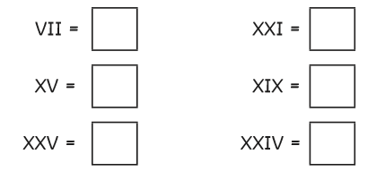
Your turn…
Convert the Roman numerals into numbers. Look back at the previous slides to help you remember the rules for converting.

Slide 17


My turn
My age: XXI
My date of birth: V1 / V / MCMXCIX
Can you work out when my Birthday is?
Your turn! Write the following numbers using Roman numerals:
Your age:
Your date of birth:
Today’s date:

Slide 18
Date: Thursday 28th January
LO. To complete number sentences using Roman numerals
Subject: Maths

Slide 19

My turn…
1. XX + XII = ?
First, work out what the numerals convert to in numbers.
XX = 20
XII = 12
Then you can work out 20 + 12.
20 + 12 = 32
32 in Roman numerals is XXXII
So… XX + XII = XXXII
Tip!
Use the column method to help you add the numbers together!

Slide 20
Your turn…
Addition up to 20 – can you solve the Roman numeral number sentences?
I + II =
V + I =
X + III =
I + X =
V + V =

Slide 21
Your turn…
Addition up to 100 – can you solve the Roman numeral number sentences?
XXV + XXV =
XVII + XII =
LVII + I =
XXXII + VI =
XXVI + IV =

Slide 22

My turn…
1. XX – XII = ?
First, work out what the numerals convert to in numbers.
XX = 20
XII = 12
Then you can work out 20 – 12.
20 – 12 = 8
8 in Roman numerals is VIII
So… XX – XII = VIII
How to subtract?
You could use…
A number line
The column method

Slide 23
Your turn…
Subtraction within 20
Have a go at completing the Roman numeral number sentences below.
X – I =
V – II =
XI – V =
XX – V =
VIII – IV =

Slide 24
Your turn…
Subtraction within 100
Have a go at completing the Roman numeral number sentences below.
XXXIV – XX =
LV – V =
LXXV – XXI =
C – XXX =
L – XXV =

Slide 25
c
Date: Thursday 21st January
Date: Friday 29th January
LO. Roman numerals consolidation
Subject: Maths

Slide 26
Can you crack the code? Work out what the Roman numeral converts to in numbers and see if you can crack the code!
1 | 2 | 3 | 4 | 5 | 6 | 7 | 8 | 9 | 10 | 11 | 12
A | B | C | D | E | F | G | H | I | J | K | L
13 | 14 | 15 | 16 | 17 | 18 | 19 | 20 | 21 | 22 | 23 | 24 | 25 | 26
M | N | O | P | Q | R | S | T | U | V | W | X | Y | Z
XXV XV XXI XVIII V I XX XVIII XXI V XVIII XV XIII I XIV !
___ __ ___ _____ _ _ __ _____ ___ _ _____ __ ____ _ ___ !

