Slide 1


Slide 2




8.2.2021
L.O. To be able to recognise money.
Go to Times Tables Rock Stars to warm up your number brain before you start your maths activity.
Subject: Maths

Slide 3
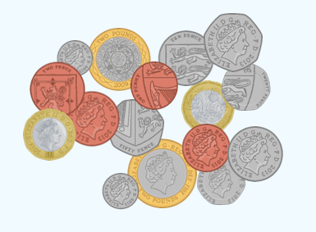

This week we will be learning about money. Have a think about the follow questions before we start.
What different coins can you see here?
What is the smallest/
largest amount?
Thinking time
What different amounts could you make with these coins?
How do you write amounts of money?

Slide 4
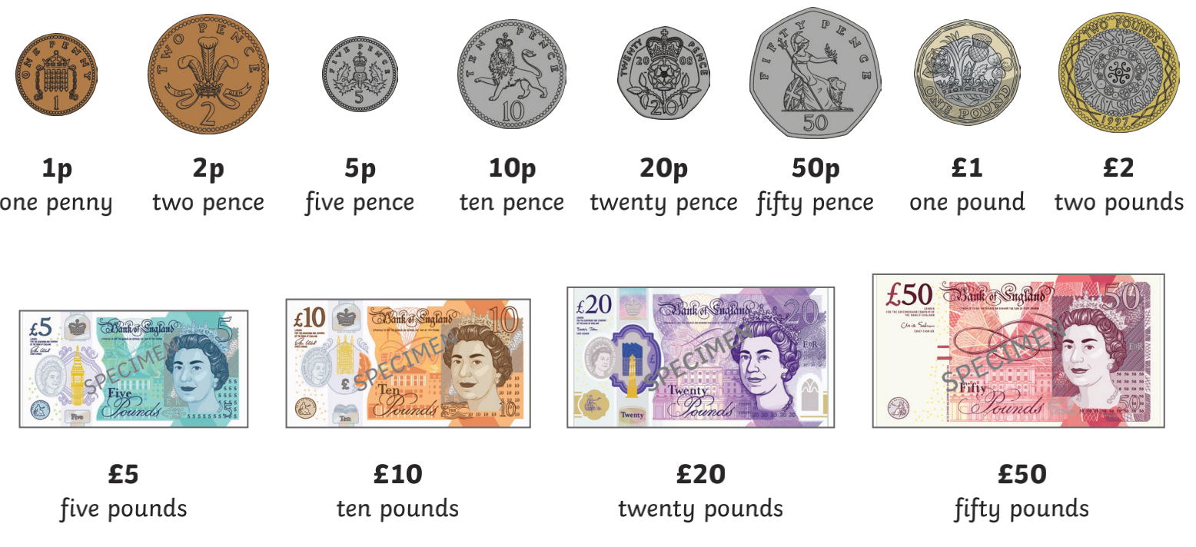

Here is the coins and notes that we use.
£1 = 100p
money can be written in both pounds and pence.
£2.50 is the same as 250p £5.42 is the same as 542p
x100 to work out how many pence so move the decimal point 2 places

Slide 5
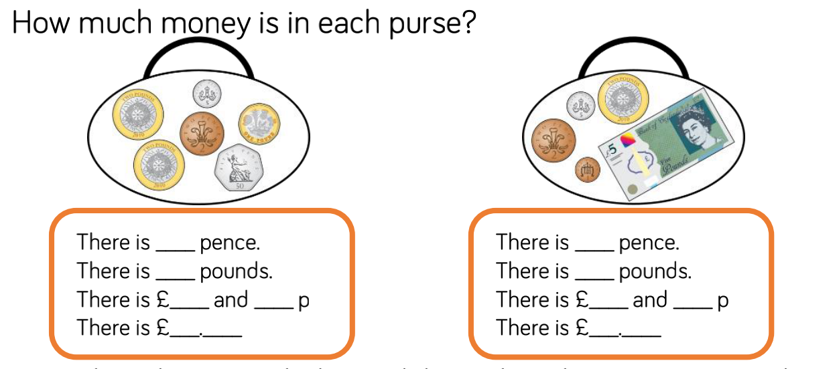

add the pence and pounds separately

Slide 6
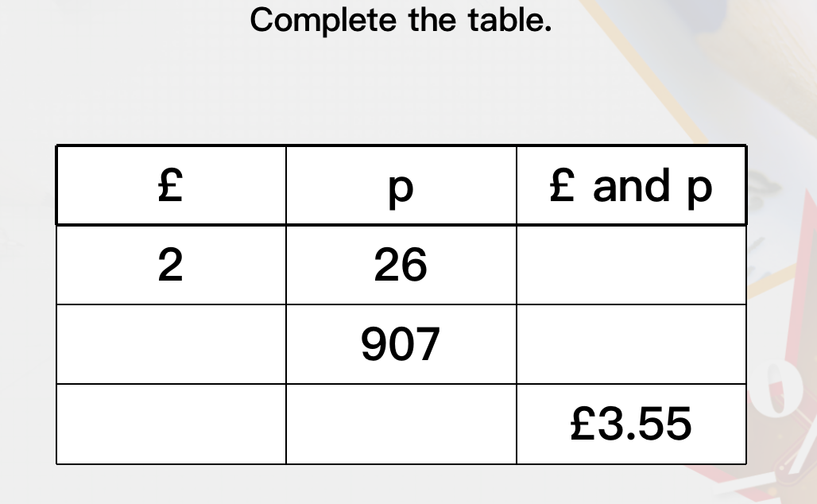
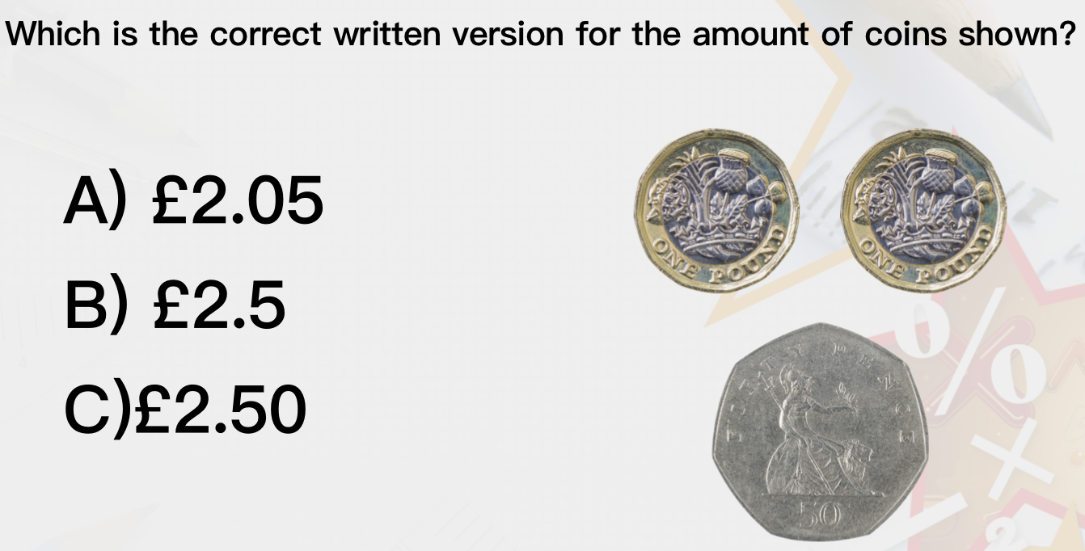
×

Slide 7
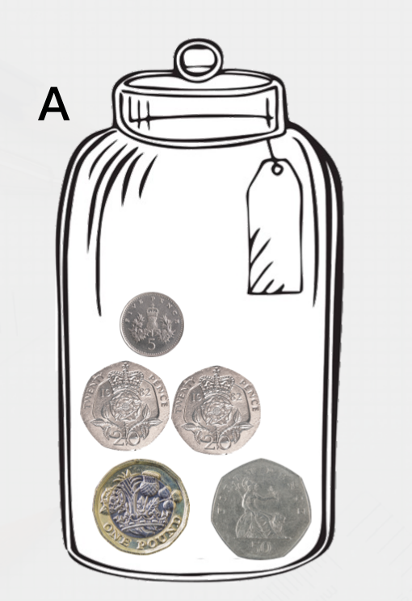
How much money is in the jar?
HINT- Add the £1 first and then add the pence
£1
50p + 20p + 20p + 5p
£___.____
5p
20p
£1
50p

Slide 8
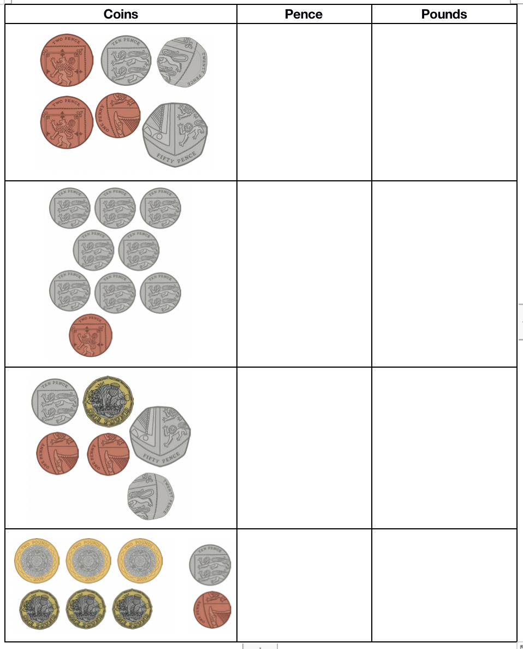
Work out how much money is in each box- show your answers in both pounds and pence
e.g. - 54p = £0.54
HINT- make the pounds first

Slide 9
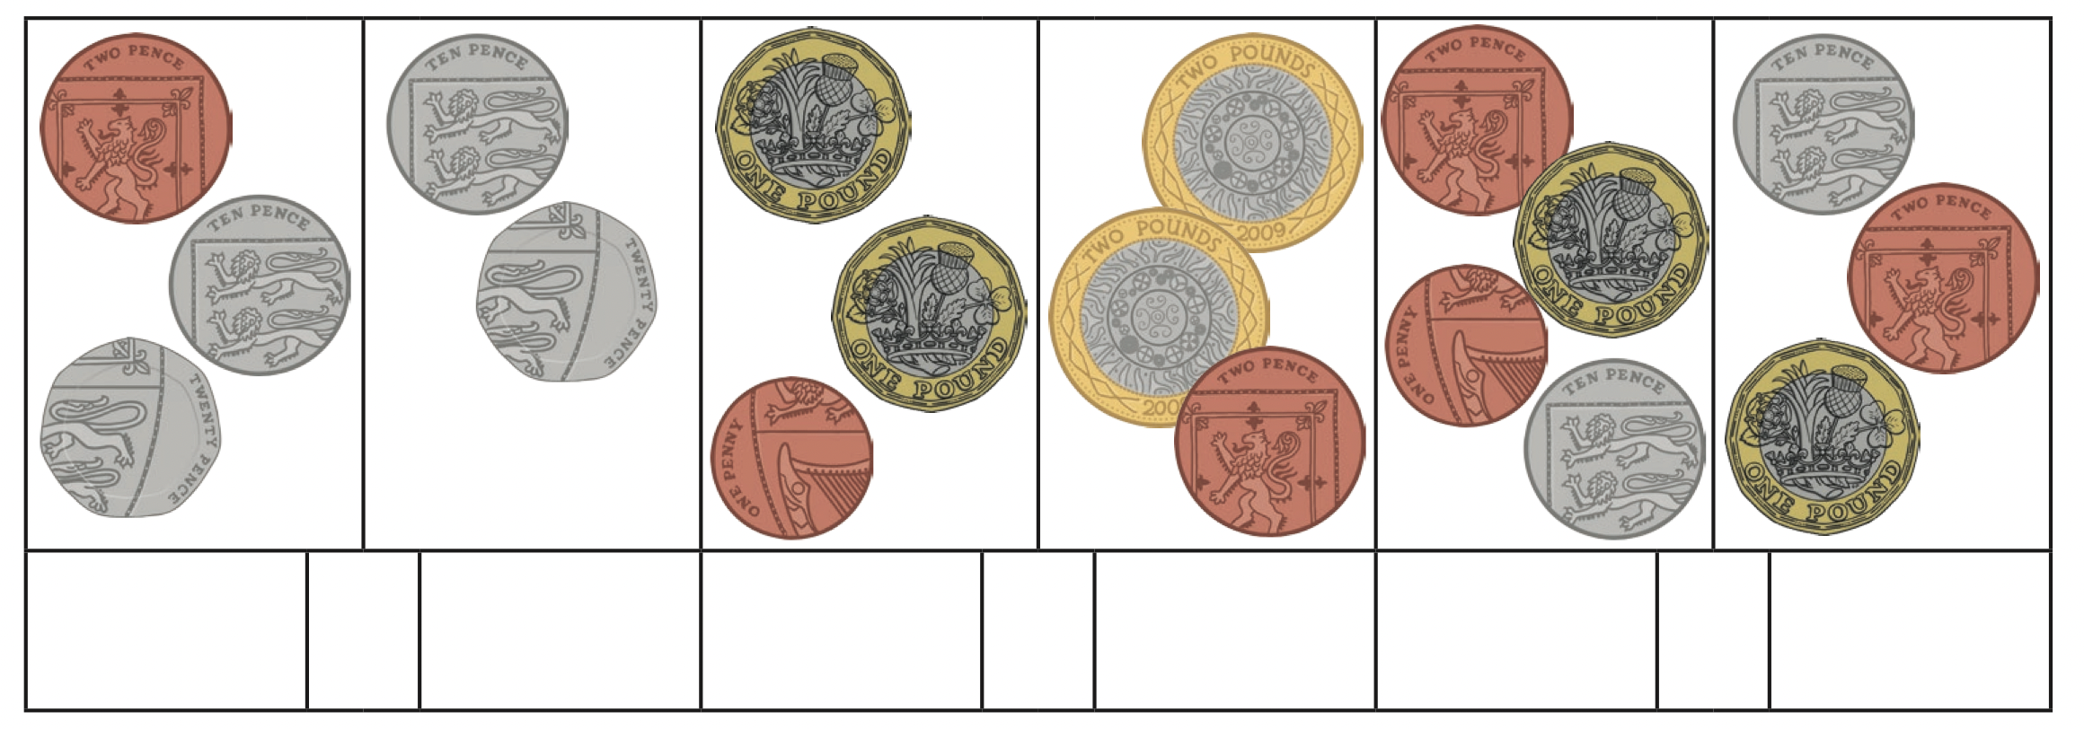
Work out the amounts add the greater than > and less than < to compare

Slide 10
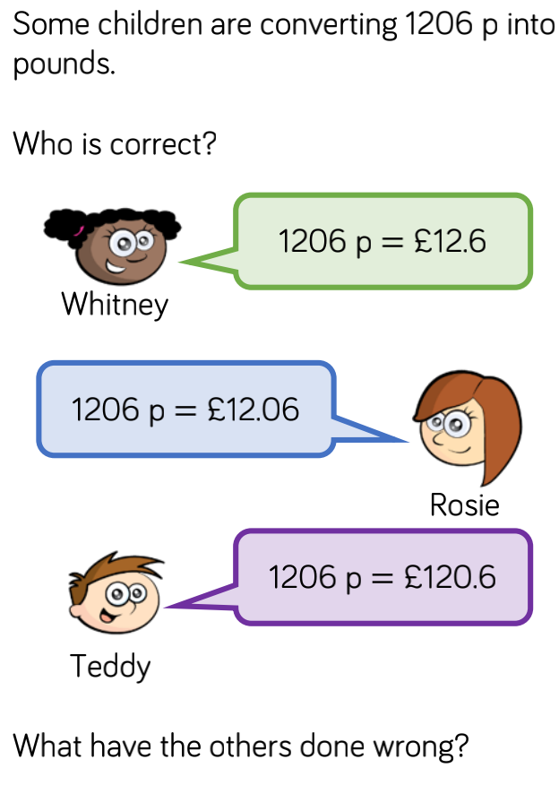
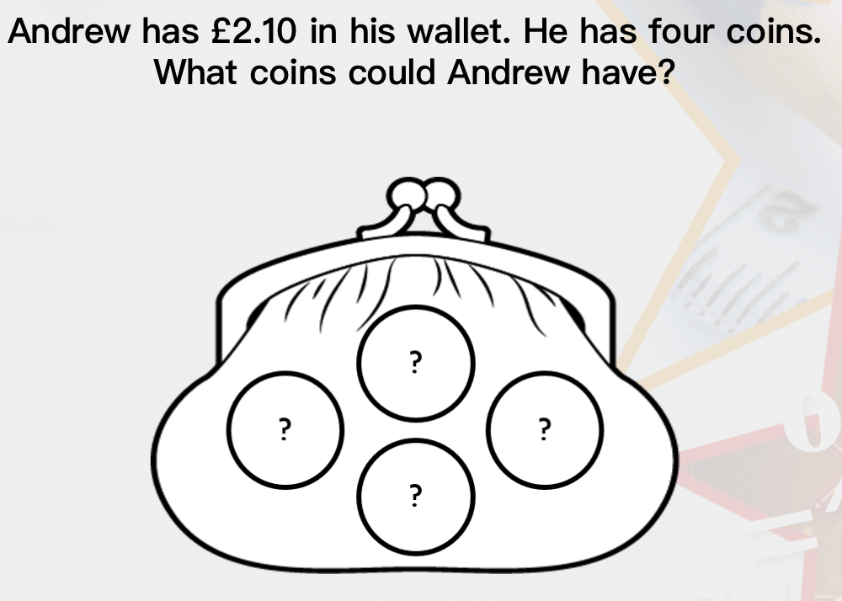
Extensions
____________________________________________________________________________________________________________________________________________________

Slide 11
9.2.2021
L.O To be able to round to estimate amounts
Go to Times Tables Rock Stars to warm up your number brain before you start your maths activity.
Subject: Maths

Slide 12
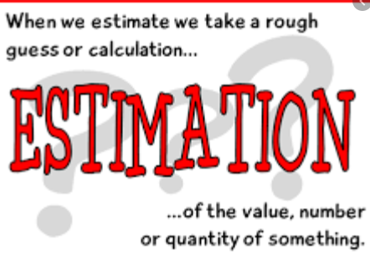
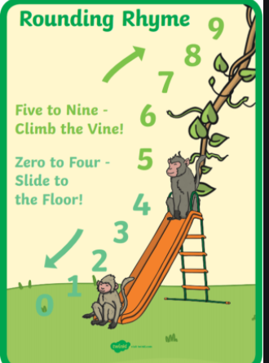
When we buy something, we often round to the nearest pound
To work this out, we look for the number after the decimal place
£1.32 - 32p is closer to £1 than £2
£1.82 - 82p is closer to £2 than £1
Think back to this rhyme to help you with rounding

Slide 13
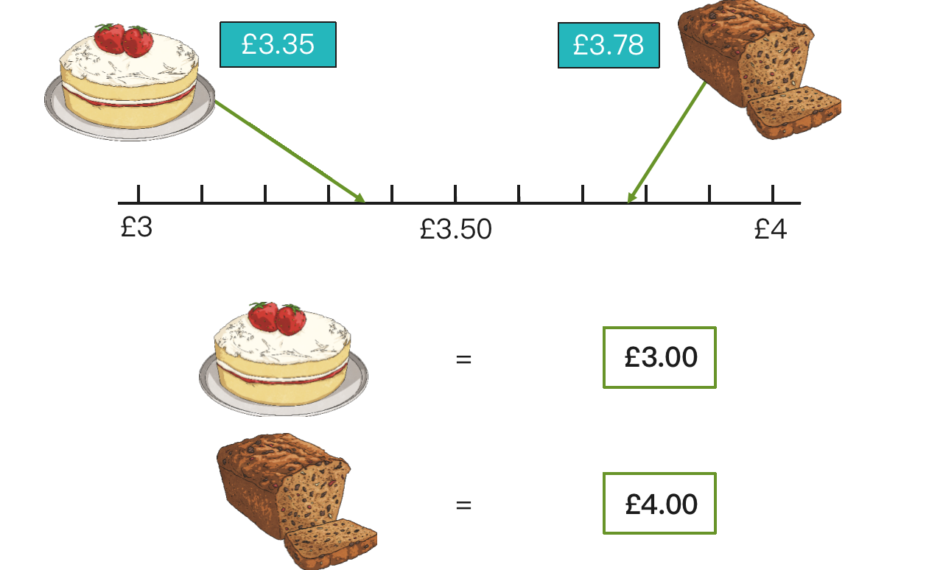
Why do we round amounts of money?
To think of money to the nearest pound (£) it makes it easier to add money together quickly
If you were shopping and had £10 to spend, rounding and estimating would help you know how much you had spent and how much change you would have.
This will give you idea that you have roughly spent £7 and would have £3 change.
Using a number line like this is a helpful way of rounding

Slide 14
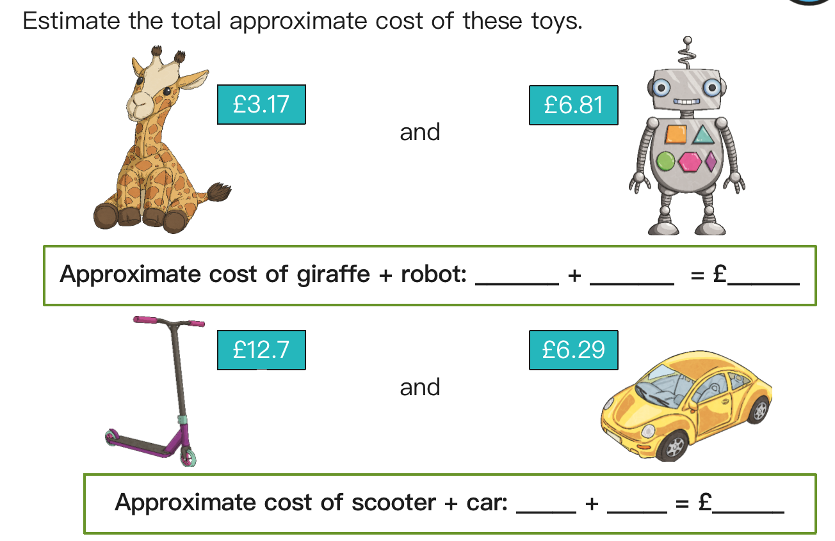
Approximate means close to the actual but not exact or accurate

Slide 15
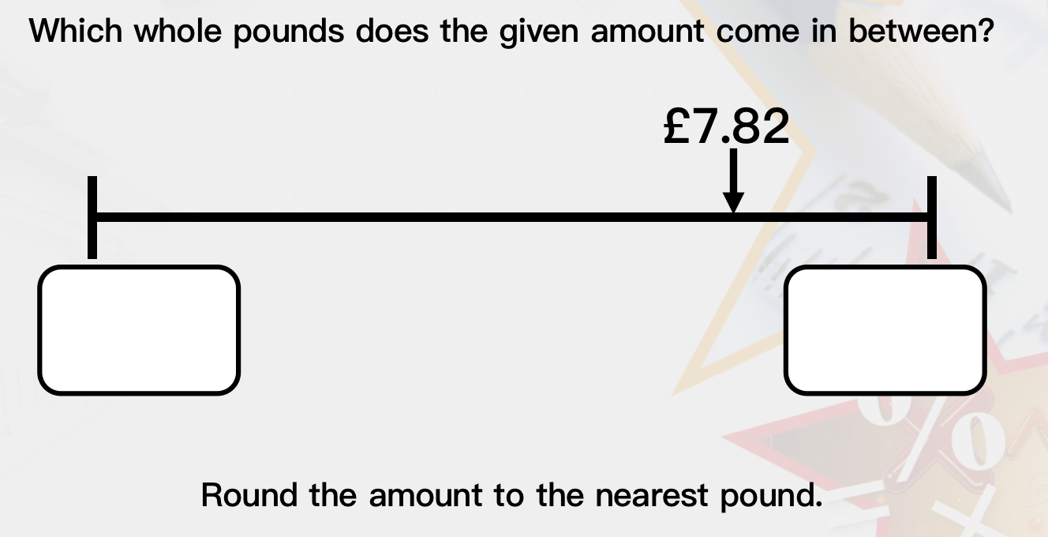
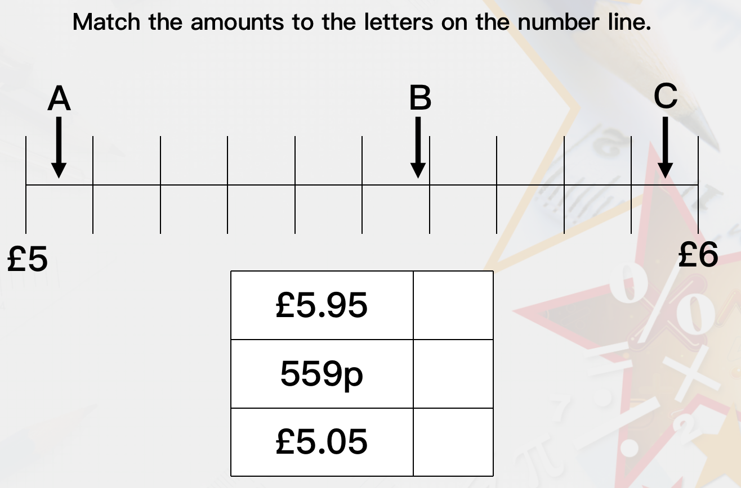

Slide 16
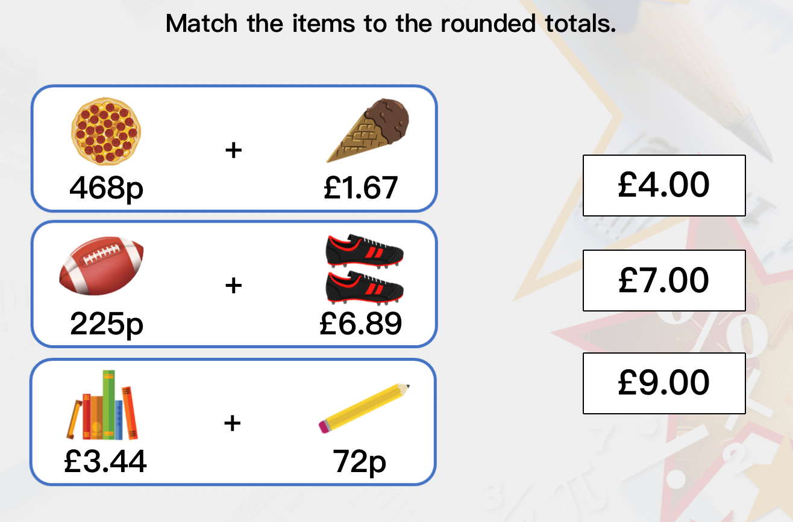
Think back to yesterday when we converted into £ and p
468p = £4.68

Slide 17
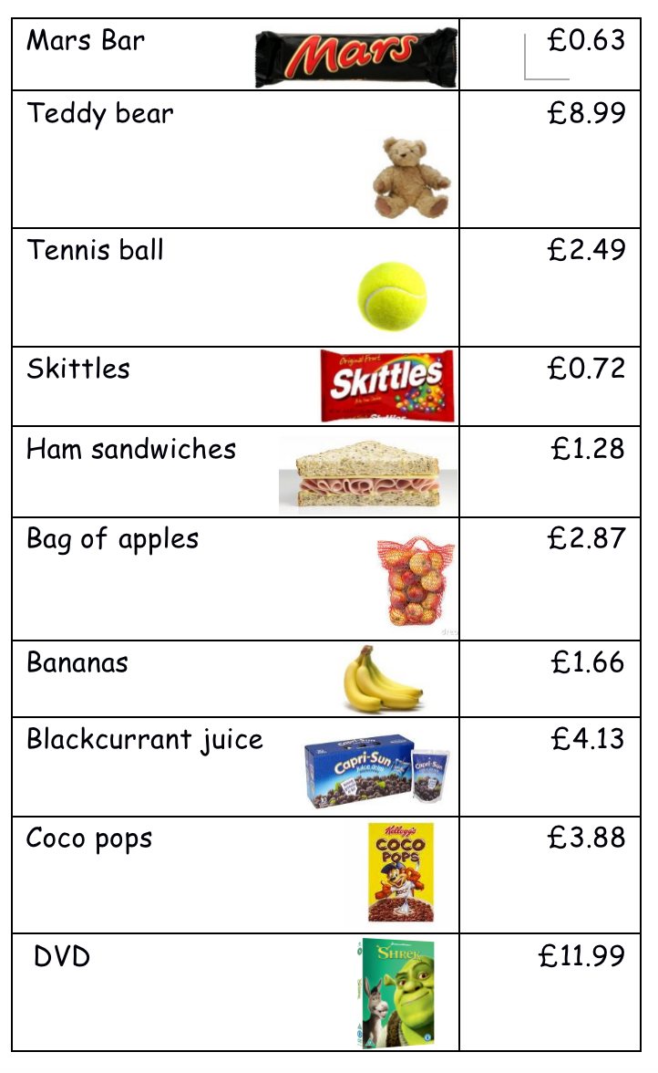
Use the shopping list to fill out the table below.
The first one has been done for you.
Item | Actual price | Estimate
Mars Bar | £0.63 | £1
Teddy
Tennis Ball
Skittles
Sandwiches
Apples
Bananas
Juice
Coco pops
DVD

Slide 18
Now use your estimated answers to answers these questions.
What is the approximate price for ...
1. A ham sandwich and a Mars Bar
________________________________________
2. A DVD and bananas
_______________________________________
3. Blackcurrant juice and skittles
_______________________________________
4. Apples and Coco Pops
_______________________________________
5. Make a list of items you could buy for £6 _______________________________________
_______________________________________
_______________________________________

Slide 19
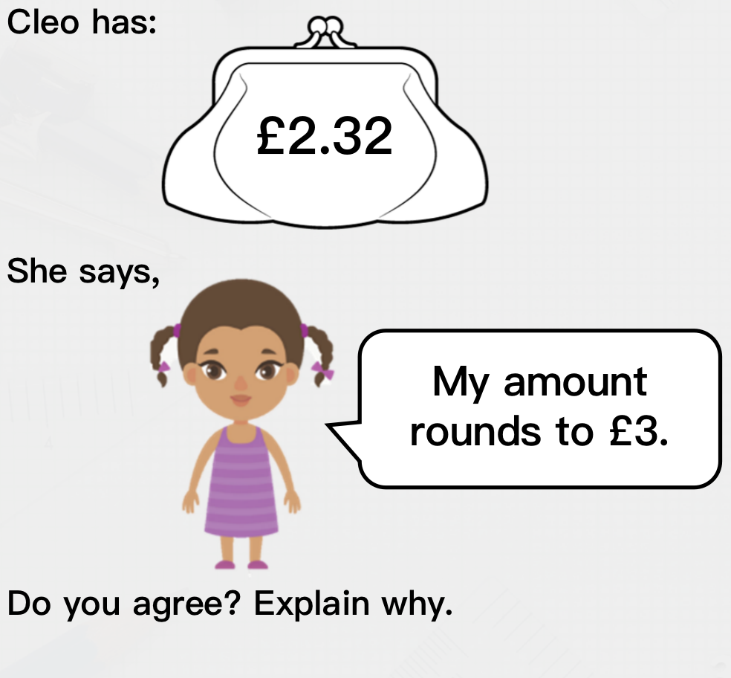
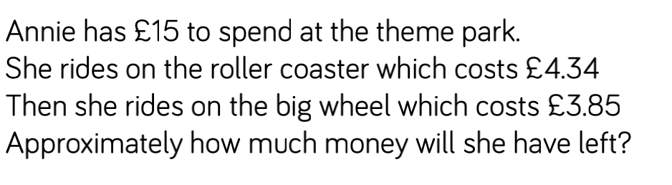
Extensions
________________________________________________________________________________________________________________________________________________________________________________________________

Slide 20
10.2.2021
L.O To be able to add amounts of money
Go to Times Tables Rock Stars to warm up your number brain before you start your maths activity.
Subject: Maths

Slide 21
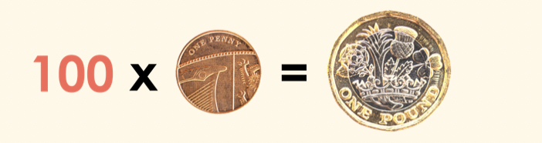
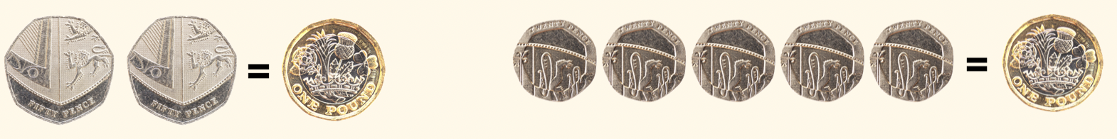
Before we start adding and subtracting amounts of money, we need to be confident in understanding the value of a £
REMEMBER- £1 = 100p
There a different ways we can make a £1
50p + 50p = £1 20p x 5 = £1
Can you think of any other ways that we can make £1?

Slide 22
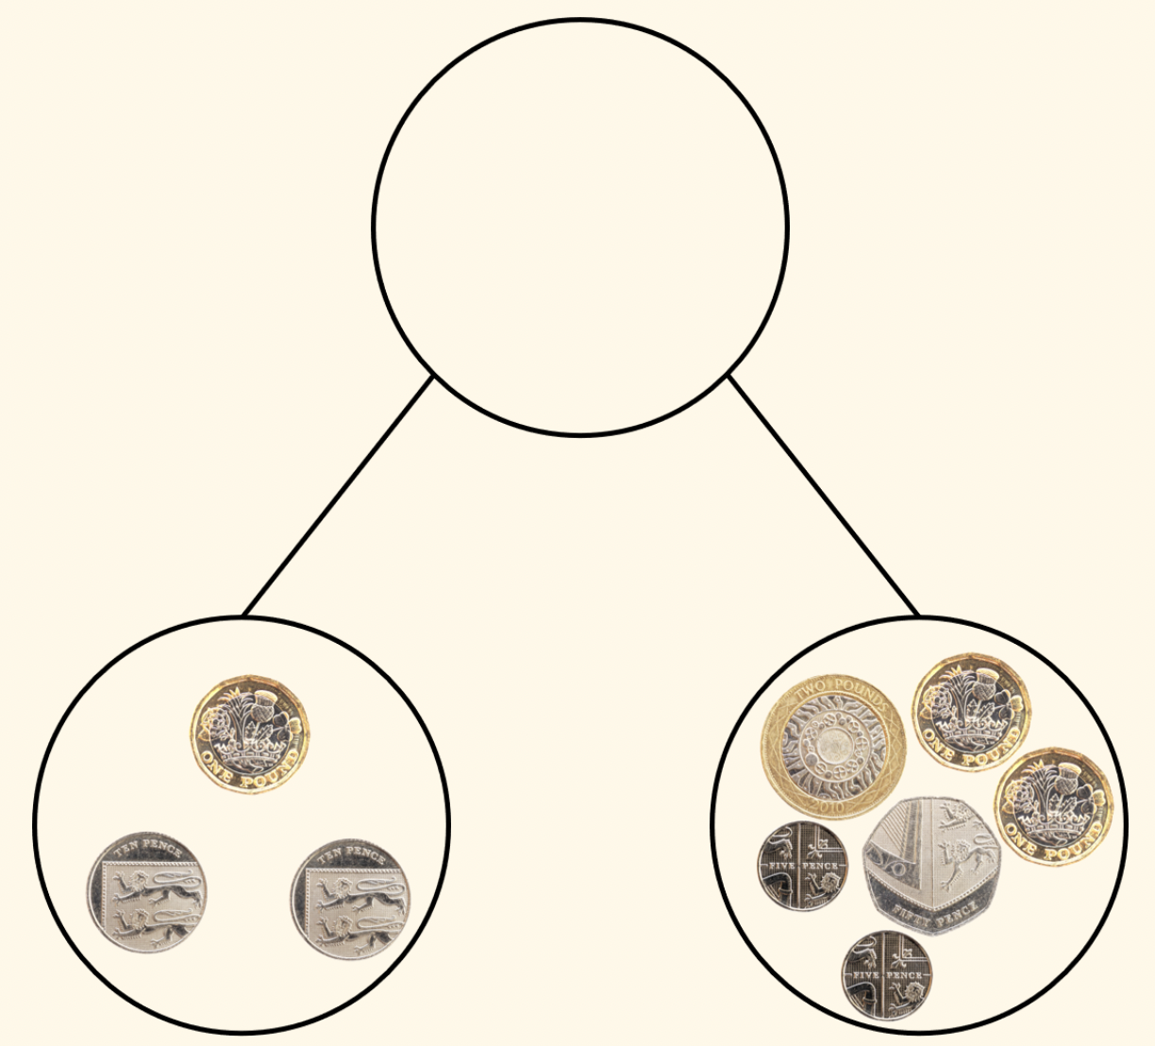
When we are adding and subtract money, it is helpful to work look at the pounds and pence separately
EXAMPLE
£5.80
Here we had the pounds first and then the pence
£1 + £4 = £5
60p + 20p = 80p
£5 + 80p = £5.80
£4.60
£1.20

Slide 23
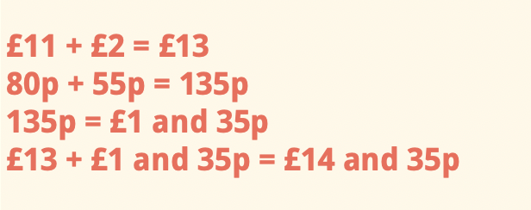
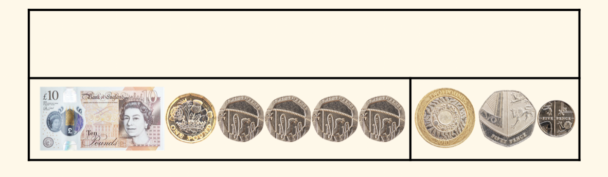
Calculations become more difficult when we have to exchange (when the pence goes over a £)
EXAMPLE
£14.35
£11.80
£2.55
Again we have added the pounds first
But in this example the pence equal higher than £1 (100p)

Slide 24
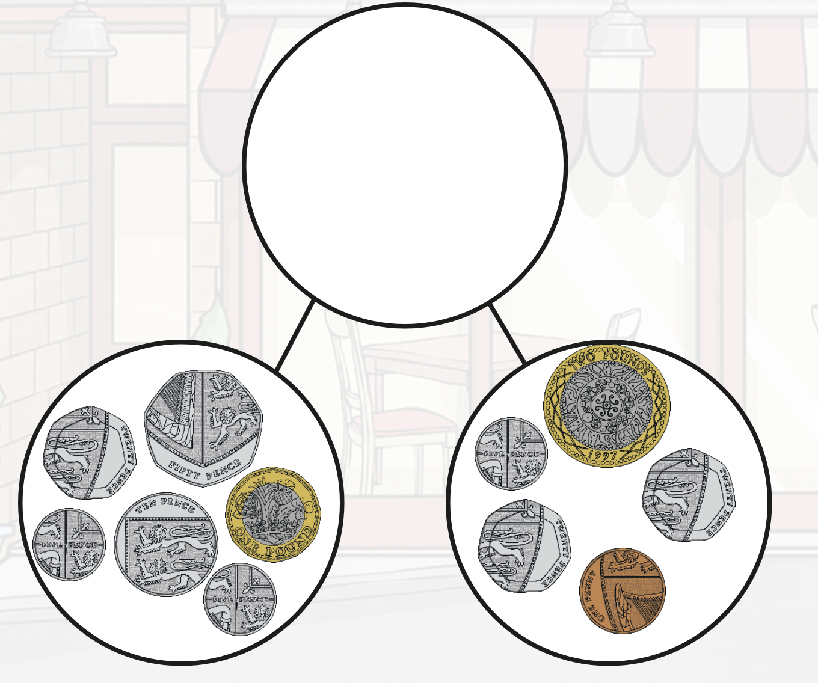
use the examples on the previous slides to help you
work out the 2 amounts
add the pounds first
HINT- you will need to exchange

Slide 25
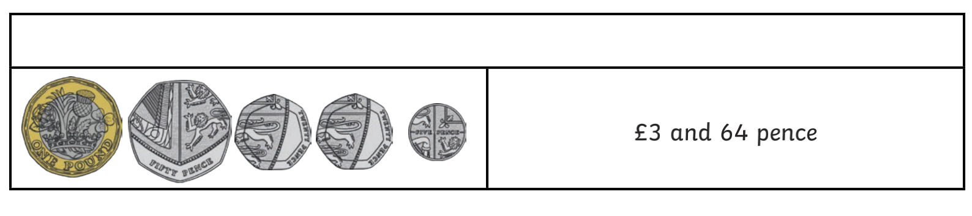
Add the 2 bottom amounts to find the total in this bar model

Slide 26
£2.50 + £3.44 =
£6.36 + £2.35 =
£9.20 + £3.49 =
£10.50 + £5.45 =
£7.60 + £2.60 =
£8.75 + £3.50 =
£9.60 + £5.55 =
£10.85 + £6.40 =
Remember to add the pounds and then add the pence
If you have any coins about at home, you could use these to help you
Example
You could use this example to help you out
£2.50 + £3.62
£2 + £3 = £5
50p + 62p = 112p
112p = £1.12
£5 + £1.12 = £6.12
Questions 5 – 8 require
exchanges

Slide 27
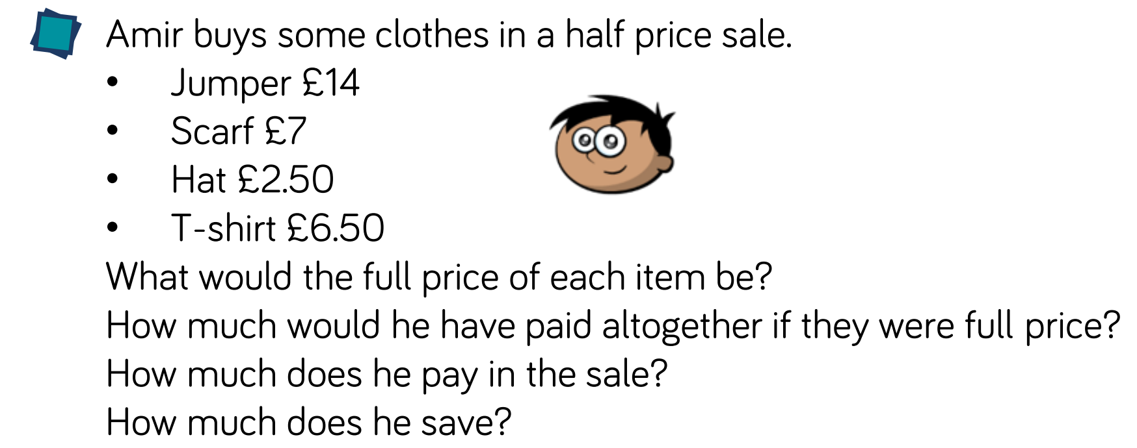
Extension
There a few different parts to this extension so make sure you read carefully

Slide 28
11.2.2021
L.O To be able to subtract amounts of money
Go to Times Tables Rock Stars to warm up your number brain before you start your maths activity.
Subject: Maths

Slide 29
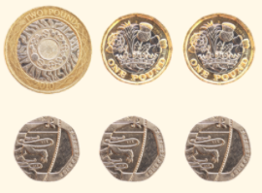
Today we are subtracting amounts of money.
We will work with pounds and pence separately like we did yesterday.
£4.60 - £2.40
£4 - £2 = £2
60p – 40p = 20p
£4.60 - £2.40 = £2.20

Slide 30
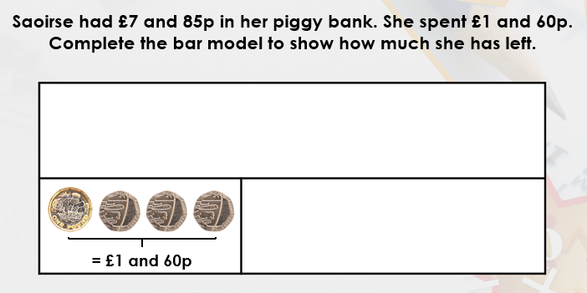
Use the method on the previous slide to work this out.
£ then pence
£7.85

Slide 31
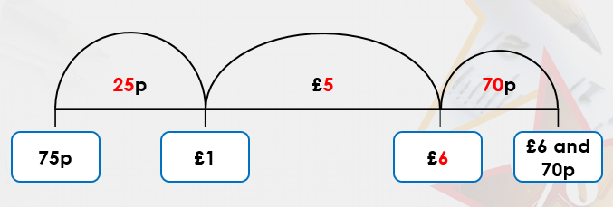
If the sums are not as easy to take away,
we can use a number line to help us.
£6.70 – 75p =
In this example we have started at 75p and are counting up to work out the difference
Jump 1- how much to add until you get to the next pound
Jump 2- how much to add until you get to the £6
Jump 3- how much to add until you get to £6.70
Then add the amounts together at the top of the number line - £5 + 25p + 70p = £5.95
£6.70 – 75p = £5.95

Slide 32
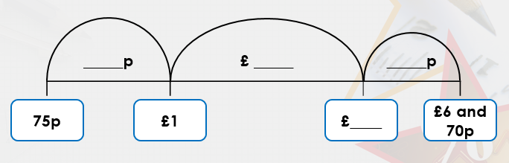
£4.50 - £1.63 =
Have a go using the number line to work out this sum.
I have done the sets at the bottom for you.
£1.63
£2
£4
£4.50

Slide 33
£7.30 - £2.85 =
Now try this one using the same method
£2.85
£7.30

Slide 34
£8.60 - £2.30
£10.50 - £1.35 =
£9.70 - £3.50 =
£12.45 - £6.30 =
5. £10.40 - £2.55 =
6. £11.25 - £3.60 =
7. £15.50 - £5.55 =
8. £12.20 - £4.45 =
You should be able to work the first 4 out by taking away the pounds and then the pence
There are some blank number lines on the next slide to help you with numbers 5-8

Slide 36
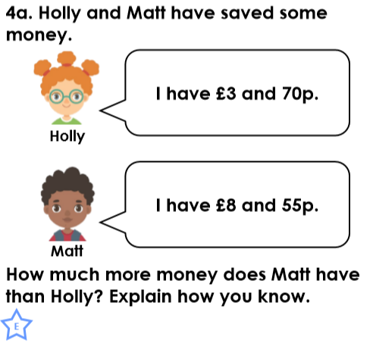
Extension
You may need a number line to work this out.

Slide 37
12.2.2021
L.O To be able to recall facts for the 7 times table
Go to Times Tables Rock Stars to warm up your number brain before you start your maths activity.
Subject: Maths

Slide 38

Pre-recorded Teaching
Access the online teaching video below that will support you to complete the work in this lesson. This video will act as a support but all of the work can still be successfully understood & completed using paper-based versions of this pack. If you need further support to understand / complete work then please contact school via e-mail or telephone.
Play Video
You can also copy and paste this link if you would prefer:
https://teachers.thenational.academy/lessons/representing-the-seven-times-table-ctk30t?from_query=7+times+table

Slide 39
Before we start looking at the 7 times table, we will recap the 6 times tables!
Circle the numbers you will find in the 6 times table
6
79
There is also a 6 times table video on the Pathfinders page on our school website
37
66
30
55
72
18
50
Thinking time
16
42
42
49

Slide 40
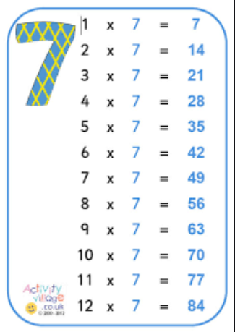
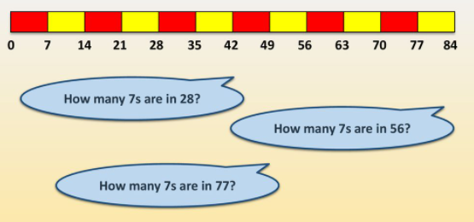
Here is the 7 times table.
Have a go chanting the table to help you remember it!

Slide 41
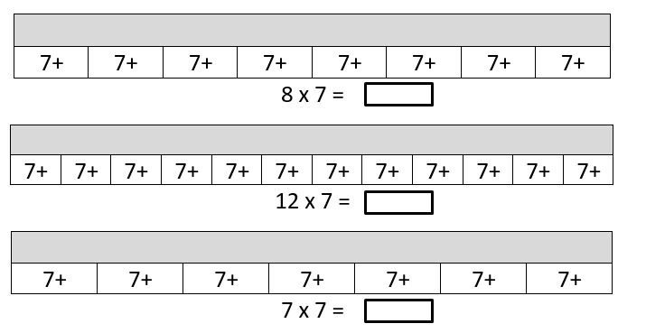
Fill in the bar models with the correct answers

Slide 42
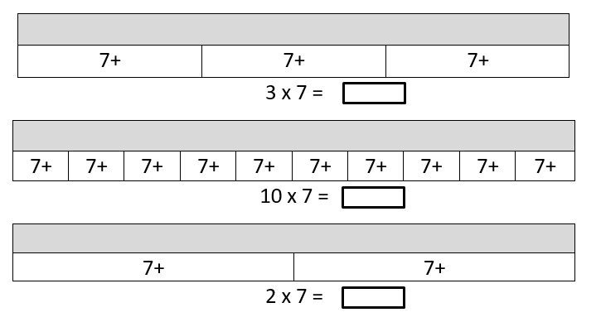
Fill in the bar models with the correct answers

Slide 43
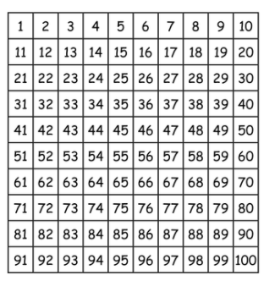
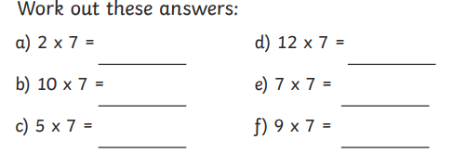
Find all the multiples of 7 on the 100 square
You can colour the multiples in or draw a circle

Slide 44
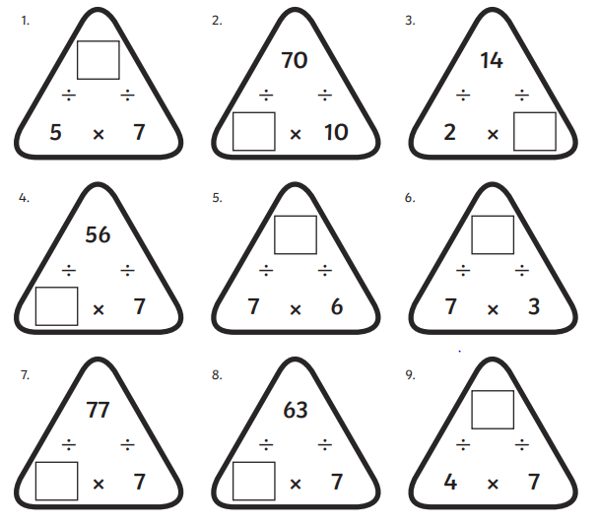

Slide 45
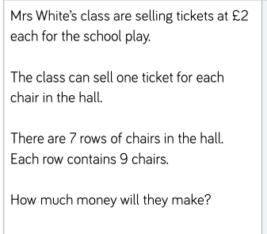
Extension
There are 2 parts to this question
Read it carefully ☺

