Slide 1

Subject: Maths
Pack: A

Slide 2



1.2.2021
L.O To be able to describe 2D shapes
Go to Times Tables Rock Stars to warm up your number brain before you start your maths activity.
Subject: Maths

Slide 3
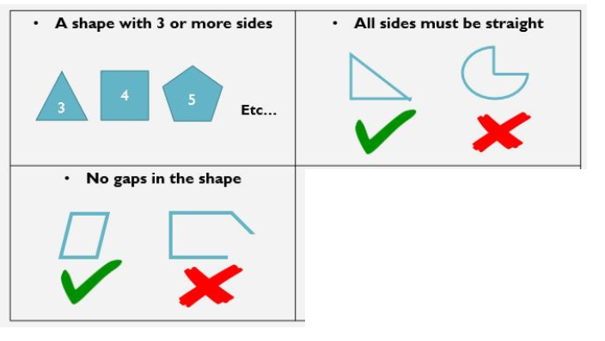

What is a Polygon? ….
If a polygon has 4 sides, it is also known as a
quadrilateral

Slide 4
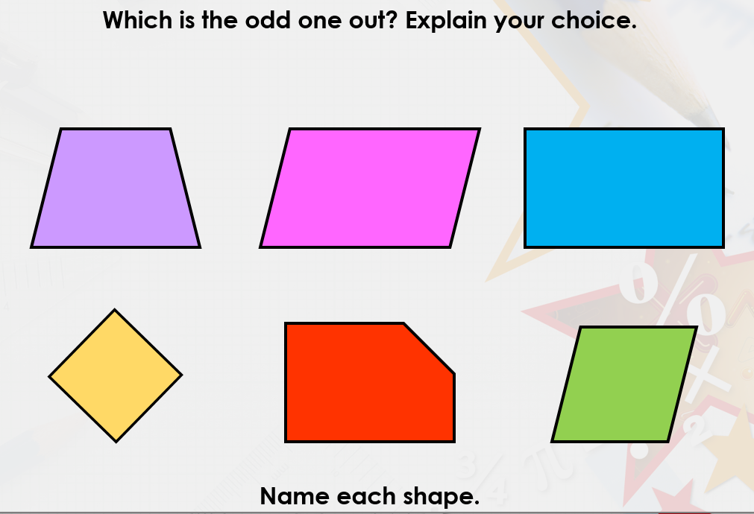

Thinking time

Slide 5
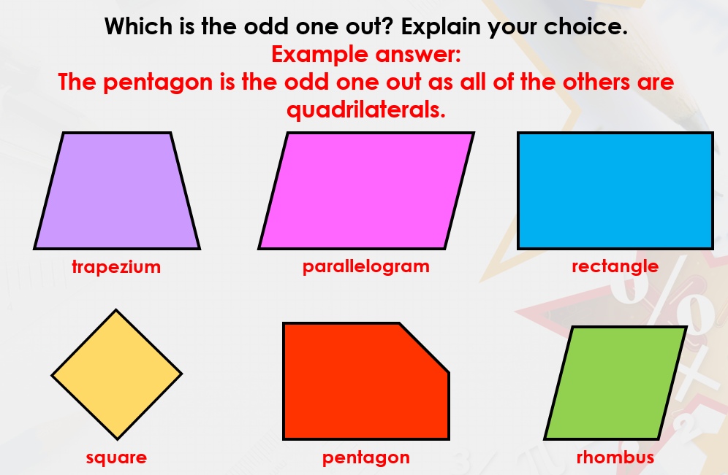

Slide 6
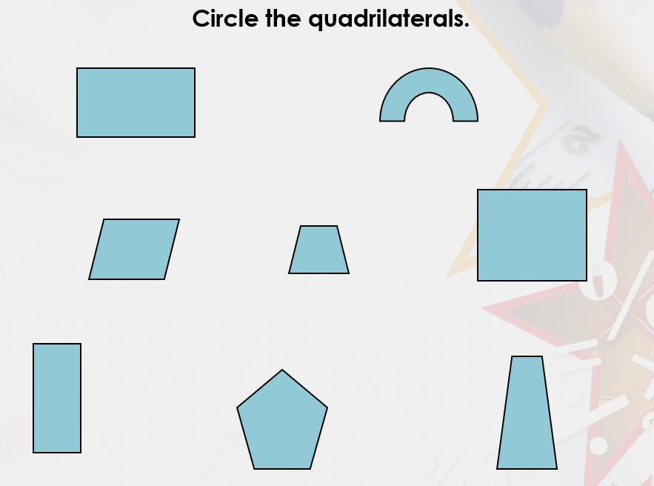

A
B
Identify which shapes are
Quadrilaterals
Remember that the sides must be straight
How do you know which shapes are not quadrilaterals?
C
D
E
F
G
H

Slide 7


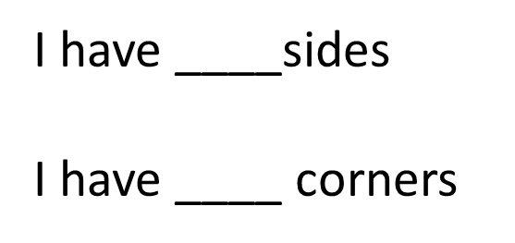

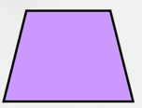
Find the properties of these polygons
I have ____sides
I have ____ corners
Pentagon
Hexagon
Octagon
Trapezium

Slide 8





Shape | Name of shape | Number of sides | Number of corners | Is it a quadrilateral?

Slide 9
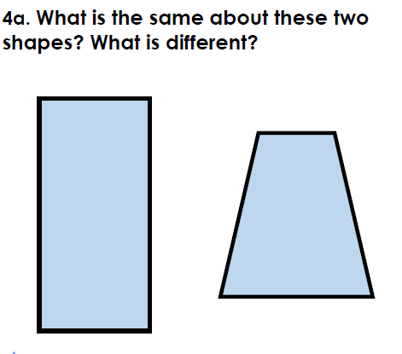
Challenge
____________________________________________________________________________________________________

Slide 10
2.2.2021
L.O To be to recognise lines of symmetry
Go to Times Tables Rock Stars to warm up your number brain before you start your maths activity.
Subject: Maths

Slide 11
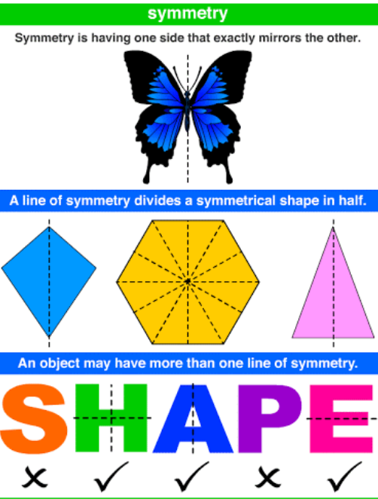

Slide 12
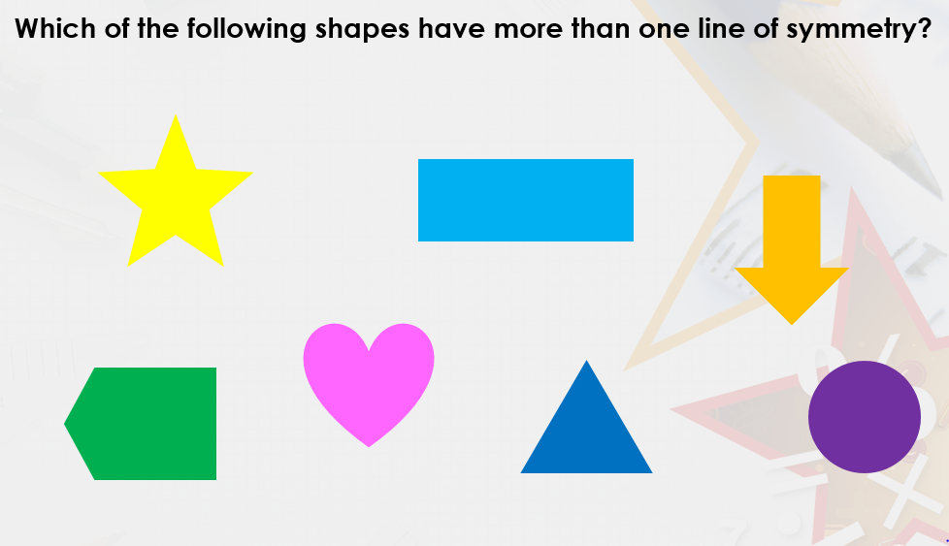
Thinking time

Slide 13
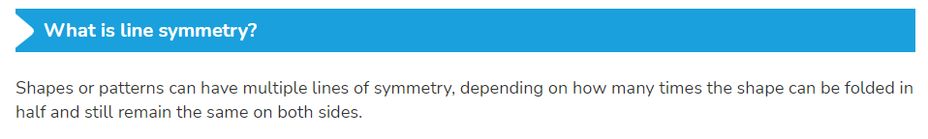
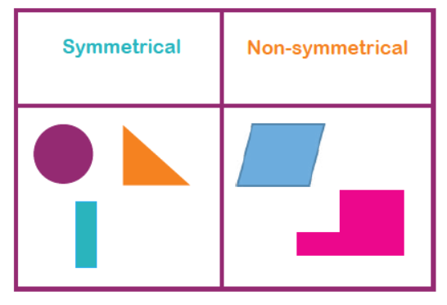
Look at these shapes
The non-symmetrical shapes cannot be folded in half and still remain the same.
Can you see where the lines of symmetry would be in the symmetrical shapes?

Slide 14
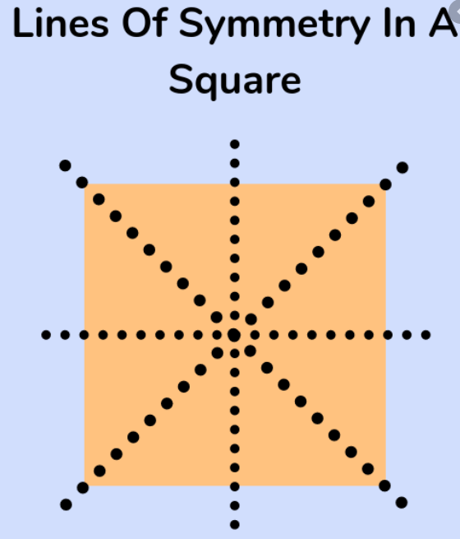

The lines of symmetry can go in any direction- they can be vertical, horizontal or diagonal
How many lines of symmetry does a square have? __________________

Slide 15
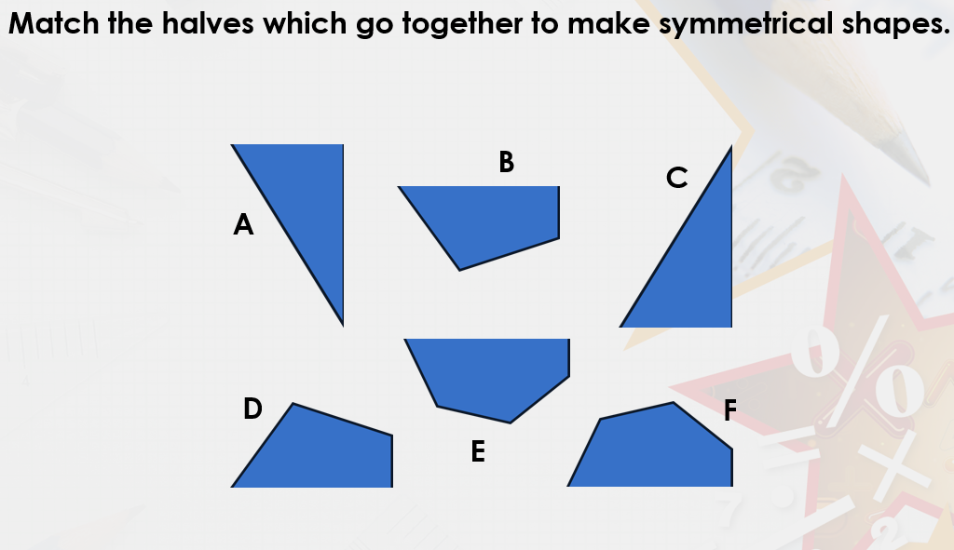
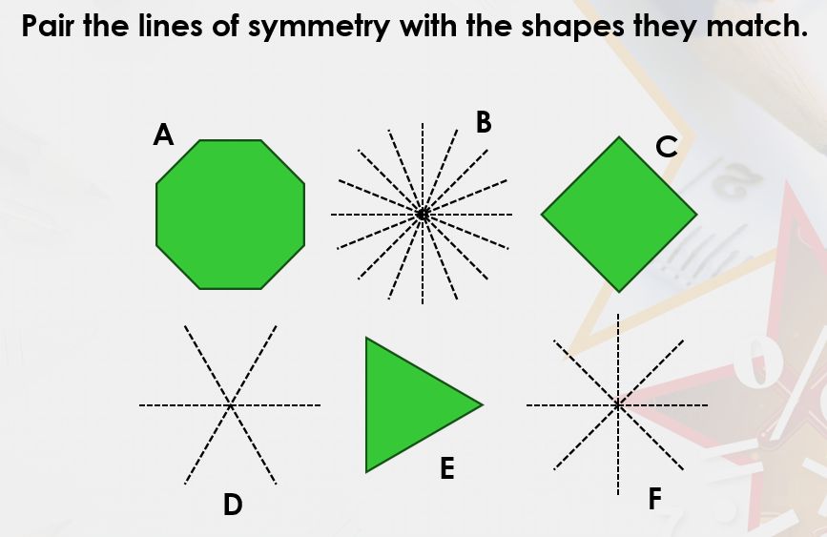
Draw lines to match the
shapes

Slide 16
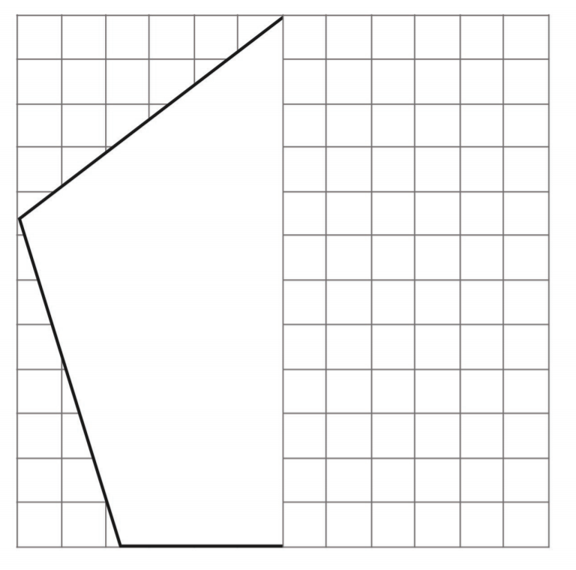
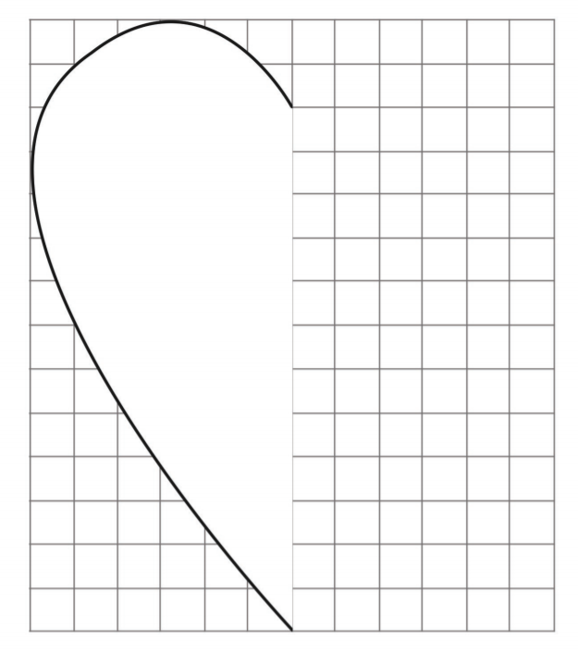
HINT- use the squares to help you ☺
Use a pencil to draw the other side of the shape. Remember they are symmetrical so make sure they are the same on both sides. You can draw lines on PowerPoint if you are working on the computer.

Slide 17
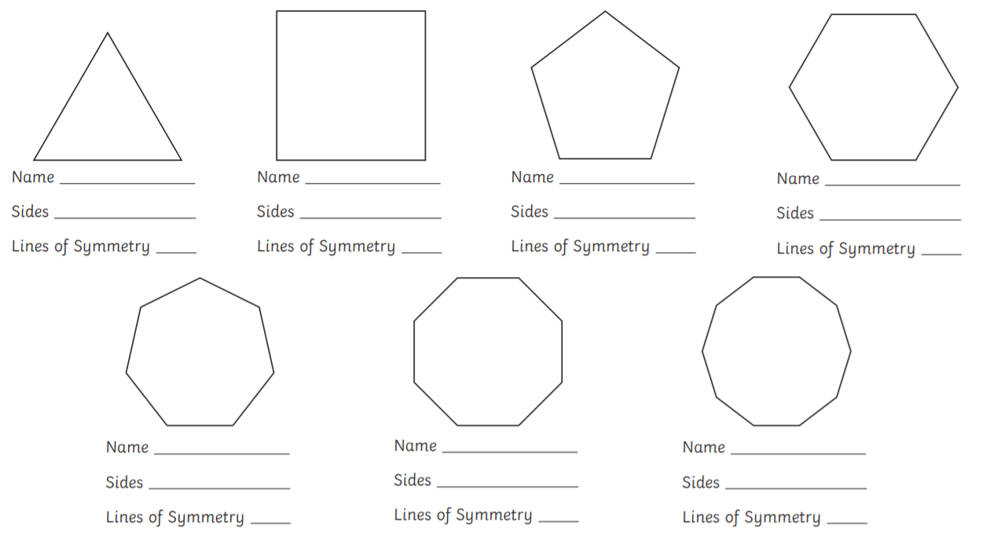

Slide 18
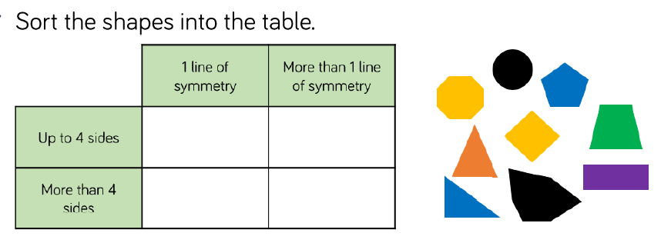
*CHALLENGE*
B
C
A
D
E
F
A
I
G
H
Sort the shapes into the correct space in the table
Put the letters in the correct box. The first one has been done for you.

Slide 19
3.2.2021
L.O To be able to complete symmetrical patterns
Go to Times Tables Rock Stars to warm up your number brain before you start your maths activity.
Subject: Maths

Slide 20

Pre-recorded Teaching
Access the online teaching video below that will support you to complete the work in this lesson. This video will act as a support but all of the work can still be successfully understood & completed using paper-based versions of this pack. If you need further support to understand / complete work then please contact school via e-mail or telephone.
Play Video
You can also copy and paste this link if you would prefer:
https://teachers.thenational.academy/lessons/to-identify-lines-of-symmetry-in-a-pattern-cgrkcc

Slide 21
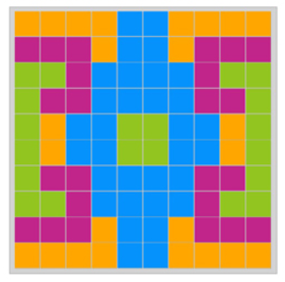
Think about what we learnt yesterday about lines of symmetry …
This is a symmetrical pattern because the pattern is exactly the same on each side

Slide 22
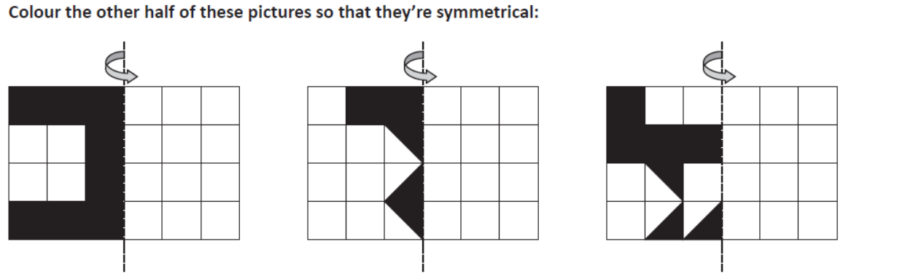
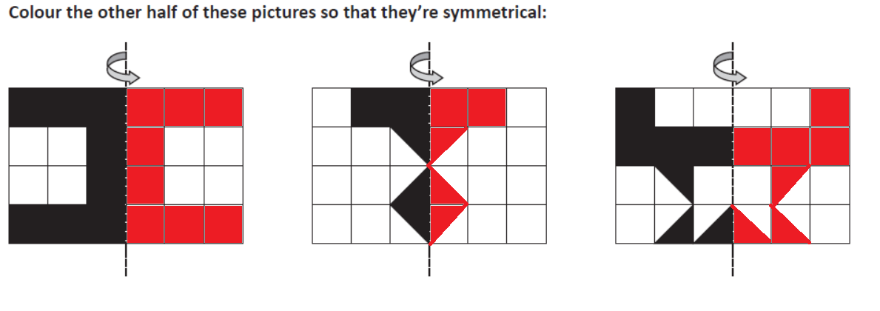
The pattern needs to be the same on both sides.
It is a mirror image of the original pattern so the red colour shows the reflected pattern.

Slide 23
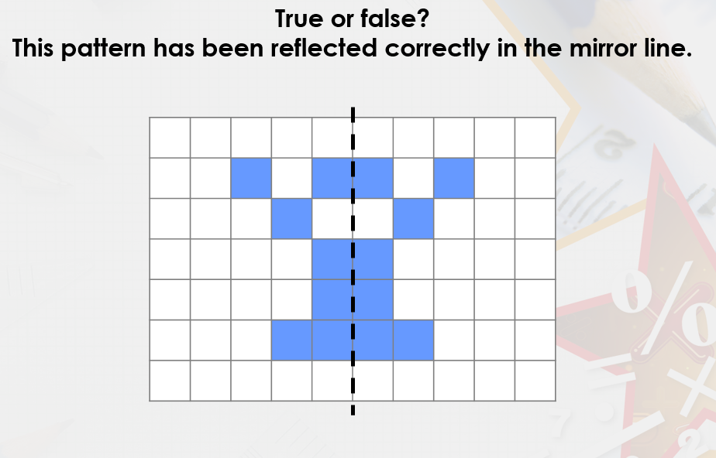
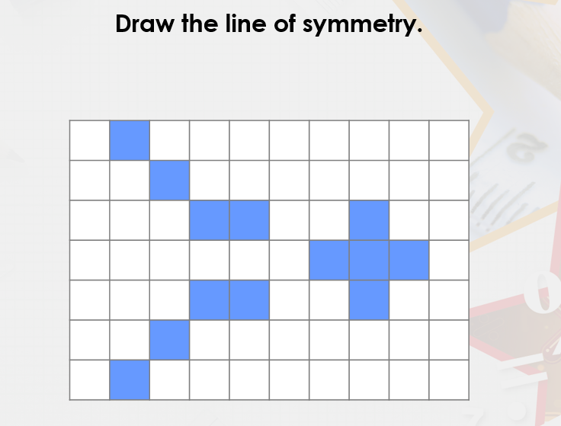
If you don’t have a ruler at home, you could use a book or a cereal box!

Slide 24
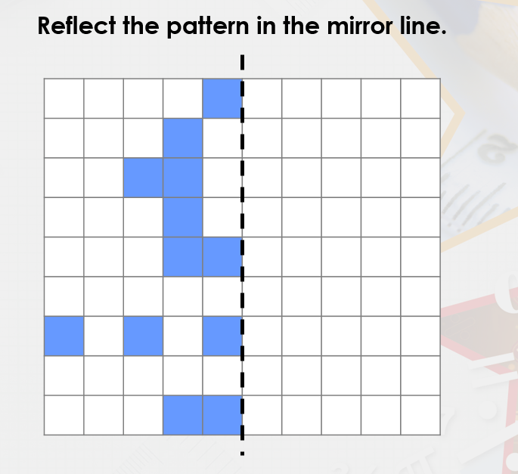
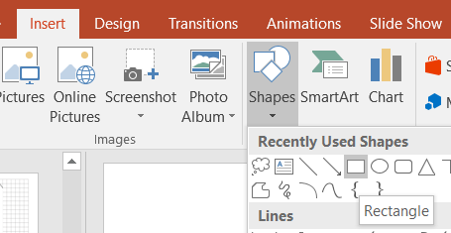
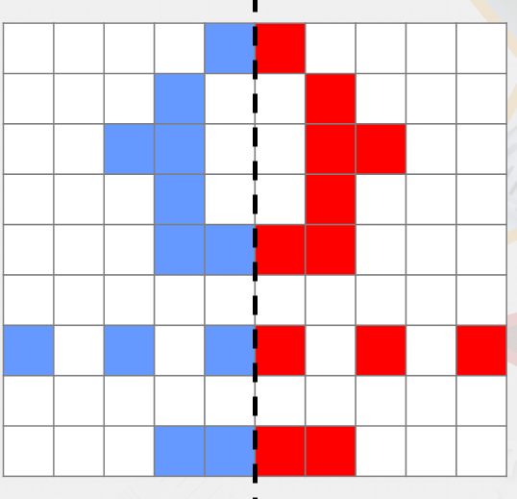
If you are working on paper you could colour in the pattern in
If you are using an electronic copy, you could create shapes and draw them in the mirror line
HINT
Your pattern should look like this >>>>>

Slide 25
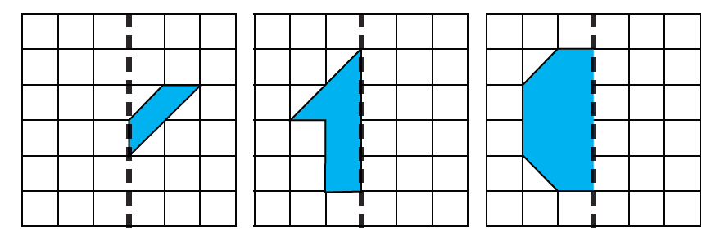
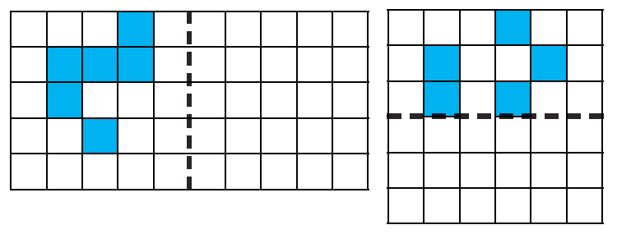
Reflect the image correctly on the other side of line of symmetry
You can work this out like we did for the our turn task

Slide 26
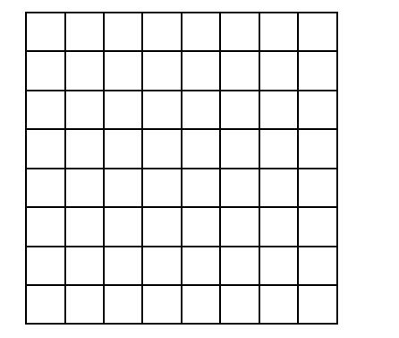
Now create your own symmetrical pattern
One grid has a vertical line of symmetrical the other has a horizontal line of symmetry
Remember you could use a mirror to check you are correct ☺

Slide 27
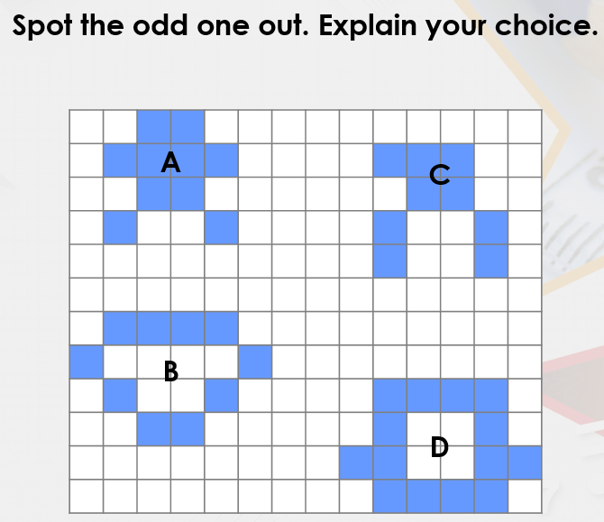
Challenge
I think ______ is the odd one out because ________________________________________________________________________________________________

Slide 28
4.2.2021
L.O To be able to classify different triangles
Go to Times Tables Rock Stars to warm up your number brain before you start your maths activity.
Subject: Maths

Slide 29
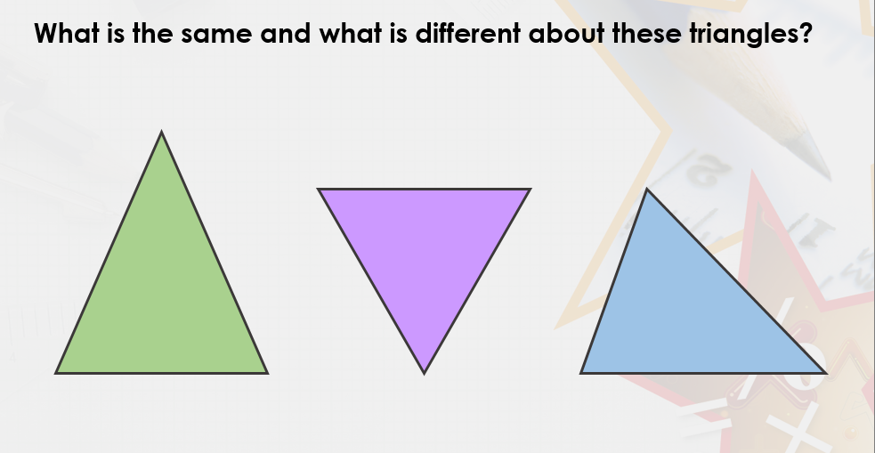
Thinking time

Slide 30
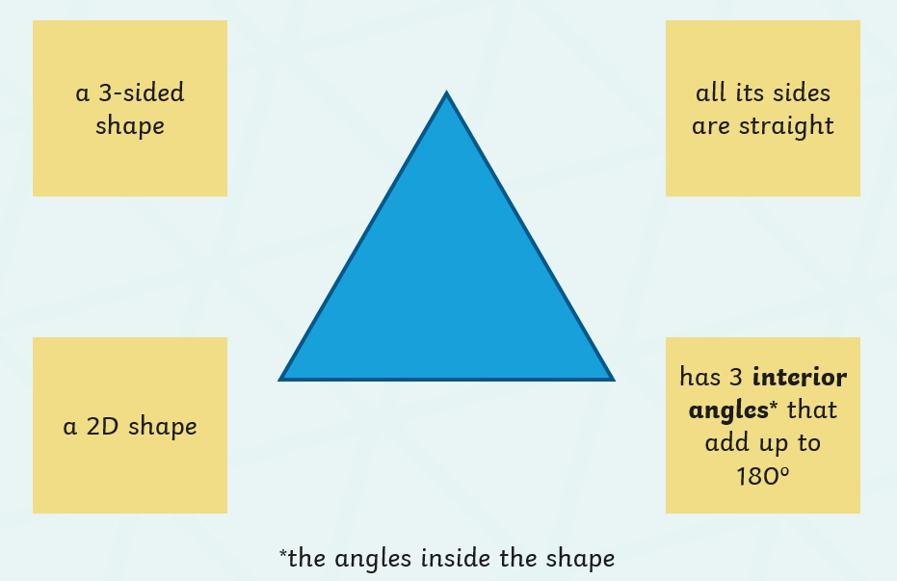
What is a triangle?
Did you know there are different types of triangles?
Can you name any of them?

Slide 31
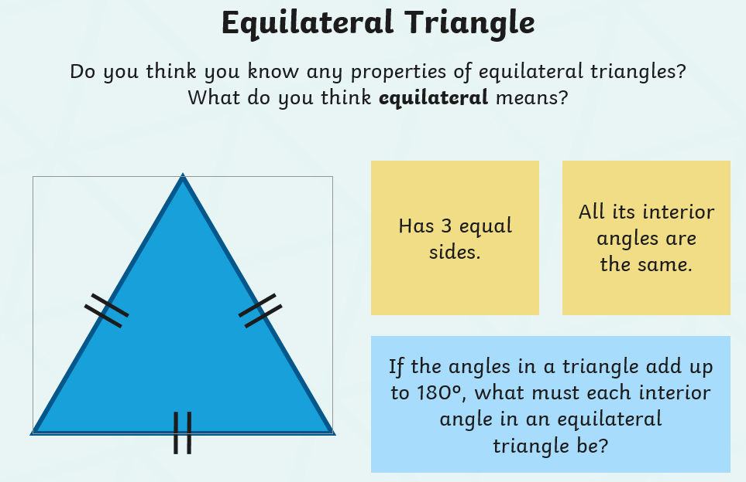
Think of your 3x table to help you
___ + ___ + ___ = 180

Slide 32
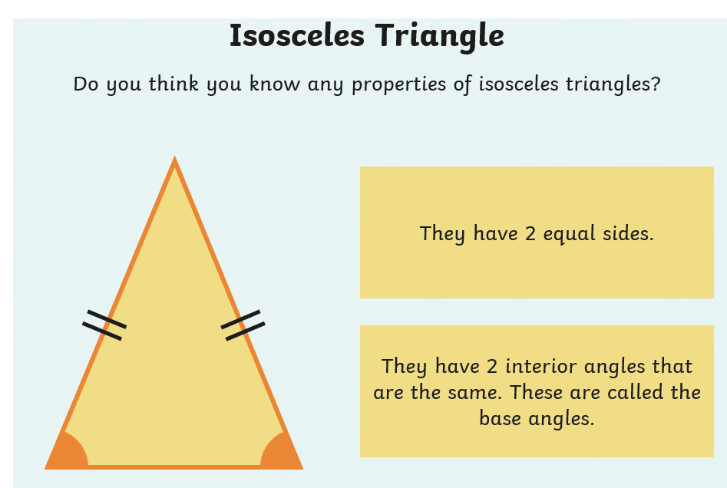

Slide 33
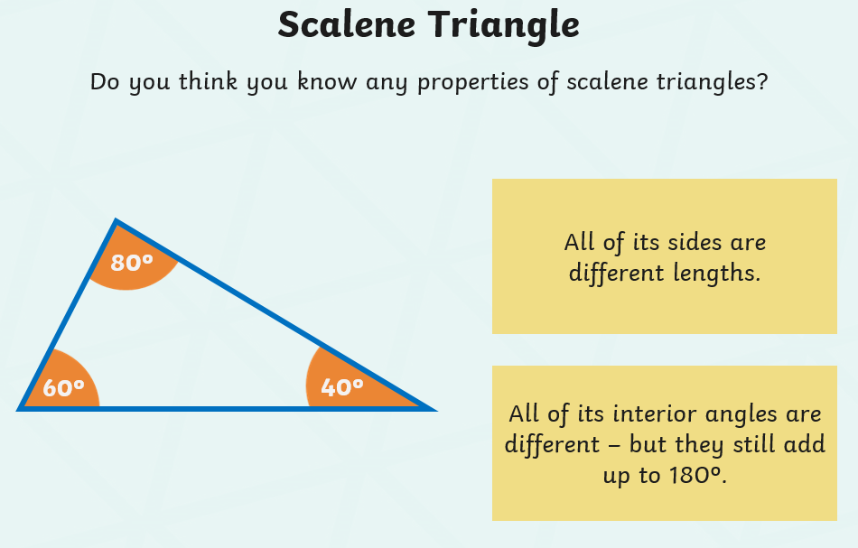
*Challenge*
If one angle was 20⁰ and one angle was 90⁰. What size would the third angle be?
______

Slide 34
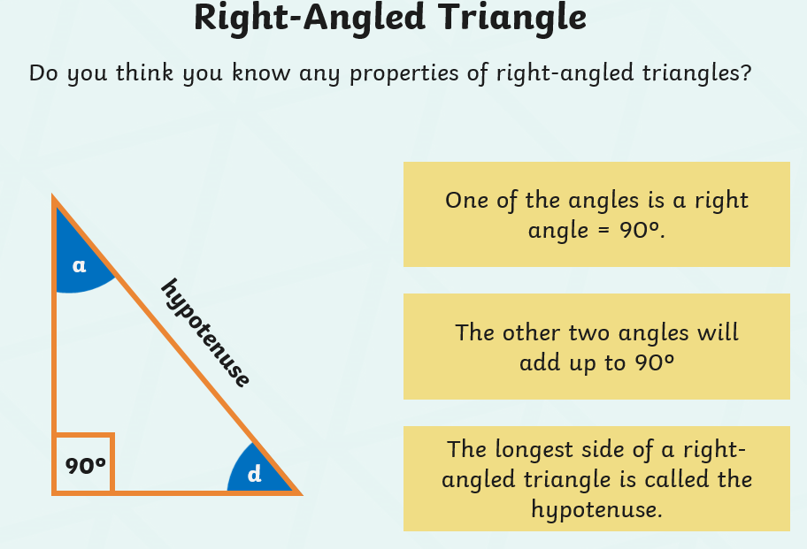

Slide 35
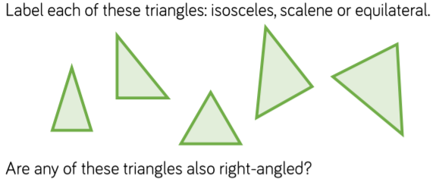
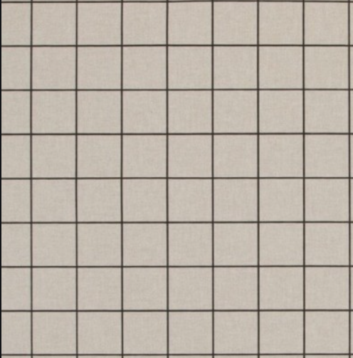
Use the squares to draw the 3
types of triangles
If you don’t have a ruler, you could always use a book

Slide 36
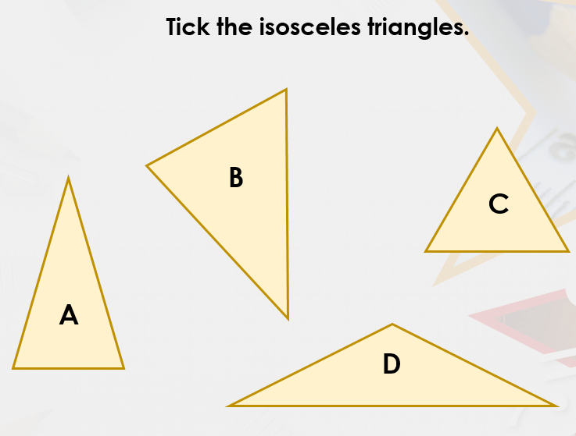
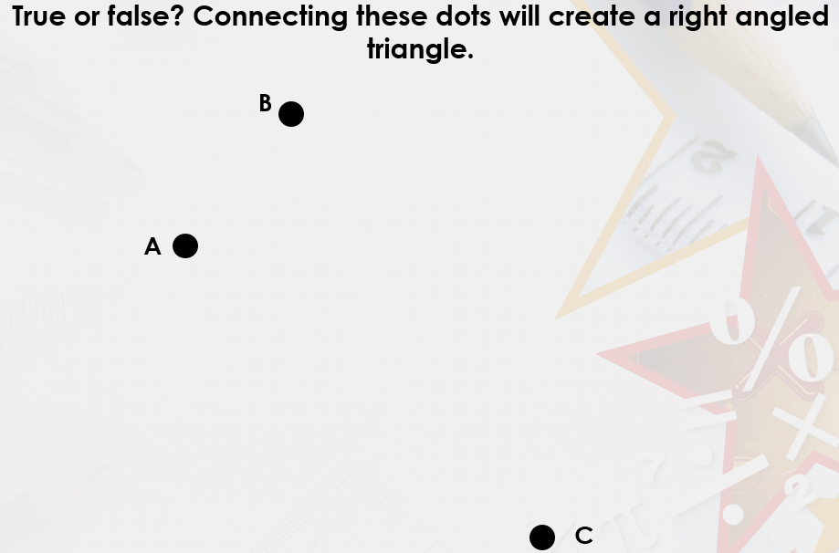
Remember an isosceles triangle has 2 equal sides

Slide 37
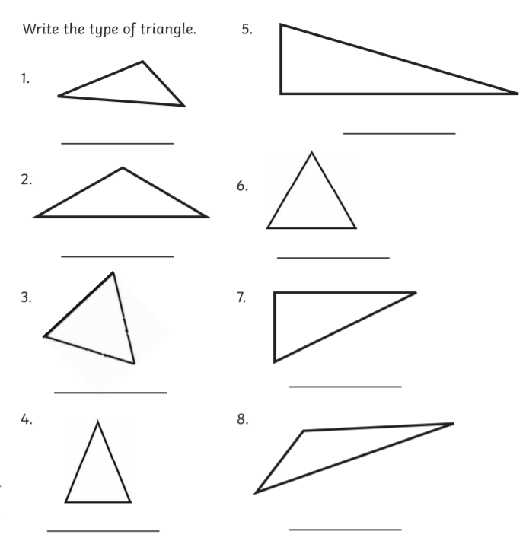
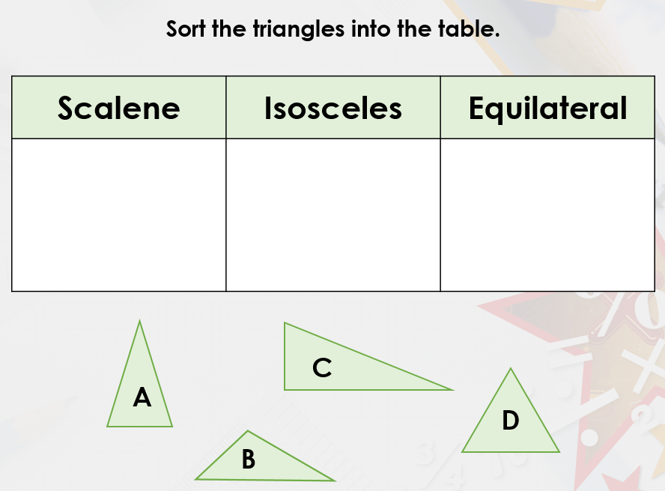

Slide 38
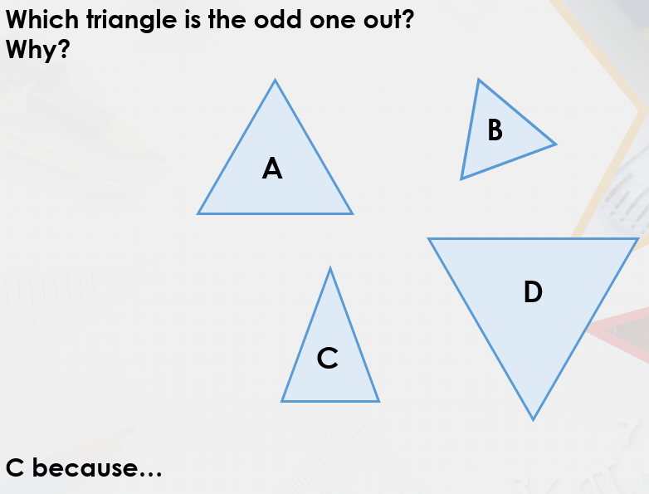
CHALLENGE!

Slide 39
5.2.2021
L.O To be able to identify angles
Go to Times Tables Rock Stars to warm up your number brain before you start your maths activity.
Subject: Maths

Slide 40
Pre-recorded Teaching
Access the online teaching video below that will support you to complete the work in this lesson. This video will act as a support but all of the work can still be successfully understood & completed using paper-based versions of this pack. If you need further support to understand / complete work then please contact school via e-mail or telephone.
Play Video
You can also copy and paste this link if you would prefer:
https://teachers.thenational.academy/lessons/shape-and-symmetry-to-identify-acute-and-obtuse-angles-crtk0r

Slide 41
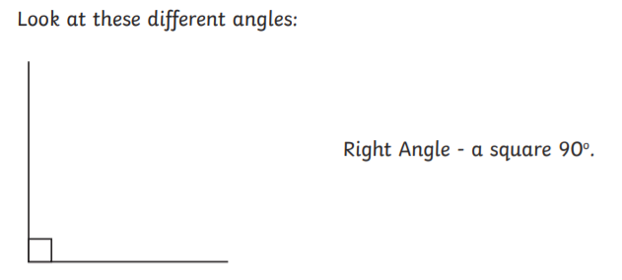
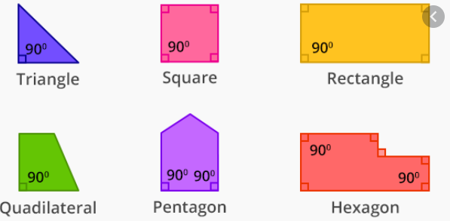
An angle is where 2 lines meet at a shared point.
There are different types of angles.
Remember we looked at right angle triangles yesterday
RIGHT ANGLE - 90⁰
All of the shapes below show a right angle. The angle is shown by a square drawn in the corner.

Slide 42

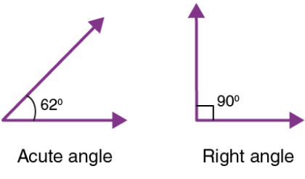
An angle is where 2 lines meet at a shared point.
There are different types of angles.
ACUTE ANGLE – LESS THAN 90⁰
Can you spot all the acute angles in these pictures?
They are smaller than right angles.

Slide 43
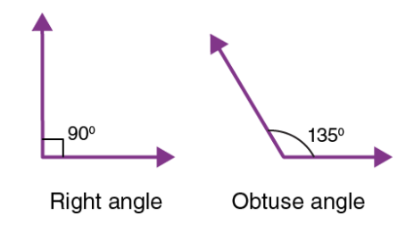
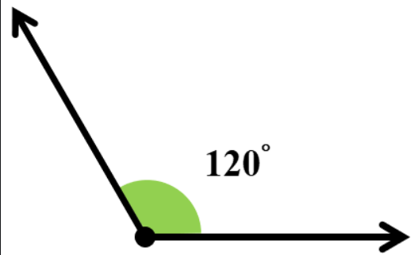
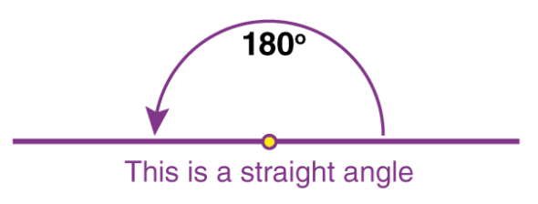
An angle is where 2 lines meet at a shared point.
There are different types of angles.
OBTUSE ANGLE – MORE THAN 90⁰
An obtuse angle is BIGGER than a right angle.
It is smaller than a straight line which is 180⁰

Slide 44
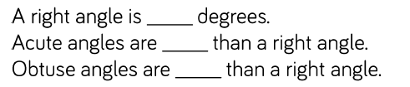

Write in the boxes provided which angle is which.
I have started it off for you.
Obtuse
Acute
Acute

Slide 45


Use these to remind you -

Slide 46


Slide 47
Use the squares to draw your own right, acute and obtuse angle
Label your angles.
Use a ruler or a straight line if working on paper
If working electronically, you can draw a line on PowerPoint ☺

Slide 48


Challenge -
________________________________________________________________________________________________________________________________________________________________
________________________________________________________________________________________________________________________________________________________________

Slide 49

Well done for all your hard work everyone!

