Slide 1



Date: Tuesday 18th – Friday 22th January
L.O To be able to recognise special friends.
Please practise phonics every day for 20 minutes.
Subject: Phonics

Slide 2
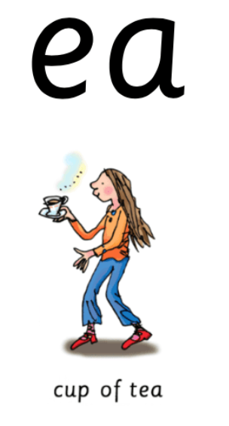
Special Friends – Sound 1
‘Special friends’ are two letters that make one sound.
When we put ‘e’ and ‘a’ together they form the sound ‘ea’.
Try my turn, your turn with a partner “ea” > “ea”
Say: ea
Cup of tea.

Slide 3


Blending Independently – Special Friends
Fred Talk - Fred Frog can only say words in sounds but not the entire word all at once for example s-ea-l.
Read the Phonics green word card: Special Friends, Fred talk, read the word.
seat
leat
meat
cear
Review the words
Special Friends, Fred Talk, read the word
Fred in your head
Speedy reading
Can you separate the real words from the alien words?

Slide 4
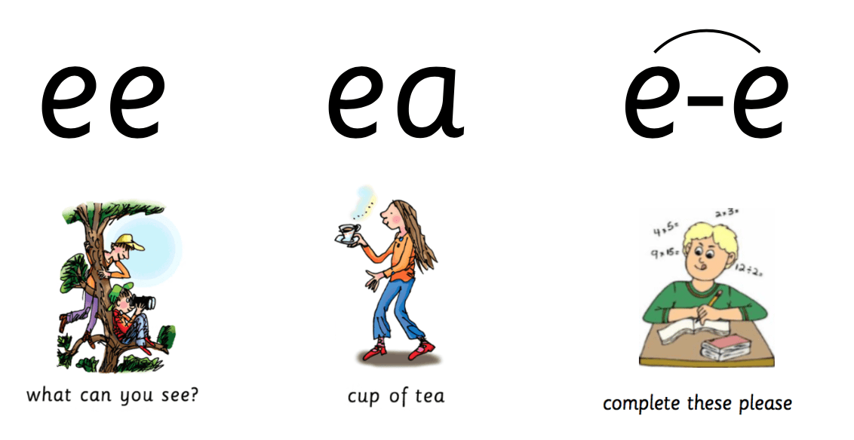
Review and Write
Can you spot todays Special Friends?
Try thinking of some other words that have the sound ‘ea’.
Examples - sea, team, tea, fear
Challenge! Can you put a word from your list into a sentence?
Example- There are so many fish in the sea.

Slide 5
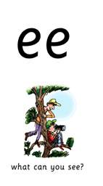
Special Friends – Sound 2
‘Special friends’ are two letters that make one sound.
When we put ‘e’ and ‘e’ together they form the sound ‘ee’.
Try my turn, your turn with a partner “ee” > “ee”
Say: “ee”
What can you see?

Slide 6


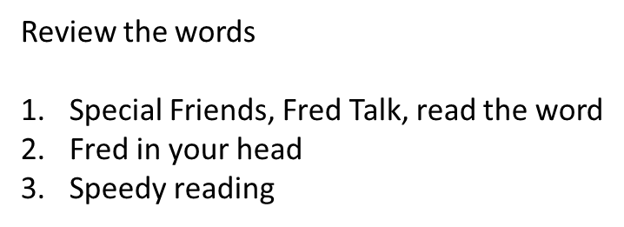

Blending Independently – Special Friends 2
Fred Talk - Fred Frog can only say words in sounds but not the entire word all at once for example .
Read the Phonics green word card: Special Friends, Fred talk, read the word.
feet
teep
queen
neep

Slide 7

Review and Write 2
Try and think of other words that have the sound ‘ee’.
Examples – bee, see, tree, bee, knee
Challenge! Can you put a word from your list into a sentence?
Example – I am going to eat my lunch under the tree.

Slide 8
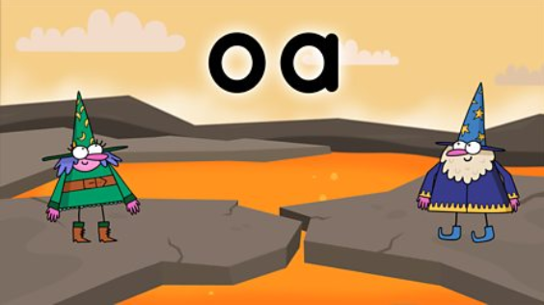
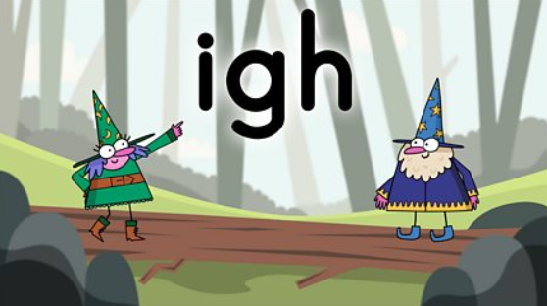
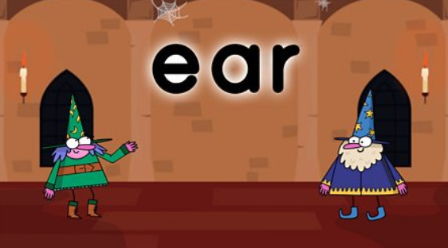
Phonics
BBC Bitesize has lots of 30 second videos focusing on each of the phonics sounds.
https://www.bbc.co.uk/bitesize/topics/zvq9bdm
Copy and paste the link.

Slide 9
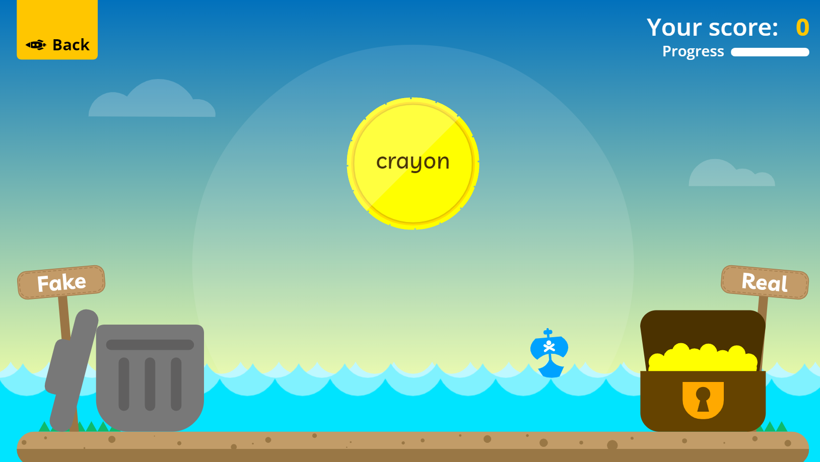
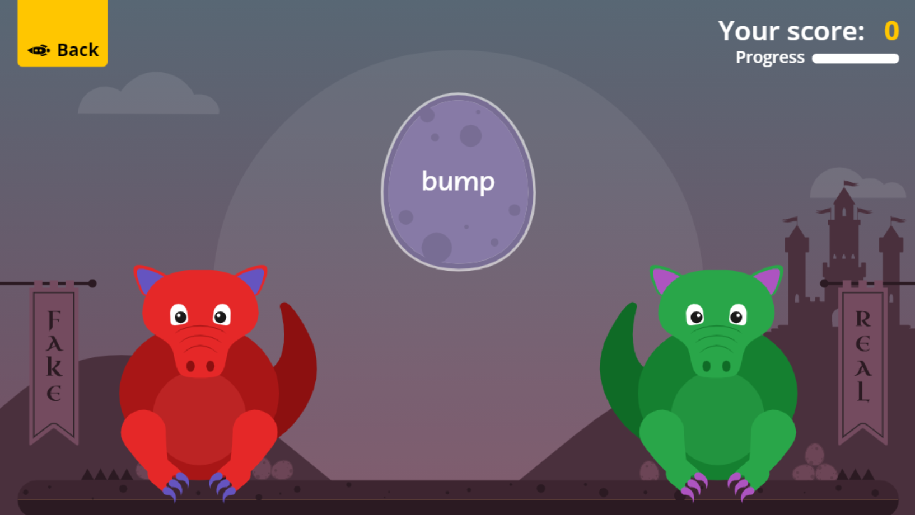

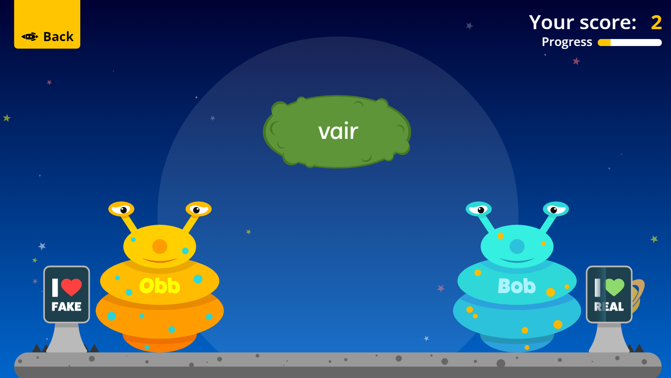
Fun Phonics Games!
Copy and paste the link to play these fun phonics games!
https://www.phonicsplay.co.uk/resources/phase/2/buried-treasure
All phases
https://www.phonicsplay.co.uk/resources/phase/2/dragons-den
All phases
https://www.phonicsplay.co.uk/resources/phase/2/picnic-on-pluto
All phases

