Slide 1




Date: 11.1.2021
L.O To be able to find 100 more or less.
Go to Times Tables Rock Stars to warm up your number brain before you start your maths activity.
Subject: Maths

Slide 2
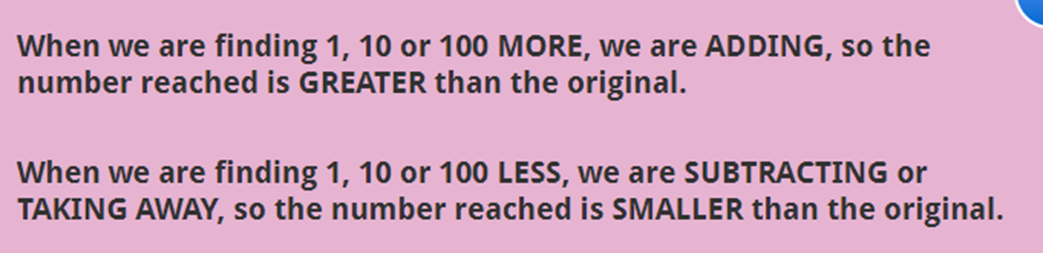
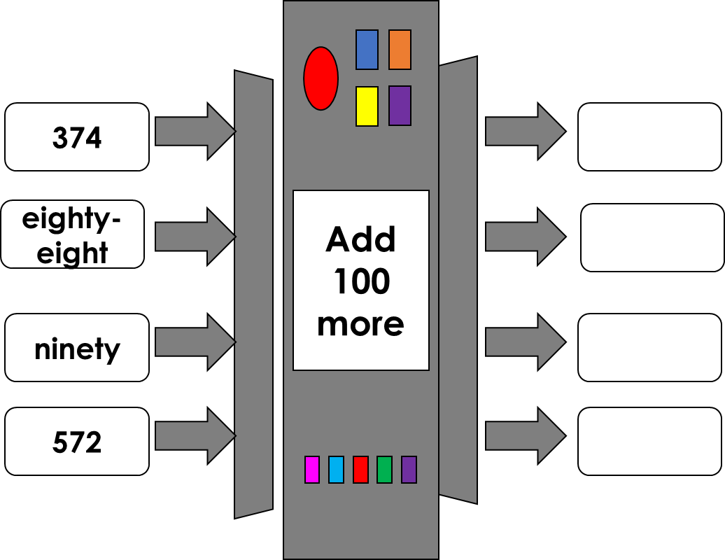
Subject: Maths

Slide 3
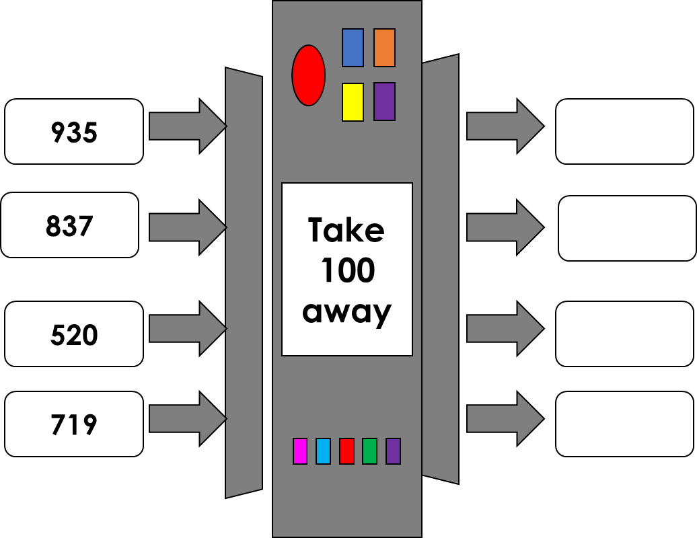
Subject: Maths

Slide 4
Now try these calculations.
1. 367 + 100 =
2. 245 + 100 =
3. 190 + 100 =
4. 732 + 100 =
5. 401 + 100 =
6. 563 – 100 =
7. 821 – 100 =
8. 703 – 100 =
9. 489 – 100 =
10. 674 – 100 =
Tip – The only number that should change is in hundreds column.
Subject: Maths

Slide 5

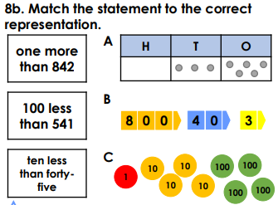
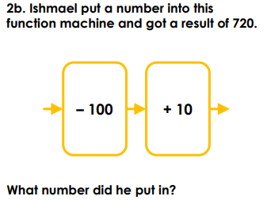
Subject: Maths

Slide 6
Date: 12.1.2021
L.O To be able to find 1000 more or less.
Go to Times Tables Rock Stars to warm up your number brain before you start your maths activity.
Subject: Maths

Slide 7
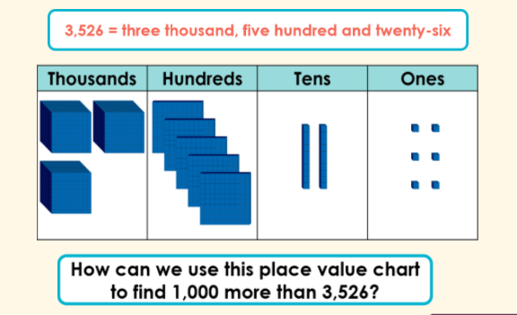
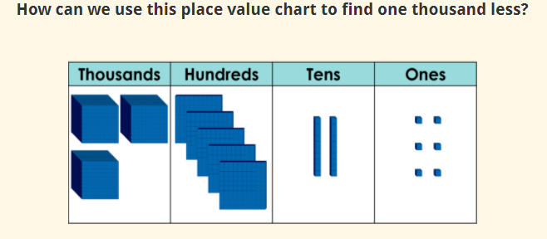
Question 1. (Go to the next slide to check the answer)
Question 2. (Go to the next slide to check the answer)
Tip: When adding or subtracting 1000 only the number in the thousand column changes.

Slide 8
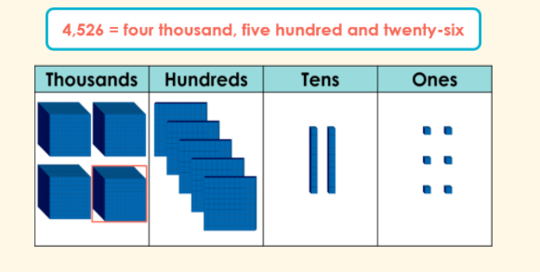
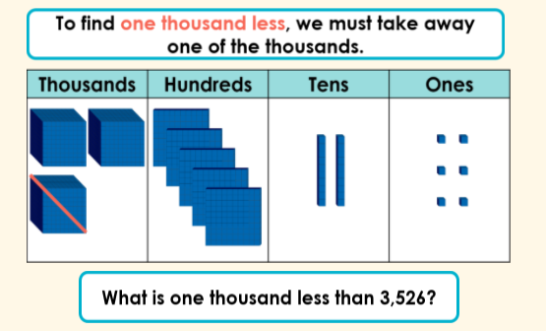
Question 1 Answer
Question 2 Answer

Slide 9
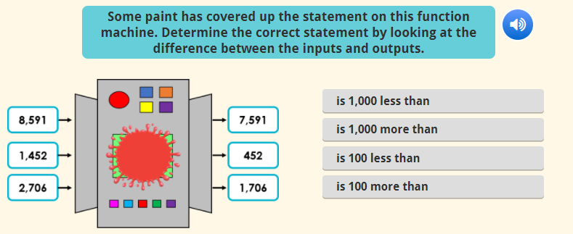
Tick the right answer

Slide 10
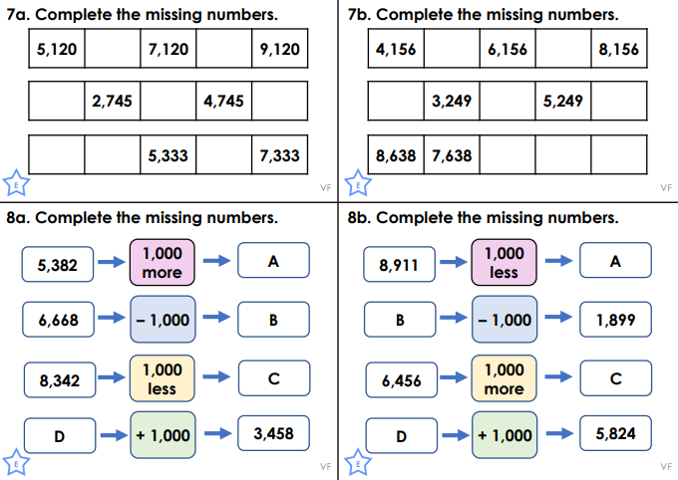

Slide 11
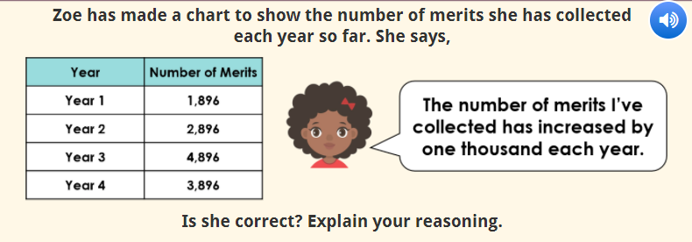
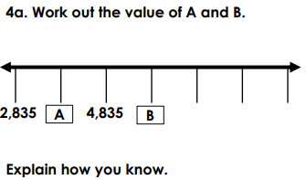

Slide 12
Date: 13.1.2021
L.O To be able to count in multiples.
Go to Times Tables Rock Stars to warm up your number brain before you start your maths activity
Subject: Maths

Slide 13
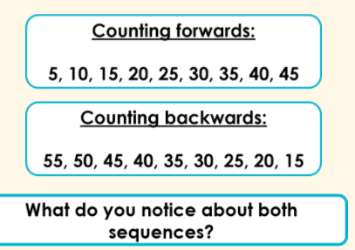
When we are counting forwards, the numbers increase in value.
When we are counting backwards, the numbers decrease in value.
Subject: Maths

Slide 14
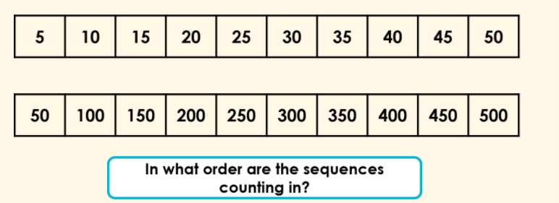
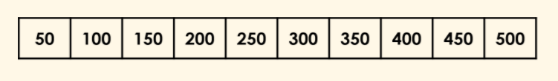

Fill in the missing numbers.

Slide 15
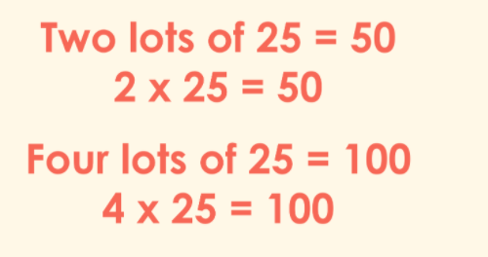
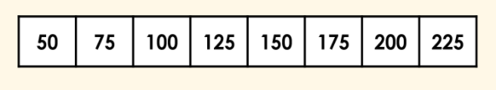

Counting in steps of 25
Fill in the missing numbers.

Slide 16
Complete these number sequences.
50 _____ 150 _____ _______
150 200 ____ _____ 350 ____
300 _____ 400 450 _____ _____
600 _____ 700 _____ _____ 850
5. 25 50 _____ _____
6. 50 ____ 100 _____ 150
7. 200 225 _____ 275 ____
8. ____ 150 _____ 200 _____
Tip. Counting in 50s is like counting in 5s
with a zero on the end of the number.

Slide 17
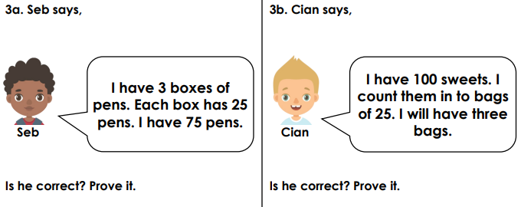

Slide 18
Date: 14.1.2021
L.O To be able to compare numbers
Go to Times Tables Rock Stars to warm up your number brain before you start your maths activity
Subject: Maths

Slide 19
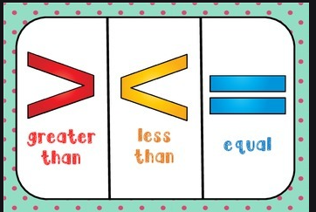
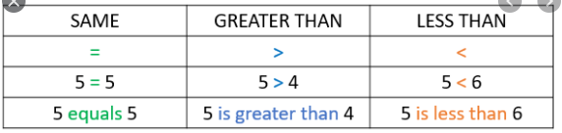
We can compare numbers using these symbols.

Slide 20
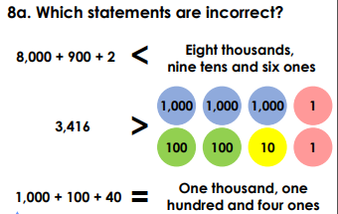

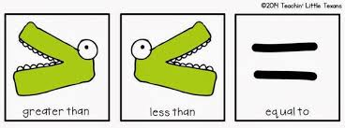
3,455 2,876
2,881 1,342
5,776 7,211
3,111 3,726
6,982 6,982
7,321 7,123

Slide 21

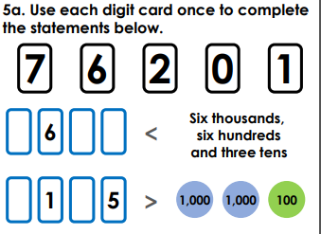
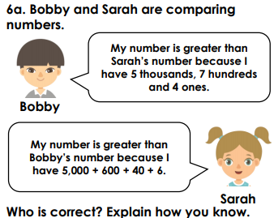
.

Slide 22
Date: 15.1.2021
L.O To be able to order numbers
Go to Times Tables Rock Stars to warm up your number brain before you start your maths activity
Subject: Maths

Slide 23
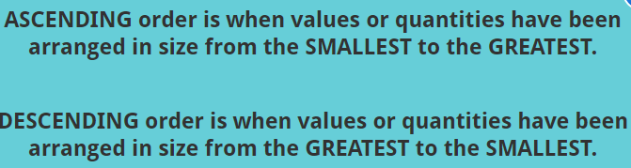
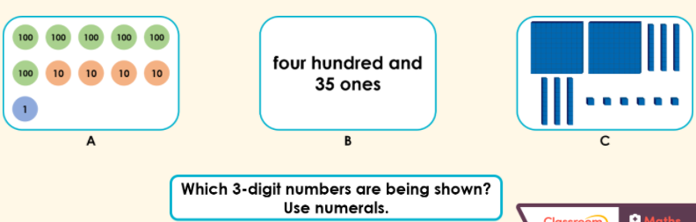
Write down the value of each set then order them into ascending order.

Slide 24
Write these numbers in ascending order (smallest to largest).
677 332 456 310
422 409 478 400
6,782 4, 672 2,882 2,100
8,732 7,334 3,992 2,782
5,321 5,892 3,771 3,032
2,456 2,742 2,114 2,338
Tip: Look at the number in the hundreds column first when ordering three digit numbers.
Tip: Look at the number in the thousand column first when ordering four digit numbers. If it is the same then look at the hundreds number.

Slide 25
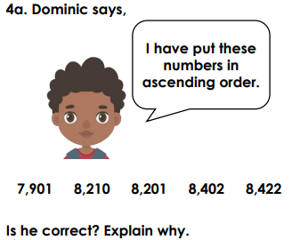
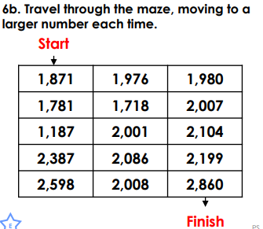
.

Slide 26
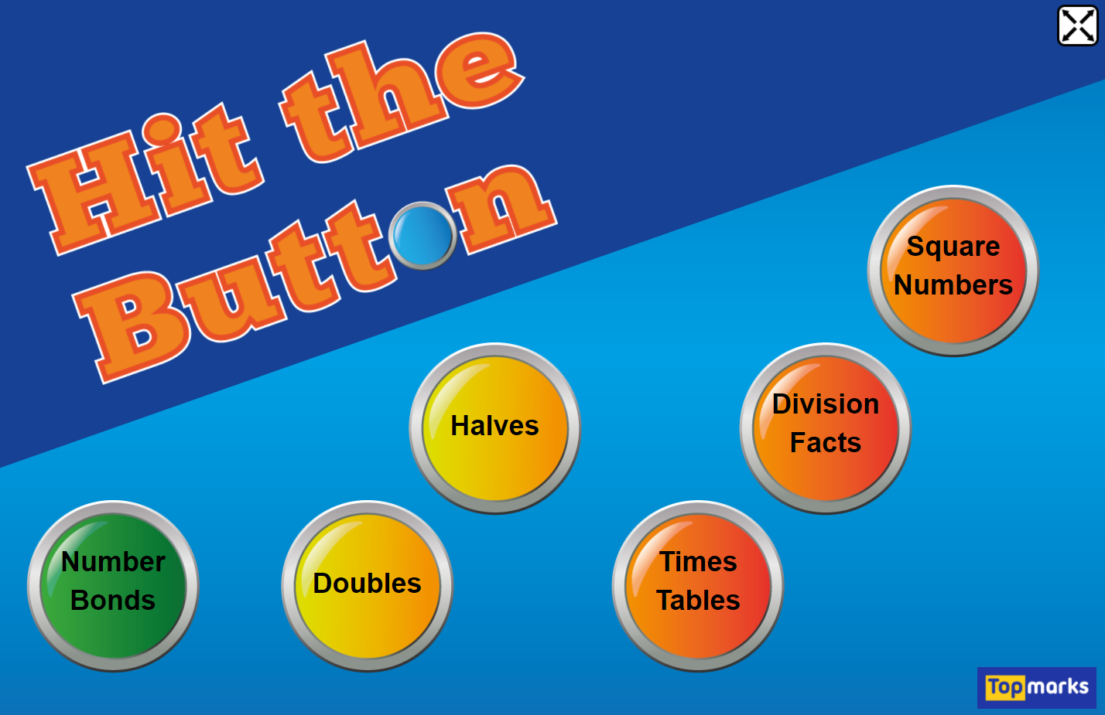
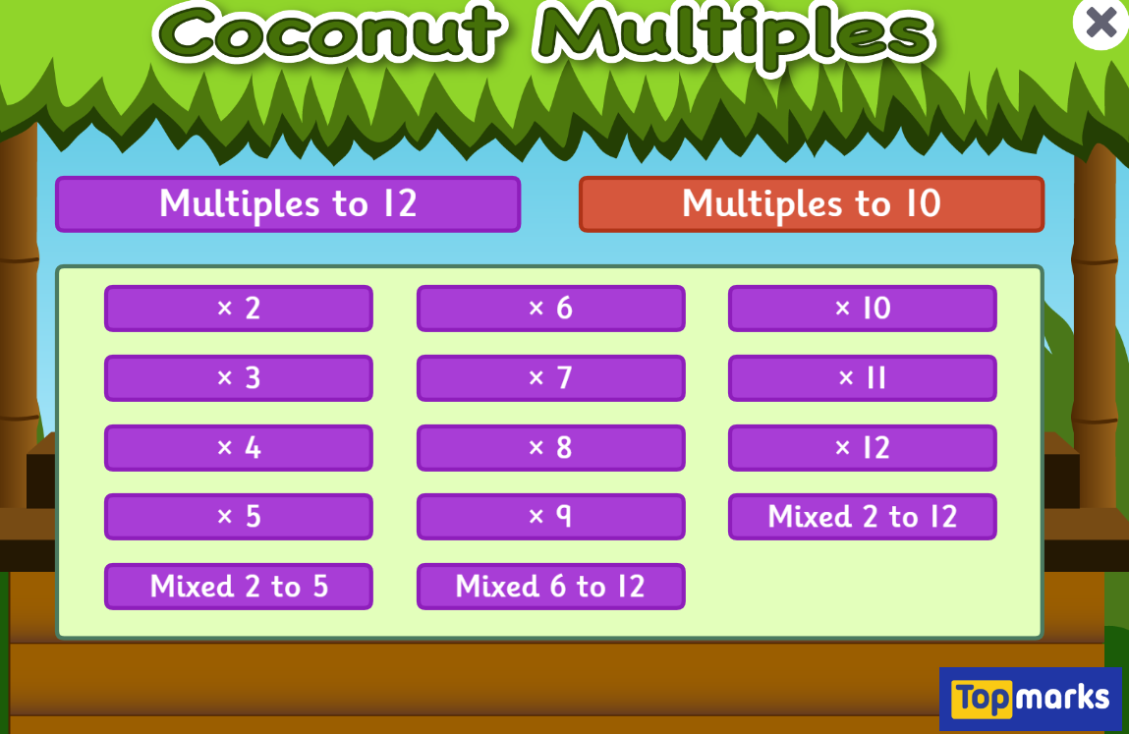

Fun Maths Games!
Copy and paste the link to play these fun maths games.
https://www.topmarks.co.uk/maths-games/hit-the-button
Times tables x4 x8 x3
https://www.topmarks.co.uk/times-tables/coconut-multiples
https://ttrockstars.com/
Multiples of numbers

