Slide 2
22.2.2021
L.O. To be able to convert between hours, minutes and seconds.
Go to Times Tables Rock Stars to warm up your number brain before you start your maths activity.
Subject: Maths

Slide 3
Pre-recorded Teaching
Access the online teaching video below that will support you to complete the work in this lesson. This video will act as a support but all of the work can still be successfully understood & completed using paper-based versions of this pack. If you need further support to understand / complete work then please contact school via e-mail or telephone.
Play Video
You can also copy and paste this link if you would prefer:
https://classroom.thenational.academy/lessons/converting-between-hours-minutes-and-seconds-6djket

Slide 4
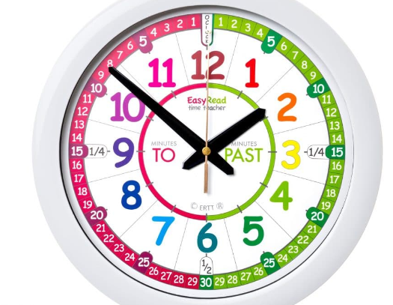
This week we are going to be looking at time.
The are 60 seconds in 1 minute
There are 60 minutes in 1 hour
There are 24 hours in 1 day

Slide 5
Look at the activities. Which ones do you think will take one hour, one minute or one second to complete? Draw a line to the correct heading.

Slide 6
Look at the activities. Which ones do you think will take one hour, one minute or one second to complete?

Slide 7
Use the information below to fill in the missing gaps.
The are 60 seconds in 1 minute There are 60 minutes in 1 hour There are 24 hours in 1 day
Hint – you know there are 60 seconds in one minute so work out how many lots of 60 are in 240

Slide 8
Use the information below to fill in the missing gaps.
The are 60 seconds in 1 minute There are 60 minutes in 1 hour There are 24 hours in 1 day
60
60
120
180
30
4

Slide 9
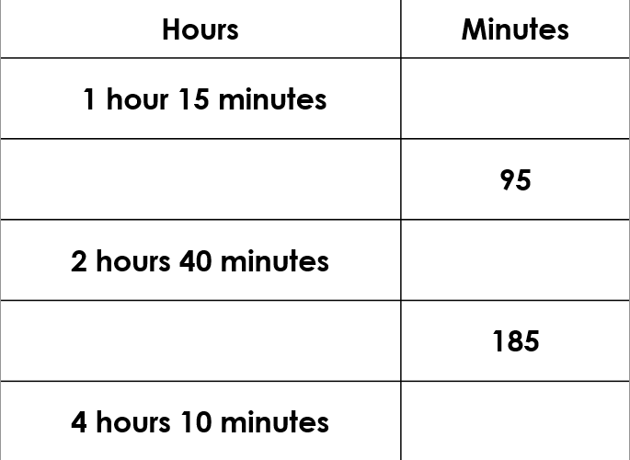
Let’s complete this table together.
75
1. 1hour=60minutes so 60+15=75 minutes
2. Take away the hour first to work out many minutes are left over. So 95-60= ______hour and _______ minutes
3. 2 hours = 60+60+40 minutes =
4. 185minutes- work out how many hours are in 180 minutes first

Slide 10
How did you do?
75
1 hour 35 minutes
160 minutes
3 hours 5 minutes
250 minutes

Slide 11
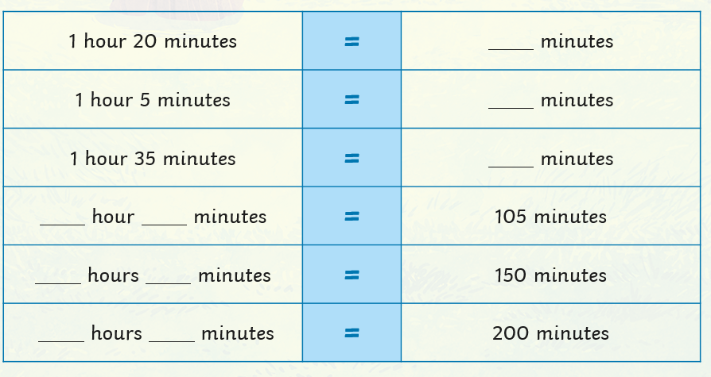
Copy out the table and complete.
We know that there are 60 minutes in 1 hour. So you would do 60+20=80 minutes
80

Slide 12
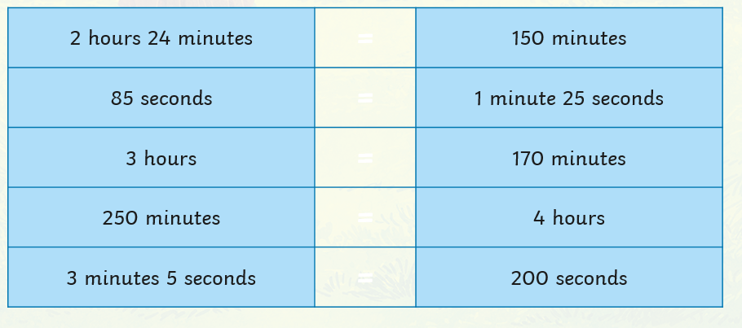
Use <, > or = to make the statements correct.

Slide 13
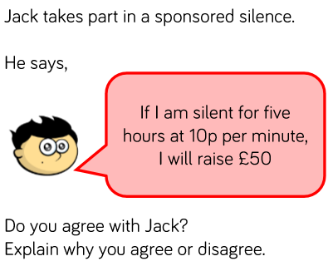
Complete the challenges.

Slide 14
23.2.2021
L.O. To be able to convert between years, months, weeks and days.
Go to Times Tables Rock Stars to warm up your number brain before you start your maths activity.
Subject: Maths

Slide 15
Pre-recorded Teaching
Access the online teaching video below that will support you to complete the work in this lesson. This video will act as a support but all of the work can still be successfully understood & completed using paper-based versions of this pack. If you need further support to understand / complete work then please contact school via e-mail or telephone.
Play Video
You can also copy and paste this link if you would prefer:
https://classroom.thenational.academy/lessons/converting-between-years-months-and-weeks-70rk2d?activity=video&step=2&view=1

Slide 16
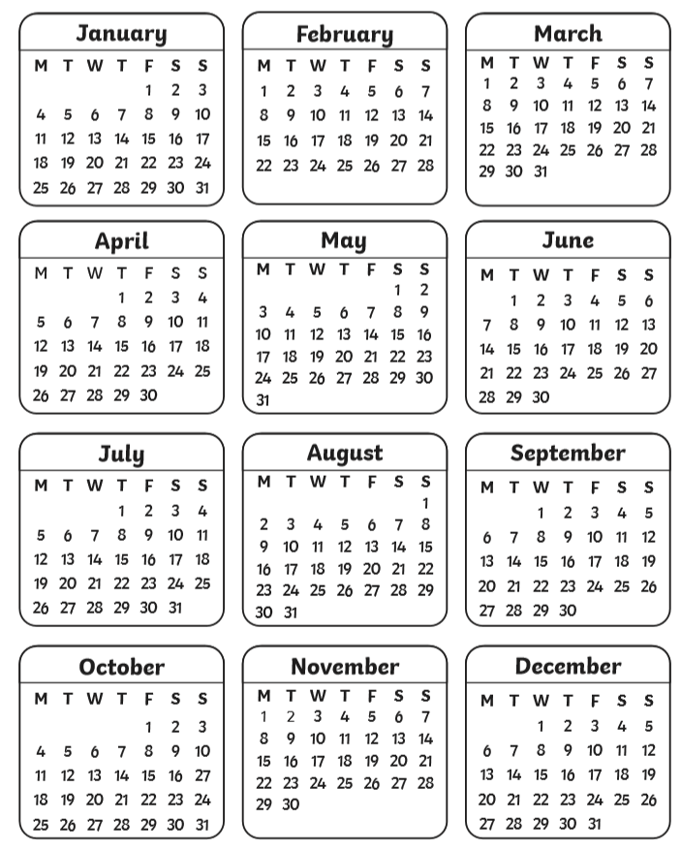
Look at the calendar for 2021 and work out how many days are in each month.

Slide 17
How did you do?
January – 31
February – 28 (or 29 in a leap year)
March – 31
April -30
May – 31
June – 30
July – 31
August – 31
September – 30
October – 31
November – 30
December - 31

Slide 18
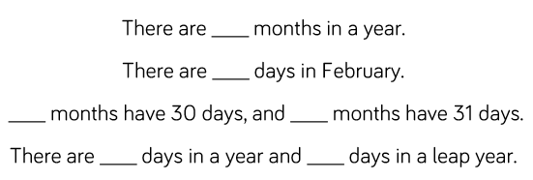
Use the calendar to help you complete the sentences.

Slide 19
Use the calendar to help you complete the sentences.
12
28
4
7
365
366

Slide 20
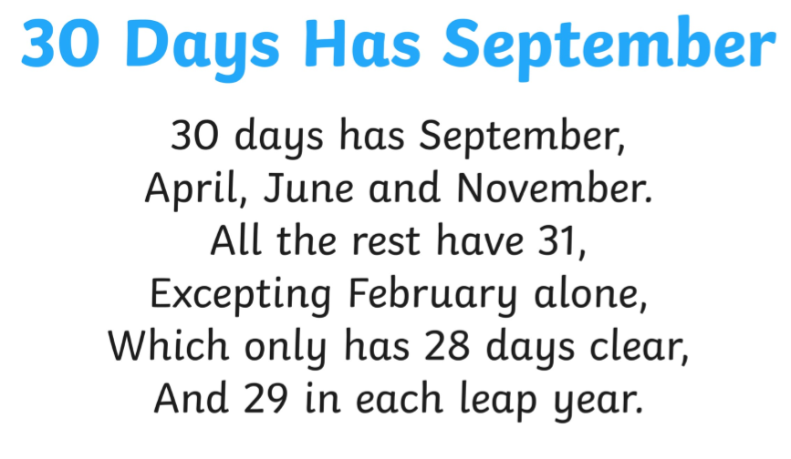
Here is a useful poem to help you remember how many days are in each month.

Slide 21
How many days are in 2 weeks and 4 days?
In order to work this out, we need to know how many days are in 1 week.
We know that 7 days are in 1 week.
Our calculation would therefore be 7+7+4= 18 days
Or you could do 7x2=14 and then 14+4=18 days

Slide 22
How many months are in 4 years?
We know that there are 12 months in 1 year.
To work this out we can do 12 x 4 = 48 months.
Or we can do 12+12+12+12 = 48 months

Slide 23
How many days are there in 4 weeks and 3 days? Fill in the blanks.
We know there are 7 days in 1 week
So we can do 7x4= ____ and then add 3= _______
Or we can add 7+7+7+7+3=__________

Slide 24
How many days are there in 4 weeks and 3 days?
We know there are 7 days in 1 week
So we can do 7x4= 28 and then add 3= 31days
Or we can add 7+7+7+7+3= 31 days

Slide 25
Copy and complete the statements.
There are ____ days in a fortnight.
There are ____ days in 3 weeks and 6 days.
There are ____ months in 3 years.
There are ____days in 2 weeks and 8 days.
Match the durations.
3 weeks =
16 months =
A fortnight =

Slide 26
Complete the table using the correct symbol <,> or =.
3 weeks and 4 days |  | 23 days
365 days |  | 1 year and 2 weeks
11 months |  | 52 weeks
19 weeks |  | Half a year
Remember:
< means less than a number.
> Means greater than a number.
= means the same as.

Slide 27
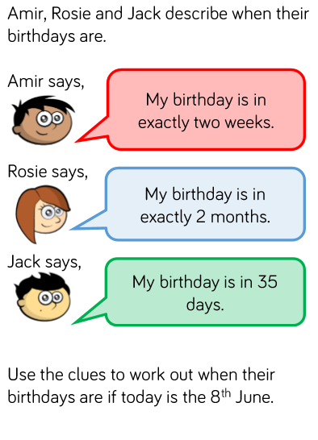
Complete the challenges.

Slide 28
24.2.2021
L.O. To be able to tell the time to 5 minutes.
Go to Times Tables Rock Stars to warm up your number brain before you start your maths activity.
Subject: Maths

Slide 29
Pre-recorded Teaching
Access the online teaching video below that will support you to complete the work in this lesson. This video will act as a support but all of the work can still be successfully understood & completed using paper-based versions of this pack. If you need further support to understand / complete work then please contact school via e-mail or telephone.
Play Video
You can also copy and paste this link if you would prefer:
https://classroom.thenational.academy/lessons/reading-the-time-on-the-clock-to-the-nearest-five-minutes-part-1-71jp4c?activity=video&step=2&view=1

Slide 30
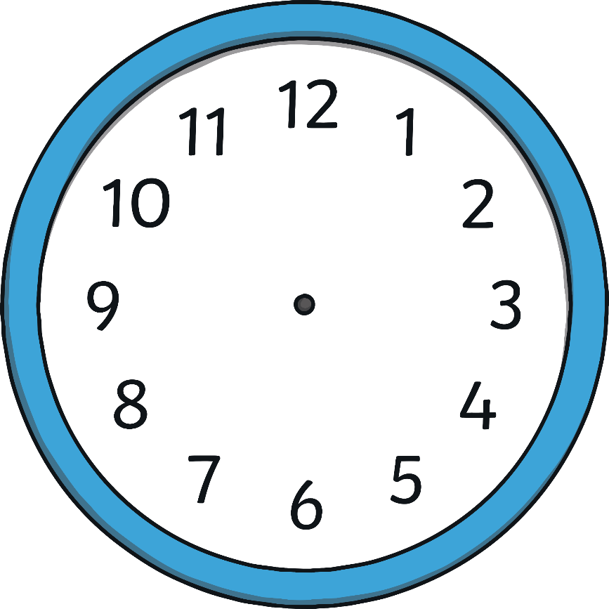
Hours and Minutes
This is the hour hand.
It is the shortest hand on the clock.
This is the minute hand.
It is longer than the hour hand.

Slide 31
Hours and Minutes
When the minute hand is pointing to 12, it is showing a full hour. We call this time ‘o’clock’.
On this clock, the hour hand is pointing at the 8 and the minute hand is pointing to the 12.
This clock is showing that the time is 8 o’clock.

Slide 32
What Time Is It?
12 o’clock
11 o’clock
1 o’clock
10 o’clock
2 o’clock
9 o’clock
3 o’clock
8 o’clock
4 o’clock
7 o’clock
5 o’clock
6 o’clock

Slide 33
What Time Is It?
It is 7 o’clock.

Slide 34
What Time Is It?
It is 3 o’clock.

Slide 35
What Time Is It?
It is 11 o’clock.

Slide 36
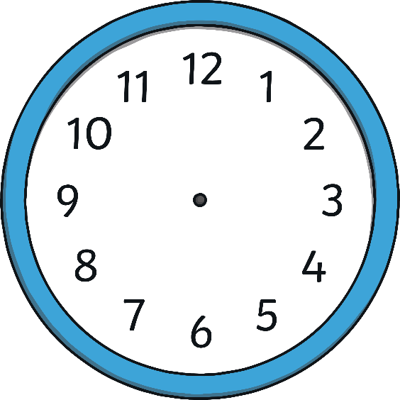
What Time Is It?
Which clock shows 2 o’clock?

Slide 37
What Time Is It?
Which clock shows 2 o’clock?

Slide 38
What Time Is It?
Which clock shows 3 o’clock?

Slide 39
What Time Is It?
Which clock shows 3 o’clock?

Slide 40
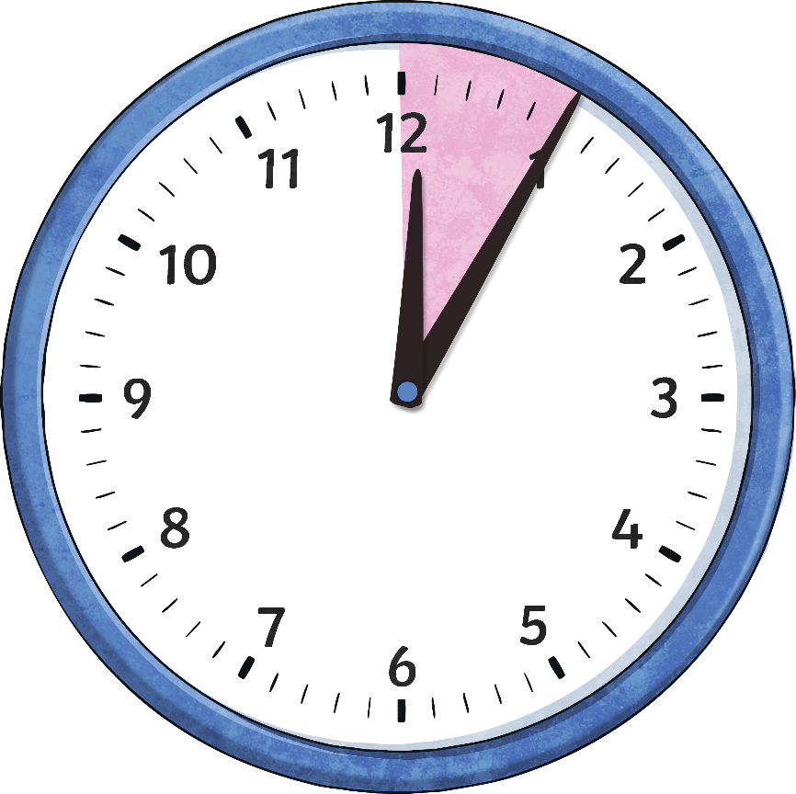
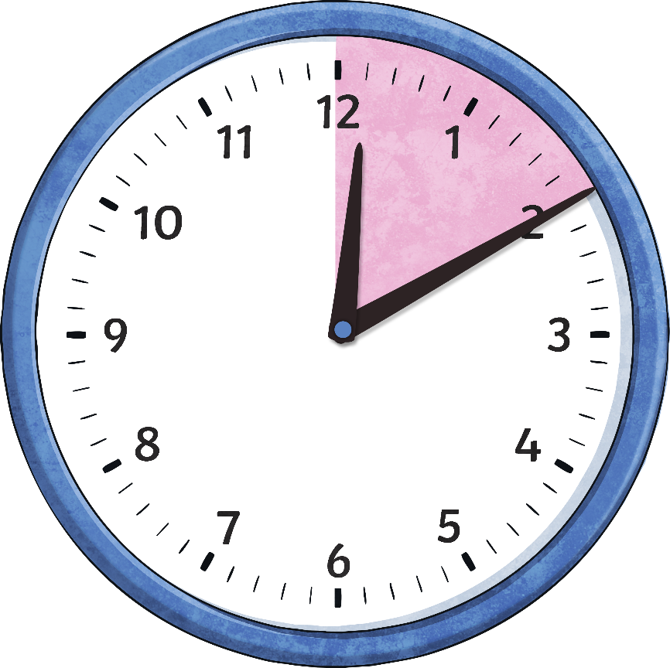
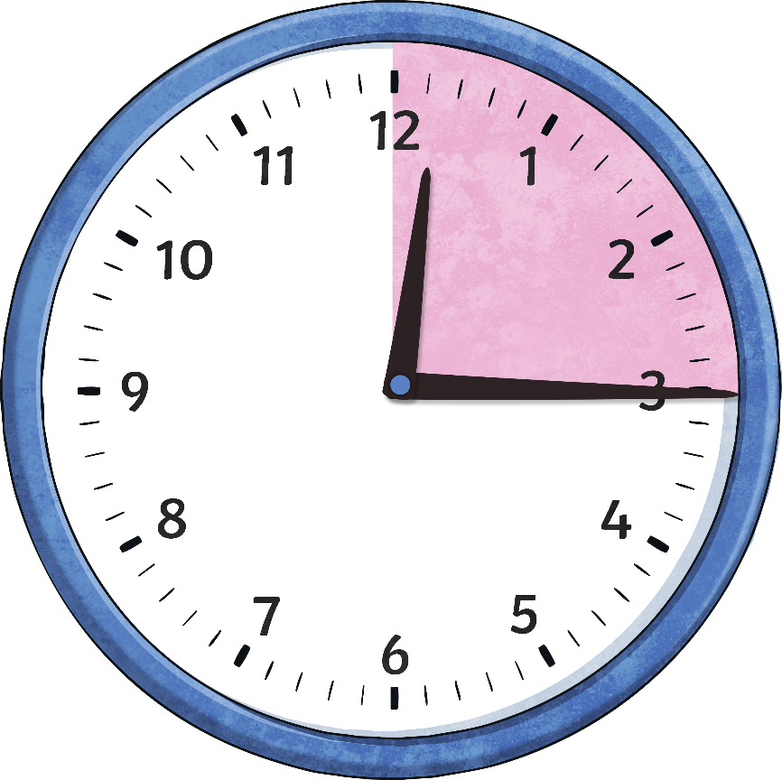
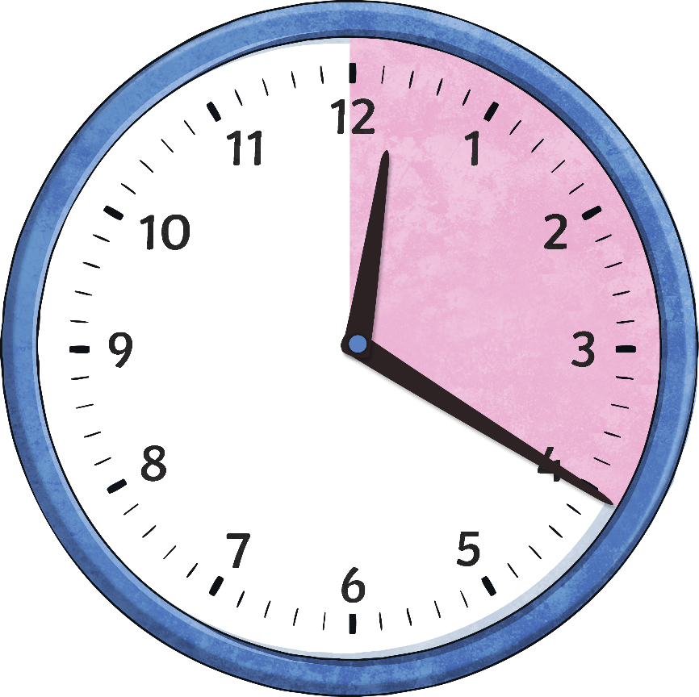
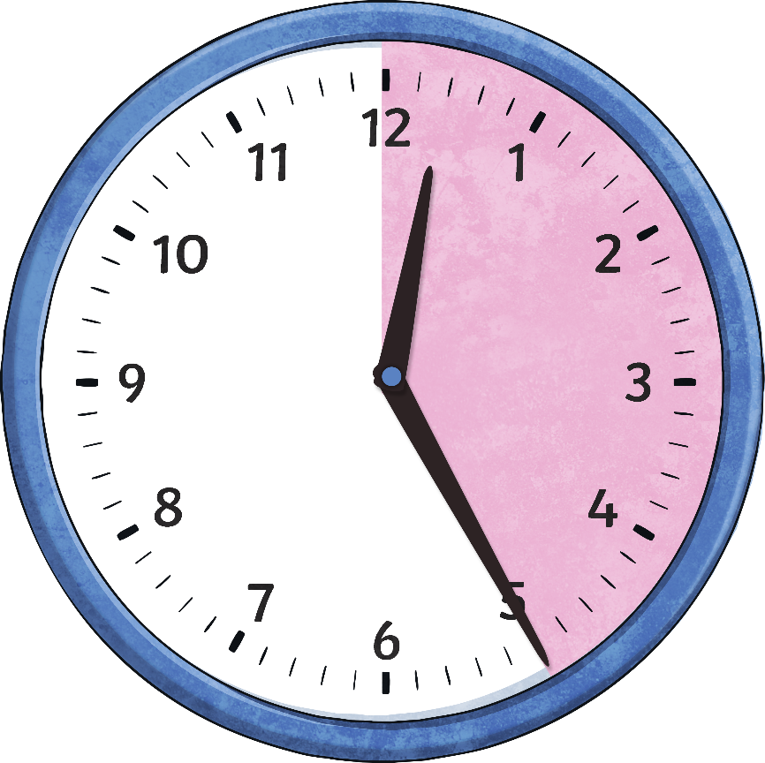
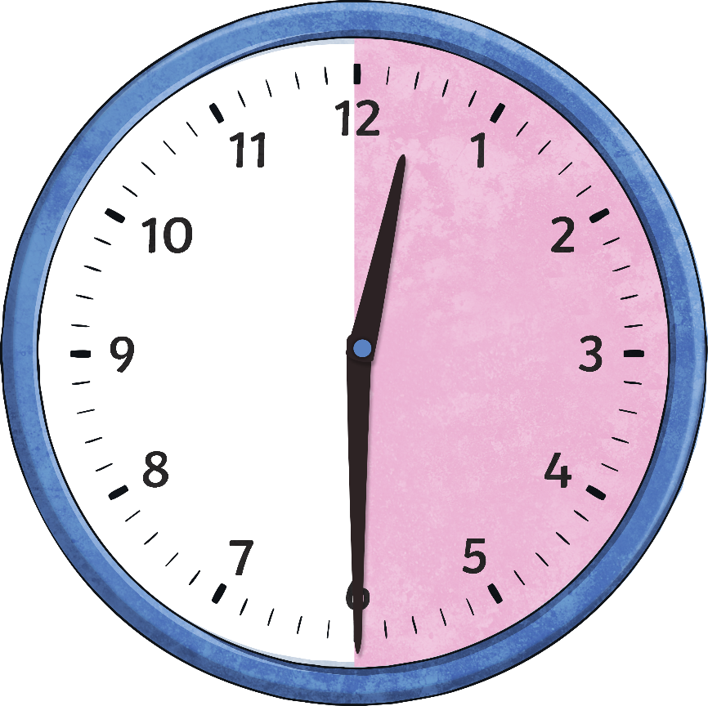
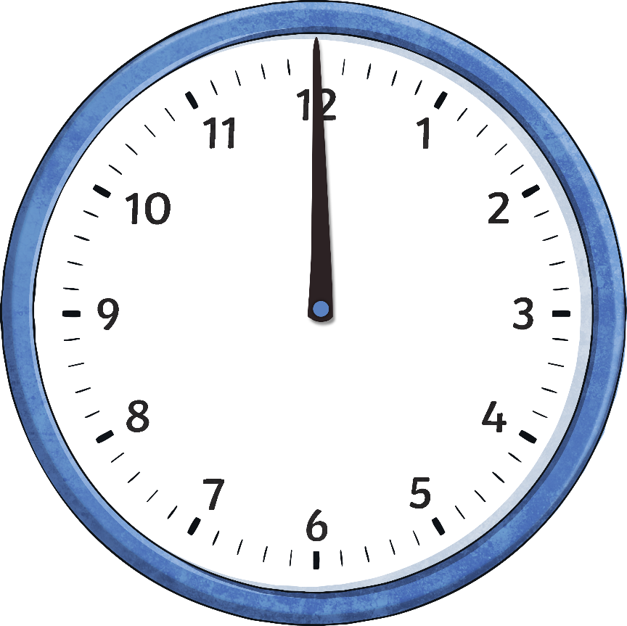
Telling the Time
The big hand on the clock counts the minutes and is called the minute hand.
We are going to look now at the minutes past the hour.
20
25
30
5
10
15
minutes
past
minutes
past
minutes
past
minutes
past
minutes
past
minutes
past
o’clock

Slide 41
When the big hand points to 1, it means…
When the big hand points to 2, it means…
10
5
minutes
past
minutes
past

Slide 42
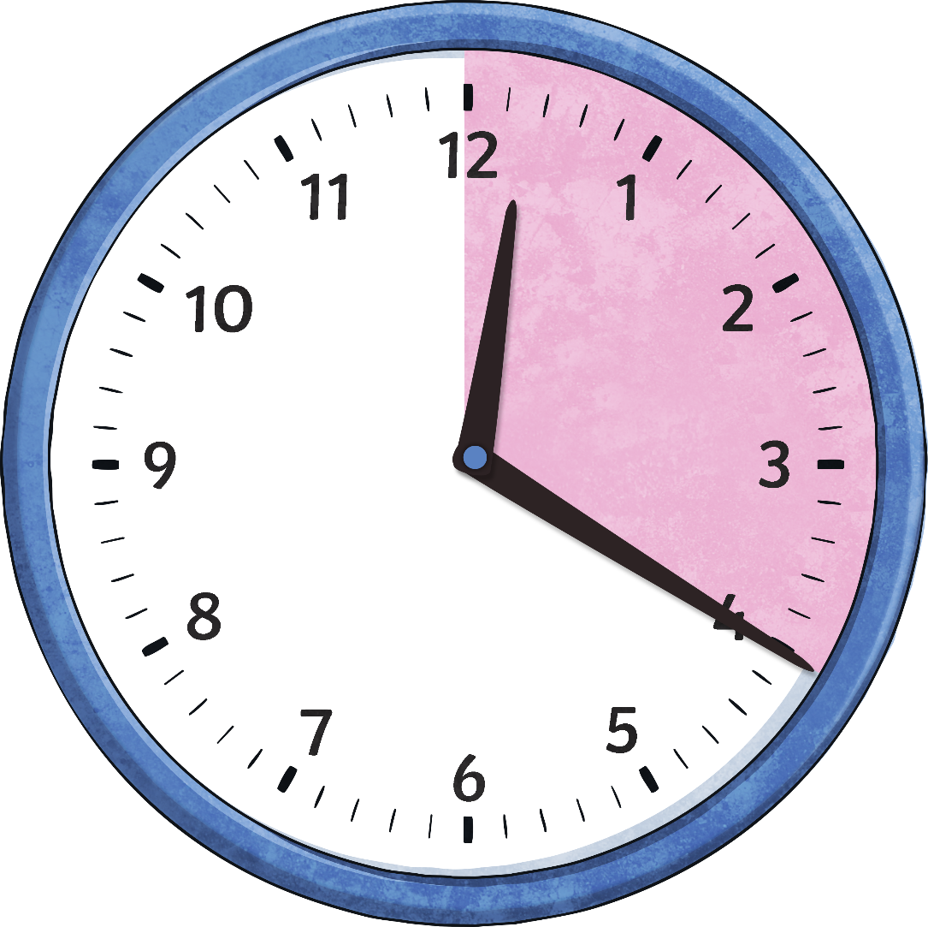
When the big hand points to 3, it means…
When the big hand points to 4, it means…
15
20
minutes
past
minutes
past

Slide 43
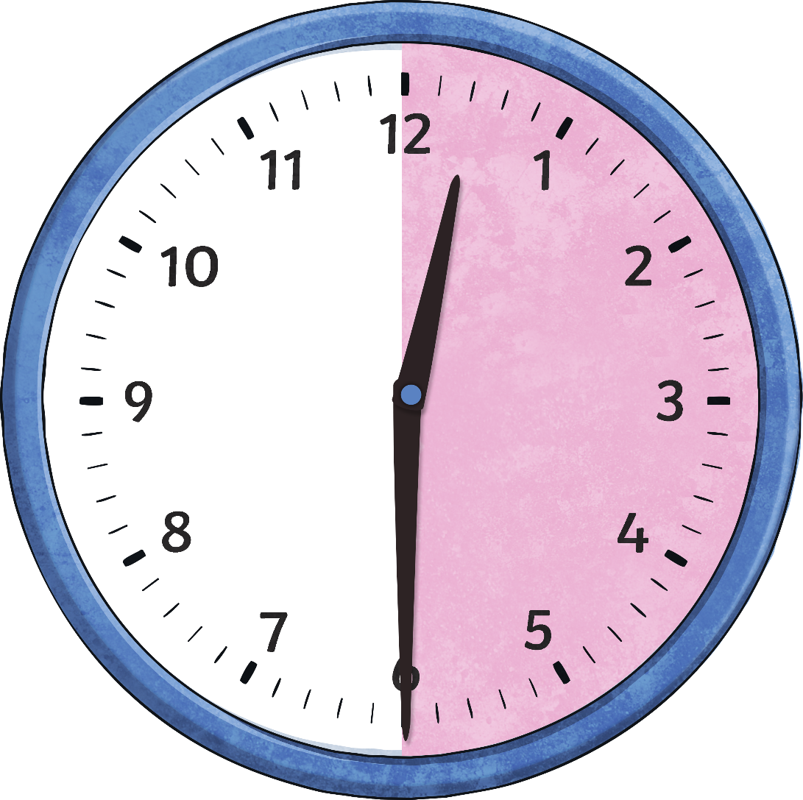
When the big hand points to 5, it means…
When the big hand points to 6, it means…
30
25
minutes
past
minutes
past

Slide 44
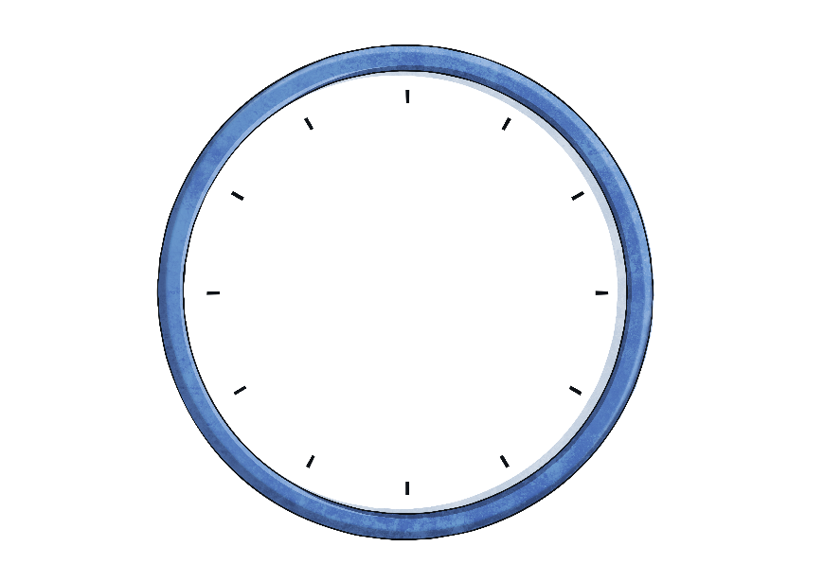
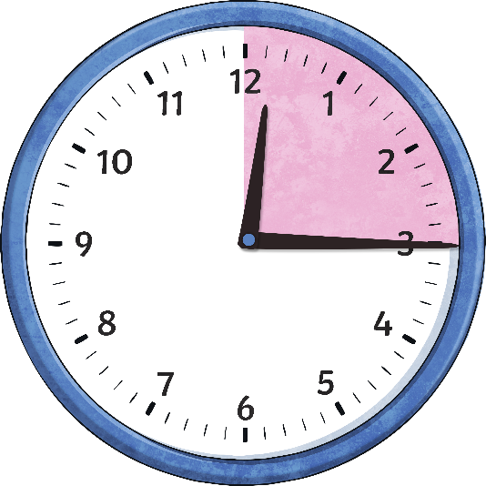
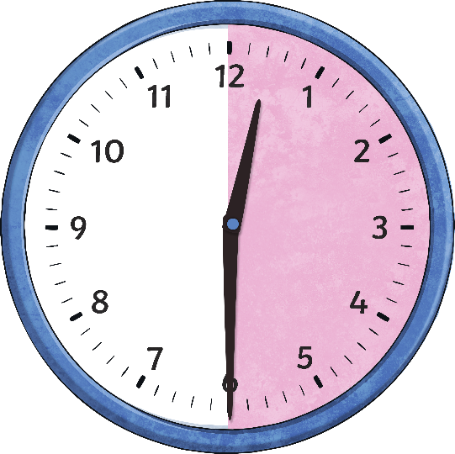
Telling the Time
How many minutes are in an hour?
Why is 15 minutes called ‘quarter past’?
Why is 30 minutes called ‘half past’?
60
minutes
15
minutes
30
minutes
= an hour
= a quarter of an hour
= half an hour

Slide 45
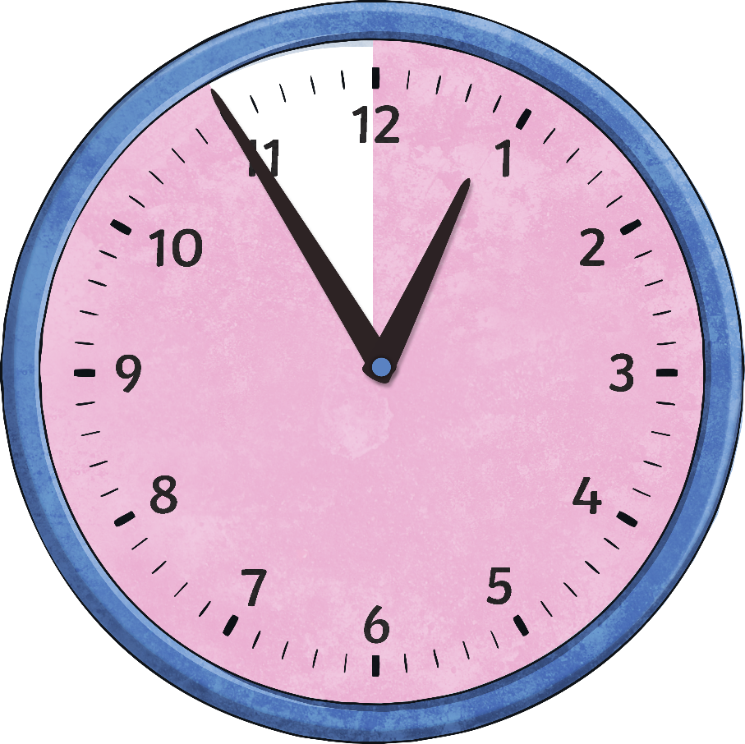
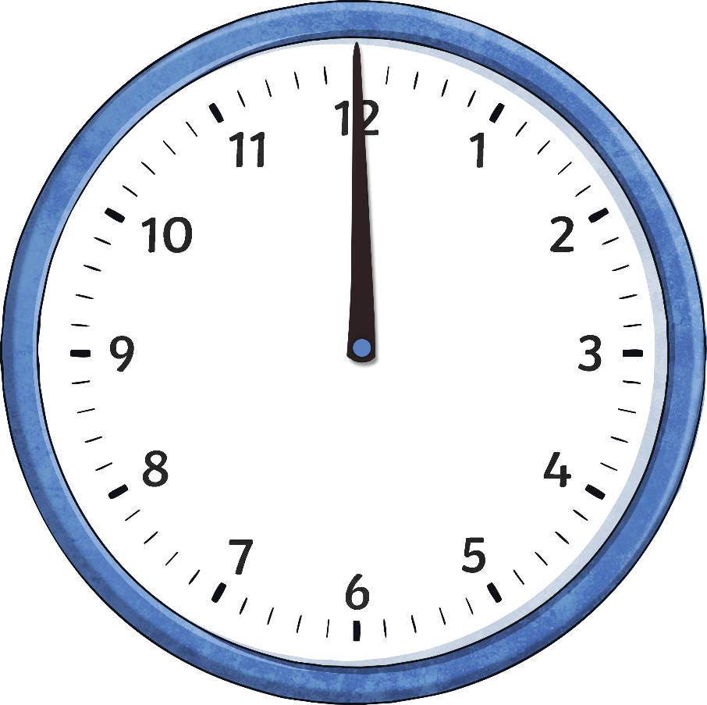
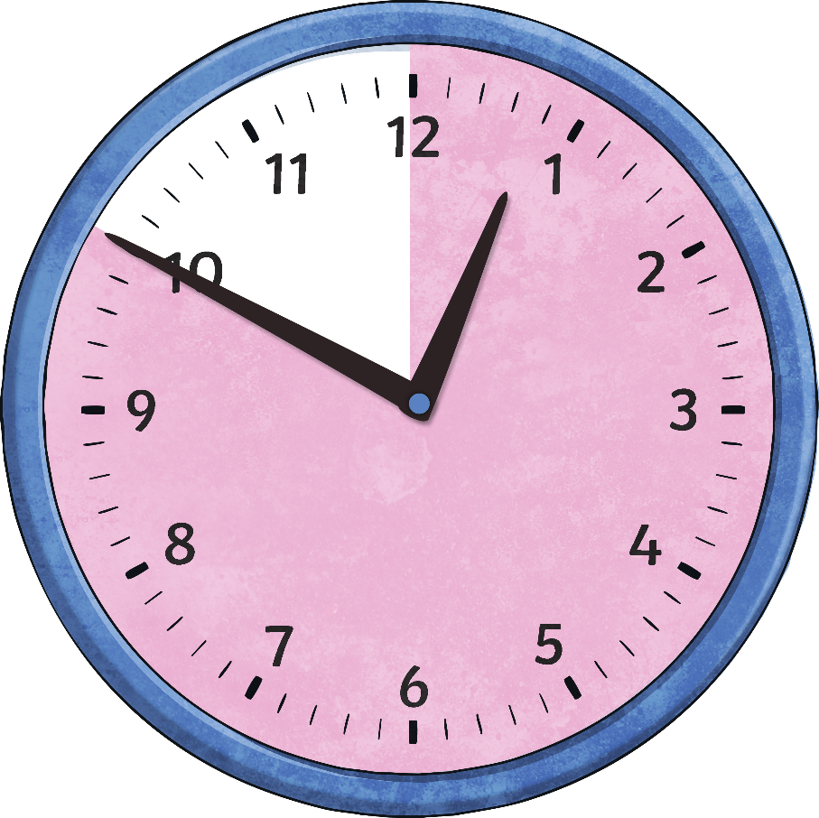
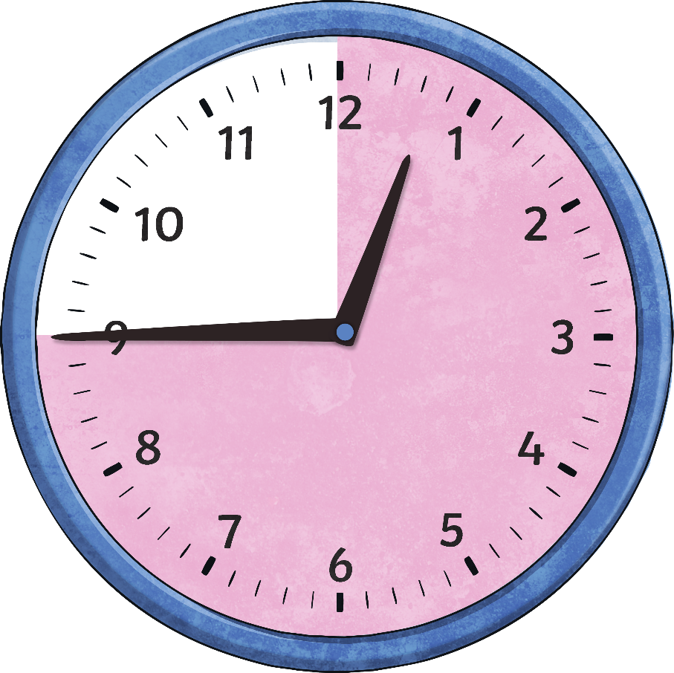
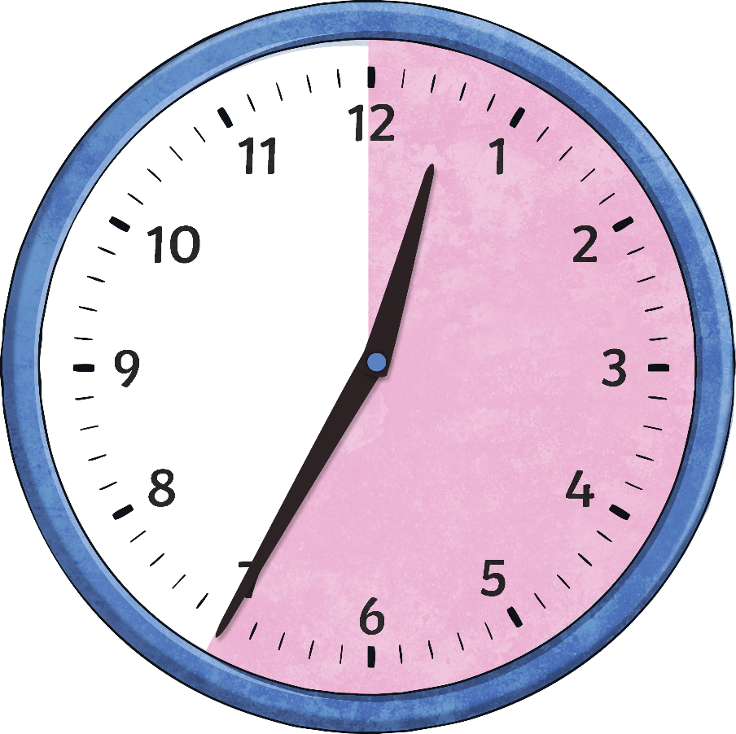
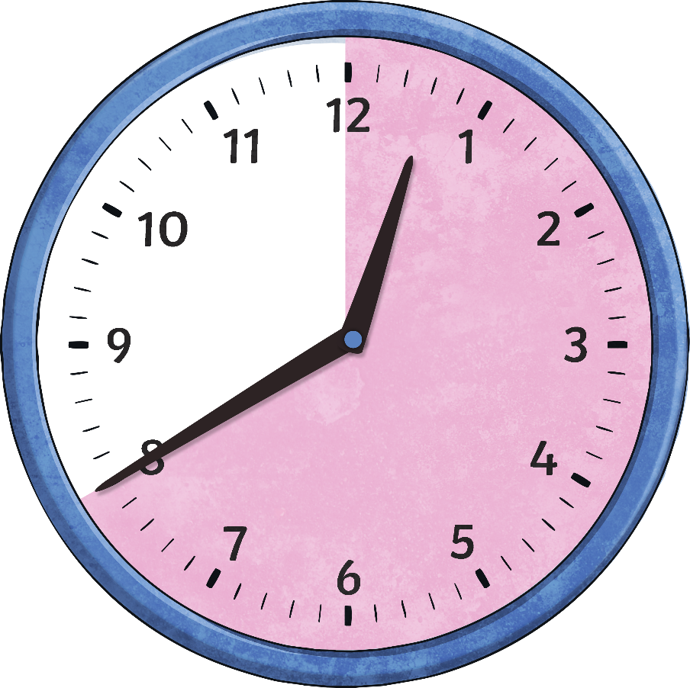
Telling the Time
Now let’s look at the other half of the clock. We are going to look at the minutes to the next hour.
5
10
15
25
20
minutes
to
minutes
to
minutes
to
minutes
to
minutes
to
o’clock

Slide 46
When the big hand points to 7, it means…
When the big hand points to 8, it means…
20
25
minutes
to
minutes
to

Slide 47
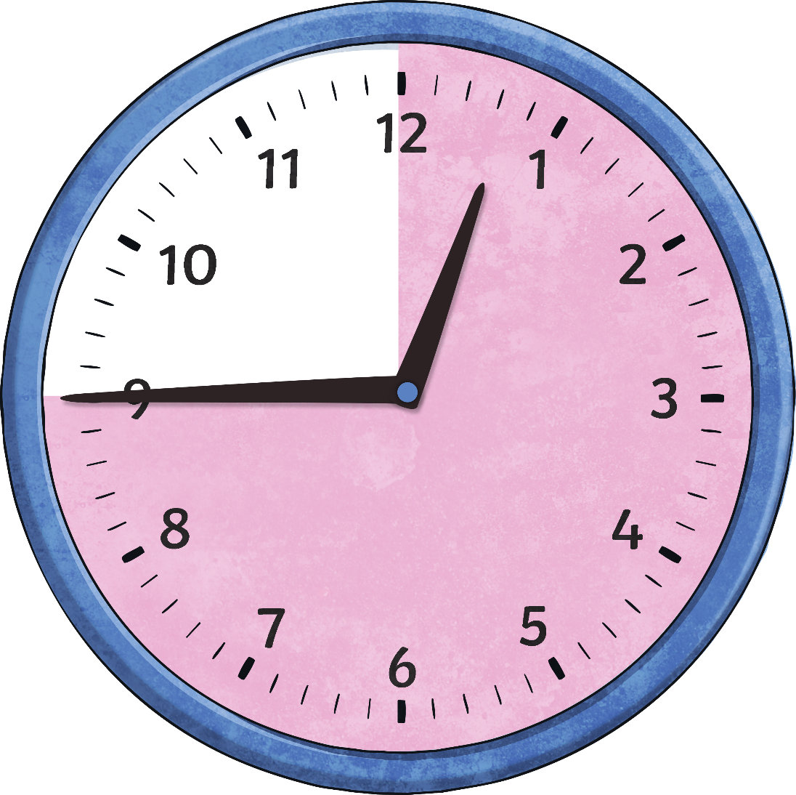
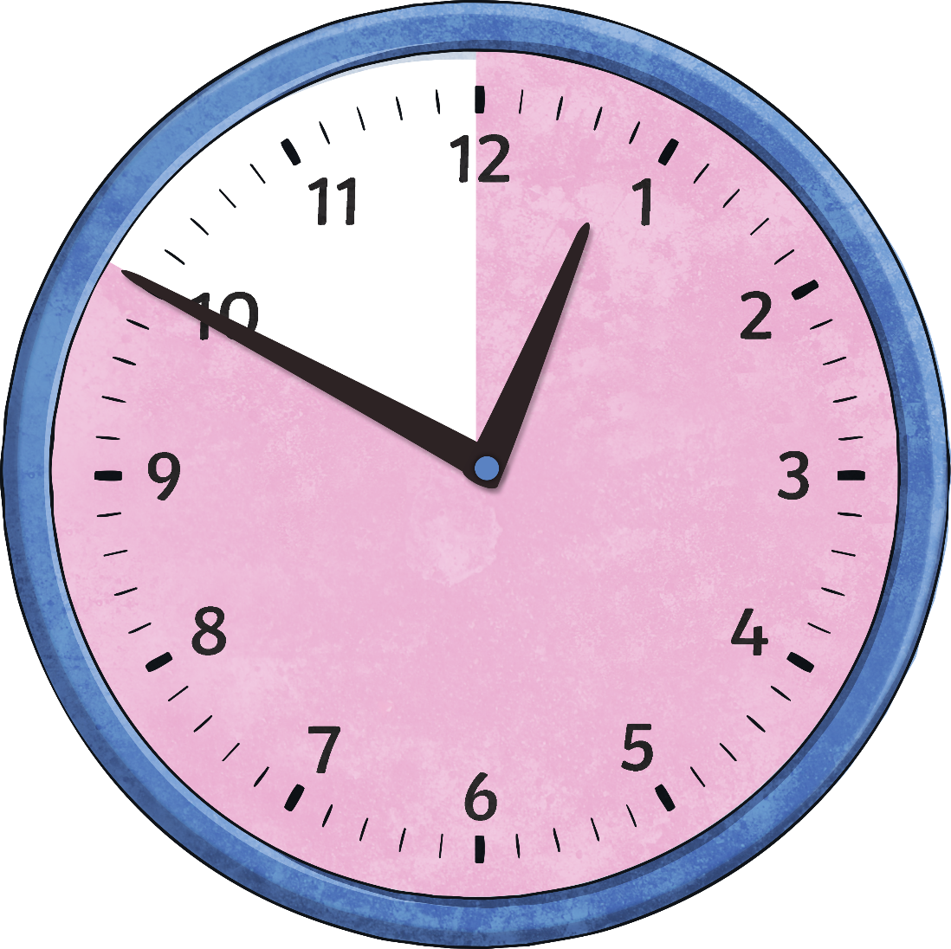
When the big hand points to 9, it means…
When the big hand points to 10, it means…
15
10
minutes
to
minutes
to

Slide 48
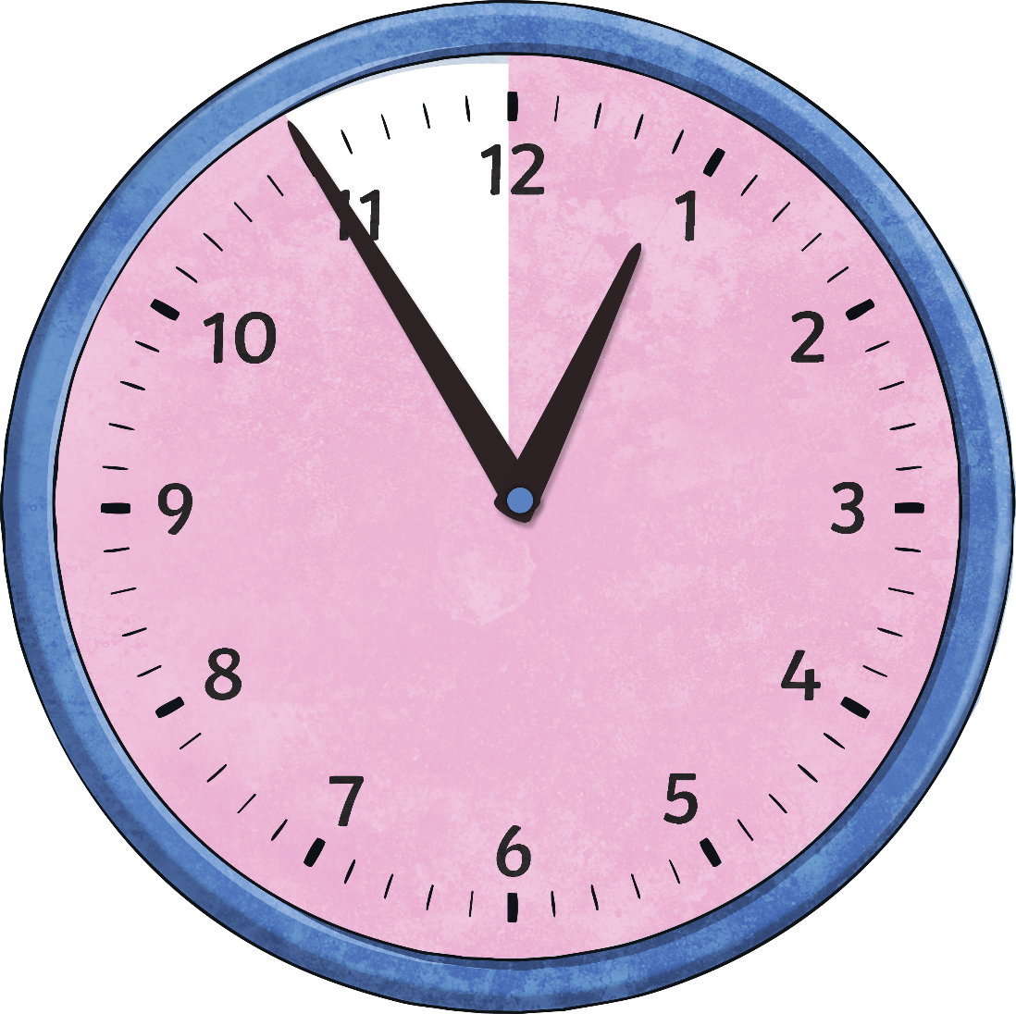
When the big hand points to 11, it means…
5
minutes
to

Slide 49
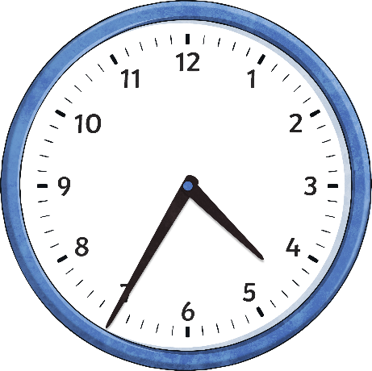
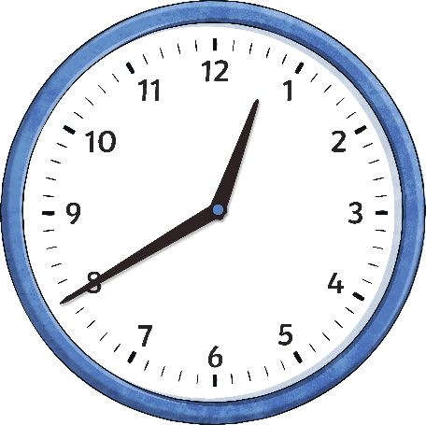
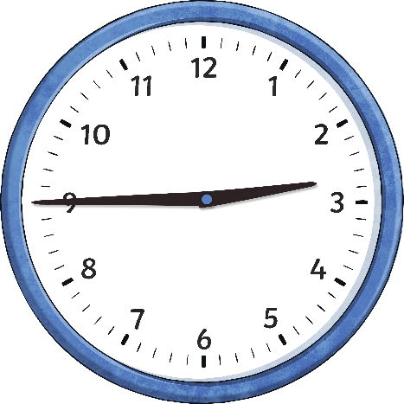
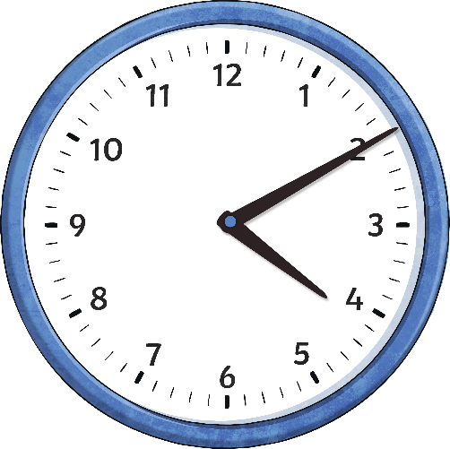
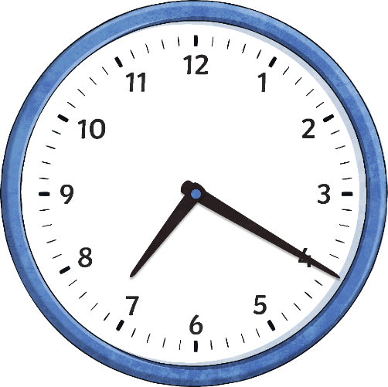
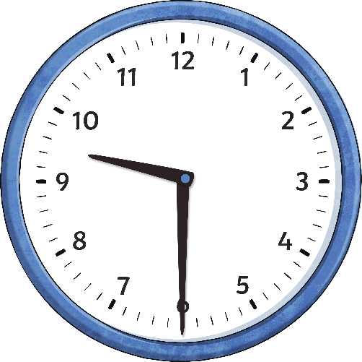
What time does it say on the clock?
___ minutes to ___
___ minutes to ___
______to ____
___ minutes past ____
___ minutes past ____
___ minutes past ____

Slide 50
What time does it say on the clock?
25 minutes to 5
20 minutes to 1
Quarter to 3
10 minutes past 4
20 minutes past 7
Half past nine

Slide 51
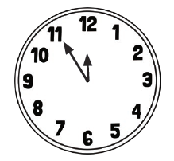
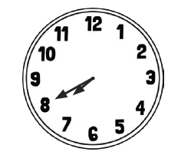
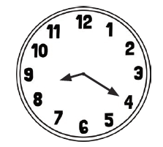
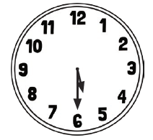
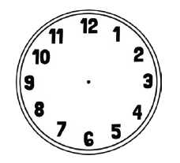
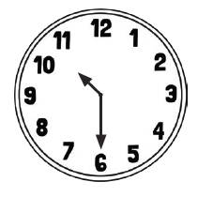
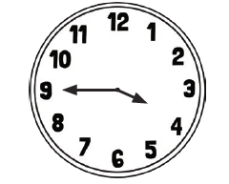
What time does it say on the clock?
Draw 10 minutes past 4 Draw 20 minutes to 3

Slide 52
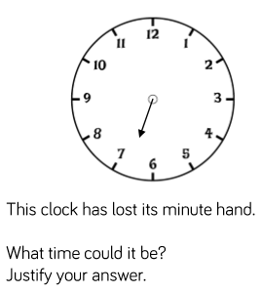
Complete the challenge.

Slide 53
25.2.2021
L.O. To be able to tell the time to 1 minute.
Go to Times Tables Rock Stars to warm up your number brain before you start your maths activity.
Subject: Maths

Slide 54
Pre-recorded Teaching
Access the online teaching video below that will support you to complete the work in this lesson. This video will act as a support but all of the work can still be successfully understood & completed using paper-based versions of this pack. If you need further support to understand / complete work then please contact school via e-mail or telephone.
Play Video
You can also copy and paste this link if you would prefer:
https://classroom.thenational.academy/lessons/reading-analogue-time-to-the-nearest-minute-cdgkjd

Slide 55
Telling the exact time
Each clock has 4 lines between the numbers. These show the minutes
The blue hand is pointing to 8. That means that the exact time shown is 8 minutes past 12.

Slide 56
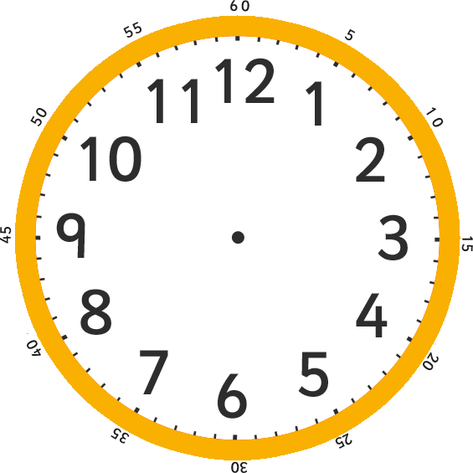
Telling the exact time
Have a look at this example
How many minutes past the hour is the blue hand showing?
The blue hand is showing 13 minutes past 12.

Slide 57
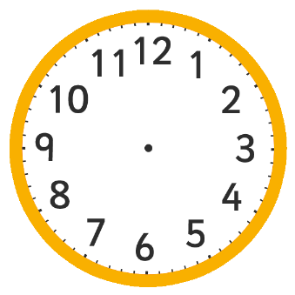
Count On and Count Back
When telling the exact time, it helps to look for points around the clock you are familiar with.
quarter past (15 minutes past)
quarter to (45 minutes past)
half past (30 minutes past)
five minute intervals
Then either count on or count back to find the exact time.
In other words, do a simple addition or subtraction to find the correct time.

Slide 58
Count On and Count Back
What exact time is it?
The blue hand is pointing at 2 minutes after 25 minutes past. In other words:
The exact time here is 27 minutes past 1.
25 + 2 = 27

Slide 59
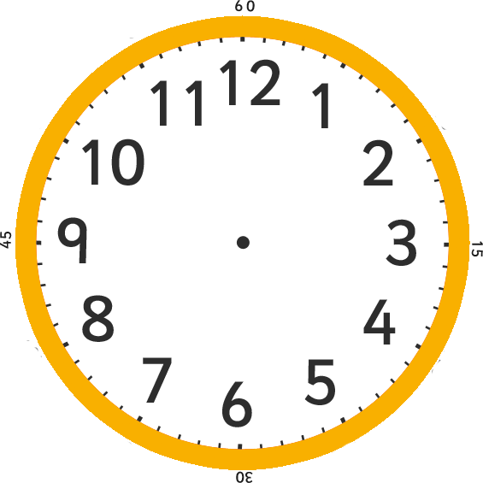
Count On and Count Back
Use the count on and count back method to tell the exact time.
The blue hand is pointing to 3 minutes after 20. That means that the exact time is 23 minutes past 12.
20+3=23
That means that the exact time is 23 minutes past 12

Slide 60
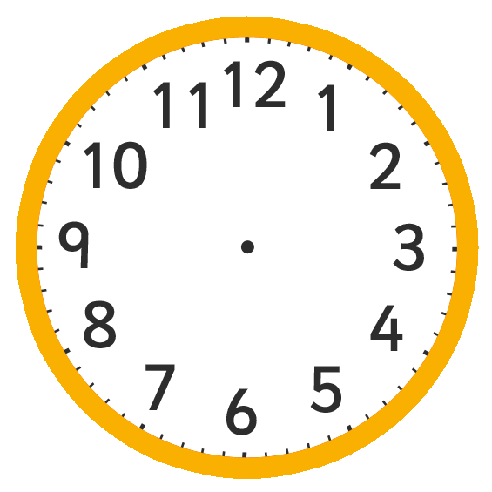
What time is on the clock?
The blue hand is pointing to 2 minutes after 25
So the time is 2+25= __________minutes past _________

Slide 61
What time is on the clock?
The blue hand is pointing to 2 minutes after 25
So the time is 2+25= 27 minutes past 2

Slide 62
What time is on the clock?
The blue hand is pointing to 1 minute to 25 minutes to 3
So 25+1= __________ minutes to __________

Slide 63
What is the time to the nearest minute?

Slide 64
Complete the challenge
It takes Carla 23 minutes to drive to work. She needs to arrive at work for half past 8. What tine does she need to set off?
Draw the time she needs to leave the house on the clock face.

Slide 65
26.2.2021
L.O. To be able use a.m. and p.m.
Go to Times Tables Rock Stars to warm up your number brain before you start your maths activity.
Subject: Maths

Slide 66
Pre-recorded Teaching
Access the online teaching video below that will support you to complete the work in this lesson. This video will act as a support but all of the work can still be successfully understood & completed using paper-based versions of this pack. If you need further support to understand / complete work then please contact school via e-mail or telephone.
Play Video
You can also copy and paste this link if you would prefer:
https://classroom.thenational.academy/lessons/telling-the-time-to-am-and-pm-68w3cd?activity=video&step=1

Slide 67
There are different times of the day. There is A.M. which is classed as the morning and can be used for anytime of the day between 12 at night and 12 midday. There is also P.M. This is the afternoon and evening which can be used for anytime of the day after 12 midday and up until 12 at night.
Hours of the day that could be a.m.
1 a.m.
2 a.m.
3 a.m.
4 a.m.
5 a.m.
6 a.m.
7 a.m.
8 a.m.
9 a.m.
10 a.m.
11 a.m.
12 a.m.
Hours of the day that could be p.m
1 p.m.
2 p.m.
3 p.m.
4 p.m.
5 p.m.
6 p.m.
7 p.m.
8 p.m.
9 p.m.
10 p.m.
11 p.m.
12 p.m.

Slide 68
Using a.m. and p.m.
Which lessons are in the morning and which are in the afternoon?

Slide 69
Using a.m. and p.m.
Which lessons are in the morning and which are in the afternoon?
Maths | French | DT
Spelling | Geography | Grammar
morning
afternoon
afternoon
10:15 a.m.
1:20 p.m.
1:55 p.m.
morning
morning
afternoon
11:55 a.m.
10:40 a.m.
3:05 p.m.

Slide 70
There are two types of clocks, do you know what they are?
Analogue
Digital

Slide 71
When we tell the time, we can do it in either analogue or digital.
Example
Imagine this clock is showing the time in the afternoon.
In analogue we would say it’s 20 minutes to 1.
In digital we would say it’s 12:40 p.m.

Slide 72
When we tell the time, we can do it in either analogue or digital.
Example
Imagine this clock is showing the time in the morning.
In analogue we would say it’s 10 minutes past 4.
In digital we would say it’s 4:10 a.m.

Slide 73
When we tell the time, we can do it in either analogue or digital.
Example
Imagine this clock is showing the time in the morning.
In analogue we would say it’s half past 9
In digital we would say its 09:30 a.m.

Slide 74
Look at the clock.
The time is 27 minutes past 1.
What would be the time in digital?
__________p.m.
__________a.m.

Slide 75
Look at the clock.
The time is 27 minutes past 1.
What would be the time in digital?
01:27p.m.
01:27a.m.

Slide 76
Look at the clock.
The time is 26 minutes to 3.
What would be the time in digital?
________p.m.
________a.m.

Slide 77
Look at the clock.
The time is 26 minutes to 3.
What would be the time in digital?
3:26 p.m.
3:26 a.m.

Slide 78
1.

Slide 79
2. Show these times on both analogue and digital clocks.
20 minutes past 4
25 minutes to 1
Quarter to 5
Half past 6

Slide 80
Complete the challenge

