Slide 1



Date: Tuesday 11th – Friday 15th January
L.O To be able to recognise special friends.
Please practise phonics every day for 20 minutes.
Subject: Phonics

Slide 2
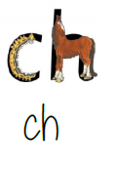
Special Friends – Sound 1
‘Special friends’ are two letters that make one sound.
When we put ‘c’ and ‘h’ together they form the sound ‘ch’.
Try my turn, your turn with a partner “ch” > “ch”
Say: ch- ch-ch-choo!
The horse sneezes when the caterpillar hairs tickle his nose.
(This is a bouncy sound)

Slide 3


Blending Independently – Special Friends
Fred Talk - Fred Frog can only say words in sounds but not the entire word all at once for example ch-i-p.
Read the Phonics green word card: Special Friends, Fred talk, read the word.
chip
chep
chat
roch
Review the words
Special Friends, Fred Talk, read the word
Fred in your head
Speedy reading
Can you separate the real words from the alien words?

Slide 4

Review and Write
Can you spot todays Special Friends?
Try thinking of some other words that have the sound ‘ch’.
Examples - chip chunk chat
Challenge! Can you put a word from your list into a sentence?
Example- I always chat with my friends.

Slide 5
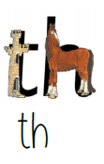
Special Friends – Sound 2
‘Special friends’ are two letters that make one sound.
When we put ‘t’ and ‘h’ together they form the sound ‘th’.
Try my turn, your turn with a partner “th” > “th”
Say: thhhhh
The horse rescues the princess from the tower and the princess says thhhhankyou.
(stretchy sound)

Slide 6




Blending Independently – Special Friends 2
Fred Talk - Fred Frog can only say words in sounds but not the entire word all at once for example .
Read the Phonics green word card: Special Friends, Fred talk, read the word.
thick
thup
path
pith

Slide 7


Review and Write 2
Try and think of other words that have the sound ‘th’.
Examples – path thick thump
Challenge! Can you put a word from your list into a sentence?
Example – I ride my bike down the path.

Slide 8


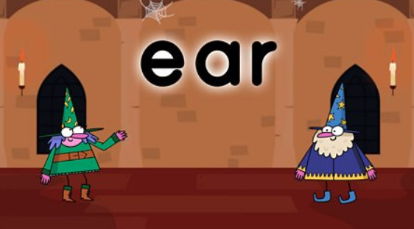
Phonics
BBC Bitesize has lots of 30 second videos focusing on each of the phonics sounds.
https://www.bbc.co.uk/bitesize/topics/zvq9bdm
Copy and paste the link.

Slide 9
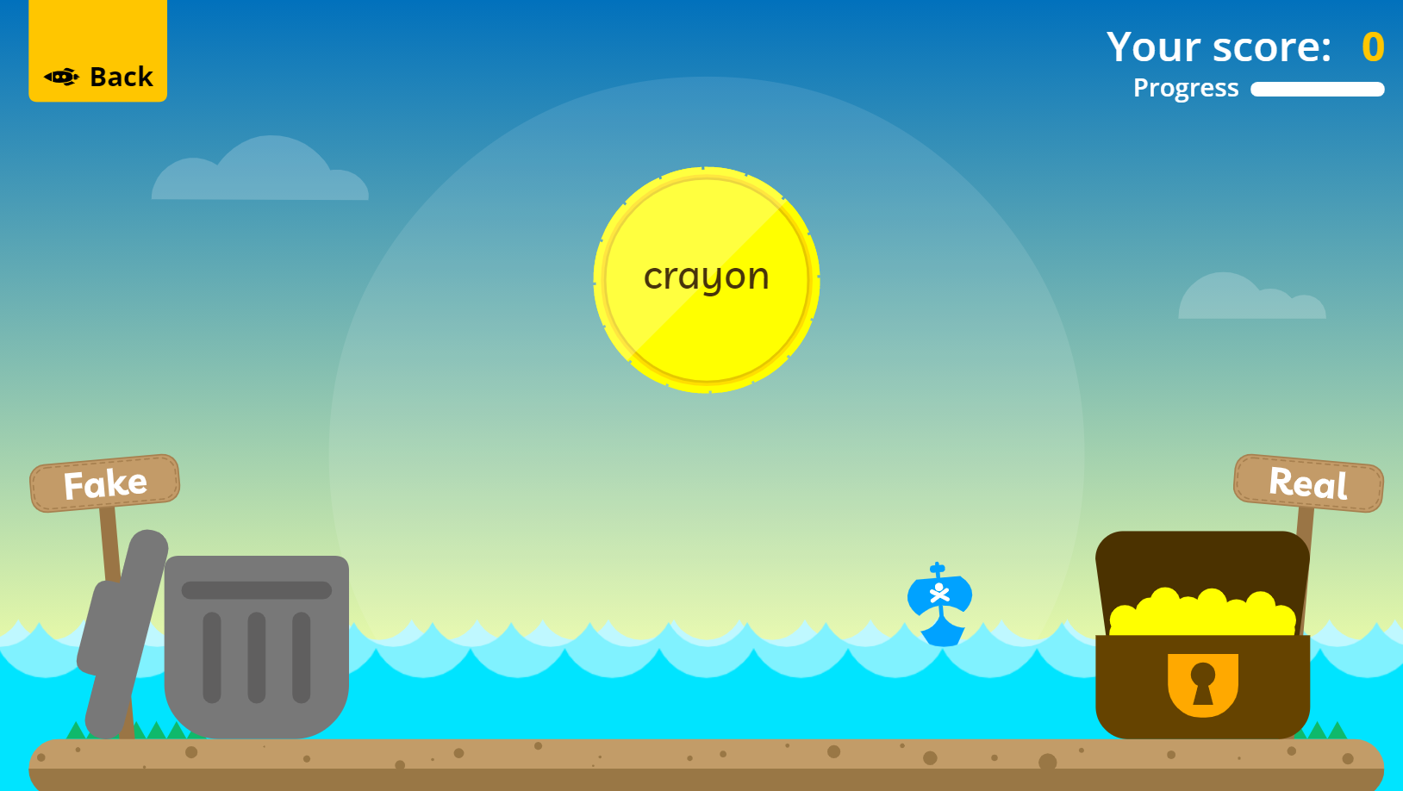
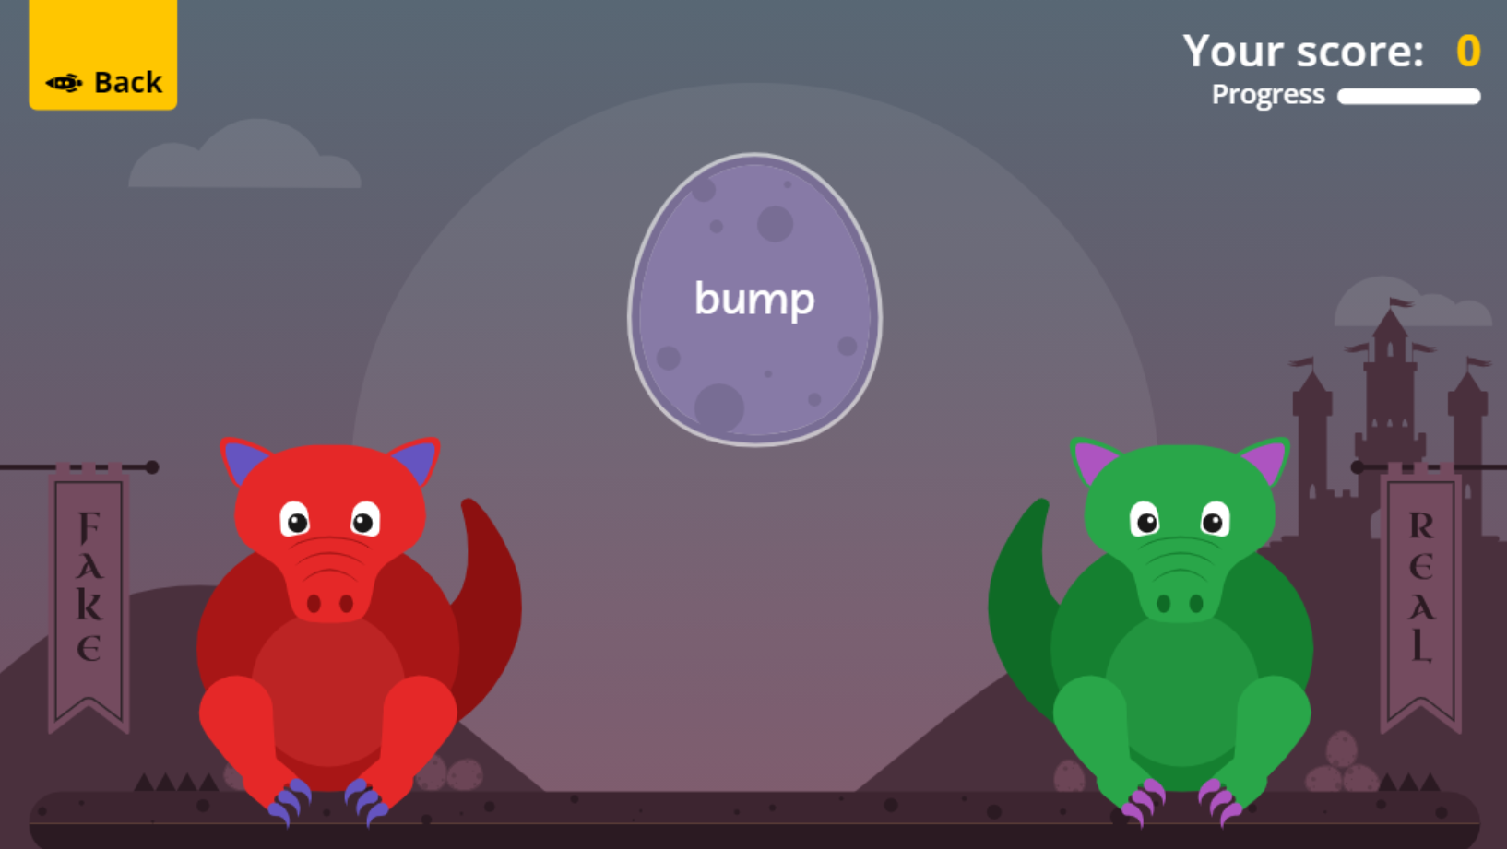

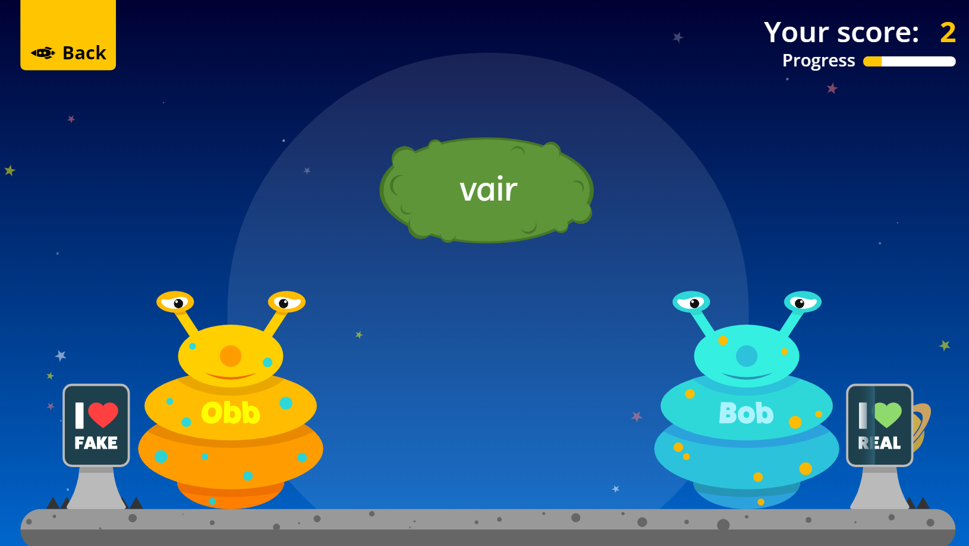
Fun Phonics Games!
Copy and paste the link to play these fun phonics games!
https://www.phonicsplay.co.uk/resources/phase/2/buried-treasure
All phases
https://www.phonicsplay.co.uk/resources/phase/2/dragons-den
All phases
https://www.phonicsplay.co.uk/resources/phase/2/picnic-on-pluto
All phases

