Slide 1

Subject: Maths
Pack: A

Slide 2

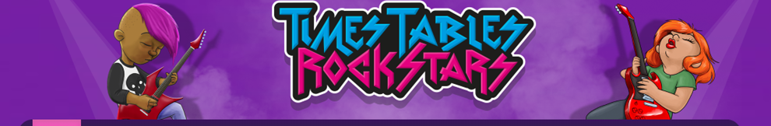

28.6.21
This lesson was also included in the first week'spowerpoint so you may have completed it if you were ahead
L.O To be able to count in multiples
Go to Times Tables Rock Stars to warm up your number brain before you start your maths activity.
Subject: Maths

Slide 3
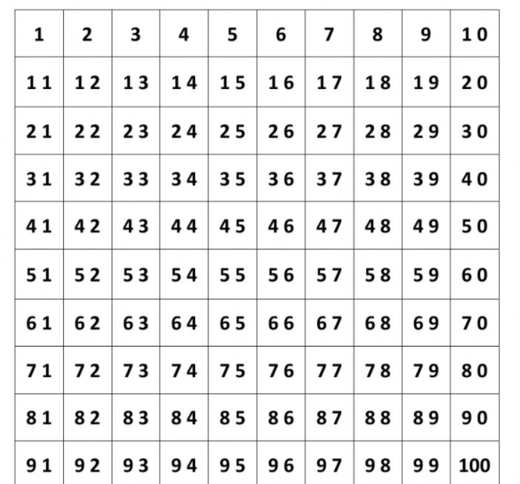

When we count in multiples we need to start at zero and count in equal steps
Use the number square and colour in all the multiples of 8.
Can you do the same using a different colour to identify the multiples of 12?

Slide 4
Complete the number sequences by counting on in jumps of 8 or 12.
1. ______ 24 36 _______ ________
2. 8 ______ _______ 32 ______
3. _______ _______ 60 _______ _______
4. 32 _______ 48 ______ ______ ______
5. 60 ________ 36 ______ ______ ______
6. 96 ______ 80 ______ ______ ______
7. 72 ______ ______ 48 _______
8. 48 ______ ______ ______ _______
9. 120 ______ 96 ______ ______ ______
10. 88 ______ 72 ______ ______ ______
Tip: Count on or back from the last number. Use the number square on the last page to help.
Subject: Maths

Slide 5
Can you use your knowledge of counting in multiples to complete the calculations
6 x _____ = 48 6. _____x _____ = 80
5 x _____ = 60 7. _____x _____ = 48
7 x _____ = 84 8. _____x _____ = 96
9 x _____ = 108 9. _____x _____ = 72
2 x _____ = 24 10. _____x _____ = 60

Slide 6
29.6.21
L.O To be able to order numbers
Go to Times Tables Rock Stars to warm up your number brain before you start your maths activity.
Subject: Maths

Slide 7
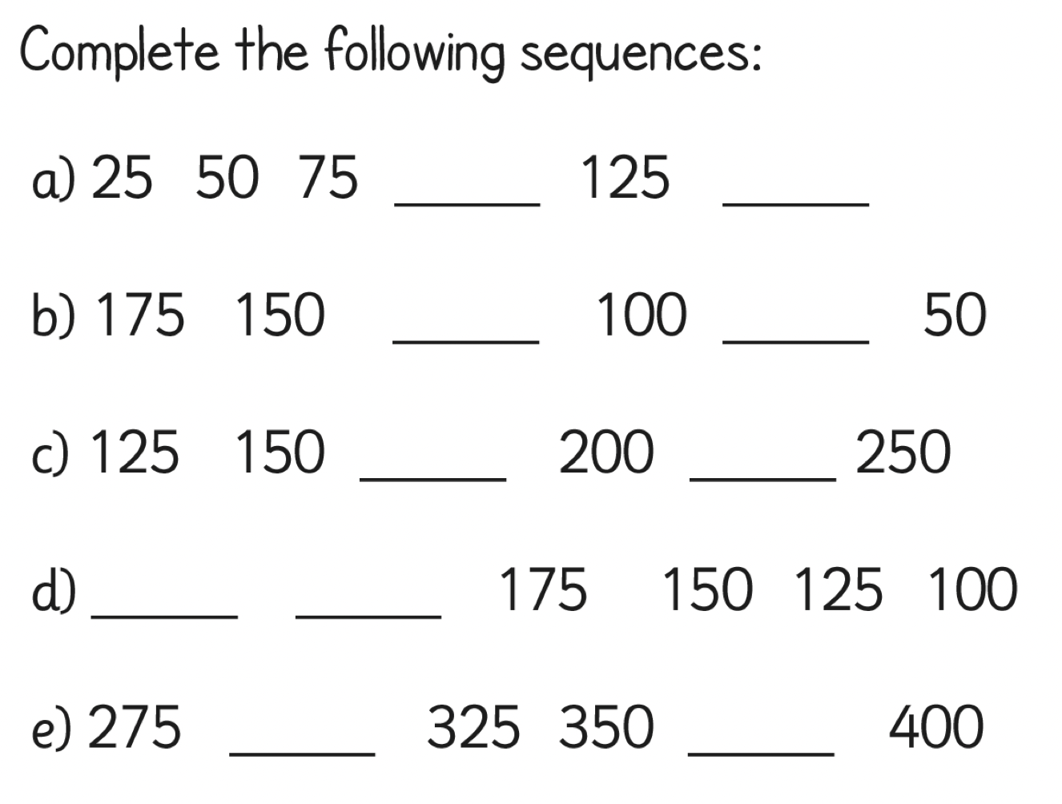

Starter - Counting in 25s

Slide 8
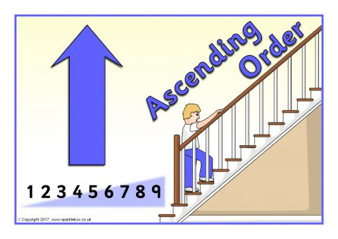
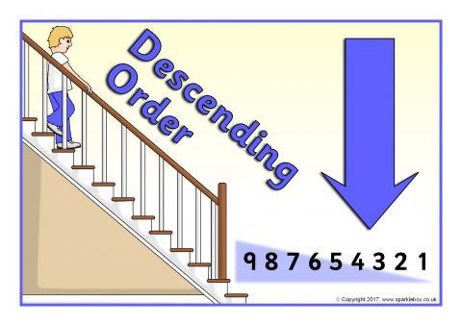
We can order numbers in ascending and descending order
Example-
Ascending - 1321, 2367, 2402
Decending- 5402, 5367, 5321

Slide 9
Order these numbers in ascending order -
1. 1218, 2421, 1223, 1204, 2105
_______ , _______ , _______ , _______ , _______
2. 3246, 3521, 4321, 1464, 3442
_______ , _______ , _______ , _______ , _______
3. 3795, 3701, 3765, 3762, 3703
_______ , _______ , _______ , _______ , _______
4. 8432, 8423, 8322, 8332, 8422
_______ , _______ , _______ , _______ , _______
HINT-
Think of place value, look at Ths first, then the H ....

Slide 10
Order these numbers in decending order -
1. 4353, 5311, 5544, 4504. 4340
_______ , _______ , _______ , _______ , _______
2. 5211, 6789, 6922, 5336, 6207
_______ , _______ , _______ , _______ , _______
3. 1422, 1490, 1435, 1418, 1486
_______ , _______ , _______ , _______ , _______
4. 2892, 2982, 2882, 2998, 2989
_______ , _______ , _______ , _______ , _______
HINT-
Think of place value, look at Ths first, then the H ....

Slide 11
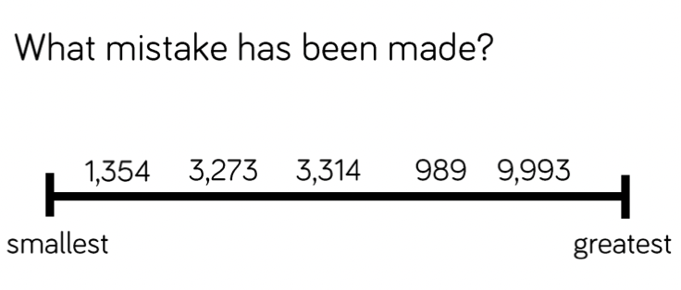
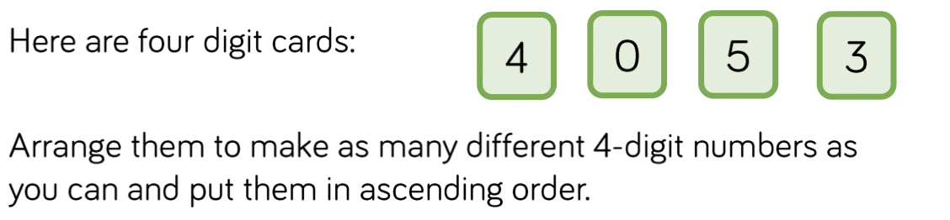
Grey box challenge

Slide 12
30.6.21
L.O To be able to compare numbers
Go to Times Tables Rock Stars to warm up your number brain before you start your maths activity.
Subject: Maths

Slide 13
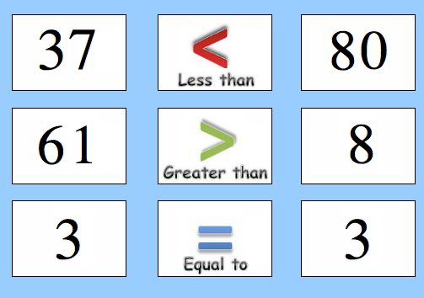
Comparing numbers
e.g.
1. 1421 ____ 1422
2. 2310 ____ 2301
3. 6326 ____ 6378
4. 6532 ____ 6522
5. 5402 ___ 5309
6. 3336 ____ 3326

Slide 14

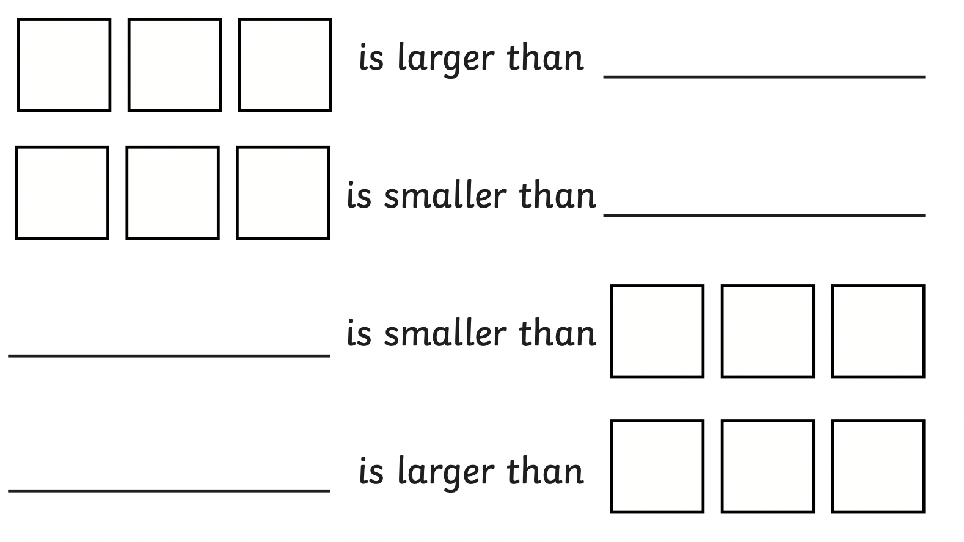
Add your own numbers to make these sentences correct. You could even roll a dice if you have one :)

Slide 15
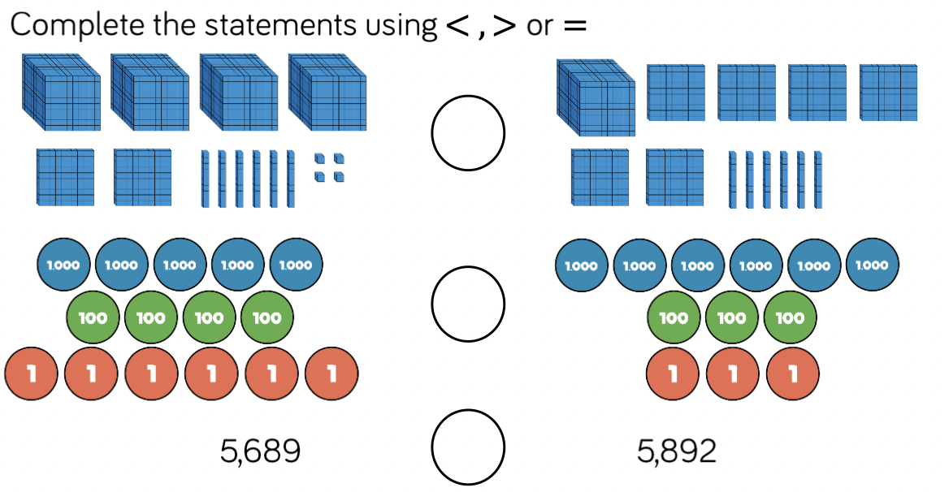

Slide 16
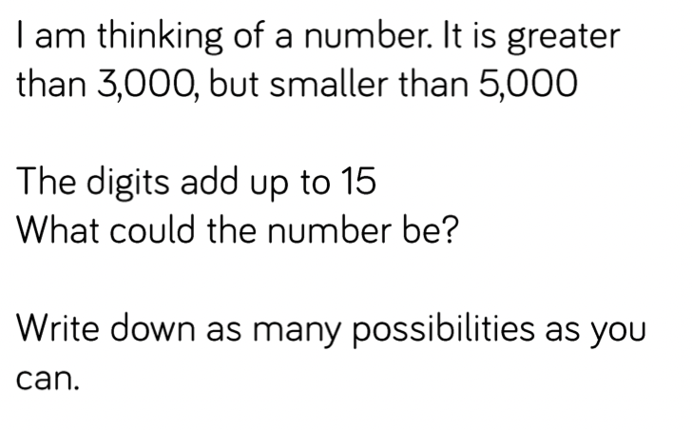
Grey box challenge
E.g.
3228
3282

Slide 17
1.7.21
L.O To be able to recognise pounds and pence
Go to Times Tables Rock Stars to warm up your number brain before you start your maths activity.
Subject: Maths

Slide 18
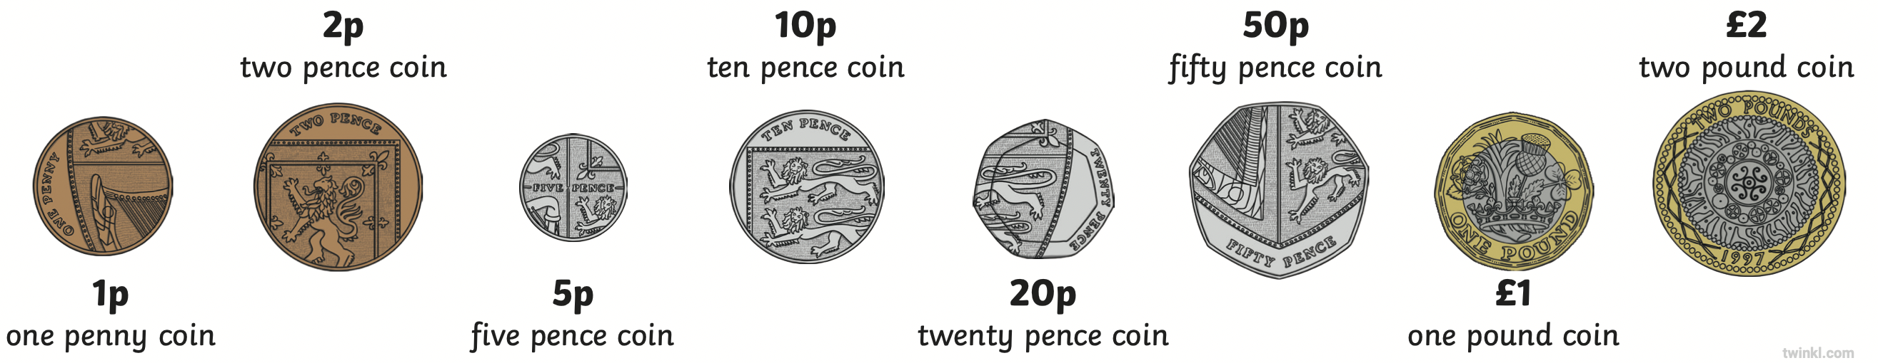
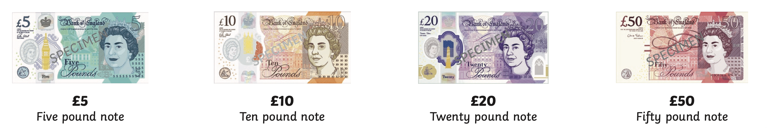
Here are all the coins and notes that we use -

Slide 19
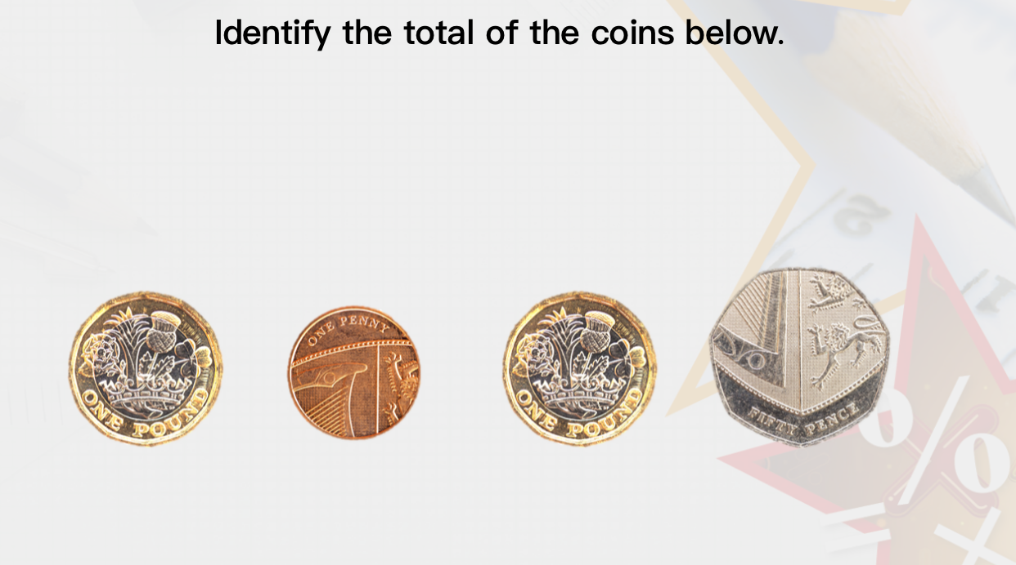
When finding the total of coins, start with the largest amount
Here I would add the 2 £1 together
then the 50 p and 1 p
Total = £2.51p

Slide 20
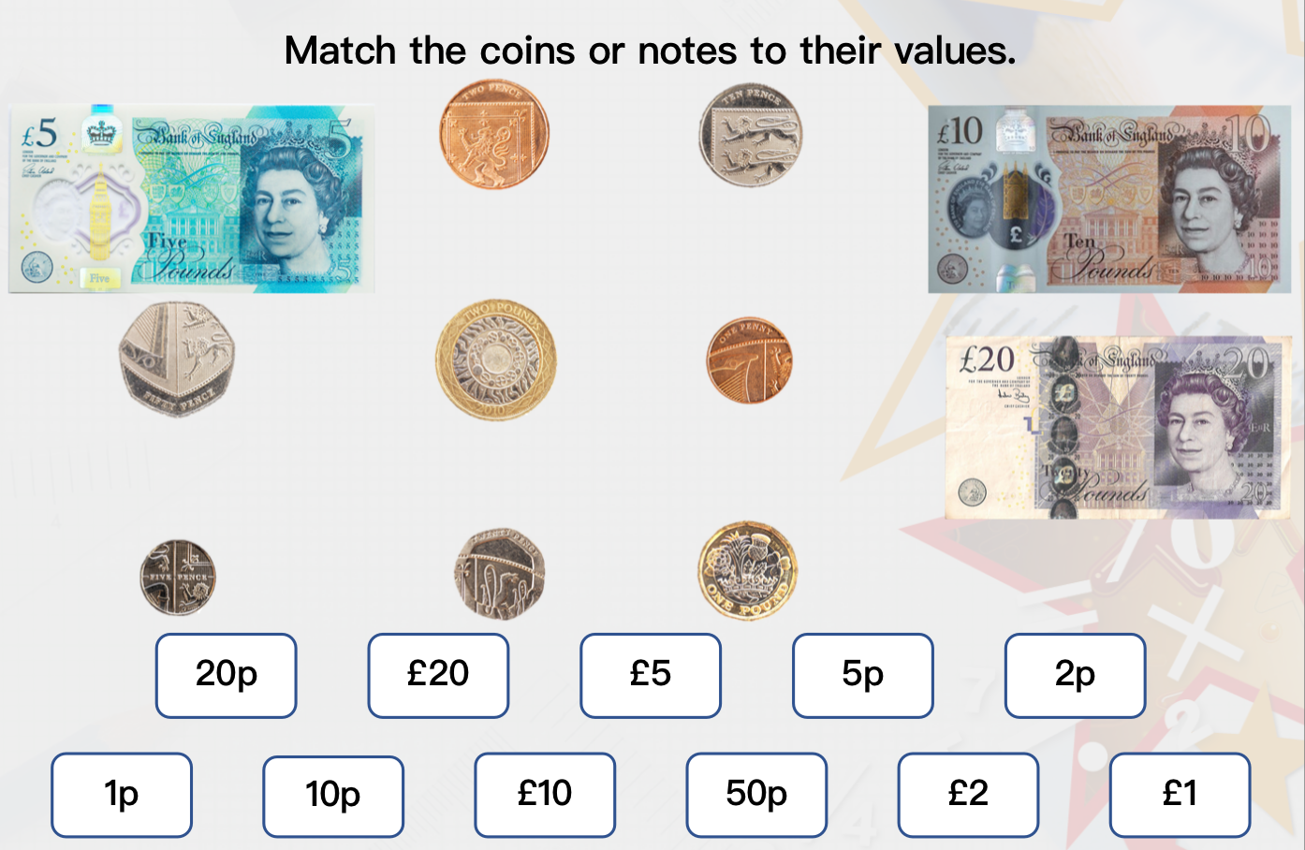

Slide 21
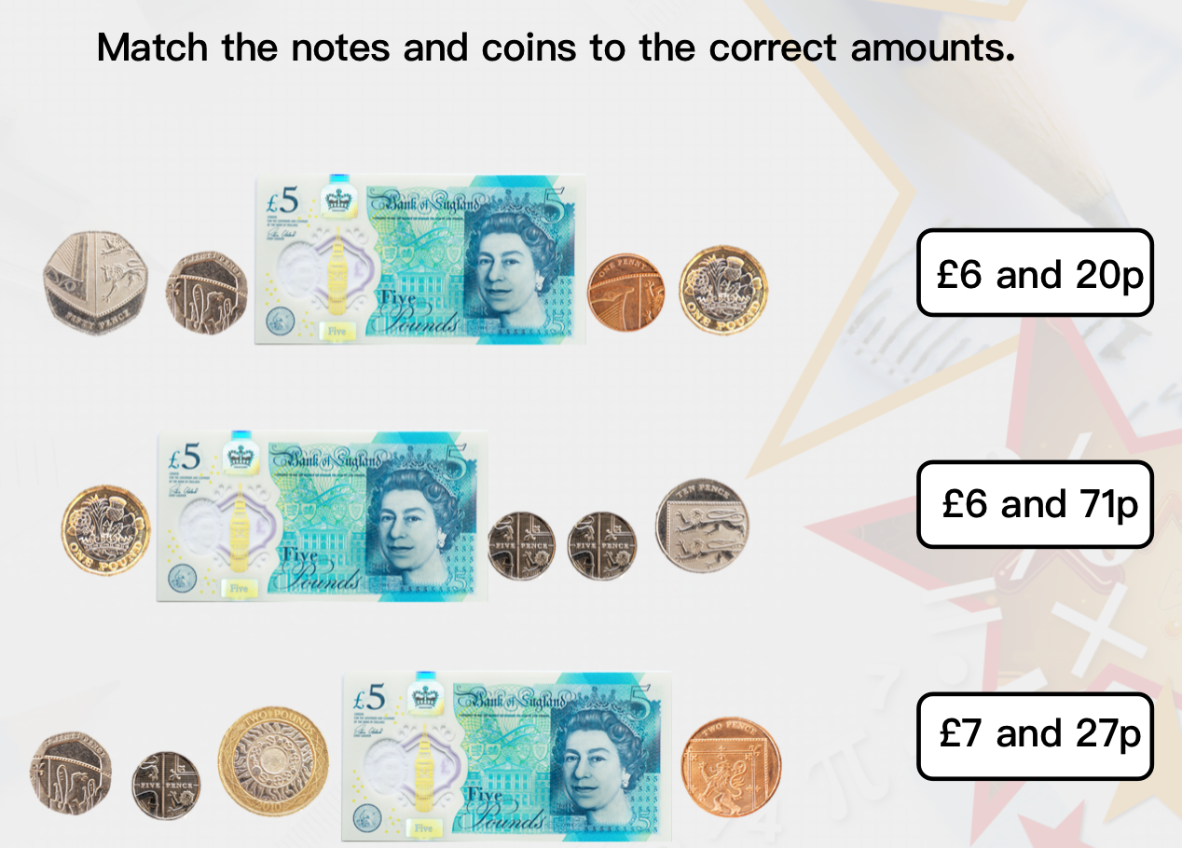

Slide 22
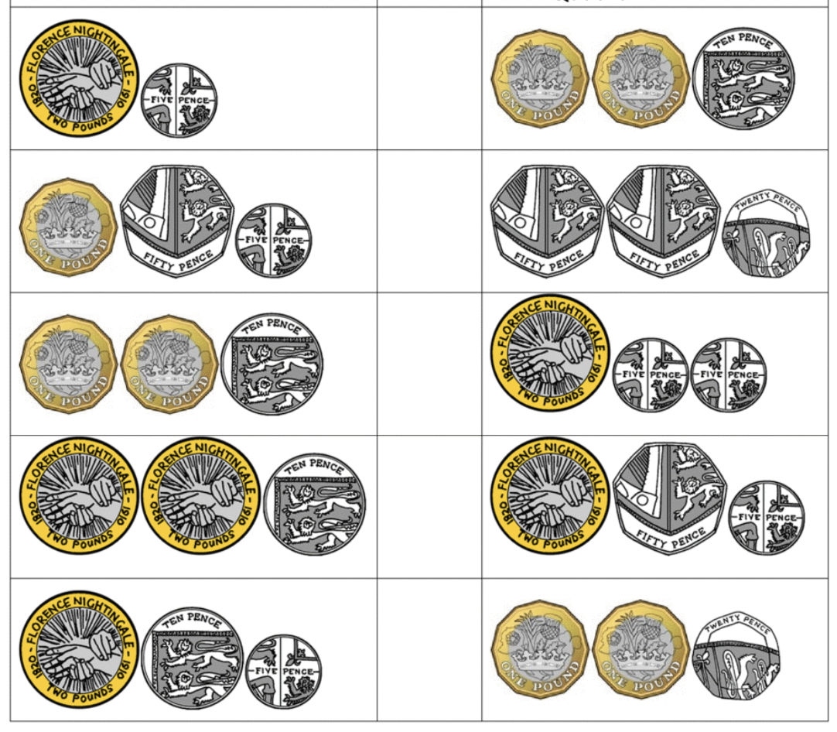
Add the the coins together and add the greater / less than sign
£2.05
_________________
_________________
_________________
_________________
£
_________________
_________________
_________________
_________________

Slide 23
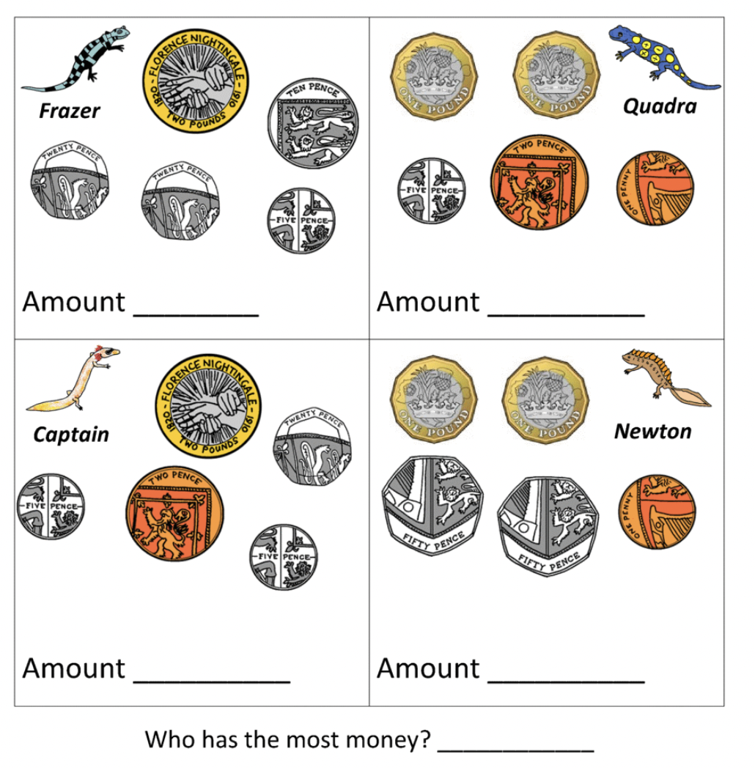
1
2
3
4

Slide 24
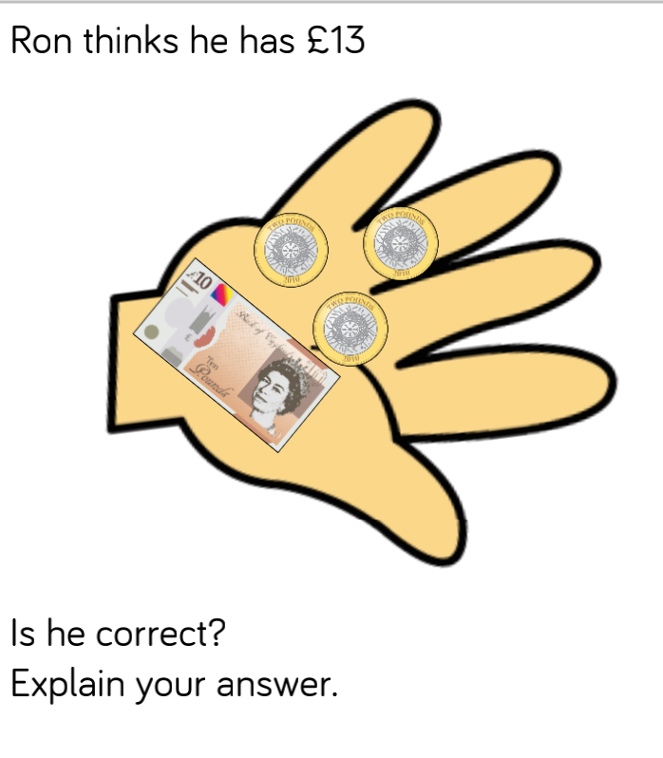
Grey box challenge

Slide 25
2.7.21
L.O To be able to identify fractions
Go to Times Tables Rock Stars to warm up your number brain before you start your maths activity.
Subject: Maths

Slide 26
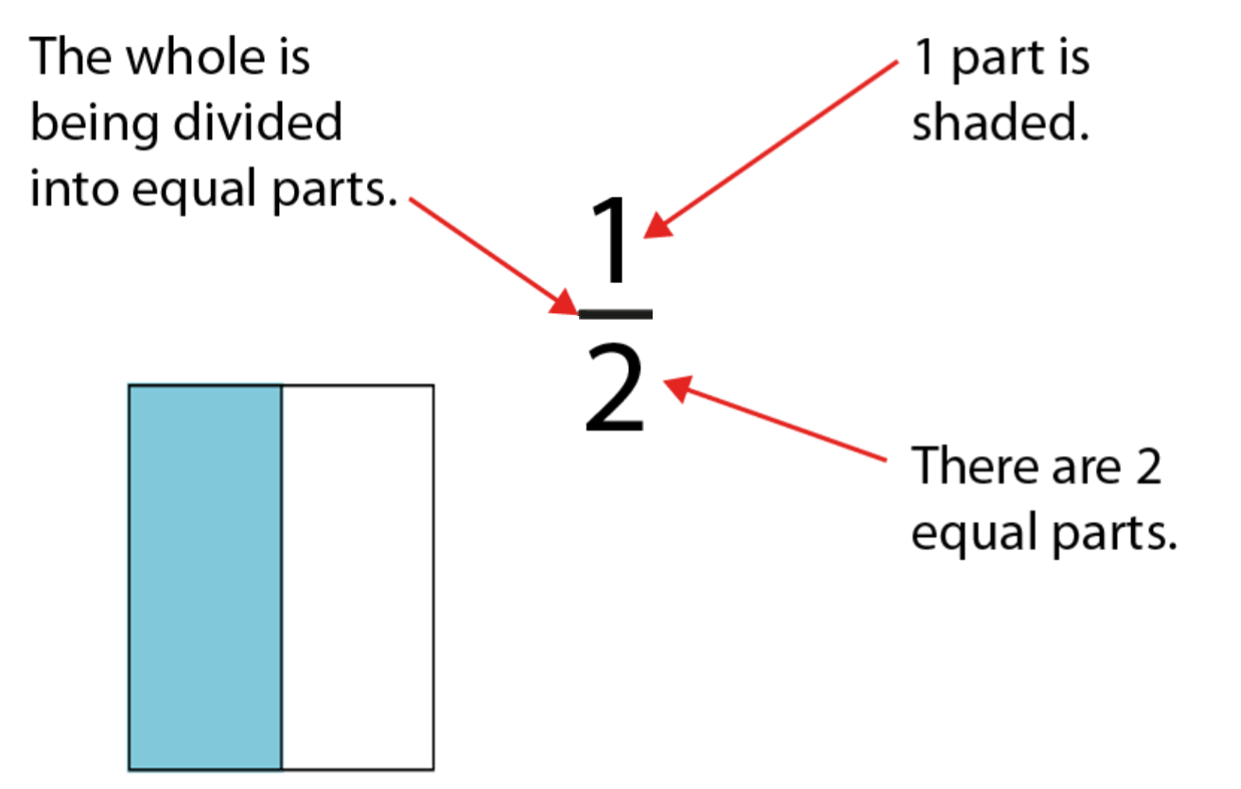
A fraction represents a part of a whole
Numerator
Denominator

Slide 27
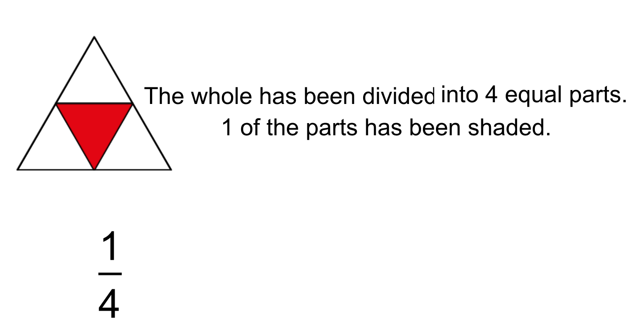

Slide 28
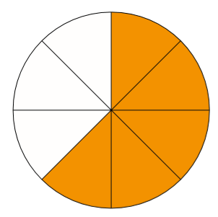
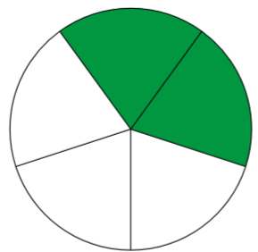


Slide 29

Fractions can be represented in different ways

Slide 30
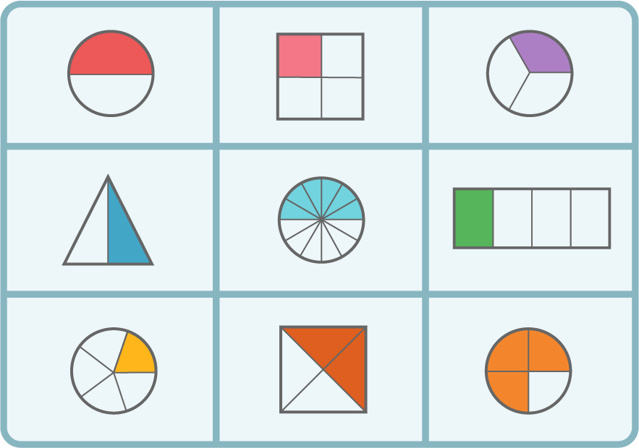
Write the correct fraction for each picture.
1.
2.
3.
4.
5.
6.
7.
8.
9.
1. 2. 3.
4. 5. 6.
7. 8. 9.

Slide 31
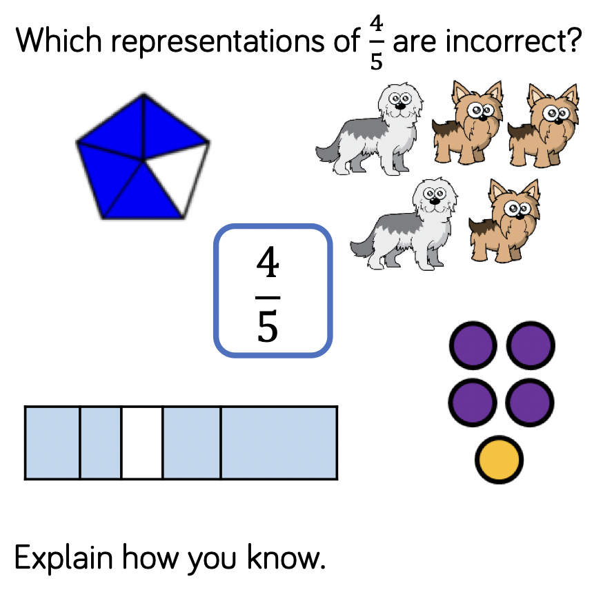
Grey box challenge

