Slide 1

Base 6

Slide 2



Date:
Monday 28th June 2021
LO
To be able identify the second set of speed sounds.
Subject: English

Slide 3


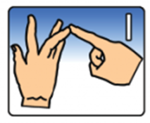


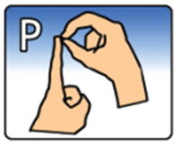
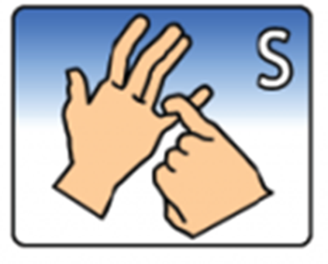
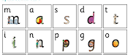

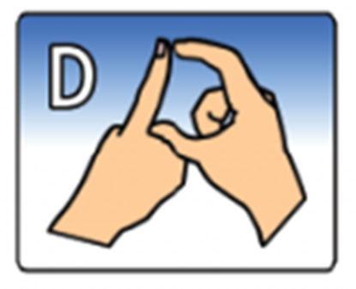
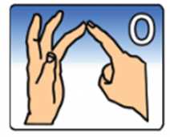
PHONICS
This week in phonics we are going to look at the following:
Blending using our speed sounds
M A S D T I N P G O

Slide 4
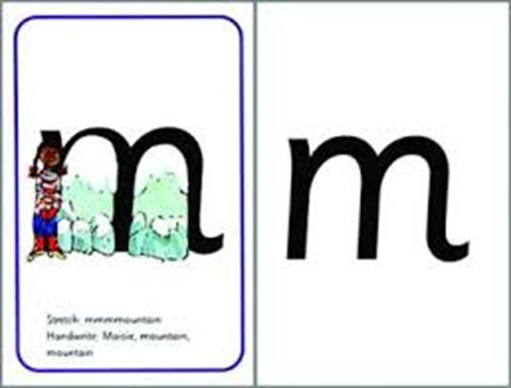

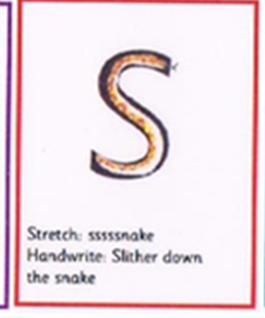
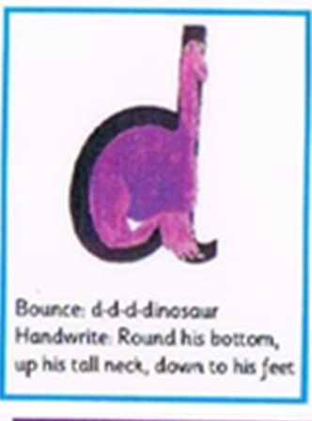

Using the letters above can you try blending the following words:
M-A-T MAT
S-A-D SAD
M-A-D MAD
A-T AT
S-A-T SAT
D-A-D DAD
Ask your child to look at you. Say the first letter in an exaggerated manner. For example, M-A-T ask your child to copy you. Point at each picture as you say them.
Then say the sounds followed by the whole word
E.g. M-A-T …Mat
Ask your child to copy.
Repeat a few times saying both the sounds and the word in an exaggerated manner. Add the meaning of the world if it helps.

Slide 5
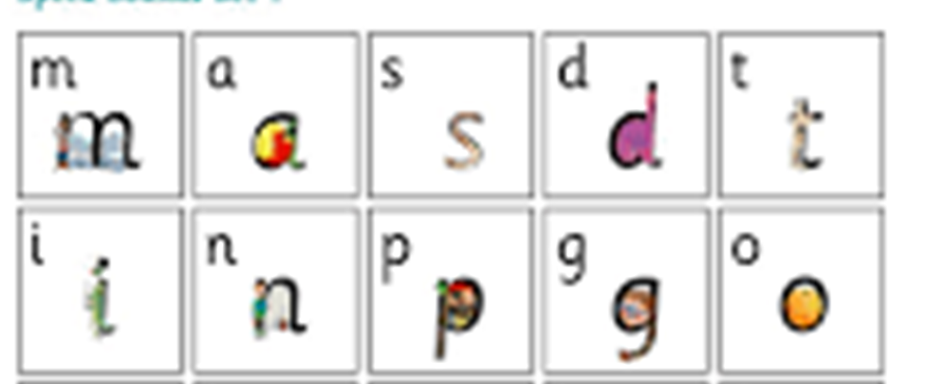
Now let's try with all these letters and sounds together.
S-a-t Sat
A-t at
M-a-t mat
M-a-d mad
S-a-d sad
D-a-d dad
I-n in
O-n on
I-t it
A-n an
A-n-d and
P-i-n pin
P-a-t pat
G-o-t got
D-o-g dog
S-i-t sit
T-i-p tip
P-a-n pan
G-a-p gap
D-i-g dig

Slide 6

Well done, you have tried hard in our phonics session!
Well done for trying so hard blending these new letters and sounds.
Grown-ups, please feel free to write down how your child has managed; we would love to see some photos of your child’s work.
Just For Fun!
Follow the link to play fun blending games!
https://www.topmarks.co.uk/english-games/5-7-years/letters-and-sounds
Here is a link to learn how to sign the full alphabet!
https://www.youtube.com/watch?v=YR0k4XlwUG8

Slide 7
Date: Monday 28th June 2021
L.O. To be able to spell words using the suffix ‘ed’ where no change to the root sound is needed.
Subject: English

Slide 8

Spellings
Remember:
1. gasped
2. parked
3. walked
4. relaxed

Slide 9
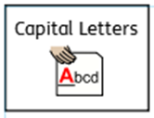
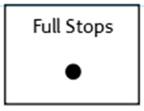

Spellings
Do not forget:
Can you put each one in a sentence?
1. gasped:
2. parked:
3. walked:
4. relaxed:

Slide 10
Date: Tuesday 29th June 2021
L.O. To be able add the suffix ‘ed’ to a verb.
Subject: English

Slide 11

Pre-recorded Teaching
Access the online teaching video below that will support you to complete the work in this lesson. This video will act as a support but all of the work can still be successfully understood & completed using paper-based versions of this pack. If you need further support to understand / complete work then please contact school via e-mail or telephone.
Play Video
You can also copy and paste this link if you would prefer:
https://classroom.thenational.academy/lessons/to-investigate-suffixes-past-and-present-60rkcc

Slide 12
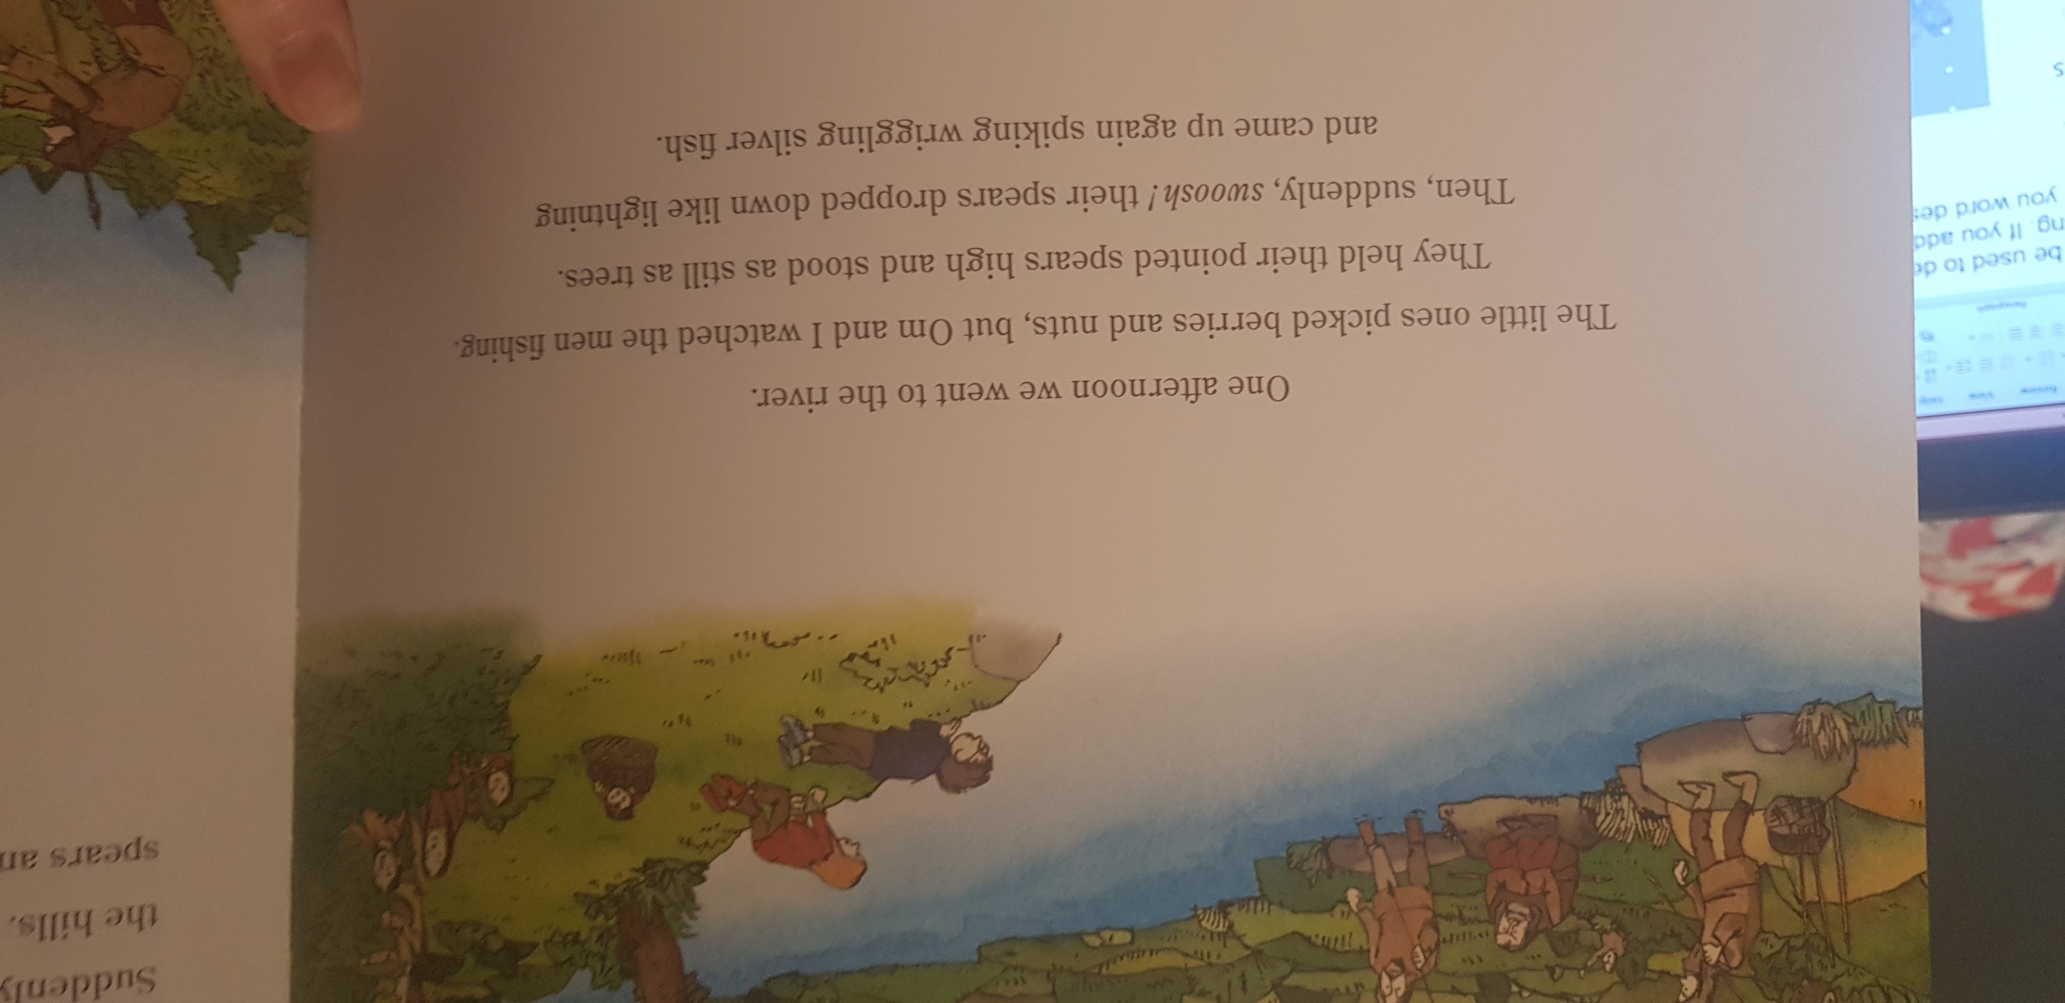
Verbs can be used to describe an action. An action is something you are doing. If you add the suffix ‘ed’ to the end of a verb, it will change the verb to describe what you have done. This is called past tense.
Example: watched
Example: picked
Om and I watched the men fishing.
The little ones picked berries.
Adding ed to the word pick makes the word picked.
Adding ed to watch makes the word watched.

Slide 13

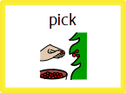
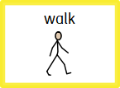
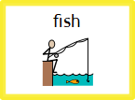
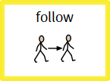
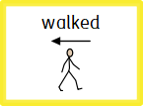
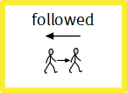
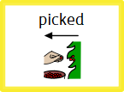
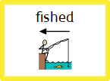
I am going to draw lines to match the root words to the past tense word which has been made by adding the suffix ‘ed’.

Slide 14

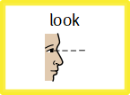
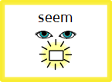
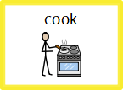
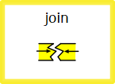
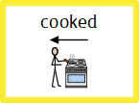
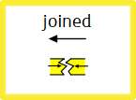
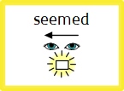
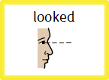
Draw lines to match the root words to the past tense word which has been made by adding the suffix ‘ed’.

Slide 15



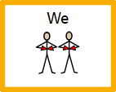
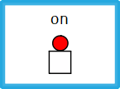
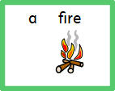

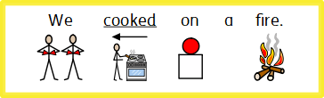
My turn, build a sentence :
Singular nouns
I am going to build a sentence in past tense using some of the verbs with ‘ed’ suffixes.
We cooked on a fire.

Slide 16
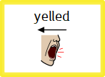
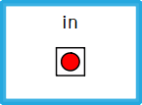
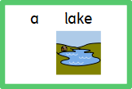

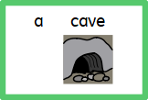

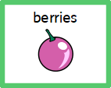
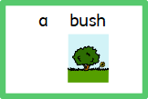
Build a sentence :
Singular nouns
Build 3 sentences in past tense using some of the verbs with ‘ed’ suffixes.

Slide 17
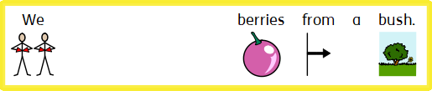


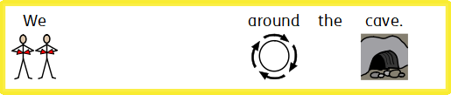


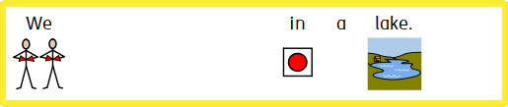

Build a sentence :
Singular nouns
Complete 3 sentences in past tense by writing a verb into each sentence with an ‘ed’ suffix.

Slide 18
Write A Sentence – Choose past tense verbs and then use them to write 6 sentences.
Verbs
cooked looked picked showed
worked shouted liked fished

Slide 19
Date: Wednesday 30th June 2021
L.O. To be able to recall and order the main events of the story.
Subject: English

Slide 20


Now that we are more familiar with our story The Stone Age Boy, we are going to try to remember, and order, what happened in the story. But before we do that, let’s listen to the story again. Click on the picture of the book to listen to the story or copy and paste the link into you web browser.
www.youtube.com/watch?v=aqy5ENpagts

Slide 21
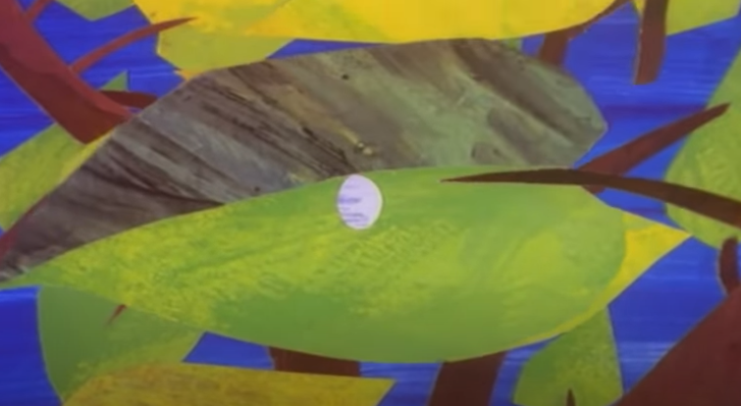
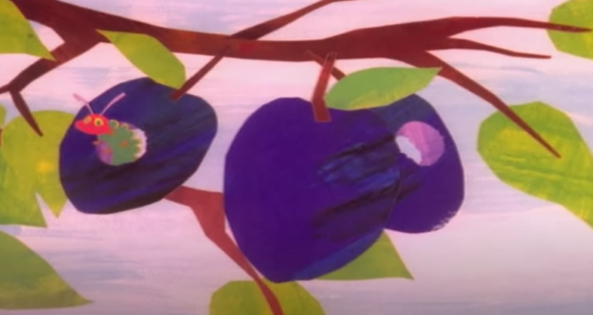
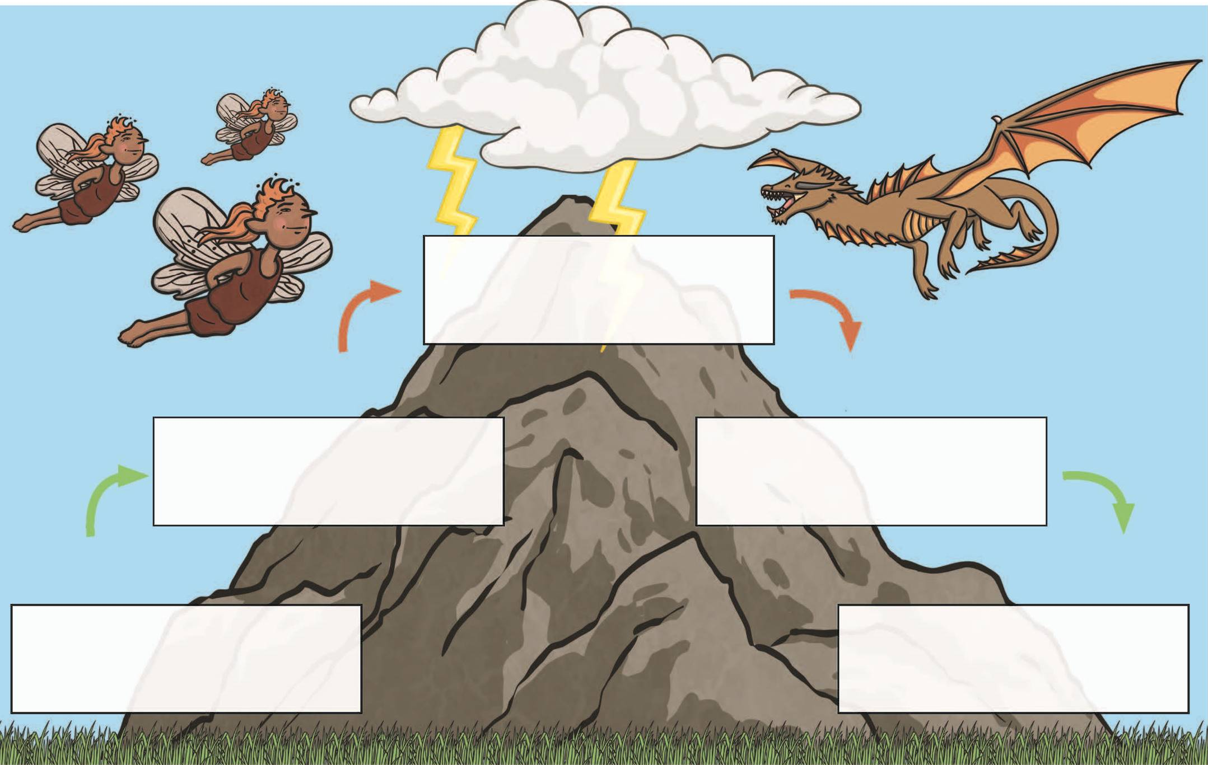
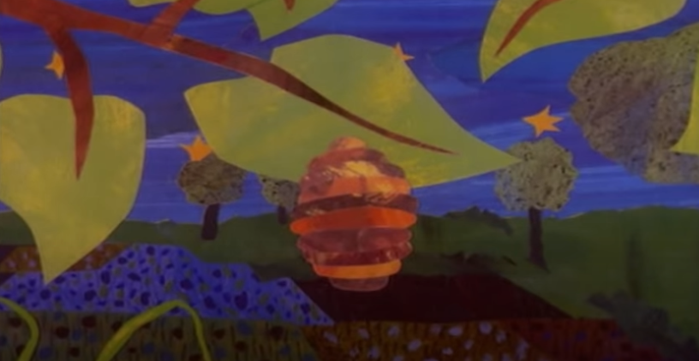
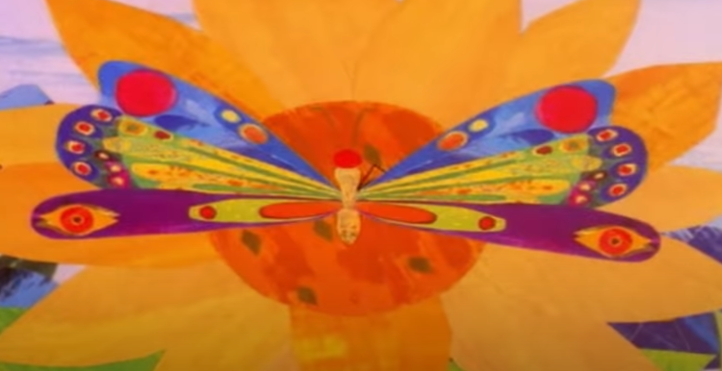
Most stories are written using an opening, a build up, a dilemma, a resolution and an ending. Look at the story mountain below, it helps us to see the build up of a story in its different stages.
Story Mountain
Build-up
Is the part of the story leading up the dilemma.
Dilemma
means problem.
Dilemma
Resolution
means a problem being fixed or solved.
Resolution
Build-up
Opening
means the beginning.
Opening
Closing
Closing
means ending.

Slide 22
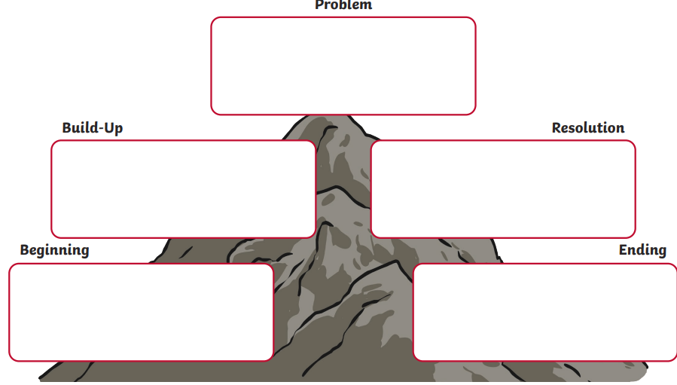
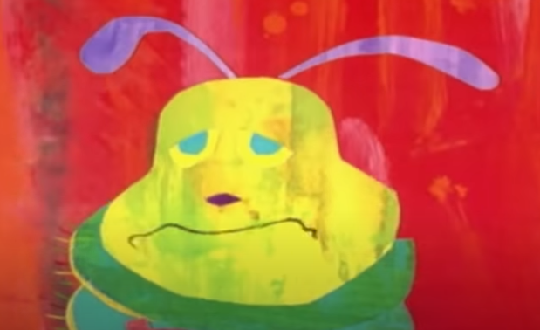
I have ordered a familiar story (The Hungry Caterpillar) onto the Story mountain below. Can you see who is in each part of the story, what they are doing and where they are?
The caterpillar ate too much food, he had a stomach. He curled up on a leaf to sleep.
The caterpillar was very hungry! He went to a garden and ate lots of food.
The caterpillar felt better after his sleep, and he built a cocoon in a tree.
The caterpillar turned into a butterfly inside his cocoon. He flew up into the sky.
There was an egg on a leaf. Out of the egg hatched a caterpillar.

Slide 23
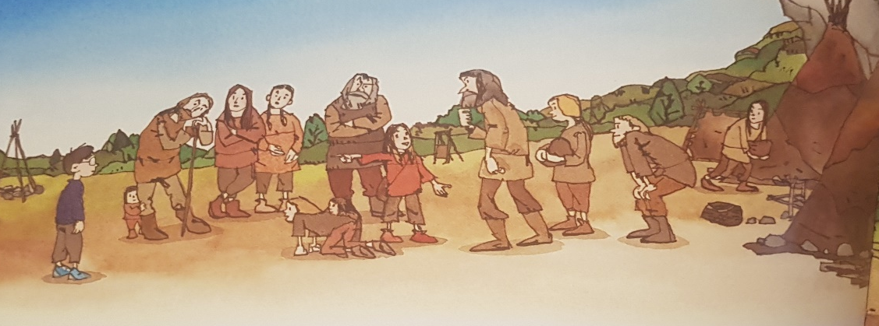







Can you order the pictures from the Stone Age Boy story onto the story mountain? Drag and drop or cut and stick them int to correct place.

Slide 24














I have placed the symbols into the correct boxes to complete the story mountain to retell the story. Can you cut and stick or move each symbol on the next page of the Power Point?

Slide 25
















Slide 26

Don’t forget to include who is in each part of the story, where they are and what they are doing or what happened.
The caterpillar ate too much food, he had a stomach. He went to sleep on a leaf.
The caterpillar was very hungry! He went to a garden and ate lots of food.
The caterpillar felt better after his sleep, and he built a cocoon in a tree.
There was an egg on a leaf. Out of the egg hatched a caterpillar.
The caterpillar came out from inside his cocoon, he had turned into a butterfly!

Slide 27
Use the words in the word bank to help you to complete the sentence by writing them into the gaps. Who is in each part of the story, where they are and what they are doing or what happened?
Word Bank
boy woods fell cave
Om inside attacked
rushed home camp
cook tools
The ___ and ___ went inside a ____. They were _________ by a bear!
The boy met a girl called _____. They went to her ______ and learned to ________ and make _________.
The boy ____ down a hole and woke up _____ a cave, the bear had gone.
A ______walked in the woods he ________ down a hole and into a _________.
The boy _______ outside the cave, he was back _________.

Slide 28
Word Bank
boy woods fell cave
Om inside attacked
rushed home camp
cook tools woke
Don’t forget to include who is in each part of the story, where they are and what they are doing or what happened.

Slide 29
Date: Thursday 1st July 2021
L.O. To be able to use direct speech.
Subject: English

Slide 30
Pre-recorded Teaching
Access the online teaching video below that will support you to complete the work in this lesson. This video will act as a support but all of the work can still be successfully understood & completed using paper-based versions of this pack. If you need further support to understand / complete work then please contact school via e-mail or telephone.
Play Video
You can also copy and paste this link if you would prefer:
https://classroom.thenational.academy/lessons/to-practise-writing-speech-69j34t?activity=video&step=1

Slide 31

Today we are going to learn how to use speech marks. Speech marks are used to show the reader what is being spoken out-loud. In our story Stone Age Boy, Om and the boy do not talk to each other, as they do not speak the same language, and so there are no speech marks. However, we can have a guess at what they may have said to each other. Look at some of the questions below and discuss your ideas with an adult or a friend.
What do you think Om and the boy would have said to each other when they first met?
What kinds of questions may they have asked each other?
Have a think about the types of questions they may ask each other: who, what, where, when, why.

Slide 32


Here is an example of a direct speech sentence below. An easy way to remember how to use them is to think of speech sandwich. First we have opening speech marks, next a capital letter to start the sentence of what the person is saying, after what is being said, then a punctuation mark and lastly the closing speech marks.
“
“
”
“My name is Om.”
”

Slide 33





Make 3 directed speech sentences; you can do this by dragging and dropping the symbols into place or by cutting and sticking them.
Challenge: Can you write them too by copying the sentences into your book or onto the lines underneath?
“
”
“
”
“
”

Slide 34



Re-write the direct speech sentences so that they are writing correctly.
“
”
oh no the bear is going to get us
you can sleep at my camp tonight
would you like some food

Slide 35



Write a piece of directed speech, spoken by Om, for each of the 6 pictures. The pictures will help to think of what she may say to the boy.
“
”

Slide 36



Write a piece of directed speech, spoken by Om, for each of the 6 pictures. The pictures will help to think of what she may say to the boy.
“
”

Slide 37
Date: Friday 2nd July 2021
L.O. To be able to use knowledge and understanding of the text to answer questions.
Subject: English

Slide 38






in a cave.
The boy woke up in a cave.

Slide 39











Make 3 sentences to answer the 3 questions; you can do this by dragging and dropping the symbols or by cutting and sticking them.
Challenge: Can you write them too by copying the sentences into your book or onto the lines underneath?

Slide 40




Complete sentences to answer the 3 questions. Challenge: Can you write them too by copying the sentences into your book?

Slide 41
Answer the 5 questions by writing you answers as a sentence.
What did the boy and Om’s family catch whilst out hunting?
Who was attacked in the cave by a bear?
Where did the children pick berries from?
Where did the boy stay after he met Om?
What did Om and the boy find on the cave walls?

