Slide 1
Date:
Monday 25th January 2021
LO
To be able identify the second set of speed sounds.
Subject: English

Slide 2
PHONICS
This week in phonics we are going to look at the following:
Blending using our speed sounds
M A S D T I N P G O

Slide 3
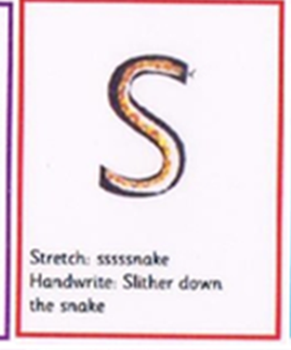
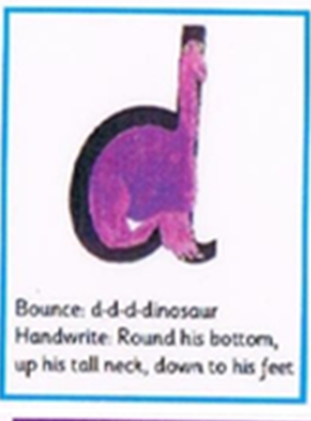
Using the letters above can you try blending the following words:
M-A-T MAT
S-A-D SAD
M-A-D MAD
A-T AT
S-A-T SAT
D-A-D DAD
Ask your child to look at you. Say the first letter in an exaggerated manner. For example, M-A-T ask your child to copy you. Point at each picture as you say them.
Then say the sounds followed by the whole word
E.g. M-A-T …Mat
Ask your child to copy.
Repeat a few times saying both the sounds and the word in an exaggerated manner. Add the meaning of the world if it helps.

Slide 4
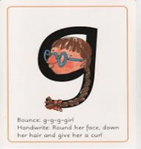
Now try these words.
I-T IT
A-N AN
A-N-D AND
P-I-N PIN
P-A-T PAT
G-O-T GOT
Let's try the same with these letters.
Say the sounds individually followed by the word. Point to each picture as you say them.
Ask your child to copy. Repeat a few times .
D-O-G DOG
S-I-T SIT
T-I-P TIP
P-A-N PAN
G-A-P GAP
D-I-G DIG

Slide 5
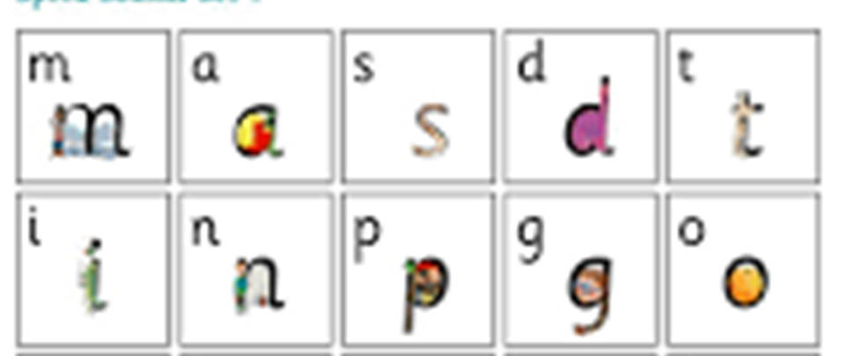
Now let's try with all these letters and sounds together.
S-a-t Sat
A-t at
M-a-t mat
M-a-d mad
S-a-d sad
D-a-d dad
I-n in
O-n on
I-t it
A-n an
A-n-d and
P-i-n pin
P-a-t pat
G-o-t got
D-o-g dog
S-i-t sit
T-i-p tip
P-a-n pan
G-a-p gap
D-i-g dig

Slide 6
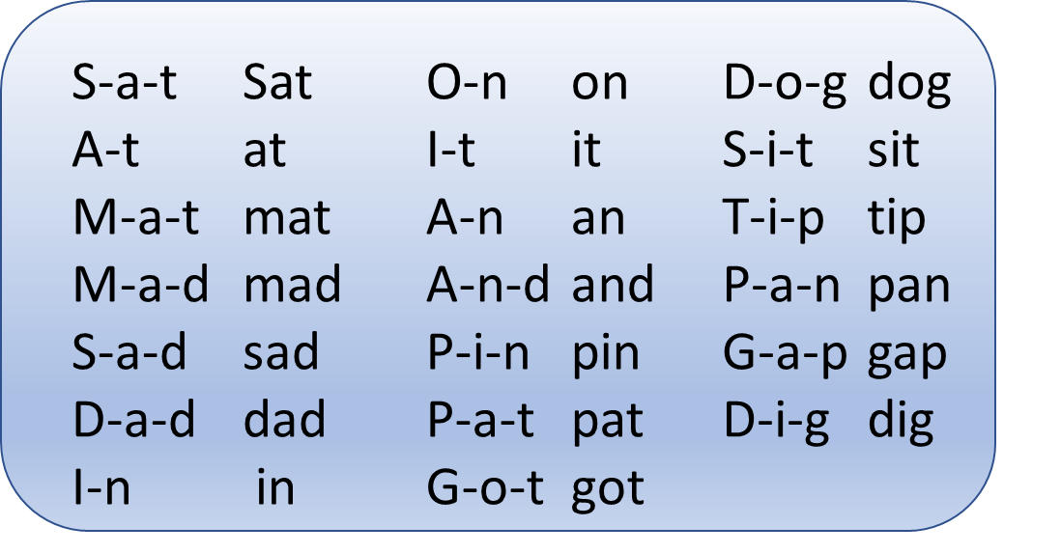
NOW IT IS CHALLENGE TIME!
Now we have learnt to blend our sounds and letters can you sign some words using our signs

Slide 7
Well done, you have tried hard in our phonics session!
Well done for trying so hard blending these new letters and sounds.
Grown-ups, please feel free to write down how your child has managed; we would love to see some photos of your child’s work.
Just For Fun!
Follow the link to play fun blending games!
https://www.topmarks.co.uk/english-games/5-7-years/letters-and-sounds
Here is a link to learn how to sign the full alphabet!
https://www.youtube.com/watch?v=YR0k4XlwUG8

Slide 8
Date:
Tuesday 26th January 2021
L.O. To be able to complete a flow chart.
Subject: English

Slide 9
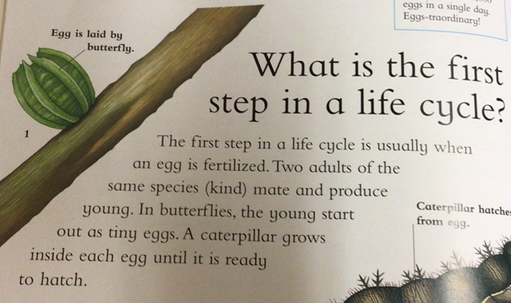
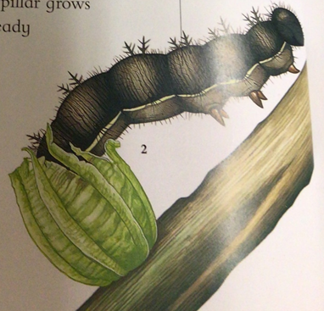
Here is an example of a flow chart showing the life cycle of a butterfly.

Slide 10
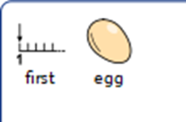
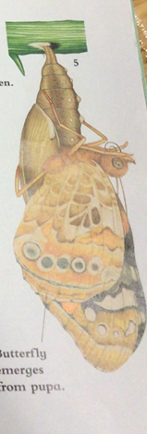
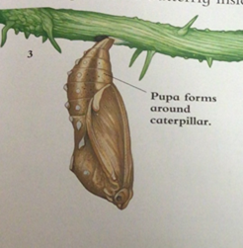
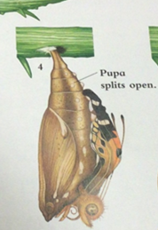
Lets try and order our life cycle of a butterfly.
My turn.

Slide 11
My turn. What comes next? Can you circle the right one?

Slide 12
Your turn. What comes next? Can you circle the right one?

Slide 13
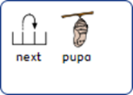
Your turn. What comes next? Can you circle the right one?

Slide 14
Date:
Wednesday 26th January 2021
LO
To be able to use capital letters and full stops.
Subject: English

Slide 15
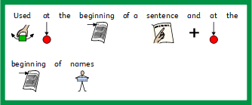
We are going to begin by looking at punctuation.

Slide 16
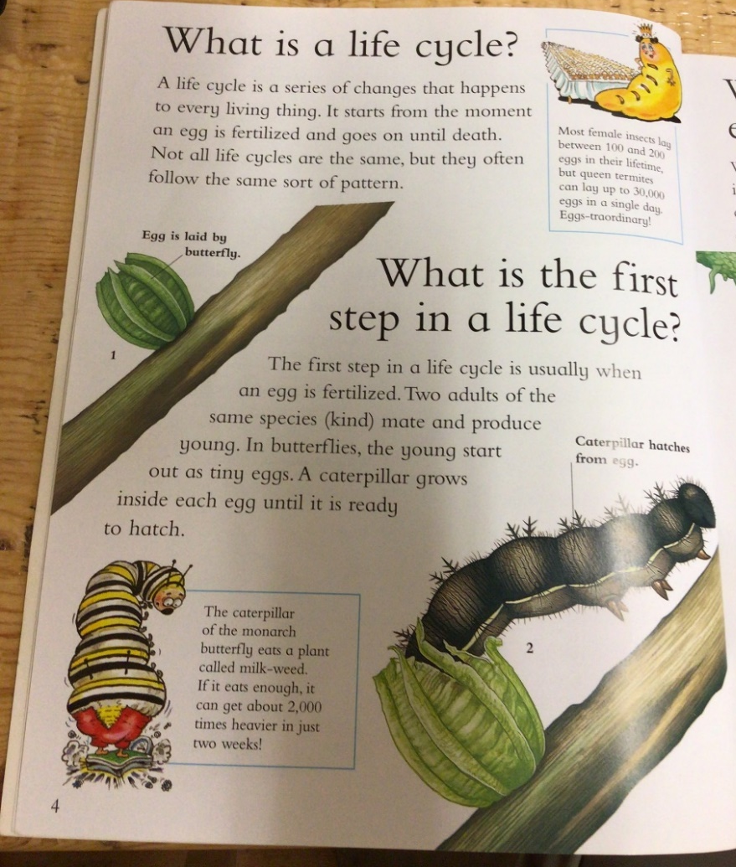
Can you find the in the text?

Slide 17
Can you find the in the text?

Slide 18
Now let’s create our own.
My Turn

Slide 19
Build A Sentence – Build a sentence about the life cycle and add your full stop in the right place.
Choose the correct ending.

Slide 20
Build A Sentence – Build a sentence about the life cycle and add your full stop in the right place. .
Choose the correct ending.

Slide 21
Build A Sentence – Build a sentence about the life cycle and add your full stop in the right place.
Choose the correct ending.

Slide 22
Date:
Thursday 27th January 2021
LO
To be able write an opening statement.
Subject: English

Slide 23
=
What happens to a caterpillar?

Slide 28
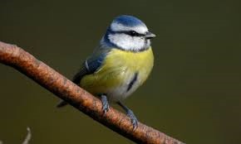

Slide 30
Date:
Friday 27th January 2021
LO
To be able write our new phonics sounds.
Subject: English

Slide 31
PHONICS
Remember our new speed sounds we looked at at the beginning of the week?
M A S D T I N P G O
Today we are going to try writing them.

Slide 32
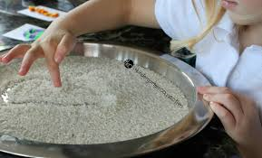
Using dry rice pour into a tray and using the letters above can you try writing the following words:
M-A-T MAT
S-A-D SAD
M-A-D MAD
A-T AT
S-A-T SAT
D-A-D DAD

Slide 33
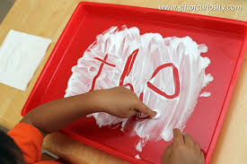
Lets try the same with these letters.
This time why don’t we try writing in shaving foam!
I-T IT
A-N AN
A-N-D AND
P-I-N PIN
P-A-T PAT
G-O-T GOT
D-O-G DOG
S-I-T SIT
T-I-P TIP
P-A-N PAN
G-A-P GAP
D-I-G DIG

Slide 34
Now lets try with all these words!
Let’s try writing these words with flour!
S-a-t Sat
A-t at
M-a-t mat
M-a-d mad
S-a-d sad
D-a-d dad
I-n in
O-n on
I-t it
A-n an
A-n-d and
P-i-n pin
P-a-t pat
G-o-t got
D-o-g dog
S-i-t sit
T-i-p tip
P-a-n pan
G-a-p gap
D-i-g dig

Slide 35
And completes our phonics session!
Well done for trying so hard blending these new letters and sounds.
Grown-ups, please feel free to write down how your child has managed; we would love to see some photos of your child’s work.
Just For Fun!
Follow the link to play fun blending games!
https://www.topmarks.co.uk/english-games/5-7-years/letters-and-sounds
Here is a link to learn how to sign the full alphabet!
https://www.youtube.com/watch?v=YR0k4XlwUG8

