Slide 1


Date: Tuesday 5th January
LO To be able to identify hot and cold temperature
Subject: Science

Slide 2
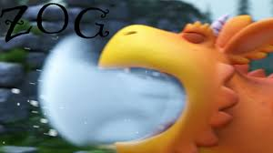
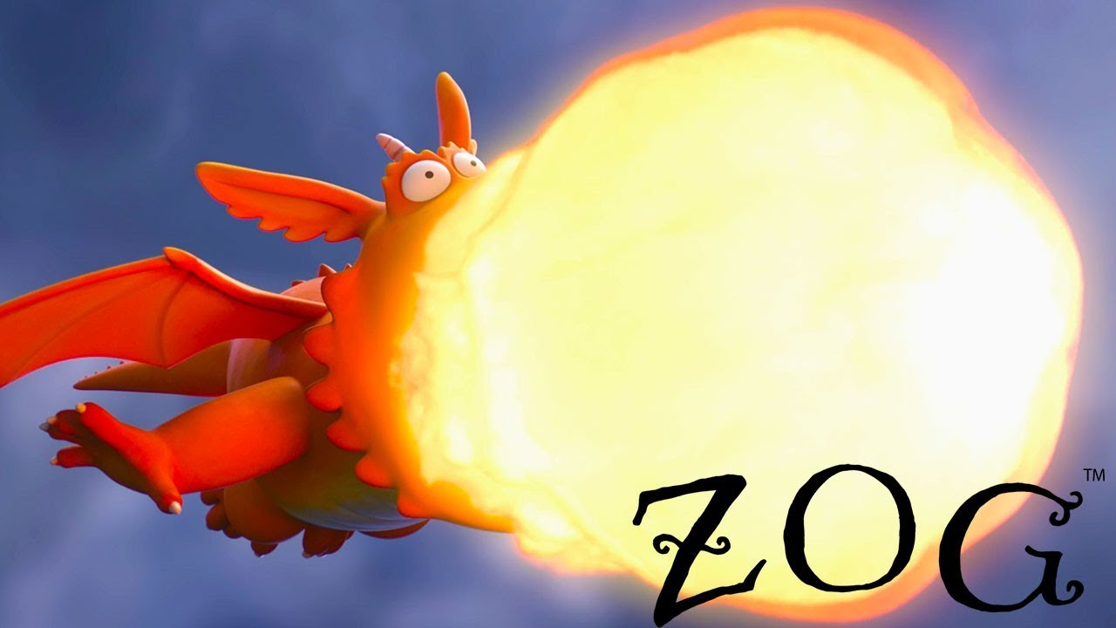
Science
CHALLENGE
Can you create you own ice ?
Once you’re finished can you write your own instructions and findings.
Here are some words to help you.
First Next After Before End Finish Finally
In our story Zog blows ice from his mouth. What things can you find in your home that is cold?
Further in the story Zog begins to blow fire from him mouth. What things can you find in your home that is hot? Be careful, remember not to touch
Copy and paste the link

Slide 3
Date: Wednesday 6th November
LO to be able to identify how people can be helpful
Subject: PSHE

Slide 4
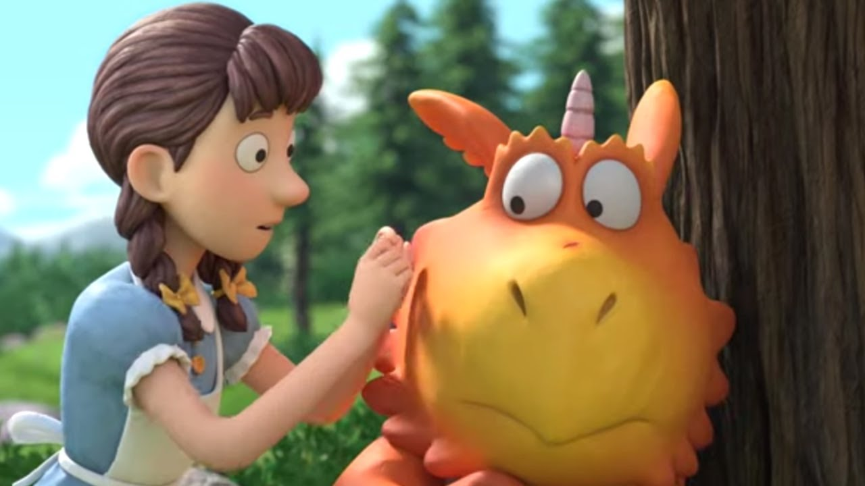
Can you draw and write a simple sentence for this picture describing how the princess helped Zog and how Zog is feeling?
CHALLENGE
What other ways did the princess help Zog?

Slide 5

Date: Thursday 7th November
LO To be able to create a 3D structure
Subject: DT

Slide 6
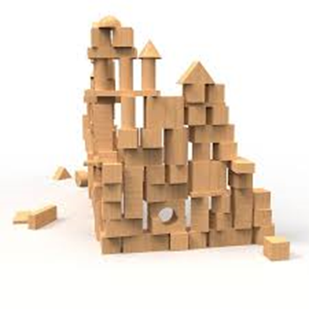
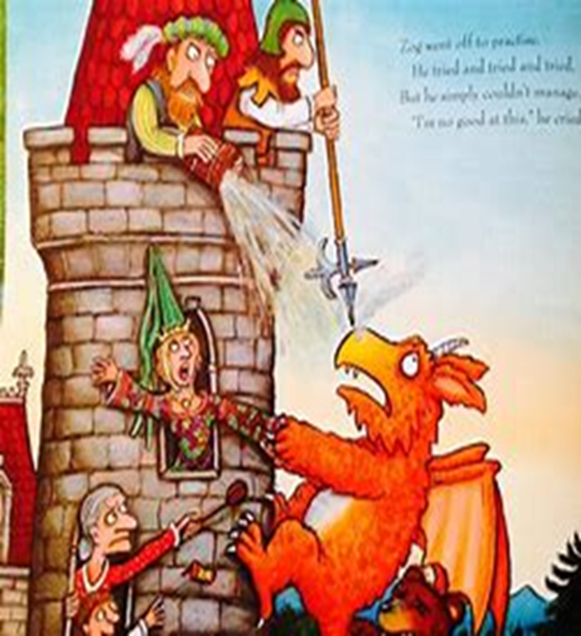
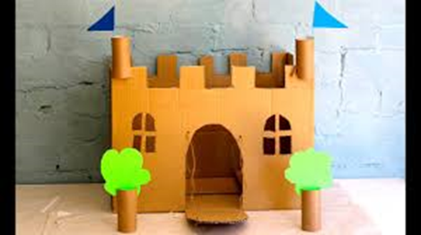
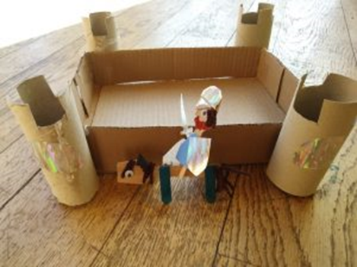
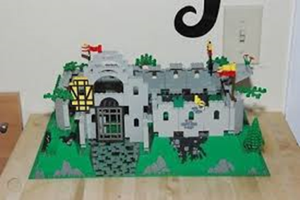
Can you create your very own castle?
Have fun!

Slide 7
Date: Friday 8th November
LO To be able design your own dragon/character.
Subject: Art

Slide 8

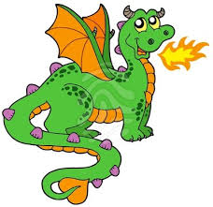

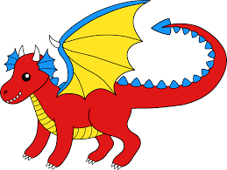

Can you create your very own dragon friend for Zog? Can you use your English work to help label your dragon?
Here is some pictures for inspiration!

