Slide 1

Subject: Maths
Pack: B

Slide 2



1.2.2021
L.O To be able to describe 2D shapes
Go to Times Tables Rock Stars to warm up your number brain before you start your maths activity.
Subject: Maths

Slide 3




Which one of theses shapes are a square
How do you know?
What makes it different to the other shapes?
Thinking time

Slide 4

A square has 4 sides….
and 4 corners
1
1
2
4
2
3
4
3

Slide 5

A rectangle also has 4 sides and 4 corners, so how is it different to square?

Slide 6
A rectangle also has 4 sides and 4 corners, so how is it different to square?
A square has equal sides (which means they are all the same length).

Slide 7
What shape am I ?
1. I have 3 sides
I have 3 corners
2. I have 1 side
I have 0 corners

Slide 8
What shape am I ?
1. I have 3 sides
I have 3 corners
2. I have 1 side
I have 0 corners
I am a circle
I am a triangle

Slide 9


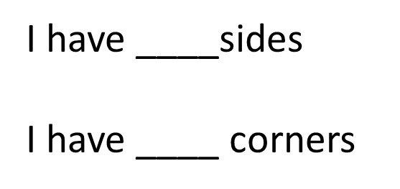



Here are some new shapes
I have ____sides
I have ____ corners
Pentagon
Hexagon
Octagon
Semi-circle

Slide 10







Copy and fill in the table below
Shape | Name of shape | Number of sides | Number of corners

Slide 11
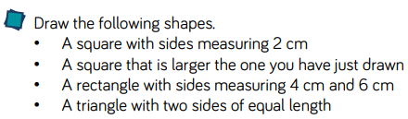
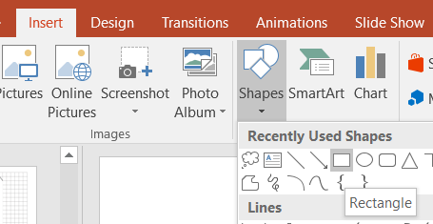
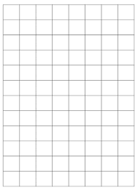
Use the squares to complete this challenge- think of each square as 1 cm
Challenge
If you haven’t got a ruler, you could use another straight edge like a book.
If you’re working electronically you can draw shapes straight onto PowerPoint

Slide 12
2.2.2021
L.O To be able to sort 2D shapes
Go to Times Tables Rock Stars to warm up your number brain before you start your maths activity.
Subject: Maths

Slide 13




Two of these Letters have curved lines. Can you tell me which ones?
How did you know?
What makes a curved line different to a straight line?
Thinking time

Slide 14
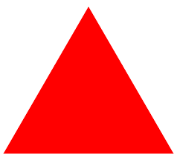


A straight line stays in the same direction, and does not bend at any point, but a curved line does.
All of the triangles sides are straight lines.
The semi-circle does have one straight line, but also has a curved line.
Can you think of any other shapes or letters with curved lines?

Slide 15

If a shape has symmetry, it looks the same on both sides
If you put a mirror in the middle of the butterfly, the wings are the same colour/size on each half, so it has 1 line of symmetry
If you fold the shape in half, it would also be the same on both sides.
There is 1 line of symmetry in the pentagon.
Can you see where is it?

Slide 16
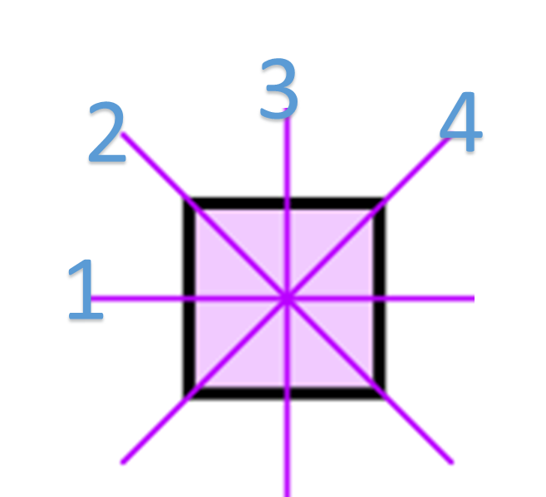
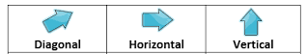
Some shapes have more than just one line of symmetry. A line of symmetry can be horizontal, vertical or diagonal.
You can put a mirror in 4 places with a square, and both sides would look the same.
You could also fold the shape and it would remaind the same on both sides.

Slide 17
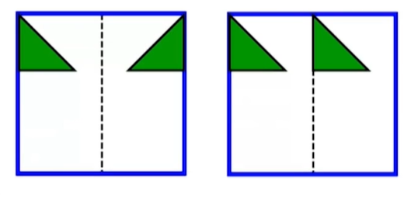
One of these images are symmetrical, can you tell which one?
Which one of these are a mirror image

Slide 18

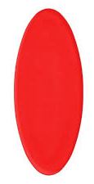
I have _______ curved lines
I have _________ lines of symmetry
Diamond
I have ____________ curved lines
I have ____________ lines of symmetry
Oval

Slide 19
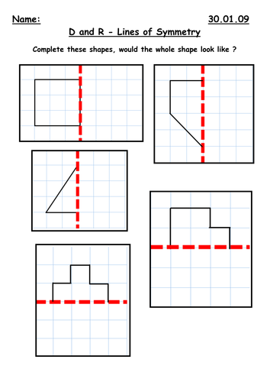
Using the dotted line as a line of symmetry, draw the other half of these shapes.
HINT- you could count the squares to make sure your shapes are the same on both sides.

Slide 20
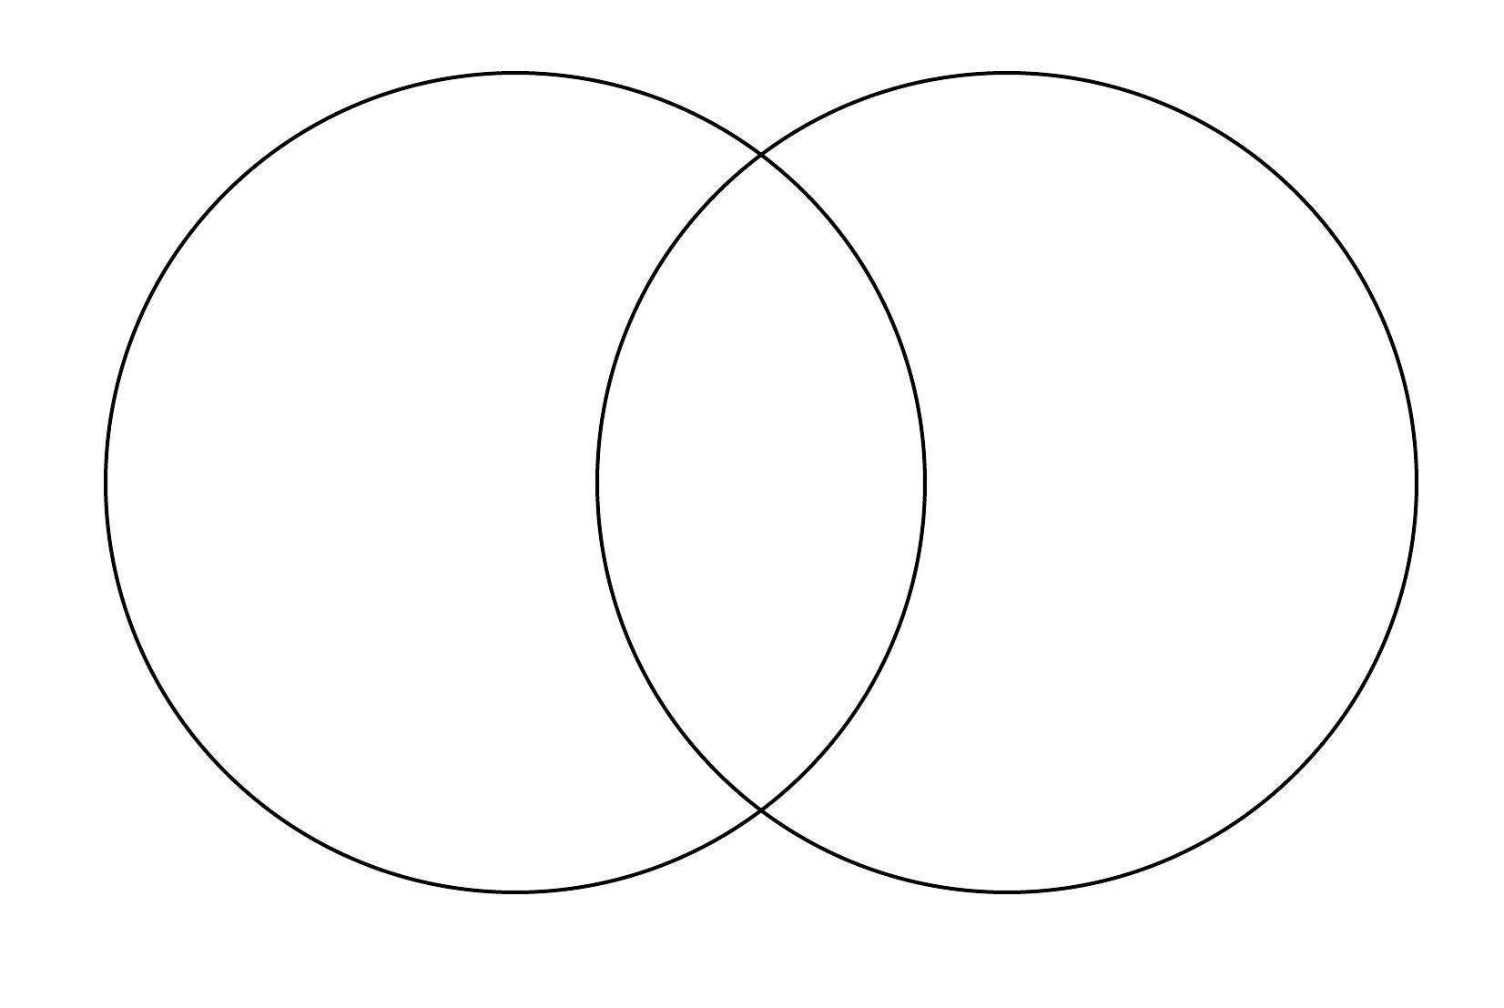



Sort these shapes into the correct section of the Venn diagram
Remember if they fit into both categories, they go in the middle
D
A
2 or more lines of symmetry
Curved lines
E
B
C
G
F

Slide 21
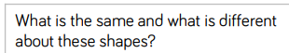
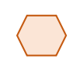

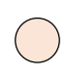
Try this challenge
___________________________________________________________________________________________________________________

Slide 22
3.2.2021
L.O To be able to recognise angles.
Go to Times Tables Rock Stars to warm up your number brain before you start your maths activity.
Subject: Maths

Slide 23

Pre-recorded Teaching
Access the online teaching video below that will support you to complete the work in this lesson. This video will act as a support but all of the work can still be successfully understood & completed using paper-based versions of this pack. If you need further support to understand / complete work then please contact school via e-mail or telephone.
Play Video
You can also copy and paste this link if you would prefer:
https://teachers.thenational.academy/lessons/to-identify-and-recognise-angles-cgu6cc

Slide 24


When two lines meet, it creates an angle.
A triangle has 3 angles
A semi-circle has 2 angles

Slide 25


How many angles do these shapes have
A pentagon has _____ angles
A rectangle has _____ angles
NOTE- If the corners make a perfect L, it is known as a right angle
A hexagon has _____ angles

Slide 26
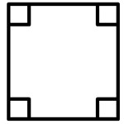
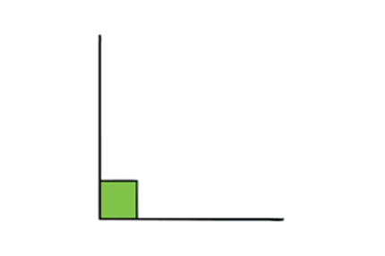
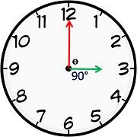
A right angle is also called a quarter turn because it is a quarter of a full turn. A right angle will form when two lines meet to create a perfect L shape. A right angle will be shown through a box. Here are some examples:
When the clock says 3 O'clock, it makes a perfect L, and makes a right angle.
The corners of a square, or rectangle, always make a perfect L, creating a right angle.

Slide 27
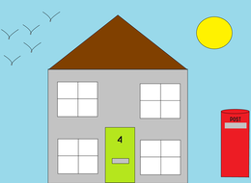
Can you see right angles in this picture
Circle the right angles you see, lets see if you can get 5

Slide 28
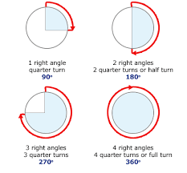
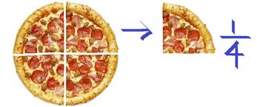

A right angle is also known as a quarter turn. When you have two right angles next to each other, it makes a half-turn, while 3 right angles make a 3 quarter turn, with 4 right angles making a complete turn.

Slide 29
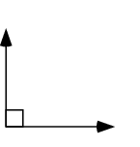
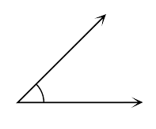
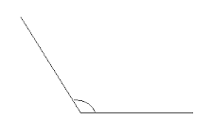
Which one of these is the right angle?
How are the other 2 different?
The lines are closer together compared to a right angle, making the angle smaller. This is called an acute angle.
These lines are further away than a right angles, making the angle bigger. This is called an obtuse angle

Slide 30



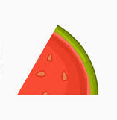
Which of these angles are acute, and which are obtuse
Here is a right angle to help you!

Slide 31


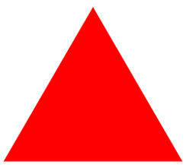


Here are some shapes, can you identify which ones have right angles, and which don’t.
Shape | Name of shape | Does it have any right angle? | How many right angles?

Slide 32
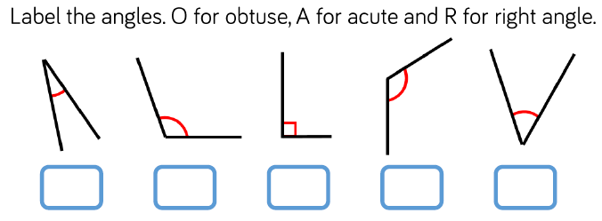
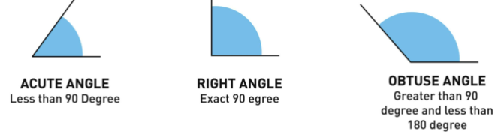
Use these to remind you -

Slide 33
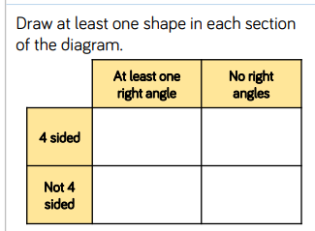
Challenge

Slide 34
4.2.2021
L.O To be able to identify different types of lines
Go to Times Tables Rock Stars to warm up your number brain before you start your maths activity.
Subject: Maths

Slide 35
What is different about these lines
Thinking time

Slide 36
What is different about these lines
When a line goes in this direction, it is vertical
When a line goes in this direction, it is diagonal
When a line goes in this direction, it is horizontal

Slide 37
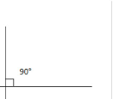
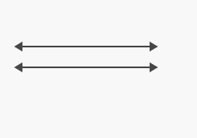
Other types of lines
Perpendicular lines are lines that meet to create a right angle
Parallel lines never meet each other, and always stay the same distance apart

Slide 38
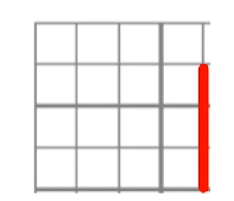
Here we have a vertical line. Can you draw a horizontal line to make this perpendicular
Remember that they meet at RIGHT ANGLE

Slide 39
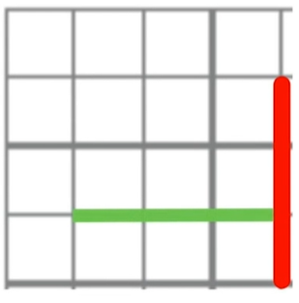
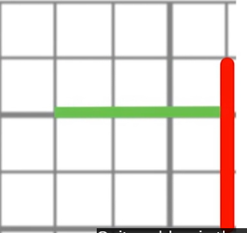

Here we have a vertical line. Can you draw a horizontal line to make this perpendicular
Did you get any of these?

Slide 40
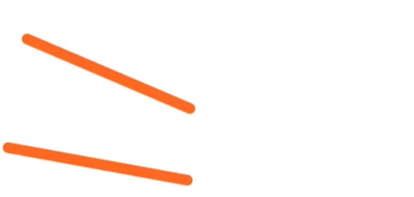
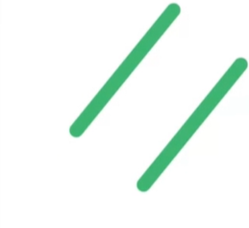
Here are two sets of lines. Can you tell me which ones are parallel
Which line are always the same distance apart

Slide 41
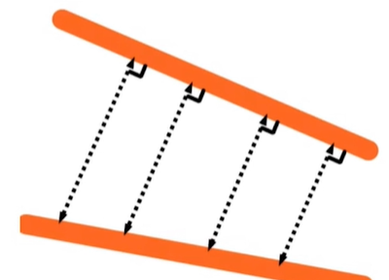

Here are two sets of lines. Can you tell me which ones are parallel
Good job if you said the green one. The orange start getting closer together so they are not parallel

Slide 42
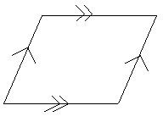

Lets look at new shapes
The rhombus has 2 pairs of parallel lines
Rhombus
The right angle triangle has 1 pair of perpendicular lines
Right angle triangle

Slide 43
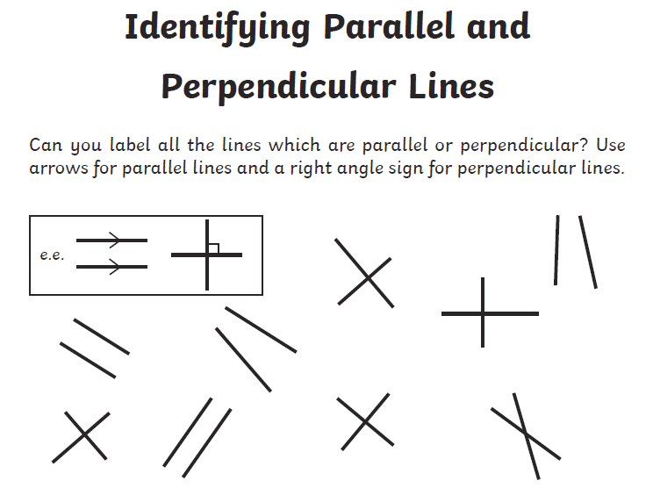
If you’re working electronically you can draw shapes straight onto PowerPoint

Slide 44
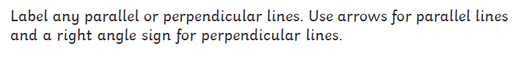
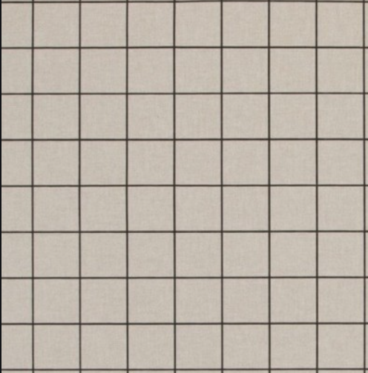
Draw your own parallel or perpendicular lines
Use the squares to draw the 3
types of triangles
If you don’t have a ruler, you could always use a book
Or draw lines using PowerPoint ☺

Slide 45
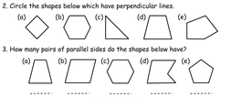
Challenge

Slide 46
5.2.2021
L.O To be recognise and describe 3D shapes
Go to Times Tables Rock Stars to warm up your number brain before you start your maths activity.
Subject: Maths

Slide 47
Pre-recorded Teaching
Access the online teaching video below that will support you to complete the work in this lesson. This video will act as a support but all of the work can still be successfully understood & completed using paper-based versions of this pack. If you need further support to understand / complete work then please contact school via e-mail or telephone.
Play Video
You can also copy and paste this link if you would prefer:
https://teachers.thenational.academy/lessons/to-describe-the-properties-of-3d-shapes-cdjkgd

Slide 48

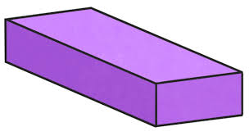


Which of these shapes are 3D
Thinking time

Slide 49

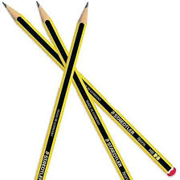
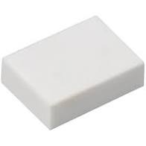
Everyday objects are 3D, such as a ball, pencil or a rubber.

Slide 50
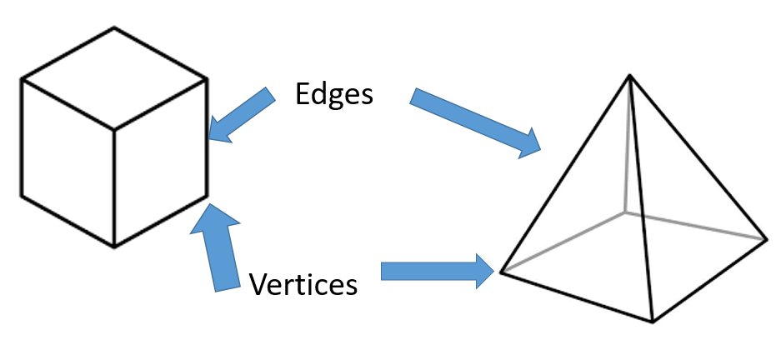
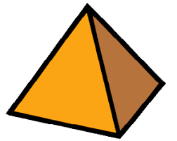

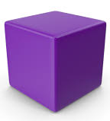
A 2D object will always have one face, because it is flat, but a 3D object will have multiple faces
FACE
FACE
3D shapes also have vertices, which is another word for corner, and edges.
FACE
FACE
FACE
FACE
2D
3D

Slide 51
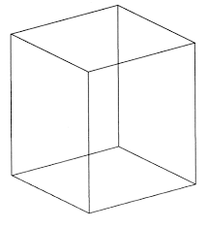
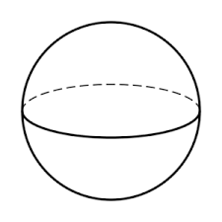
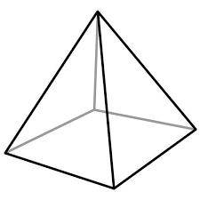
Every 3D shape is different. Let’s have a look at a few now
Shape | Cube | Pyramid | Sphere
Number of faces | 6 | 5 | 1
Number of edges | 12 | 8 | 0
Number of vertices | 8 | 5 | 0

Slide 52




Here are some new shapes
I have ___ faces
I have _____ vertices
I have ______ edge
Cone
I have ___ faces
I have _____ vertices
I have ______ edge
Cuboid

Slide 53




I have ___ faces
I have _____ vertices
I have ______ edges
Cube
I have ___ faces
I have _____ vertices
I have ______ edges
Triangular prism

Slide 54

Challenge 1

Slide 55

Challenge 2 – 3D shape hunt!
Have a look around the house and see what 3D objects you can find!
You could take some photos or make a list of what
You have found!
Could you even count how many faces, vertices and edges each object has

Slide 56

Well done for all your hard work everyone!

