Slide 1


Subject: Topic

Slide 2


Date: Monday 1st March 2021
L.O. To observe the work of Artist Angie Lewin
Subject: Art

Slide 3

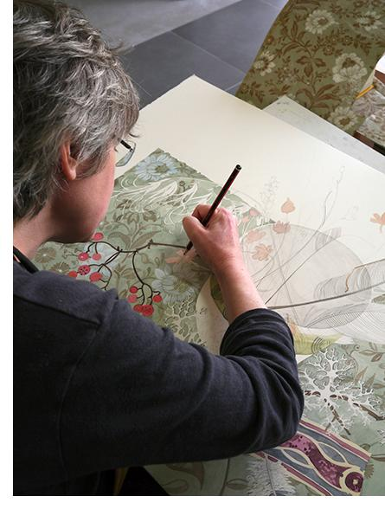

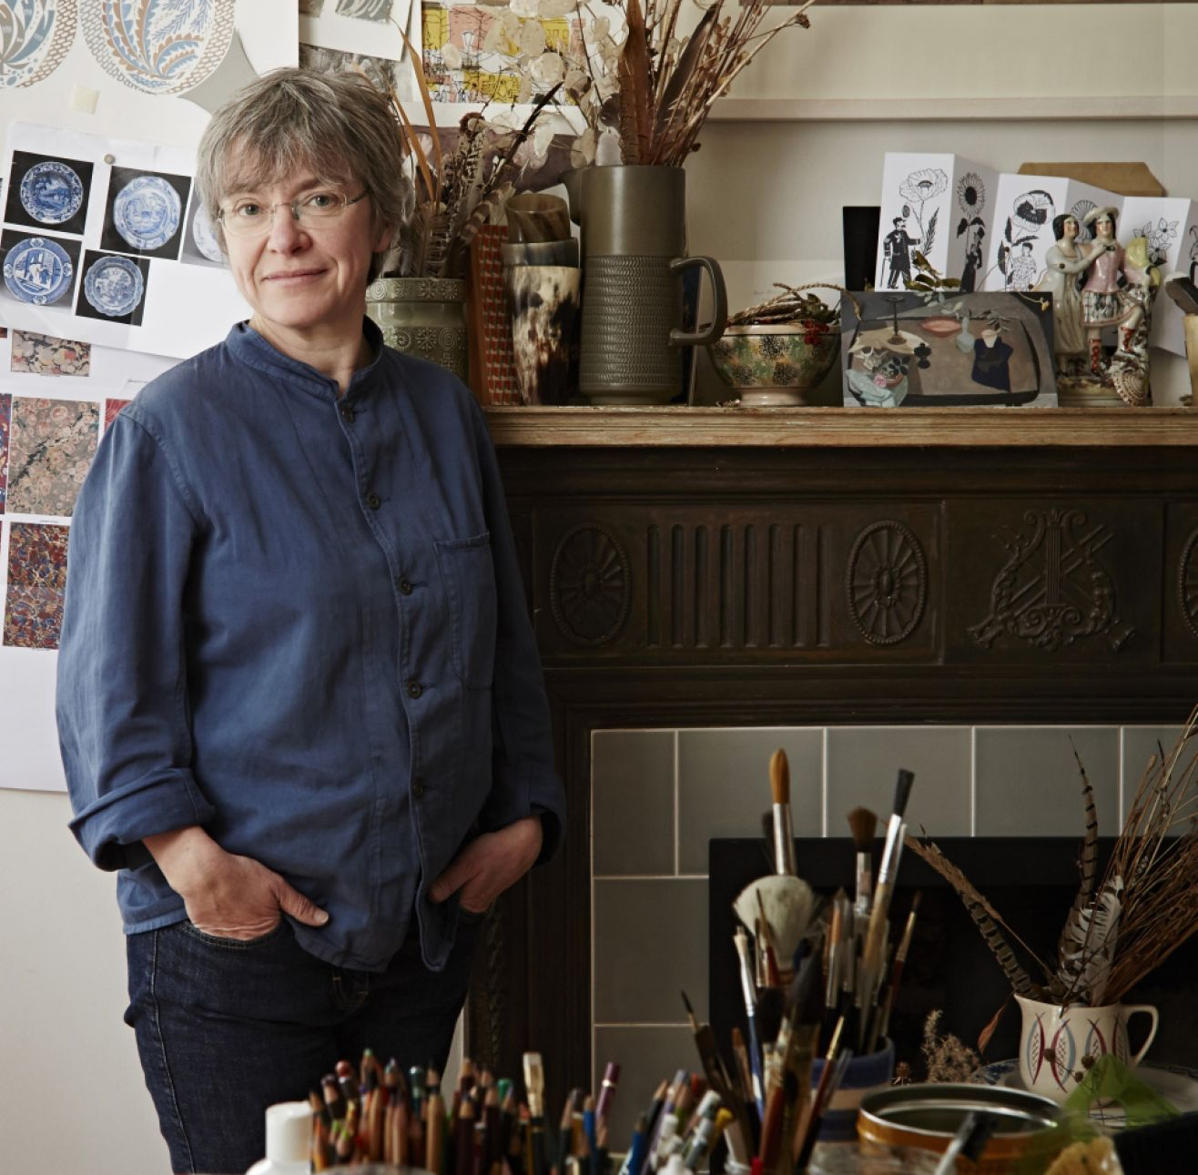
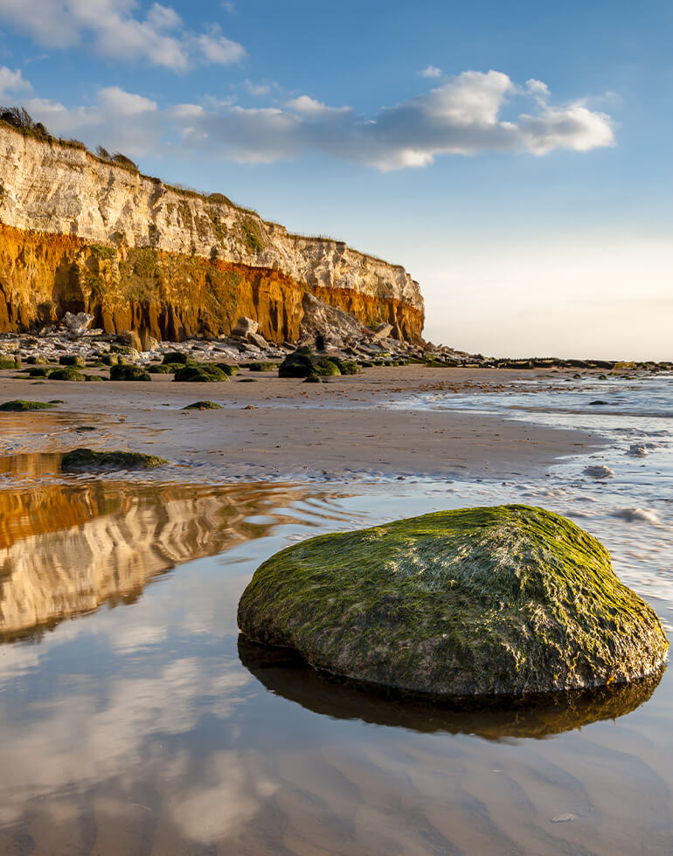
“I studied BA (Hons) Fine Art Printmaking at Central St. Martins College of Art and Design between 1983 and 1986, followed by a year’s part-time postgraduate printmaking at Camberwell School of Arts and Crafts.
After working in London as an illustrator I studied horticulture and a move to Norfolk prompted a return to printmaking.
My work is inspired by both the clifftops and saltmarshes of the North Norfolk coast and the Scottish Highlands.”

Slide 4

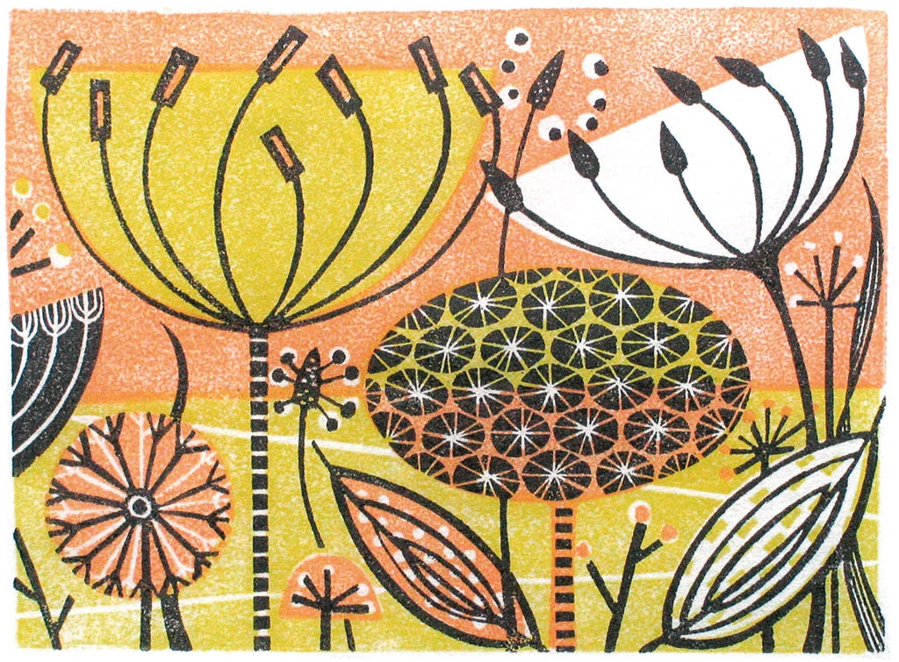
This piece of art is called “Clifftop III”
What do you notice about this print?
Has Angie Lewin used shading? Has she used her pen to colour parts of the flowers? Has she outlined her shapes?

Slide 5

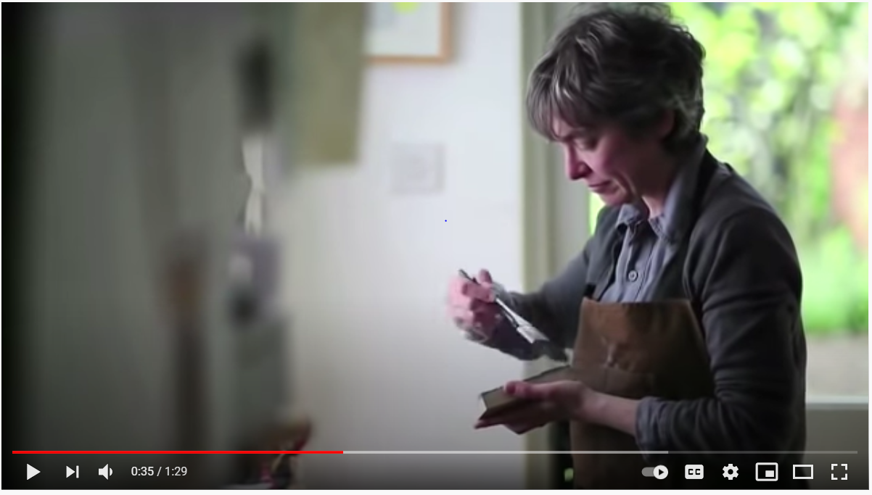
Watch the video carefully…
Click here to watch the video of how Angie Lewin creates her art...
What tools did you see Angie Lewin using to create her art work? Discuss or write down a list of tools.
Angie Lewin is a printmaker!
Lets have a look at some more of her prints on the next slide…

Slide 6

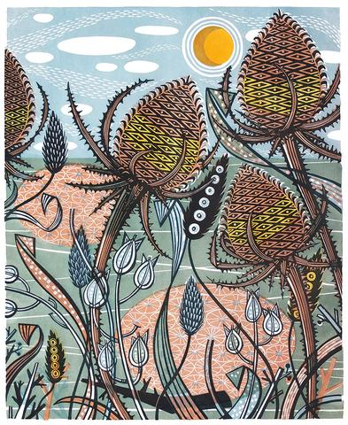
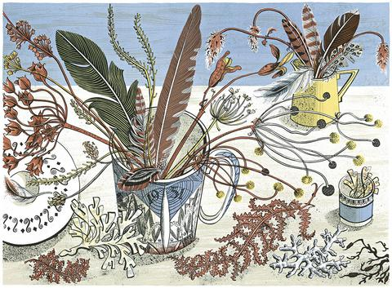

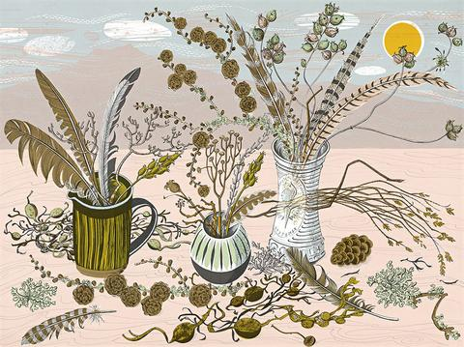
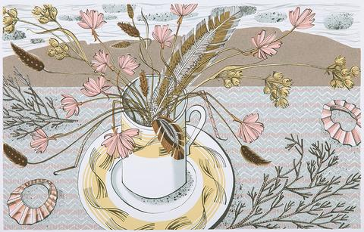
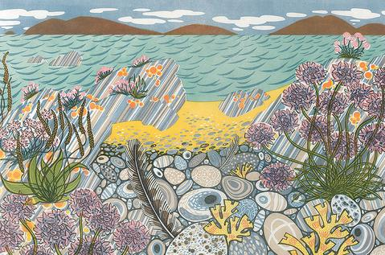
Let’s look at more of her work…
https://www.angielewin.co.uk/collections/limited-edition-prints
What can you see? What colours / shapes have been used? Which is your favourite print? Why?

Slide 7
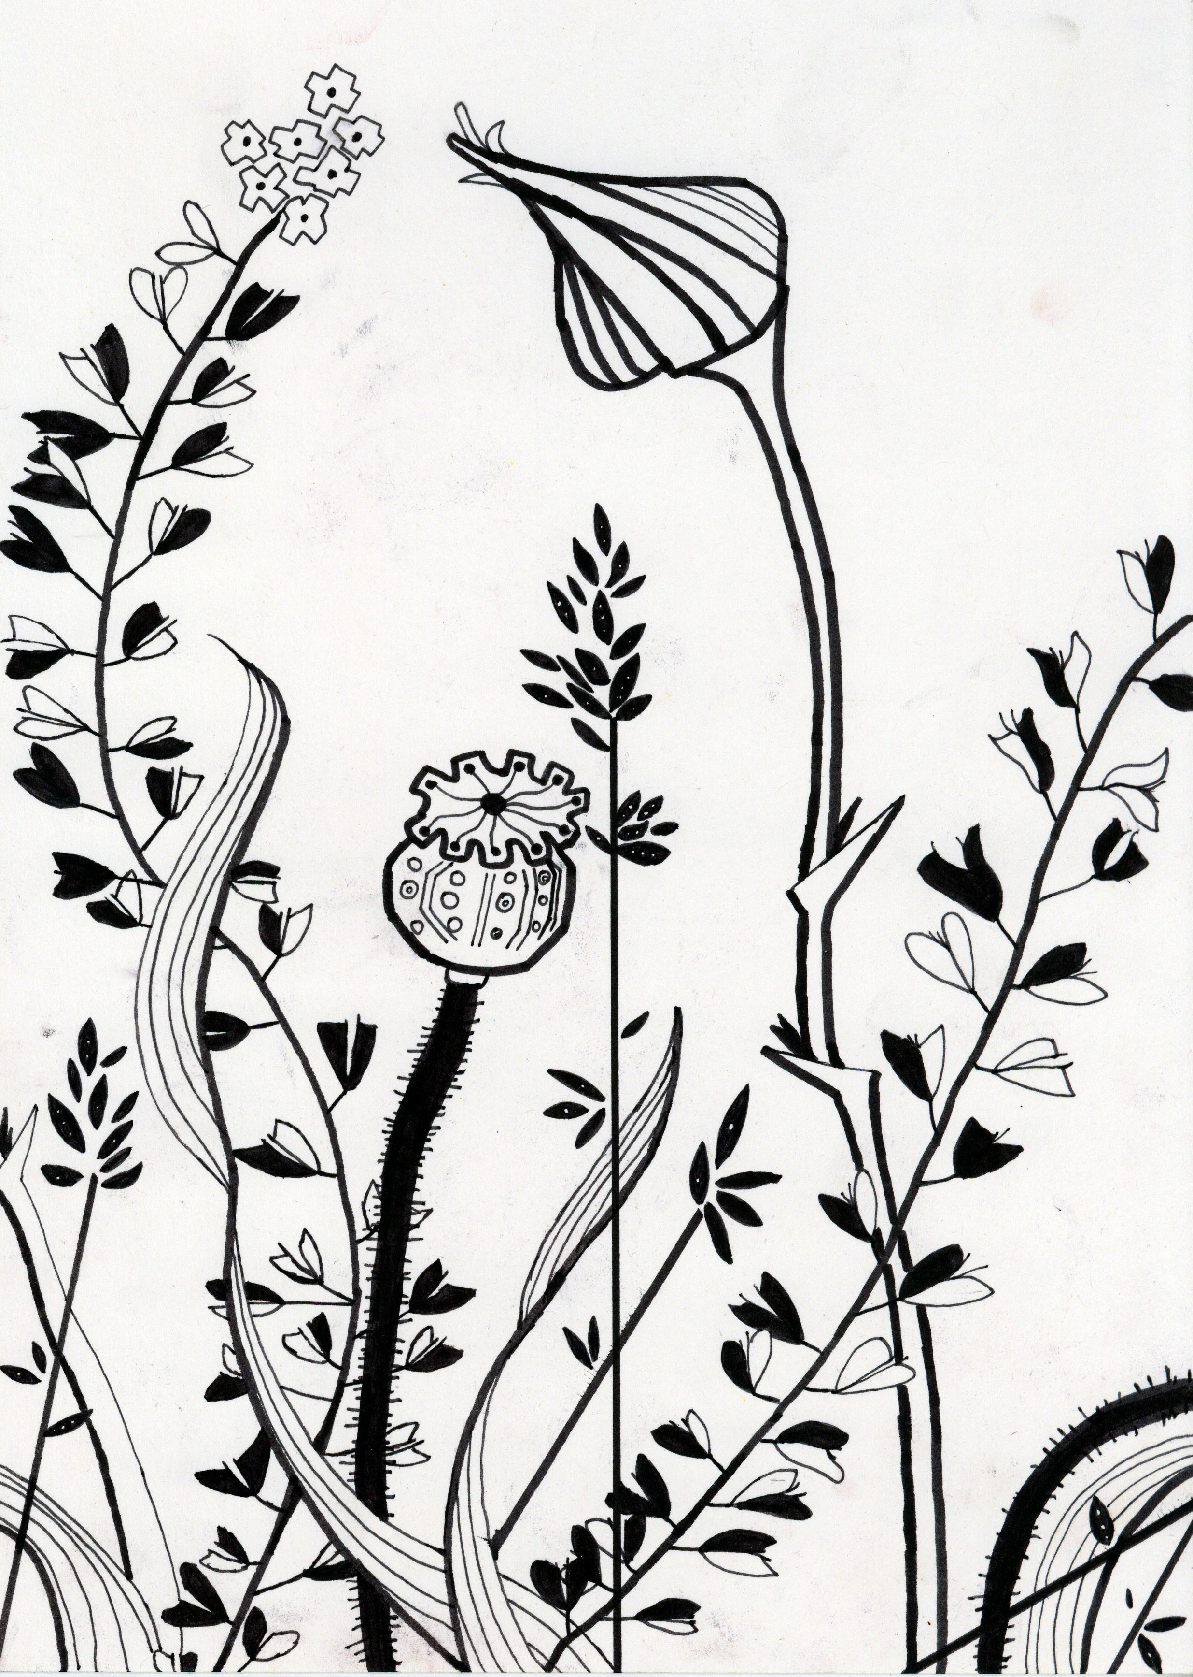
Your task…
On a piece of plain, white paper, experiment drawing flowers in the style of Angie Lewin.
Think about
- How you draw your lines
Shading
Detail
You can be as creative as you like!

Slide 8
Date: Tuesday 2nd March 2021
L.O. To print a background in the style of Angie Lewin
Subject: Art

Slide 9
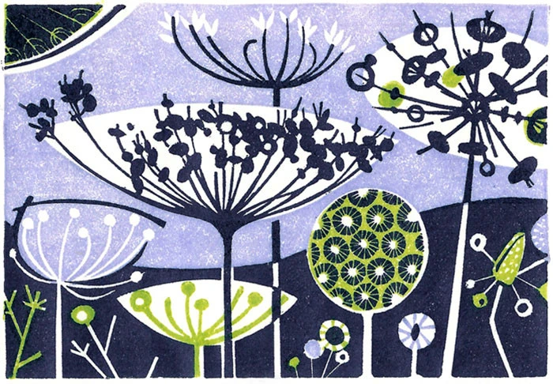
What is similar about these prints?
What is different? Discuss.
Clifftop III
Clifftop II

Slide 10
How does Angie Lewin create the backgrounds of her prints?
To create her prints, Angie Lewin first has to create the background, then wait for it to dry before she can print the flowers on. How many colours does Angie Lewin use in the prints we have been looking at?
We are going to be creating a piece of art in the style of Angie Lewin!
First, we need to create our background!

Slide 11
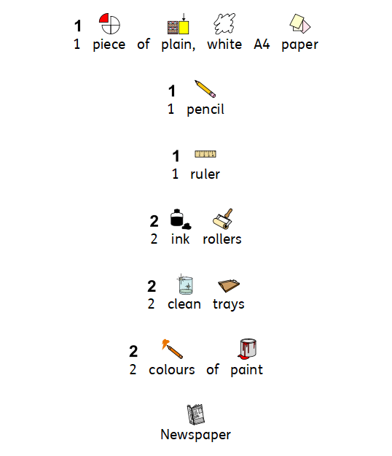
To make your background, you will need:

Slide 12

Step 1)
Turn your paper landscape.
Can you remember what landscape means? We have done it in Maths!!

Slide 13
Step 2)
Using a pencil and ruler, draw a faint line across the middle of your page to separate the sky from the ground.

Slide 14
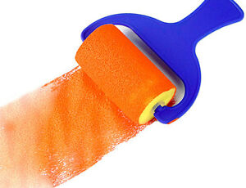
Step 3)
Choose 2 colours for your sky and ground.
Remember – don’t mix the colours up, keep the same roller in the same tray of paint!
Make sure your paper is landscape and positioned on top of the newspaper so that you don’t get the table messy!
Use the rollers to create your background of sky and ground. Make sure you roll it backwards and forwards then side to side before rolling it onto the paper.

Slide 15
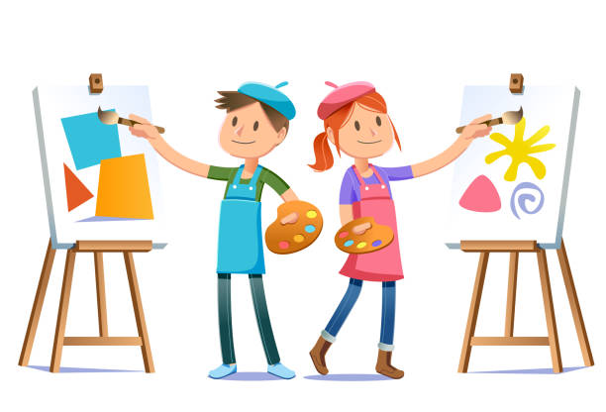
Well done!
Great work Base 5. You have created the background of your print!
Leave your paper to dry overnight and we will continue working on our prints tomorrow!

Slide 16
Date: Wednesday 3rd March 2021
L.O. To print flowers in the style of Angie Lewin
Subject: Art

Slide 17
How does Angie Lewin create the flowers of her prints?
What shapes can you see in this print? Discuss with a partner or write down any shapes you can see.

Slide 18
I could see…
Semi circles
Circles
Ovals

Slide 19
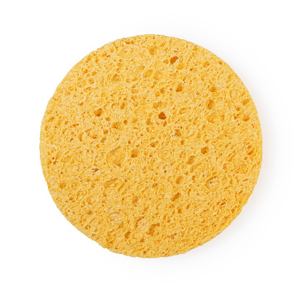
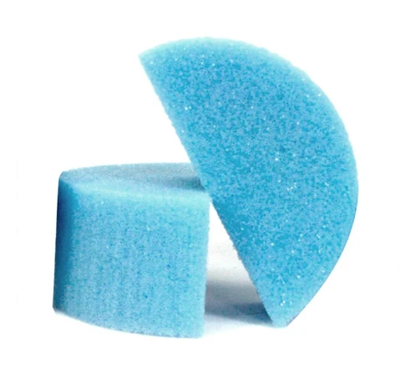
Printing flowers
Now it’s time to print our flowers on top of the background.
We are going to use sponges in the shape of circles and semi circles to print our flowers.
You are going to create 3 shape prints on top of your background using the sponges.
Think carefully – what colours are your flowers going to be? Will they stand out from your background?

Slide 20
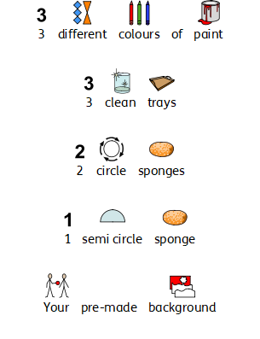
To print your flower shapes, you will need:

Slide 21
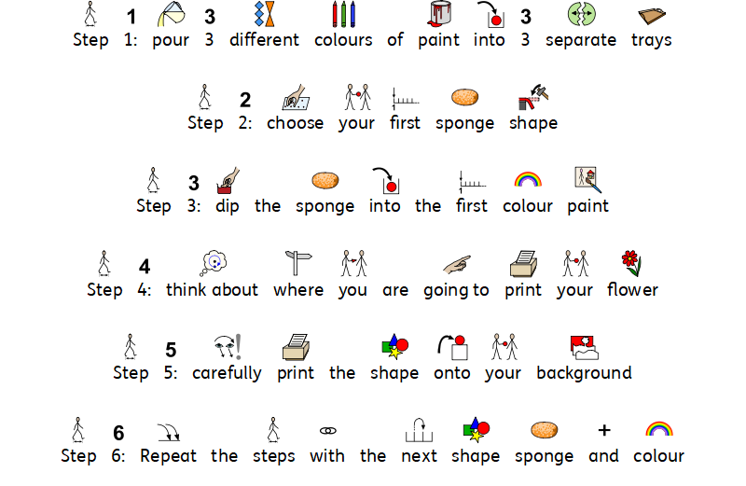
Time to print the flowers onto your background

Slide 22

Well done!
Now you should have 3 flower shapes on top of your background.
Leave it to dry overnight.
When we all return to school on Monday 8th March we will continue to work on our prints, adding line details! I can’t wait to see the finished product!
If you are working from home – bring your background into school. Don’t worry if you forget, we will have time to make another one!

Slide 23
Date: Thursday 4th March 2021
L.O. To be able to identify how sounds are made and how we hear them
Subject: Science

Slide 24

Pre-recorded Teaching
Access the online teaching video below that will support you to complete the work in this lesson. This video will act as a support but all of the work can still be successfully understood & completed using paper-based versions of this pack. If you need further support to understand / complete work then please contact school via e-mail or telephone.
Play Video
You can also copy and paste this link if you would prefer:
https://teachers.thenational.academy/lessons/what-is-sound-chh30r?from_query=sound

Slide 25


How is sound created?
Sounds are made when objects vibrate. These vibrations make any other particles touching the object vibrate as well which get ‘pushed’ through the air. These are called sound waves. Our ears are designed to sense these air vibrations and tell our brain what type of sound we are hearing.
This means that if an object is making a sound it is vibrating. Sometimes you can see the vibrations for example when you pluck a guitar.

Slide 26

How is sound created?
Sounds are made when objects _________________
These vibrations make any _______________ touching the object
vibrate as well, which get ‘pushed’ through the______________
3. The vibrations are sensed by our ____________ which tell our
brain the type of sound we are hearing.
air ear particles vibrate

Slide 27


How are different sounds made?
Sounds come in all different volumes. What makes a sound loud or quiet? The volume depends on how strong the vibration is. The stronger the vibration the louder the sound. If you clapped your hands really softly, you will hear a quiet sound. If you clap them hard together, you will create a louder sound because the vibrations are stronger.
When you move further away from the source of a sound, it gets quieter. When you watch T.V and go into another room, it will be much quieter than if you were sitting right in front of it.

Slide 28

How does sound travel?
Sound can travel through solids, liquids and gases.
Soundwaves can travel through solid forms such as bricks and glass which is why you might hear noise outside of the class or school.
In liquid forms, such as under water, particles are closer together so vibrations and soundwaves move quicker.
In gas forms, such as air, sound travels through vibrating particles.

Slide 29

How do you prevent sound?
If there is a sound you want to stop, you need to block the particles from vibrating. You can do this through solid objects, such as closing a door to stop the sound on the other side making it through. You can also use soft objects, such as ear muffs, as they prevent most of the the vibrations from reaching your ears.
You can try blocking the vibrations yourself. Say something outload. Now say the same thing, but this time cover your mouth. Was it quieter? That’s because your hand (a solid object) is blocking the vibrations in the air.

Slide 30

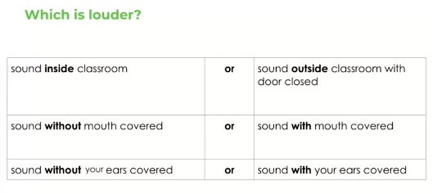
How do you prevent sound?
Discuss this with a friend or an adult

Slide 31
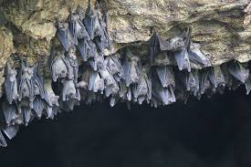
How do animals use sound?
When particles vibrate so quickly, it creates ultrasonic sound. When this happens, sounds are created that humans can’t hear but other animals who have sensitive hearing can. For example, dog whistles create a sound that humans cannot hear but dogs can.
Rats and mice use ultrasonic sound to communicate so they can talk without animals such as cats being able to hear them.
Bats use sound to search for food and feed. They send out sound waves to the walls of the cave. When the sound reaches back to their ears, they build a detailed map of everything around them which makes it easier to find food.

Slide 32
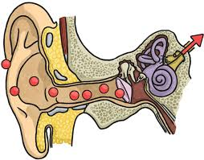
How do we hear sound?
While the particles are vibrating, they will eventually make their way towards your ears and are funnelled into a small spot.
Vibrating particles are small enough to get in to your ear and travel down the ear canal. They travel all the way down until they hit the ear drum. Then they vibrate the ear drum through some small bones which goes all the way to the cochlea. This is the part of the body that tells your brain the kind of sound you have heard.

Slide 33
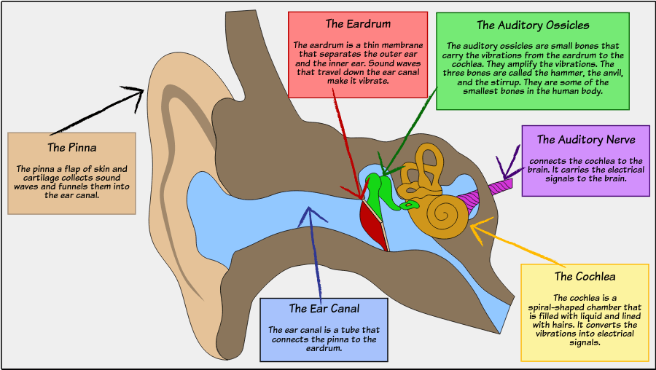
Parts of the ear
Can you see where the cochlea is?

Slide 34
How do we hear sounds?
When vibrating particles reach our ears, they travel down our
ear canal until it reaches our ______ __________
2. It is our ____________ that sends signals to our brain to tell us what
sound we can hear.
3. Animals can communicate, hunt and feed because of ______________ sound.
Cochlea Ultrasonic ear drums

Slide 35

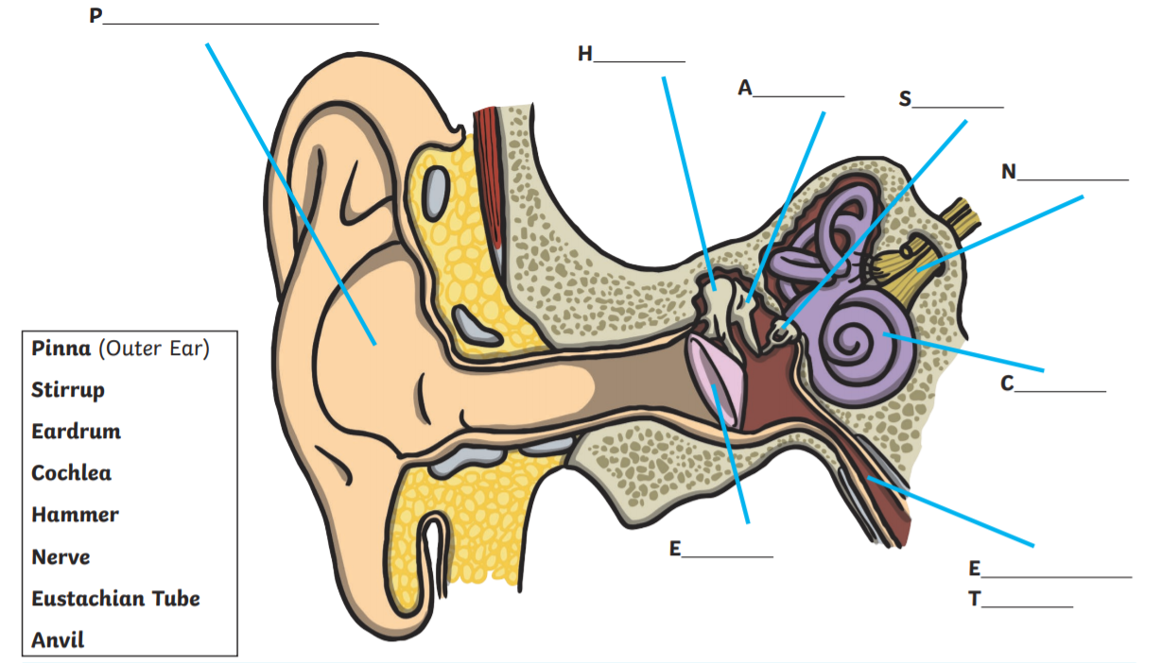
Label the parts of the ears.

Slide 36
Challenge: complete these sentences.
Sound is made when__________________________________________
When the vibrations are stronger _______________________________
Animals use sound to _________________________________________
When vibrating particles enters our ears, it travels through your _____
___________ and vibrates our _______ __________
5. The cochlea sends signals _______________________________

Slide 37
Date: Friday 5th March 2021
L.O. To be able to make different sounds
Subject: Science

Slide 38
Pre-recorded Teaching
Access the online teaching video below that will support you to complete the work in this lesson. This video will act as a support but all of the work can still be successfully understood & completed using paper-based versions of this pack. If you need further support to understand / complete work then please contact school via e-mail or telephone.
Play Video
You can also copy and paste this link if you would prefer:
https://teachers.thenational.academy/lessons/how-are-different-sounds-produced-6nj3et

Slide 39

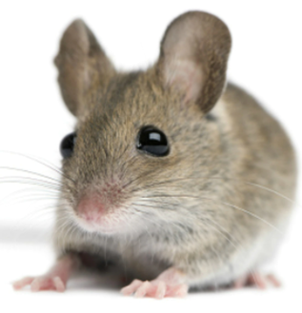
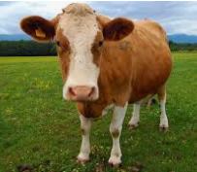
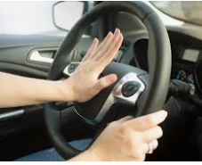
All sounds are made by making vibrations through the air.
The vibrations come from different objects are very different.
Sometimes they sound high pitched like a mouse’s squeak or low like a cow’s moo.
Sometimes they are very quiet like a whisper or very loud like a car horn.

Slide 40
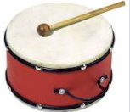
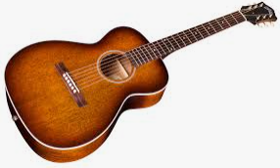
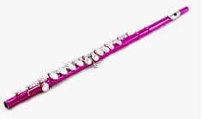
Every time there is a kind of sound, vibrations travel through the air. This means that, to create a sound, all we need to do is create vibrations in the air. We can do this by: striking something, like a drum plucking it, like a guitar blowing through it, like a flute

Slide 41
S ______________________
P ______________________
B ______________________
What are three ways can a sound be created?

Slide 42
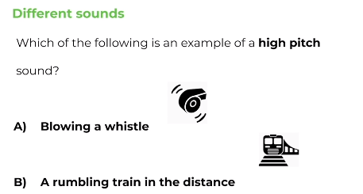
Remember, a high pitched sound is a high sound like a mouse’s squeak!

Slide 43
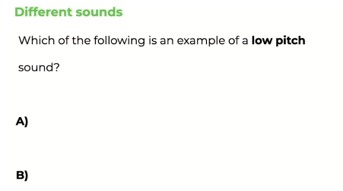


Remember, a low pitched sound is a low sound like a cow’s moo.
A birds tweet
A lions roar

Slide 44
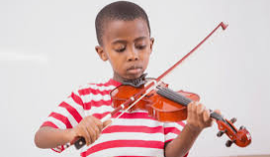
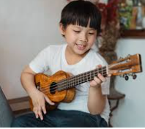
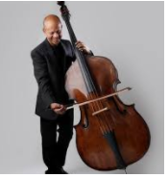
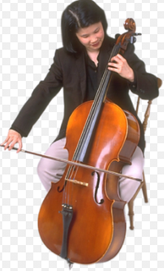
Different instruments create different sounds.
Violin
The larger the instrument the lower the pitch. The smaller the instrument the higher the pitch.
Cello
Ukulele
Double Bass

Slide 45
Label these instruments as high pitched or low pitched.
Violin
Cello
Ukulele
Double Bass

Slide 46
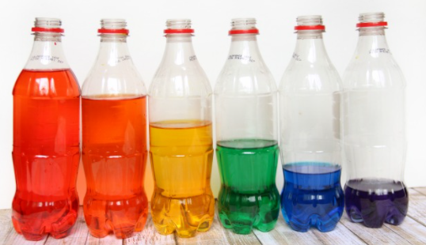
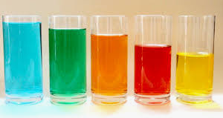

Lets investigate…
You are going to make your own ‘Water bottle xylophone’
You will need:
4-6 water bottles/jars/glasses that are all the
same size and made out of plastic or glass.
Water
A wooden spoon, pencil or stick
Food colouring is optional to change water colour

Slide 47
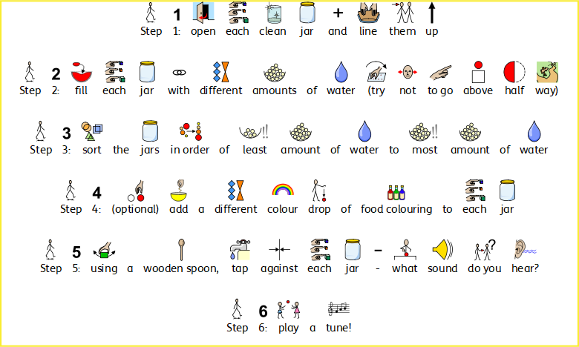
Follow these instructions to make your own ‘water bottle xylophone’
https://www.bbc.co.uk/teach/bring-the-noise/found-sounds/z4rcbdm

Slide 48

When you tap a jar with the spoon it vibrates, making that clinking sound. The faster something vibrates, the higher the ‘pitch’ of the sound it makes. Adding water to the jar makes the jar vibrate more slowly, lowering the pitch of the sound.
For xylophones and glockenspiels, it’s the length of the bars that are hit that changes the pitch. The shorter bars vibrate faster, and make a higher pitched note.

Slide 49
What did you notice?
The container that had the most amount of water ___________________
_______________________________________________________________
2. The container with least amount of water ___________________________
_______________________________________________________________
3. To create a high pitch sound you need ______________ water.
4. To create a low pitch sound you need _______________ water.

