Slide 1



Date: Monday 25th January
LO To be able to identify features of a letter.
Subject: English

Slide 2
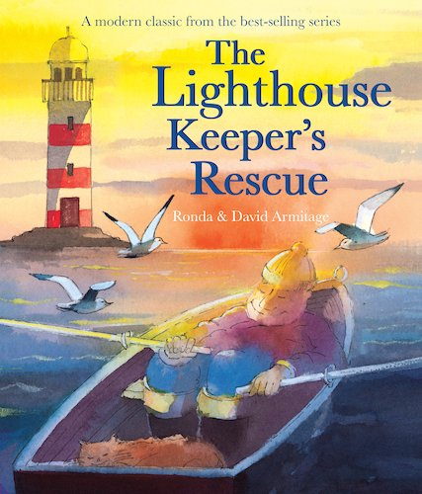
This is the story we are going to be focusing on this week.
We hope you enjoy it!
The Lighthouse Keeper's Rescue - Give Us A Story! – YouTube
Click on the link or copy and paste it into your internet browser to listen to the story being read.

Slide 3
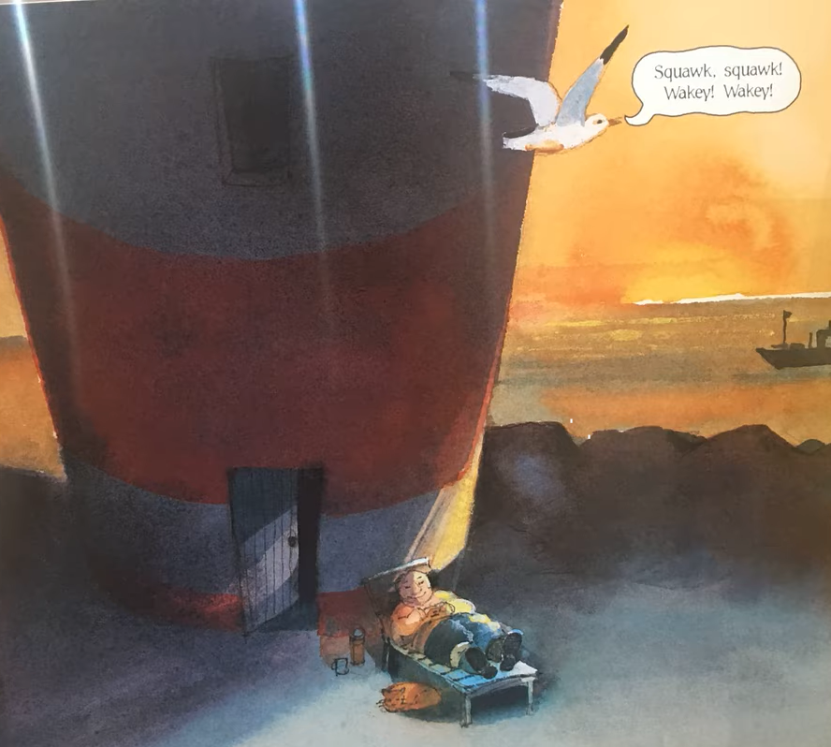
Thank you letter
This week we are going to be writing a thank you letter to the lighthouse inspectors.
What do you think we might need to include when writing a letter?
What are the key features of a letter?
Write your ideas on a piece of paper or type your ideas on the lines.

Slide 4
Thank you letter
Read my letter!
23 Harbour View,
Ocean Bay
OB2 4EN
25th January 2021
Dear inspectors of lighthouses,
I am writing to say thank you for allowing me to keep my job. You won’t regret it!
I am extremely sorry for the mistakes I made and falling asleep whilst at work! I’m getting old now and my bones ache because of this I need to sleep more often. Did you know I have been a lighthouse keeper for over 40 years?
What is my new assistant like? Does he know when to turn the light on and off? Don’t worry he is in safe hands with me! I will make sure he knows everything there is to know about being a lighthouse keeper! I’m sure with my training he will become the second best lighthouse keeper in the world!
Thanks again for your support. I will make sure I go to bed early and get lots of rest on my days off so that I can do the job to the best of my ability. I will not let you down again because I love being a lighthouse keeper and keeping the brave sailors safe.
Yours sincerely,
Mr Grinling
P.S Mrs Grinling has baked you a delicious, chocolate cake to say thank you because we are ever so grateful.

Slide 5
Now find the features …
Thank you letter
23 Harbour View,
Ocean Bay
OB2 4EN
25th January 2021
Dear inspectors of lighthouses,
I am writing to say thank you for allowing me to keep my job. You won’t regret it!
I am extremely sorry for the mistakes I made and falling asleep whilst at work! I’m getting old now and my bones ache because of this I need to sleep more often. Did you know I have been a lighthouse keeper for over 40 years?
What is my new assistant like? Does he know when to turn the light on and off? Don’t worry he is in safe hands with me! I will make sure he knows everything there is to know about being a lighthouse keeper! I’m sure with my training he will become the second best lighthouse keeper in the world!
Thanks again for your support. I will make sure I go to bed early and get lots of rest on my days off so that I can do the job to the best of my ability. I will not let you down again because I love being a lighthouse keeper and keeping the brave sailors safe.
Yours sincerely,
Mr Grinling
P.S Mrs Grinling has baked you a delicious, chocolate cake to say thank you because we are ever so grateful.
Use the key to highlight/ underline the key features in the correct colour
Address
Date
Dear
Yours Sincerely
Question
Exclamation mark
and

Slide 6

Well done for all of your hard work! We can’t wait to see your completed work.
Could any completed work / photographic evidence of completed work please be sent to pioneerspupils@gmail.com
Thank you!

Slide 7
Date: Tuesday 26th January
LO To be able to punctuate questions with a question mark.
Subject: English

Slide 8
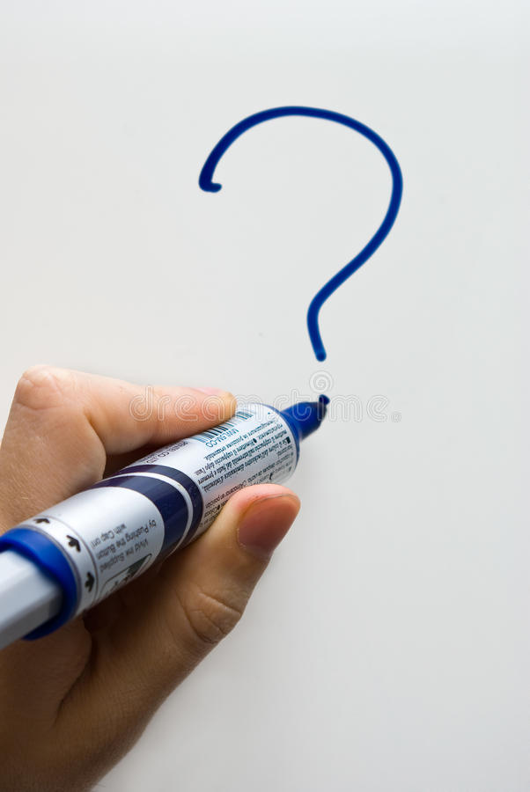
Recap - Question Marks
A question mark looks like this ?
It goes at the end of a question
Can you draw a question mark with your finger?
Now can you write a question mark on your paper?

Slide 9
What?
Question words
When?
Who?
Now can you write questions to ask the Inspector of Lighthouses.
Where?
Why?
How?
Example
Who will be my assistant?
Write 3 questions on the lines below or on a piece of paper.

Slide 10

Did
The word ‘did’ is often used to start questions.
Look at these examples:
Did you enjoy your tea party?
Did you go for a walk today?
Did Mrs Grinling bake a cake?
Did you know the sun sets at different time each day?
Did you know the tide comes in at different times each day?
All of the examples end with a question mark because when we use the word ‘did’ at the start of a sentence we are asking a question.

Slide 11
Add the question mark
Can you punctuate the sentences correctly using a question mark – remember a question mark looks like this ?
Where is the lighthouse
What do seagulls eat
How do you turn the light on in the lighthouse
When does the tide come in
Did you know that lighthouses are used to stop boats crashing into the rocks
Remember the ? goes at the end of the sentence

Slide 12

Add the question mark - answers
Check your answers. Did you put the question mark in the right place?
Where is the lighthouse?
What do seagulls eat?
How do you turn the light on in the lighthouse?
When does the tide come in?
Did you know that lighthouses are used to stop boats crashing into the rocks?

Slide 13
Question or statement?
A statement is a simple sentence.
A statement is always punctuated with a full stop at the end.
A question is something you can ask or answer.
A question is always punctuated with a question mark at the end .

Slide 14
Question or statement?
Read the sentences and decide if they need a full stop or question mark at the end. Use the word at the start of the sentence to help you decide.
1. Lighthouses are usually at the end of a pier
2. How does the lighthouse keeper get to the lighthouse
3. Did you know lighthouses are used to stop boats crashing into the rocks
4. Lighthouses are red and white
5. When does the light turn on
6. Where does the lighthouse keeper live
7. Seagull eat small fish
8. Why does the light turn on at different times every day

Slide 15
Question or statement? Answers
Check your answers. Did you get them all right?
1. Lighthouses are usually at the end of a pier.
2. How does the lighthouse keeper get to the lighthouse?
3. Did you know lighthouses are used to stop boats crashing into the rocks?
4. Lighthouses are red and white.
5. When does the light turn on?
6. Where does the lighthouse keeper live?
7. Seagull eat small fish.
8. Why does the light turn on at different times every day?

Slide 16
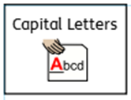


Now can you write your own questions to ask the Inspectors of Lighthouses?
You can use some of the questions we have already looked at to help.
What?
Who?
Question words
Don’t forget:
When?
Why?
Where?
Write your questions neatly onto a piece of paper or type them on the lines below. You will be able to use them in your writing on Thursday!
How?
Did?

Slide 17
Well done for all of your hard work! We can’t wait to see your completed work.
Could any completed work / photographic evidence of completed work please be sent to pioneerspupils@gmail.com
Thank you!

Slide 18
Date: Wednesday 27th January
LO To be able to use ‘and’ to extend sentences.
Subject: English

Slide 19
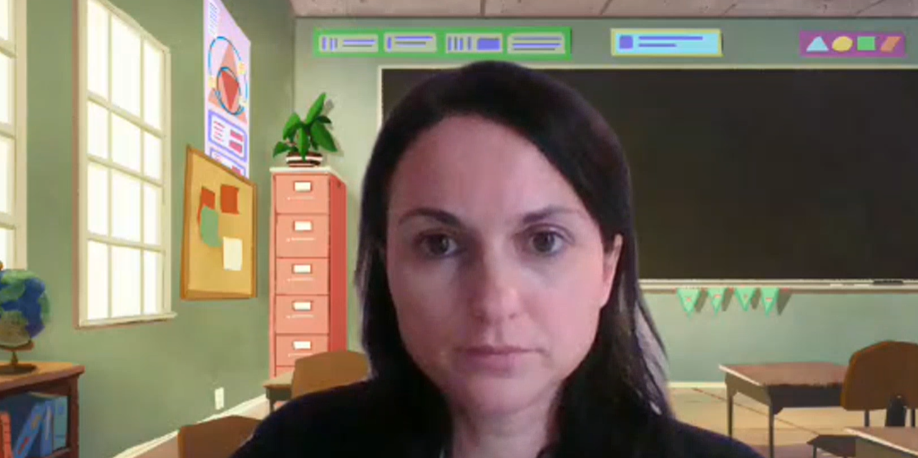
Pre Recorded Teaching
On the school website you will find a pre recorded video that will support the teaching of todays lesson. The video is called English video – using and.

Slide 20
and
We are going to use the word and to extend our sentences.
Can you say the word and?
Can you sound it out a n d?
Now can you practise writing the word and on a piece of paper?

Slide 21

The word ‘and’ can be used as a conjunction. Conjunctions join two sentences together …
The lighthouse is red and white.
The and in this sentence is not used correctly
because it joins two words not two sentences.
Mr Grinling sat down and watched the noisy, white seagulls fly past.

Slide 22
Match the correct ending to the sentences
Sentence starters:
Ending:
Mr Grinling sat down and
forgot to turn the light on.
Mr Grinling fell asleep and
watched the noisy, white seagull fly past.
Mr Grinling was sad and
and got his job back.
He saved the huge, black whale
hid in his bedroom.

Slide 23
Match the correct ending to the sentences - answers
Sentence starters:
Ending:
Mr Grinling sat down and
forgot to turn the light on.
Mr Grinling fell asleep and
watched the noisy, white seagull fly past.
Mr Grinling was sad and
and got his job back.
He saved the huge, black whale
hid in his bedroom.

Slide 24
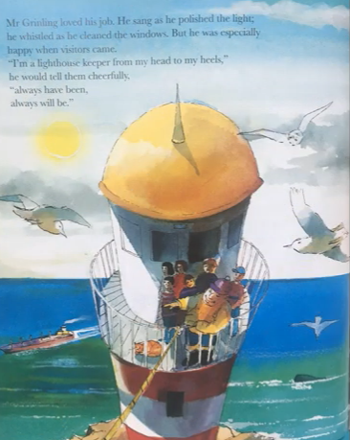
Complete my sentences:
Mr Grinling fell asleep and ___________________________________________.
The seagull flew through the sky and ___________________________________________.
Everyone in the village pushed the whale and ___________________________________________.
The word ‘and’ is a …
Conjunction

Slide 25
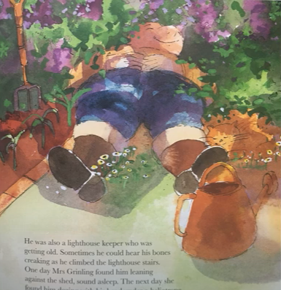
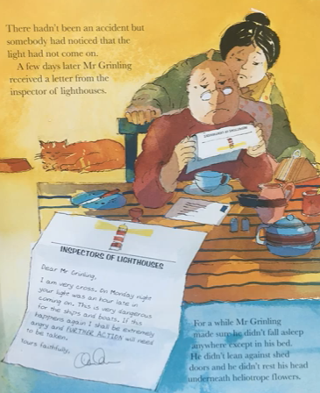
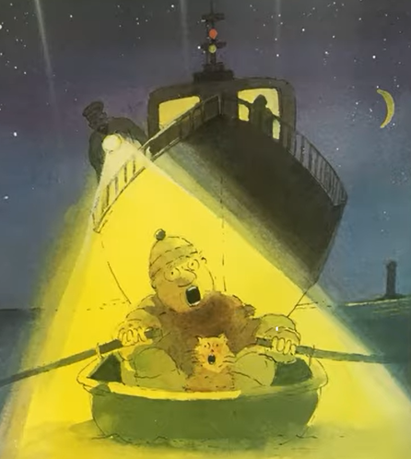
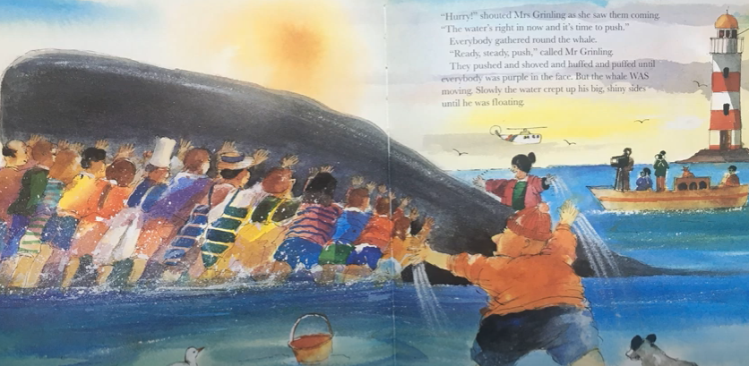
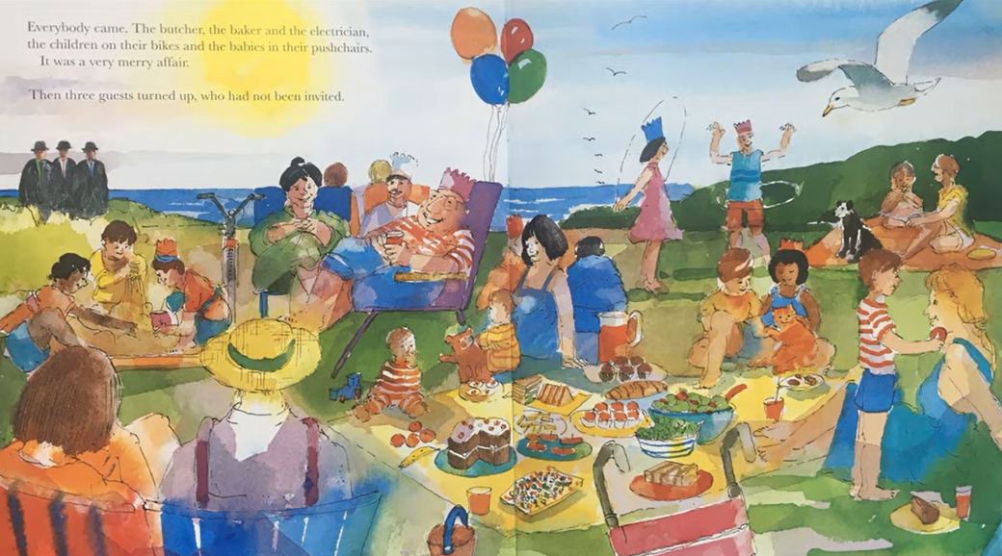

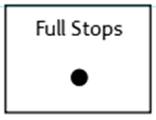
Your Sentences…
Write your own sentences about the story using the conjunction ‘and’ to extend your sentences
Don’t forget:
Use the pictures to help

Slide 26
Well done for all of your hard work! We can’t wait to see your completed work.
Could any completed work / photographic evidence of completed work please be sent to pioneerspupils@gmail.com
Thank you!

Slide 27
Date: Thursday 28th January
LO To be able to write a letter.
Subject: English

Slide 28
Thank you letter
Re read my letter to get it back in your head.
23 Harbour View,
Ocean Bay
OB2 4EN
25th January 2021
Dear the Inspectors of Lighthouses,
I am writing to say thank you for allowing me to keep my job. You won’t regret it!
I am extremely sorry for the mistakes I made and for falling asleep whilst at work! My bones ache because I’m getting old so I need to sleep more often. Did you know I have been a lighthouse keeper for over 40 years?
What is my new assistant like? Does he know when to turn the light on and off? Don’t worry he is in safe hands with me! I will make sure he knows everything there is to know about being a lighthouse keeper! I’m sure with my training he will become the second best lighthouse keeper in the world!
Thanks again for your support. I will make sure I go to bed early and get lots of rest on my days off so that I can do the job to the best of my ability. I will not let you down again because I love being a lighthouse keeper and keeping the brave sailors safe.
Yours sincerely,
Mr Grinling
P.S Mrs Grinling has baked you a delicious, chocolate cake to say thank you because we are ever so grateful.

Slide 29


Write a thank you letter
Today you are going to pretend to be Mr Grinling and write a thank you letter to the Inspectors of Lighthouses for allowing you to keep your job!
Your letter must include:
An address for the lighthouse inspectors
The date underneath the address
Dear Inspectors of Lighthouses
An introduction explaining why you are writing (1 sentence)
sentences about what you will do differently to do the job better (at least 5 sentences)
Questions (at least 3)
Yours sincerely Mr Grinling
You can use the blank lines on the next slide to type your letter or you can write your letter on paper.
Address
Dear
Date
Information
This piece of writing should take approximately 45 minutes
Yours sincerely

Slide 31
Well done for all of your hard work! We can’t wait to see your completed work.
Could any completed work / photographic evidence of completed work please be sent to pioneerspupils@gmail.com
Thank you!

Slide 32
Date: Friday 29th January
LO To be able to read and spell words with the ‘oy’ sound.
Subject: English

Slide 33

oy
The sound we are focusing on today is oy.
The oysound is normally at the end of words.
Click on the links or copy and paste the links into your internet browser to watch the phonics videos.
Phonics Lesson - Set 2 'oy' sound for Reception and Year 1 – YouTube
Geraldine the Giraffe learns /oy/ - YouTube
The OY Sound | Phase 5 | Phonics - YouTube

Slide 34
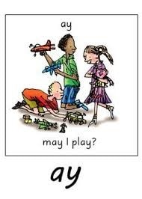
Read the ‘oy’ words
toy
joy
boys
boy
soy
toys
enjoy
ahoy
annoy
alloy
loyal
royal
Now write the words on a piece of paper and underline the ‘oy’ sound.

Slide 35
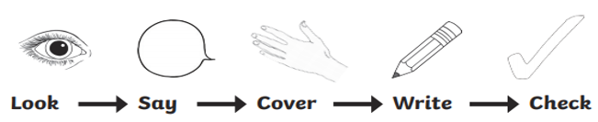
word | 1st try | 2nd try | 3rd try
boy
toy
joy
soy
enjoy
annoy
loyal
royal
Practice writing the words on a piece of paper or type into the table on your computer.

Slide 36
Real or Alien words?
Read the words and decide if they are real words or alien words.
Real words
joy
Alien words
qoy
xoy
boy
loy
enjoy
bjnoy
ahoy
gtoy
ftoy
royal
Remember alien words are made up words!

Slide 37
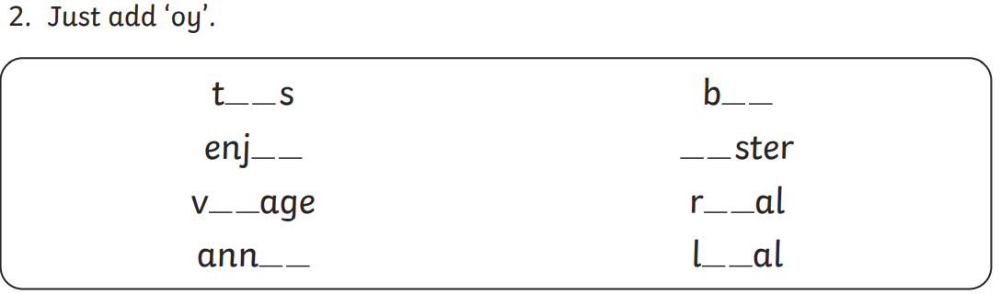
What words have you created?

Slide 38
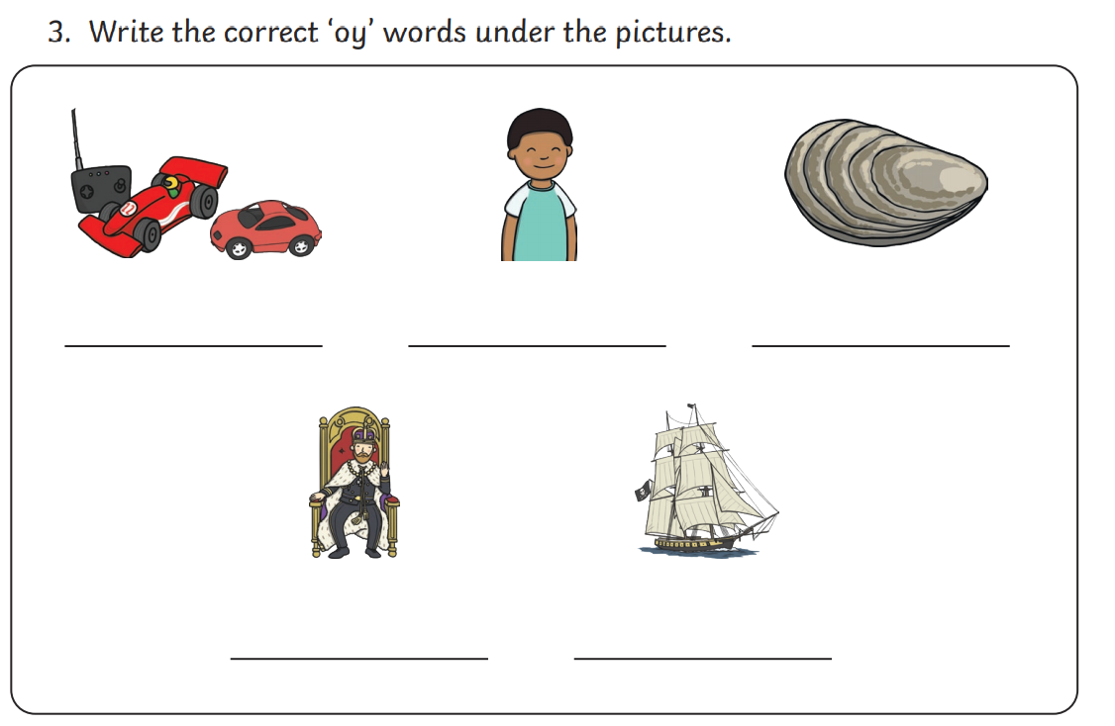

Slide 39
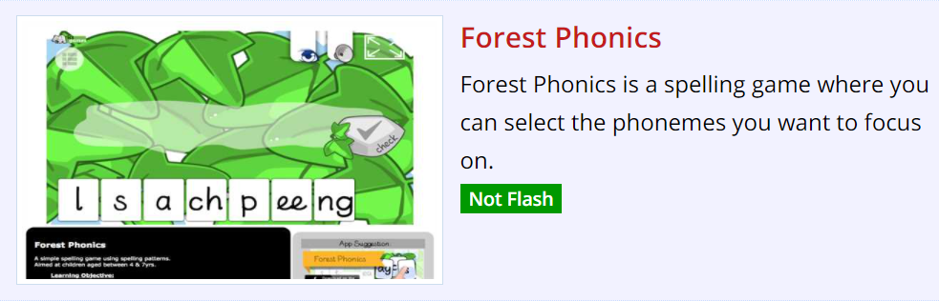
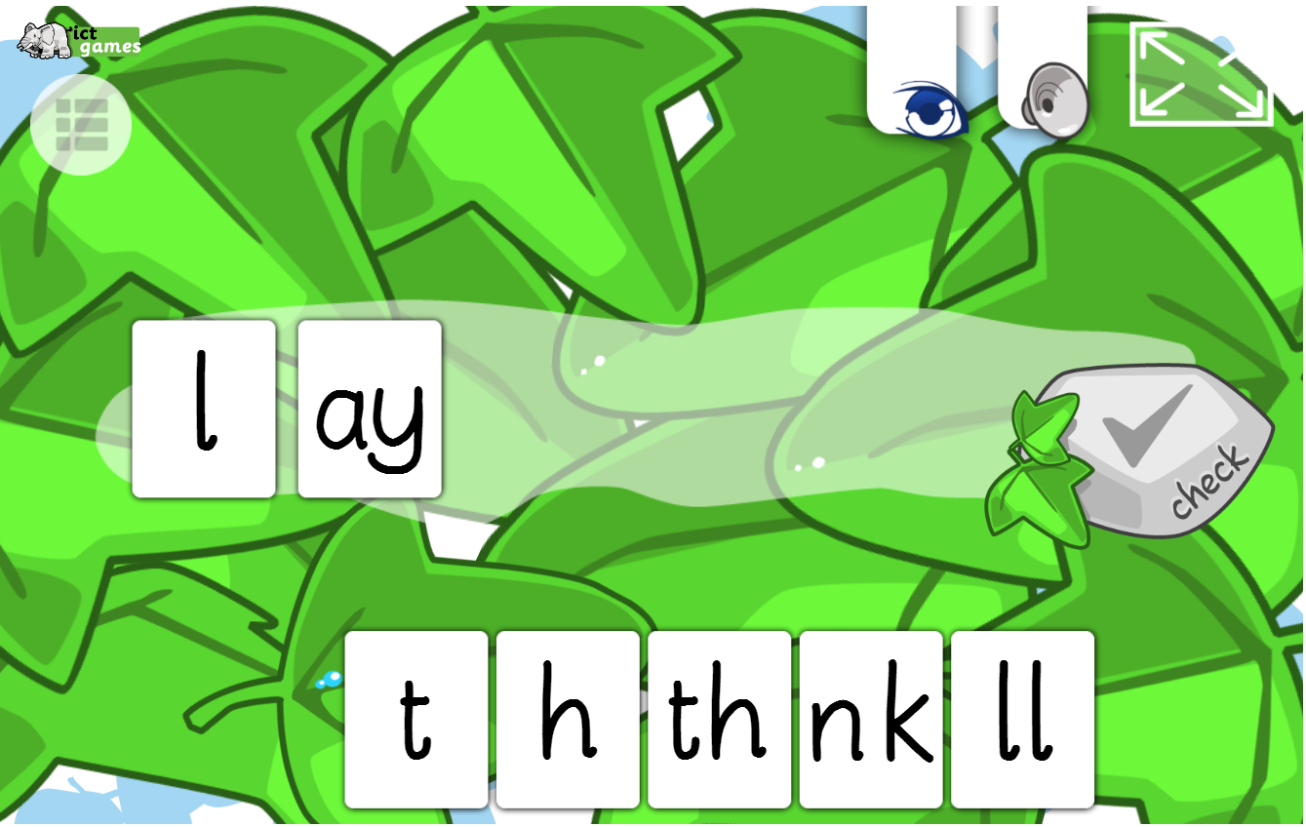
Spelling game!
Use the link to play the game and practice spelling the ‘oy’ words
Forest Phonics - mobile friendly (ictgames.com)

Slide 40
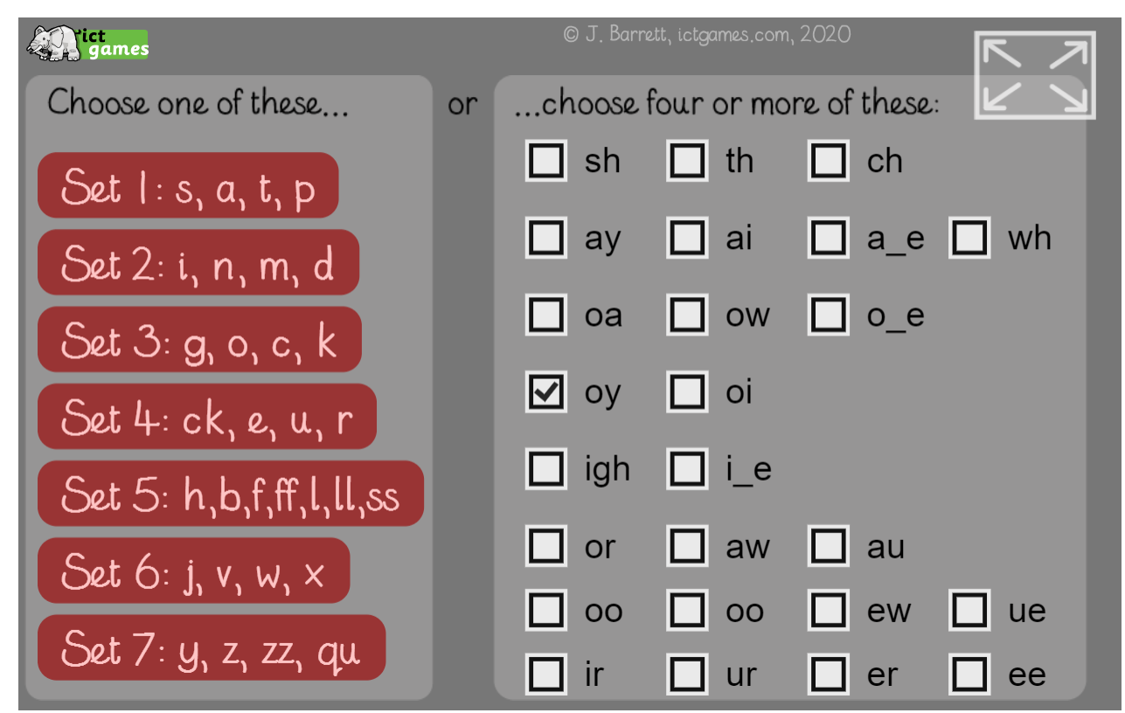
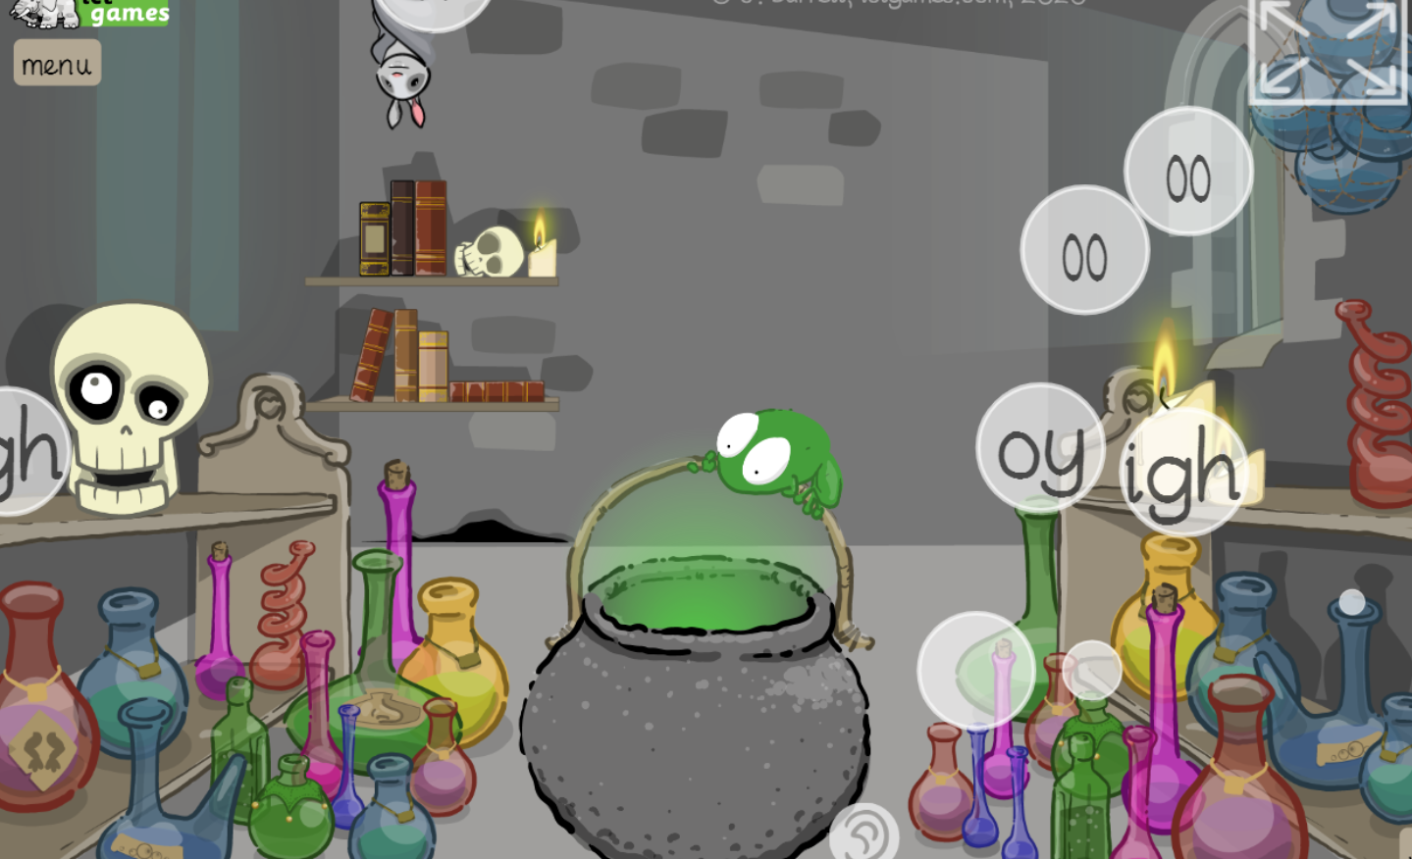
Spelling game!
Use the link to play the game and practice spelling the ‘oy’ words
Spooky Sounds (ictgames.com)

Slide 41
Well done for all of your hard work! We can’t wait to see your completed work.
Could any completed work / photographic evidence of completed work please be sent to pioneerspupils@gmail.com
Thank you!

