Slide 1


Subject: Phonics and Guided Reading

Slide 2


Date: Monday 22nd February
LO To be able to practise phonics sounds.
LO To be able to answer questions about a text.
Please practise phonics every day for 20 minutes.
Subject: Phonics/Guided Reading

Slide 3
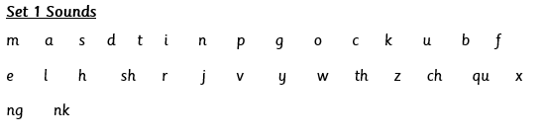

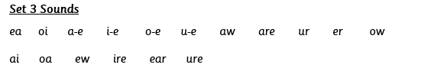
Each day we are going to focus on a different sound.
Please choose from set 1, set 2, set 3 or guided reading. Each day, for phonics, there will be a video to watch and some words to read linked to the taught sound. For guided reading, there will be a text to read and some questions to answer.
Here are the sounds which are in each set.
Please contact the school if you are not sure which set your child should be focusing on, or whether you’re unsure if your child does guided reading rather than phonics.
Then, play some phonics games!
Guided Reading
For those children who know all of the phonics sounds from set 1, set 2 and set 3 and are confident readers.

Slide 4

Set 1 Sounds
Skip this slide if your child is not focusing on this set.
Today’s sound:
Please click the link or copy the below link into the internet:
https://www.youtube.com/watch?v=-iOKgIlQk5M&list=PLPVrkr0oJX1tBTpbocNce93WUH8G-um6A&index=17
Or copy the below into YouTube:
‘Phonic Lesson - Set 1 Sound - Learning to Read and Write “l" for Reception and Year 1’ – Early Years Learning is Fun
Scavenger Hunt!
What can you find in your house that begins with l?

Slide 5
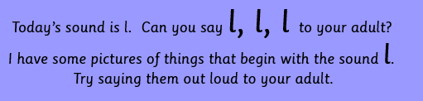

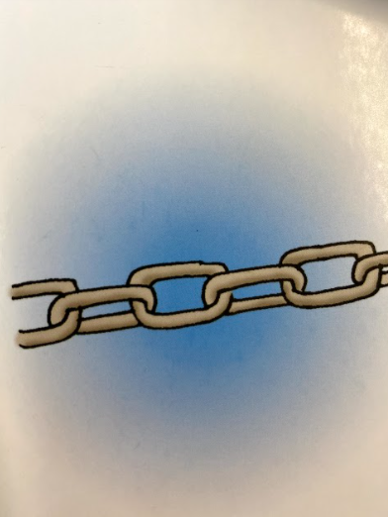
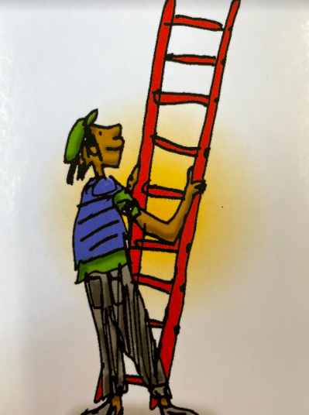
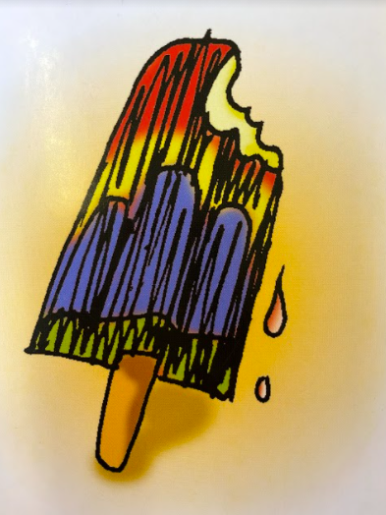
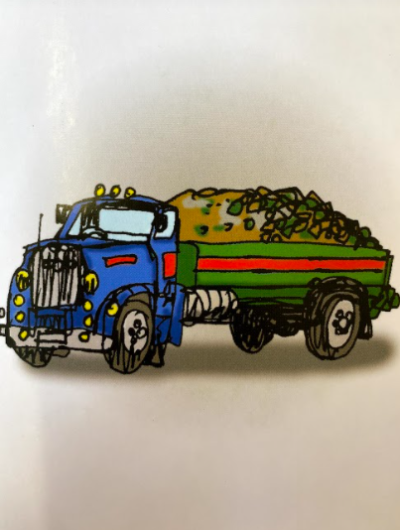
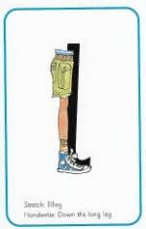

l l lock
l l ladder
l l lolly
l l lorry
Hiding behind the leg is the grapheme l. Can you point to it and say l?
When you see this side of the card say l.
Look at the picture on the left.
That is a
leg.
When you see this picture, as quick as you can say leg.

Slide 6

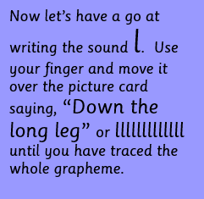
Below, I have given you some cards. Point to each one and say leg or l.
Now have a turn on your own. Keep practising until you get it right.

Slide 7







Set 1 Sounds
Now its time to Fred talk, read the word. Let me show you.
Here is my green word.
I am going to point to the button below each sound and say it out loud. This is Fred Talk.
l o g, after sounding out the word remember to read the word, log. I have now read the word.
Now time to read some words including ‘l’. You could even practise writing these words!

Slide 8

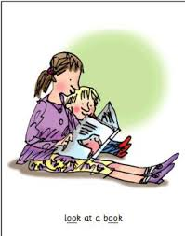
Recap: Set 2 Sounds
Skip this slide if your child is not focusing on this set.
Today’s sound:
Please click the link or copy the below link into the internet:
https://www.youtube.com/watch?v=c9U9y5XfJEs&list=PLPVrkr0oJX1sBGLJU2hNbPE2neuhezWSu&index=5
Or copy the below into YouTube:
‘Phonic Lesson - Set 2 ‘short oo’ sound for Reception and Year 1’ – Early Years Learning is Fun
Can you think of any words with the ‘oo’ sound in it?

Slide 9

Today’s sound is oo. It is pronounced ‘u’. Can you say oo, oo, oo to your adult?
Look at the picture on your left. What can you see?
They are looking at a book.
“look at a book”
Let’s Fred Talk some ‘oo’ words.
l oo k t oo k f oo t
On the other side of the card is the digraph, oo.
These letters are
special friends.
They are two letters that make one sound. When we see them we say,
oo (u).
When we see the picture side we say,
“look at a book”

Slide 10
Below, I have given you some cards. Point to each one and say oo or look at a book.
Now let’s have a go at writing the sound oo. You already know how to form each letter. Now we simply put them together to write the sound oo
Now have a turn on your own. Keep practising until you get it right.

Slide 11

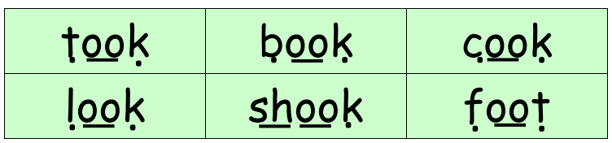
Set 2 Sounds
Now its time to Fred talk, read the word. Let me show you.
Here is my green word.
I am going to point to the button below each sound and say it out loud. This is Fred Talk.
t oo k, after sounding out the word remember to read the word, took.
I have now read the word.
Now it’s your turn. Fred talk, read the words below.

Slide 12
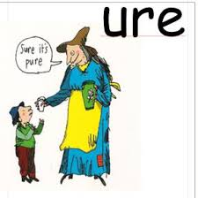
Set 3 Sounds
Skip this slide if your child is not focusing on this set.
Today’s sound:
Please click the link or copy the below link into the internet:
https://www.youtube.com/watch?v=H3Gl3SuSizc&list=PLPVrkr0oJX1smTl2RWUHKgvupRrMZkKEE&index=17
Or copy the below into YouTube:
Phonics Lesson - Set 3 sound ‘ure' for Foundation Stage and Year 1
Can you think of any words with the ‘ure’ sound in it?

Slide 13
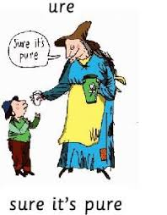

Today’s sound is ure. Can you say ure, ure, ure to your adult?
Look at the picture on your left. What can you see?
The lady is saying,
“sure it’s pure.”
Let’s Fred Talk some ‘ure’ words.
s ure p ure p i c t ure
On the other side of the card is the trigraph, ure.
These letters are
special friends.
They are three letters that make one sound. When we see them we say,
ure.
When we see the picture side we say,
“sure it’s pure”

Slide 14
Below, I have given you some cards. Point to each one and say ure or sure its pure.
Now let’s have a go at writing the sound ure. You already know how to form each letter. Now we simply put them together to write the sound ure
Now have a turn on your own. Keep practising until you get it right.

Slide 15

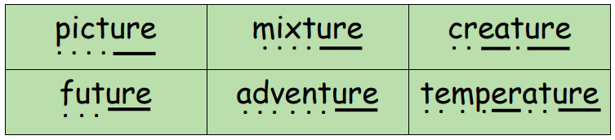
Set 3 Sounds
Now its time to Fred talk, read the word. Let me show you.
Here is my green word.
I am going to point to the button below each sound and say it out loud. This is Fred Talk.
p i c t ure after sounding out the word remember to read the word, picture. I have now read the word.
Now time to read some words including ‘ure’. You could even practise writing these words!

Slide 16
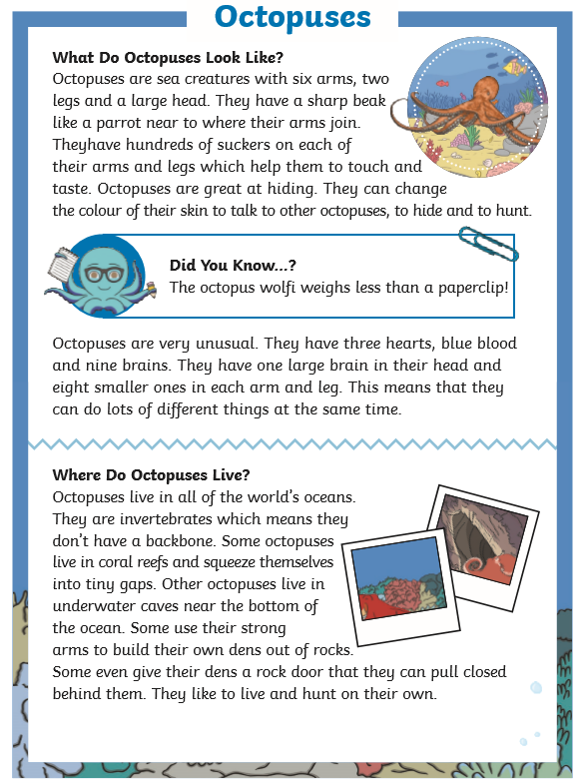
Guided Reading
Page 1
Read the text below before answering the questions on the following slides.

Slide 17
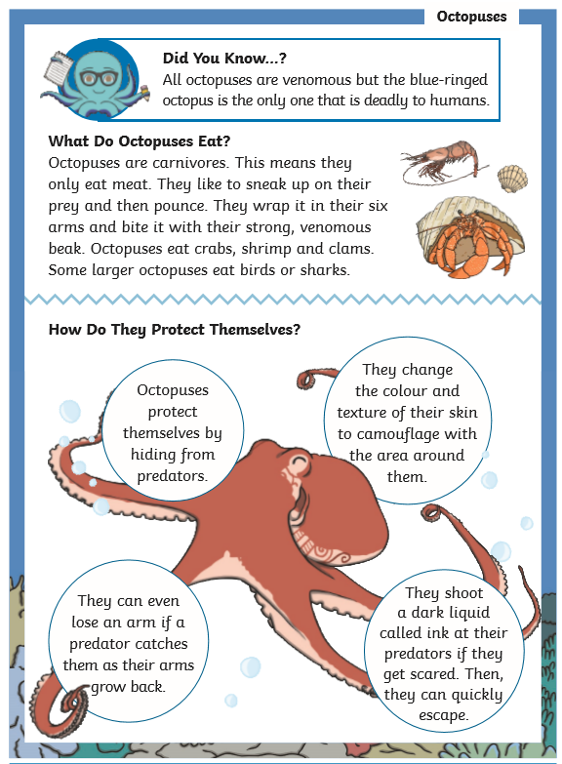
Guided Reading
Page 2
Read the text below before answering the questions on the following slides.

Slide 18
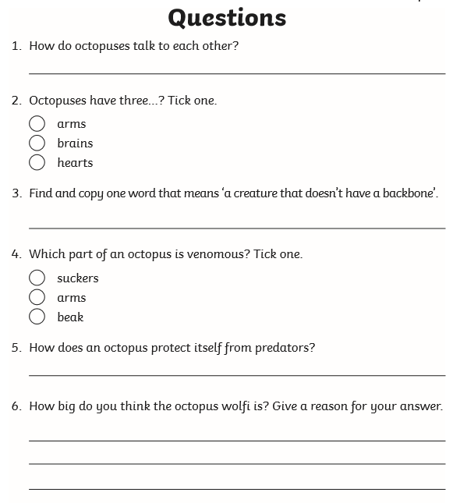
Questions

Slide 19
Date: Tuesday 23rd February
LO To be able to practise phonics sounds.
LO To be able to answer questions about a text.
Please practise phonics every day for 20 minutes.
Subject: Phonics

Slide 20
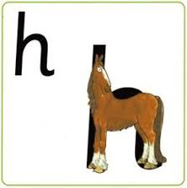
Set 1 Sounds
Skip this slide if your child is not focusing on this set.
Today’s sound:
Please click the link or copy the below link into the internet:
https://www.youtube.com/watch?v=JjEjzYMHl2k&list=PLPVrkr0oJX1tBTpbocNce93WUH8G-um6A&index=18
Or copy the below into YouTube:
‘Phonic Lesson - Set 1 Sound - Learning to Read and Write “h" for Reception and Year 1’ – Early Years Learning is Fun
Scavenger Hunt!
What can you find in your house that begins with h?

Slide 21
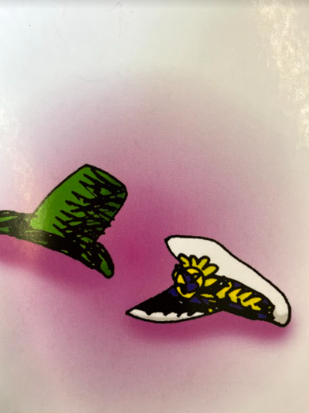
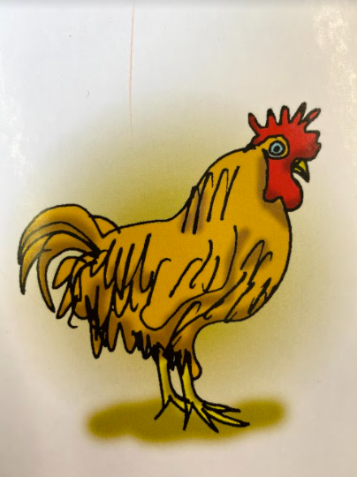
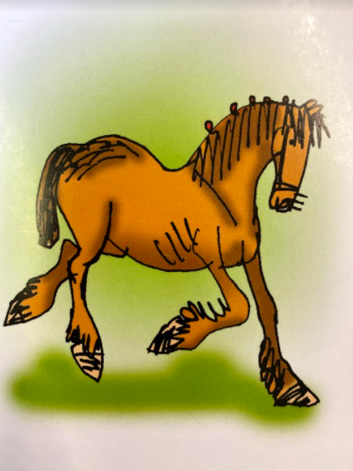
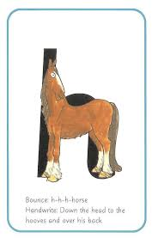

Today’s sound is h. Can you say h, h, h to your adult?
I have some pictures of things that begin with the sound h.
Try saying them out loud to your adult.
h h hat
h h hen
h h horse
Hiding behind the horse is the grapheme h. Can you point to it and say h?
When you see this side of the card say h.
Look at the picture on the left.
That is a
horse.
When you see this picture, as quick as you can say horse.

Slide 22
Below, I have given you some cards. Point to each one and say horse or h.
Now let’s have a go at writing the sound h. Use your finger and move it over the picture card saying, “Down the head, to the hooves and over his back” or h h h h until you have traced the whole grapheme.
Now have a turn on your own. Keep practising until you get it right.

Slide 23



Set 1 Sounds
Now its time to Fred talk, read the word. Let me show you.
Here is my green word.
I am going to point to the button below each sound and say it out loud. This is Fred Talk.
h e n, after sounding out the word remember to read the word, hen. I have now read the word.
Now time to read some words including ‘h’. You could even practise writing these words!

Slide 24

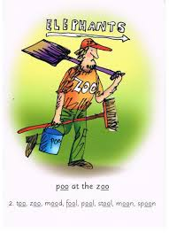
Recap: Set 2 Sounds
Skip this slide if your child is not focusing on this set.
Today’s sound:
Please click the link or copy the below link into the internet:
https://www.youtube.com/watch?v=5s5P-iSSJsU&list=PLPVrkr0oJX1sBGLJU2hNbPE2neuhezWSu&index=6
Or copy the below into YouTube:
‘Phonic Lesson - Set 2 ‘long oo sound’ for Reception and Year 1’ – Early Years Learning is Fun
Can you think of any words with the ‘oo’ sound in it?

Slide 25
Today’s sound is oo. Can you say oo, oo, oo to your adult?
Look at the picture on your left. What can you see?
The zoo keeper is cleaning up the poo at the zoo.
“poo at the zoo”
Let’s Fred Talk some ‘ee’ words.
zoo meet sleep.
On the other side of the card is the digraph, oo.
These letters are
special friends.
They are two letters that make one sound. When we see them we say,
oo.
When we see the picture we say,
“poo at the zoo”

Slide 26
Below, I have given you some cards. Point to each one and say oo or poo at the zoo
Now let’s have a go at writing the sound oo. You already know how to form each letter. Now we simply put them together to write the sound oo.
Now have a turn on your own. Keep practising until you get it right.

Slide 27

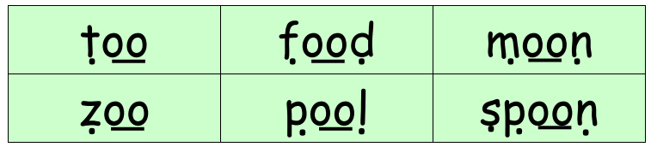
Set 2 Sounds
Now its time to Fred talk, read the word. Let me show you.
Here is my green word.
I am going to point to the button below each sound and say it out loud. This is Fred Talk.
t oo, after sounding out the word remember to read the word, too.
I have now read the word.
Now time to read some words including ‘oo’. You could even practise writing these words!

Slide 28

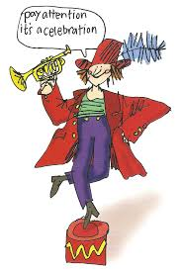
Set 3 Sounds
Skip this slide if your child is not focusing on this set.
Today’s sound:
Please click the link or copy the below link into the internet:
https://www.youtube.com/watch?v=1ljtqR7H_O0&list=PLPVrkr0oJX1smTl2RWUHKgvupRrMZkKEE&index=18
Or copy the below into YouTube:
Phonics Lesson - Set 3 sound ‘tion' for Foundation Stage and Year 1
Can you think of any words with the ‘tion’ sound in it?

Slide 29
Today’s sound is tion. Can you say tion, tion, tion to your adult?
Look at the picture on your left. What can you see?
The person dancing? It must be a celebration! He is saying,
“Pay attention! It’s a celebration”
Let’s Fred Talk some ‘tion’ words.
a tt e n tion t r a d i tion
On the other side of the card is the digraph, tion.
These letters are
special friends.
They are four letters that make one sound. When we see them we say,
tion.
When we see the picture side we say,
“chew the stew”

Slide 30
Below, I have given you some cards. Point to each one and say tion or celebration.
Now let’s have a go at writing the sound tion. You already know how to form each letter. Now we simply put them together to write the sound tion
Now have a turn on your own. Keep practising until you get it right.

Slide 31

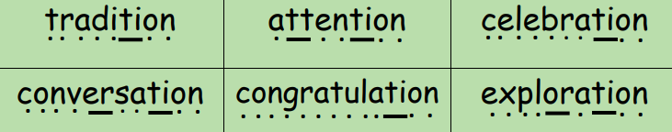
Set 3 Sounds
Now its time to Fred talk, read the word. Let me show you.
Here is my green word.
I am going to point to the button below each sound and say it out loud. This is Fred Talk.
t r a d i tion, after sounding out the word remember to read the word, tradition. I have now read the word.
Now time to read some words including ‘tion’. You could even practise writing these words!

Slide 32
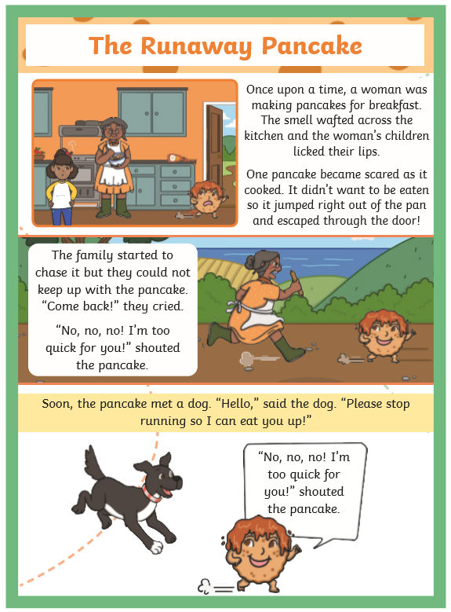
Guided Reading
Page 1
Read the text below before answering the questions on the following slides.

Slide 33
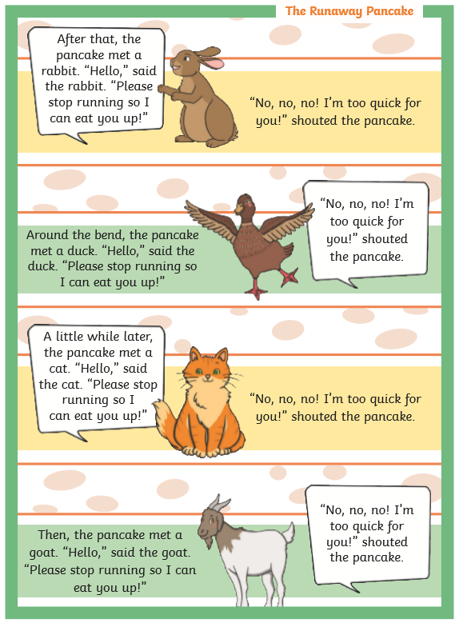
Guided Reading
Page 2
Read the text below before answering the questions on the following slides.

Slide 34
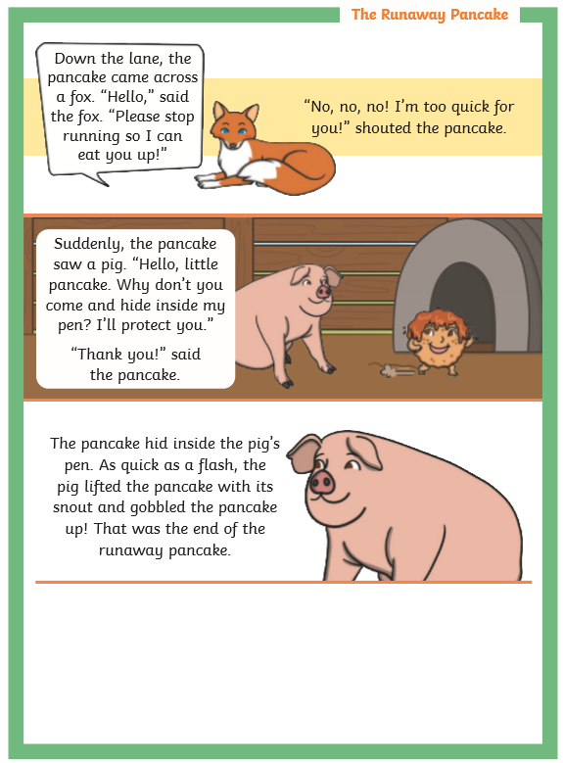
Guided Reading
Page 3
Read the text below before answering the questions on the following slides.

Slide 35
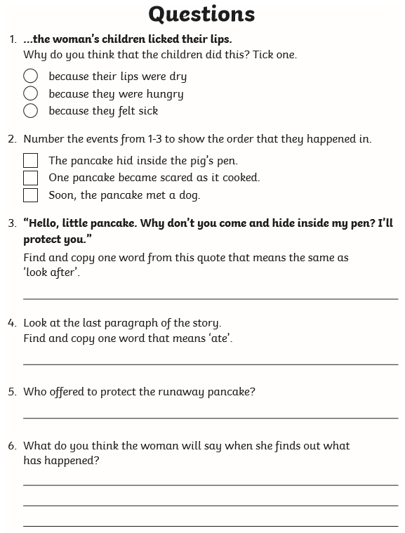
Questions

Slide 36
Date: Wednesday 24th February.
LO To be able to practise phonics sounds.
LO To be able to answer questions about a text.
Please practise phonics every day for 20 minutes.
Subject: Phonics

Slide 37


Set 1 Sounds
Skip this slide if your child is not focusing on this set.
Today’s sound:
Please click the link or copy the below link into the internet:
https://www.youtube.com/watch?v=ZOvvbl2qtmU&list=PLPVrkr0oJX1tBTpbocNce93WUH8G-um6A&index=19
Or copy the below into YouTube:
‘Phonic Lesson - Set 1 Sound - Learning to Read and Write “sh" for Reception and Year 1’ – Early Years Learning is Fun
Scavenger Hunt!
What can you find in your house that begins with sh?

Slide 38
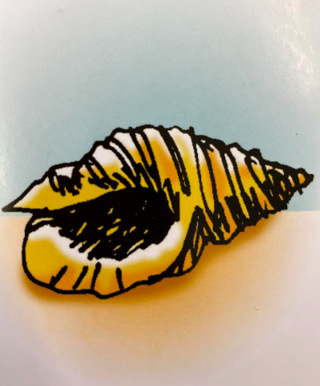
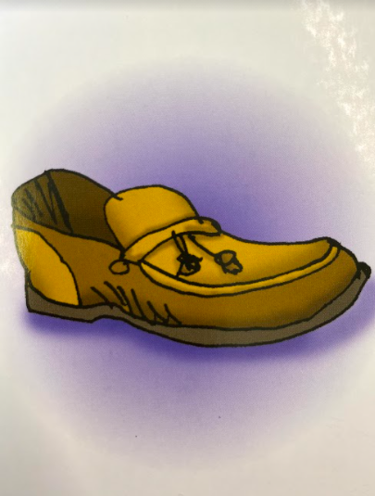
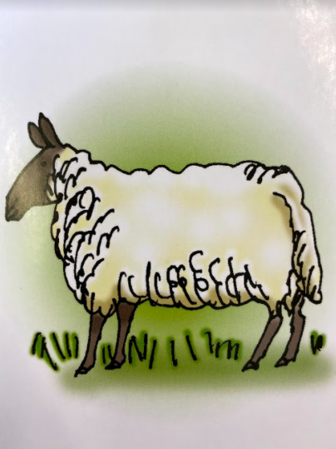


Today’s sound is sh. Can you say sh, sh, sh to your adult?
I have some pictures of things that begin with the sound sh.
Try saying them out loud to your adult.
sh sh shell
sh sh shoe
sh sh sheep
Look at the picture on the left.
That is a
snake and a horse.
When you see this picture, as quick as you can say snake and horse.
Hiding behind the snake and horse is the grapheme sh. Can you point to it and say sh?
When you see this side of the card say sh.

Slide 39
Below, I have given you some cards. Point to each one and say snake and horse or sh.
Now have a turn on your own. Keep practising until you get it right.
You know how to write each letter now. Can you say shhhhhh as you write the sound?

Slide 40




Set 1 Sounds
Now its time to Fred talk, read the word. Let me show you.
Here is my green word.
I am going to point to the button below each sound and say it out loud. This is Fred Talk.
sh o p, after sounding out the word remember to read the word, shop. I have now read the word.
Now time to read some words including ‘sh’. You could even practise writing these words!

Slide 41
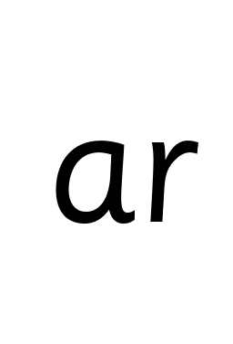
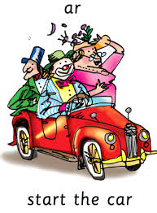
Recap: Set 2 Sounds
Skip this slide if your child is not focusing on this set.
Today’s sound:
Please click the link or copy the below link into the internet:
https://www.youtube.com/watch?v=7NPAgQhdKN4&list=PLPVrkr0oJX1sBGLJU2hNbPE2neuhezWSu&index=7
Or copy the below into YouTube:
‘Phonic Lesson - Set 2 ‘ar’ sound for Reception and Year 1’ – Early Years Learning is Fun
Can you think of any words with the ‘ar’ sound in it?

Slide 42
Today’s sound is ar.
Can you say ar, ar, ar to your adult?
Look at the picture on your left. What can you see?
Can you see the people in the car?
“ar, start the car”
Let’s Fred Talk some ‘ar’ words.
c ar s t ar p ar t
On the other side of the card is the diagraph ar.
These letters are
special friends.
They are two letters that make one sound. When we see them we say,
ar.
When we see the picture we say,
“ar,
start the car”

Slide 43
Below, I have given you some cards. Point to each one and say ar or start the car.
Now let’s have a go at writing the sound ar. You already know how to form each letter. Now we simply put them together to write the sound ar
Now have a turn on your own. Keep practising until you get it right.

Slide 44

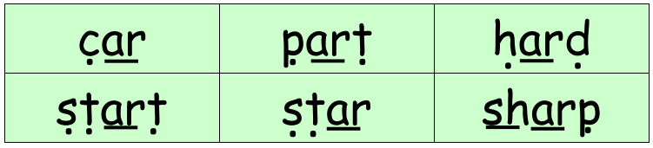
Set 2 Sounds
Now its time to Fred talk, read the word. Let me show you.
Here is my green word.
I am going to point to the button below each sound and say it out loud. This is Fred Talk.
c ar, after sounding out the word remember to read the word, car.
I have now read the word.
Now time to read some words including ‘ar’. You could even practise writing these words!

Slide 45

Set 3 Sounds
Skip this slide if your child is not focusing on this set.
Today’s sound:
Please click the link or copy the below link into the internet:
https://www.youtube.com/watch?v=rP3OP3qaYYw&list=PLPVrkr0oJX1smTl2RWUHKgvupRrMZkKEE
Or copy the below into YouTube:
‘Phonic Lesson - Set 3 ‘oi’ sound for Reception and Year 1’ – Early Years Learning is Fun
Can you think of any words with the ‘oi’ sound in it?

Slide 46
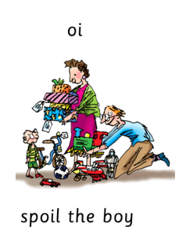

Today’s sound is oi. Can you say oi, oi, oi to your adult?
Look at the picture on your left. What can you see?
Can you the parents giving the boy lots of presents?
“spoil the boy”
Let’s Fred Talk some ‘oi’ words.
j oi n c oi n
On the other side of the card is the digraph, oi.
These letters are
special friends.
They are two letters that make one sound. When we see them we say,
oi.
When we see the picture side we say,
“spoil the boy”

Slide 47
Below, I have given you some cards. Point to each one and say oi or spoil the boy.
Now let’s have a go at writing the sound oi. You already know how to form each letter. Now we simply put them together to write the sound oi
Now have a turn on your own. Keep practising until you get it right.

Slide 48


Set 3 Sounds
Now its time to Fred talk, read the word. Let me show you.
Here is my green word.
I am going to point to the button below each sound and say it out loud. This is Fred Talk.
j oi n, after sounding out the word remember to read the word, join. I have now read the word.
Now time to read some words including ‘oi’. You could even practise writing these words!

Slide 49
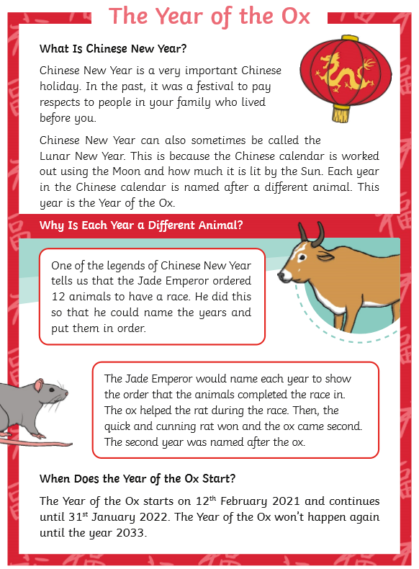
Guided Reading
Guided Reading
Page 1
Page 1
Read the text below before answering the questions on the following slides.

Slide 50
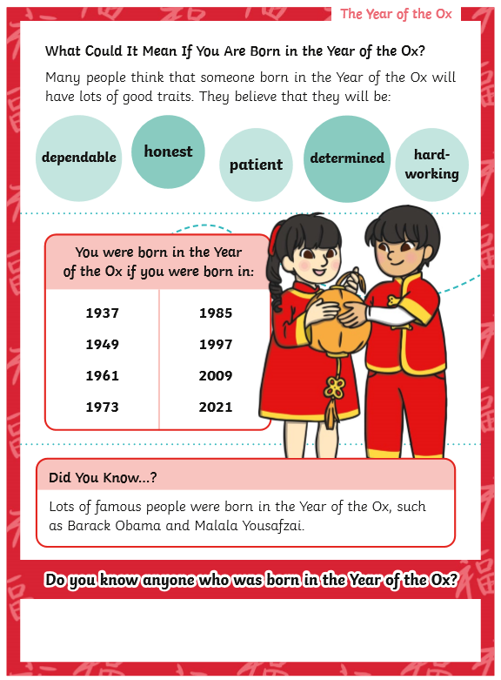
Guided Reading
Guided Reading
Page 2
Read the text below before answering the questions on the following slides.

Slide 51
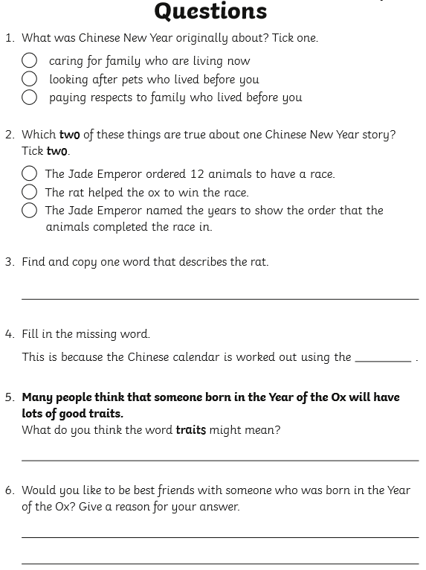
Questions

Slide 52
Date: Thursday 25th February.
LO To be able to practise phonics sounds.
LO To be able to answer questions about a text.
Please practise phonics every day for 20 minutes.
Subject: Phonics

Slide 53

Set 1 Sounds
Skip this slide if your child is not focusing on this set.
Today’s sound:
Please click the link or copy the below link into the internet:
https://www.youtube.com/watch?v=f5TNqRnf6_I&list=PLPVrkr0oJX1tBTpbocNce93WUH8G-um6A&index=20
Or copy the below into YouTube:
‘Phonic Lesson - Set 1 Sound - Learning to Read and Write “r" for Reception and Year 1’ – Early Years Learning is Fun
Scavenger Hunt!
What can you find in your house that begins with r?

Slide 54
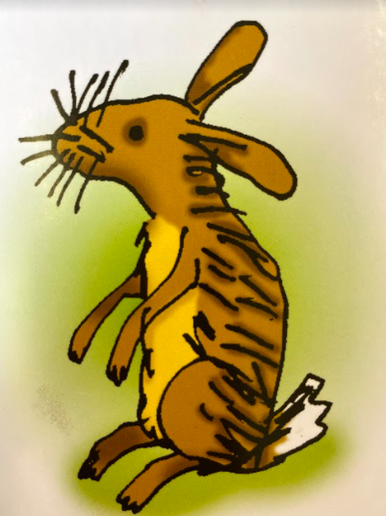
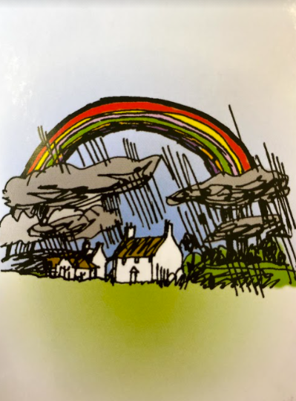
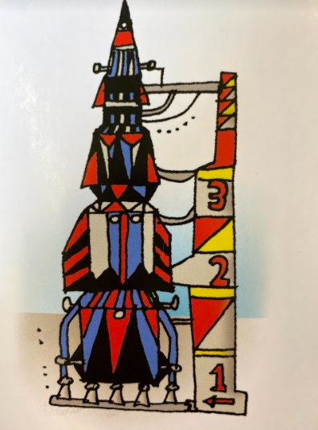
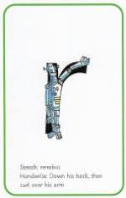

Today’s sound is r. Can you say r, r, r to your adult?
I have some pictures of things that begin with the sound r.
Try saying them out loud to your adult.
r r rabbit
r r rainbow
r r rocket
Hiding behind the robot is the grapheme r. Can you point to it and say r?
When you see this side of the card say r.
Look at the picture on the left.
That is a
robot.
When you see this picture, as quick as you can say robot.

Slide 55
Below, I have given you some cards. Point to each one and say robot or r.
Now let’s have a go at writing the sound r. Use your finger and move it over the picture card saying, “Down his back, then curl over his arm” or r r r until you have traced the whole grapheme.
Now have a turn on your own. Keep practising until you get it right.

Slide 56






Set 1 Sounds
Now its time to Fred talk, read the word. Let me show you.
Here is my green word.
I am going to point to the button below each sound and say it out loud. This is Fred Talk.
r e d, after sounding out the word remember to read the word, red. I have now read the word.
Now time to read some words including the sound ‘r’. You could even practise writing these words!

Slide 57
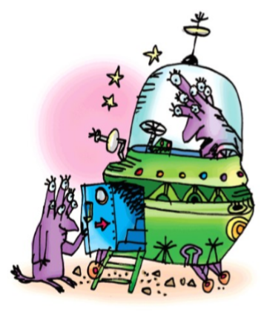
Set 2 Sounds
Skip this slide if your child is not focusing on this set.
Today’s sound:
Please click the link or copy the below link into the internet:
https://www.youtube.com/watch?v=Mape-qC0W54&list=PLPVrkr0oJX1sBGLJU2hNbPE2neuhezWSu&index=8
Or copy the below into YouTube:
‘Phonics Lesson - Set 2 'or' sound for Reception and Year 1’
Or shut the door
Can you think of any words with the ‘or’ sound in it?

Slide 58

Today’s sound is or. Can you say or, or, or to your adult?
Look at the picture on your left. What can you see?
Can you see the aliens in their spaceship? Yes that’s right they are saying,
“or, shut the door.”
Let’s Fred Talk some ‘or’ words.
c or n f or k sh or t.
or shut the door
On the other side of the card is the digraph, or.
These letters are
special friends.
They are two letters that make one sound. When we see them we say,
or.
When we see the picture side we say,
“or, shut the door.”
or shut the door

Slide 59
Below, I have given you some cards. Point to each one and say or or or, shut the door.
or shut the door
Now let’s have a go at writing the sound or. You already know how to form each letter. Now we simply put them together to write the sound or.
Now have a turn on your own. Keep practising, saying the sound, until you get it right.

Slide 60

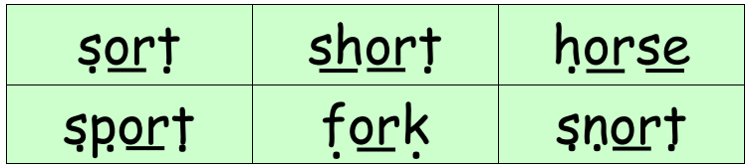
Set 2 Sounds
Now its time to Fred talk, read the word. Let me show you.
Here is my green word.
I am going to point to the button below each sound and say it out loud. This is Fred Talk.
s or t, after sounding out the word remember to read the word, sort.
I have now read the word.
Now time to read some words including ‘or’. You could even practise writing these words!

Slide 61
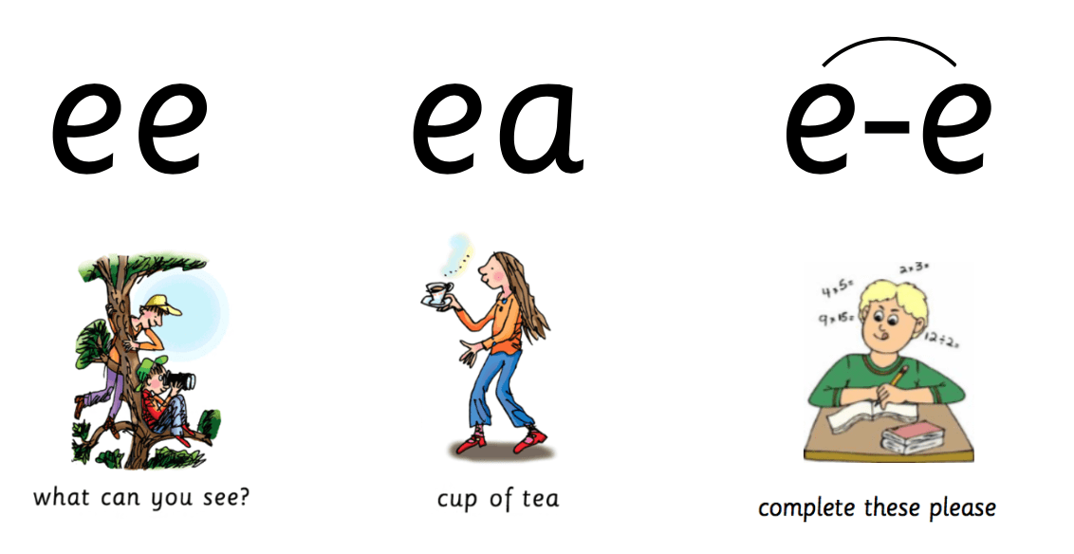
Set 3 Sounds
Skip this slide if your child is not focusing on this set.
Today’s sound:
Please click the link or copy the below link into the internet:
https://www.youtube.com/watch?v=UHzu7dkn3sY&list=PLPVrkr0oJX1smTl2RWUHKgvupRrMZkKEE&index=2
Or copy the below into YouTube:
‘Phonic Lesson - Set 3 ‘ea’ sound for Reception and Year 1’ – Early Years Learning is Fun
Can you think of any words with the ‘ea’ sound in it?

Slide 62
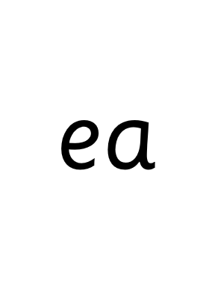
Today’s sound is ea. Can you say ea, ea, ea to your adult?
Look at the picture on your left. What can you see?
Can you see the girl carrying a cup of tea?
“cup of tea”
Let’s Fred Talk some ‘ea’ words.
t ea s ea t c l ea n
On the other side of the card is the digraph, ea.
These letters are
special friends.
They are two letters that make one sound. When we see them we say,
ea.
When we see the picture side we say,
“cup of tea”

Slide 63
Below, I have given you some cards. Point to each one and say ea or cup of tea.
Now let’s have a go at writing the sound ea. You already know how to form each letter. Now we simply put them together to write the sound ea
Now have a turn on your own. Keep practising until you get it right.

Slide 64

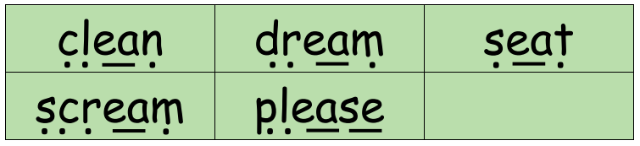
Set 3 Sounds
Now its time to Fred talk, read the word. Let me show you.
Here is my green word.
I am going to point to the button below each sound and say it out loud. This is Fred Talk.
c l ea n, after sounding out the word remember to read the word, clean. I have now read the word.
Now time to read some words including ‘ea’. You could even practise writing these words!

Slide 65
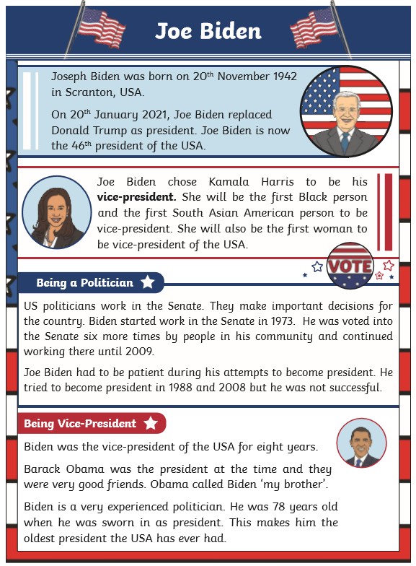
Guided Reading
Page 1
Read the text below before answering the questions on the following slides.

Slide 66

Guided Reading
Page 2
Read the text below before answering the questions on the following slides.

Slide 67

Questions

Slide 68
Date: Friday 26th February.
LO To be able to practise reading and writing tricky words.
LO To be able to answer questions about a text.
Please practise phonics every day for 20 minutes.
Subject: Phonics

Slide 69


Pick a slide appropriate to your child’s ability

Slide 70

Pick a slide appropriate to your child’s ability

Slide 71

Pick a slide appropriate to your child’s ability

Slide 72



Tricky Words!
https://www.youtube.com/watch?v=TvMyssfAUx0
‘Tricky Words and Sight Words Song’ - YouTube
https://www.youtube.com/watch?v=R087lYrRpgY&t=2s
‘Phase 3 Say Hello To’ - YouTube
https://www.youtube.com/watch?v=3NOzgR1ANc4
‘Phase 4 Tricky Words Song’ - YouTube

Slide 73




Games & Videos!
https://www.phonicsplay.co.uk/resources
Username: jan21
Password: home
https://www.bbc.co.uk/bitesize/topics/zcqqtfr
https://www.phonicsbloom.com/
https://www.bbc.co.uk/cbeebies/shows/alphablocks
https://www.youtube.com/channel/UC_qs3c0ehDvZkbiEbOj6Drg

Slide 74

Daily Phonics Videos
Click the below link, copy and paste into the internet or search ‘Ruth Miskin Training’ in YouTube to see daily phonics videos.
Read Write Inc are offering free phonics lessons on YouTube. Videos for all abilities are available.
They are posted at 9.30am and are available for 24 hours.
https://www.youtube.com/channel/UCo7fbLgY2oA_cFCIg9GdxtQ

Slide 75

Guided Reading
Page 1
Read the text below before answering the questions on the following slides.

Slide 76

Guided Reading
Page 2
Read the text below before answering the questions on the following slides.

Slide 77

Questions

