Slide 1
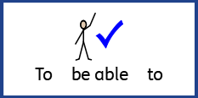


Date: Monday 22th February 2021
L.O. To be able a identify key physical and human characteristics.
Subject: Science

Slide 2
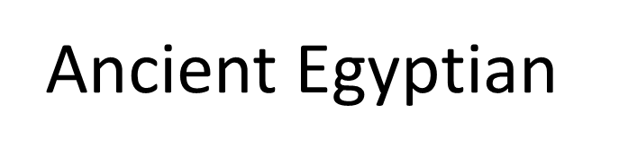
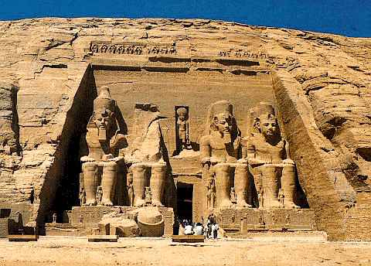

Slide 3
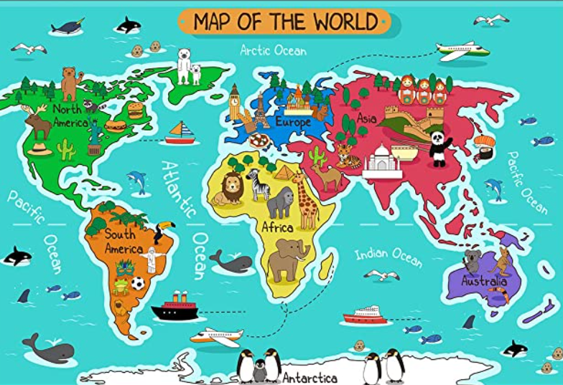
Where is Egypt?
.
Here is Egypt
Egypt is normal represented a pyramid.

Slide 4
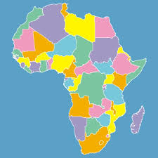
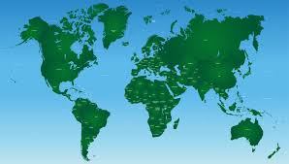
Your turn, can you find Egypt on the map?
Can you point to where you think Egypt is?

Slide 5
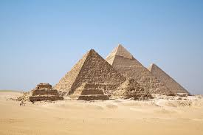
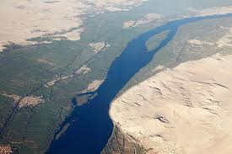
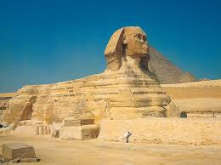
Egypt
Egypt, a country linking northeast Africa with the Middle East, dates to the time of the pharaohs. Millennia-old monuments sit along the fertile Nile River Valley, including Giza's colossal Pyramids and Great Sphinx as well as Luxor's hieroglyph-lined Karnak Temple and Valley of the Kings tombs. The capital, Cairo, is home to Ottoman landmarks like Muhammad Ali Mosque and the Egyptian Museum, a trove of antiquities.

Slide 6
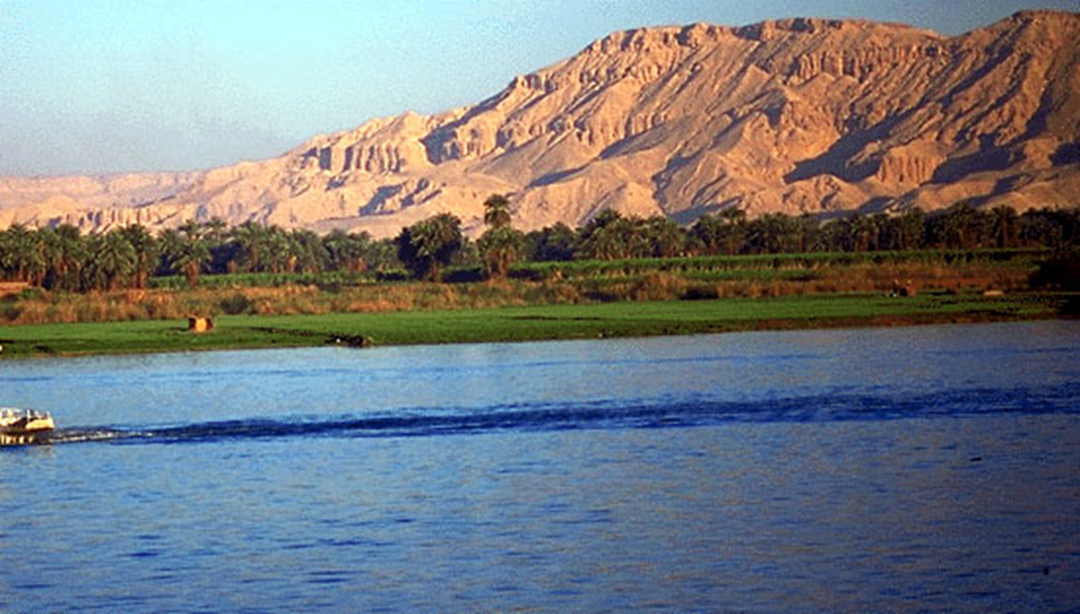
The River Nile
The Nile River is the longest river in the world (6,650 kilometers), it flows north from the heart of Africa to the Mediterranean Sea. It’s flood plain was a magnet for life: human, plant and animal. Humans were drawn there because they could grow crops and settle into permanent villages.

Slide 7
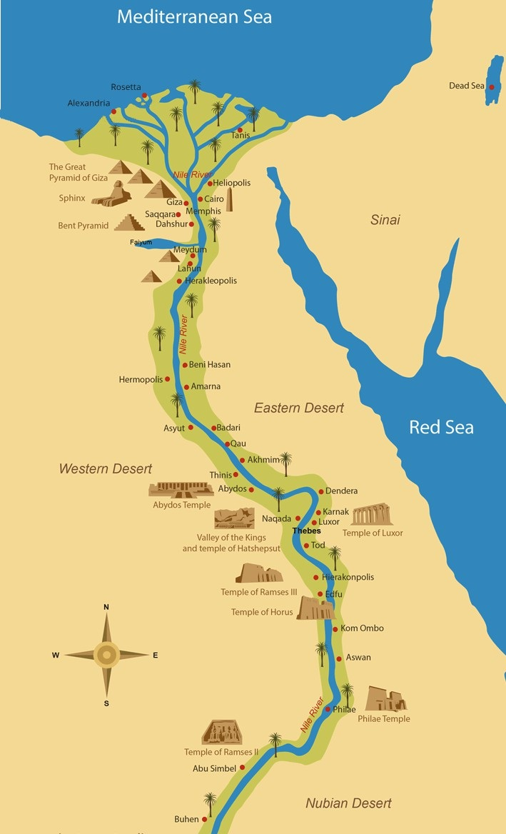
The River Nile
Ancient Egypt was protected on the south, east and west by an impenetrable desert, and on the north by the sea,
This meant ancient Egypt was protected from outside influences, which allowed it to evolve in its own unique way.

Slide 8
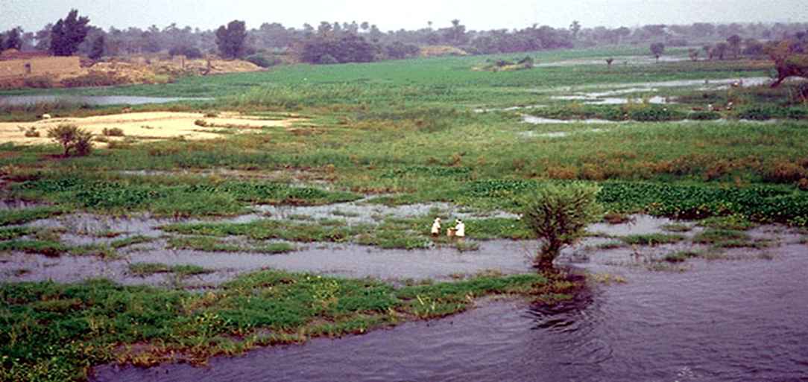
The River Nile
For centuries, the Nile River flooded the Valley, enriching the land with a thick layer of alluvial soil. Flooding occurred from July to September as the result of the tropical rains in the Ethiopian tableland. The river attained its highest level in October, then began to recede to its lowest point sometime between April and June.

Slide 9
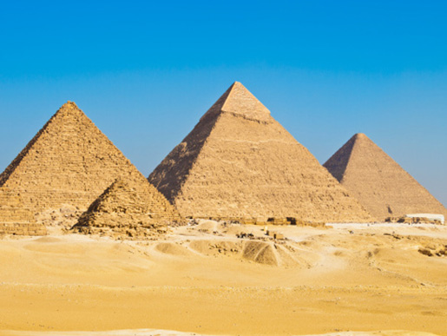
The ancient Egyptians built their pyramids, tombs, temples and palaces out of stone, the most durable of all building materials.
These building projects took a high degree of architectural and engineering skill, and the organization of a large workforce consisting of highly trained craftsmen and laborers.
The Pyramids

Slide 10
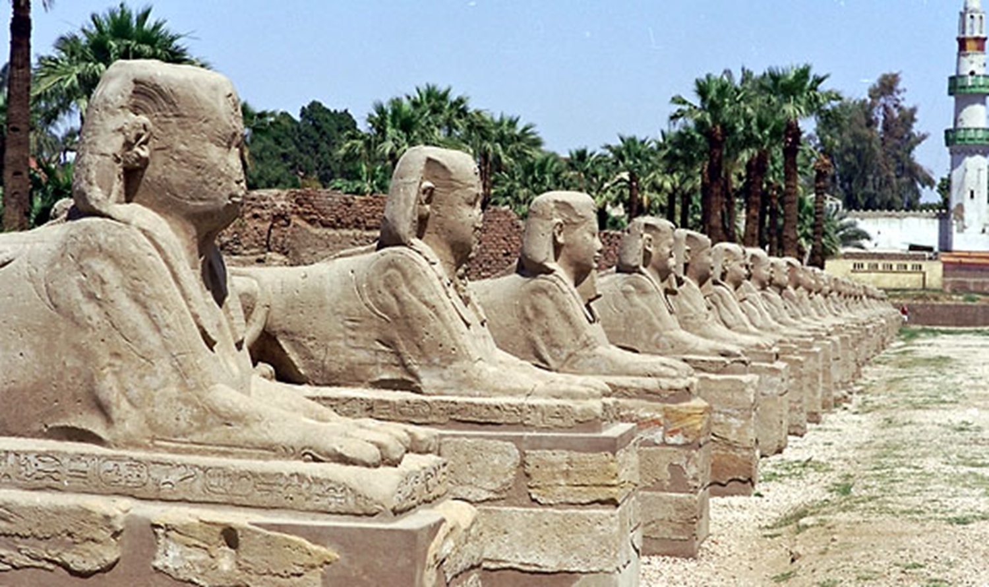
The Sphinx
Apart from the pyramids, Egyptian buildings were decorated with paintings, carved stone images, hieroglyphs and three dimensional statues. The art tells the story of the pharaohs, the gods, the common people and the natural world of plants, birds and animals.

Slide 11
Your turn. Can you now write me 2 facts about each of the human and physical features. You may what to use the internet to find out more facts. Parents, please support you child with this task.
The River Nile
Pyramids
Sphinx

Slide 12
Date: Tuesday 23rd February 2021
L.O. To be able to compare our local area to Egypt.
Subject:

Slide 13
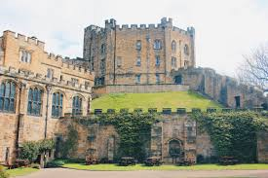
My turn: Lets have a look at the differences between Ancient Egypt and the area we live.
Durham Cathedral. This is where people are buried.
This is a Pyramid where the Pharaohs are buried.

Slide 14
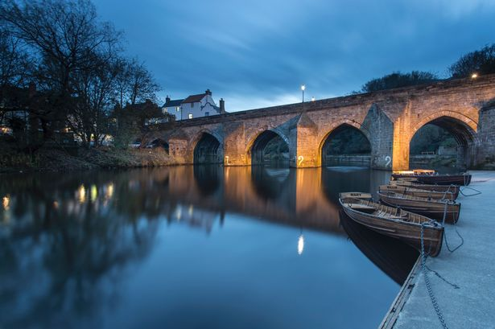
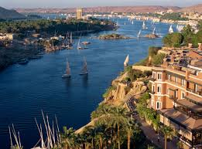
My turn: Let’s have a look at the differences between Ancient Egypt and the area we live.
This is the River Wear and runs around the whole of the castle. It runs from the East Pennines and finishes at the North Sea Sunderland.
This is a River Neil in Egypt. It begins at White Nile in East Africa and finishes at the Mediterranean Sea.

Slide 15
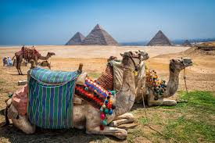
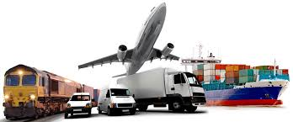
My turn: Let’s have a look at the differences between Ancient Egypt and the area we live.
Our transport now.
This is a Camel the people in Ancient Egypt use as a for of transport.

Slide 16
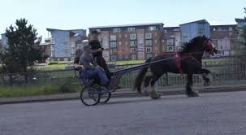
My turn: Can you have a look at the area you live in and try and write some comparisons?
This is a camel, the people use this for transport in Ancient Egypt.
Animals used for local transport in Wheatley Hill.

Slide 17
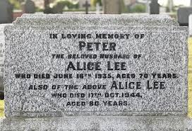
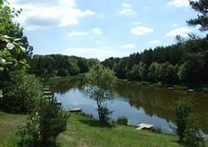
Your turn: Can you have a look at the area you live and try and write some comparisons to similar places in Ancient Egypt?

Slide 18
Date: Wednesday 24th February 2021
L.O. To be able to discuss Ancient Egyptian civilization and answer questions.
Subject: History

Slide 19
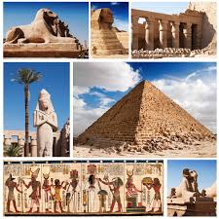
Over the next three weeks we are going to learn all about the Ancient Egyptians and their civilization. We will look at the different periods of time, the Pharaohs and their pyramids, Mummification, Tutankhamun's Tomb and who discovered him.
The ancient Egyptian civilisation began 5,000 years ago when people started building villages next to the River Nile in north-east Africa. It lasted for around 3,000 years.
The ancient Egyptians were ruled by kings and queens called pharaohs. Religion was an important part of their civilisation. They worshiped over 2,000 gods and goddesses!
The ancient Egyptians also believed in a never-ending afterlife. They thought it was more important than their life on Earth, so they spent a lot of time planning for their death.
The ancient Egyptians preserved the bodies of important people through mummification. They built special tombs to be buried in, which they filled with all their favourite things. Some pharaohs built their tombs in the shape of giant pyramids.

Slide 20
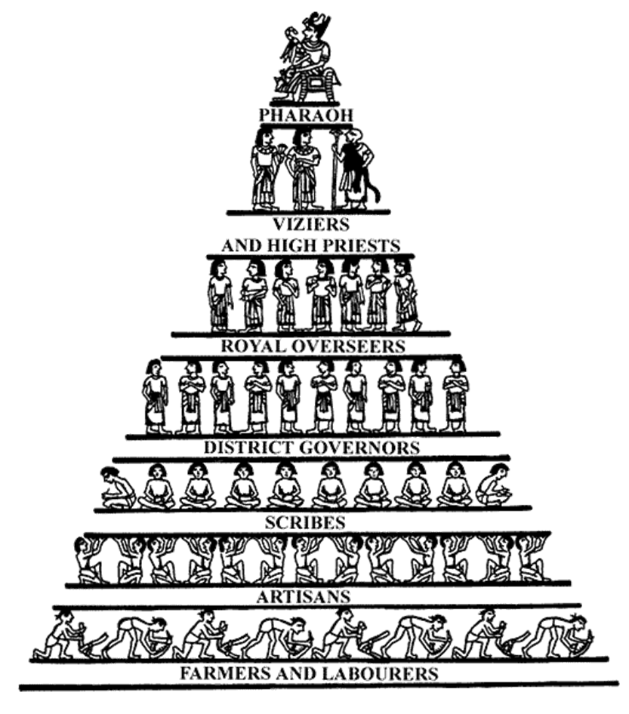
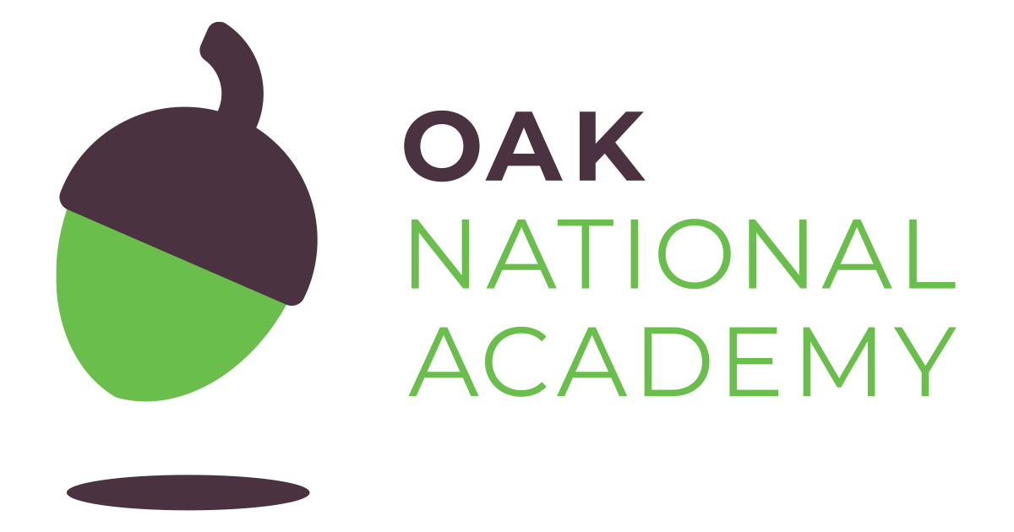
The Structure of Society
Ancient Egypt achieved stability through the co-operation of all levels of the population.
The pharaoh was at the top of the social hierarchy.
At the bottom of the hierarchy were the scribes, artisans, farmers, and laborers.
https://classroom.thenational.academy/lessons/what-was-ancient-egyptian-society-like-6hgk0t?step=2&activity=video
Please watch the link to help support your learning.

Slide 21
My Turn:
Our next task is to extract the information to answer the questions. Remember back to last week, how we extracted the answers.
Look for the words that are in the question and try and find it in the text.
The ancient Egyptian civilisation began 5,000 years ago when people started building villages next to the River Nile in north-east Africa. It lasted for around 3,000 years
See if you can find a picture to support your answer too.
Question:
When did the ancient Egyptian civilisation begin?

Slide 22
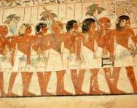
Your turn:
Can you now use the text about answer to questions on Ancient Egyptian? Adults, can you support you child with this task.
When did ancient Egyptian civilisation began?
What river did the people start building next to?
Who ruled the Egyptians?

Slide 23
Your turn:
4. How many God or Goddesses did the people worship?
5. What was the most important thing in life?
6. What did they spend their time planning?
7. What is mummification ?
8. The people built special what to be buried in?
9. What was the shape of the building the pharaohs built to be buried in.

Slide 24
Date: Thursday 25th February 2021
L.O. To be able to sequence a simple timeline.
Subject: History

Slide 25
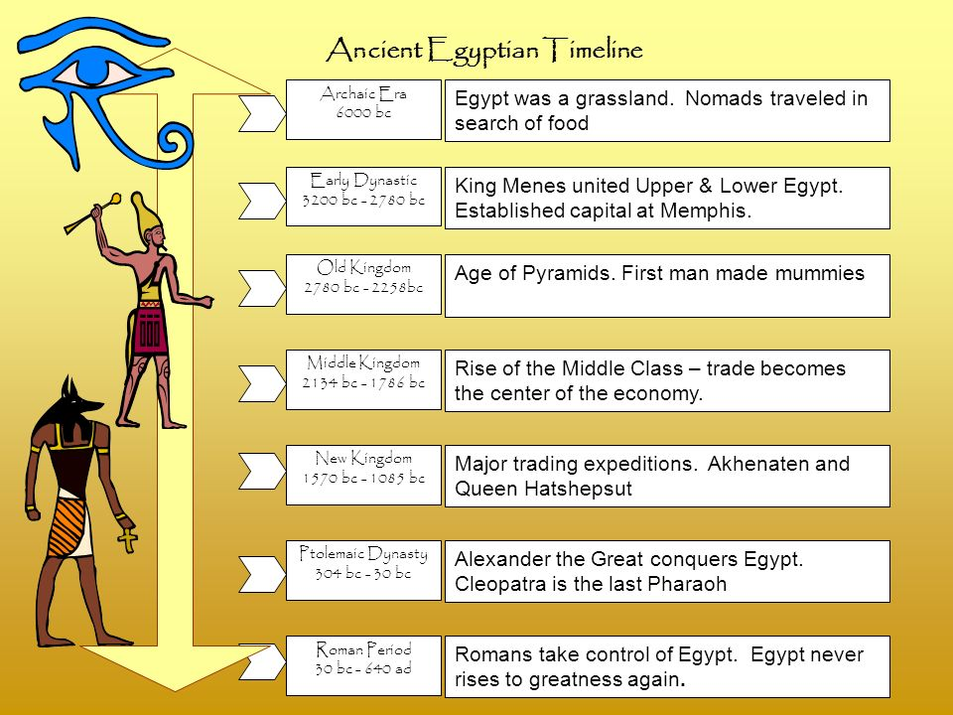
Today, we are going to look at the time line of the Ancient Egyptians. Adult people read to your child.
Please watch the clip to help support with your learning.
https://slideplayer.com/slide/8633004/

Slide 26


Major trading expedition. Akhenaten and Queen Hatshepsut.
Rise of the Middle Class-trade becoming the centre of the economy.
Age od pyramids. First man made mummies.
King Menes united Upper & Lower Egypt Established capital at Memphis.
Egypt was a grassland. Nomads travelled in search of food.
Alexander the Great conquers Egypt. Cleopatra is the last Pharaoh.
Romans take control of Egypt. Egypt never rises to greatness again.
Can you drag and drop the statement to the correct period of time.

Slide 27
My Turn: Now we have looked at the timeline of The Ancient Egyptians, I am going to show you a timeline of my life.
School
2005 my Son’s birth.
2002 my Daughter was born.
1998 I got married to Mr Jeffrey Anderson.
In 1996 I got my first job in a sports shop.
In 1988 I attended St Bedes Comprehensive in Peterlee.
I went to St Godrics Primary School in Wheatley Hill in 1981.
I was born in 1977 in Durham hospital to Anne and George Burke.

Slide 28
Your turn. Can you now create your own time line of your life or a family member? An adult can help you with the dates that you need to complete this.
.

Slide 29
Date: Friday 26th February 2021
L.O. To use vocabulary associated to the Egyptians.
Subject: History

Slide 30
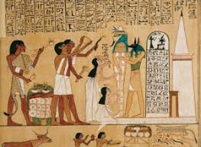
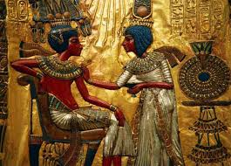
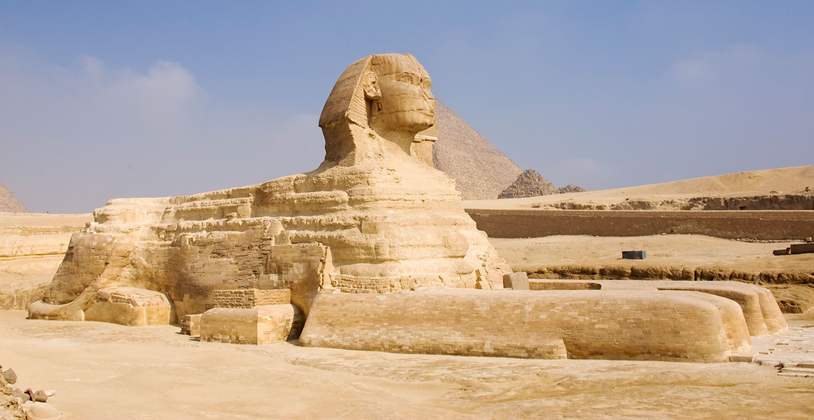
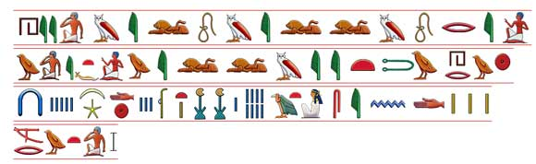
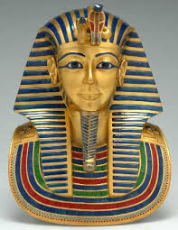
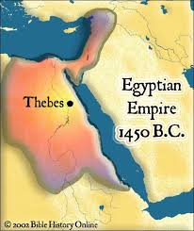
My Turn: As part of our learning we need to be able to understand some of the vocabulary the Egyptians used. Lets take a look at some of the most applicable words.
Pharaoh - The supreme ruler of all of Ancient Egypt. He or she was considered a god.
Hieroglyphics - A type of writing used by the Ancient Egyptians that used a combination of pictures and symbols.
Mummification - A technique used to preserve a body so that it could enter the afterlife.
Sphinx - A mythological beast with the body of a lion and the head of a pharaoh or god. The Egyptians built sphinx statues to guard tombs.
Tutankhamun - A pharaoh of Egypt that is famous for his tomb that was discovered. The tomb was largely untouched and was full of treasure.
Empire – The land and people the Pharaoh owns

Slide 31
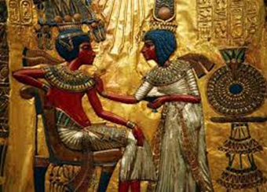


Your Turn:
Drag and drop the words to the correct pictures.
Hieroglyphics
Tutankhamun
Sphinx
Pharaoh
Empire

Slide 32

https://classroom.thenational.academy/lessons/what-was-ancient-egyptian-society-like-6hgk0t?step=2&activity=video

Slide 33
