Slide 1



Date: 11.01.21
LO To be able to count in 2s.
Subject: Maths

Slide 2


Pre-recorded Teaching
Access the online teaching video below that will support you to complete the work in this lesson. This video will act as a support but all of the work can still be successfully understood & completed using paper-based versions of this pack. If you need further support to understand / complete work then please contact school via e-mail or telephone.
Play Video

Slide 3
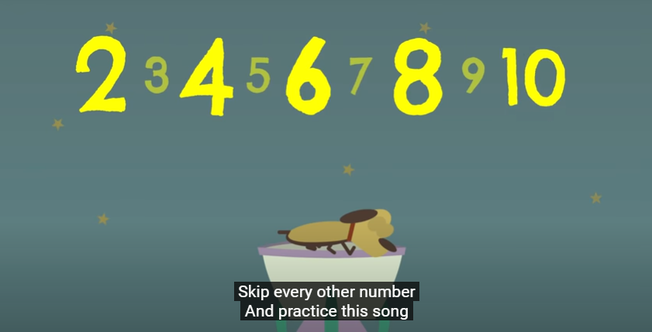
Watch this video! Can you count in 2s whilst the rocket flies into space?
https://www.youtube.com/watch?v=GvTcpfSnOMQ
Click the link or copy and paste the above into the internet to play the video.
‘The Counting by Twos Song | Counting Songs | Scratch Garden’ - YouTube

Slide 4
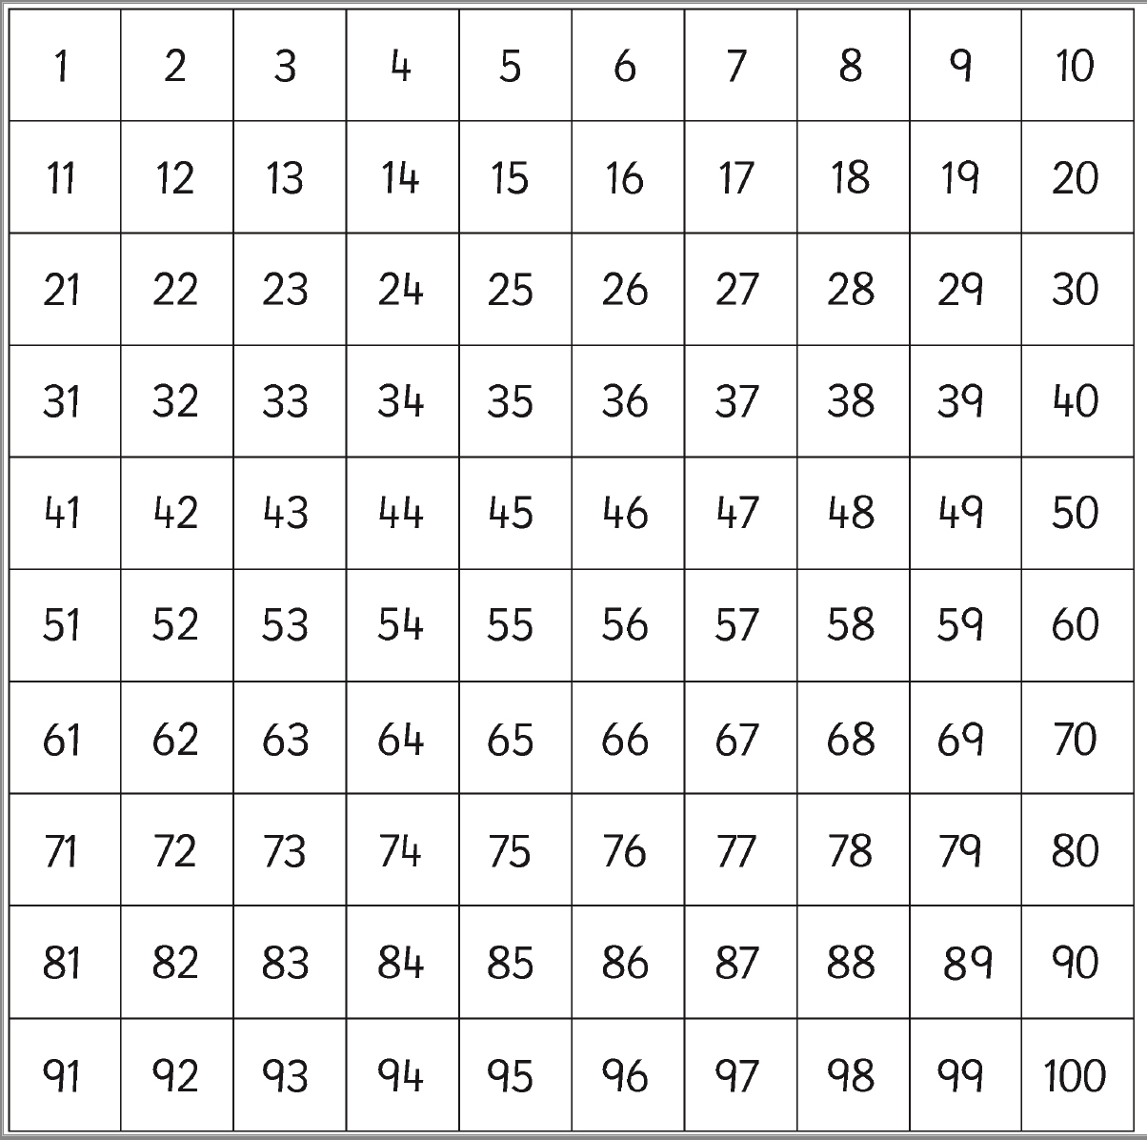
Count in 2s
2, 4, 6, 8, 10, 12, 14, 16, 18, 20, 22, 24
Can you notice the pattern?
Counting in 2s always ends in 2, 4, 6, 8 and 0.
If you are working on a computer, insert a shape on multiples of 2s.
Task:
Highlight/colour the multiples of 2s
Can you go all the way to 100?

Slide 5
Answers
2, 4, 6, 8, 10, 12, 14, 16, 18, 20, 22, 24
Can you notice the pattern?
Counting in 2s always ends in 2, 4, 6, 8 and 0.
Task:
Highlight/colour the multiples of 2s
Can you go all the way to 100?

Slide 6
Fill in the missing numbers …
2 ___ 6 ___ 10 ___ 14 ___ 18 ___ 22
2 4 ___ 8 ___ 12 ___ 16 18 ___ 22
4 ___ 8 ___ 12 ___ 16 ___ 20 ___ 24
0 2 ___ 6 ___ 10 ___ ___ 16 18 20
16 14 12 ___ 8 ___ 4 ___ 0
If you are working on a computer, insert a text box to type your answer.

Slide 7
Answers!
2 4 6 8 10 12 14 16 18 20 22
2 4 6 8 10 12 14 16 18 20 22
4 6 8 10 12 14 16 18 20 22 24
0 2 4 6 8 10 12 14 16 18 20
16 14 12 10 8 6 4 2 0

Slide 8

Count in 2s
Let’s count how many socks there are altogether
2
There are 2 socks in a pair so we need to count in 2s.
4
There are 6 socks altogether!
6

Slide 9
Count in 2s
Let’s count how many socks there are altogether
There are 2 socks in a pair so we need to count in 2s.
Answer:
If you are working on a computer, type your answer here:
There are 10 socks!
Move the box to find the answer

Slide 10
Count in 2s
Let’s count how many socks there are altogether
There are 2 socks in a pair so we need to count in 2s.
Answer:
If you are working on a computer, type your answer here:
There are 20 socks!
Move the box to find the answer

Slide 11
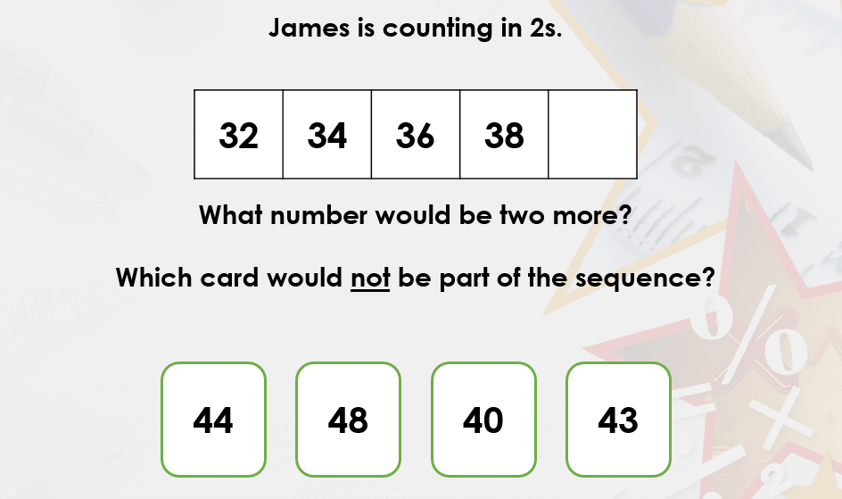

Challenge!
If you are working on a computer, insert a text box to type your answer.

Slide 12
Date: 12.01.21
LO To be able to count in 5s.
Subject: Maths

Slide 13
Pre-recorded Teaching
Access the online teaching video below that will support you to complete the work in this lesson. This video will act as a support but all of the work can still be successfully understood & completed using paper-based versions of this pack. If you need further support to understand / complete work then please contact school via e-mail or telephone.
Play Video

Slide 14
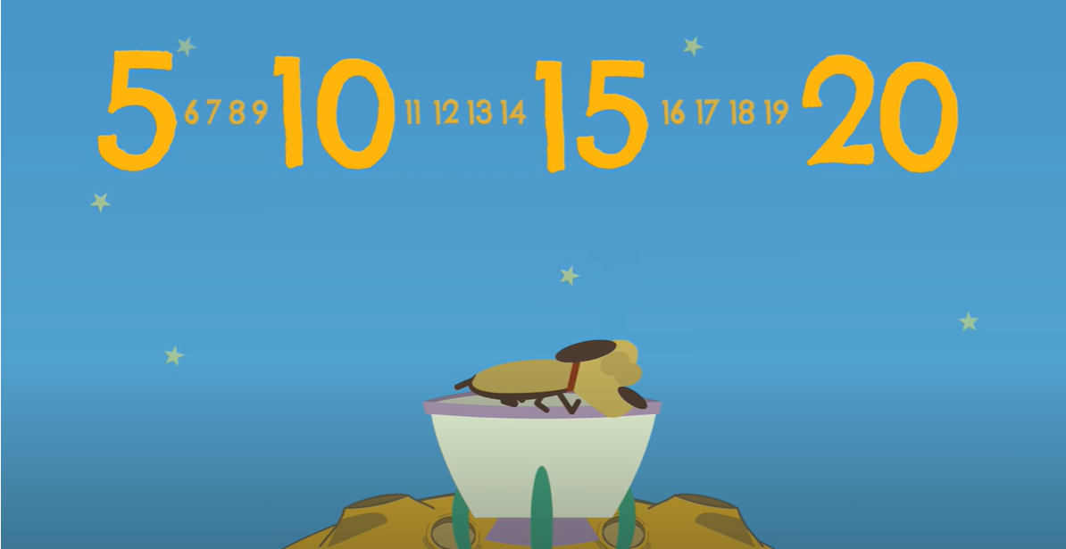
Watch this video! Can you count in 5s whilst the rocket flies into space?
https://www.youtube.com/watch?v=EemjeA2Djjw
Click the link or copy and paste the above into the internet to play the video.
‘The Counting by Fives Song | Counting Songs | Scratch Garden’ - YouTube

Slide 15
Count in 5s
5, 10, 15, 20, 25, 30, 35, 40, 45, 50, 55, 60
Can you notice the pattern?
Counting in 5s always ends in 5 and 0.
If you are working on a computer, insert a shape on multiples of 5s.
Task:
Highlight/colour the multiples of 5s
Can you go all the way to 100?

Slide 16
Count in 5s
5, 10, 15, 20, 25, 30, 35, 40, 45, 50, 55, 60
Can you notice the pattern?
Counting in 5s always ends in 5 or 0.
Task:
Highlight/colour the multiples of 5s
Can you go all the way to 100?

Slide 17
Fill in the missing numbers …
If you are working on a computer, insert a text box to type your answer.
5 10 ___ 20 ___ 30 ___ 40 ___ 50
5 ___ 15 ___ 25 ___ 35 ___ 45 ___ 55
15 ___ ___ 30 ___ 40 45 ___ 55
15 20 ___ 30 ___ 40 ___ 50 ___
50 45 40 ___ 30 ___ 20 15 ___ ___

Slide 18
Answers!
5 10 15 20 25 30 35 40 45 50
5 10 15 20 25 30 35 40 45 50 55
15 20 25 30 35 40 45 50 55
15 20 25 30 35 40 45 50 55
50 45 40 35 30 25 20 15 10 5

Slide 19

Count in 5s
Let’s count how many fingers there are altogether
5
There are 5 fingers on 1 hand so we need to count in 5s.
10
There are 15 fingers altogether!
15

Slide 20
Count in 5s
Let’s count how many fingers there are altogether
There are 5 fingers on 1 hand so we need to count in 5s.
Answer:
If you are working on a computer, type your answer here:
There are 20 fingers!
Move the box to find the answer

Slide 21
Count in 5s
Let’s count how many fingers there are altogether
There are 5 fingers on 1 hand so we need to count in 5s.
Answer:
If you are working on a computer, type your answer here:
There are 30 fingers!
Move the box to find the answer

Slide 22
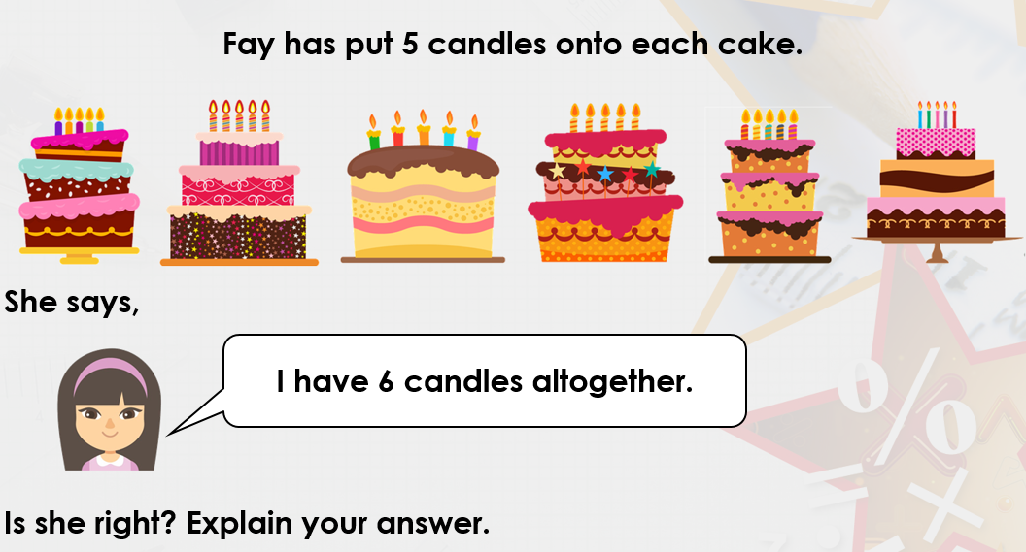
Challenge!
If you are working on a computer, insert a text box to type your answer.

Slide 23
Date: 13.01.21
LO To be able to count money.
Subject: Maths

Slide 24
Pre-recorded Teaching
Access the online teaching video below that will support you to complete the work in this lesson. This video will act as a support but all of the work can still be successfully understood & completed using paper-based versions of this pack. If you need further support to understand / complete work then please contact school via e-mail or telephone.
Play Video

Slide 25

Warm up your maths brain by counting to 20 and working out!
https://www.youtube.com/watch?v=_MVzXKfr6e8
Click the link or copy and paste the above into the internet to play the video.
‘Count to 20 and Workout | Fun Counting Song for Kids | Count by 1's to 20 | Jack Hartmann’ - YouTube

Slide 26








Coins
Lets have a look at the coins we have been learning about!
1p
2p
5p
10p
20p
50p
£1
£2

Slide 27
Match the coins with the value!
Task: Draw a line or if you are working on a computer, drag the coins/insert a line.
5p
20p
£2
2p
50p
£1
1p
10p

Slide 28
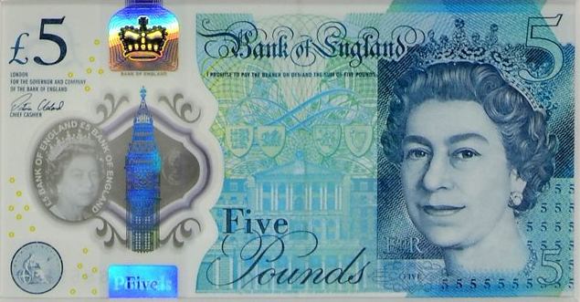
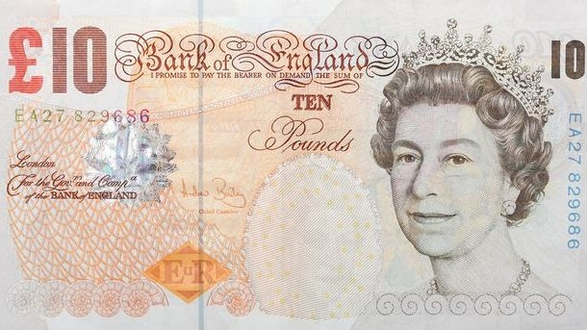
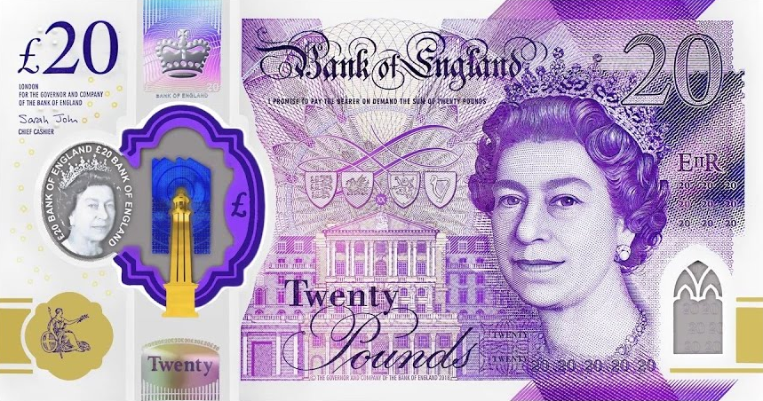
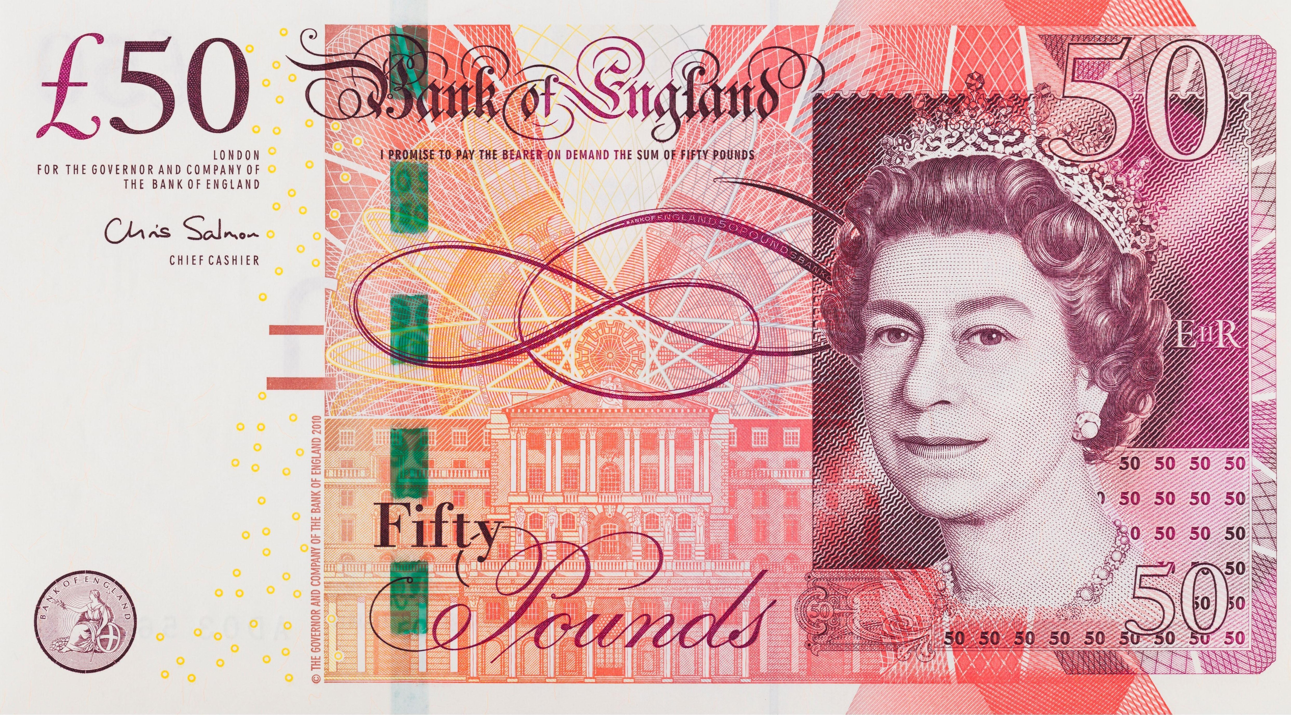
Notes
Lets have a look at the notes we have been learning about!
£5
£10
£20
£50

Slide 29
Match the notes with the value!
Task: Draw a line or if you are working on a computer, drag the coins/insert a line.
£10
£50
£20
£5

Slide 30

Counting coins
My turn!
= 6p
This coin is a 1p so I have counted in 1s.
I have put numicon underneath the coins to help me count in 1s.

Slide 31
Counting coins
Your turn!
= __p
This coin is a 1p so you need to count in 1s.
I have put numicon underneath the coins to help you count in 1s.

Slide 32

Counting coins
My turn!
= 8p
2
4
6
8
This coin is a 2p so you need to count in 2s.
I have put numicon underneath the coins to help you count in 2s.

Slide 33
Counting coins
Your turn!
= __p
This coin is a 2p so you need to count in 2s.
I have put numicon underneath the coins to help you count in 2s.

Slide 34

Counting coins
My turn!
= 20p
5
10
15
20
This coin is a 5p so what do you think we are going to count in this time?
You’re right, we’re going to count in 5s!
I have put numicon underneath the coins to help you count in 5s.

Slide 35
Counting coins
Your turn!
= __p
5
10
15
20
25
30
This coin is a 5p so remember to count in 5s!
I have put numicon underneath the coins to help you count in 5s.

Slide 36

Counting coins
My turn!
= 40p
10
20
30
40
This coin is a 10p. What do you think we will be counting in this time?
You’re right, we will be counting in 10s.
I have put numicon underneath the coins to help you count in 10s.

Slide 37
Counting coins
Your turn!
= ___p
This coin is a 10p. Remember you need to count in 10s.
I have put numicon underneath the coins to help you count in 10s.

Slide 38
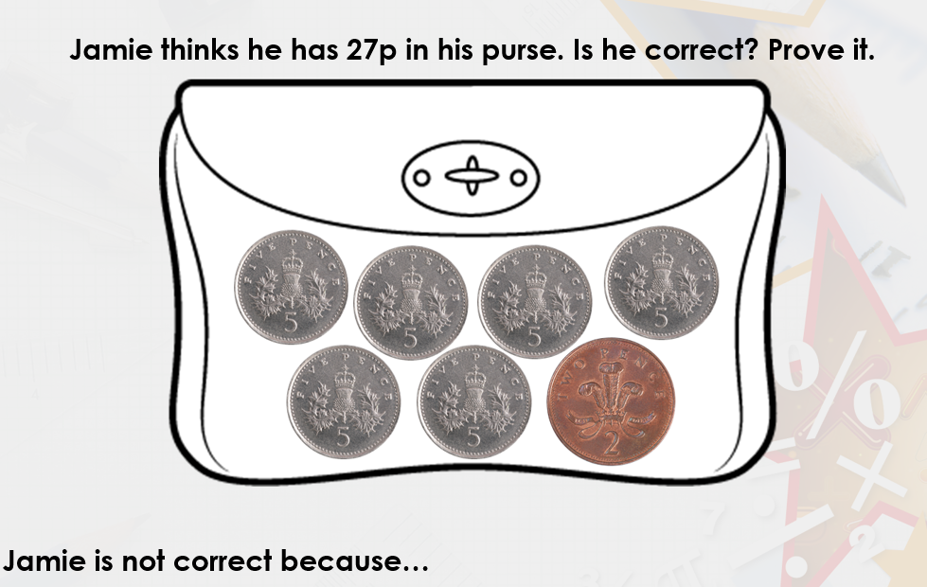
Challenge!
If you are working on a computer, insert a text box to type your answer.
(Count in 5s and then add on the 2)

Slide 39
Date: 14.01.21
LO To be able to count money.
Subject: Maths

Slide 40
Pre-recorded Teaching
Access the online teaching video below that will support you to complete the work in this lesson. This video will act as a support but all of the work can still be successfully understood & completed using paper-based versions of this pack. If you need further support to understand / complete work then please contact school via e-mail or telephone.
Play Video

Slide 41
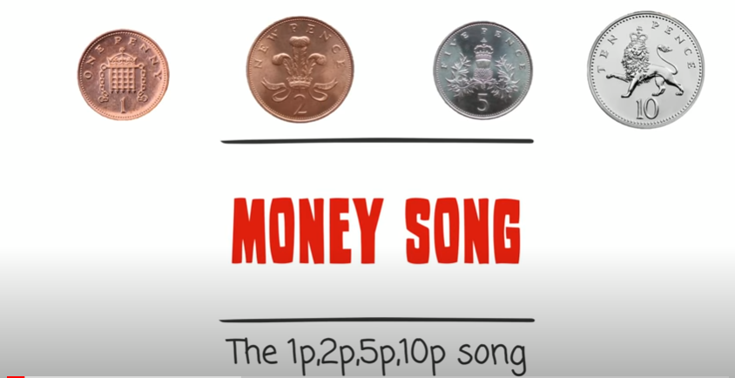
Watch this video! Can you sing along and recognise the coins?
https://www.youtube.com/watch?v=dFzAU3u06Ps
Click the link or copy and paste the above into the internet to play the video.
‘Money Song for Children UK’ - YouTube

Slide 42
Recap!
Lets have a look at the money we have been learning about!
1p
2p
5p
10p
20p
50p
£1
£2
£5
£10
£20
£50

Slide 43
Counting money
My turn!
This time, all of the coins are not the same so there are different ways to work this out.
You can count in 2s and then add on the 1.
Or
You can count the total number of numicon.
2
4
6
7
So I have 7p in total!

Slide 44
Counting money
Let’s try together
This time, all of the coins are not the same so there are different ways to work this out.
You can count in 2s and then add on the 1.
Or
You can count the total number of numicon.
2
4
6
8
9
Answer:
I have helped you count in 2s and then add on the 1p. How much money do we have?
9p
____p
Move the box to find the answer

Slide 45
Counting money
Your turn!
This time, all of the coins are not the same so there are different ways to work this out.
You can count in 2s and then add on the 1.
Or
You can count the total number of numicon.
= ____p
Answer:
5p
Move the box to find the answer

Slide 46
Counting money
My turn!
This time, all of the coins are not the same so there are different ways to work this out.
You can count in 5s and then add on the 1.
Or
You can count the total number of numicon.
5
10
15
16
So I have 16p in total!

Slide 47
Counting money
Let’s try together
This time, all of the coins are not the same so there are different ways to work this out.
You can count in 5s and then add on the 1.
Or
You can count the total number of numicon.
Answer:
5
10
11
12
12p
I have helped you count in 5s and then counted the two 1ps. How much money do we have?
____p
Move the box to find the answer

Slide 48
Counting money
Your turn!
This time, all of the coins are not the same so there are different ways to work this out.
You can count in 5s and then add on the 1.
Or
You can count the total number of numicon.
= ____p
Answer:
17p
Move the box to find the answer

Slide 49
Counting money
My turn!
This time, all of the coins are not the same so there are different ways to work this out.
You can count in 10s and then add on the 1.
Or
You can count the total number of numicon.
10
20
30
31
So I have 31p in total!

Slide 50
Counting money
Let’s try together
This time, all of the coins are not the same so there are different ways to work this out.
You can count in 10s and then add on the 1.
Or
You can count the total number of numicon.
Answer:
10
20
30
40
41
41p
I have helped you count in 10s and then counted the 1p. How much money do we have?
____p
Move the box to find the answer

Slide 51
Counting money
Your turn!
This time, all of the coins are not the same so there are different ways to work this out.
You can count in 10s and then add on the 1.
Or
You can count the total number of numicon.
= ____p
Answer:
21p
Move the box to find the answer

Slide 52
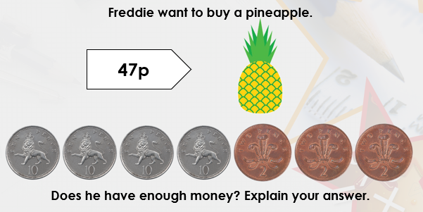
If you are working on a computer, insert a text box to type your answer.
Challenge!

Slide 53
Date: 15.01.21
LO To be able to subtract within 10.
Subject: Maths

Slide 54

Watch this video! Can you help the pirates subtract?
https://www.youtube.com/watch?v=QkPa9V2wtZs
Click the link or copy and paste the above into the internet to play the video.
‘When You Subtract with a Pirate’ - YouTube

Slide 55
Subtraction (taking away)
My turn!
5 – 2 = 3
I started with 5 and took away 2. I was left with 3!

Slide 56
Subtraction (taking away)
Let’s try together
I started with 7 and took away 3. How many are left?
Answer:
7 – 3 = _____
4
Move the box to find the answer

Slide 57
Subtraction (taking away)
Your turn!
Cross out how many you need to take away. If you are working on a computer, delete or put a cross through the image
8 – 2 = _____
Answer:
6
Move the box to find the answer

Slide 58

Subtraction (taking away)
Your turn!
Cross out how many you need to take away. If you are working on a computer, delete or put a cross through the image
Answer:
6 – 4 = _____
2
Move the box to find the answer

Slide 59

Subtraction (taking away)
Your turn!
Cross out how many you need to take away. If you are working on a computer, delete or put a cross through the image
Answer:
7 – 5 = _____
2
Move the box to find the answer

Slide 60
Subtraction (taking away)
Your turn!
5 – 2 = ___
6 – 3 = ___
8 – 4 = ___
4. 5 – 3 = ___
5. 9 – 1 = ___
6. 7 – 2 = ___
Use your fingers or draw pictures to help you! Start with the first number and take away the number after the subtraction symbol.

Slide 61
Answers
5 – 2 = 3
6 – 3 = 3
8 – 4 = 4
4. 5 – 3 = 2
5. 9 – 1 = 8
6. 7 – 2 = 5

Slide 62
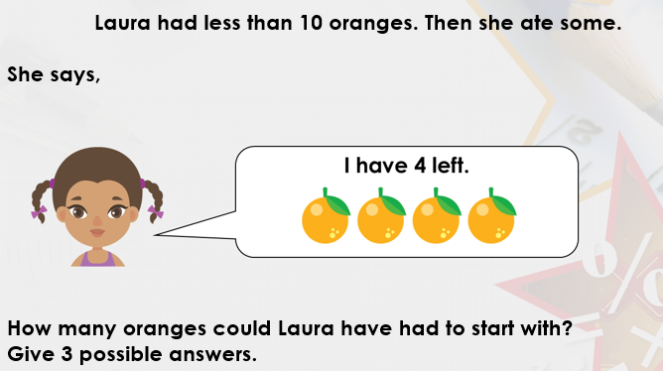
If you are working on a computer, insert a text box to type your answer.
Challenge!

Slide 63
Further Learning - Pre-recorded
Access the online teaching video below that will support you to access some further learning around the Lesson Objective. If you need further support to understand / complete work then please contact school via e-mail or telephone.
Play Video

Slide 64

Well done for your hard work this week!
Could any completed work / photographic evidence of completed work please be sent to Pioneerspupils@gmail.com
Thank you

