Slide 1
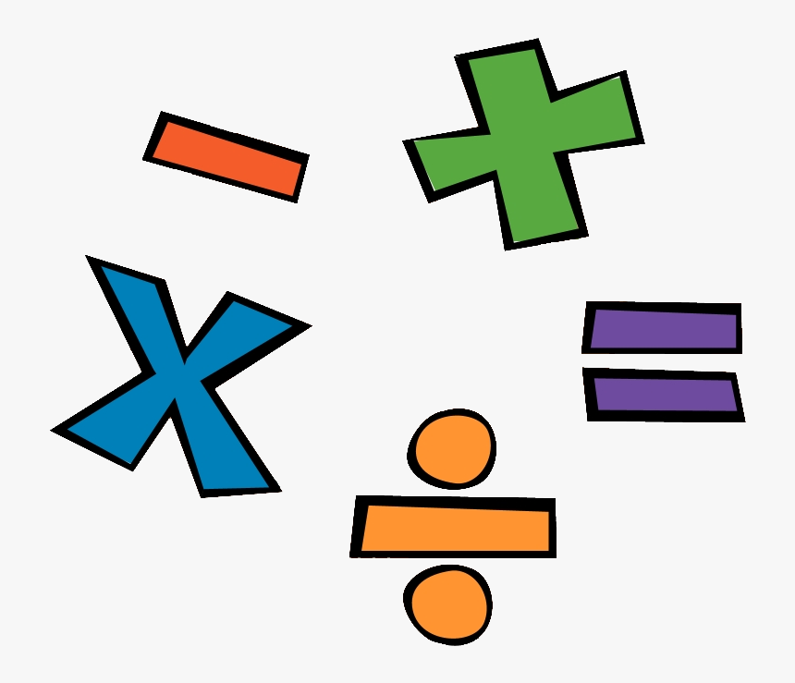
Remote Learning – Base 5
W.B. 04.01.21
Maths

Slide 2
Hello!
This week we will revisit our Number topic, rather than start something new. When we return to school we will begin our next Maths topic! ☺
Please keep any work you complete / photographs and bring them into school when you return so we can add them to your books / journals.
If you have any questions please don’t hesitate to contact school.
Mollie ☺

Slide 3
Date: 5.01.2021
L.O. To be able to understand place value
Subject: Maths

Slide 4
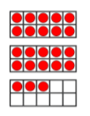
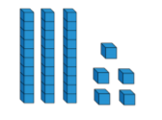
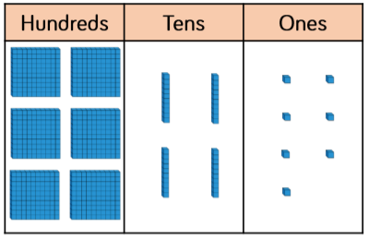
Task 1:
Look at the pictures below – what numbers are being represented?
Write down the answer for each one.
1)
2)
3)
4)
5)

Slide 5
Task 2:
Using your knowledge of place value, order the answers you got from the previous slide from smallest to largest.
smallest
largest
Maths Games - Click here to find some fun place value games!

Slide 6
Date: 6.01.2021
L.O. To be able to add numbers with up to 3-digits together using the column method
Subject: Maths

Slide 7
Task 1: Adding a 2-digit numbers using the column method
Write out the following sums using the column method and work out the answer.
10 + 20 =
21 + 24 =
34 + 54 =
45 + 22 =
51 + 47 =
When writing down sums, separate the numbers into ones and tens. List the numbers in a column and always start adding with the ones first.
So…
Starting with the ones, 6 + 3 = 9, so we write this underneath in the ones column.
Then 6 + 1 = 7, so we write this underneath in the tens column. What does the 6 and the 1 represent here?
T O
66
+ 13
7 9

Slide 8
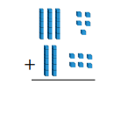
Task 2: Adding a 2-digit number to a 3-digit number using the column method
Can you write out the following questions and work out the answer using the column method?
Can you work out the answer?
154 + 41 =
142 + 11 =
235 + 21 =
524 + 10 =
656 + 13 =
Maths Games - Click here to find some fun addition and subtraction games!

Slide 9
Date: 7.01.2021
L.O. To be able to subtract numbers with up to 3 digits, using the column method
Subject: Maths

Slide 10
Task 1: Subtracting a 2-digit number from a 2-digit number using the column method
Can you write out the following questions and work out the answer using the column method like I have in the example?
Example: 66-33 = 33
66
33
33
54 – 21 =
42 – 31 =
39 – 26 =
24 – 23 =
56 – 21 =

Slide 11
Task 2: Subtracting a 2-digit number from a 3-digit number using the column method
Can you write out the following questions and work out the answer using the column method?
154 – 41 =
142 – 11 =
239 – 22 =
524 – 13 =
656 – 31 =
Maths Games - Click here to find some fun addition and subtraction games!

Slide 12
Date: 8.01.2021
L.O. To know my 10 times tables
Subject: Maths

Slide 13
Can you work out the answers to the following questions? Write out the number sentence e.g. 1 x 10 = 10 Practice reciting your 10 times tables out loud. Challenge: ask a family member to test you!
10 Times Tables Song
1 x 10 =
2 x 10 =
3 x 10 =
4 x 10 =
5 x 10 =
6 x 10 =
7 x 10 =
8 x 10 =
9 x 10 =
10 x 10 =

Slide 14
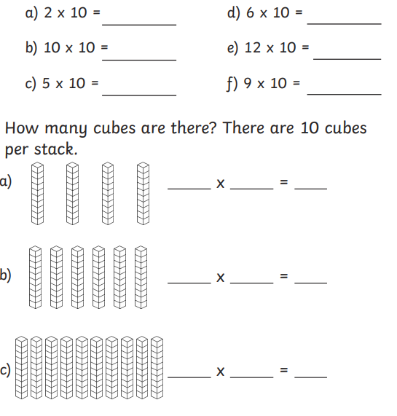
4
10
40
10 Times Tables Interactive Activities - Click here to find some fun times tables games!

