Slide 1



Date: Monday 11th January
LO To be able to identify features of a story.
Subject: English

Slide 2

We are going to continue looking at Winnie and Wilbur under the sea.
https://www.youtube.com/watch?v=D5YE4rxQJhg
You can re watch the video to remind you of the story.

Slide 3
Retell of the story …
One summers day, Winnie and Wilbur packed their suitcase ready for a holiday on a remote desert island surrounded by shark infested waters. Winnie packed her colourful swimsuit and blue flippers so that she could practice her swimming in the deep sea.
Wilbur was terrified of the water and sat on the wooden jetty watching Winnie as she swam. He could see all of the delicious fish as they swam by and wished he could catch one for his lunch. He slowly reached out his paw to test the water but he thought it was nasty and wet! Suddenly, Winnie had an idea. She waved her magic wand in a gigantic circle, shouted abracadabra and WHOOSH Wilbur turned into a cat-fish!
Wilbur loved being a cat-fish! He spent the day chasing little fish and swimming through secret tunnels under the water. Winnie watched Wilbur having so much fun and wished she could become a fish too! Winnie thought long and hard about the spell she would need. Then with a wave of her magic wand she turned into a huge, yellow octopus with pink tentacles!
All of a sudden, a giant sea lion with long whiskers swam past knocking Winnie’s want out of her hand! She tried to catch it but she missed. The wand tumbled quickly down to the bottom of the ocean and landed in the wreck of an old sailing ship. They searched under the ropes, under the anchor and behind the crab but it was nowhere to be seen! Eventually, they found the want inside an old treasure chest and cast a spell to turn back to normal.

Slide 4
Retell of the story …
Now find the features!
One summers day, Winnie and Wilbur packed their suitcase ready for a holiday on a remote desert island surrounded by shark infested waters. Winnie packed her colourful swimsuit and blue flippers so that she could practice her swimming in the deep sea.
Wilbur was terrified of the water and sat on the wooden jetty watching Winnie as she swam. He could see all of the delicious fish as they swam by and wished he could catch one for his lunch. He slowly reached out his paw to test the water but he thought it was nasty and wet! Suddenly, Winnie had an idea. She waved her magic wand in a gigantic circle, shouted abracadabra and WHOOSH Wilbur turned into a cat-fish!
Wilbur loved being a cat-fish! He spent the day chasing little fish and swimming through secret tunnels under the water. Winnie watched Wilbur having so much fun and wished she could become a fish too! Winnie thought long and hard about the spell she would need. Then with a wave of her magic wand she turned into a huge, yellow octopus with pink tentacles!
All of a sudden, a giant sea lion with long whiskers swam past knocking Winnie’s want out of her hand! She tried to catch it but she missed. The wand tumbled quickly down to the bottom of the ocean and landed in the wreck of an old sailing ship. They searched under the ropes, under the anchor and behind the crab but it was nowhere to be seen! Eventually, they found the want inside an old treasure chest and cast a spell to turn back to normal.
Use the key to highlight/ underline the key features in the correct colour
Remember an adjective is a describing word
Capital letters
Exclamation marks
Full stops
adjectives

Slide 5
Date: Tuesday 12th January
LO To be able to punctuate sentences correctly.
Subject: English

Slide 6
Capital letters
Why do I need capital letters?
Capital letters are needed at the start of a sentence, for peoples names and places.
Full stops
Full stops go at the end of sentences so that the person reading your writing knows you have finished your sentence.

Slide 7
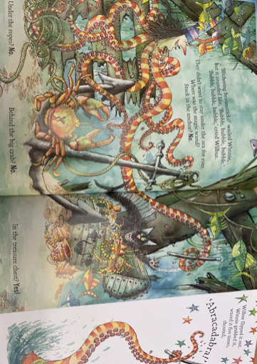
Capital letters and full stops
Example
Use of capital letters and a full stop
Full stop at the end of the sentence
The octopus has orange and yellow tentacles.
Capital letter for the start of the sentence
Winnie and Wilbur saw a crab under the sea.
Capital letter for a name
Capital letter for the start of the sentence
Full stop at the end of the sentence

Slide 8
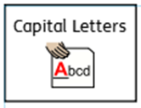
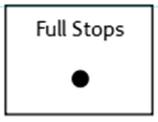
Punctuate the sentences correctly
Add the capital letters and full stops
1. the crab is big and red
2. winnie lost her wand
3. next to the chest is a brown pot
4. under the water wilbur chased little fish

Slide 9

Using capital letters and full stops
Use the picture to help you write 5 sentences.
Don’t forget:
Winnie can see a big red crab. The orange fish is next to the old treasure chest.

Slide 10
Date: Wednesday 13th January
LO To be able to retell the beginning of ‘Winnie and Wilbur under the sea’.
Subject: English

Slide 11
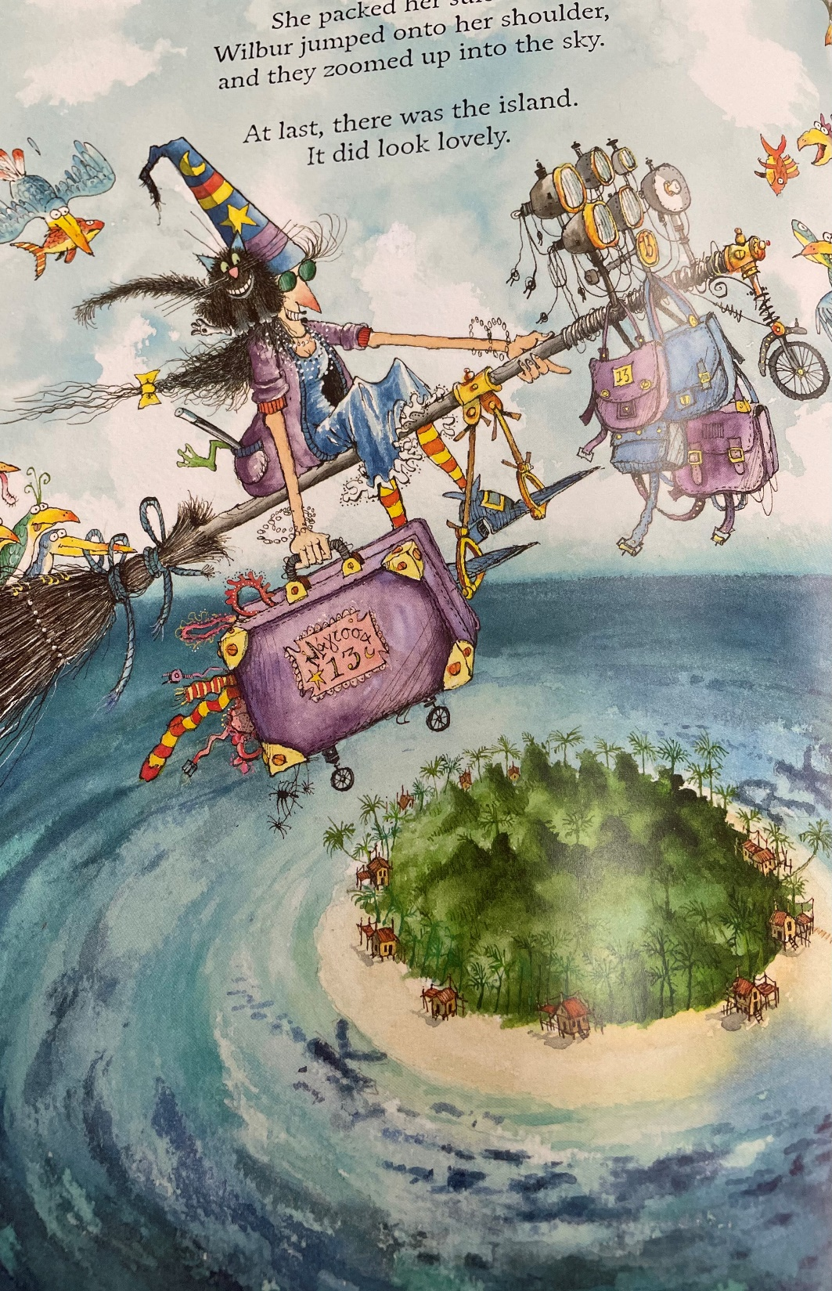
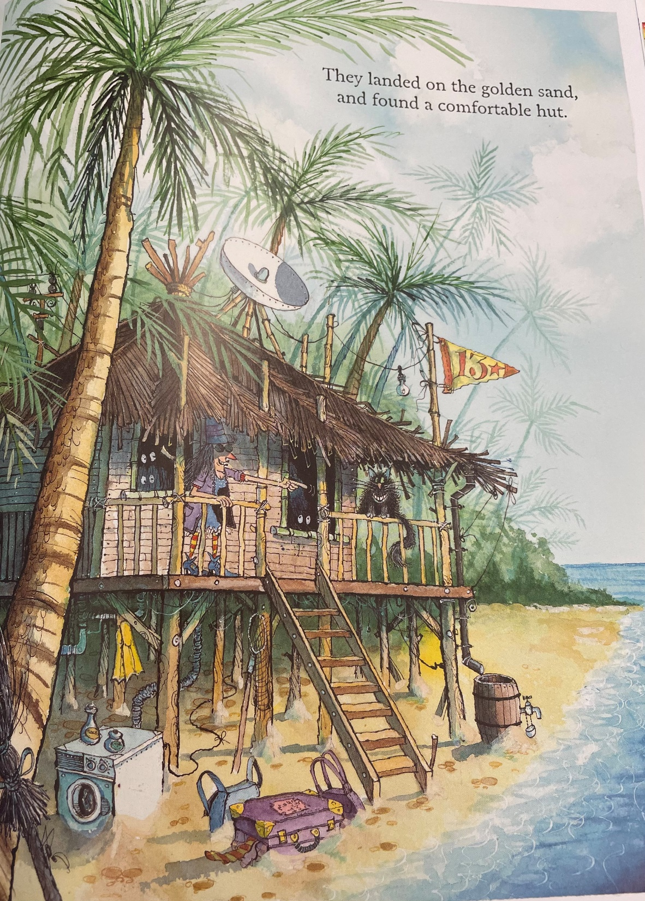
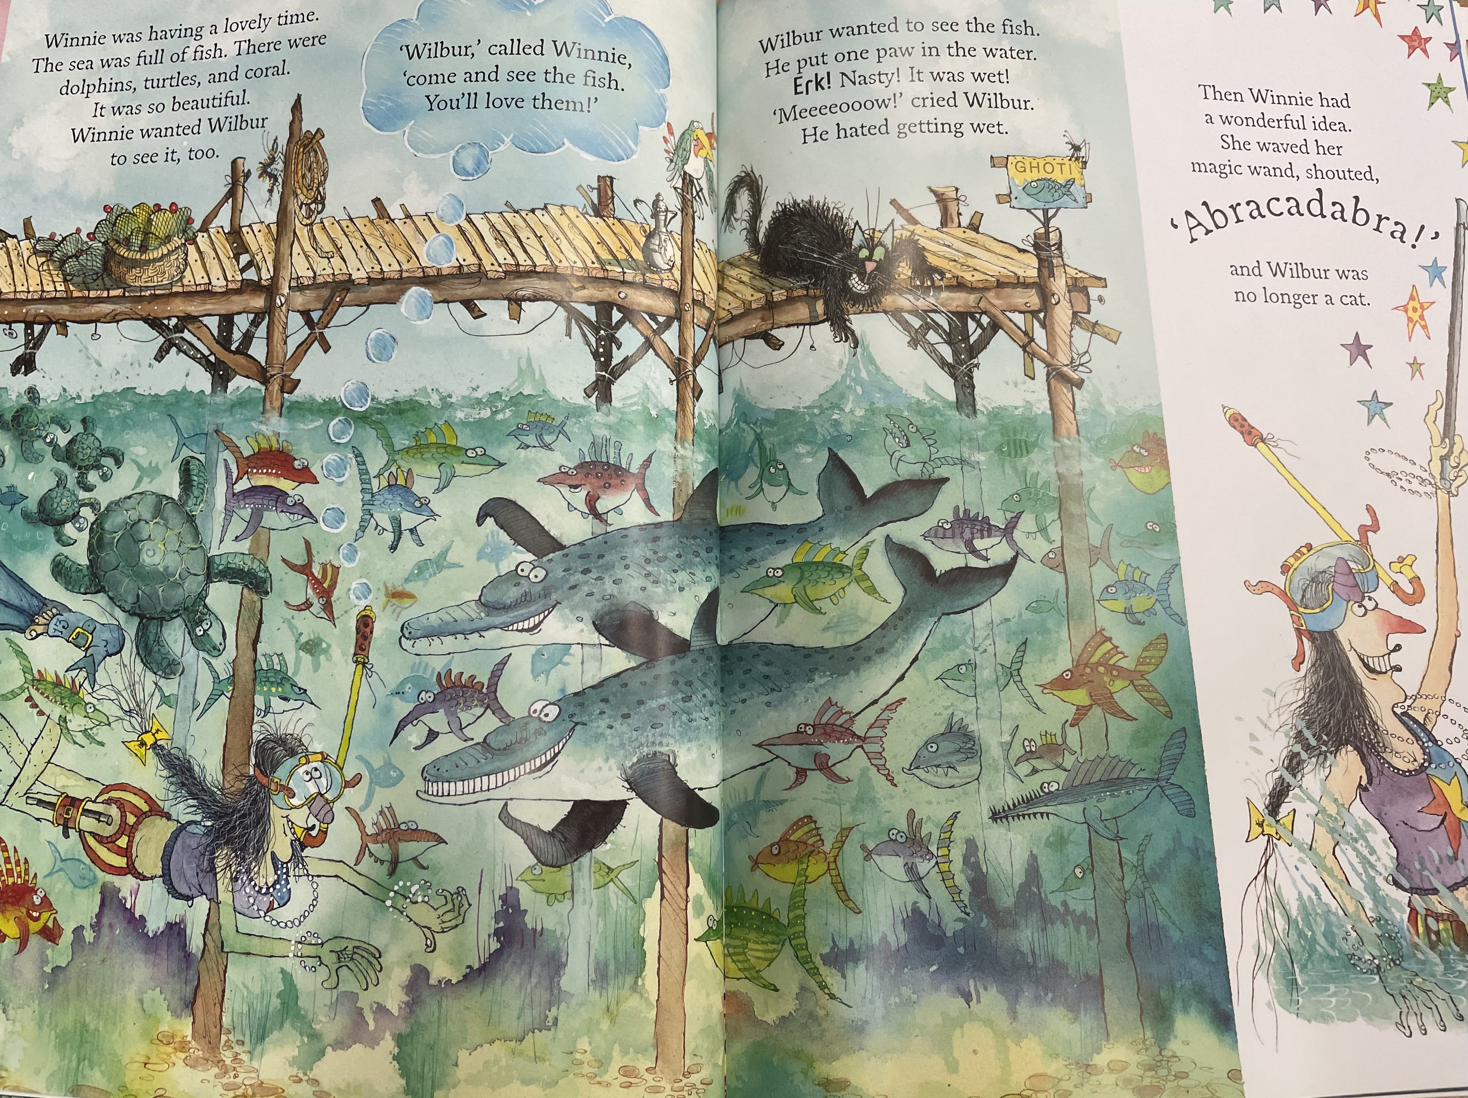
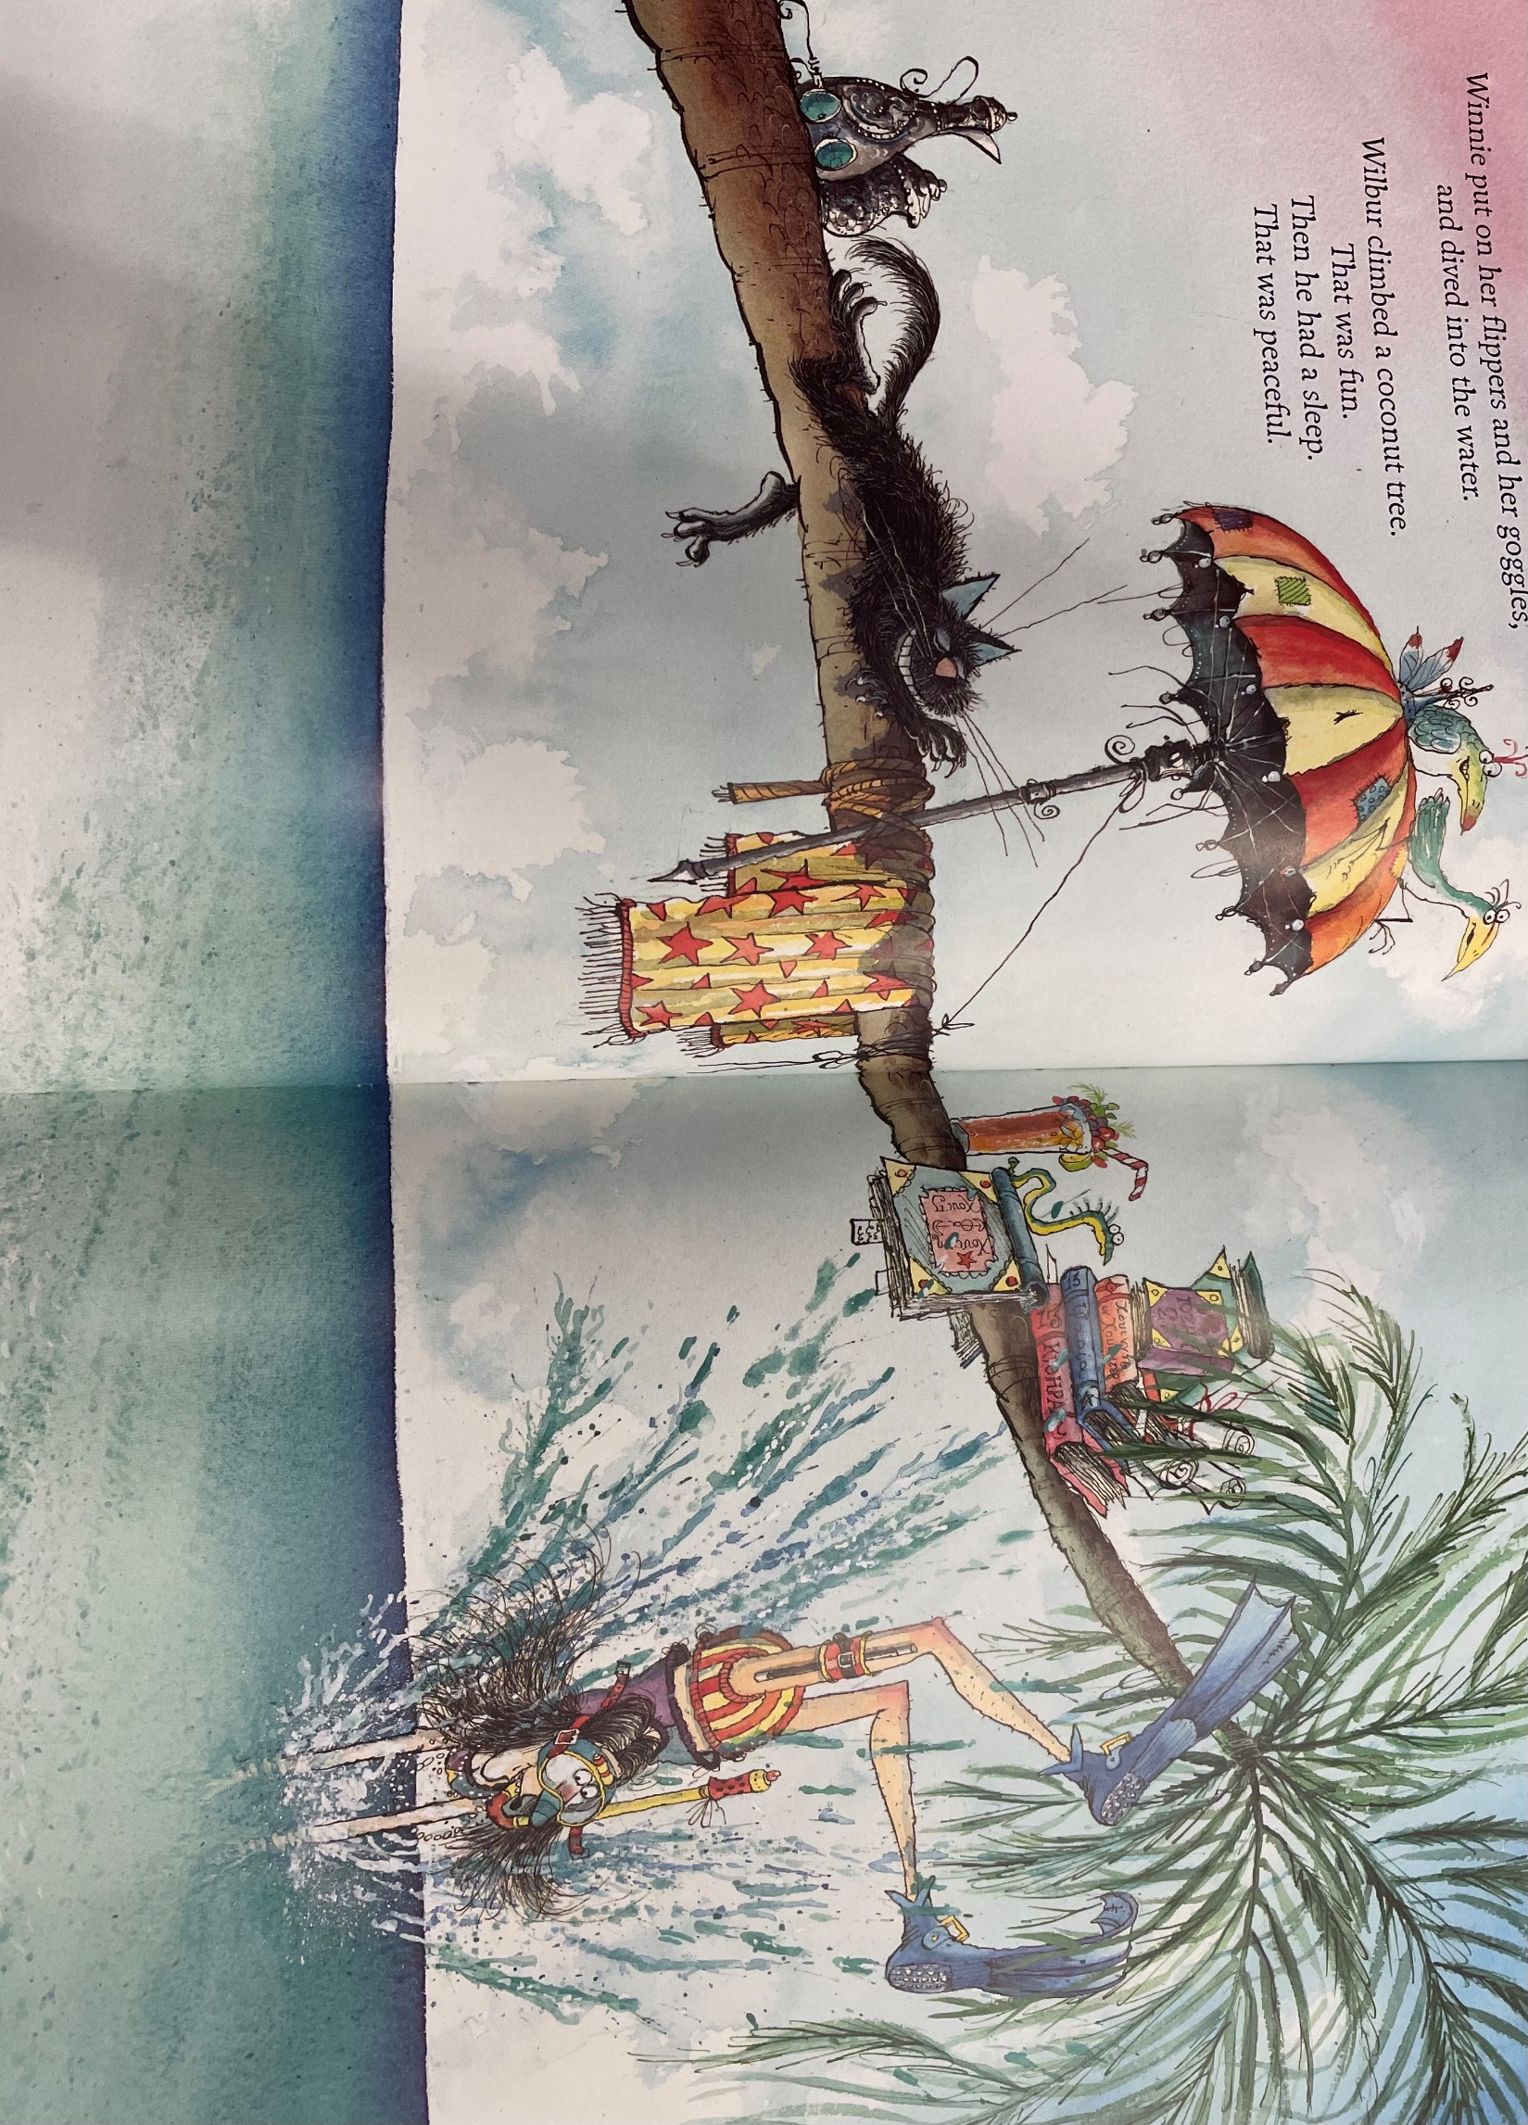
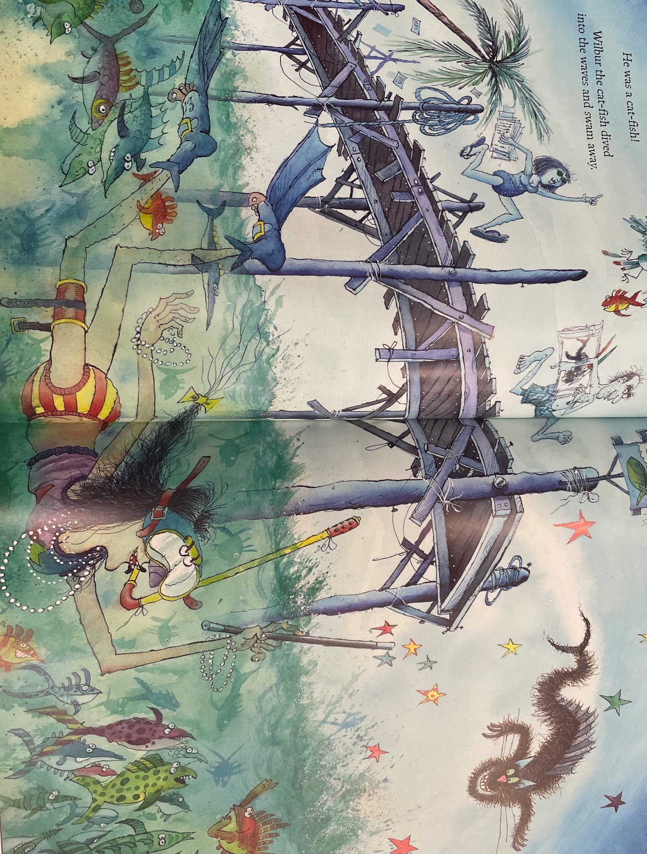
Beginning of the story …
Read my beginning of the story.
One summers day, Winnie and Wilbur packed their suitcase ready for a holiday on a remote desert island surrounded by shark infested waters. Winnie packed her colourful swimsuit, blue flippers and her snorkel so that she could practice her swimming in the deep, cold sea.
Wilbur was terrified of the water and sat on the broken, wooden jetty watching Winnie as she swam. He could see all of the delicious, colourful fish as they swam by and wished he could catch one for his lunch. He slowly reached out his paw to test the water but he thought it was nasty and wet! Suddenly, Winnie had an idea. She waved her magic wand in a gigantic circle, shouted abracadabra and WHOOSH Wilbur turned into a cat-fish!

Slide 12
Capital letters and full stops
Remember capital letters are used at the start of sentences, for names or places.
Example
Winnie packed her swimsuit and flippers in her huge suitcase.
Now it is your turn…
Add the capital letters and full stops
1. wilbur has black fur and a long tail
2. the island has trees and a wooden hut

Slide 13


Write your own beginning of the story
Make sure you use capital letters and full stops
Don’t forget:
Use these pictures to help you write your story
One summers day, Winne packed her swimsuit and flippers ready for her holiday on a remote desert island.
Remember names of characters need capital letters!

Slide 14
Date: Thursday 14th January
LO To be able to retell the ending of ‘Winnie and Wilbur under the sea’.
Subject: English

Slide 15
Recap on adjectives
An adjective is a describing word
grey clouds
green leaves
yellow flag
black cat
wooden hut
brown barrel
little pot
cold water
purple suitcase

Slide 16
Adjectives are describing words.
Complete the noun phrases by
adding 1 adjective before the noun.
deep water
purple suitcase
_____________ leaves
_____________ sand
_____________ cat
_______________ clouds
_____________ sky
_____________flag

Slide 17
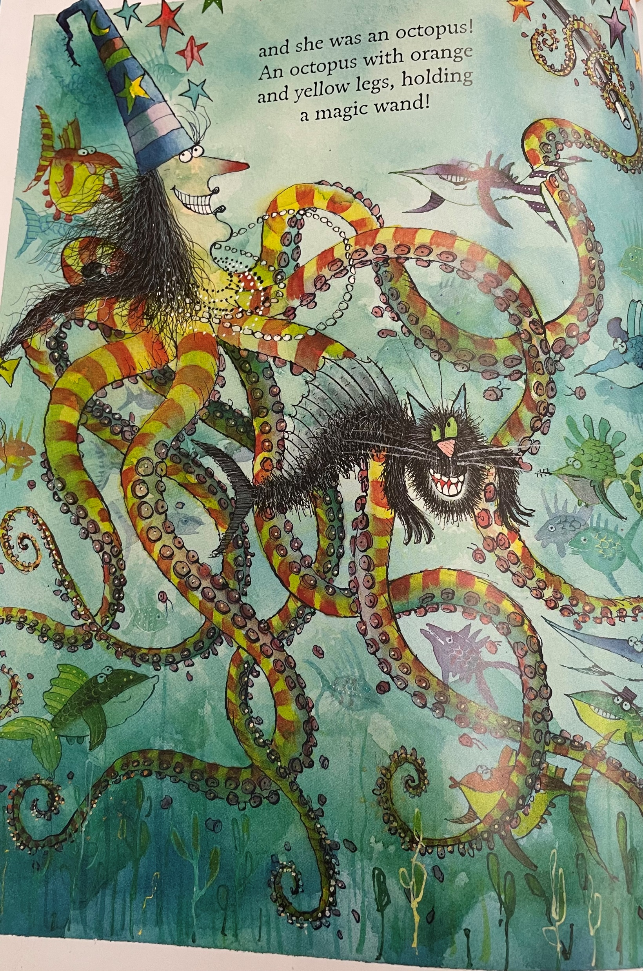
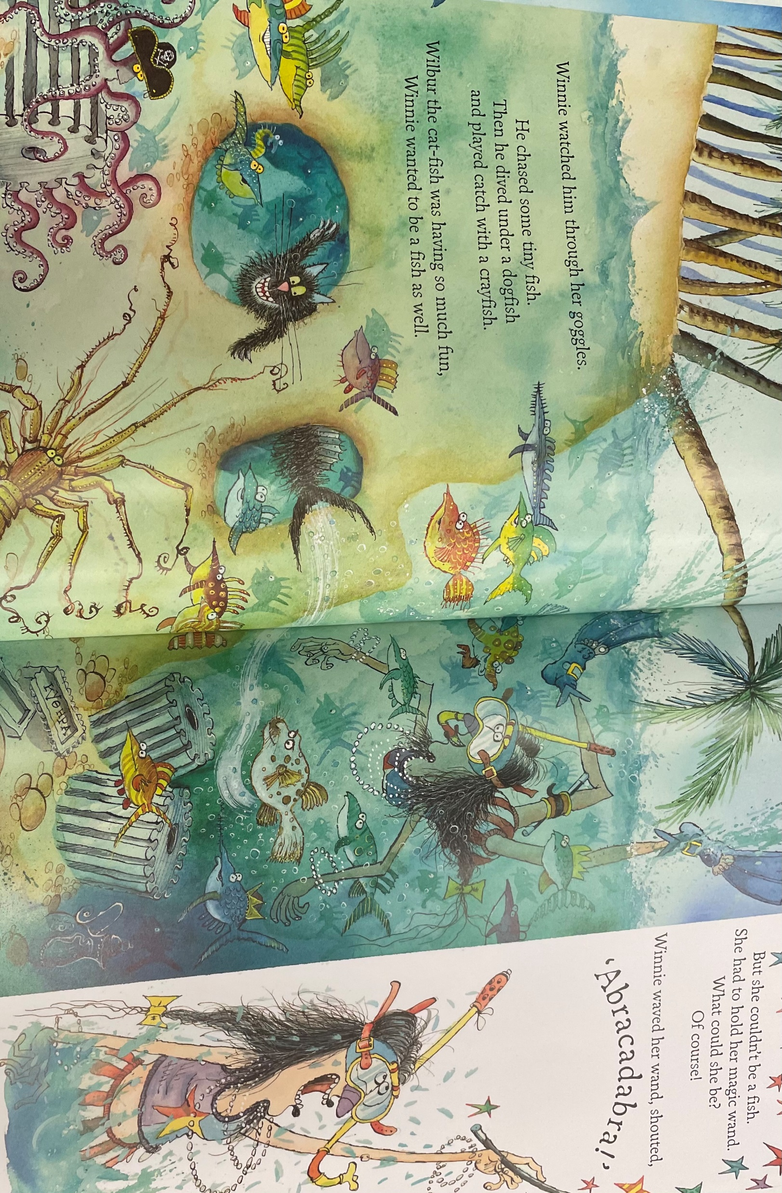
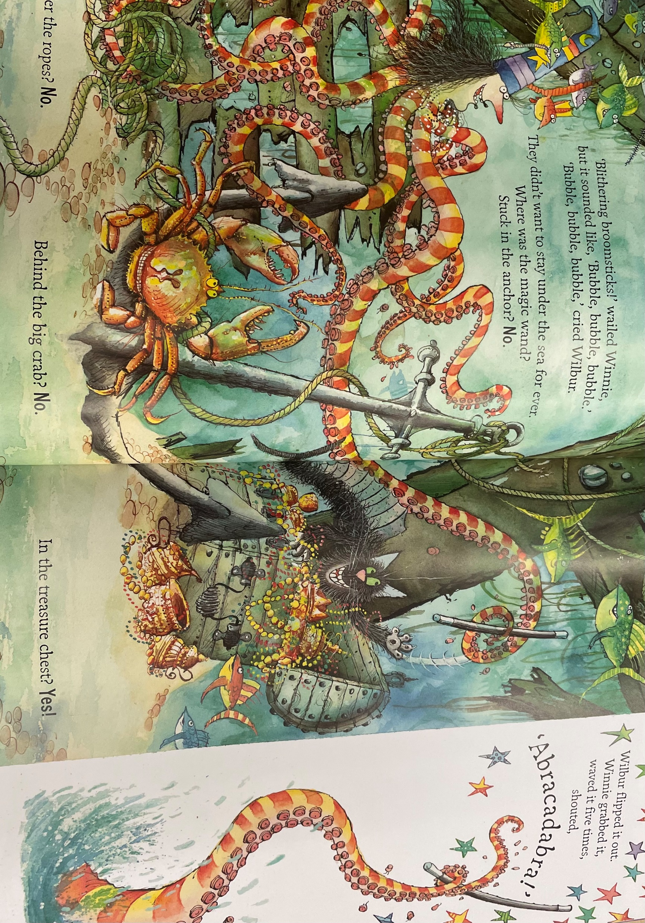
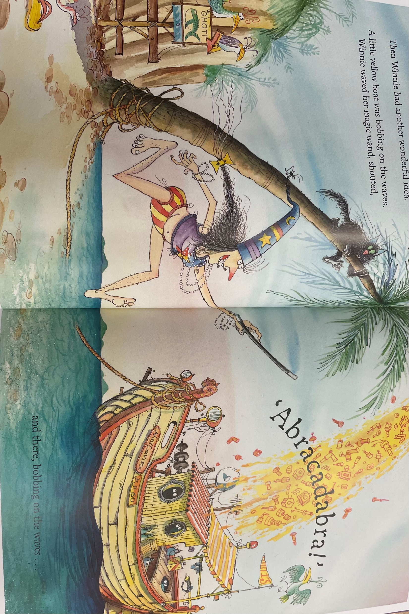
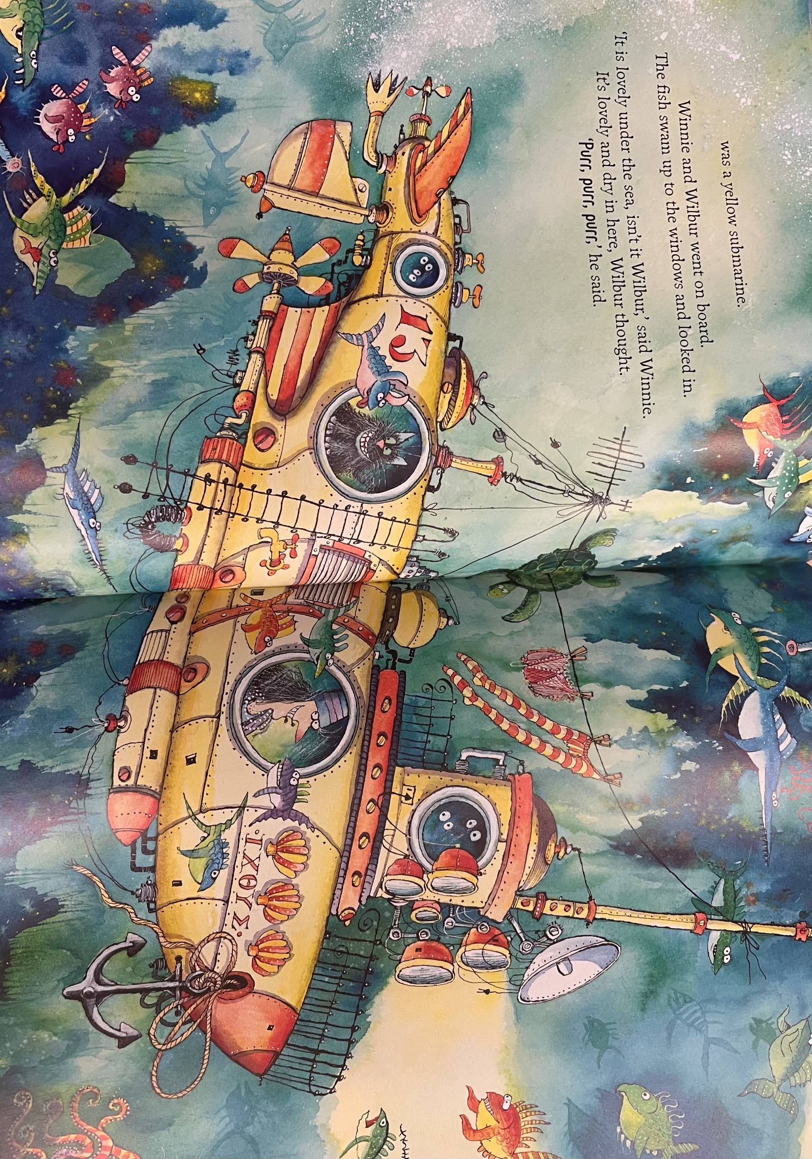
Write your own ending of the story
Make sure you adjectives
Don’t forget:
Use these pictures to help you write your story
All of a sudden, Winnie waved her magical wand and turned into a huge octopus with lots of round tentacles.

Slide 18
Date: Friday 15th January
LO To be able to read and spell common exception words.
Subject: English

Slide 19
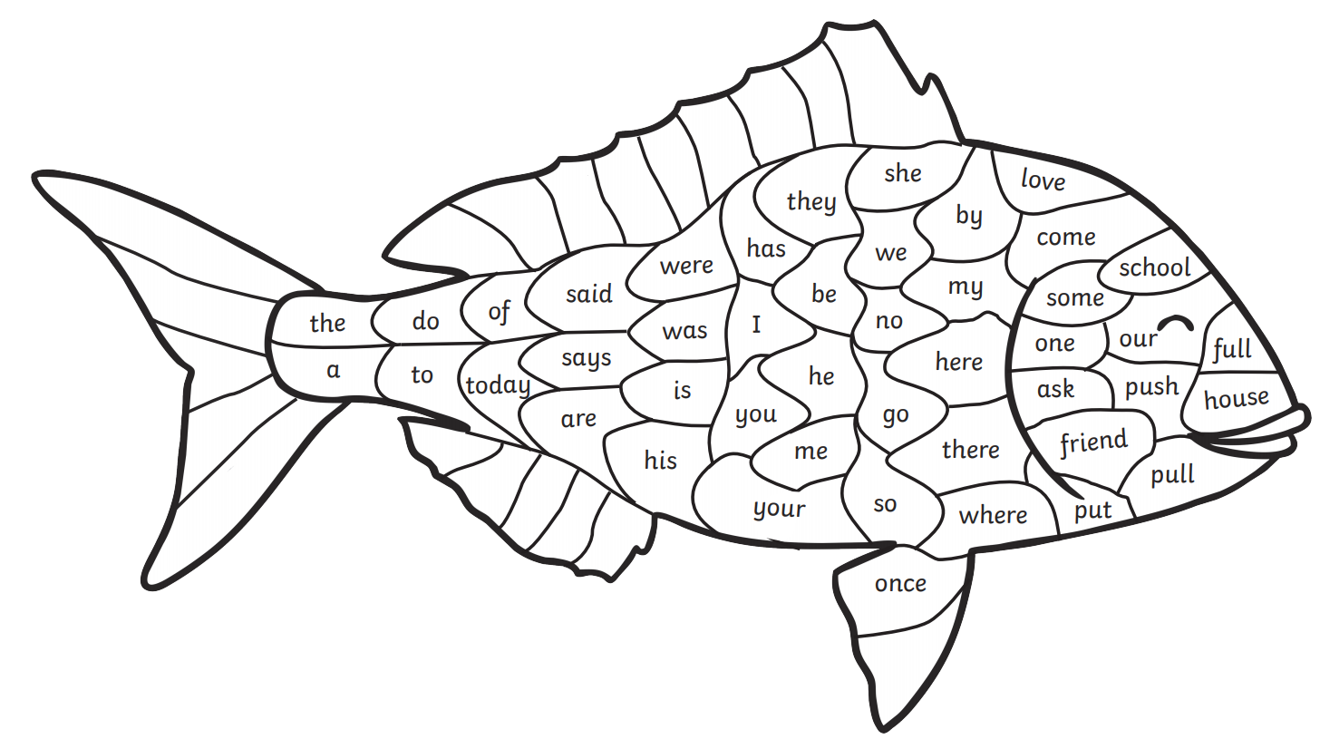
Read the common exception words
These are some of the words we need to know how to spell

Slide 20
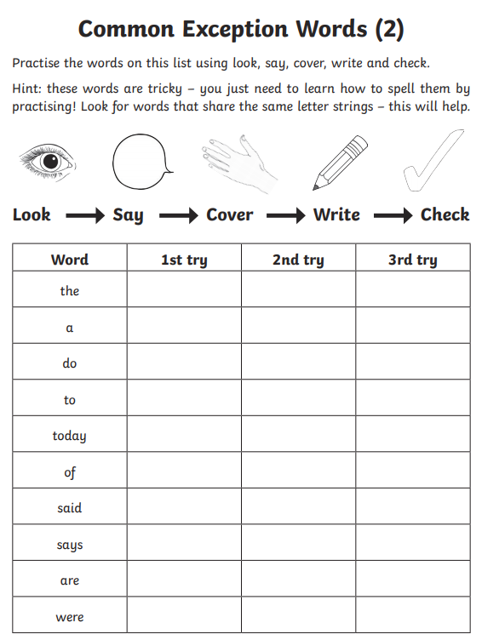
Look, cover, write and check!

Slide 21
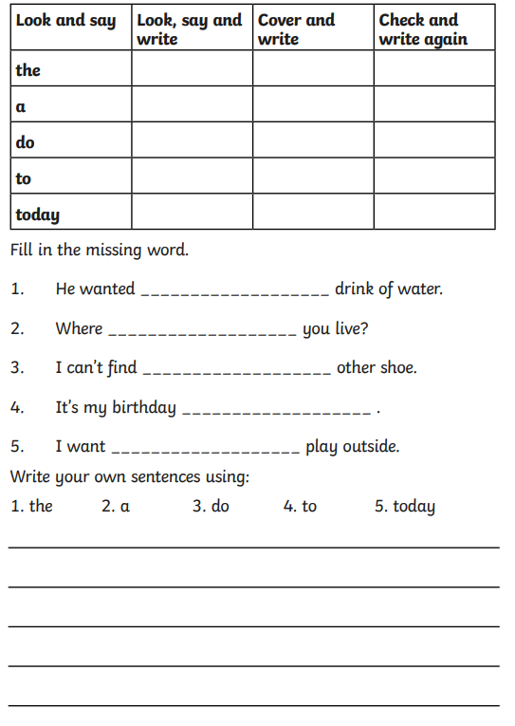
Don’t forget your sentences need capital letters, finger spaces and a full stop.

Slide 22
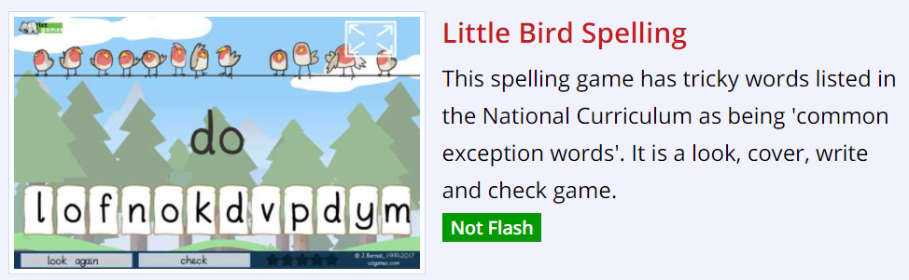
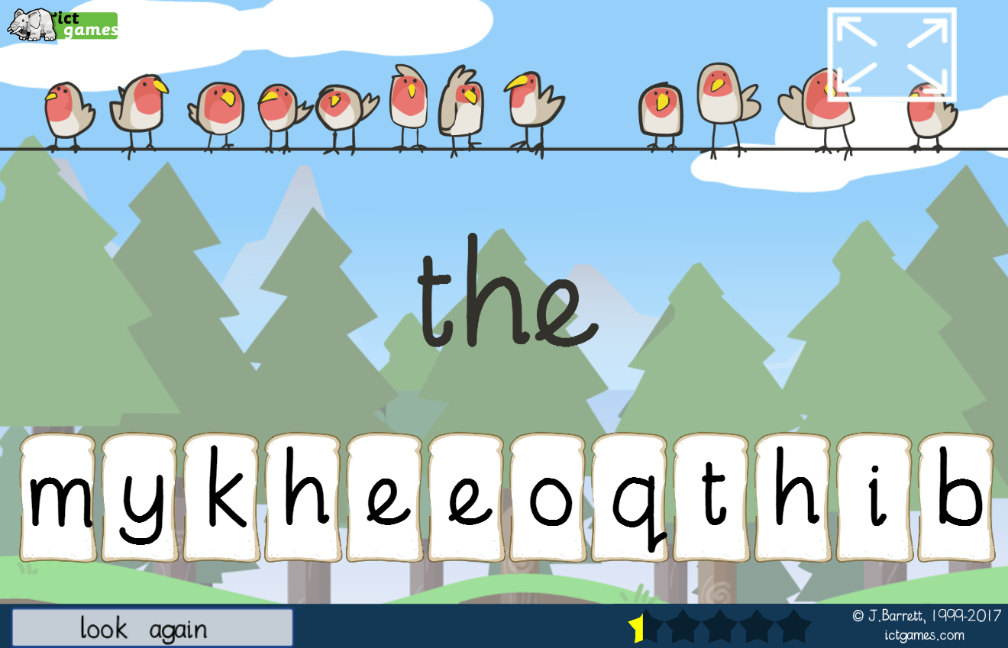
Spelling game!
Use the link to play the game and practice spelling the common exception words
Little Bird Spelling || Practise spelling Common Exception Words (ictgames.com)

Slide 23
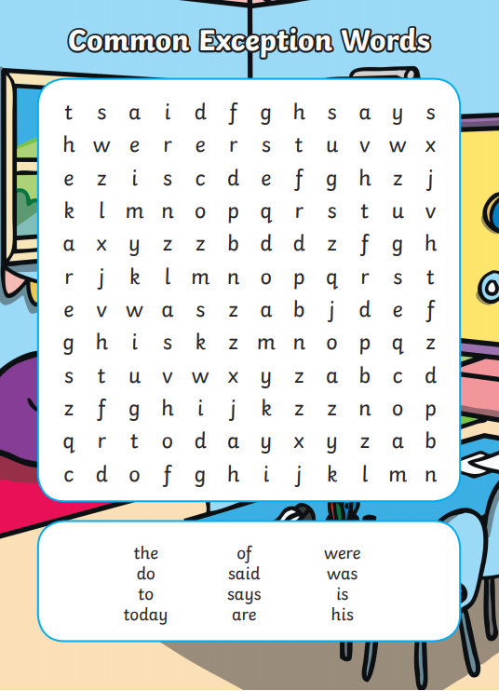
Word search
Find the common exception words in the word search

Slide 24

Well done for all of your hard work this week! We can’t wait to see your completed work.
Could any completed work / photographic evidence of completed work please be sent to pioneerspupils@gmail.com
Thank you!

