Slide 1
Remote Learning - Base 5
W.B. 04.01.21
English

Slide 2
Hello!
In English this week, we will revisit some of the skills we have learned so far. When we all return to school, we will begin our new topic and learn some new writing skills.
Please keep any work you complete / photographs and bring them into school when you return so we can add them to your books / journals.
If you have any questions please don’t hesitate to contact us at school.
Mollie ☺

Slide 3
Date: Tuesday 5th January 2021
L.O. To practice new spellings
Subject: Spellings

Slide 4
L.O. To practice new spellings
L.O. To practice new spellings
Tasks:
Read, write, cover, check!
Read each word, copy it then have a go at writing it yourself using your neatest handwriting.
Write each word 5 times.

Slide 5
Date: Tuesday 5th January 2021
L.O. To set the scene of a story
Subject: English

Slide 6
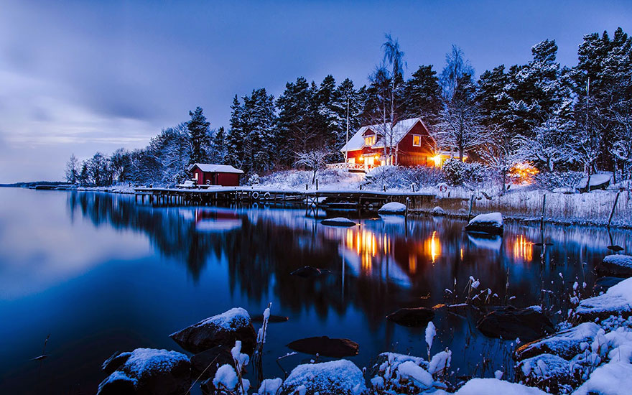
Look at the picture below – discuss or write down what you can see.
Task: Write an opening paragraph to a story based on the picture above. Think about what you might see, hear, smell, taste and touch. See my example on the next slide for ideas.

Slide 7
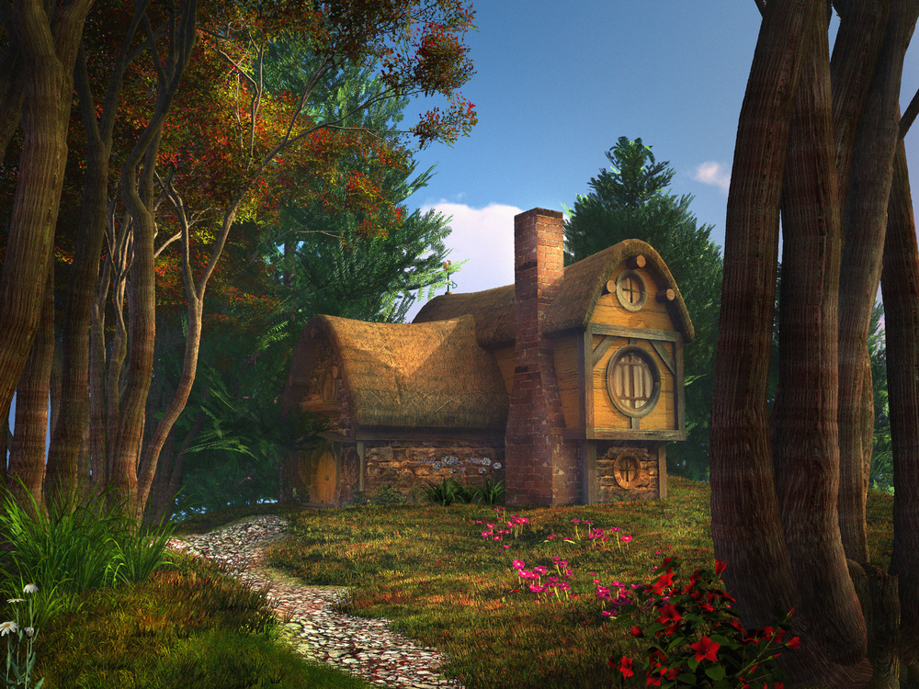
Example…
On a bright and sunny day, Daisy was skipping through the woods collecting bright, beautiful flowers. The birds were chirping cheerfully and the trees were swaying gently in the summer breeze. Suddenly, Daisy stopped. She noticed a small, brown house at the end of the pebbled path. She had been in these woods many times before, but had never seen this house. Daisy wondered who lived here, so she quietly crept towards the tiny door. Knock, knock, knock… who could be inside?

Slide 8
Date: Wednesday 6th January 2021
L.O. To practice new spellings
Subject: Spellings

Slide 9
L.O. To practice new spellings
L.O. To practice new spellings
Tasks:
Read, write, cover, check!
Read each word, copy it then have a go at writing it yourself using your neatest handwriting.
Write each word 5 times.

Slide 10
Date: Wednesday 6th January 2021
L.O. To describe a character
Subject: English

Slide 11
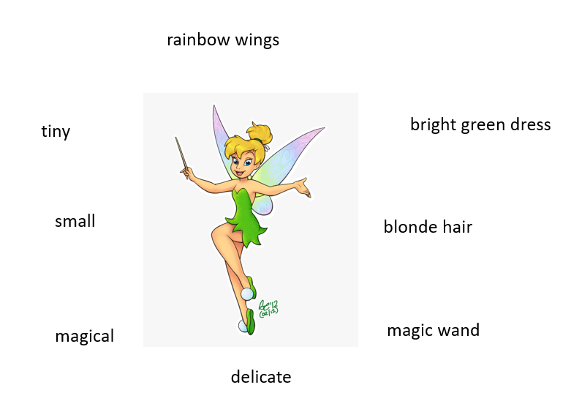
L.O. To describe a character
Task 1:
Can you draw a picture of your favourite character, then write a list of adjectives to describe them?

Slide 12
Task 2:
Can you write a descriptive paragraph about your
character, using the adjectives you came up with in task 1?
Tinkerbell is a tiny fairy who wears a bright green dress. She is fair-skinned and has soft, blonde hair. When angered, her entire body turns fiery red!
Can you find the adjectives used to describe Tinkerbell?

Slide 13
Date: Thursday 7th January 2021
L.O. To use my new spellings in sentences
Subject: Spellings

Slide 14
L.O. To use my new spellings in sentences
Task:
Can you put each word into a sentence and write it down? Don’t forget to use the correct punctuation.
Example: Suddenly, it started to rain, so I ran back inside!

Slide 15
Date: Thursday 7th January 2021
L.O. To create a story map
Subject: English

Slide 16
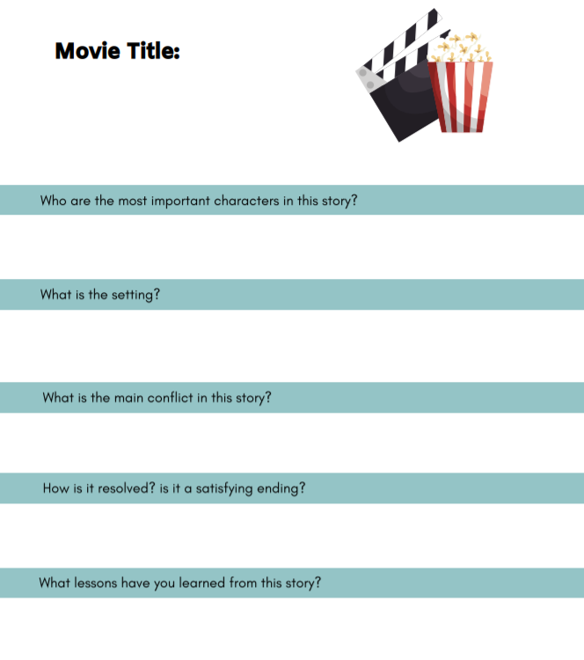
Title of the movie
Finding Nemo
Who
Main characters
Nemo, Marlin, Dory, Bruce
Where
Where is the movie set?
The Great Barrier Reef
What
What is the dilemma / problem?
Nemo is captured by a fishing boat and is taken to Sydney, where he ends up in a dentists fish tank!
How
How is the problem solved?
Marlin ventures off to find Nemo and meets a friend, Dory, along the way. Together they eventually find Nemo after he manages to escape!

Slide 17
L.O. To create a story map
Task: Choose a movie to watch – can you answer the questions on the sheet about the storyline? Remember to use full sentences. Use my example on the previous slide to help you.

Slide 18
Date: Friday 8th January 2021
L.O. Spelling test
Subject: Spellings

Slide 19
L.O. Spelling test
Spelling test!
Can you independently spell the words you have been practising?
Ask an adult to read out each word and have a go at writing it.

Slide 20
Date: Friday 8th January 2021
L.O. To write an alternative ending to a story
Subject: English

Slide 21
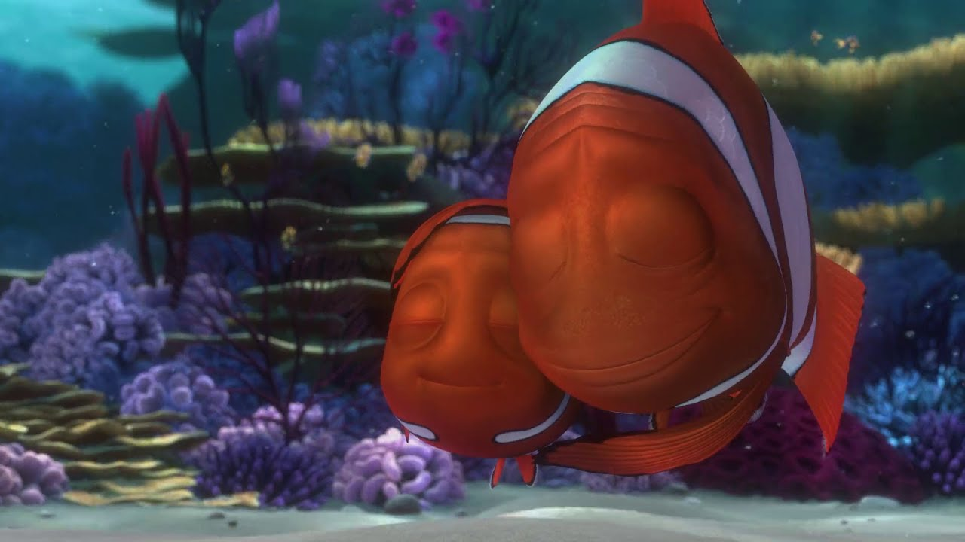
L.O. To write an alternative ending to a story
Task:
Think about the movie you watched yesterday. How did it end? Can you think of another ending that could be used for the movie instead? Write down your ideas using full sentences.

