Slide 1
Subject: Phonics and Guided Reading

Slide 2
Date: Monday 1st March
LO To be able to practise phonics sounds.
LO To be able to answer questions about a text.
Please practise phonics every day for 20 minutes.
Subject: Phonics/Guided Reading

Slide 3
Each day we are going to focus on a different sound.
Please choose from set 1, set 2, set 3 or guided reading. Each day, for phonics, there will be a video to watch and some words to read linked to the taught sound. For guided reading, there will be a text to read and some questions to answer.
Here are the sounds which are in each set.
Please contact the school if you are not sure which set your child should be focusing on, or whether you’re unsure if your child does guided reading rather than phonics.
Then, play some phonics games!
Guided Reading
For those children who know all of the phonics sounds from set 1, set 2 and set 3 and are confident readers.

Slide 4
Set 1 Sounds
Skip this slide if your child is not focusing on this set.
Today’s sound:
Please click the link or copy the below link into the internet:
https://www.youtube.com/watch?v=cq4NJZ-rE4k&list=PLPVrkr0oJX1tBTpbocNce93WUH8G-um6A&index=21
Or copy the below into YouTube:
‘Phonic Lesson - Set 1 Sound - Learning to Read and Write “j" for Reception and Year 1’ – Early Years Learning is Fun
Scavenger Hunt!
What can you find in your house that begins with j?

Slide 5
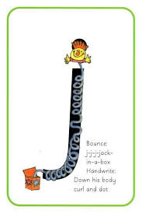
Today’s sound is j. Can you say j, j, j to your adult?
I have some pictures of things that begin with the sound j. Try saying them out loud to your adult.
j j jam
j j jelly
j j jug
Hiding behind the Jack in the box is the grapheme j. Can you point to it and say j?
When you see this side of the card say j.
Look at the picture on the left.
That is a
Jack in the box.
When you see this picture, as quick as you can say Jack in the box.

Slide 6
Below, I have given you some cards. Point to each one and say Jack in the box or j.
Now let’s have a go at writing the sound j. Use your finger and move it over the picture card saying ‘Down his body, curl and dot’ or j j j j until you have traced the whole grapheme.
Now have a turn on your own. Keep practising until you get it right.

Slide 7
Set 1 Sounds
Now its time to Fred talk, read the word. Let me show you.
Here is my green word.
I am going to point to the button below each sound and say it out loud. This is Fred Talk.
j e t, after sounding out the word remember to read the word, jet. I have now read the word.
Now time to read some words including ‘j’. You could even practise writing these words!

Slide 8
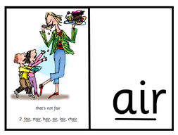
Recap: Set 2 Sounds
Skip this slide if your child is not focusing on this set.
Today’s sound:
Please click the link or copy the below link into the internet:
https://www.youtube.com/watch?v=rwLEjJ50LfY&list=PLPVrkr0oJX1sBGLJU2hNbPE2neuhezWSu&index=9
Or copy the below into YouTube:
‘Phonics Lesson - Set 2 'air' sound for Reception and Year 1’
Can you think of any words with the ‘air’ sound in it?

Slide 9
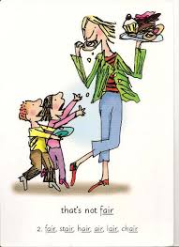
Today’s sound is air. Can you say air, air, air to your adult?
Look at the picture on your left. What can you see?
Can you see that the grown up is eating the cake? That’s right, the children are saying “that’s not fair”
Let’s Fred Talk some ‘air’ words.
h air f air s t air
On the other side of the card is the digraph, air.
These letters are
special friends.
They are three letters that make one sound. When we see them we say,
air.
When we see the picture side we say,
“that’s not fair”

Slide 10
Below, I have given you some cards. Point to each one and say air or that’s not fair.
Now let’s have a go at writing the sound air. You already know how to form each letter. Now we simply put them together to write the sound air
Now have a turn on your own. Keep practising until you get it right.

Slide 11
Set 2 Sounds
Now its time to Fred talk, read the word. Let me show you.
Here is my green word.
I am going to point to the button below each sound and say it out loud. This is Fred Talk.
f air, after sounding out the word remember to read the word, fair. I have now read the word.
Now time to read some words including ‘air’. You could even practise writing these words!

Slide 12
Recap: Set 3 Sounds
Skip this slide if your child is not focusing on this set.
Today’s sound:
Please click the link or copy the below link into the internet:
https://www.youtube.com/watch?v=jmR3fRRwNB8&list=PLPVrkr0oJX1smTl2RWUHKgvupRrMZkKEE&index=3
Or copy the below into YouTube:
‘Phonic Lesson - Set 3 ‘a-e’ sound for Reception and Year 1’ – Early Years Learning is Fun
Can you think of any words with the ‘a-e’ sound in it?

Slide 13
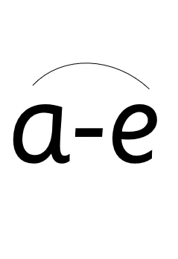
Today’s sound is a-e. It is pronounced ‘ay’. Can you say a-e, a-e, a-e to your adult?
Look at the picture on your left. What can you see?
They are making a cake.
“Make a cake.”
Let’s Fred Talk some ‘a-e’ words.
m a k e c a k e s a k e
On the other side of the card is the diagraph, a-e.
These letters are
special friends.
They are two letters that make one sound. When we see them we say,
a-e.
When we see the picture side we say,
“make a cake”

Slide 14
Below, I have given you some cards. Point to each one and say a-e or make a cake.
Now let’s have a go at writing the sound a-e. You already know how to form each letter. Now we simply put them together to write the sound a-e.
Now have a turn on your own. Keep practising until you get it right.

Slide 15
Set 3 Sounds
Now its time to Fred talk, read the word. Let me show you.
Here is my green word.
I am going to point to the button below each sound and say it out loud. This is Fred Talk.
m a k e after sounding out the word remember to read the word, make. I have now read the word.
Now time to read some words including ‘a-e’. You could even practise writing these words!

Slide 16
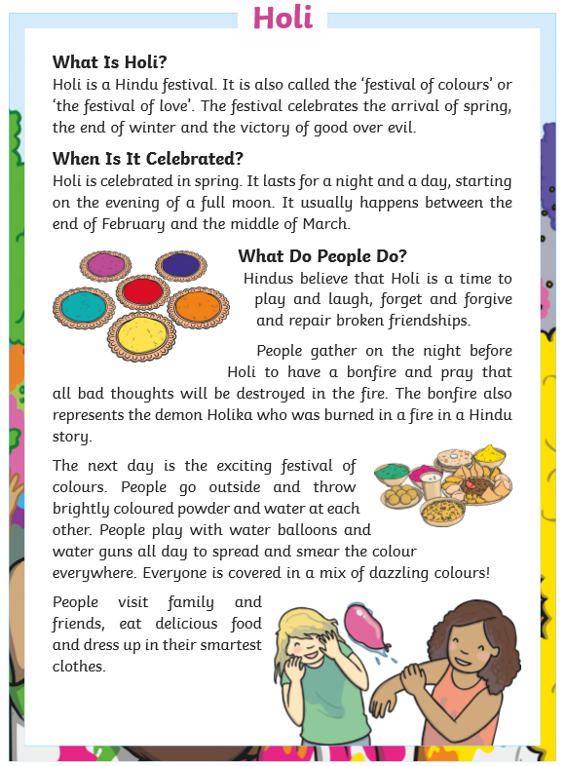
Guided Reading
Page 1
Read the text below before answering the questions on the following slides.

Slide 17
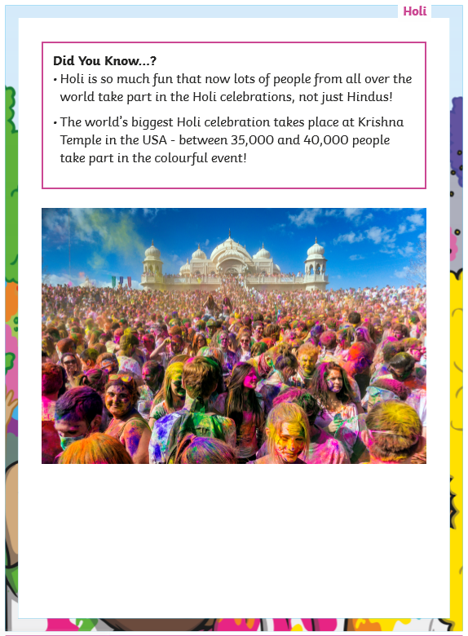
Guided Reading
Page 2
Read the text below before answering the questions on the following slides.

Slide 18
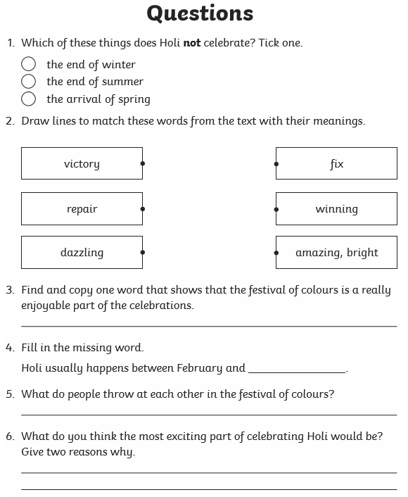
Questions

Slide 19
Date: Tuesday 2nd March
LO To be able to practise phonics sounds.
LO To be able to answer questions about a text.
Please practise phonics every day for 20 minutes.
Subject: Phonics

Slide 20
Set 1 Sounds
Skip this slide if your child is not focusing on this set.
Today’s sound:
Please click the link or copy the below link into the internet:
https://www.youtube.com/watch?v=ubPp5aRh1y8&list=PLPVrkr0oJX1tBTpbocNce93WUH8G-um6A&index=22
Or copy the below into YouTube:
‘Phonic Lesson - Set 1 Sound - Learning to Read and Write “v" for Reception and Year 1’ – Early Years Learning is Fun
Scavenger Hunt!
What can you find in your house that begins with v?

Slide 21
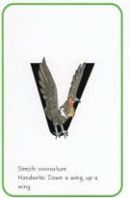
Today’s sound is v. Can you say vvvvv to your adult?
I have some pictures of things that begin with the sound v.
Try saying them out loud to your adult.
v v vet
v v van
v v vase
Hiding behind the vulture is the grapheme v. Can you point to it and say v?
When you see this side of the card say v.
Look at the picture on the left.
That is a
vulture.
When you see this picture, as quick as you can say vulture.

Slide 22
Below, I have given you some cards. Point to each one and say vulture or v.
Now let’s have a go at writing the sound v. Use your finger and move it over the picture card saying, “Down a wing, up a wing” or vvvvvv until you have traced the whole grapheme.
Now have a turn on your own. Keep practising until you get it right.

Slide 23
Set 1 Sounds
Now its time to Fred talk, read the word. Let me show you.
Here is my green word.
I am going to point to the button below each sound and say it out loud. This is Fred Talk.
v e t, after sounding out the word remember to read the word, vet. I have now read the word.
Now time to read some words including ‘v’. You could even practise writing these words!
van

Slide 24
Recap: Set 2 Sounds
Skip this slide if your child is not focusing on this set.
Today’s sound:
Please click the link or copy the below link into the internet:
https://www.youtube.com/watch?v=Wh7TpEK6TIY&list=PLPVrkr0oJX1sBGLJU2hNbPE2neuhezWSu&index=10
Or copy the below into YouTube:
‘‘Phonics Lesson - Set 2 ‘ir' sound for Reception and Year 1’
Can you think of any words with the ‘ir’ sound in it?

Slide 25
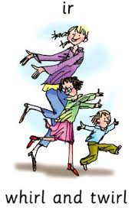
Today’s sound is ir. Can you say ir, ir, ir to your adult?
Look at the picture on your left. What can you see?
Can you see the people dancing? They are whirling and twirling
“whirl and twirl”
Let’s Fred Talk some ‘ir’ words.
wh ir l t w ir l d ir t
On the other side of the card is the digraph, ir.
These letters are
special friends.
They are two letters that make one sound. When we see them we say,
ir.
When we see the picture side we say,
“whirl and twirl”

Slide 26
Below, I have given you some cards. Point to each one and say ir or whirl and twirl.
Now let’s have a go at writing the sound ir. You already know how to form each letter. Now we simply put them together to write the sound ir
Now have a turn on your own. Keep practising until you get it right.

Slide 27
Set 2 Sounds
Now its time to Fred talk, read the word. Let me show you.
Here is my green word.
I am going to point to the button below each sound and say it out loud. This is Fred Talk.
g ir l, after sounding out the word remember to read the word, girl. I have now read the word.
Now time to read some words including ‘ir’. You could even practise writing these words!

Slide 28
Recap: Set 3 Sounds
Skip this slide if your child is not focusing on this set.
Today’s sound:
Please click the link or copy the below link into the internet:
https://www.youtube.com/watch?v=SFW1vnaXZBI&list=PLPVrkr0oJX1smTl2RWUHKgvupRrMZkKEE&index=4
Or copy the below into YouTube:
‘Phonic Lesson - Set 3 ‘i-e’ sound for Reception and Year 1’ – Early Years Learning is Fun
Can you think of any words with the ‘i-e’ sound in it?

Slide 29
Today’s sound is i-e. It is pronounced ‘igh’. Can you say i-e, i-e, i-e to your adult?
Look at the picture on your left. What can you see?
A boy smiling? He has a nice smile.
“Nice smile”
Let’s Fred Talk some ‘i-e’ words.
l i k e sm i l e sl i m e
On the other side of the card is the digraph, i-e.
These letters are
special friends.
They are two letters that make one sound. When we see them we say,
i-e.
When we see the picture side we say,
“nice smile”

Slide 30
Below, I have given you some cards. Point to each one and say i-e or nice smile.
Now let’s have a go at writing the sound i-e. You already know how to form each letter. Now we simply put them together to write the sound tion
Now have a turn on your own. Keep practising until you get it right.

Slide 31
Set 3 Sounds
Now its time to Fred talk, read the word. Let me show you.
Here is my green word.
I am going to point to the button below each sound and say it out loud. This is Fred Talk.
l i k e, after sounding out the word remember to read the word, like. I have now read the word.
Now time to read some words including ‘i-e’. You could even practise writing these words!

Slide 32
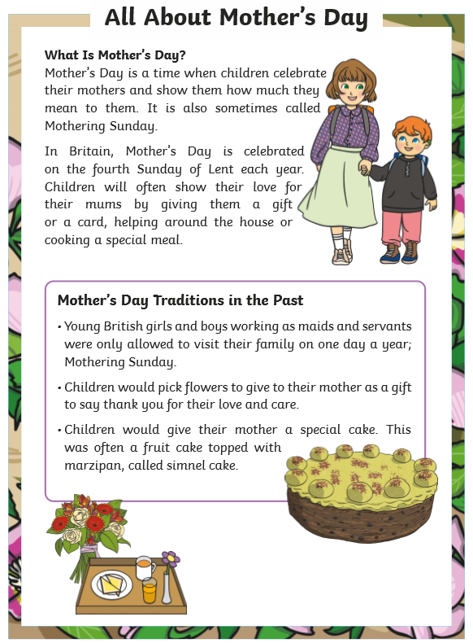
Guided Reading
Page 1
Read the text below before answering the questions on the following slides.

Slide 33
Guided Reading
Page 2
Read the text below before answering the questions on the following slides.

Slide 34
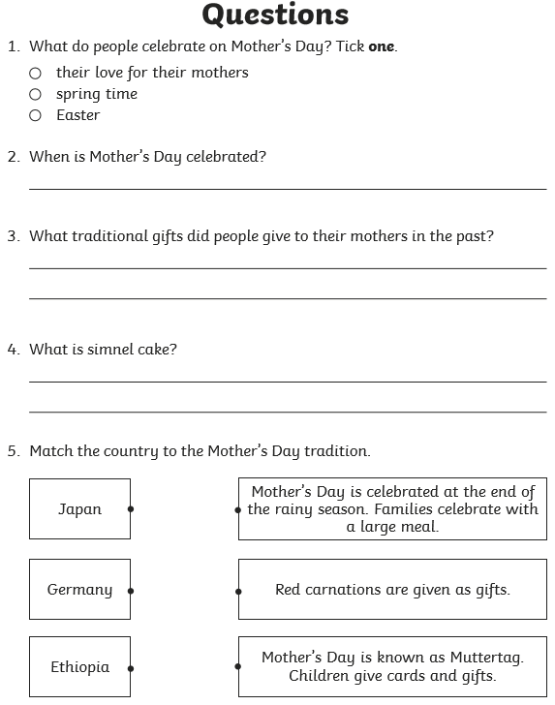
Questions

Slide 35
Date: Wednesday 3rd March.
LO To be able to practise phonics sounds.
LO To be able to answer questions about a text.
Please practise phonics every day for 20 minutes.
Subject: Phonics

Slide 36
Set 1 Sounds
Skip this slide if your child is not focusing on this set.
Today’s sound:
Please click the link or copy the below link into the internet:
https://www.youtube.com/watch?v=gNgcMGwMcek&list=PLPVrkr0oJX1tBTpbocNce93WUH8G-um6A&index=23
Or copy the below into YouTube:
‘Phonic Lesson - Set 1 Sound - Learning to Read and Write “y" for Reception and Year 1’ – Early Years Learning is Fun
Scavenger Hunt!
What can you find in your house that begins with y?

Slide 37
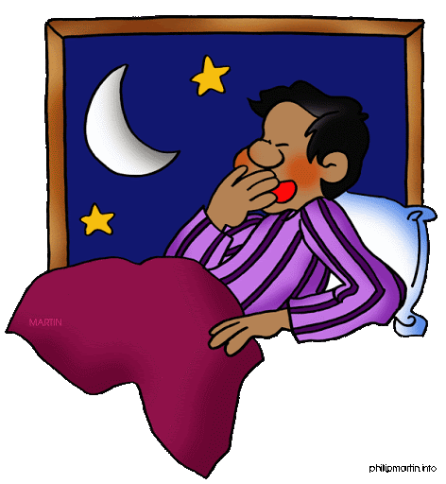
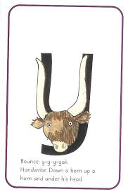
Today’s sound is y. Can you say y, y, y to your adult?
I have some pictures of things that begin with the sound y.
Try saying them out loud to your adult.
y y yoyo
y y yawn
Look at the picture on the left.
That is a
yak.
When you see this picture, as quick as you can say yak.
Hiding behind the yak is the grapheme y. Can you point to it and say y?
When you see this side of the card say y.

Slide 38
Below, I have given you some cards. Point to each one and say yak or y.
Now let’s have a go at writing the sound y. Use your finger and move it over the picture card saying, “Down a horn, up a horn, under its head” or y y y until you have traced the whole grapheme.
Now have a turn on your own. Keep practising until you get it right.

Slide 39
Set 1 Sounds
Now its time to Fred talk, read the word. Let me show you.
Here is my green word.
I am going to point to the button below each sound and say it out loud. This is Fred Talk.
y e s, after sounding out the word remember to read the word, yes. I have now read the word.
Now time to read some words including ‘y’. You could even practise writing these words!

Slide 40
Recap: Set 2 Sounds
Skip this slide if your child is not focusing on this set.
Today’s sound:
Please click the link or copy the below link into the internet:
https://www.youtube.com/watch?v=WIxsvUbulYY&list=PLPVrkr0oJX1sBGLJU2hNbPE2neuhezWSu&index=11
Or copy the below into YouTube:
‘Phonics Lesson - Set 2 'ou' sound for Reception and Year 1’
Can you think of any words with the ‘ou’ sound in it?

Slide 41
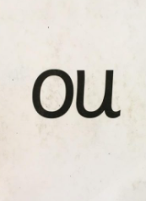
Today’s sound is ou. Can you say ou, ou, ou to your adult?
Look at the picture on your left. What can you see?
Can you see the people shouting?
“shout it out”
Let’s Fred Talk some ‘ou’ words.
ou t sh ou t l ou d
On the other side of the card is the digraph, ou.
These letters are
special friends.
They are two letters that make one sound. When we see them we say,
ou.
When we see the picture side we say,
“shout it out”

Slide 42
Below, I have given you some cards. Point to each one and say ou or shout it out.
Now let’s have a go at writing the sound ou. You already know how to form each letter. Now we simply put them together to write the sound ou
Now have a turn on your own. Keep practising until you get it right.

Slide 43
Set 2 Sounds
Now its time to Fred talk, read the word. Let me show you.
Here is my green word.
I am going to point to the button below each sound and say it out loud. This is Fred Talk.
ou t, after sounding out the word remember to read the word, out. I have now read the word.
Now time to read some words including ‘ou’. You could even practise writing these words!

Slide 44
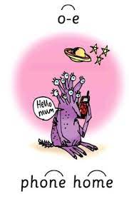
Recap: Set 3 Sounds
Skip this slide if your child is not focusing on this set.
Today’s sound:
Please click the link or copy the below link into the internet:
https://www.youtube.com/watch?v=VZ6UpWKjzog&list=PLPVrkr0oJX1smTl2RWUHKgvupRrMZkKEE&index=5
Or copy the below into YouTube:
‘Phonic Lesson - Set 3 sound split diagraph ‘o-e’ for foundation stage and Year 1’ – Early Years Learning is Fun
Can you think of any words with the ‘o-e’ sound in it?

Slide 45
Today’s sound is o-e. This is pronounced ‘oh’. Can you say o-e, o-e, o-e to your adult?
Look at the picture on your left. What can you see?
Can you see the alien phoning home?
“phone home”
Let’s Fred Talk some ‘o-e’ words.
h o m e h o p e
On the other side of the card is the digraph, o-e.
These letters are
special friends.
They are two letters that make one sound. When we see them we say,
o-e.
When we see the picture side we say,
“phone home”

Slide 46
Below, I have given you some cards. Point to each one and say o-e or phone home.
Now let’s have a go at writing the sound o-e. You already know how to form each letter. Now we simply put them together to write the sound o-e
Now have a turn on your own. Keep practising until you get it right.

Slide 47
Set 3 Sounds
Now its time to Fred talk, read the word. Let me show you.
Here is my green word.
I am going to point to the button below each sound and say it out loud. This is Fred Talk.
h o m e, after sounding out the word remember to read the word, home. I have now read the word.
Now time to read some words including ‘o-e’. You could even practise writing these words!

Slide 48
Guided Reading
Page 1
Read the text below before answering the questions on the following slides.

Slide 49
Guided Reading
Page 2
Read the text below before answering the questions on the following slides.

Slide 50
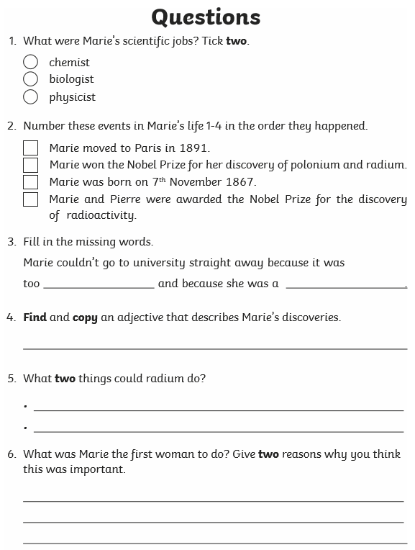
Questions

Slide 51
Date: Thursday 4th March
LO To be able to practise phonics sounds.
LO To be able to answer questions about a text.
Please practise phonics every day for 20 minutes.
Subject: Phonics

Slide 52
Set 1 Sounds
Skip this slide if your child is not focusing on this set.
Today’s sound:
Please click the link or copy the below link into the internet:
https://www.youtube.com/watch?v=fLl_rD-fnA0&list=PLPVrkr0oJX1tBTpbocNce93WUH8G-um6A&index=24
Or copy the below into YouTube:
‘Phonic Lesson - Set 1 Sound - Learning to Read and Write “w" for Reception and Year 1’ – Early Years Learning is Fun
Scavenger Hunt!
What can you find in your house that begins with w?

Slide 53
Today’s sound is w. Can you say w, w, w to your adult?
I have some pictures of things that begin with the sound w.
Try saying them out loud to your adult.
w w worm
w w web
w w window
Hiding behind the worm is the grapheme w. Can you point to it and say w?
When you see this side of the card say w.
Look at the picture on the left.
That is a
worm.
When you see this picture, as quick as you can say worm.

Slide 54
Below, I have given you some cards. Point to each one and say worm or w.
Now let’s have a go at writing the sound w. Use your finger and move it over the picture card saying, “Down, up, down, up” or w w w until you have traced the whole grapheme.
Now have a turn on your own. Keep practising until you get it right.

Slide 55
Set 1 Sounds
Now its time to Fred talk, read the word. Let me show you.
Here is my green word.
I am going to point to the button below each sound and say it out loud. This is Fred Talk.
w e t, after sounding out the word remember to read the word, wet. I have now read the word.
Now time to read some words including the sound ‘w’. You could even practise writing these words!

Slide 56
Recap: Set 2 Sounds
Skip this slide if your child is not focusing on this set.
Today’s sound:
Please click the link or copy the below link into the internet:
https://www.youtube.com/watch?v=x1nuoVWUix8&list=PLPVrkr0oJX1sBGLJU2hNbPE2neuhezWSu&index=12
Or copy the below into YouTube:
‘Phonics Lesson - Set 2 'oy' sound for Reception and Year 1’
Can you think of any words with the ‘oy’ sound in it?

Slide 57
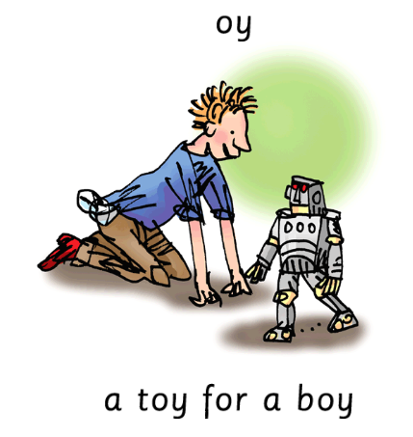
Today’s sound is oy. Can you say oy, oy, oy to your adult?
Look at the picture on your left. What can you see?
Can you see the boy playing with a toy?
“toy for a boy”
Let’s Fred Talk some ‘oy’ words.
t oy b oy e n j oy
On the other side of the card is the digraph, oy.
These letters are
special friends.
They are two letters that make one sound. When we see them we say,
oy.
When we see the picture side we say,
“toy for a boy”

Slide 58
Below, I have given you some cards. Point to each one and say oy or toy for a boy.
Now let’s have a go at writing the sound oy. You already know how to form each letter. Now we simply put them together to write the sound oy
Now have a turn on your own. Keep practising until you get it right.

Slide 59
Set 2 Sounds
Now its time to Fred talk, read the word. Let me show you.
Here is my green word.
I am going to point to the button below each sound and say it out loud. This is Fred Talk.
b oy, after sounding out the word remember to read the word, boy. I have now read the word.
Now time to read some words including ‘oy’. You could even practise writing these words!

Slide 60
Recap: Set 3 Sounds
Skip this slide if your child is not focusing on this set.
Today’s sound:
Please click the link or copy the below link into the internet:
https://www.youtube.com/watch?v=cYz1eGqWAsE&list=PLPVrkr0oJX1smTl2RWUHKgvupRrMZkKEE&index=6
Or copy the below into YouTube:
‘Phonic Lesson - Set 3 sound split diagraph ‘u-e’ for foundation stage and Year 1’ – Early Years Learning is Fun
Can you think of any words with the ‘u-e’ sound in it?

Slide 61
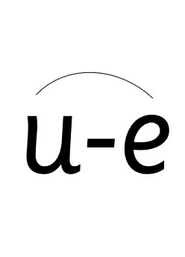
Today’s sound is u-e. This is pronounced ‘oo’. Can you say u-e, u-e, u-e to your adult?
Look at the picture on your left. What can you see?
Can you see a brute? It is huge.
“Huge brute”
Let’s Fred Talk some ‘u-e’ words.
R u d e h u g e j u n e
On the other side of the card is the digraph, u-e.
These letters are
special friends.
They are two letters that make one sound. When we see them we say,
u-e.
When we see the picture side we say,
“huge brute”

Slide 62
Below, I have given you some cards. Point to each one and say u-e or huge brute.
Now let’s have a go at writing the sound u-e. You already know how to form each letter. Now we simply put them together to write the sound u-e
Now have a turn on your own. Keep practising until you get it right.

Slide 63
Set 3 Sounds
Now its time to Fred talk, read the word. Let me show you.
Here is my green word.
I am going to point to the button below each sound and say it out loud. This is Fred Talk.
r u d e, after sounding out the word remember to read the word, rude. I have now read the word.
Now time to read some words including ‘u-e’. You could even practise writing these words!

Slide 64
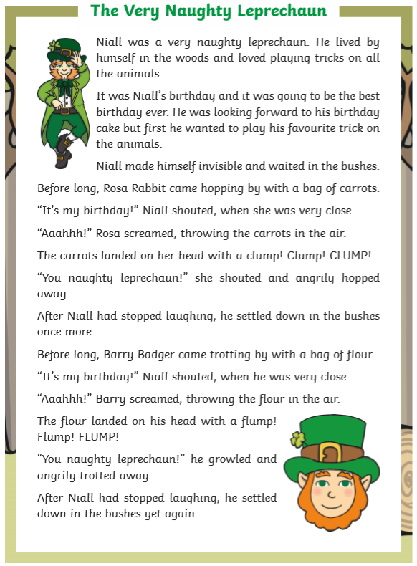
Guided Reading
Page 1
Read the text below before answering the questions on the following slides.

Slide 65
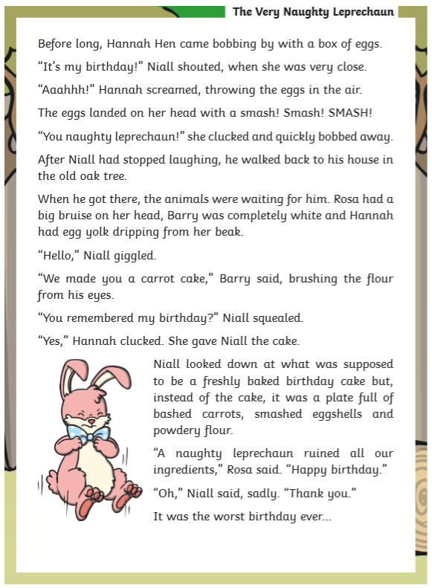
Guided Reading
Page 2
Read the text below before answering the questions on the following slides.

Slide 66
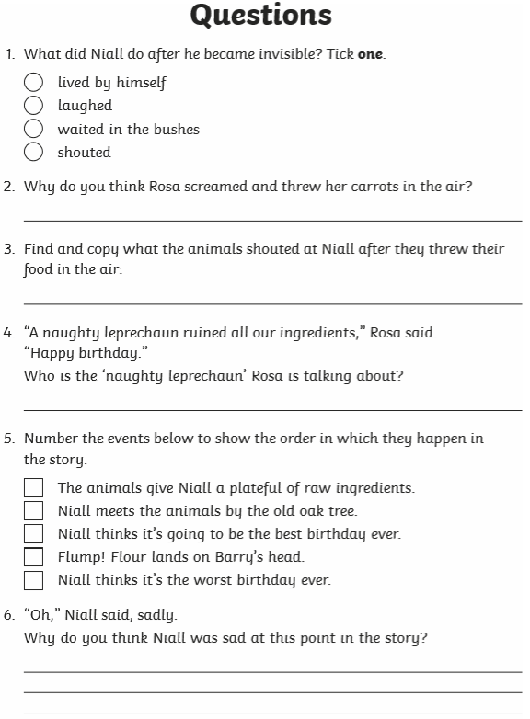
Questions

Slide 67
Date: Friday 5th March
LO To be able to practise reading and writing tricky words.
LO To be able to answer questions about a text.
Please practise phonics every day for 20 minutes.
Subject: Phonics

Slide 68
Pick a slide appropriate to your child’s ability
Read and write the red words.
These are words we cannot sound out.
If your child does not know these words, say the words and get your child to repeat.
You could also play a game of bingo. Say the words and get your child to cross out the word.

Slide 69
Pick a slide appropriate to your child’s ability
Read and write the red words.
These are words we cannot sound out.
If your child does not know these words, say the words and get your child to repeat.
You could also play a game of bingo. Say the words and get your child to cross out the word.

Slide 70
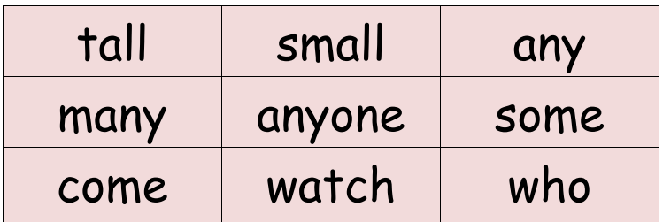
Pick a slide appropriate to your child’s ability
Read and write the red words.
These are words we cannot sound out.
If your child does not know these words, say the words and get your child to repeat.
You could also play a game of bingo. Say the words and get your child to cross out the word.

Slide 71
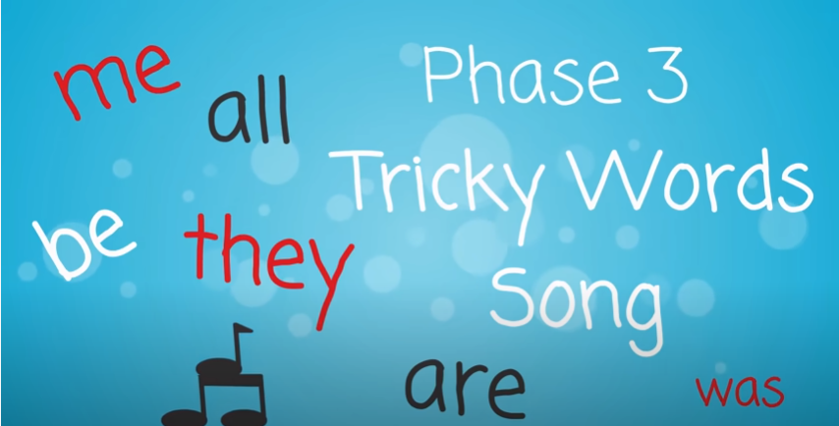
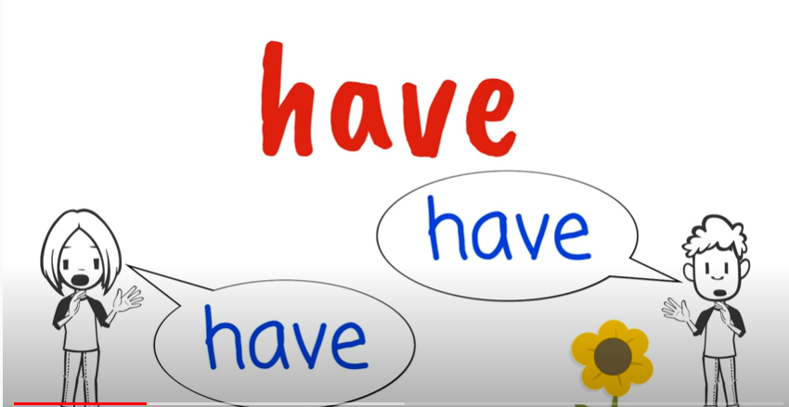
Tricky Words!
https://www.youtube.com/watch?v=TvMyssfAUx0
‘Tricky Words and Sight Words Song’ - YouTube
https://www.youtube.com/watch?v=R087lYrRpgY&t=2s
‘Phase 3 Say Hello To’ - YouTube
https://www.youtube.com/watch?v=3NOzgR1ANc4
‘Phase 4 Tricky Words Song’ - YouTube

Slide 72
Games & Videos!
https://www.phonicsplay.co.uk/resources
Username: jan21
Password: home
https://www.bbc.co.uk/bitesize/topics/zcqqtfr
https://www.phonicsbloom.com/
https://www.bbc.co.uk/cbeebies/shows/alphablocks
https://www.youtube.com/channel/UC_qs3c0ehDvZkbiEbOj6Drg

Slide 73
Daily Phonics Videos
Click the below link, copy and paste into the internet or search ‘Ruth Miskin Training’ in YouTube to see daily phonics videos.
Read Write Inc are offering free phonics lessons on YouTube. Videos for all abilities are available.
They are posted at 9.30am and are available for 24 hours.
https://www.youtube.com/channel/UCo7fbLgY2oA_cFCIg9GdxtQ

Slide 74
Guided Reading
Page 1
Read the text below before answering the questions on the following slides.

Slide 75
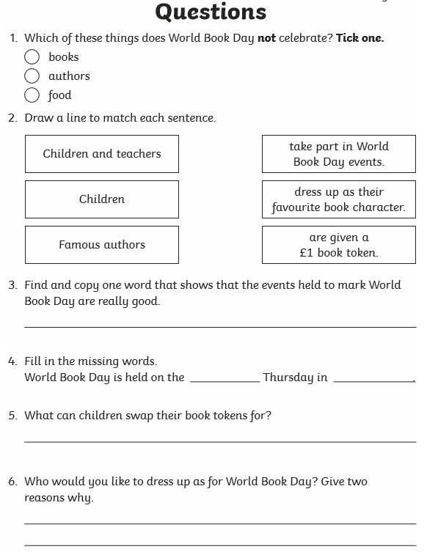
Questions

