Slide 1
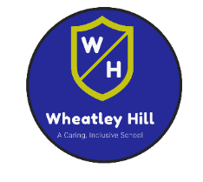


Remote Learning - Base 5
W.B. 04.01.21
English

Slide 2
Hello!
In English this week we will revisit some of the skills we have learned so far. When we all return to school, we will begin our new topic and learn some new writing skills.
Please keep any work you complete / photographs and bring them into school when you return so we can add them to your books / journals.
If you have any questions please don’t hesitate to contact us at school.
Mollie ☺

Slide 3


Date: Tuesday 5th January 2021
L.O. To assess knowledge of speed sounds
Subject: Phonics

Slide 4
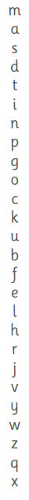


L.O. To assess knowledge of speed sounds
Task:
Read aloud each speed sound from top to bottom in your whisper voice. If you get them all right – try again using your GIANT voice.
Challenge – ask an adult to point to a speed sound at random and see if you can tell them what it is.
Speed Sounds Video

Slide 5
Date: Tuesday 5th January 2021
L.O. To set the scene of a story using the 5 senses
Subject: English

Slide 6


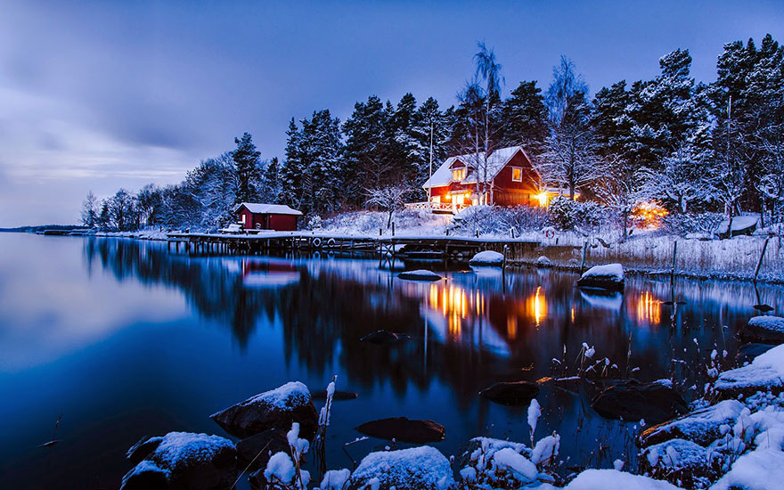



Look at the picture below – discuss or write down what you might see, hear, smell, taste and touch.

Slide 7
Date: Wednesday 6th January 2021
L.O. To read and write the ‘m’ sound
Subject: Phonics

Slide 8
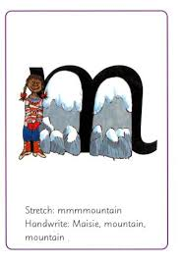
L.O. To read and write the ‘m’ sound
L.O. To practice new spellings
Video
Click on the link above to take part in a virtual interactive Read Write Inc Phonics session!
How many words can you think of that begin with
‘m’?

Slide 9
Date: Wednesday 6th January 2021
L.O. To describe a character
Subject: English

Slide 10
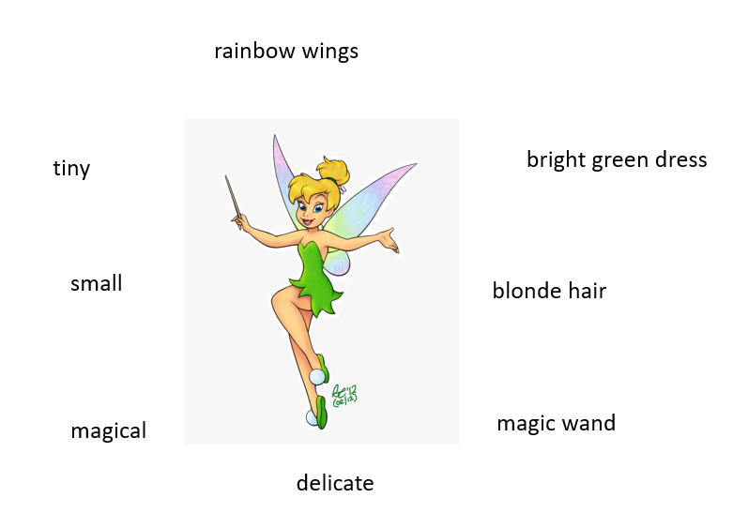
L.O. To describe a character
Task 1:
Can you draw a picture of your favourite character, then write a list of adjectives to describe them?

Slide 11
Task 2:
Can you write a description about your
character, using the adjectives you came up with in task 1?
Tinkerbell is a tiny fairy who wears a bright green dress. She is fair-skinned and has soft, blonde hair. When angered, her entire body turns fiery red!
Can you find the adjectives used to describe Tinkerbell?

Slide 12
Date: Thursday 7th January 2021
L.O. To read and write the ‘c’ sound
Subject: Phonics

Slide 13

L.O. To read and write the ‘c’ sound
Task
Video
Click on the link above to take part in a virtual, interactive phonics session.
How many words can you think of that begin with ‘c’?

Slide 14
Date: Thursday 7th January 2021
L.O. To create a story map
Subject: English

Slide 15
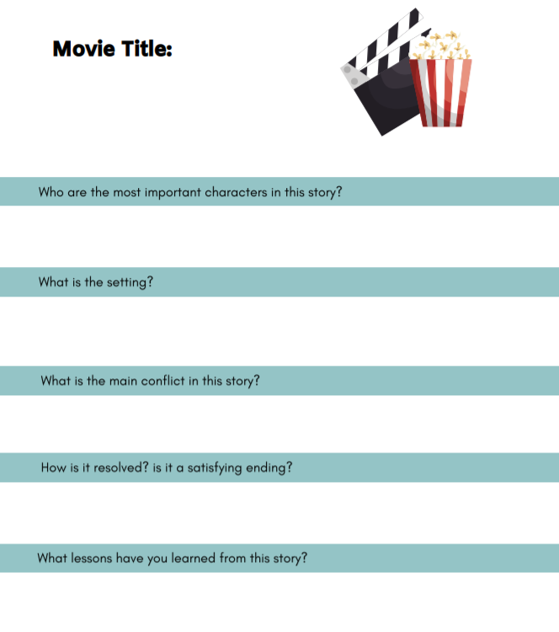
Title of the movie
Finding Nemo
Who
Main characters
Nemo, Marlin, Dory, Bruce
Where
Where is the movie set?
The Great Barrier Reef
What
What is the dilemma / problem?
Nemo is captured by a fishing boat and is taken to Sydney, where he ends up in a dentists fish tank!
How
How is the problem solved?
Marlin ventures off to find Nemo and meets a friend, Dory, along the way. Together they eventually find Nemo after he manages to escape!

Slide 16
L.O. To create a story map
Task: Choose a movie to watch – can you answer the questions on the sheet about the storyline?
Use my example on the previous slide to help you.

Slide 17
Date: Friday 8th January 2021
L.O. To practice blending
Subject: Phonics

Slide 18
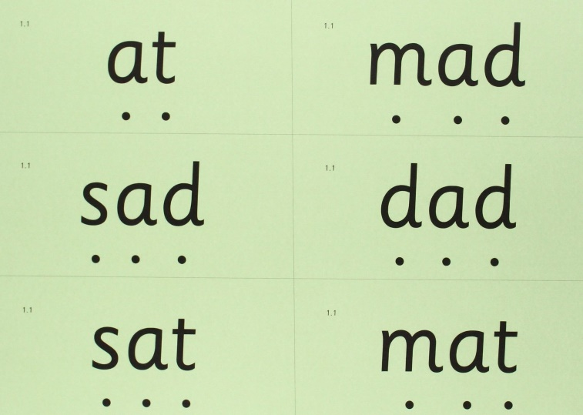
L.O. To practice blending
Use the sound buttons to segment each word, then blend to read them out loud.
Practice writing each word 3 times.
Blending CVC words – Video
Phonics Play Resources
Click on the link above to access a range of free Phonics blending games ☺

Slide 19
Date: Friday 8th January 2021
L.O. To write an alternative ending to a story
Subject: English

Slide 20
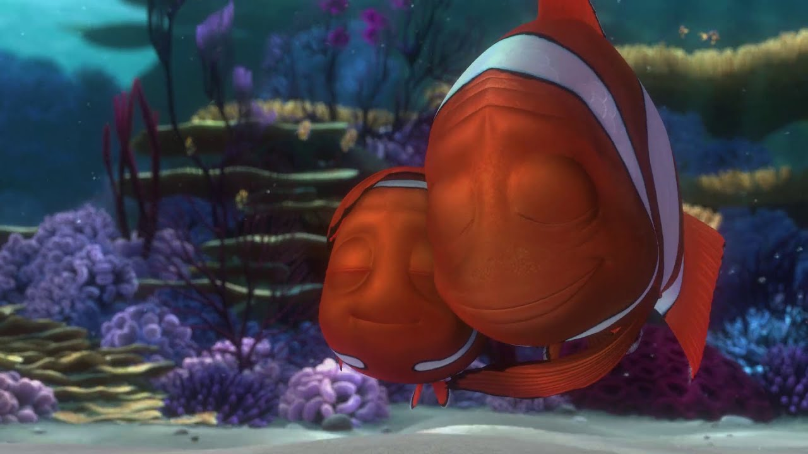
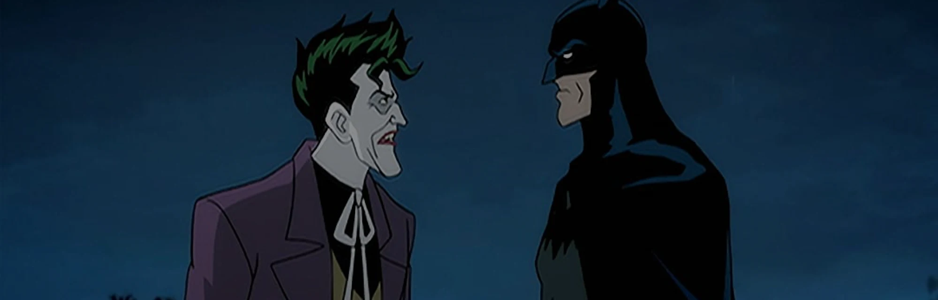
L.O. To write an alternative ending to a story
Task:
Think about the movie you watched yesterday. How did it end? Can you think of another ending that could be used for the movie instead? Write down your ideas, try to use full sentences.

