Slide 1
Date: Monday 11th January
LO To be able to match sentences that rhyme
Subject: English

Slide 2
We finished last week’s lesson with rhyming words. Can you now match the two sentences together that rhyme?
You can point at each answer?
He tried his hardest to win a golden star.
Here is a recap on some rhyming words:
flew and blue
stay and hay
ago and know
Far and star
(remember: rhyming words sound the same; but, do not always look the same)
Madam Dragon ran a school. Many moons ago.
His plaster gleaming pinkly as he zigzagged through the blue.
Zog, the biggest dragon, was the keenest one by far.
I’ll let you be my pupils’ pet, and feed you lots of hay.
“ What a good idea!” said Zog. Then up and off he flew.
Challenge
Can you now write 3 more sentences from the story which rhyme
Then Madam Dragon told the horse, “I really hope you’ll stay”.
She taught the young dragon all the things that dragons need to know.

Slide 3
Date: Tuesday 12th January
LO To be able to describe a setting
Subject: English

Slide 4
https://www.bbc.co.uk/iplayer/episode/b0bwdw8y/zog
Here is the link again for Zog, to recap the story before starting your task.

Slide 5
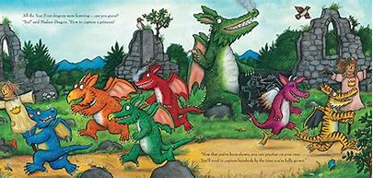
Please use the word map on the next slide to support your children.
Can you describe the setting and what is happening in the picture?

Slide 6
run
Here are some words to help you on your way?
stripped
green
smoke
blue
castle
mountain
stone
chase
Challenge
Can you now write 3 sentences using your descriptive words and a conjunction.
Conjunction are.
and, but, or, for and so

Slide 7
Date: Wednesday 13th January
LO To be able to write sentences with conjunctions.
Subject: English

Slide 8
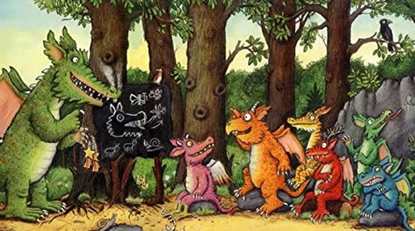
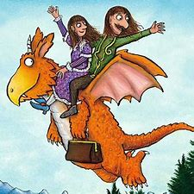
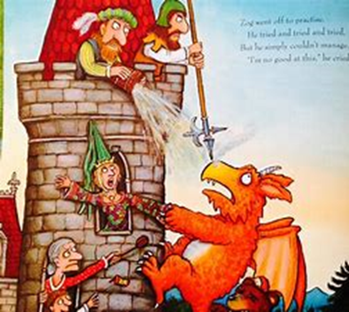
Zog went to dragon school and wanted to get a gold star
Zog tried to help the princess but the knight fought him off.
Don’t forget to use your conjunctions
conjunction
conjunction
Conjunction are.
and, but, or, for and so
Can you write 3 sentences on each picture to explain what has happened at the beginning, middle and end of the story. Please remember your capital letters, finger spaces and full stops

Slide 9
Date: Thursday 14th January
LO To be able to write a diary entry
Subject: English

Slide 10
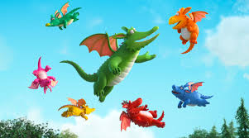
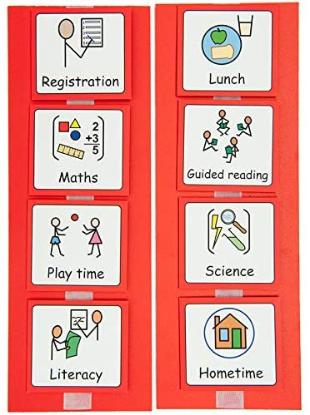
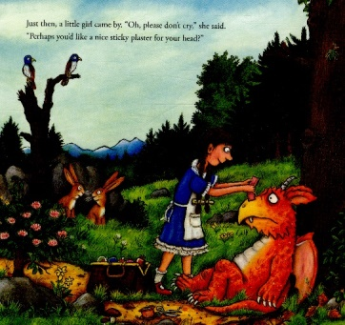
Time openers are:
Next
First
last
Before
After
Meanwhile
Then
Can you write and draw Zog a visual timetable like what you use at school? You could use time connectives to help.
For example
For Example
Zog went to Dragan School and leant how to fly.
Next, he bumped into a tree.
Then, the princess put a plaster on his head.

Slide 11
Date: Friday 15th January
LO To be able to write a persuasive letter
Subject: English

Slide 12
capture
definitely
amazing
Important
Persuasive
words for writing
best
need
believe
inspire
must
will
powerful

Slide 13
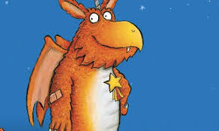
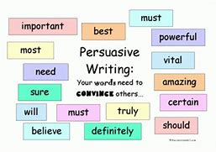
The person’s name and address
The person and place it has come from.
Do you think you can write a letter to persuade Zog to come and visit our school and see your visual time table and how amazing our school is.
Base Camp 6
Wheatley Hill School
Wheatley Hill
Dh6 3LQ
Mr Zog
10 Dragon Lane
Cliff Top
Dover
Dear Zog.
The person’s name
Your letter will need to include
Why you want him to visit school?
Who will he meet?
What will he see?
When can he visit?
How you feel about if he visits?
What lessons he will do?
The person who sent the letter
Yours Sincerely (your name)
Please use the word mat on the next slide to support your writing.

Slide 14
Date: Friday 15th January
LO To identify sh, ch and th sounds .
Subject: English

Slide 15
chocolate
ch
chips
thumb
th
three
Can you find the sounds in the word?
sh
chain
teeth
shed
ship
shop

Slide 16
Now you can identify the sounds sh, ch and th. Can you look around your home and see if you can find anything that has the same sounds in for example
Here is some websites for you to visit it has lots of fun phonics games, enjoy!
https://www.phonicsplay.co.uk/
https://www.teachyourmonstertoread.com/
Also there is a great app for ipads called Hairy phonics, its free to!

