Slide 1


Subject: Maths
Base camp 3

Slide 2



Date: Monday 7th February 2021
LO. To be able to sort shapes based on name and colour.
Subject: Maths

Slide 3
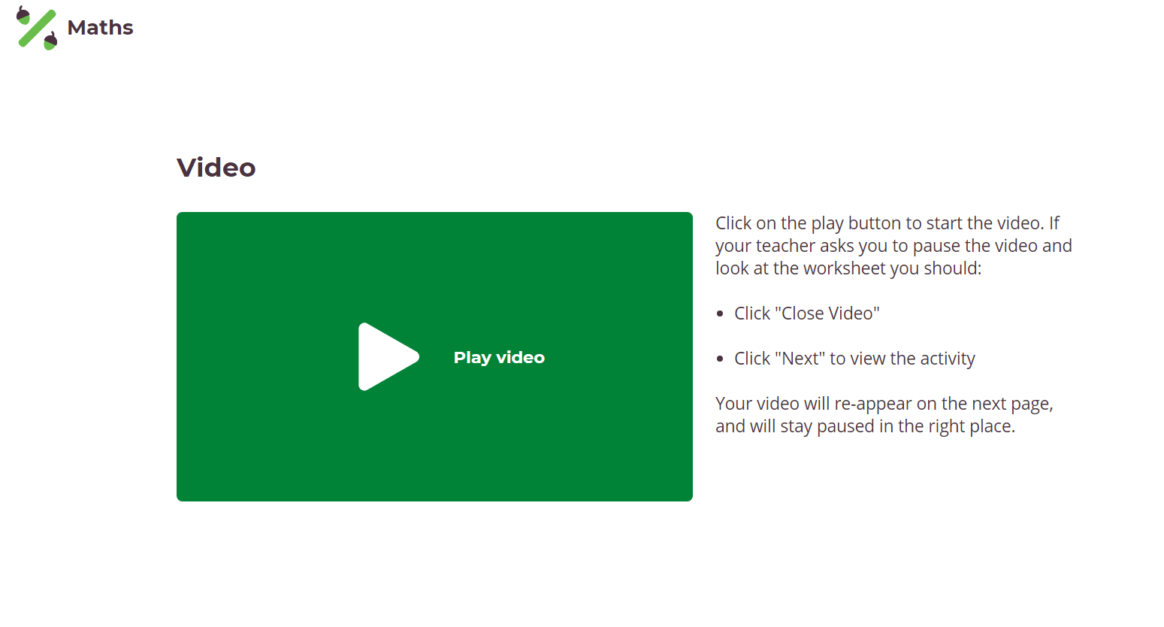

Slide 4
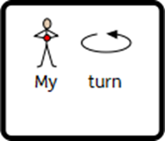







Slide 5
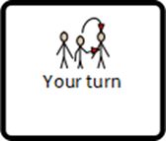

Slide 6





Slide 7




Slide 8





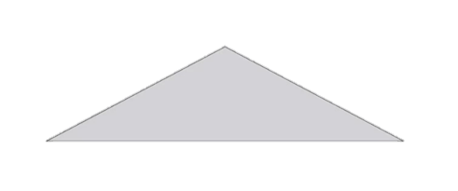

Slide 9
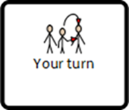

Slide 10


Slide 11
Date: Tuesday 8th February 2021
LO. To be able to sort objects according to characteristics.
Subject: Maths

Slide 12

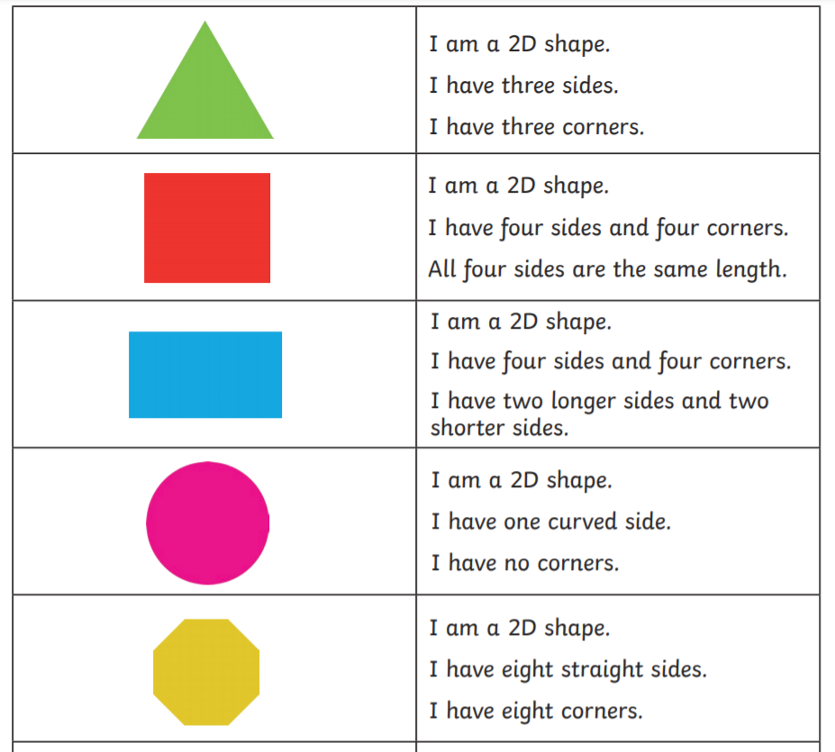


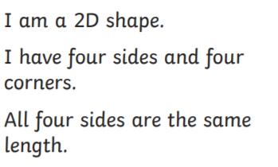

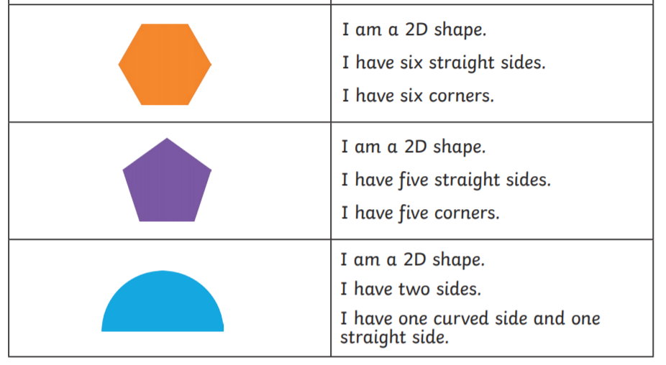

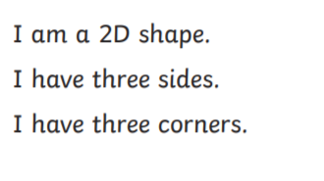

Draw a line or point to the correct answer.

Slide 13
Draw a line or point to the correct answer.

Slide 14






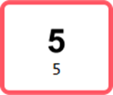
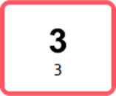
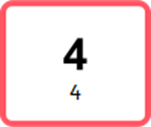




Slide 16



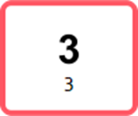

Slide 17






Slide 18
Date: Wednesday 9th February 2021
LO. To attempt to order objects by size.
Subject: Maths

Slide 19
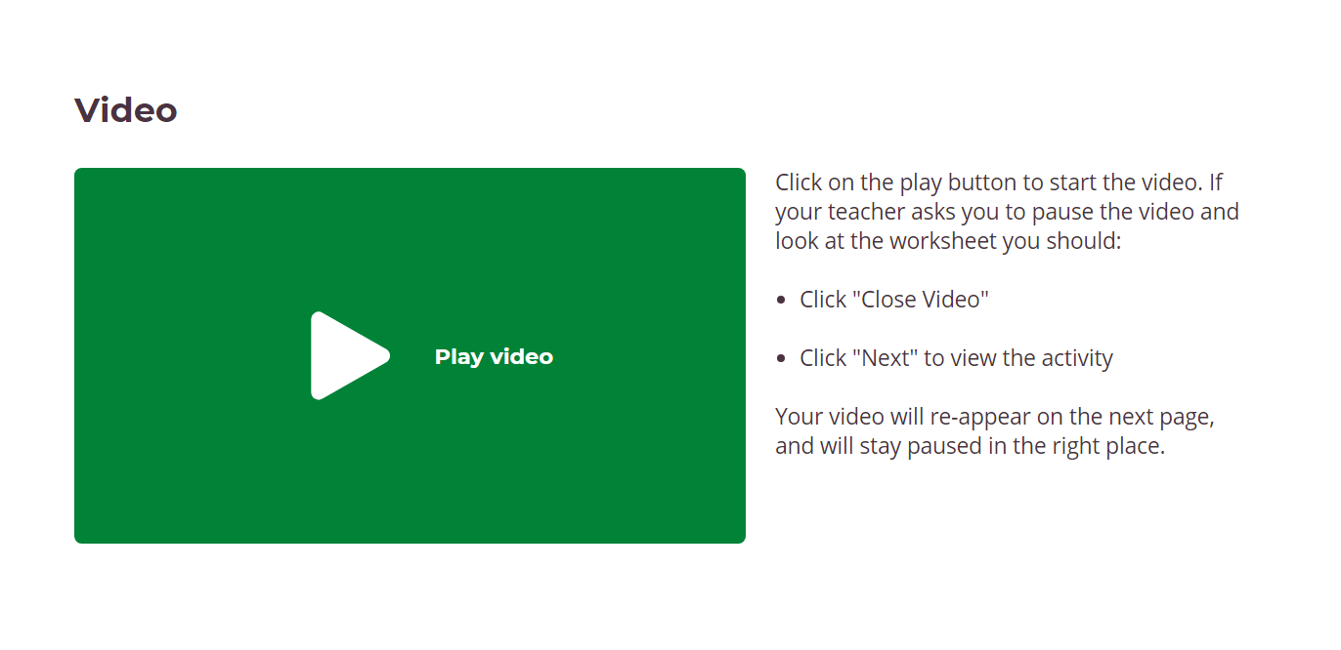

Slide 20

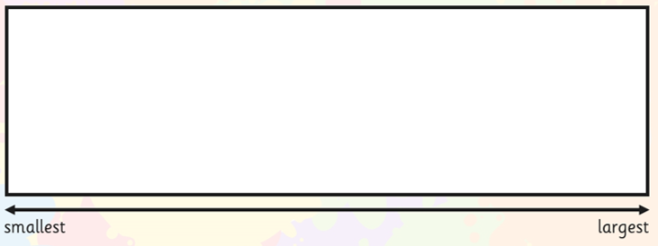





Slide 21
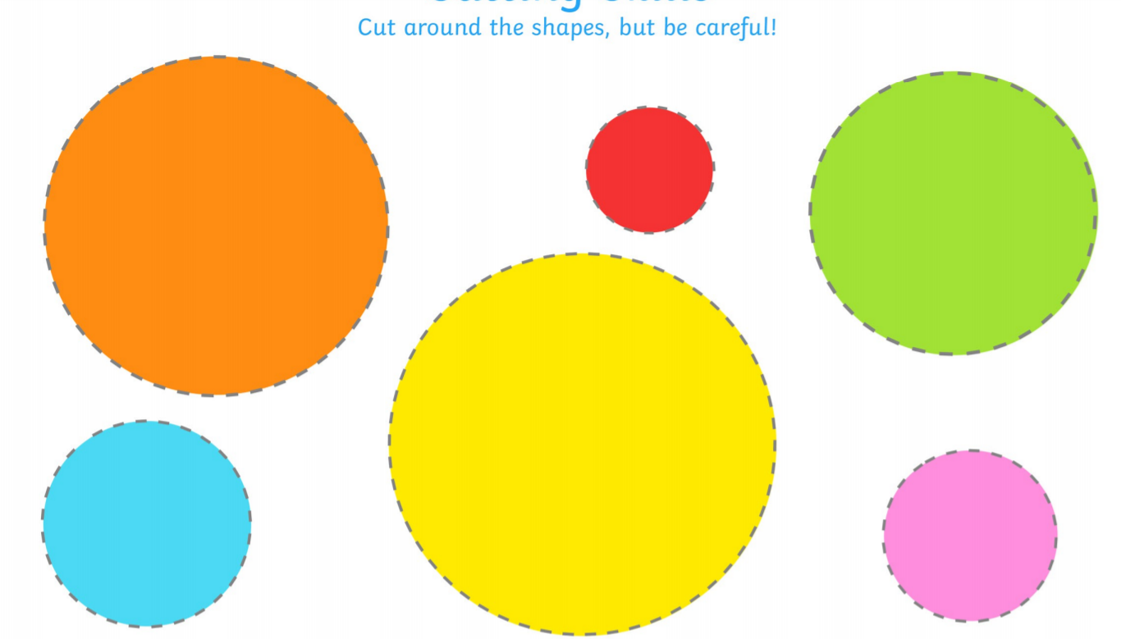
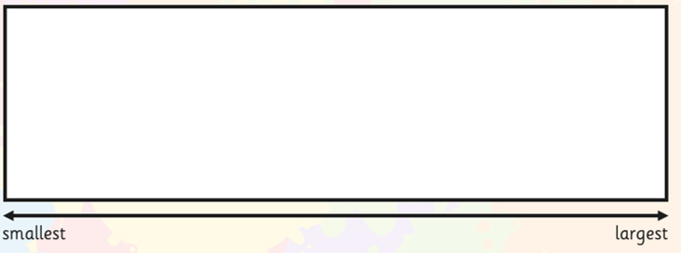

Slide 22


Slide 23


Slide 24
Date: Thursday 10th February 2021
LO. To attempt to write numbers to 10.
Subject: Maths

Slide 25

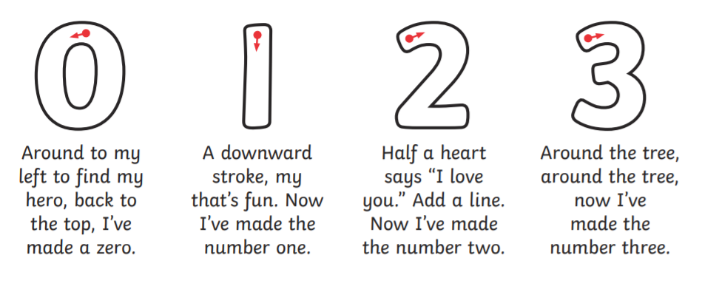

Don’t worry if you can not print off you can write these on paper.

Slide 26
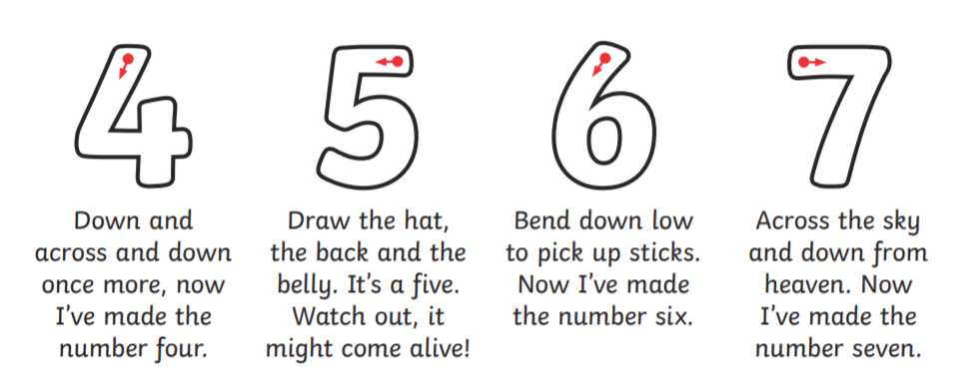


Slide 27
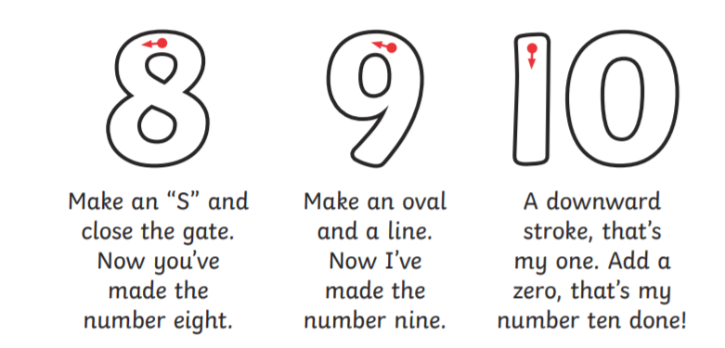


Slide 28



Challenge- Now cover up the numbers. Can your child write numbers 1-10 independently?

Slide 29
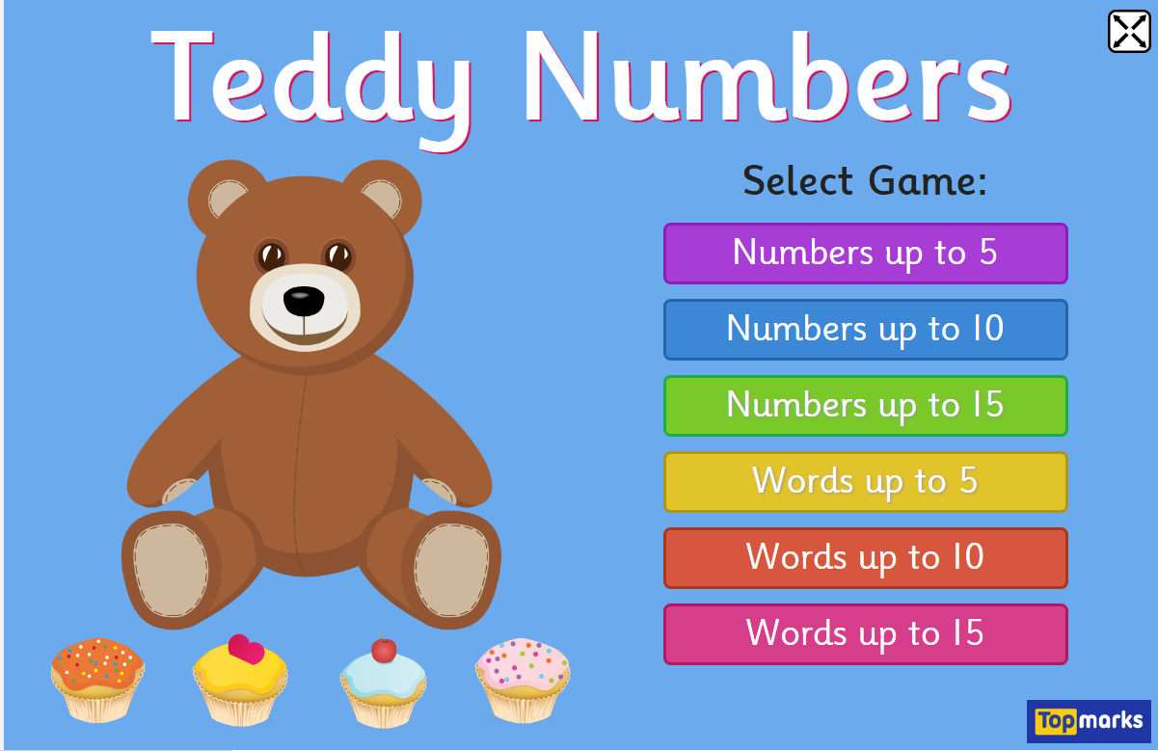

If you would like to do more numbers to 10 click the picture below to play the teddy number games.
https://www.topmarks.co.uk/learning-to-count/teddy-numbers

Slide 30
Date: Friday 11th February 2021
LO. To find 1 more.
Subject: Maths

Slide 31


Slide 32
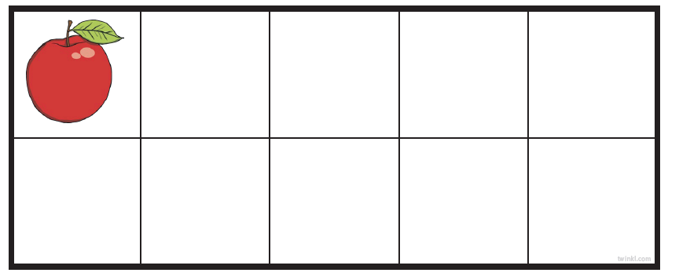

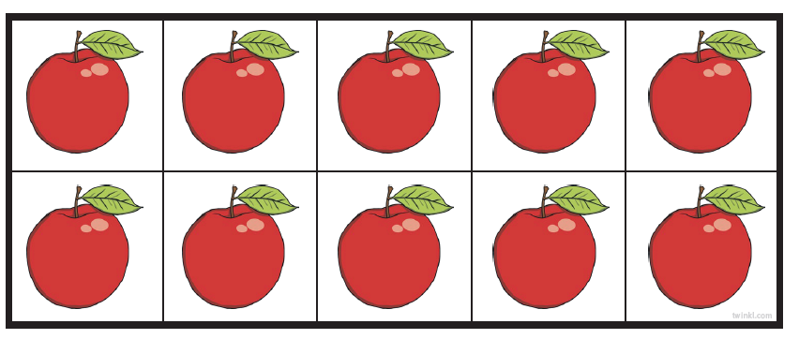



Slide 33

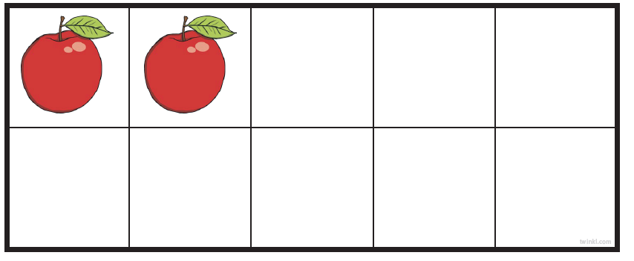
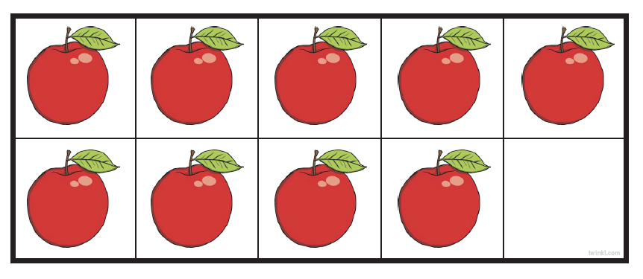
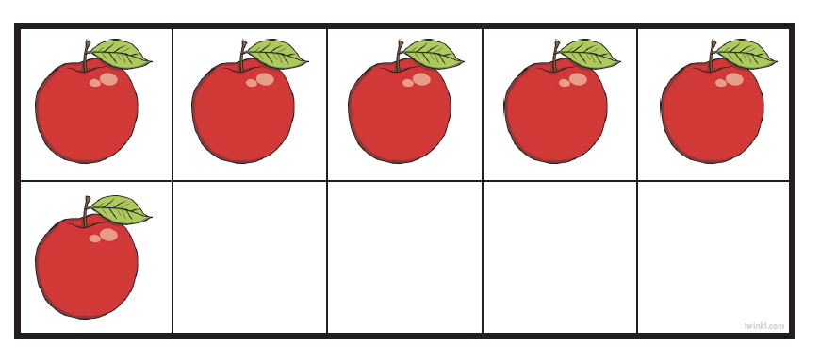
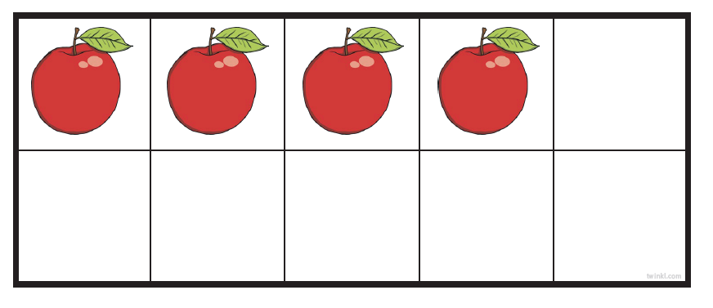

Slide 34




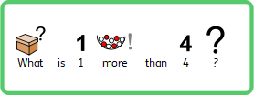


Slide 35
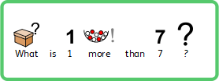




Slide 36

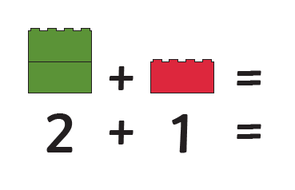
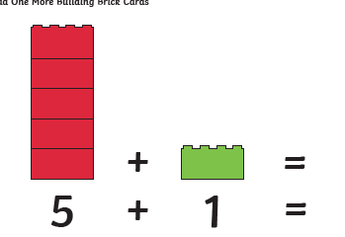
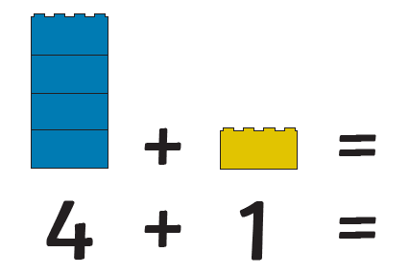
Can you write in the correct number?

Slide 37





