Slide 1


Subject: Phonics and Guided Reading

Slide 2
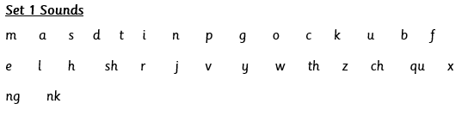

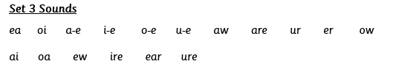
Each day we are going to focus on a different sound.
Please choose from set 1, set 2, set 3 or guided reading. Each day, for phonics, there will be a video to watch and some words to read linked to the taught sound. For guided reading, there will be a text to read and some questions to answer.
Here are the sounds which are in each set.
Please contact school if you are not sure which set your child should be focusing on, or whether you’re unsure if your child does guided reading rather than phonics.
Then, play some phonics games!
Guided Reading
For those children who know all of the phonics sounds from set 1, set 2 and set 3 and are confident readers.

Slide 3


Date: Monday 28th June
LO To be able to practise phonics sounds.
LO To be able to answer questions about a text.
Please practise phonics every day for 20 minutes.
Subject: Phonics/Guided Reading

Slide 4

Set 1 Sound
Skip this slide if your child is not focusing on this set.
Today’s sound:
Please click the link or copy the below link into the internet:
https://www.youtube.com/watch?v=TAHUPTFjvaY&list=PLPVrkr0oJX1tBTpbocNce93WUH8G-um6A&index=15
Or copy the below into YouTube:
‘Phonic Lesson - Set 1 Sound - Learning to Read and Write “b" for Reception and Year 1’ – Early Years Learning is Fun
Scavenger Hunt!
What can you find in your house that begins with b?

Slide 5

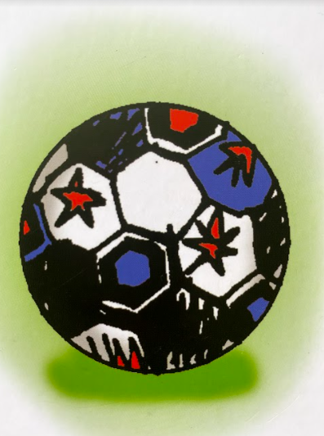
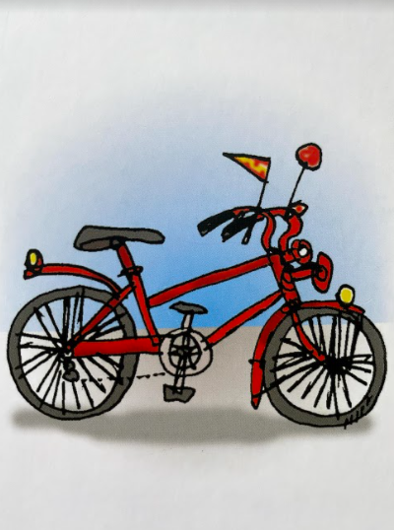
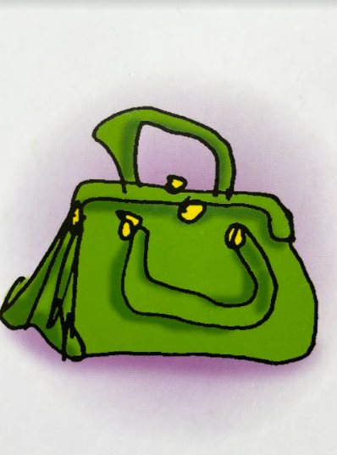
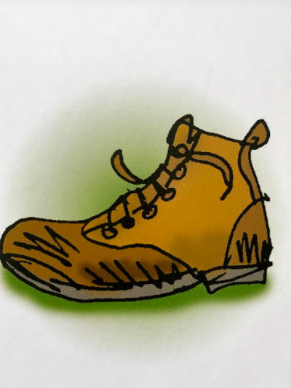
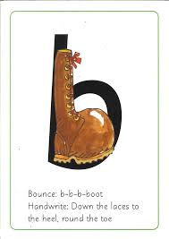

Today’s sound is b. Can you say b, b, b to your adult?
I have some pictures of things that begin with the sound b.
Try saying them out loud to your adult.
b b ball
b b bicycle
b b bag
b b boot
Hiding behind the boot is the grapheme b. Can you point to it and say b?
When you see this side of the card say b.
Look at the picture on the left.
That is a
boot.
When you see this picture, as quick as you can say boot.

Slide 6

Below, I have given you some cards. Point to each one and say boot or b.
Now let’s have a go at writing the sound b. Use your finger and move it over the picture card saying, “Down the laces to the heel, round the toe” or b b b until you have traced the whole grapheme.
Now have a turn on your own. Keep practising until you get it right.

Slide 7





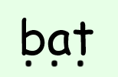
Set 1 Sounds
Now its time to Fred talk, read the word. Let me show you.
Here is my green word.
I am going to point to the button below each sound and say it out loud. This is Fred Talk.
b e d, after sounding out the word remember to read the word, bed. I have now read the word.
Now time to read some words including ‘b’. You could even practise writing these words!

Slide 8
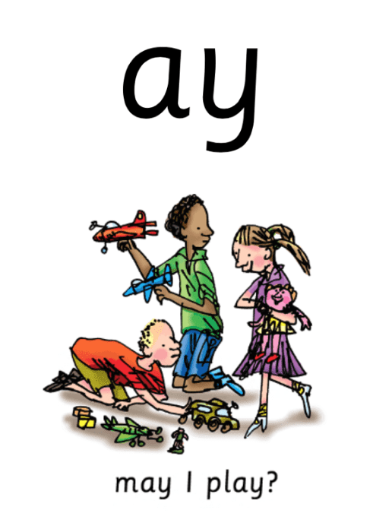
Set 2 Sound
Skip this slide if your child is not focusing on this set.
Today’s sound:
Please click the link or copy the below link into the internet:
https://www.youtube.com/watch?v=WL_-QHxJnFQ&list=PLPVrkr0oJX1sBGLJU2hNbPE2neuhezWSu
Or copy the below into YouTube:
‘Phonic Lesson - Set 2 ‘ay’ sound for Reception and Year 1’ – Early Years Learning is Fun
Can you think of any words with the ‘ay’ sound in it?

Slide 9
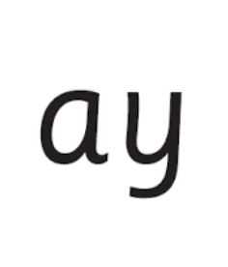
Today’s sound is ay. Can you say ay, ay, ay to your adult?
Look at the picture on your left. What can you see?
Can you see that the girls and boys are playing? Yes that’s right they are saying,
“ay, may I play?”
Let’s Fred Talk some ‘ay’ words.
s t ay p l ay s ay.
On the other side of the card is the digraph, ay.
These letters are
special friends.
They are two letters that make one sound. When we see them we say,
ay.
When we see the picture side we say,
“ay,
may I play?”

Slide 10
Below, I have given you some cards. Point to each one and say ay or may I play.
Now let’s have a go at writing the sound ay. You already know how to form each letter. Now we simply put them together to write the sound ay
Now have a turn on your own. Keep practising until you get it right.

Slide 11

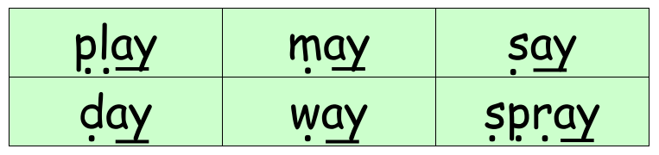
Set 2 Sounds
Now its time to Fred talk, read the word. Let me show you.
Here is my green word.
I am going to point to the button below each sound and say it out loud. This is Fred Talk.
p l ay, after sounding out the word remember to read the word, play.
I have now read the word.
Now it’s your turn. Fred talk, read the words below.

Slide 12
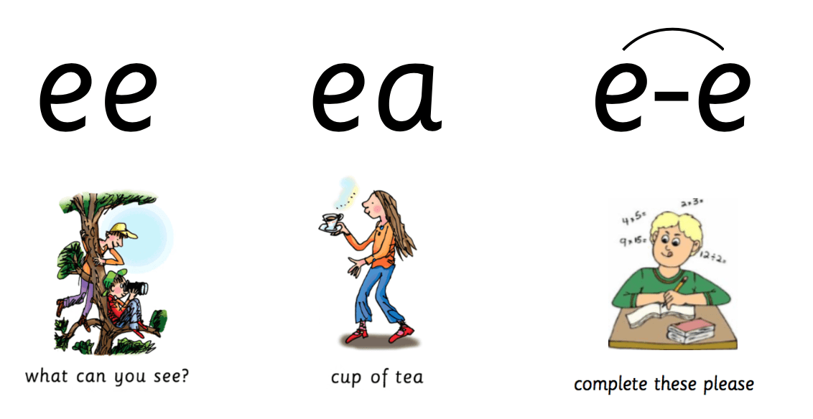
Set 3 Sound
Skip this slide if your child is not focusing on this set.
Today’s sound:
Please click the link or copy the below link into the internet:
https://www.youtube.com/watch?v=UHzu7dkn3sY&list=PLPVrkr0oJX1smTl2RWUHKgvupRrMZkKEE&index=2
Or copy the below into YouTube:
‘Phonic Lesson - Set 3 ‘ea’ sound for Reception and Year 1’ – Early Years Learning is Fun
Can you think of any words with the ‘ea’ sound in it?

Slide 13
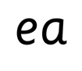
Today’s sound is ea. Can you say ea, ea, ea to your adult?
Look at the picture on your left. What can you see?
The lady is saying,
“cup of tea.”
Let’s Fred Talk some ‘ea’ words.
t ea c l ea n t ea m
On the other side of the card is the diagraph, ea.
These letters are
special friends.
They are two letters that make one sound. When we see them we say,
ea.
When we see the picture side we say,
“cup of tea”

Slide 14

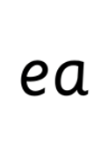
Below, I have given you some cards. Point to each one and say ea or cup of tea.
Now let’s have a go at writing the sound ea. You already know how to form each letter. Now we simply put them together to write the sound ea.
Now have a turn on your own. Keep practising until you get it right.

Slide 15

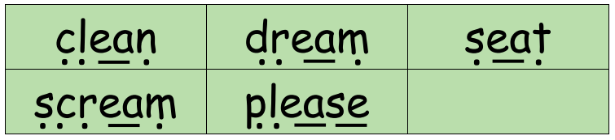
Set 3 Sounds
Now its time to Fred talk, read the word. Let me show you.
Here is my green word.
I am going to point to the button below each sound and say it out loud. This is Fred Talk.
s ea t after sounding out the word remember to read the word, seat. I have now read the word.
Now time to read some words including ‘ea’. You could even practise writing these words!

Slide 16
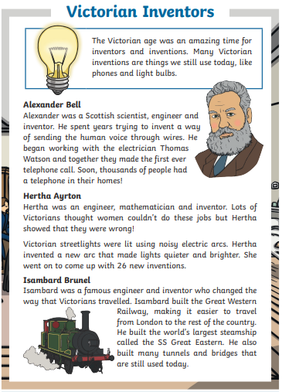
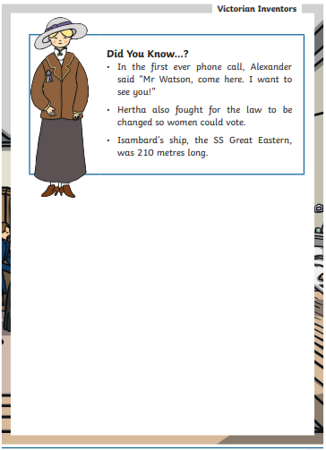
Guided Reading
Skip this if your child is not focusing on guided reading.
Read the text below before answering the questions on the following slides.

Slide 17
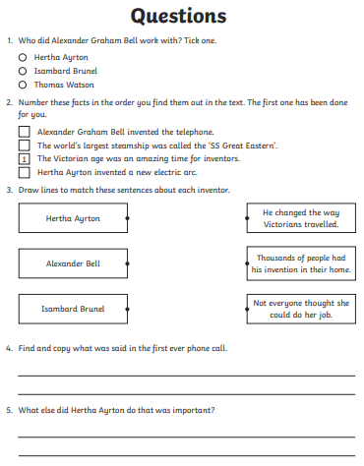
Questions

Slide 18
Date: Tuesday 29th June
LO To be able to practise phonics sounds.
LO To be able to answer questions about a text.
Please practise phonics every day for 20 minutes.
Subject: Phonics

Slide 19
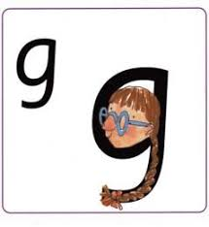
Set 1 Sound
Skip this slide if your child is not focusing on this set.
Today’s sound:
Please click the link or copy the below link into the internet:
https://www.youtube.com/watch?v=_NID9A6Y4Yo&list=PLPVrkr0oJX1tBTpbocNce93WUH8G-um6A&index=9
Or copy the below into YouTube:
‘Phonic Lesson - Set 1 Sound - Learning to Read and Write “g" for Reception and Year 1’ – Early Years Learning is Fun
Scavenger Hunt!
What can you find in your house that begins with g?

Slide 20
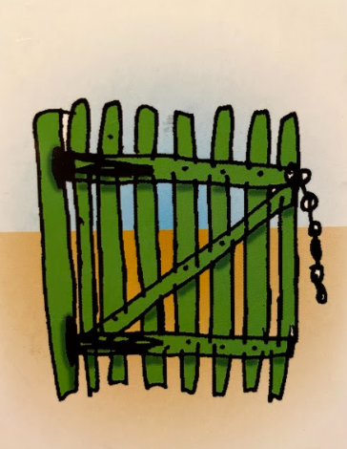
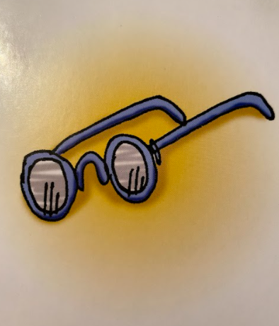
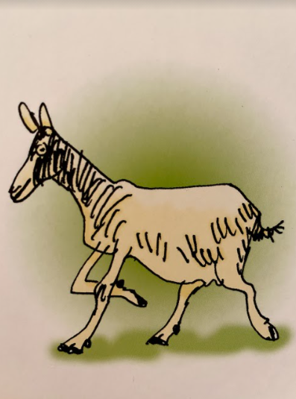
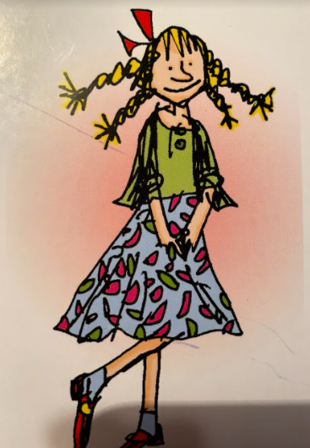
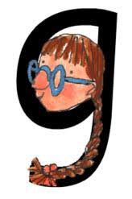

Today’s sound is g. Can you say g, g, g to your adult?
I have some pictures of things that begin with the sound g.
Try saying them out loud to your adult.
g g gate
g g glasses
g g goat
g g girl
Hiding behind the girl is the grapheme g. Can you point to it and say g?
When you see this side of the card say g.
Look at the picture on the left.
That is a
girl.
When you see this picture, as quick as you can say girl.

Slide 21
Below, I have given you some cards. Point to each one and say girl or g.
Now let’s have a go at writing the sound g. Use your finger and move it over the picture card saying, “Round her face, down her hair and give her a curl” or g g g g until you have traced the whole grapheme.
Now have a turn on your own. Keep practising until you get it right.

Slide 22






Set 1 Sounds
Now its time to Fred talk, read the word. Let me show you.
Here is my green word.
I am going to point to the button below each sound and say it out loud. This is Fred Talk.
g a p, after sounding out the word remember to read the word, gap. I have now read the word.
Now time to read some words including ‘g’. You could even practise writing these words!

Slide 23
Set 2 Sound
Skip this slide if your child is not focusing on this set.
Today’s sound:
Please click the link or copy the below link into the internet:
https://www.youtube.com/watch?v=M1uW4OtU7aU&list=PLPVrkr0oJX1sBGLJU2hNbPE2neuhezWSu&index=2
Or copy the below into YouTube:
‘Phonic Lesson - Set 2 ‘ee’ sound for Reception and Year 1’ – Early Years Learning is Fun
Can you think of any words with the ‘ee’ sound in it?

Slide 24
Today’s sound is ee. Can you say ee, ee, ee to your adult?
Look at the picture on your left. What can you see?
Can you see what they are looking at? Yes that’s right they are saying,
“ee, what can you see”
Let’s Fred Talk some ‘ee’ words.
Feet meet sleep.
ee
On the other side of the card is the digraph, ee.
These letters are
special friends.
They are two letters that make one sound. When we see them we say,
ee.
When we see the picture we say,
“ee,
What can
you see”

Slide 25
Below, I have given you some cards. Point to each one and say ee or what can you see.
ee
ee
ee
Now let’s have a go at writing the sound ee. You already know how to form each letter. Now we simply put them together to write the sound ee.
Now have a turn on your own. Keep practising until you get it right.

Slide 26

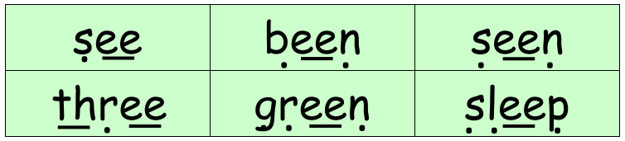
Set 2 Sounds
Now its time to Fred talk, read the word. Let me show you.
Here is my green word.
I am going to point to the button below each sound and say it out loud. This is Fred Talk.
s ee n, after sounding out the word remember to read the word, seen.
I have now read the word.
Now time to read some words including ‘ee’. You could even practise writing these words!

Slide 27
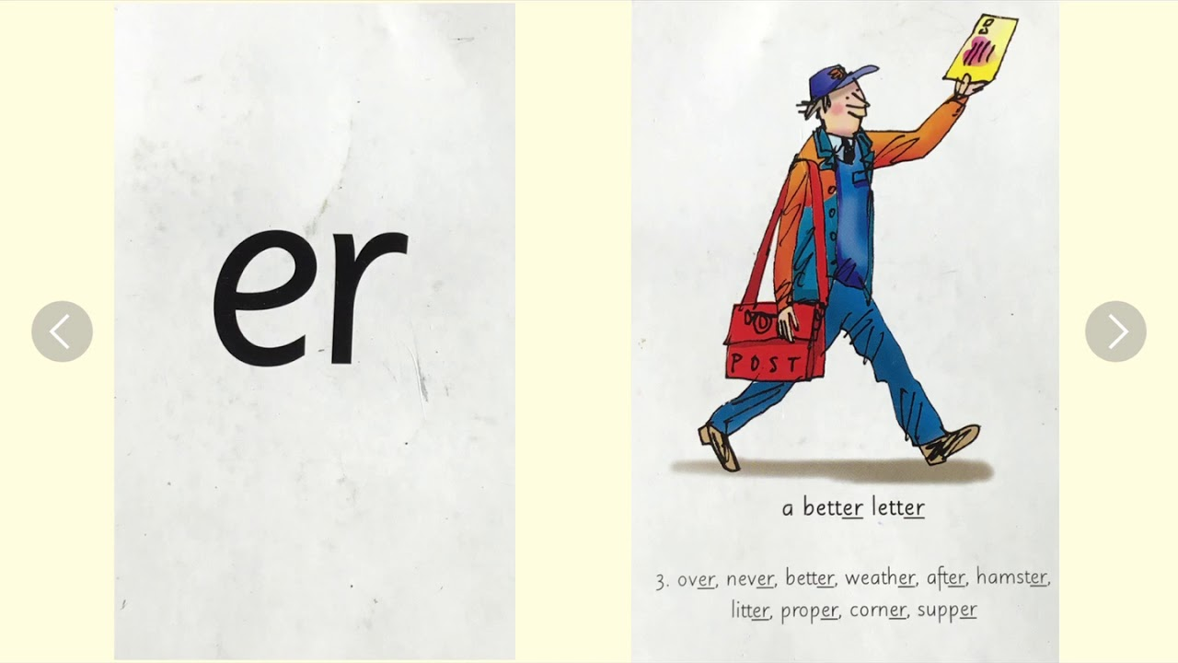
Set 3 Sound
Skip this slide if your child is not focusing on this set.
Today’s sound:
Please click the link or copy the below link into the internet:
https://www.youtube.com/watch?v=Wg7uwAaR2m4&list=PLPVrkr0oJX1smTl2RWUHKgvupRrMZkKEE&index=9
Or copy the below into YouTube:
Phonics Lesson - Set 3 sound 'er' for Foundation Stage and Year 1
Can you think of any words with the ‘er’ sound in it?

Slide 28
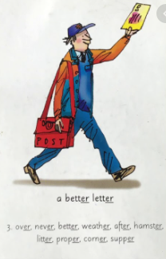
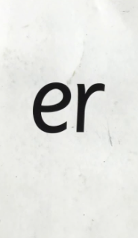
Today’s sound is er. Can you say er, er, er to your adult?
Look at the picture on your left. What can you see?
Can you see the postman with a letter? He is saying,
“a better letter”
Let’s Fred Talk some ‘er’ words.
n e v er u n d er a f t er.
On the other side of the card is the digraph, er.
These letters are
special friends.
They are two letters that make one sound. When we see them we say,
er.
When we see the picture side we say,
“a better letter”

Slide 29
Below, I have given you some cards. Point to each one and say er or a better letter.
Now let’s have a go at writing the sound er. You already know how to form each letter. Now we simply put them together to write the sound er
Now have a turn on your own. Keep practising until you get it right.

Slide 30
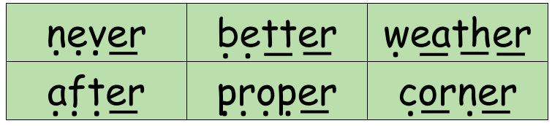
Set 3 Sounds
Now its time to Fred talk, read the word. Let me show you.
Here is my green word.
I am going to point to the button below each sound and say it out loud. This is Fred Talk.
n e v er, after sounding out the word remember to read the word, never. I have now read the word.
Now time to read some words including ‘er’. You could even practise writing these words!

Slide 31

Guided Reading
Skip this if your child is not focusing on guided reading.
Read the text below before answering the questions on the following slides.

Slide 32
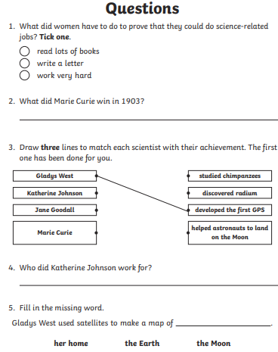
Questions

Slide 33
Date: Wednesday 30th June
LO To be able to practise phonics sounds.
LO To be able to answer questions about a text.
Please practise phonics every day for 20 minutes.
Subject: Phonics

Slide 34

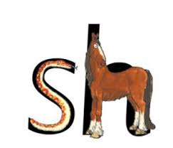
Set 1 Sound
Skip this slide if your child is not focusing on this set.
Today’s sound:
Please click the link or copy the below link into the internet:
https://www.youtube.com/watch?v=ZOvvbl2qtmU&list=PLPVrkr0oJX1tBTpbocNce93WUH8G-um6A&index=19
Or copy the below into YouTube:
‘Phonic Lesson - Set 1 Sound - Learning to Read and Write “sh" for Reception and Year 1’ – Early Years Learning is Fun
Can you think of any words which begin with sh?

Slide 35
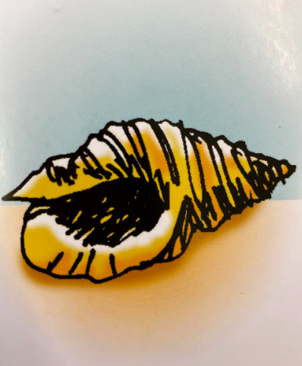
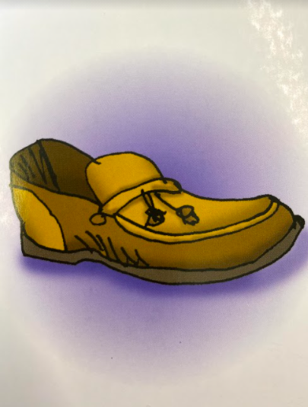
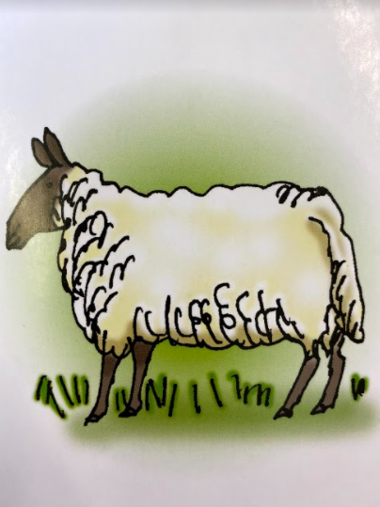
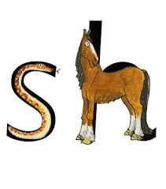

Today’s sound is sh. Can you say sh, sh, sh to your adult?
I have some pictures of things that begin with the sound sh.
Try saying them out loud to your adult.
sh sh shell
sh sh shoe
sh sh sheep
Look at the picture on the left.
That is a
snake and a horse.
When you see this picture, as quick as you can say snake and horse.
Hiding behind the snake and horse is the grapheme sh. Can you point to it and say sh?
When you see this side of the card say sh.

Slide 36
Below, I have given you some cards. Point to each one and say snake and horse or sh.
Have a turn on your own. Keep practising until you get it right.
Can you say shhhhhh as you write the sound?

Slide 37




Set 1 Sound
Now its time to Fred talk, read the word. Let me show you.
Here is my green word.
I am going to point to the button below each sound and say it out loud. This is Fred Talk.
sh o p, after sounding out the word remember to read the word, shop. I have now read the word.
Now time to read some words including ‘sh’. You could even practise writing these words!

Slide 38
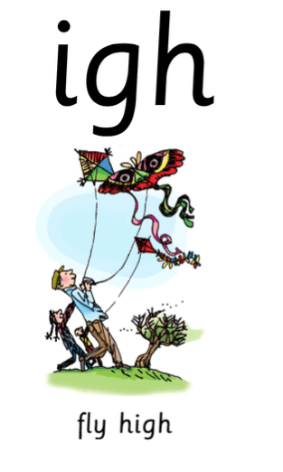
Set 2 Sound
Skip this slide if your child is not focusing on this set.
Today’s sound:
Please click the link or copy the below link into the internet:
https://www.youtube.com/watch?v=Y46--B_7BMs&list=PLPVrkr0oJX1sBGLJU2hNbPE2neuhezWSu&index=3
Or copy the below into YouTube:
‘Phonic Lesson - Set 2 ‘igh’ sound for Reception and Year 1’ – Early Years Learning is Fun
Can you think of any words with the ‘igh’ sound in it?

Slide 39
Today’s sound is igh.
Can you say igh, igh, igh to your adult?
Look at the picture on your left. What can you see?
Can you see that they are flying a kite? Yes that’s right they are saying,
“igh, fly high”
Let’s Fred Talk some ‘ee’ words.
high might tight.
On the other side of the card is the trigraph, igh.
These letters are
special friends.
They are three letters that make one sound. When we see them we say,
igh.
When we see the picture we say,
“igh,
fly high”
igh

Slide 40

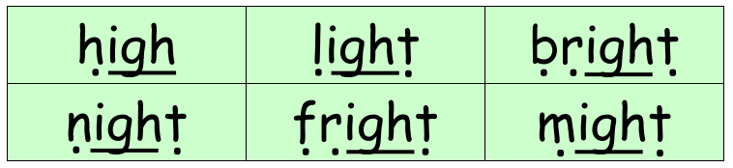
Set 2 Sounds
Now its time to Fred talk, read the word. Let me show you.
Here is my green word.
I am going to point to the button below each sound and say it out loud. This is Fred Talk.
h igh, after sounding out the word remember to read the word, high.
I have now read the word.
Now time to read some words including ‘igh’. You could even practise writing these words!

Slide 41
Below, I have given you some cards. Point to each one and say igh or fly high.
igh
igh
igh
Now let’s have a go at writing the sound igh. You already know how to form each letter. Now we simply put them together to write the sound igh
igh
Now have a turn on your own. Keep practising until you get it right.

Slide 42

Set 3 Sound
Skip this slide if your child is not focusing on this set.
Today’s sound:
Please click the link or copy the below link into the internet:
https://www.youtube.com/watch?v=4rq0xIjM1Ow&list=PLPVrkr0oJX1smTl2RWUHKgvupRrMZkKEE&index=10
Or copy the below into YouTube:
Phonics Lesson - Set 3 sound 'are' for Foundation Stage and Year 1
Can you think of any words with the ‘are’ sound in it?

Slide 43
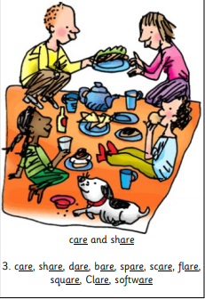
Today’s sound is are. Can you say are, are, are to your adult?
Look at the picture on your left. What can you see?
Can you see the family sharing food at a picnic?
“Care and share”
Let’s Fred Talk some ‘are’ words.
sh are c are b are
On the other side of the card is the digraph, are.
These letters are
special friends.
They are three letters that make one sound. When we see them we say,
are.
When we see the picture side we say,
“care and share”

Slide 44
Below, I have given you some cards. Point to each one and say are or care and share.
Now let’s have a go at writing the sound are. You already know how to form each letter. Now we simply put them together to write the sound are
Now have a turn on your own. Keep practising until you get it right.

Slide 45

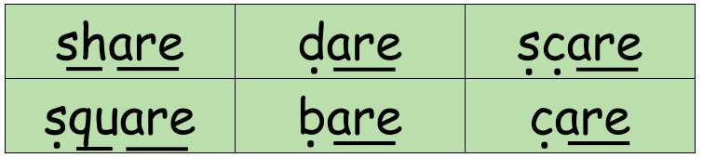
Set 3 Sounds
Now its time to Fred talk, read the word. Let me show you.
Here is my green word.
I am going to point to the button below each sound and say it out loud. This is Fred Talk.
sh are, after sounding out the word remember to read the word, share. I have now read the word.
Now time to read some words including ‘are’. You could even practise writing these words!

Slide 46
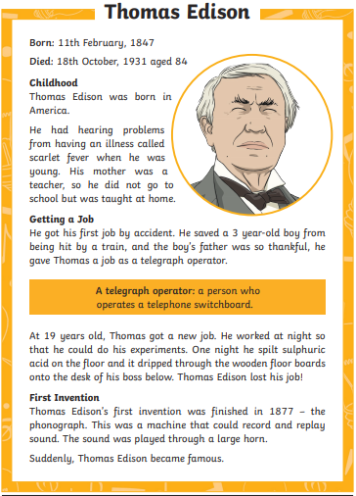
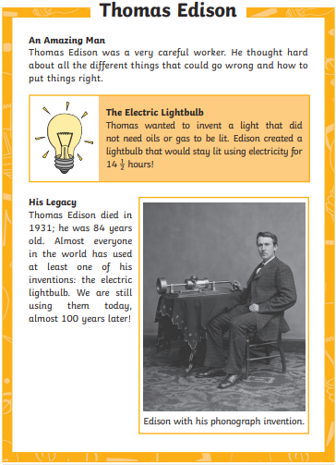
Guided Reading
Skip this if your child is not focusing on guided reading.
Read the text below before answering the questions on the following slides.

Slide 47
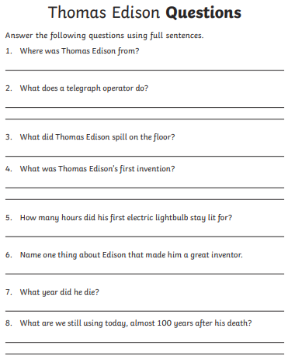
Questions

Slide 48
Date: Thursday 1st July
LO To be able to practise phonics sounds.
LO To be able to answer questions about a text.
Please practise phonics every day for 20 minutes.
Subject: Phonics

Slide 49

Set 1 Sound
Skip this slide if your child is not focusing on this set.
Today’s sound:
Please click the link or copy the below link into the internet:
https://www.youtube.com/watch?v=HigMFPwC0TI&list=PLPVrkr0oJX1tBTpbocNce93WUH8G-um6A&index=28
Or copy the below into YouTube:
‘Phonic Lesson - Set 1 Sound - Learning to Read and Write “ch" for Reception and Year 1’ – Early Years Learning is Fun
Can you think of any words that begin with ch?

Slide 50



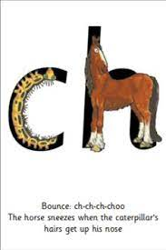
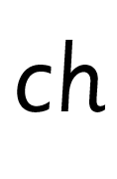
Today’s sound is ch. Can you say ch, ch, ch to your adult?
I have some pictures of things that begin with the sound ch.
Try saying them out loud to your adult.
ch ch chip
ch ch chick
ch ch cheese
Hiding behind the caterpillar and horse is the diagraph ch. Can you point to it and say ch?
When you see this side of the card say ch.
The horse sneezes when the caterpillar’s hairs get up his nose. When you see this card say
ch-ch-ch-choo

Slide 51
Below, I have given you some cards. Point to each one and say ch-ch-ch-choo or ch.
Now let’s have a go at writing the sound ch. Say ch-ch-ch-choo as you are writing ‘ch’.
Now have a turn on your own. Keep practising until you get it right.

Slide 52








Set 1 Sounds
Now its time to Fred talk, read the word. Let me show you.
Here is my green word.
I am going to point to the button below each sound and say it out loud. This is Fred Talk.
ch i p, after sounding out the word remember to read the word, chip. I have now read the word.
Now time to read some words including ‘h’. You could even practise writing these words!

Slide 53
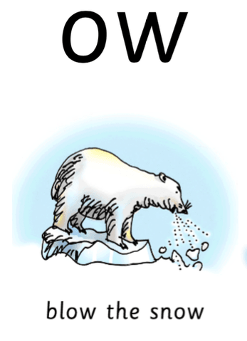
Set 2 Sound
Skip this slide if your child is not focusing on this set.
Today’s sound:
Please click the link or copy the below link into the internet:
https://www.youtube.com/watch?v=iiap-EZwJAs&list=PLPVrkr0oJX1sBGLJU2hNbPE2neuhezWSu&index=4
Or copy the below into YouTube:
‘Phonic Lesson - Set 2 ‘ow’ sound for Reception and Year 1’ – Early Years Learning is Fun
Can you think of any words with the ‘ow’ sound in it?

Slide 54
Today’s sound is ow.
Can you say ow, ow, ow to your adult?
Look at the picture on your left. What can you see?
Can you see the polar bear blowing the snow? Yes that’s right they are saying,
“ow, blow the snow”
Let’s Fred Talk some ‘ow’ words.
low snow blow.
On the other side of the card is the digraph, ow.
These letters are
special friends.
They are two letters that make one sound. When we see them we say,
ow.
When we see the picture
we say,
“ow,
blow the snow”
ow

Slide 55
Below, I have given you some cards. Point to each one and say ow or blow the snow.
ow
ow
ow
Now let’s have a go at writing the sound ow. You already know how to form each letter. Now we simply put them together to write the sound ow.
Now have a turn on your own. Keep practising until you get it right.

Slide 56

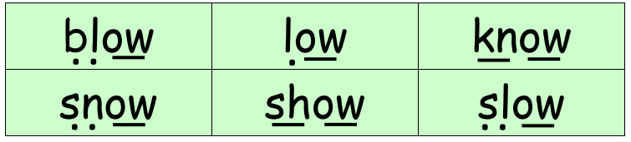
Set 2 Sounds
Now its time to Fred talk, read the word. Let me show you.
Here is my green word.
I am going to point to the button below each sound and say it out loud. This is Fred Talk.
b l ow, after sounding out the word remember to read the word, blow.
I have now read the word.
Now time to read some words including ‘ow’. You could even practise writing these words!

Slide 57
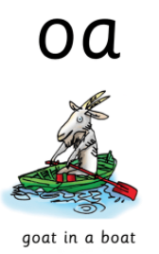
Set 3 Sound
Skip this slide if your child is not focusing on this set.
Today’s sound:
Please click the link or copy the below link into the internet:
https://www.youtube.com/watch?v=AF6vrRAFn9c&list=PLPVrkr0oJX1smTl2RWUHKgvupRrMZkKEE&index=11
Or copy the below into YouTube:
Phonics Lesson - Set 3 sound 'oa' for Foundation Stage and Year 1
Can you think of any words with the ‘oa’ sound in it?

Slide 58
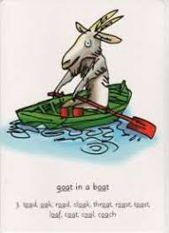

Today’s sound is oa. Can you say oa, oa, oa to your adult?
Look at the picture on your left. What can you see?
Can you see the goat in a boat?
“goat in a boat”
Let’s Fred Talk some ‘oa’ words.
b oa t c oa t r oa d
On the other side of the card is the digraph, oa.
These letters are
special friends.
They are two letters that make one sound. When we see them we say,
oa.
When we see the picture side we say,
“goat in a boat”

Slide 59
Below, I have given you some cards. Point to each one and say oa or goat in a boat.
Now let’s have a go at writing the sound oa. You already know how to form each letter. Now we simply put them together to write the sound oa
Now have a turn on your own. Keep practising until you get it right.

Slide 60

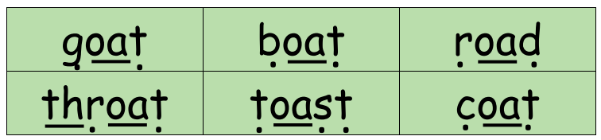
Set 3 Sounds
Now its time to Fred talk, read the word. Let me show you.
Here is my green word.
I am going to point to the button below each sound and say it out loud. This is Fred Talk.
g oa t, after sounding out the word remember to read the word, goat. I have now read the word.
Now time to read some words including ‘oa’. You could even practise writing these words!

Slide 61
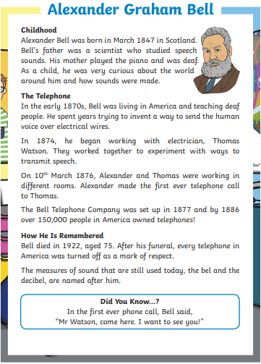
Guided Reading
Skip this if your child is not focusing on guided reading.
Read the text below before answering the questions on the following slides.

Slide 62

Questions

Slide 63
Date: Friday 2nd July
LO To be able to practise reading tricky words.
LO To be able to answer questions about a text.
Please practise phonics every day for 20 minutes.
Subject: Phonics

Slide 64

Pick a slide appropriate to your child’s ability
‘Tricky word’ word search

Slide 65

Pick a slide appropriate to your child’s ability
‘Tricky word’ word search

Slide 66

Pick a slide appropriate to your child’s ability
‘Tricky word’ word search

Slide 67




Games & Videos!
https://www.phonicsplay.co.uk/resources
https://www.bbc.co.uk/bitesize/topics/zcqqtfr
https://www.phonicsbloom.com/
https://www.bbc.co.uk/cbeebies/shows/alphablocks
https://www.youtube.com/channel/UC_qs3c0ehDvZkbiEbOj6Drg

Slide 68

Guided Reading
Skip this if your child is not focusing on guided reading.
Read the text below before answering the questions on the following slides.

Slide 69

Questions

