Slide 1



Date: 5.01.2021
LO To be able to complete a fact family for addition problems.
Subject: Maths

Slide 2
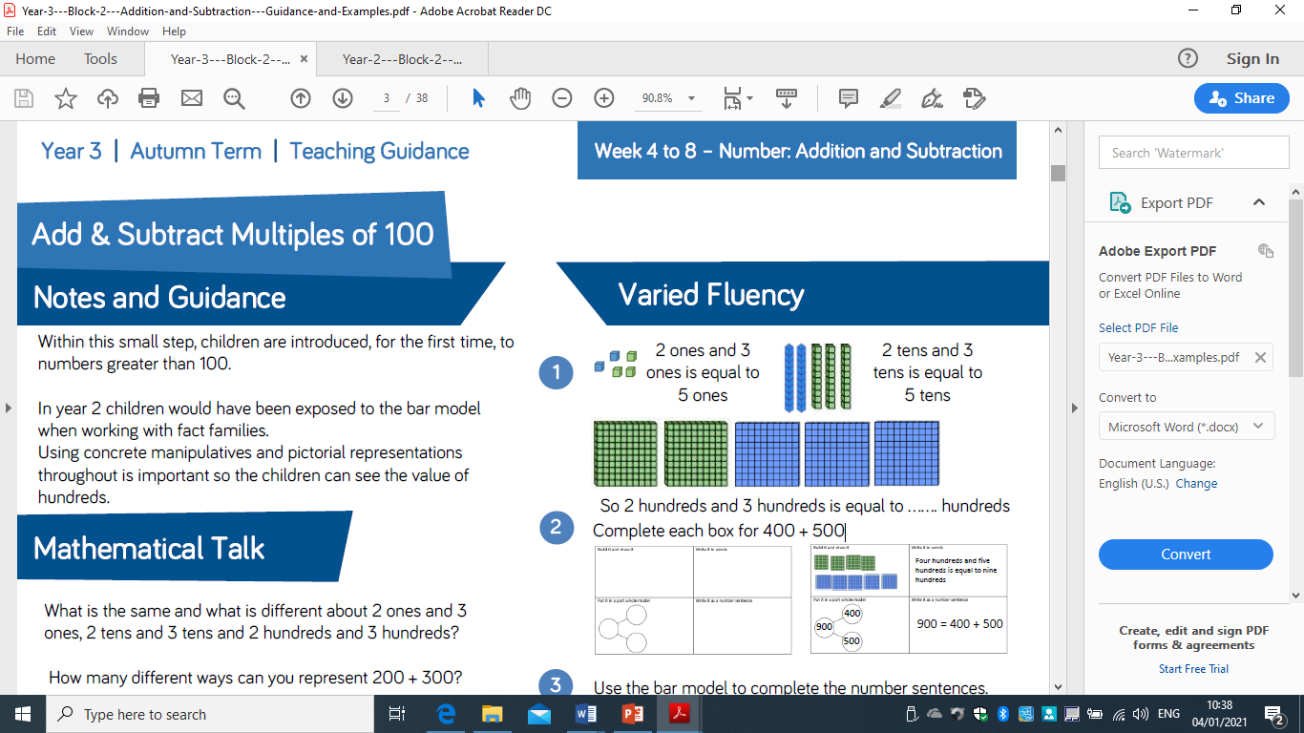
1. Draw it
Draw it: | Write it using words:
Use a part whole method: | Write it as a number sentence:

Slide 3
2. Write it
Build it / Draw it: | Write it using words: Six hundred takeaway two hundred equals four hundred
Use a part whole method: | Write it as a number sentence:

Slide 4
3. Use a part whole method
Build it / Draw it: | Write it using words: Two hundred add three hundred equals five hundred
Use a part whole method: | Write it as a number sentence:
6003
400
200

Slide 5
3. Use a part whole method
Build it / Draw it: | Write it using words: Two hundred add three hundred equals five hundred
Use a part whole method: | Write it as a number sentence: 600 + 200 = 400
400
600563
200

Slide 6
Try yourself…
1. 150
2. 300
3. 340
4. 470
5. 580
6. 630
7. 740
8. 860
9. 895
10. 1000

Slide 7
Date: 6.01.2021
LO To be able to complete a fact family for subtraction problems.
Subject: Maths

Slide 8
1. Draw it
Draw it: | Write it using words:
Use a part whole method: | Write it as a number sentence:

Slide 9
2. Write it
Build it / Draw it: | Write it using words: Two hundred add three hundred equals five hundred
Use a part whole method: | Write it as a number sentence:

Slide 10
3. Use a part whole method
Build it / Draw it: | Write it using words: Two hundred add three hundred equals five hundred
Use a part whole method: | Write it as a number sentence:
300
500563
200

Slide 11
3. Use a part whole method
Build it / Draw it: | Write it using words: Two hundred add three hundred equals five hundred
Use a part whole method: | Write it as a number sentence: 200 + 300 = 500
300
500563
200

Slide 12
Try yourself…
100
2. 200
3. 230
4. 450
5. 570
6. 653
7. 742
8. 866
9. 892
10. 961

Slide 13
Date: 7.01.2021
LO To be able to complete addition and subtraction word problems.
Subject: Maths

Slide 14
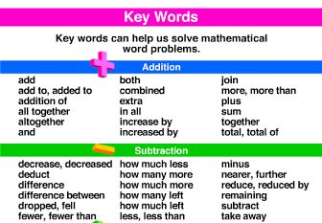
1. Identify if the problem is addition or subtraction.
There are 160 cubes in one box and 330 in another. How many cubes do we have altogether?
Look for your key words
Means it is an addition sum.

Slide 15
2. Use your column method to work out the answer.
There are 160 cubes in one box and 330 in another. How many cubes do we have altogether?
Identify the numbers, then write out your sum.
Remember to work down each column, starting on the right.
 | 1 | 6 | 0
+ | 3 | 3 | 0
= | 4 | 9 | 0

Slide 16
Try yourself…
Base 1 have 167 and Base 3 have 330 books. How many books are there altogether in both class rooms?
Jay has a collection of 263 Pokémon cards. Bobby has 143. How many fewer cards does Jay have than Bobby?
A family drive 208 miles from London to Manchester, and then 213 on to Glasgow. How far did they travel altogether?
Harry played on his x box for 30 minutes. Fiona played on her PlayStation for 70 minutes. What is the difference in time?
Polly had 108 crackers and Peter had 347 crackers. How many did they have combined?

Slide 17
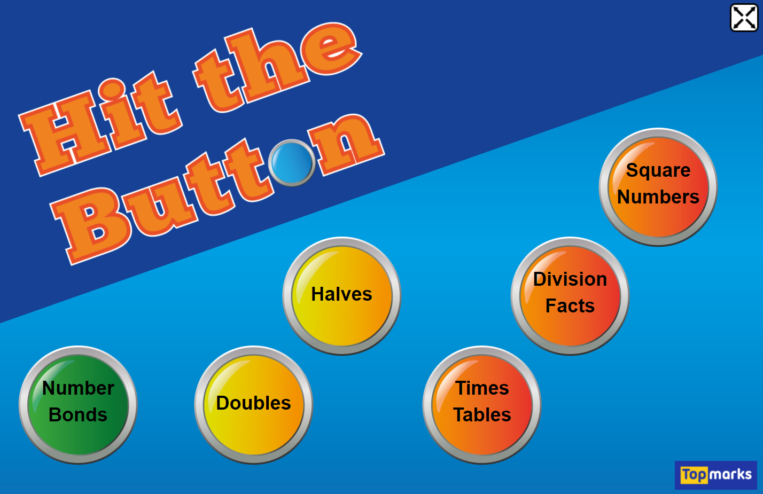
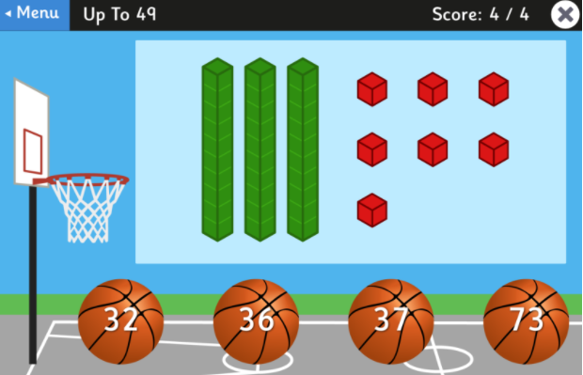
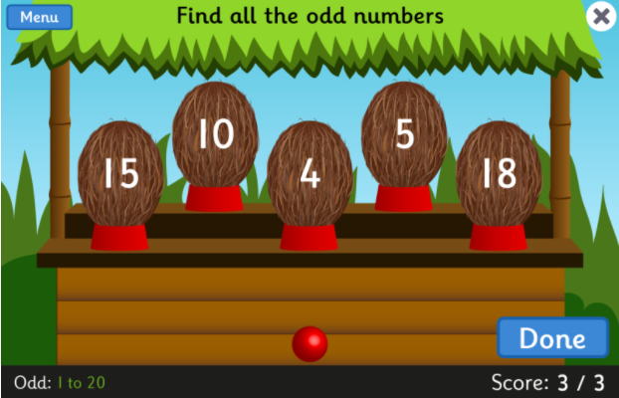
Fun Maths Games!
Copy and paste the link to play these fun maths games.
Number bonds to make 10
Number bonds to make 20
Number bonds to make 100
Times tables x10, x2, x5
https://www.topmarks.co.uk/maths-games/hit-the-button
https://www.topmarks.co.uk/learning-to-count/place-value-basketball
Numbers up to 100
https://www.topmarks.co.uk/learning-to-count/coconut-odd-or-even
Odd and even numbers to 100

