Slide 1
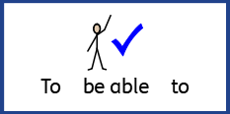

Date: Monday 18th January
LO To be able to read an information text.
Subject: English

Slide 2
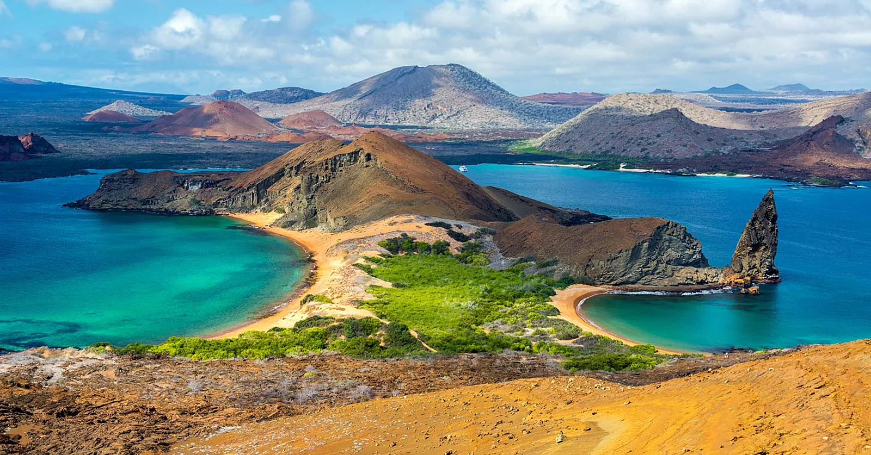
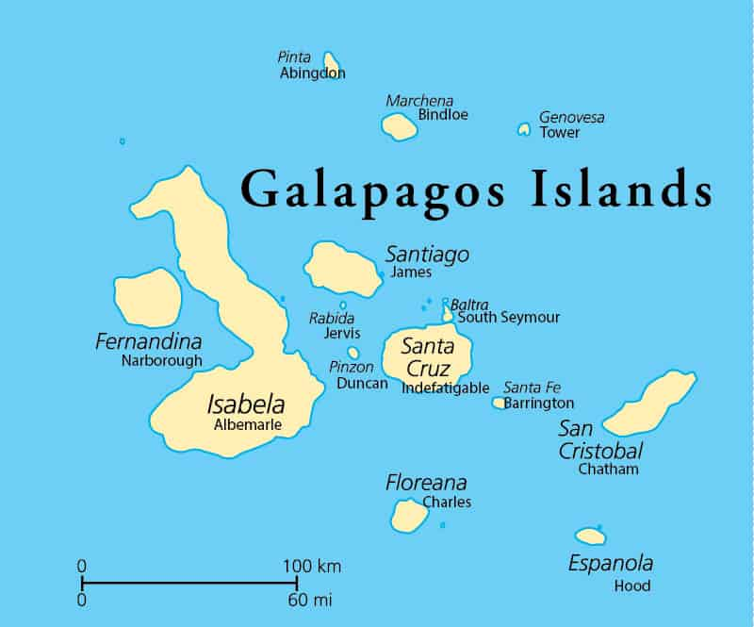
Over the next two weeks we are going to look at, investigate and create your own information text on the Galapagos island.
The Galapagos Islands
The Galapagos Islands belong to the South American country of Ecuador, located in the Pacific Ocean. The Islands are formed from underwater volcanoes that spew lava up from the bottom of the sea. The Galapagos Islands are home to a variety of plants, animals and birds that have gradually adapted to life there. The Island’s do not have big palm tress or lots of beach; only small bushes, desert plants and strips of sand.

Slide 3
Challenge:
Please take a look at the two websites for more information? Remember to take notes you will need them later on in the week.
https://www.natgeokids.com/uk/discover/geography/countries/ng-kids-heads-to-the-galapagos-islands/
What you can look for?
The animals
The climate
Who discovered them?
How many islands there are?
What information I have found out?
1, The islands belong to the South American country of Ecuador.
2, Charles Darwin discovered the Islands.
3, There are located in the Pacific Oceans

Slide 4
Date: Tuesday 19th January
LO To be able to explore and identify features in an information text.
Subject: English

Slide 5
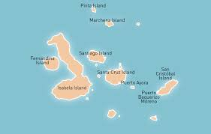
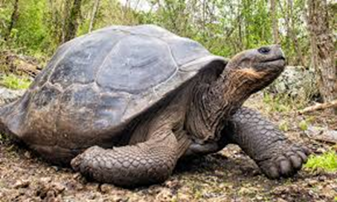
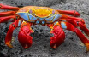
Title
The Galapagos Island
What have you found out?
Information 1,
The Lava crab is also known as the Sally Lightfoot crab
Short statement.
What you are writing about?
The Galapagos Islands belong to the South American country of Ecuador, located in the Pacific Ocean. The Islands are formed form underwater volcanoes, that spew lava up form the bottom of the sea. The Galapagos Islands are home to a variety of plants, animals and birds that have gradually adapted to life there. The Islands do not have big palm trees, or lots of beach, only small bushes, desert plants and strips of sand.
Animals that live on the island?
Iguanas
Seals
Tortoise
Lava Crab
Illustrations
Information 2,
The weather is a different temperature throughout the year.
Information 3
The Marine iguanas are the only sea going lizards in the world.
This is an example of information text

Slide 6
The Galapagos Island
Information 1
Challenge:
Can you and your adult now discuss the different features.
Information 2
Information 3

Slide 7
Date: Wednesday 20th January
LO To be able to use capital letters and full stops.
Subject: English

Slide 8
Capital letters and full stops
Location
Word of the week
When do you use a capital letter?
A sentence always begins with a capital letter.
2. A proper noun, like a person’s name, begins with a capital letter.
3. A proper noun, like a place, begins with a capital letter.
4. Proper nouns, which are SPECIAL names, begin with a capital letter. (Christmas, Easter, June, Monday etc.)
When do you use a full stop.
1. At the end of a sentences.
The beginning of the sentence
( capital letter)
Place
The location of the Galapagos island are in the Pacific Ocean.
Full stop
Name of the Ocean

Slide 9

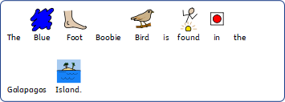
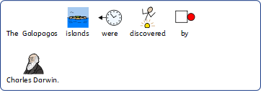


Can you now point to all the capital letters and full stops
.

Slide 10
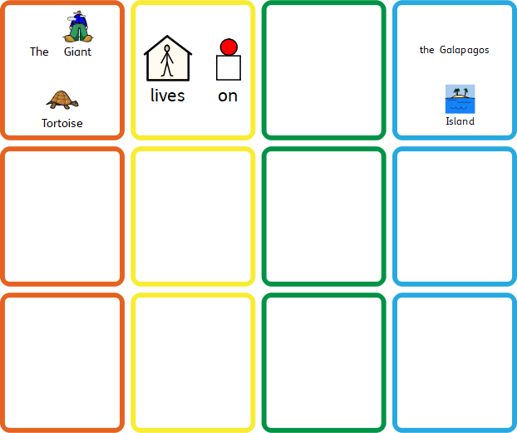
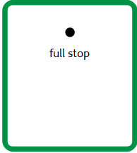
Build A Sentence my turn
The Giant Tortoise live on the Galapagos Island.

Slide 11
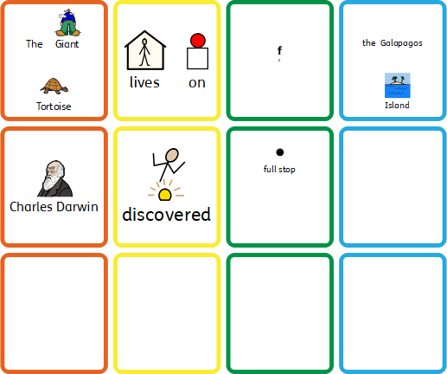
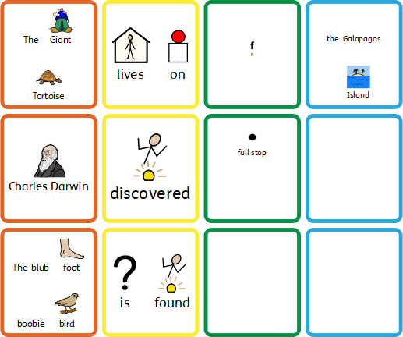
Build A Sentence your turn, can you now make and write your own 3 sentences.

Slide 12
Date: Thursday 21nd January
LO To be able to use question marks.
Subject: English

Slide 13
What is a Question Mark?
Question marks usually end question sentences.
A question sentence is one that often starts with one of the following words:
WHAT?
WHO?
WHERE?
HOW?
Question marks can also be used with sentences that start with other words. This is most the time thought speech.
Example:
“Can you see the Lava Crab?” “Are there any iguanas on the rocks?”
https://www.theschoolrun.com/what-is-a-question-mark#:~:text=Question%20marks%20usually%20end%20question,that%20start%20with%20other%20words.

Slide 14

Challenge 1:
Can you now point out with is a question and which is not?
Also please put in the full stops
1, What is the length of the Albatrosses wings
2, The weather is good today, on the island of Galapagos
3, “Can you see the Frigate bird flying high in the sky”
4, Who discover the Galapagos Islands
5, There are now people living on the island

Slide 15
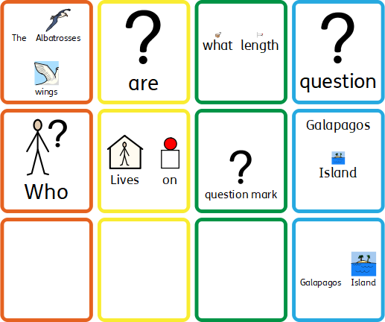

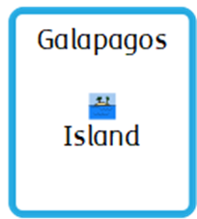
Build A Sentence my turn
Who lives on the Galapagos Island?

Slide 16
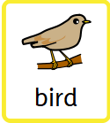
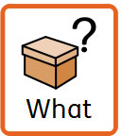
Build A Sentence your turn, can you now make and write your own 3 sentences.

Slide 17
Date: Friday 22nd January
To be able begin to spell words which contain ‘ei’
Subject: phoincs

Slide 18
Today we are spotting ‘ei’ in words
Here are some words that contain ‘ei’ , can you spot them?
height
leisure
eight
reign
their
ceiling
Can you and your adult take turns reading some of these words?
receipt
protein
receive

Slide 19
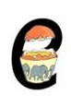
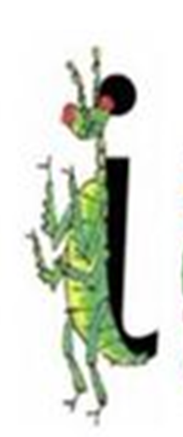
Practise writing task
How many more words can you find?
Down the insects body and dot for hit head.
Crack the egg and scoop it out
Remember guys, when writing the letters, they sit together on the line. Just like this ei___ei___ei
Also don’t forget your finger spaces.

Slide 20
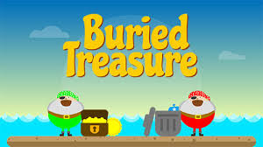
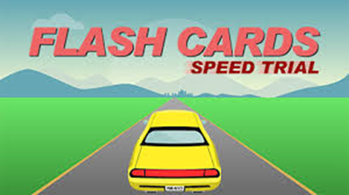
Here is a link for you to access some fun phonics games online.
https://www.phonicsplay.co.uk/
At the moment there is a free login for parent to use at home.
Username: jan21
Password: home

