Slide 1


Subject: English
Pack: A

Slide 2
Text type: Mystery Narrative
Trailblazers
Monday | Tuesday | Wednesday | Thursday | Friday
L.O. To be able to identify common features in Arthur Conan Doyle’s books. | L.O. To be able to develop vocabulary for a mystery narrative. | L.O. To be able to use figurative language. | L.O. To be able to vary sentence length for effect. | L.O. To be able to write a setting description for a mystery narrative.

Slide 3
Read, copy, cover, spell this week’s spellings.
Date: Monday 22nd February 2021
deceive
conceive
receive
perceive
ceiling
receipt
protein
caffeine
seize
neither

Slide 4


Date: Monday 22nd February 2021
L.O. To be able to identify common features in Arthur Conan Doyle’s books.
Subject: English

Slide 5
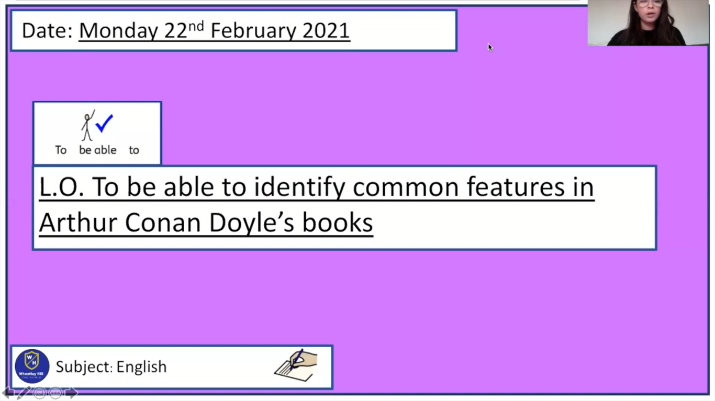
Pre-recorded Teaching
Miss Umpleby’s online teaching video is on our school website. It will support you to complete the work in this lesson. This video will act as a support but all of the work can still be successfully understood & completed using paper-based versions of this pack. If you need further support to understand / complete work then please contact school via e-mail or telephone.
You can also copy and paste this link if you would prefer:
https://www.whprimary.com/copy-4-of-covid19

Slide 6

Arthur Conan Doyle
Arthur Conan Doyle was born on 22 May 1859.
He divided his time between medicine and writing.
He is known for writing mystery books about Sherlock Holmes.
Sherlock Holmes is a well-known fictional detective.

Slide 7
What language did Arthur Conan Doyle use?
Dialogue
Simile
Formal language
Onomatopoeia
Language
Narrative voice
Mystery vocabulary
Personification

Slide 8
Simile
A simile is a way of comparing two things.
We use the words like or as to compare two things.
Examples:
  The weather was as cold as ice.
  My heart was beating like a drum

Slide 9
Dialogue
Dialogue is what the characters say aloud.
It helps brings them to life.
We use inverted commas “ ” to show direct speech in a sentence.
Example:
  “Look there!” said Sherlock Holmes .

Slide 10
Formal Language
Arthur Conan Doyle uses formal language in his stories.
He uses language such as:
  Companions,
  Sir,
  Fortunate,
  Pleasant.
Formal language is associated with particular choices of grammar and vocabulary.
We use formal language in situations that are serious or when we don’t know people very well.

Slide 11
Mystery vocabulary
We would expect to see vocabulary that adds suspense, drama and tension.
For example:
  Motive
  Evidence
  Detective
  Witness
  Suspicion
  Discovery
  Mystery
  Quest

Slide 12
Personification
Personification is describing objects as if they are people.
It makes sentences more exciting.
Examples:
  Lightning danced across the sky.
  The wind howled in the night.

Slide 13
Narrative voice
Arthur Conan Doyle uses Holmes' companion, John Watson, as a narrator.
Watson's viewpoint allows us to share his wonder at Holmes' skills as a detective.
Example:
  Holmes walked slowly up and down the ill-trimmed lawn and examined with deep attention the outsides of the windows.

Slide 14
Onomatopoeia
Onomatopoeia is when a word sounds like the noise it is describing.
It can help to bring a story to life for the reader.
Examples:
  The owl hooted in the tree.
  The leaves crunched under my feet as I walked through the woods.
  The wind was howling in the darkens.
  There was a loud bang at the door.

Slide 15

Create a spider diagram with the language Arthur Conan Doyle uses.
Language

Slide 16
Create a spider diagram with the language Arthur Conan Doyle uses.
Dialogue is what the characters say aloud.
Simile
Dialogue
A simile is a way of comparing two things.
We use the words like or as to compare two things.
Formal language
Onomatopoeia
Arthur Conan Doyle uses formal language in his stories.
He uses language such as: Companions, Sir, Fortunate, Pleasant.
Onomatopoeia is when a word sounds like the noise it is describing.
Language
Narrative voice
Mystery vocabulary
Arthur Conan Doyle uses Holmes' companion, John Watson as a narrator. The story is told through his eyes.
We would expect to see vocabulary that adds suspense, drama and tension.
For example: Suspicion, evidence, examine etc.
Personification
Personification is describing objects as if they are people.

Slide 17

The Adventure of the Speckled Band.
A young woman named Helen Stoner contacts Sherlock Holmes and Dr. Watson for help in stopping the villainous plans of her stepfather, Grimesby Roylott.

Slide 18
Can you spot any language used by Arthur Conan Doyle? Using the colours you have at home, highlight or underline the key language features.
At Waterloo we were fortunate in catching a train for Leatherhead, where we hired a trap at the station inn and drove for four or five miles through the lovely Surrey lanes. It was a perfect day, with a bright sun and a few fleecy clouds in the heavens. The trees and wayside hedges were just throwing out their first green shoots, and the air was full of the pleasant smell of the moist earth. To me at least there was a strange contrast between the sweet promise of the spring and this sinister quest upon which we were engaged. My companion sat in the front of the trap, his arms folded, his hat pulled down over his eyes, and his chin sunk upon his breast, buried in the deepest thought. Suddenly, however, he started, tapped me on the shoulder, and pointed over the meadows.
Onomatopoeia
Narrative voice
Simile
Personification
Dialogue
Formal language
Mystery vocabulary

Slide 19
Can you spot any language used by Arthur Conan Doyle? Using the colours you have at home, highlight or underline the key language features.
“Look there!” said he.
A heavily timbered park stretched up in a gentle slope, thickening into a grove at the highest point. From amid the branches there jutted out the grey gables and high rooftree of a very old mansion.
“Stoke Moran?” said he.
“Yes, sir, that be the house of Dr. Grimesby Roylott,” remarked the driver.
“There is some building going on there,” said Holmes; “that is where we are going.”
Onomatopoeia
Narrative voice
Simile
Personification
Dialogue
Formal language
Mystery vocabulary

Slide 20
Can you spot any language used by Arthur Conan Doyle? Using the colours you have at home, highlight or underline the key language features.
The building was of grey, lichen-blotched stone, with a high central portion and two curving wings, like the claws of a crab, thrown out on each side. In one of these wings the windows were broken and blocked with wooden boards, while the roof was partly caved in, a picture of ruin. The central portion was in little better repair, but the right-hand block was comparatively modern, and the blinds in the windows, with the blue smoke curling up from the chimneys, showed that this was where the family resided. Some scaffolding had been erected against the end wall, and the stone-work had been broken into, but there were no signs of any workmen at the moment of our visit. Holmes walked slowly up and down the ill-trimmed lawn and examined with deep attention the outsides of the windows.
Onomatopoeia
Narrative voice
Simile
Personification
Dialogue
Formal language
Mystery vocabulary

Slide 21
Can you spot any language used by Arthur Conan Doyle?
At Waterloo we were fortunate in catching a train for Leatherhead, where we hired a trap at the station inn and drove for four or five miles through the lovely Surrey lanes. It was a perfect day, with a bright sun and a few fleecy clouds in the heavens. The trees and wayside hedges were just throwing out their first green shoots, and the air was full of the pleasant smell of the moist earth. To me at least there was a strange contrast between the sweet promise of the spring and this sinister quest upon which we were engaged. My companion sat in the front of the trap, his arms folded, his hat pulled down over his eyes, and his chin sunk upon his breast, buried in the deepest thought. Suddenly, however, he started, tapped me on the shoulder, and pointed over the meadows.
Onomatopoeia
Narrative voice
Simile
Personification
Dialogue
Formal language
Mystery vocabulary

Slide 22
Can you spot any language used by Arthur Conan Doyle?
“Look there!” said he.
A heavily timbered park stretched up in a gentle slope, thickening into a grove at the highest point. From amid the branches there jutted out the grey gables and high rooftree of a very old mansion.
“Stoke Moran?” said he.
“Yes, sir, that be the house of Dr. Grimesby Roylott,” remarked the driver.
“There is some building going on there,” said Holmes; “that is where we are going.”
Onomatopoeia
Narrative voice
Simile
Personification
Dialogue
Formal language
Mystery vocabulary

Slide 23
Can you spot any language used by Arthur Conan Doyle?
The building was of grey, lichen-blotched stone, with a high central portion and two curving wings, like the claws of a crab, thrown out on each side. In one of these wings the windows were broken and blocked with wooden boards, while the roof was partly caved in, a picture of ruin. The central portion was in little better repair, but the right-hand block was comparatively modern, and the blinds in the windows, with the blue smoke curling up from the chimneys, showed that this was where the family resided. Some scaffolding had been erected against the end wall, and the stone-work had been broken into, but there were no signs of any workmen at the moment of our visit. Holmes walked slowly up and down the ill-trimmed lawn and examined with deep attention the outsides of the windows.
Onomatopoeia
Narrative voice
Simile
Personification
Dialogue
Formal language
Mystery vocabulary

Slide 24

Reading time
Now that you have finished your main task, please enjoy some reading time.
You can read to yourself, an adult or sibling.
This can be done by logging on to your myON account, picking a book or magazine and enjoying at least 15 minutes reading time.
https://www.myon.co.uk/login/index.html
Remember that your login is your first name and first letter of your surname then password:
harryp
password1
Please email trailblazerspupils@gmail.com if you have any login issues.

Slide 25
End of lesson.

Slide 26
Read, copy, cover, spell this week’s spellings.
Date: Tuesday 23nd February 2021
deceive
conceive
receive
perceive
ceiling
receipt
protein
caffeine
seize
neither

Slide 27
Date: Tuesday 23nd February 2021
L.O. To be able to develop vocabulary for a mystery narrative.
Subject: English

Slide 28
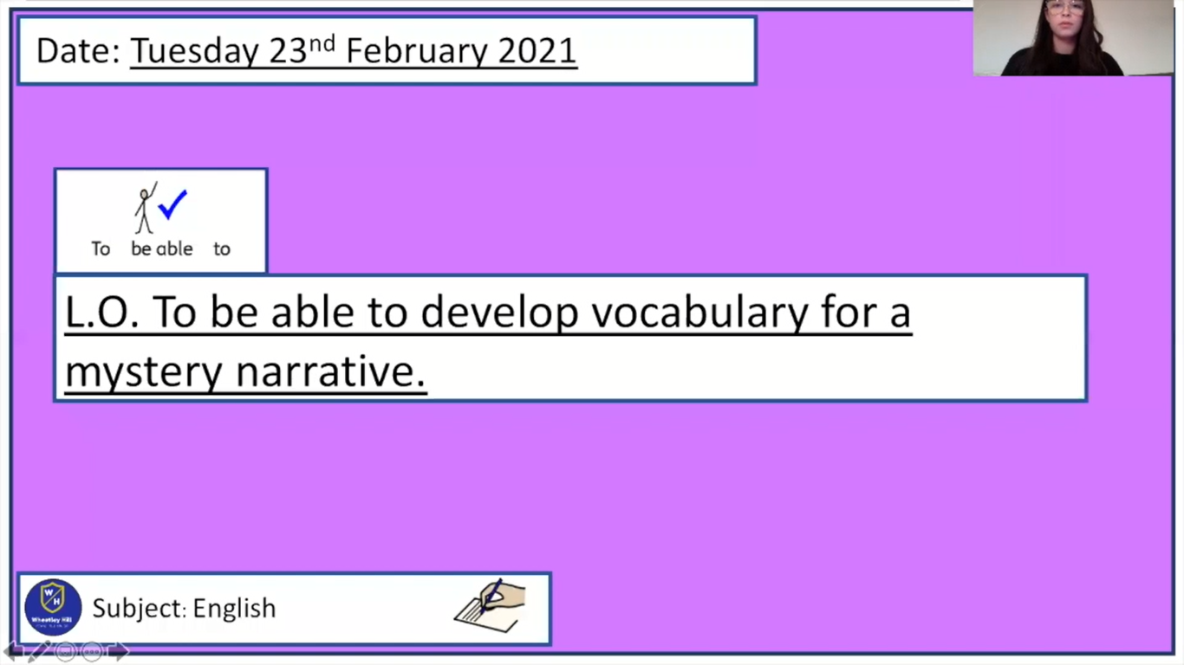
Pre-recorded Teaching
Miss Umpleby’s online teaching video is on our school website. It will support you to complete the work in this lesson. This video will act as a support but all of the work can still be successfully understood & completed using paper-based versions of this pack. If you need further support to understand / complete work then please contact school via e-mail or telephone.
You can also copy and paste this link if you would prefer:
https://www.whprimary.com/copy-4-of-covid19

Slide 29
What language did Arthur Conan Doyle use?
Starter
Language

Slide 30
What language did Arthur Conan Doyle use?
Starter
Dialogue
Simile
Formal language
Onomatopoeia
Language
Narrative voice
Mystery vocabulary
Personification

Slide 31
Mystery vocabulary
When we write a mystery story, we would expect to see vocabulary that adds suspense, drama and tension.
We want the reader to be on edge.
For example:
  The old, isolated mansion was in the deep, dark woods.
  As I looked down the dark hallway, I heard an eerie sound.

Slide 32
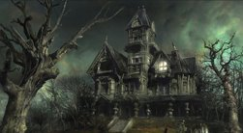
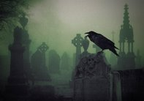
We know that the language used in a mystery story should add suspense, tension and drama. Think of words or phrases that might be found in a mystery text.

Slide 33
Here are some examples. Write these down to create a bank of vocabulary.
Secret | Clue | Suddenly,…
Puzzle | Hidden | Quest
Unknown | Elusive | Witness
Perplexity | Intrigue | Motive
Confusion | Strange | Examine
Grey | Dilemma | Suspicion
Unsolved | Revelation | Discovery
Mystery | Detective | Eerie
Dark | Old

Slide 34
Definitions
Perplexity: this means a state of confusion or a complicated and difficult situation or thing.
Example:
  “Hum!” said he, scratching his chin in some perplexity, “My theory certainly presents some difficulties.”
Suspicion: this means you have an idea that something is true.
Example:
  I've got a suspicion that we're going the wrong way.

Slide 35
Definitions
Mystery: this means not known or not understood.
Example:
  The mystery was solved when the police discovered the murder weapon.
Revelation: this means finding out something the has been a secret.
Example:
  A revelation was made, the killer was found.

Slide 36
Definitions
Elusive: this means something that is difficult to find or catch.
Example:
  He is the elusive, secretive, and well-informed leader.
Eerie-: this means something that is strange or frightening.
Example:
  She heard the eerie noise of the wind howling through the trees.

Slide 37
Definitions
Dilemma: this means a situation that requires a choice between two things.
Example:
  We are faced with a dilemma and it seems there is no correct choice.
Intrigue: this means to be interested or curious about something.
Example:
  I was intrigued by your question.

Slide 38
Write down the words or phrases which show this is a mystery text.
To me at least there was a strange contrast between the sweet promise of the spring and this sinister quest upon which we were engaged.
He examined with deep attention the outsides of the windows.
“Hum!” said he, scratching his chin in some perplexity, “my theory certainly presents some difficulties. No one could pass these shutters if they were bolted. Well, we shall see if the inside throws any light upon the matter.”
The discovery that this was a dummy, and that the bed was clamped to the floor, instantly gave rise to the suspicion that the rope was there as a bridge for something passing through the hole and coming to the bed.

Slide 39
Write down the words or phrases which show this is a mystery text.
To me at least there was a strange contrast between the sweet promise of the spring and this sinister quest upon which we were engaged.
He examined with deep attention the outsides of the windows.
“Hum!” said he, scratching his chin in some perplexity, “my theory certainly presents some difficulties. No one could pass these shutters if they were bolted. Well, we shall see if the inside throws any light upon the matter.”
The discovery that this was a dummy, and that the bed was clamped to the floor, instantly gave rise to the suspicion that the rope was there as a bridge for something passing through the hole and coming to the bed.

Slide 40
Finish these sentences using vocabulary to add suspense, tension and drama.
As we pulled up to the crime scene, ____________.
In the middle of the night, I heard __________.

Slide 41
Finish these sentences using vocabulary to add suspense, tension and drama.
As we pulled up to the crime scene, I was intrigued by the house standing high upon the hill.
In the middle of the night, I heard an eerie sound.

Slide 42
Task
Write 6 sentences to describe the photos below. Use the vocabulary in the box to help you.
Word bank:
Secret | Clue | Suddenly,…
Puzzle | Hidden | Quest
Unknown | Elusive | Witness
Perplexity | Intrigue | Motive
Confusion | Strange | Examine | Dark
Labyrinth | Dilemma | Suspicion | Old
Unsolved | Revelation | Discovery | Grey
Mystery | Detective | Eerie

Slide 43
Reading time
Now that you have finished your main task, please enjoy some reading time.
You can read to yourself, an adult or sibling.
This can be done by logging on to your myON account, picking a book or magazine and enjoying at least 15 minutes reading time.
https://www.myon.co.uk/login/index.html
Remember that your login is your first name and first letter of your surname then password:
harryp
password1
Please email trailblazerspupils@gmail.com if you have any login issues.

Slide 44
End of lesson.

Slide 45
Read, copy, cover, spell this week’s spellings.
Date: Wednesday 24th February 2021
deceive
conceive
receive
perceive
ceiling
receipt
protein
caffeine
seize
neither

Slide 46
Date: Wednesday 24th February 2021
L.O. To be able to use figurative language.
Subject: English

Slide 47
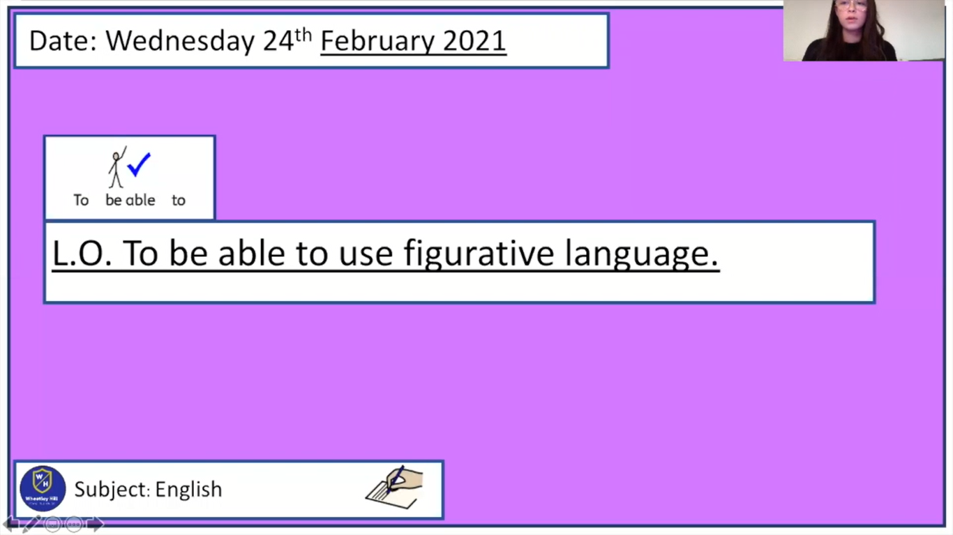
Pre-recorded Teaching
Miss Umpleby’s online teaching video is on our school website. It will support you to complete the work in this lesson. This video will act as a support but all of the work can still be successfully understood & completed using paper-based versions of this pack. If you need further support to understand / complete work then please contact school via e-mail or telephone.
You can also copy and paste this link if you would prefer:
https://www.whprimary.com/copy-4-of-covid19

Slide 48
What is onomatopoeia?
Onomatopoeia is when a word sounds like the noise it is describing.
It can help to bring a story to life for the reader.

Slide 49
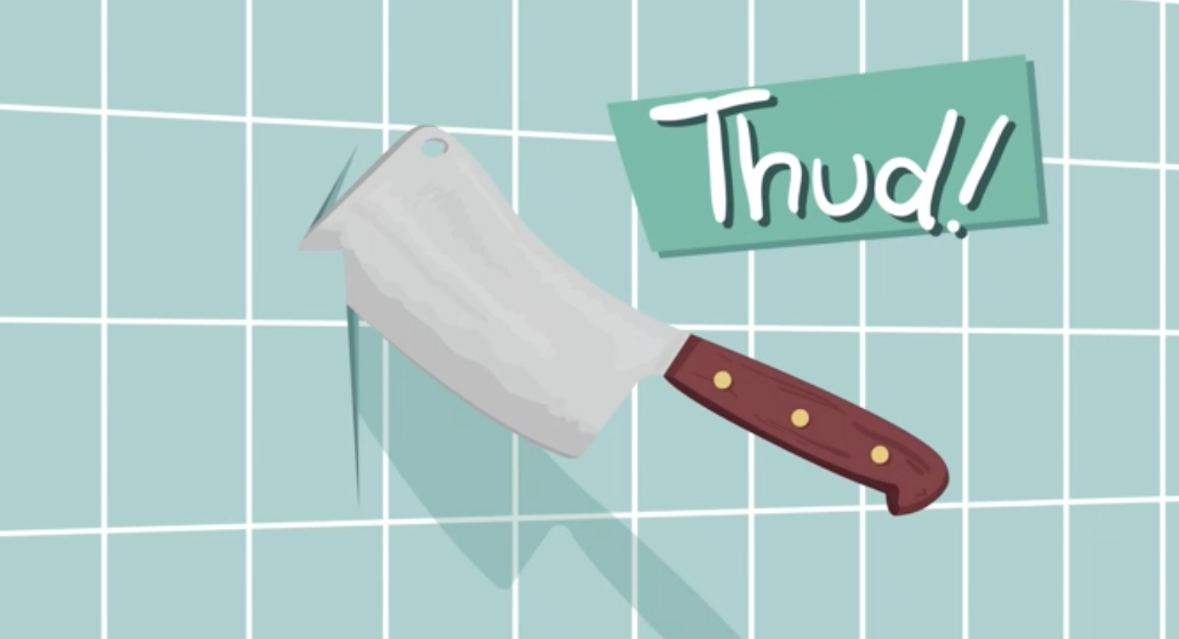
Examples
Thud

Slide 50
Examples
Thud
The knife thudded into the wall.

Slide 51
Examples
Bang

Slide 52
Examples
Bang
A sudden bang broke the night’s silence.

Slide 53
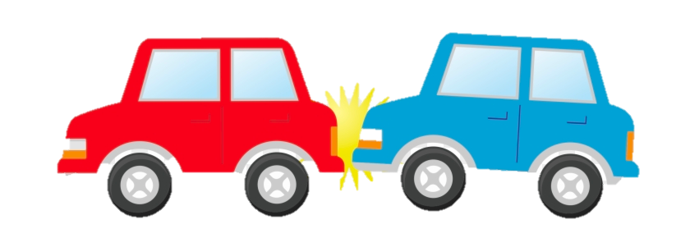
Examples
Crash

Slide 54
Examples
Crash
As we investigated the scene, there was a crash in the cellar.

Slide 55
Onomatopoeia in sentences.
The owl hooted in the tree.
The leaves crunched under my feet as I walked through the woods.
The wind was howling in the darkens.
There was a loud bang at the door.

Slide 56
Examples of onomatopoeia in Arthur Conan Doyle's Stories. Write down the examples of onomatopoeia.
The wind was howling outside, and the rain was beating and splashing against the windows.
The pistol clinked upon the stone floor.
The handcuffs clattered upon his wrists.

Slide 57
Examples of onomatopoeia in Arthur Conan Doyle's Stories.
The wind was howling outside, and the rain was beating and splashing against the windows.
The pistol clinked upon the stone floor.
The handcuffs clattered upon his wrists.

Slide 58
Let’s write some examples together. Choose a word to create onomatopoeia.
I listened to the ____ of the leaves as I made my way through the graveyard.
The door ___ open.
The wind ____ in the darkens.
The mansion was eerie, only the ___ clock could be heard.
crunch/rustle
creaked/slammed
roared/ howled
ticking/clicking

Slide 59
Here are the ones I chose.
I listened to the rustle of the leaves as I made my way through the graveyard.
The door creaked open.
The wind howled in the darkens.
The mansion was eerie, only the ticking clock could be heard.
crunch/rustle
creaked/slammed
roared/ howled
ticking/clicking

Slide 60
Let’s write some examples together. Fill in the missing word.
I heard the ____ of a twig.
The fire _____, keeping the room warm.
The rain ______ down for hours on end.

Slide 61
Let’s write some examples together. Fill in the missing word.
I heard the snap of a twig.
The fire crackled, keeping the room warm.
The rain drizzled down for hours on end.

Slide 62
Write a sentence that includes onomatopoeia to describe this photograph.
Word bank:
Howled,
Creaked,
Ticked,
Slammed,
Rustled.

Slide 63
Write a sentence that includes onomatopoeia to describe this photograph.
As I made my way towards the steps of the mansion, the wind howled.

Slide 64
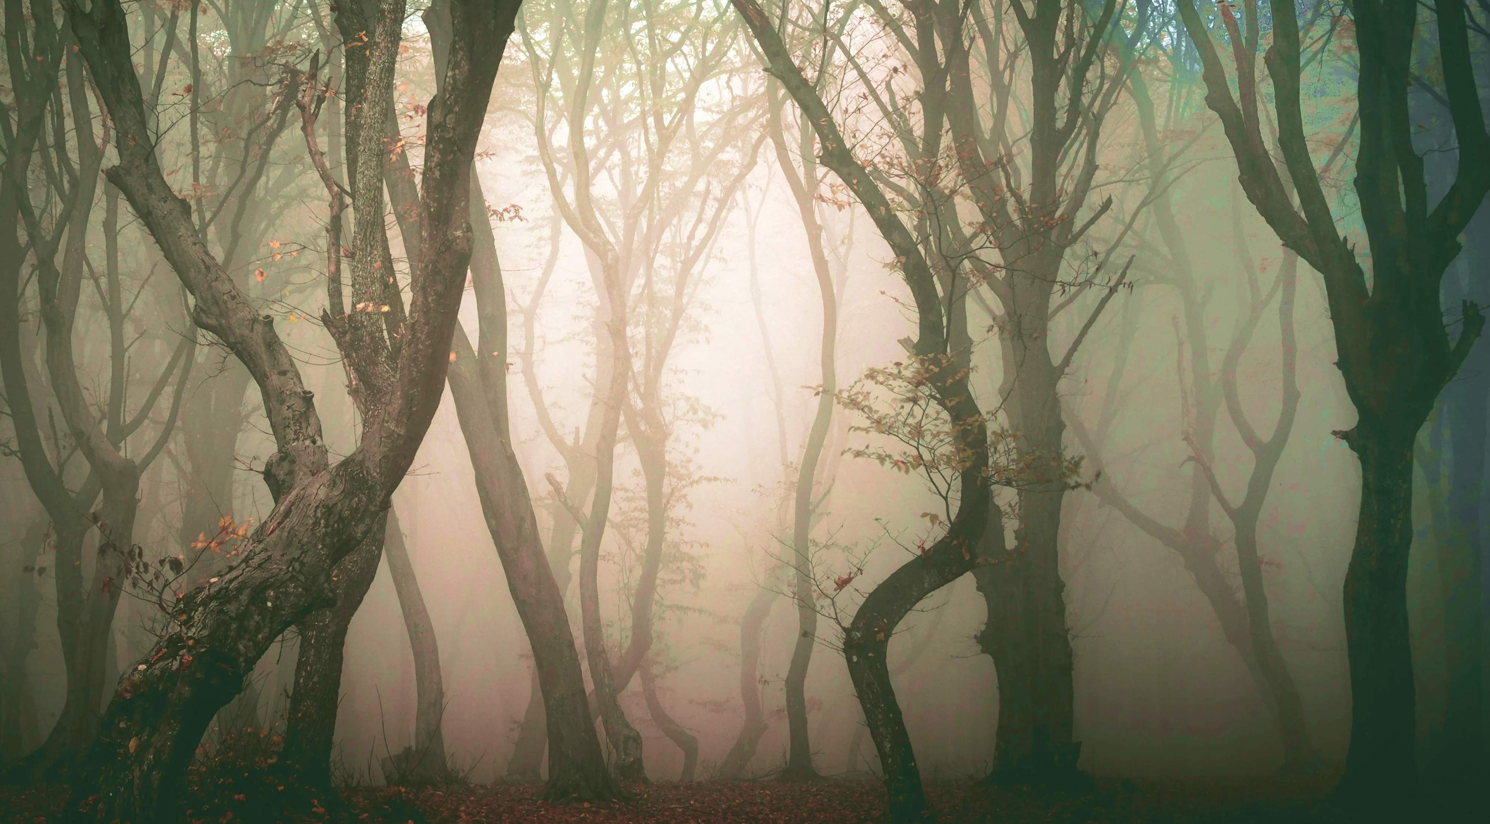
Task
Write 6 sentences that include an onomatopoeia. You can use the photos and word bank to help you.
Word bank:
Howled,
Creaked,
Ticked,
Slammed,
Rustled.
Don’t forget to try and include mystery vocabulary.

Slide 65
Reading time
Now that you have finished your main task, please enjoy some reading time.
You can read to yourself, an adult or sibling.
This can be done by logging on to your myON account, picking a book or magazine and enjoying at least 15 minutes reading time.
https://www.myon.co.uk/login/index.html
Remember that your login is your first name and first letter of your surname then password:
harryp
password1
Please email trailblazerspupils@gmail.com if you have any login issues.

Slide 66
End of lesson.

Slide 67
Read, copy, cover, spell this week’s spellings.
Date: Thursday 25th February 2021
deceive
conceive
receive
perceive
ceiling
receipt
protein
caffeine
seize
neither

Slide 68
Date: Thursday 25th February 2021
L.O. To be able to vary sentence length for effect.
Subject: English

Slide 69
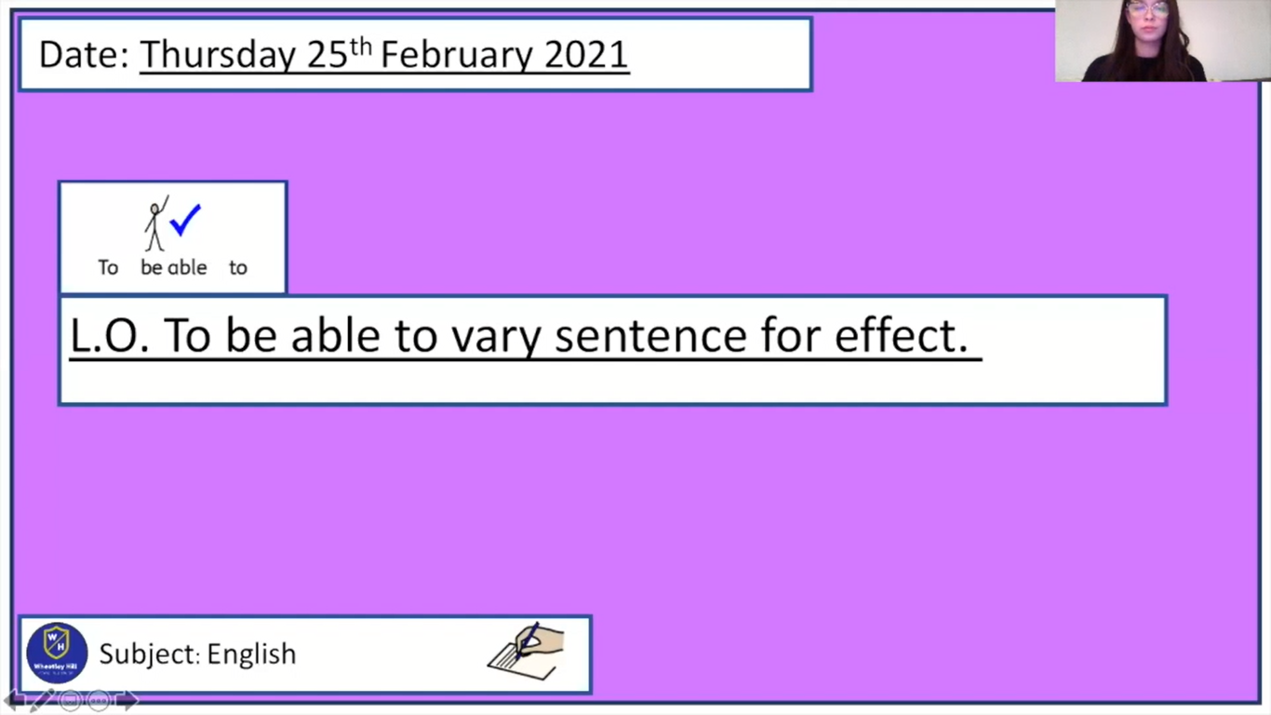
Pre-recorded Teaching
Miss Umpleby’s online teaching video is on our school website. It will support you to complete the work in this lesson. This video will act as a support but all of the work can still be successfully understood & completed using paper-based versions of this pack. If you need further support to understand / complete work then please contact school via e-mail or telephone.
You can also copy and paste this link if you would prefer:
https://www.whprimary.com/copy-4-of-covid19

Slide 70
When we are writing we should always aim to use a variety of sentence types. This means sometimes using long sentences and short sentences.

Slide 71
Varied sentence length.
Short sentences are more punchy, quick and dynamic.
They are good for describing dramatic events or action.
Long sentences can be used to slow a description down.

Slide 72
Short sentences
Short sentences are good for action, and dramatic lines.
Short sentences can create a punchy, choppy rhythm.
A short sentence is a simple sentence with one main clause.
For example:
  A shot rang out.

Slide 73
Long sentences
Long sentences are slow, descriptive or explanatory.
They can create a sense of relaxation, flow, or time dragging.
Using long sentences can create a fluent style and rhythm.
A long sentence can be compound or complex sentences.
For example:
  I jumped out of bed, but nothing was to be seen in the room.

Slide 74
Compound sentence
A compound sentence is a sentence that has more than one main clause.
We link the two main clauses with a coordinating conjunction.
For example: and, or, but and so.
  I jumped out of bed, but nothing was to be seen in the room.

Slide 75
Complex sentence
A complex sentence is a sentence that has one main clause and at least one dependent clause.
We link the two main clauses with a subordinating conjunction.
For example: because, as, although, before, whilst, when, until.
Whilst walking through the wood, he saw a fox that started following him.

Slide 76
Is this a short or long sentence?
But I saw nothing.

Slide 77
Is this a short or long sentence?
But I saw nothing.
This is a short and snappy sentence. In the story, Holmes and Watson had just heard a noise. They sprung out of bed but saw nothing. It adds drama to the story.

Slide 78
Is this a short or long sentence?
I sprang up and lit the lamp, but nothing was to be seen in the room.

Slide 79
Is this a short or long sentence?
I sprang up and lit the lamp, but nothing was to be seen in the room.
This is a long, compound sentence. This long sentence is used to explain events that happened.

Slide 80
Write down one short and one long sentence from this text.
It was a wild night. The wind was howling outside, and the rain was beating and splashing against the windows. Suddenly, amid all the hubbub of the gale, there burst forth the wild scream of a terrified woman. I knew that it was my sister’s voice.
Why does Arthur Conan Doyle vary the sentence length?

Slide 81
Write down one short and one long sentence from this text.
It was a wild night. The wind was howling outside, and the rain was beating and splashing against the windows. Suddenly, amid all the hubbub of the gale, there burst forth the wild scream of a terrified woman. I knew that it was my sister’s voice.
Why does Arthur Conan Doyle vary the sentence length?

Slide 82
Write down one short and one long sentence from this text.
It was a wild night. The wind was howling outside, and the rain was beating and splashing against the windows. Suddenly, amid all the hubbub of the gale, there burst forth the wild scream of a terrified woman. I knew that it was my sister’s voice.
The paragraph starts with a short sentence. It draws suspense to the story. As a reader, we want to know why it was a wild night.
Arthur Conan Doyle then uses two long sentences to add description about the events that happened that night.
It ends with a short sentence. This brings back the drama.

Slide 83
Let’s write a short sentence about this photo.
The trees crowded over me.
This short and snappy sentence adds tension to the story.

Slide 84
Let’s add a conjunction to make this a longer sentence.
The trees crowded over me as I walked to the steps of the old mansion.
By making the sentence longer we add more description.

Slide 85
Task
Pick one of the scenes below and write 6 sentences about it. Remember to vary your sentence length for effect. Try to add in vocabulary found in a mystery story and onomatopoeia.
Word bank:
And,
Yet,
But,
As,
Whilst,
Although,
Because,
When,
Until.

Slide 86
Reading time
Now that you have finished your main task, please enjoy some reading time.
You can read to yourself, an adult or sibling.
This can be done by logging on to your myON account, picking a book or magazine and enjoying at least 15 minutes reading time.
https://www.myon.co.uk/login/index.html
Remember that your login is your first name and first letter of your surname then password:
harryp
password1
Please email trailblazerspupils@gmail.com if you have any login issues.

Slide 87
End of lesson.

Slide 88
Read, copy, cover, spell this week’s spellings.
Date: Friday 26th February 2021
deceive
conceive
receive
perceive
ceiling
receipt
protein
caffeine
seize
neither

Slide 89
Date: Friday 26th February 2021
L.O. To be able to write a setting description for a mystery narrative.
Subject: English

Slide 90
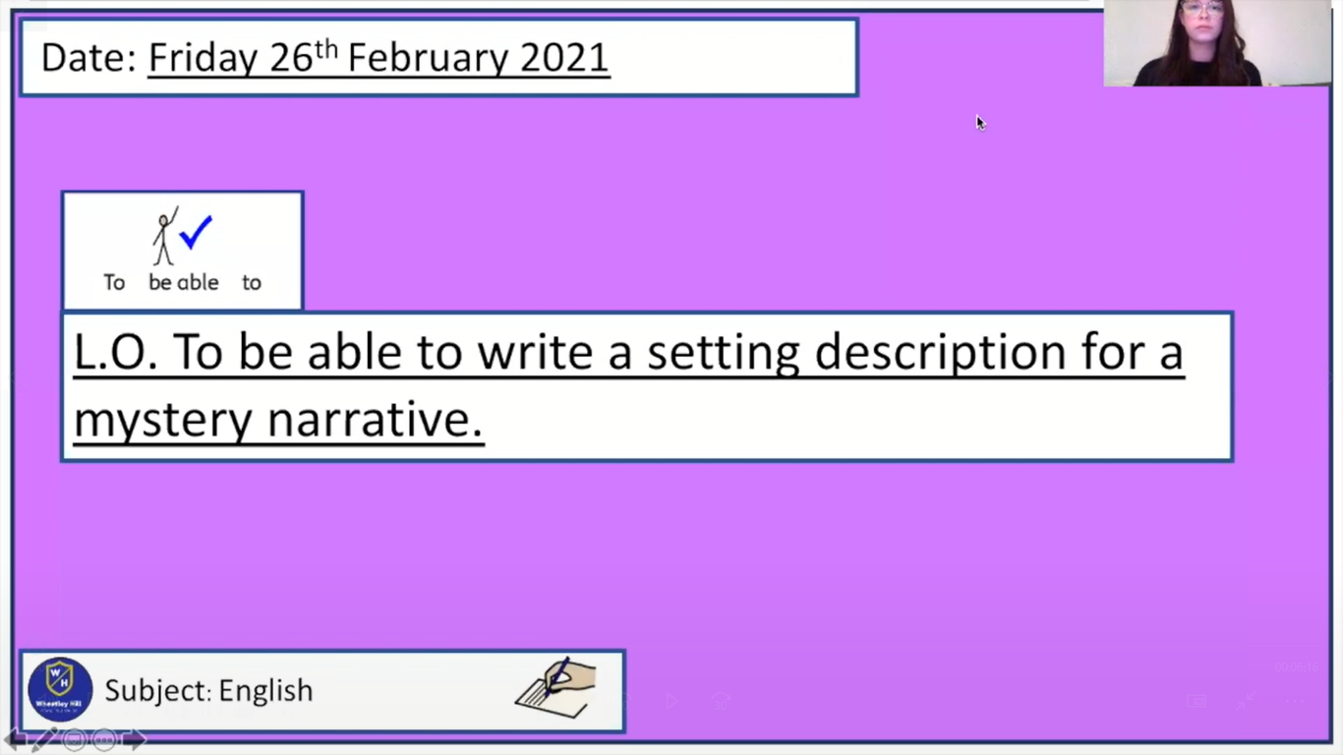
Pre-recorded Teaching
Miss Umpleby’s online teaching video is on our school website. It will support you to complete the work in this lesson. This video will act as a support but all of the work can still be successfully understood & completed using paper-based versions of this pack. If you need further support to understand / complete work then please contact school via e-mail or telephone.
You can also copy and paste this link if you would prefer:
https://www.whprimary.com/copy-4-of-covid19

Slide 91
What should we find in a setting description?
In a mystery story, the main character of the story is often not familiar with the setting of the crime.
Therefore, a lot of detail is given to its description using adjectives, similes, metaphors, personification, onomatopoeia etc.
The setting could be anything you choose.
  For example: a house, mansion, graveyard, woods, school, local town etc.
But it must trigger a mystery.

Slide 92
Read this setting description. What do you think about it?
The building was of grey, lichen-blotched stone, with a high central portion and two curving wings, like the claws of a crab, thrown out on each side. In one of these wings the windows were broken and blocked with wooden boards, while the roof was partly caved in, a picture of ruin. The central portion was in little better repair, but the right-hand block was comparatively modern, and the blinds in the windows, with the blue smoke curling up from the chimneys, showed that this was where the family resided. Some scaffolding had been erected against the end wall, and the stone-work had been broken into, but there were no signs of any workmen at the moment of our visit. Holmes walked slowly up and down the ill-trimmed lawn and examined with deep attention the outsides of the windows.

Slide 93
Read this setting description. What do you think about it?
The building was of grey, lichen-blotched stone, with a high central portion and two curving wings, like the claws of a crab, thrown out on each side. In one of these wings the windows were broken and blocked with wooden boards, while the roof was partly caved in, a picture of ruin. The central portion was in little better repair, but the right-hand block was comparatively modern, and the blinds in the windows, with the blue smoke curling up from the chimneys, showed that this was where the family resided. Some scaffolding had been erected against the end wall, and the stone-work had been broken into, but there were no signs of any workmen at the moment of our visit. Holmes walked slowly up and down the ill-trimmed lawn and examined with deep attention the outsides of the windows.

Slide 94
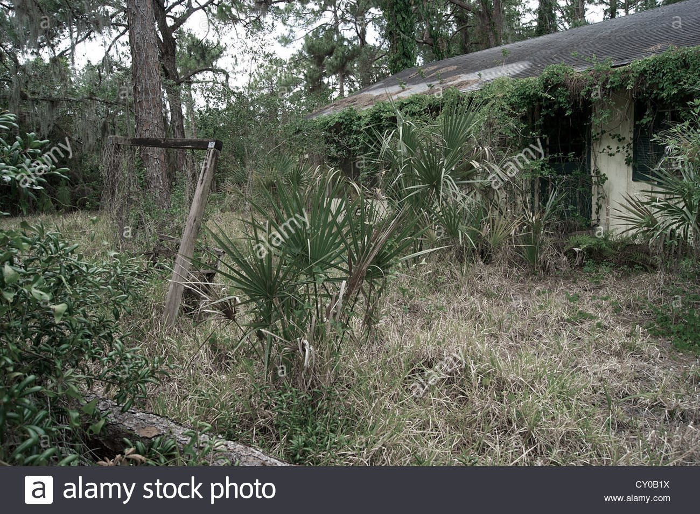
Read this setting description. What do you think about it?
This setting description allows the reader to imagine what the mansion is like. We can imagine a large old stone mansion with broken windows and a broken roof. We also wonder why only one half of the mansion is modern. This might be revealed later in the story. We can also imagine an overgrown garden that hasn’t been taken care of.

Slide 95
What should we include in our setting description?
First you need to pick where your setting is.
There needs to be some mystery to the setting.
You could include some clues or signs there has been a crime that your detective will examine.
You may also wish to add a character to the setting. They may be the ones who asked for your help. They may live at your setting. They could be a victim of the crime. Or they could be the villain that has not yet been revealed.
Arthur Conan Doyle uses Watson as the narrative voice. You could think of a partner for the detective to tell the story through.
Remember to use formal language and a variety of sentence lengths for effect.

Slide 96
Mind-map some ideas for your setting using this template.
Where is the setting?
Is there anything that draws the detective’s attention? There may be things he/she will examine.
What is your detective called?
Setting
Description
What does the setting look like?
Use descriptive language, e.g. adjectives, similes, personification etc.
Does your detective have a partner?
Is anyone there? Does anyone greet you at the setting?

Slide 97
Plan template.
You have just pulled up to the setting.
Where are you? What can you see? Is there anyone here? Is there any buildings?
Include:
Mystery vocabulary
Narrative voice.
Do you notice anything mysterious about the setting?
Include:
Mystery vocabulary
Narrative voice
Descriptive language.
What will you examine?
Include:
Dialogue
Mystery vocabulary
Narrative voice.

Slide 98
Task
Write a setting description for your own mystery story. Use the templates in this lesson and the word banks to help you. Remember to use formal language and a variety of sentence lengths for effect.
Conjunction word bank:
And,
Yet,
But,
As,
Whilst,
Although,
Because,
When,
Until.
Onomatopoeia word bank:
Howled,
Creaked,
Ticked,
Slammed,
Rustled,
Hooted,
Bang,
Crackle,
Smash.
Vocabulary word bank:
Elusive,
Perplexity,
Eerie,
Intrigue
Unknown,
Mysterious,
Strange,
Hidden,
Confusion

Slide 99
My work is finished when:
Joined, neat handwriting.
One paragraph (6 – 8 sentences)
Mystery vocabulary
Figurative language (onomatopoeia, simile, metaphor, personification)
Varied sentence length for effect (short and long sentences)
Narrative voice
Dialogue

Slide 100
Reading time
Now that you have finished your main task, please enjoy some reading time.
You can read to yourself, an adult or sibling.
This can be done by logging on to your myON account, picking a book or magazine and enjoying at least 15 minutes reading time.
https://www.myon.co.uk/login/index.html
Remember that your login is your first name and first letter of your surname then password:
harryp
password1
Please email trailblazerspupils@gmail.com if you have any login issues.

Slide 101
End of lesson.

