Slide 1



Date: Monday 1st February
LO To be able to practise phonics sounds.
LO To be able to answer questions about a text.
Please practise phonics every day for 20 minutes.
Subject: Phonics/Guided Reading

Slide 2
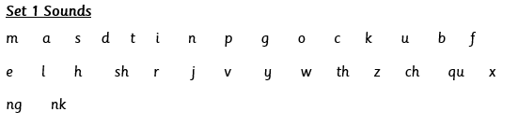

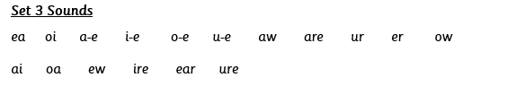
Each day we are going to focus on a different sound.
Please choose from set 1, set 2, set 3 or guided reading. Each day, for phonics, there will be a video to watch and some words to read linked to the taught sound. For guided reading, there will be a text to read and some questions to answer.
Here are the sounds which are in each set.
Please contact the school if you are not sure which set your child should be focusing on, or whether you’re unsure if your child does guided reading rather than phonics.
Then, play some phonics games!
Guided Reading
For those children who know all of the phonics sounds from set 1, set 2 and set 3 and are confident readers.

Slide 3
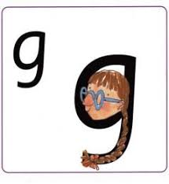
Set 1 Sounds
Skip this slide if your child is not focusing on this set.
Today’s sound:
Please click the link or copy the below link into the internet:
https://www.youtube.com/watch?v=_NID9A6Y4Yo&list=PLPVrkr0oJX1tBTpbocNce93WUH8G-um6A&index=9
Or copy the below into YouTube:
‘Phonic Lesson - Set 1 Sound - Learning to Read and Write “g" for Reception and Year 1’ – Early Years Learning is Fun
Scavenger Hunt!
What can you find in your house that begins with g?

Slide 4

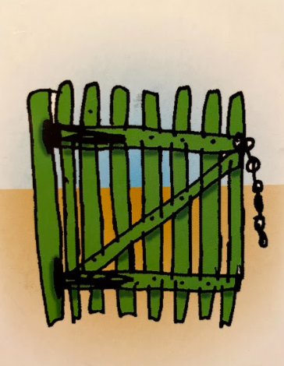
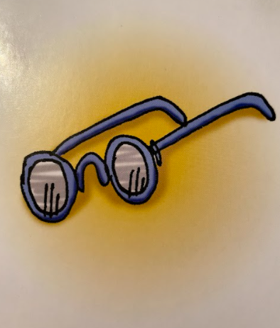
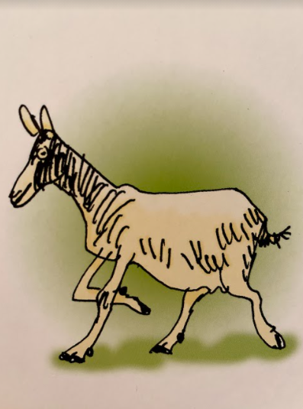
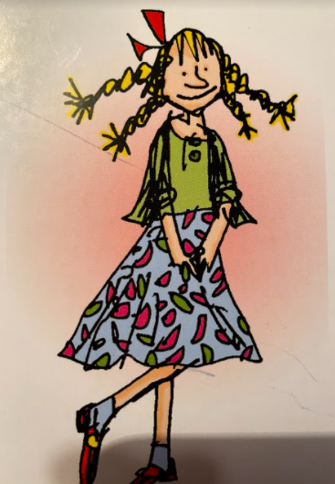


Today’s sound is g. Can you say g, g, g to your adult?
I have some pictures of things that begin with the sound g.
Try saying them out loud to your adult.
g g gate
g g glasses
g g goat
g g girl
Hiding behind the girl is the grapheme g. Can you point to it and say g?
When you see this side of the card say g.
Look at the picture on the left.
That is a
girl.
When you see this picture, as quick as you can say girl.

Slide 5

Below, I have given you some cards. Point to each one and say girl or g.
Now let’s have a go at writing the sound g. Use your finger and move it over the picture card saying, “Round her face, down her hair and give her a curl” or g g g g until you have traced the whole grapheme.
Now have a turn on your own. Keep practising until you get it right.

Slide 6







Set 1 Sounds
Now its time to Fred talk, read the word. Let me show you.
Here is my green word.
I am going to point to the button below each sound and say it out loud. This is Fred Talk.
g a p, after sounding out the word remember to read the word, gap. I have now read the word.
Now time to read some words including ‘g’. You could even practise writing these words!

Slide 7
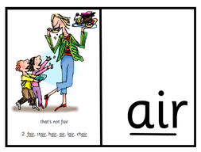
Set 2 Sounds
Skip this slide if your child is not focusing on this set.
Today’s sound:
Please click the link or copy the below link into the internet:
https://www.youtube.com/watch?v=rwLEjJ50LfY&list=PLPVrkr0oJX1sBGLJU2hNbPE2neuhezWSu&index=9
Or copy the below into YouTube:
‘Phonics Lesson - Set 2 'air' sound for Reception and Year 1’
Can you think of any words with the ‘air’ sound in it?

Slide 8
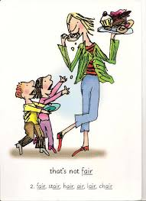

Today’s sound is air. Can you say air, air, air to your adult?
Look at the picture on your left. What can you see?
Can you see that the grown up is eating the cake? That’s right, the children are saying “that’s not fair”
Let’s Fred Talk some ‘air’ words.
h air f air s t air
On the other side of the card is the digraph, air.
These letters are
special friends.
They are three letters that make one sound. When we see them we say,
air.
When we see the picture side we say,
“that’s not fair”

Slide 9
Below, I have given you some cards. Point to each one and say air or that’s not fair.
Now let’s have a go at writing the sound air. You already know how to form each letter. Now we simply put them together to write the sound air
Now have a turn on your own. Keep practising until you get it right.

Slide 10

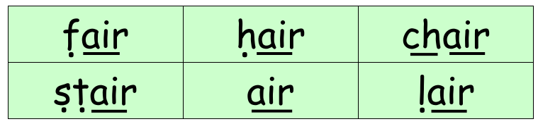
Set 2 Sounds
Now its time to Fred talk, read the word. Let me show you.
Here is my green word.
I am going to point to the button below each sound and say it out loud. This is Fred Talk.
f air, after sounding out the word remember to read the word, fair. I have now read the word.
Now time to read some words including ‘air’. You could even practise writing these words!

Slide 11
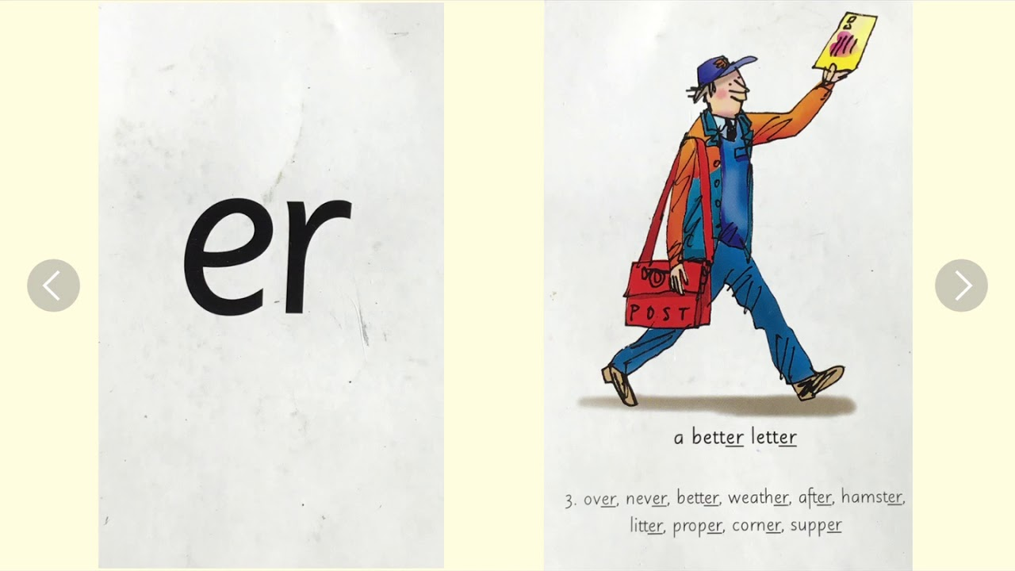
Set 3 Sounds
Skip this slide if your child is not focusing on this set.
Today’s sound:
Please click the link or copy the below link into the internet:
https://www.youtube.com/watch?v=Wg7uwAaR2m4&list=PLPVrkr0oJX1smTl2RWUHKgvupRrMZkKEE&index=9
Or copy the below into YouTube:
Phonics Lesson - Set 3 sound 'er' for Foundation Stage and Year 1
Can you think of any words with the ‘er’ sound in it?

Slide 12
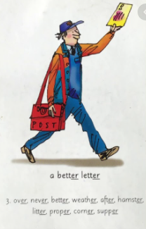
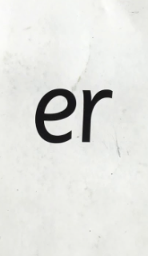
Today’s sound is er. Can you say er, er, er to your adult?
Look at the picture on your left. What can you see?
Can you see the postman with a letter? He is saying,
“a better letter”
Let’s Fred Talk some ‘er’ words.
n e v er u n d er a f t er.
On the other side of the card is the digraph, er.
These letters are
special friends.
They are two letters that make one sound. When we see them we say,
er.
When we see the picture side we say,
“a better letter”

Slide 13
Below, I have given you some cards. Point to each one and say er or a better letter.
Now let’s have a go at writing the sound er. You already know how to form each letter. Now we simply put them together to write the sound er
Now have a turn on your own. Keep practising until you get it right.

Slide 14
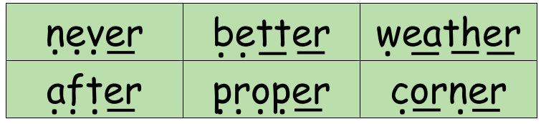
Set 3 Sounds
Now its time to Fred talk, read the word. Let me show you.
Here is my green word.
I am going to point to the button below each sound and say it out loud. This is Fred Talk.
n e v er, after sounding out the word remember to read the word, never. I have now read the word.
Now time to read some words including ‘er’. You could even practise writing these words!

Slide 15
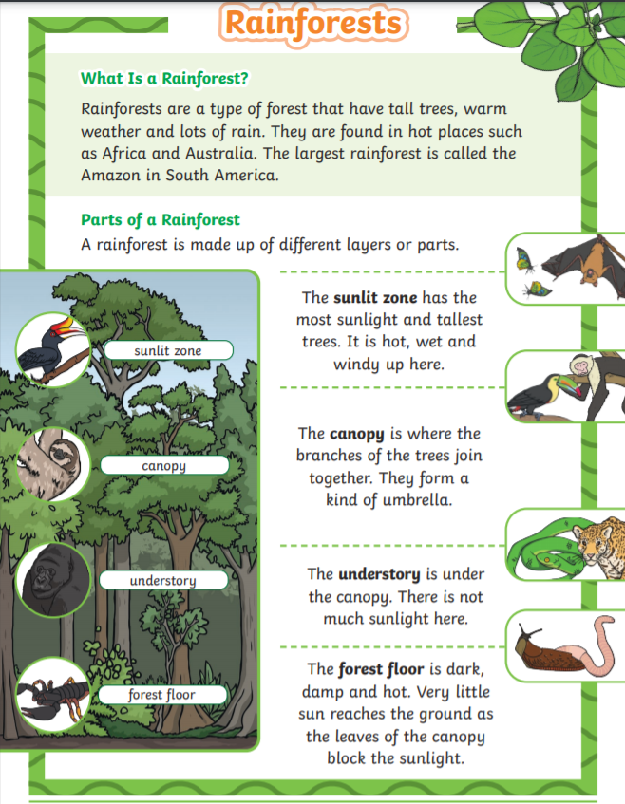
Guided Reading
Page 1
Read the text below before answering the questions on the following slides.

Slide 16
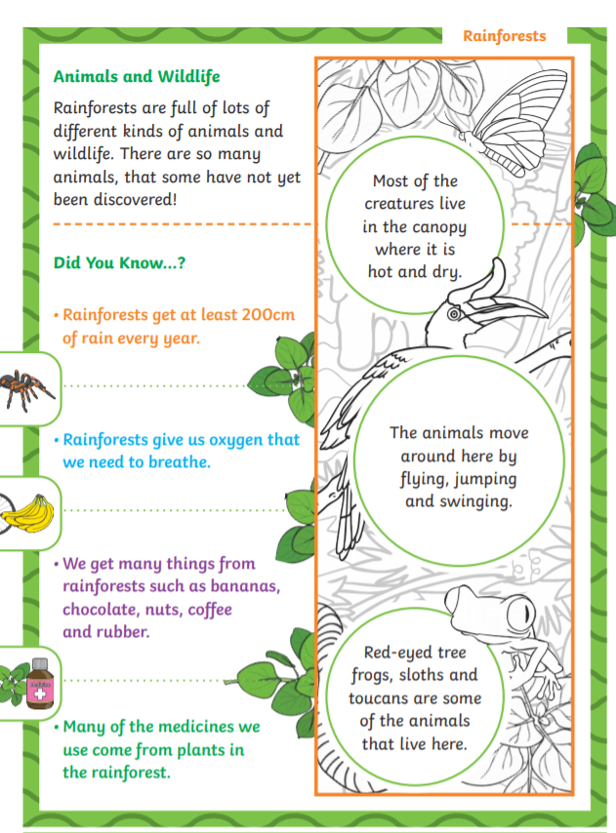
Guided Reading
Page 2
Read the text below before answering the questions on the following slides.

Slide 17
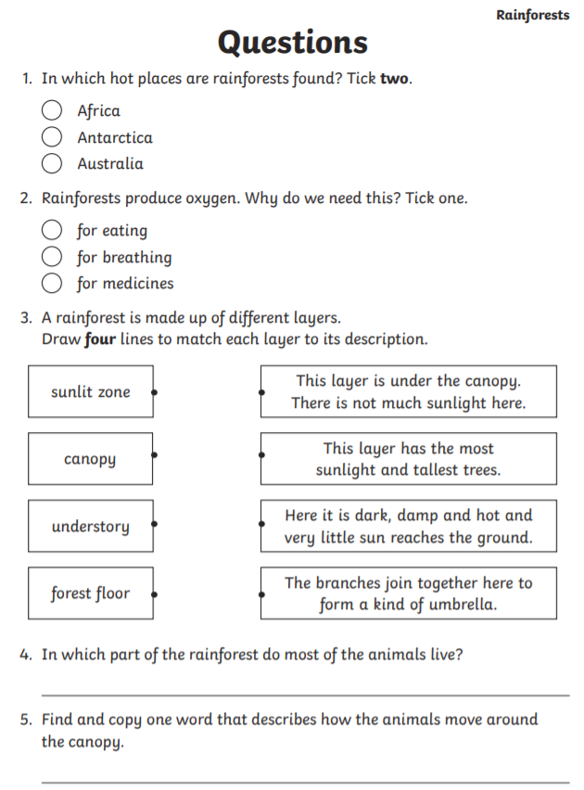
Questions

Slide 18
Date: Tuesday 2nd February
LO To be able to practise phonics sounds.
LO To be able to answer questions about a text.
Please practise phonics every day for 20 minutes.
Subject: Phonics

Slide 19
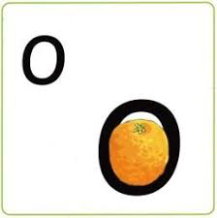
Set 1 Sounds
Skip this slide if your child is not focusing on this set.
Today’s sound:
Please click the link or copy the below link into the internet:
https://www.youtube.com/watch?v=GqixotoeQWc&list=PLPVrkr0oJX1tBTpbocNce93WUH8G-um6A&index=10
Or copy the below into YouTube:
‘Phonic Lesson - Set 1 Sound - Learning to Read and Write “o" for Reception and Year 1’ – Early Years Learning is Fun
Scavenger Hunt!
What can you find in your house that begins with o?

Slide 20
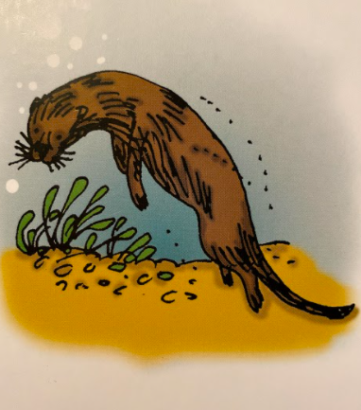
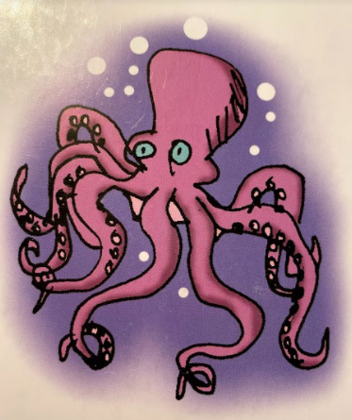
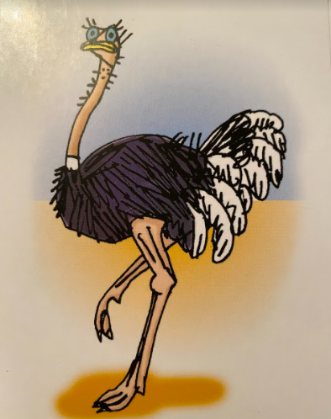
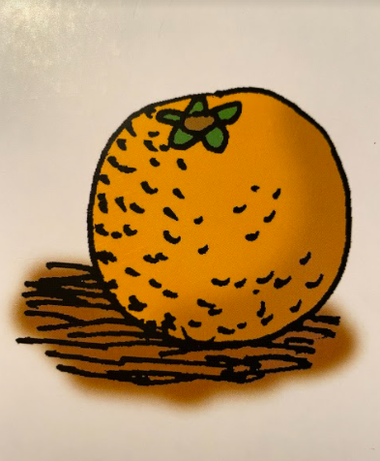


Today’s sound is o. Can you say o, o, o to your adult?
I have some pictures of things that begin with the sound o.
Try saying them out loud to your adult.
o o otter
o o octopus
o o ostrich
o o orange
Hiding behind the orange is the grapheme o. Can you point to it and say o?
When you see this side of the card say o.
Look at the picture on the left.
That is an
orange.
When you see this picture, as quick as you can say orange.

Slide 21
Below, I have given you some cards. Point to each one and say orange or o.
Now let’s have a go at writing the sound o. Use your finger and move it over the picture card saying, “All around the orange” or o o o until you have traced the whole grapheme.
Now have a turn on your own. Keep practising until you get it right.

Slide 22






Set 1 Sounds
Now its time to Fred talk, read the word. Let me show you.
Here is my green word.
I am going to point to the button below each sound and say it out loud. This is Fred Talk.
g o t, after sounding out the word remember to read the word, got. I have now read the word.
Now time to read some words including ‘o’. You could even practise writing these words!

Slide 23

Set 2 Sounds
Skip this slide if your child is not focusing on this set.
Today’s sound:
Please click the link or copy the below link into the internet:
https://www.youtube.com/watch?v=Wh7TpEK6TIY&list=PLPVrkr0oJX1sBGLJU2hNbPE2neuhezWSu&index=10
Or copy the below into YouTube:
‘‘Phonics Lesson - Set 2 ‘ir' sound for Reception and Year 1’
Can you think of any words with the ‘ir’ sound in it?

Slide 24
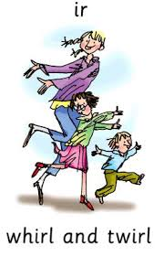

Today’s sound is ir. Can you say ir, ir, ir to your adult?
Look at the picture on your left. What can you see?
Can you see the people dancing? They are whirling and twirling
“whirl and twirl”
Let’s Fred Talk some ‘ir’ words.
wh ir l t w ir l d ir t
On the other side of the card is the digraph, ir.
These letters are
special friends.
They are two letters that make one sound. When we see them we say,
ir.
When we see the picture side we say,
“whirl and twirl”

Slide 25
Below, I have given you some cards. Point to each one and say ir or whirl and twirl.
Now let’s have a go at writing the sound ir. You already know how to form each letter. Now we simply put them together to write the sound ir
Now have a turn on your own. Keep practising until you get it right.

Slide 26

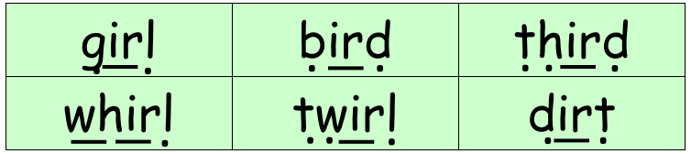
Set 2 Sounds
Now its time to Fred talk, read the word. Let me show you.
Here is my green word.
I am going to point to the button below each sound and say it out loud. This is Fred Talk.
g ir l, after sounding out the word remember to read the word, girl. I have now read the word.
Now time to read some words including ‘ir’. You could even practise writing these words!

Slide 27

Set 3 Sounds
Skip this slide if your child is not focusing on this set.
Today’s sound:
Please click the link or copy the below link into the internet:
https://www.youtube.com/watch?v=4rq0xIjM1Ow&list=PLPVrkr0oJX1smTl2RWUHKgvupRrMZkKEE&index=10
Or copy the below into YouTube:
Phonics Lesson - Set 3 sound 'are' for Foundation Stage and Year 1
Can you think of any words with the ‘are’ sound in it?

Slide 28
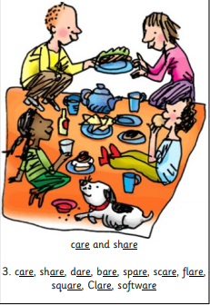
Today’s sound is are. Can you say are, are, are to your adult?
Look at the picture on your left. What can you see?
Can you see the family sharing food at a picnic?
“Care and share”
Let’s Fred Talk some ‘are’ words.
sh are c are b are
On the other side of the card is the digraph, are.
These letters are
special friends.
They are three letters that make one sound. When we see them we say,
are.
When we see the picture side we say,
“care and share”

Slide 29
Below, I have given you some cards. Point to each one and say are or care and share.
Now let’s have a go at writing the sound are. You already know how to form each letter. Now we simply put them together to write the sound are
Now have a turn on your own. Keep practising until you get it right.

Slide 30

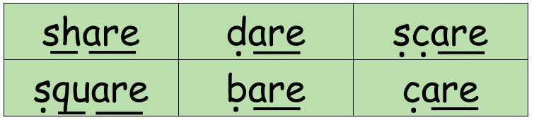
Set 3 Sounds
Now its time to Fred talk, read the word. Let me show you.
Here is my green word.
I am going to point to the button below each sound and say it out loud. This is Fred Talk.
sh are, after sounding out the word remember to read the word, share. I have now read the word.
Now time to read some words including ‘are’. You could even practise writing these words!

Slide 31
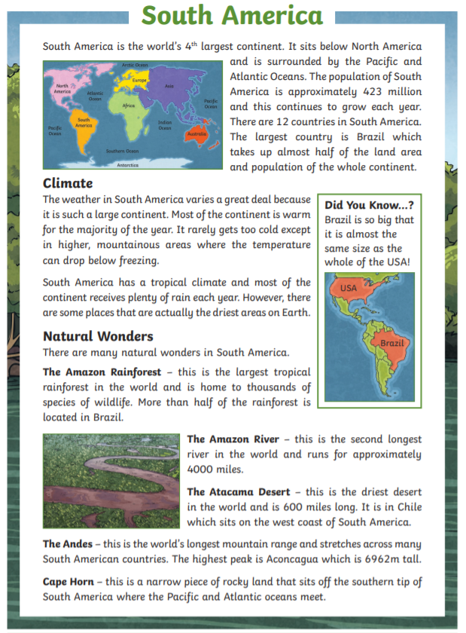
Guided Reading
Page 1
Read the text below before answering the questions on the following slides.

Slide 32
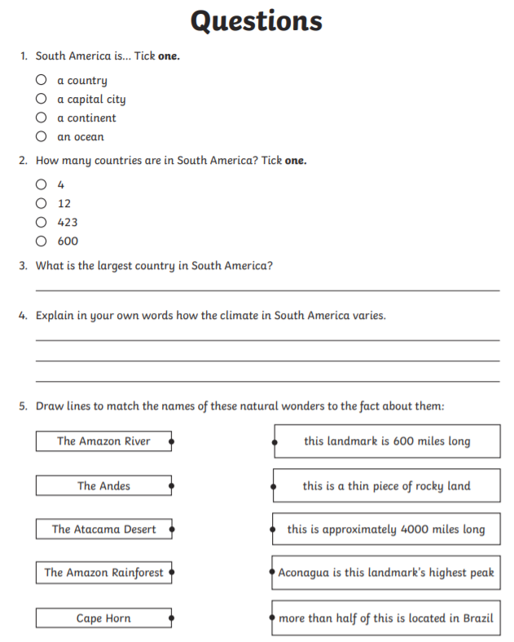
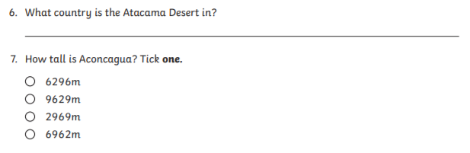
Questions

Slide 33
Date: Wednesday 3rd February
LO To be able to practise phonics sounds.
LO To be able to answer questions about a text.
Please practise phonics every day for 20 minutes.
Subject: Phonics

Slide 34

Set 1 Sounds
Skip this slide if your child is not focusing on this set.
Today’s sound:
Please click the link or copy the below link into the internet:
https://www.youtube.com/watch?v=KkL8e50c6i4&list=PLPVrkr0oJX1tBTpbocNce93WUH8G-um6A&index=11
Or copy the below into YouTube:
‘Phonic Lesson - Set 1 Sound - Learning to Read and Write “c" for Reception and Year 1’ – Early Years Learning is Fun
Scavenger Hunt!
What can you find in your house that begins with c?

Slide 35
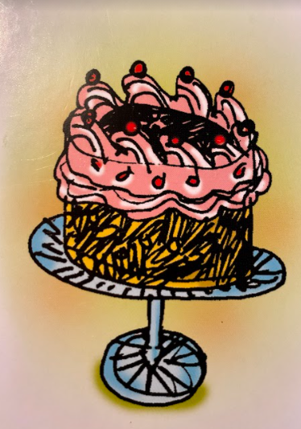
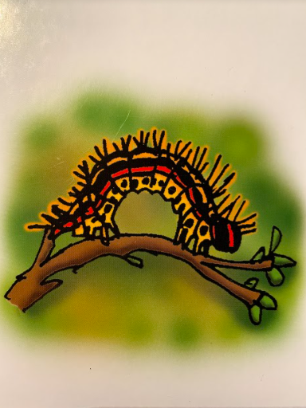
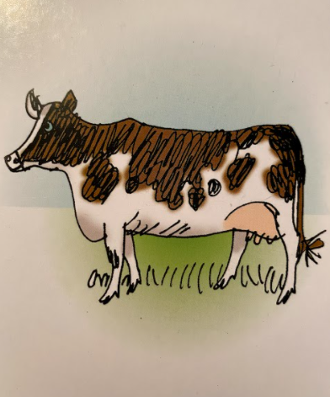
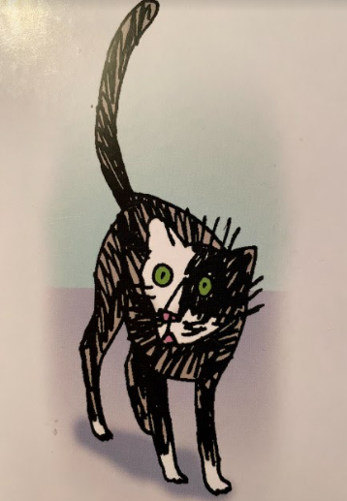


Today’s sound is c. Can you say c, c, c to your adult?
I have some pictures of things that begin with the sound c.
Try saying them out loud to your adult.
c c cake
c c caterpillar
c c cow
c c cat
Hiding behind the caterpillar is the grapheme c. Can you point to it and say c?
When you see this side of the card say c.
Look at the picture on the left.
That is a
caterpillar.
When you see this picture, as quick as you can say caterpillar.

Slide 36
Below, I have given you some cards. Point to each one and say caterpillar or c.
Now let’s have a go at writing the sound c. Use your finger and move it over the picture card saying, “Curl around the caterpillar” or c c c until you have traced the whole grapheme.
Now have a turn on your own. Keep practising until you get it right.

Slide 37


Set 1 Sounds
Now its time to Fred talk, read the word. Let me show you.
Here is my green word.
I am going to point to the button below each sound and say it out loud. This is Fred Talk.
c u p, after sounding out the word remember to read the word, cup. I have now read the word.
Now time to read some words including ‘c’. You could even practise writing these words!

Slide 38

Set 2 Sounds
Skip this slide if your child is not focusing on this set.
Today’s sound:
Please click the link or copy the below link into the internet:
https://www.youtube.com/watch?v=WIxsvUbulYY&list=PLPVrkr0oJX1sBGLJU2hNbPE2neuhezWSu&index=11
Or copy the below into YouTube:
‘Phonics Lesson - Set 2 'ou' sound for Reception and Year 1’
Can you think of any words with the ‘ou’ sound in it?

Slide 39

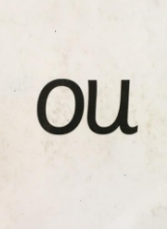
Today’s sound is ou. Can you say ou, ou, ou to your adult?
Look at the picture on your left. What can you see?
Can you see the people shouting?
“shout it out”
Let’s Fred Talk some ‘ou’ words.
ou t sh ou t l ou d
On the other side of the card is the digraph, ou.
These letters are
special friends.
They are two letters that make one sound. When we see them we say,
ou.
When we see the picture side we say,
“shout it out”

Slide 40
Below, I have given you some cards. Point to each one and say ou or shout it out.
Now let’s have a go at writing the sound ou. You already know how to form each letter. Now we simply put them together to write the sound ou
Now have a turn on your own. Keep practising until you get it right.

Slide 41

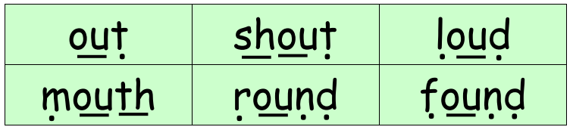
Set 2 Sounds
Now its time to Fred talk, read the word. Let me show you.
Here is my green word.
I am going to point to the button below each sound and say it out loud. This is Fred Talk.
ou t, after sounding out the word remember to read the word, out. I have now read the word.
Now time to read some words including ‘ou’. You could even practise writing these words!

Slide 42

Set 3 Sounds
Skip this slide if your child is not focusing on this set.
Today’s sound:
Please click the link or copy the below link into the internet:
https://www.youtube.com/watch?v=AF6vrRAFn9c&list=PLPVrkr0oJX1smTl2RWUHKgvupRrMZkKEE&index=11
Or copy the below into YouTube:
Phonics Lesson - Set 3 sound 'oa' for Foundation Stage and Year 1
Can you think of any words with the ‘oa’ sound in it?

Slide 43
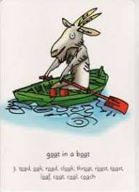

Today’s sound is oa. Can you say oa, oa, oa to your adult?
Look at the picture on your left. What can you see?
Can you see the goat in a boat?
“goat in a boat”
Let’s Fred Talk some ‘oa’ words.
b oa t c oa t r oa d
On the other side of the card is the digraph, oa.
These letters are
special friends.
They are two letters that make one sound. When we see them we say,
oa.
When we see the picture side we say,
“goat in a boat”

Slide 44
Below, I have given you some cards. Point to each one and say oa or goat in a boat.
Now let’s have a go at writing the sound oa. You already know how to form each letter. Now we simply put them together to write the sound oa
Now have a turn on your own. Keep practising until you get it right.

Slide 45

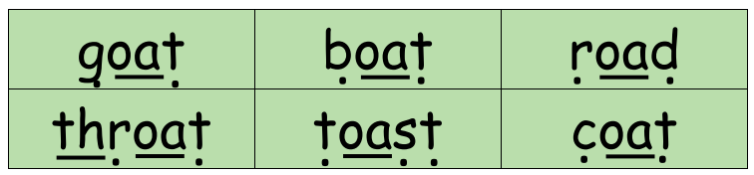
Set 3 Sounds
Now its time to Fred talk, read the word. Let me show you.
Here is my green word.
I am going to point to the button below each sound and say it out loud. This is Fred Talk.
g oa t, after sounding out the word remember to read the word, goat. I have now read the word.
Now time to read some words including ‘oa’. You could even practise writing these words!

Slide 46
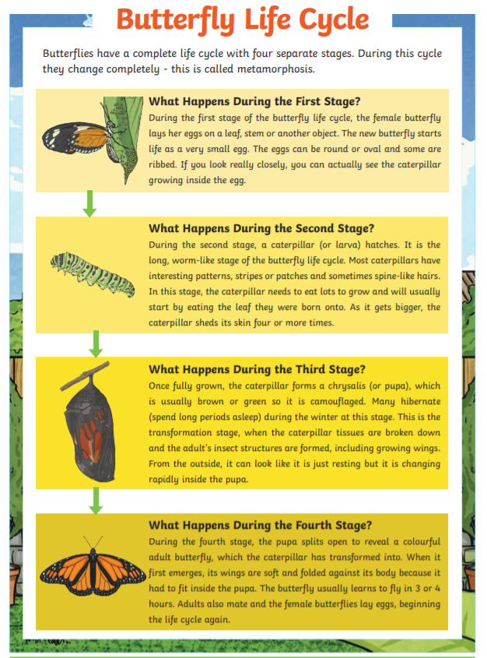
Guided Reading
Guided Reading
Page 1
Page 1
Read the text below before answering the questions on the following slides.

Slide 47
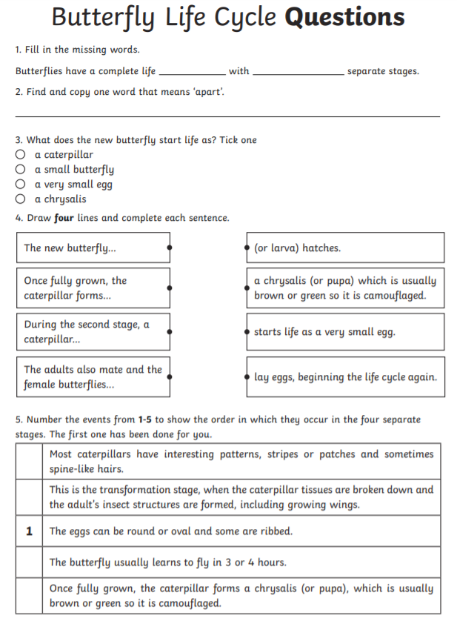
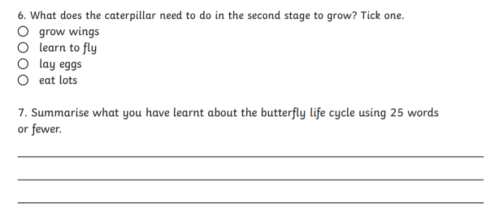
Questions

Slide 48
Date: Thursday 4th February
LO To be able to practise phonics sounds.
LO To be able to answer questions about a text.
Please practise phonics every day for 20 minutes.
Subject: Phonics

Slide 49

Set 1 Sounds
Skip this slide if your child is not focusing on this set.
Today’s sound:
Please click the link or copy the below link into the internet:
https://www.youtube.com/watch?v=PyAmRhsFhd4&list=PLPVrkr0oJX1tBTpbocNce93WUH8G-um6A&index=12
Or copy the below into YouTube:
‘Phonic Lesson - Set 1 Sound - Learning to Read and Write “k" for Reception and Year 1’ – Early Years Learning is Fun
Scavenger Hunt!
What can you find in your house that begins with k?

Slide 50
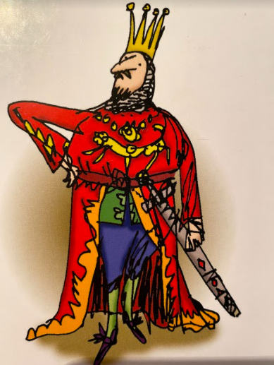
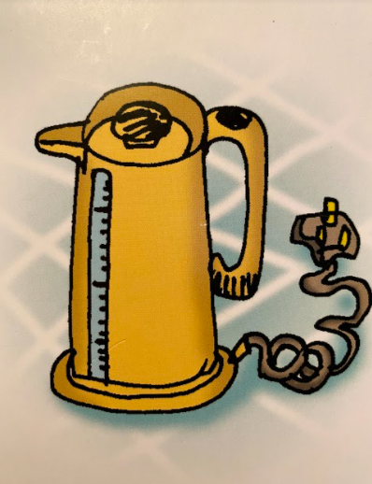
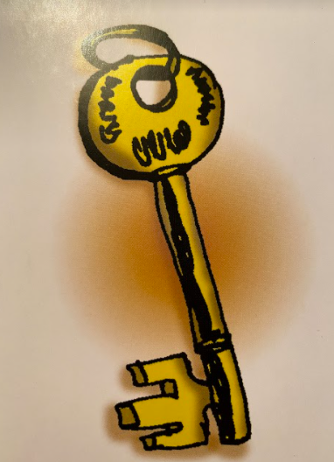
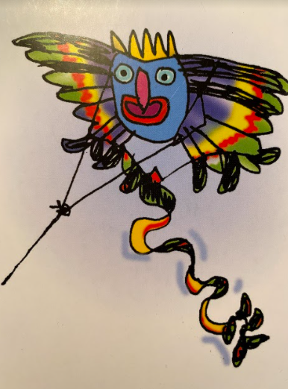


Today’s sound is k. Can you say k, k, k to your adult?
I have some pictures of things that begin with the sound k.
Try saying them out loud to your adult.
k k king
k k kettle
k k key
k k kite
Hiding behind the kangaroo is the grapheme k. Can you point to it and say k?
When you see this side of the card say k.
Look at the picture on the left.
That is a
kangaroo.
When you see this picture, as quick as you can say kangaroo.

Slide 51
Below, I have given you some cards. Point to each one and say kangaroo or k.
Now let’s have a go at writing the sound k. Use your finger and move it over the picture card saying, “Down the kangaroo’s body, tail and leg” or k k k until you have traced the whole grapheme.
Now have a turn on your own. Keep practising until you get it right.

Slide 52

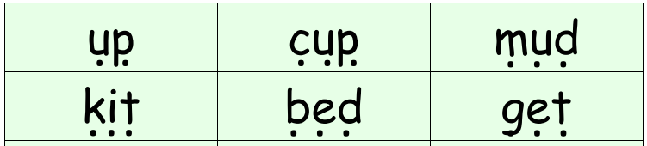
Set 1 Sounds
Now its time to Fred talk, read the word. Let me show you.
Here is my green word.
I am going to point to the button below each sound and say it out loud. This is Fred Talk.
k i t, after sounding out the word remember to read the word, kit. I have now read the word.
Now time to read some words including sounds we have been practising. You could even practise writing these words!

Slide 53

Set 2 Sounds
Skip this slide if your child is not focusing on this set.
Today’s sound:
Please click the link or copy the below link into the internet:
https://www.youtube.com/watch?v=x1nuoVWUix8&list=PLPVrkr0oJX1sBGLJU2hNbPE2neuhezWSu&index=12
Or copy the below into YouTube:
‘Phonics Lesson - Set 2 'oy' sound for Reception and Year 1’
Can you think of any words with the ‘oy’ sound in it?

Slide 54
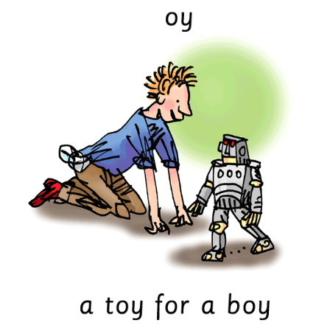

Today’s sound is oy. Can you say oy, oy, oy to your adult?
Look at the picture on your left. What can you see?
Can you see the boy playing with a toy?
“toy for a boy”
Let’s Fred Talk some ‘oy’ words.
t oy b oy e n j oy
On the other side of the card is the digraph, oy.
These letters are
special friends.
They are two letters that make one sound. When we see them we say,
oy.
When we see the picture side we say,
“toy for a boy”

Slide 55
Below, I have given you some cards. Point to each one and say oy or toy for a boy.
Now let’s have a go at writing the sound oy. You already know how to form each letter. Now we simply put them together to write the sound oy
Now have a turn on your own. Keep practising until you get it right.

Slide 56

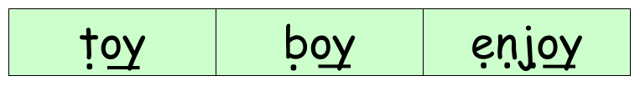
Set 2 Sounds
Now its time to Fred talk, read the word. Let me show you.
Here is my green word.
I am going to point to the button below each sound and say it out loud. This is Fred Talk.
b oy, after sounding out the word remember to read the word, boy. I have now read the word.
Now time to read some words including ‘oy’. You could even practise writing these words!

Slide 57
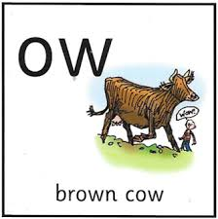
Set 3 Sounds
Skip this slide if your child is not focusing on this set.
Today’s sound:
Please click the link or copy the below link into the internet:
https://www.youtube.com/watch?v=XCntWjLYvw0&list=PLPVrkr0oJX1smTl2RWUHKgvupRrMZkKEE&index=12
Or copy the below into YouTube:
Phonics Lesson - Set 3 sound 'ow' for Foundation Stage and Year 1
Can you think of any words with the ‘ow’ sound in it?

Slide 58
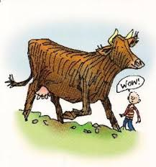

Today’s sound is ow. Can you say ow, ow, ow to your adult?
Look at the picture on your left. What can you see?
That’s right you can see a brown cow.
“brown cow”
Let’s Fred Talk some ‘ow’ words.
c ow n ow h ow
On the other side of the card is the digraph, ow.
These letters are
special friends.
They are two letters that make one sound. When we see them we say,
ow.
When we see the picture side we say,
“brown cow”

Slide 59
Below, I have given you some cards. Point to each one and say ow or brown cow.
Now let’s have a go at writing the sound ow. You already know how to form each letter. Now we simply put them together to write the sound ow
Now have a turn on your own. Keep practising until you get it right.

Slide 60

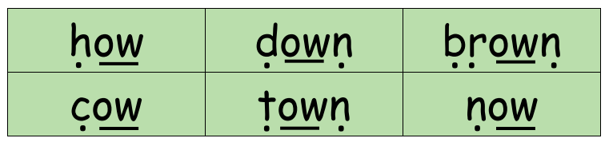
Set 3 Sounds
Now its time to Fred talk, read the word. Let me show you.
Here is my green word.
I am going to point to the button below each sound and say it out loud. This is Fred Talk.
h ow, after sounding out the word remember to read the word, how. I have now read the word.
Now time to read some words including ‘ow’. You could even practise writing these words!

Slide 61

Guided Reading
Page 1
Read the text below before answering the questions on the following slides.

Slide 62

Guided Reading
Page 2
Read the text below before answering the questions on the following slides.

Slide 63

Questions

Slide 64
Date: Friday 5th February
LO To be able to practise reading and writing tricky words.
LO To be able to answer questions about a text.
Please practise phonics every day for 20 minutes.
Subject: Phonics

Slide 65

If you’ve got a dice at home, roll the dice and say the words you land on!
Who will finish first?

Slide 66

Can you make it to the finish line by reading the tricky words?
Pick some of the words which you struggle with the most and see how many times you can write the word in 1 minute. Go!

Slide 67



Tricky Words!
https://www.youtube.com/watch?v=TvMyssfAUx0
‘Tricky Words and Sight Words Song’ - YouTube
https://www.youtube.com/watch?v=R087lYrRpgY&t=2s
‘Phase 3 Say Hello To’ - YouTube
https://www.youtube.com/watch?v=3NOzgR1ANc4
‘Phase 4 Tricky Words Song’ - YouTube

Slide 68




Games & Videos!
https://www.phonicsplay.co.uk/resources
Username: jan21
Password: home
https://www.bbc.co.uk/bitesize/topics/zcqqtfr
https://www.phonicsbloom.com/
https://www.bbc.co.uk/cbeebies/shows/alphablocks
https://www.youtube.com/channel/UC_qs3c0ehDvZkbiEbOj6Drg

Slide 69

Daily Phonics Videos
Click the below link, copy and paste into the internet or search ‘Ruth Miskin Training’ in YouTube to see daily phonics videos.
Read Write Inc are offering free phonics lessons on YouTube. Videos for all abilities are available.
They are posted at 9.30am and are available for 24 hours.
https://www.youtube.com/channel/UCo7fbLgY2oA_cFCIg9GdxtQ

Slide 70


Guided Reading
Page 1

Slide 71


Guided Reading
Page 2

Slide 72

Questions

