Slide 1




Date: Monday 11th January
LO To count in 5’s
Subject: Maths

Slide 2
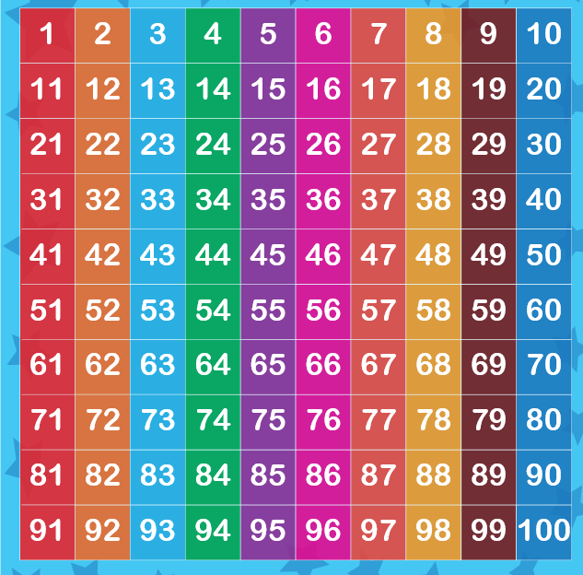
Today we are going to be counting in 5’s. Please can you help your child count in 5’s on the number grid.
Here is a website to help you count in 5’s, but also get up and groove!
https://www.youtube.com/watch?app=desktop&v=amxVL9KUmq8

Slide 3

Can you now fill in the missing numbers to 5’s
0
10
20
10
25
40
10
15
45
55
70

Slide 4
20
25
30
40
50
60
75
10
95
75

Slide 5
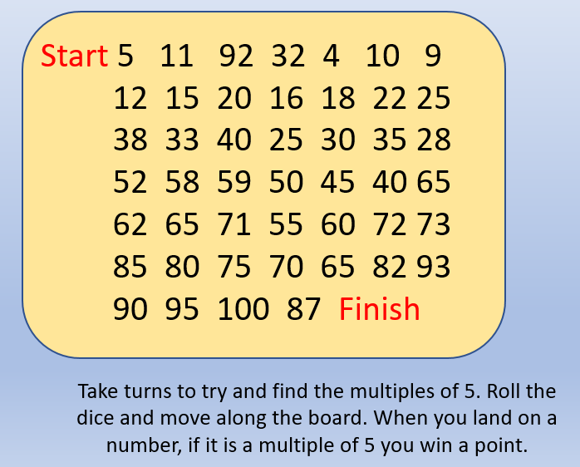
Here is a game to play:

Slide 6
Date: Tuesday 12th January
LO To multiply in 5’s
Subject: Maths

Slide 7
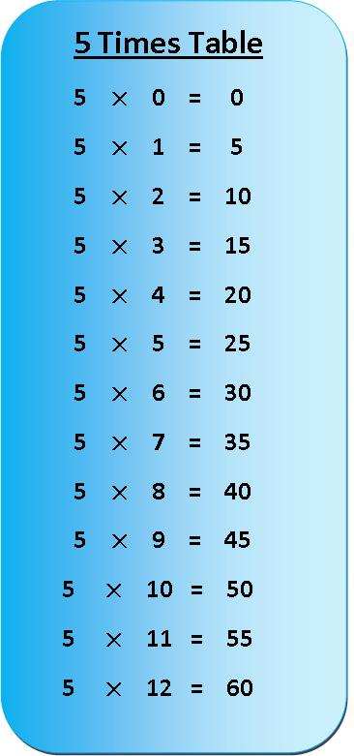
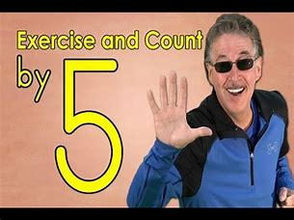
To recap your counting can you now chant in 5’s?
Here is a grid to help you out. May be you could get the rest of the family to join in?
Challenge
Come on boys lets get up and move and groove. Click on the link below and get ready to go.
https://www.bing.com/videos/search?q=jack+hartmann+counting+in+5s&view=detail&mid=DA833F307B1311B7EDF3DA833F307B1311B7EDF3&FORM=VIRE0&ru=%2fsearch%3fq%3djack%2bhartmann%2bcounting%2bin%2b5s%26qs%3dSS%26pq%3djack%2bhartmann%2bcounting%2bin%2b5%26sc%3d1-27%26cvid%3dCD9D49ACFDE045FB96FEEFB5233EDD3A%26FORM%3dQBRE%26sp%3d1%26ghc%3d1%26adlt%3dstrict

Slide 8
Today we are going to be multiplying in 5’s by using number sentences.
5 + 5 + 5 = 15
3 x 5 = 15
5 + 5 + 5 + 5 =
4 x 5 =
5 + 5 =
2 x 5 =
5 + 5 + 5 + 5 + 5 + 5 =
6 x 5 =
5 + 5 + 5 + 5 + 5 + 5 + 5+ 5 + 5 =
9 x 5 =
5 + 5 + 5 + 5 + 5 + 5 + 5=
7 x 5 =
5 + 5 + 5 + 5 + 5 =
5 x 5 =
5 + 5 + 5 + 5 + 5 + 5 + 5 + 5 + 5 + 5 =
10 x 5 =
5 + 5 + 5 + 5 + 5 + 5 + 5 + 5 =
8 x 5 =
5 + 5 + 5 + 5 + 5 + 5 + 5 + 5 + 5 + 5 + 5 =
11 x 5 =

Slide 9
Date Wednesday 13th January
LO multiply in 5’s
Subject: Maths

Slide 10
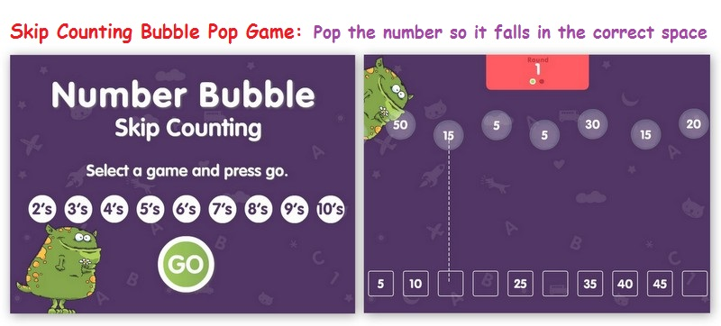
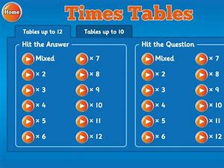
As a warm up to your task here are some number games counting and multiplying by 5
https://www.abcya.com/games/number_bubble_skip_counting
https://www.topmarks.co.uk/maths-games/hit-the-button

Slide 11
Here is a maths challenge for you, can you now multiply in 5’s. I'm ready for you to blow my socks off!
1 x 5=
2 x 5 =
3 x 5 =
4 x 5 =
5 x 5 =
6 x 5 =
7 x 5 =
8 x 5 =
9 x 5 =
10 x 5 =
11 x 5 =
12 x 5 =
10 x 5 =
3 x 5 =
7 x 5 =
5 x 5 =
11 x 5 =
6 x 5 =
1 x 5 =
9 x 5 =
2 x 5 =
12 x 5 =
4 x 5 =
8 x 5 =

Slide 12
Date Thursday 14th January
LO multiply by 5
Subject: Maths

Slide 13
Here is a maths challenge for you, can you now multiply in 5’s. I'm ready for you to blow my socks off!
__ x 5 =5
__ x 5 =10
__ x 5 =15
__ x 5 =20
__ x 5 =25
__ x 5 =30
__ x 5 =35
__ x 5 =40
__ x 5 =45
__ x 5 =50
__ x 5 =55
__ x 5 =60
__ x 5 =50
__ x 5 =15
__ x 5 = 35
__ x 5 =25
__ x 5 =55
__ x 5 =30
__ x 5 =5
__ x 5 =45
__ x 5 =10
__ x 5 =60
__ x 5 =20
__ x 5 = 40

Slide 14
Date Thursday 14th January
LO multiply by 5
Subject: Maths

Slide 15
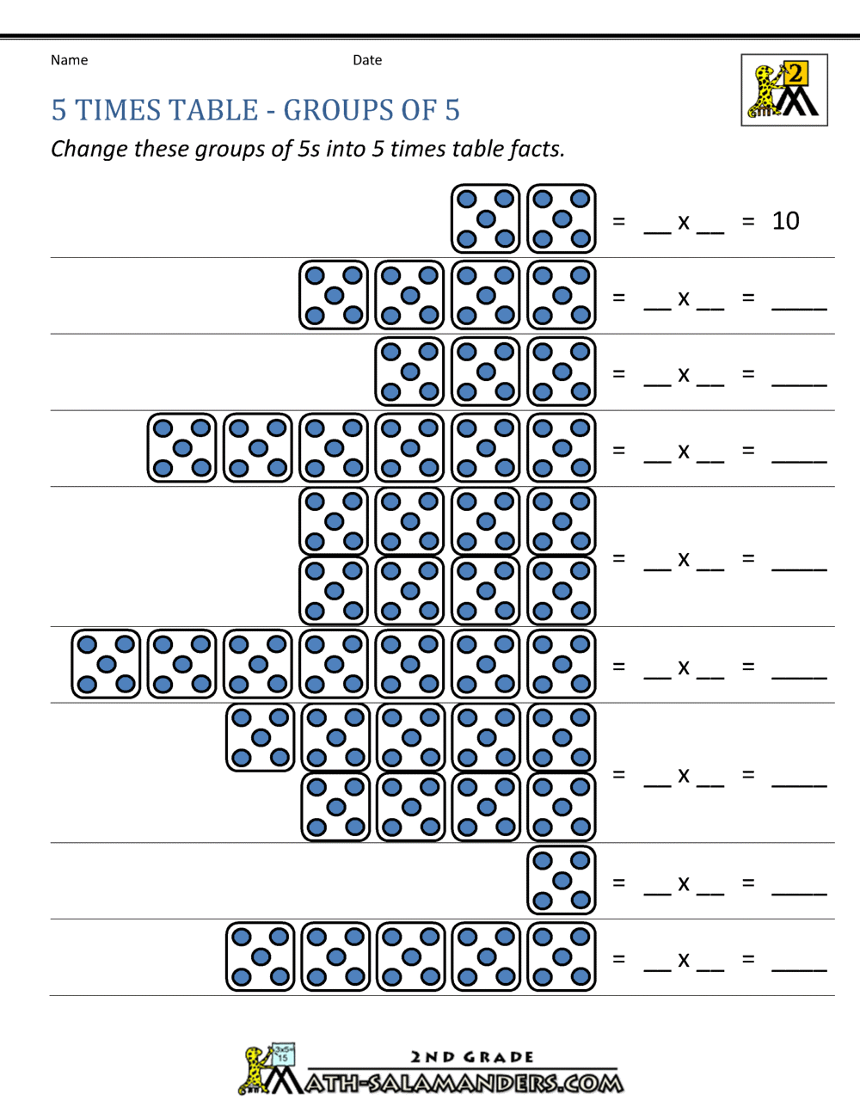
Can you complete your own number sentences?
5 + 5 2 x 5 =10
2 dice
5 + 5 + 5 + 5 4 x 5 =20
4 dice
Can you complete the grid. Please show your working out. Good luck.

