Slide 1


Subject: Maths

Slide 2



Date: 28.6.2021
LO. To develop an understanding of sharing.
Subject: Maths

Slide 3
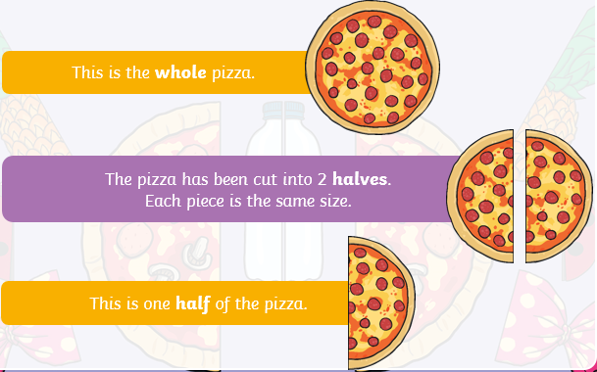

What is halving?
Let’s have a look at what we mean by halving. You might have already heard of it, especially with food such as cakes and pizzas!
Halving is when we split or share something between 2.

Slide 4
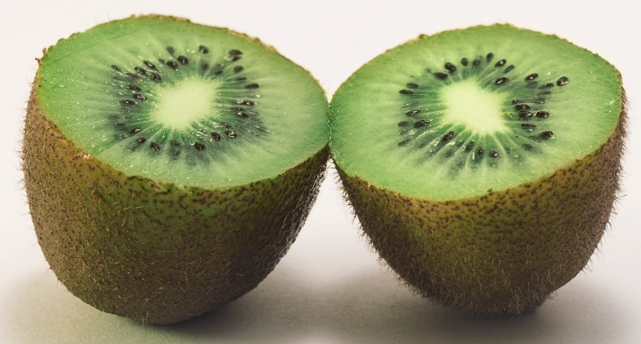
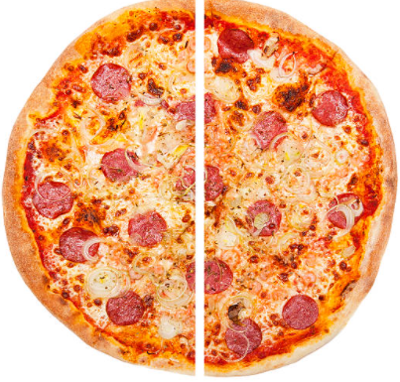
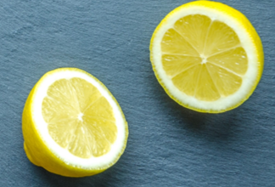
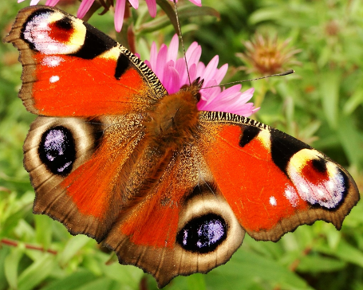
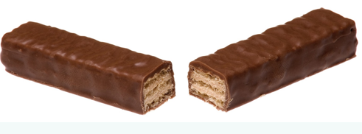
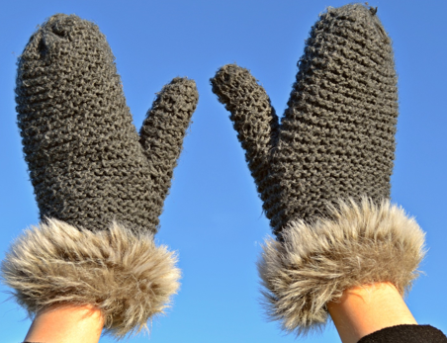
Examples of halving
Here are some foods halved. Items like gloves and socks come in pairs, so half of those are 1 for each hand or foot. The butterfly has 2 wings and the pattern is the same on each.
What other examples can you think of?

Slide 5
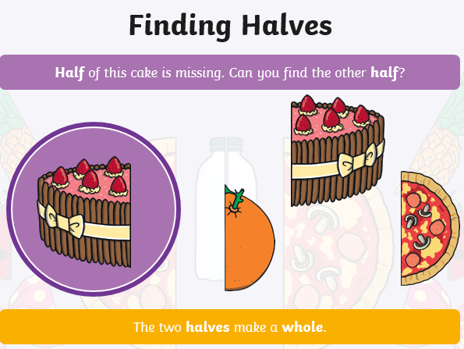

Point to the other half of the cake or you can draw a circle around it.
Which half looks the same?

Slide 6
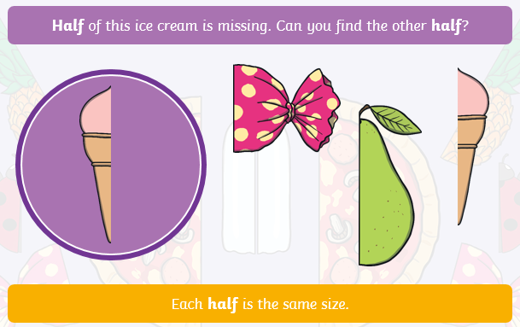

Point to the other half of the ice-cream or you can draw a circle around it.

Slide 7
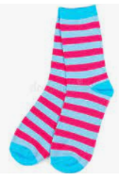
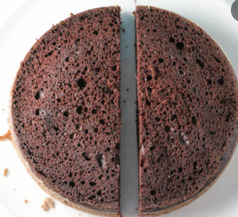
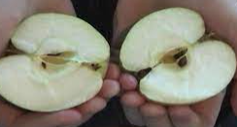
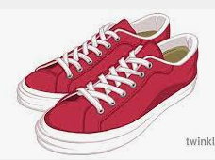
Task: Explore finding halves
I have a special job for you to do. I want you to explore finding halves. You can use different objects or foods you have at home, can you explore finding halves?

Slide 8
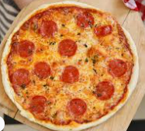
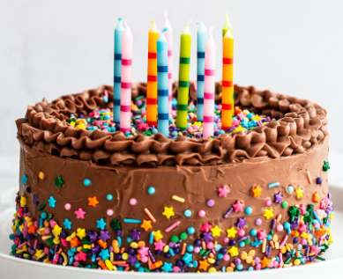
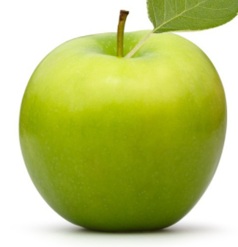
If you would prefer to do a written task, then find half the objects below:
You can draw a line through them or cut them in half. Remember, each part needs to be equal so both halves are the same!
Extension: If you like, you could draw some objects of your own and half them!

Slide 9

End of lesson.
Well done for all your efforts in maths today!

Slide 10
Date: 29.6.2021
LO. To develop an understanding of sharing.
Subject: Maths

Slide 11

Sharing equally
The dots on a butterfly are equally shared out on both wings.
There are 10 dots in total on the butterfly and each wing has 5 dots. The dots are shared equally as each wing has 5 dots.
Sharing equally means what is shared out has to be the same, so for the butterfly, each wing has to have the same number of dots.

Slide 12

Let’s have a look at this butterfly, can you help me to count the dots?
We need to make sure each wing has the same amount of dots so that it is equal.
Each wing has _____ dots.
How many dots are there in total?
_______

Slide 13
Did you get it correct?
Each wing has 3 dots.
How many dots are there in total?
6

Slide 14
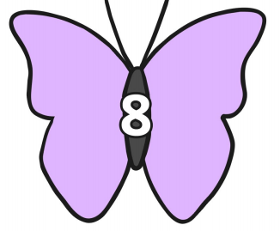
Now, have a try at this one on your own. Can you share 8 dots equally onto the butterfly’s wings?
Drag the dots or draw them on to the wings.
Each wing has _____ dots.

Slide 15
Did you get it correct?
Each wing has 4 dots.

Slide 16
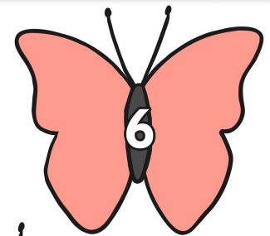

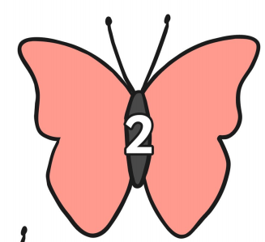

Here is your task, can you share the dots equally on to the wings of the butterflies and ladybirds. You can draw the dots on. The total number of dots the insects need is in the centre of each animal.
4
12

Slide 17

Let’s check, did you get them correct?
4
12

Slide 18
End of lesson.
Well done for all your efforts in maths today!

Slide 19
Date: 30.6.2021
LO. To develop an understanding of sharing.
Subject: Maths

Slide 20

What is sharing?
Sharing is making equal groups of something.
The 6 strawberries are shared equally on the 2 plates.
Each plate has 3 strawberries.
The plates are the same

Slide 21

What happens when it is not equal?
Here there are 3 strawberries on a plate and 6 on another.
This is not equal.
The plates are not the same.
3 6

Slide 22
What happens when it is not equal?
What could we do to make it equal? Have a discussion with your grown up.
3 6
Share them differently?
Eat some?
Get rid of some?

Slide 23


Let’s try and share these objects.
How many cakes would be on each plate?
Remember, each plate needs to have the same number of cakes on it.
You can draw a line from each cake to the plate or draw the cakes on the plate.

Slide 24
Each plate will have 2 cakes.

Slide 25
Now, can you share the 8 cakes equally between the 2 plates?
Each plate has _______ cakes.

Slide 26
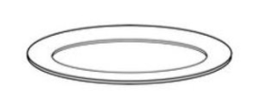
Let’s check…
Each plate has 4 cakes.

Slide 27
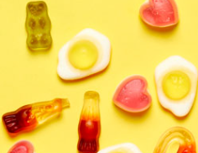
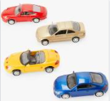
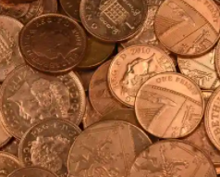
Task- Explore sharing objects
For your task, I would like you to practise sharing different amounts of objects between 2.
When you are sharing different amounts, please use no more than 20 of the same object at a time.
You can try this task practically using toys, sweets, treats, money or any objects you have at home.

Slide 28
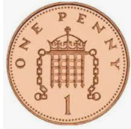
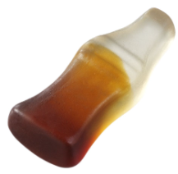

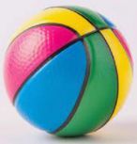
If you don’t want to work practically, you can complete the task below:
You can drag or draw the objects shared out equally onto each plate.

Slide 29
Let’s check your answers:
8 sweets
4 on each plate
6 coins
3 on each plate
10 cars
5 on each plate
12 balls
6 on each plate

Slide 30


If you would like to do more work on sharing, click on the link below.
Pre-recorded Teaching
Access the online teaching video below that will support you to complete the work in this lesson. This video will act as a support but all of the work can still be successfully understood & completed using paper-based versions of this pack. If you need further support to understand / complete work then please contact school via e-mail or telephone.
Play Video
You can also copy and paste this link if you would prefer:
https://classroom.thenational.academy/lessons/understanding-the-concept-of-half-part-1-ccvp8t
When you click on the link make sure you use google chrome to access the full 10 minutes video.

Slide 31
End of lesson.
Well done for all your efforts in maths today!

Slide 32
Date: 1.7.2021
LO. To develop an understanding of sharing using the part/part/whole model.
Subject: Maths

Slide 33
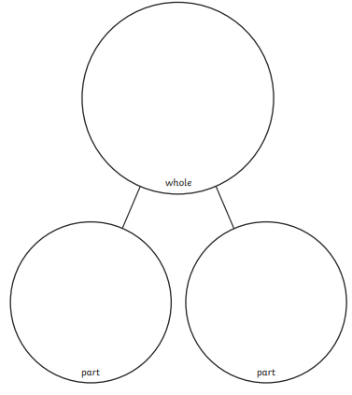
Sharing using part/part/whole model
Let’s have a look at sharing using our part/part/whole model.
The total or number of objects we have is the whole.
We need to share the number of objects out equally between the 2 parts.

Slide 34


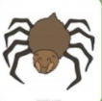
There are 8 leaves (whole)
I have shared them out equally between to two mini beasts.
When we share out the 8 leaves, each mini beast will have 4 leaves.

Slide 35



Can you help me to share the leaves out equally into the parts?
I have done one part, can you make sure the other part is equal?
Each bug gets ______ leaves.

Slide 36
Let’s check your answer.
Each bug gets 3 leaves.

Slide 37
Now you have a try. Share the leaves out equally between the bugs, you can draw them on or drag them into place.
____ leaves
____ leaves each

Slide 38
Let’s check your answer…
12 leaves
6 leaves each

Slide 39
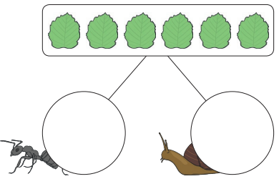
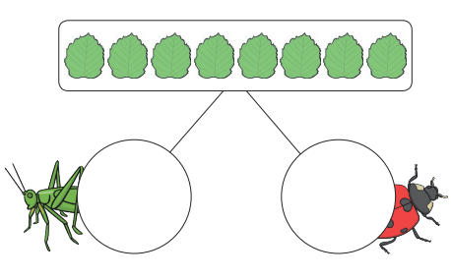
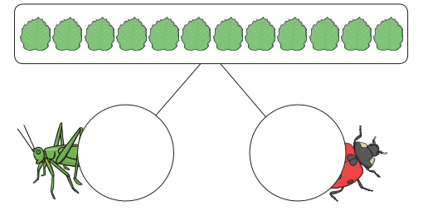
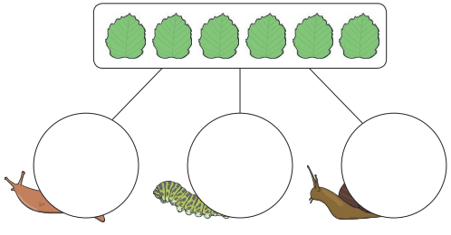
Can you share the leaves between the mini beasts? You can draw the leaves or put dots in the circles to show how many each mini beast would get.
For this one, have a try at sharing between the 3 circles.

Slide 40
Let’s check your answers…
8 leaves
4 leaves each
6 leaves
3 leaves each
12 leaves
6 leaves each
6 leaves
2 leaves each

Slide 41
End of lesson.
Well done for all your efforts in maths today!

Slide 42
Date: 2.7.2021
LO. To be able to re-call doubles .
Subject: Maths

Slide 43
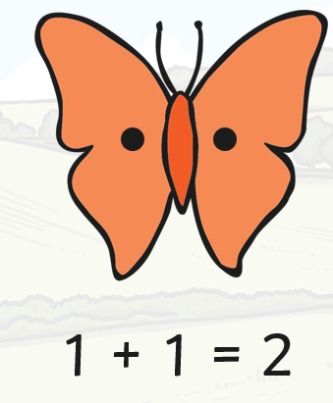
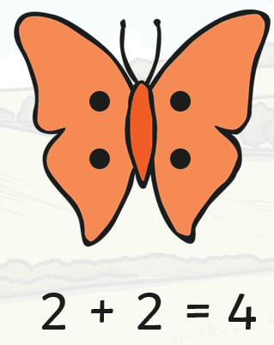
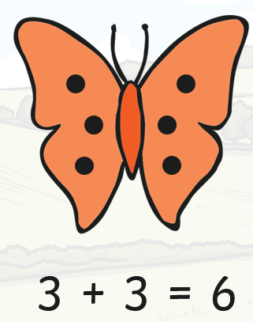
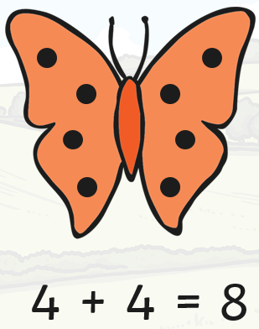
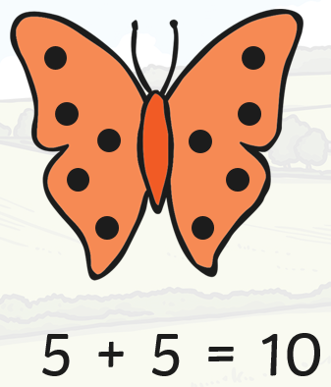
Doubling numbers
Last week we worked hard on doubling numbers. Let’s see what you can remember!
Remember when we double a number it gets bigger.

Slide 44
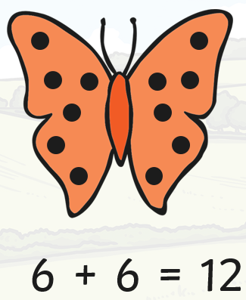
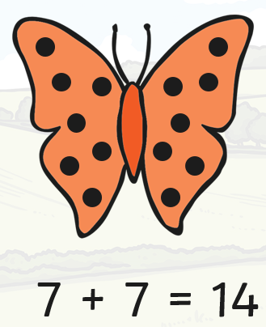
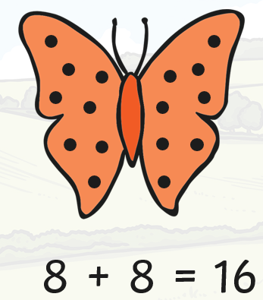
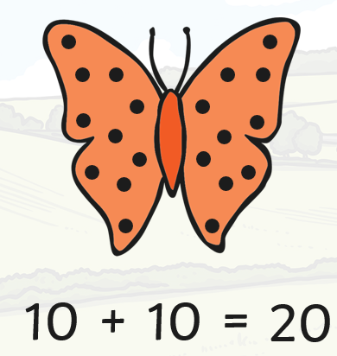
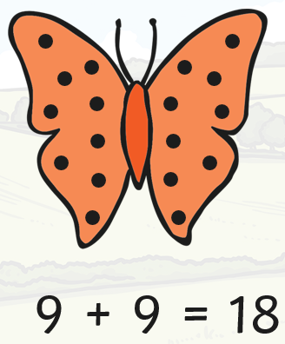

Slide 45
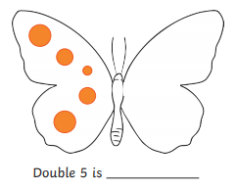
Can you help me to double these numbers on the butterfly’s wings?
Draw the dots on to the wings or drag the correct number dots into place.

Slide 46
Let’s check…
Double 5 is 10.

Slide 47
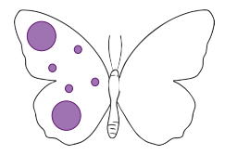
Now, can you draw the dots on the wings to double the number?
Double 6 = ____

Slide 48
Let’s check your answer…
Double 6 = _12___

Slide 49
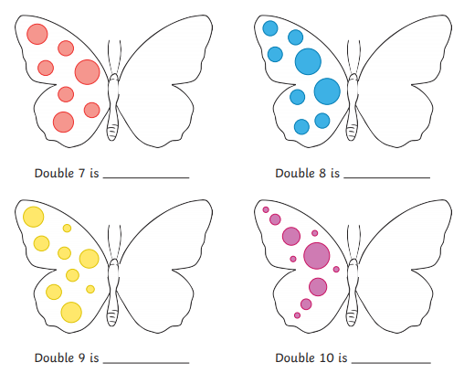
For your task, draw the dots on the wings to double the number.

Slide 50

Let’s check your answers…
14
16
18
20

Slide 51











Challenge: See if you can learn your doubles to recall from memory…
Double 6 =12
Double 7 = 14
Double 8 = 16
Double 9 = 18
Double 10 = 20
Double 1 = 2
Double 2 = 4
Double 3= 6
Double 4= 8
Double 5 =10

Slide 52

End of lesson.
Well done for all your efforts in maths today!

