Slide 1



Date: Tuesday 5th January 2021
LO. To be able to describe a familiar character.
Subject: English

Slide 2
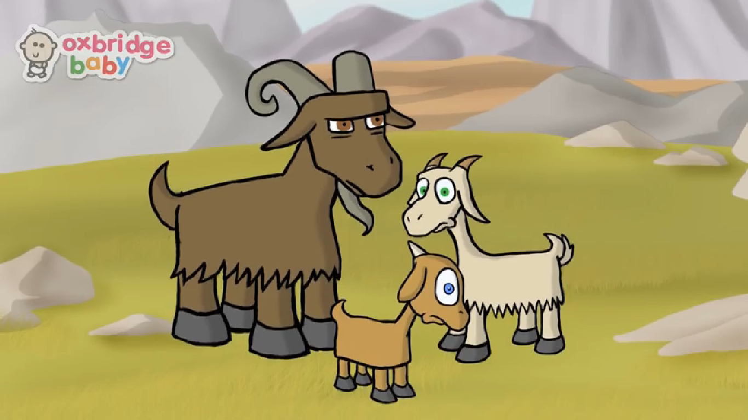
This week we will be looking at the fairy tale The Three Billy Goats Gruff. Please start by watching the animated video.
Video
Copy and paste the link to watch the video of The Three Billy Goats Gruff.
https://www.youtube.com/watch?v=aiy3a1v9Q2E

Slide 3

Did you enjoy the story, tell your adult what you liked about it and if there was anything in the story that you didn’t like. Lets think about the characters in the story, did you like them and who was your favourite?
Miss Hodge’s favourite was the little Billy Goat Gruff, she really likes his small voice.
Mr Scarr’s favourite character was the troll. Can you think why he likes him so much?
You could use your ideas to help you with the next part. Click on the next slide to find out what to do.
You might like to write these down for the children to see.

Slide 4
Draw what you think the troll looks like in the box below (or on a piece of paper), use the information in the story to help you with the details.
I think the troll looks like…
Can you think of some words to describe the troll?
Encourage the children to hear the sounds in the words and write down what they can hear. Feel free to support the child as much as they need.

Slide 5
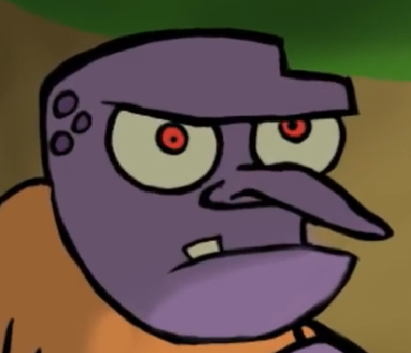
You thought about why Mr Scarr liked the troll. Did you include these words in your description?
Lets find out from Mr Scarr why his favourite character was the troll.
“I like the troll because he has got eyes as big as melons.”
What a great job you have done in English today. Try and remember all of your description words, you will need them for tomorrows lesson.

Slide 6

Date: 5.1.2021
LO. To be able to count up to 5 objects and identify numerals 1 to 5.
Subject: Maths

Slide 7
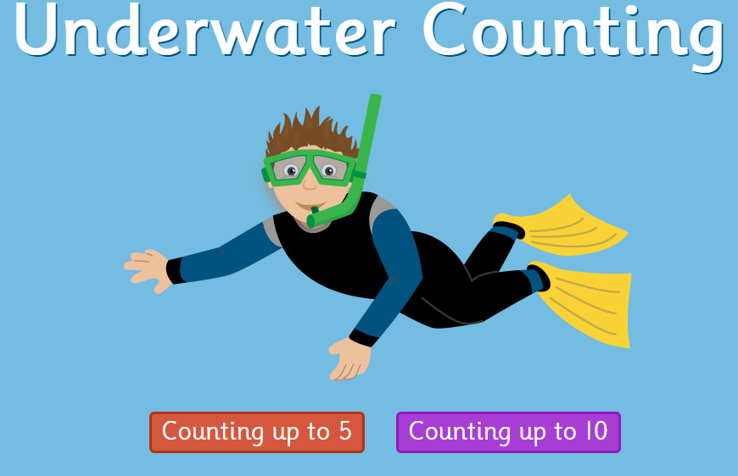
g
Over the last few weeks we have been focusing on the numbers to 5. We have been learning how to recognise digits, quantities and different representations of 5. This week we will revisit some of those ideas and look at adding objects to 5.
Lets start by playing the game below. See how much you can remember about counting up to 5. If you would like to, also have a go at counting up to 10.
https://www.topmarks.co.uk/learning-to-count/underwater-counting

Slide 8






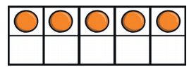
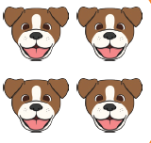



g
Can you recognise these different representations of the numbers 1 to 5?
Write the answer in the box next to the picture.

Slide 9
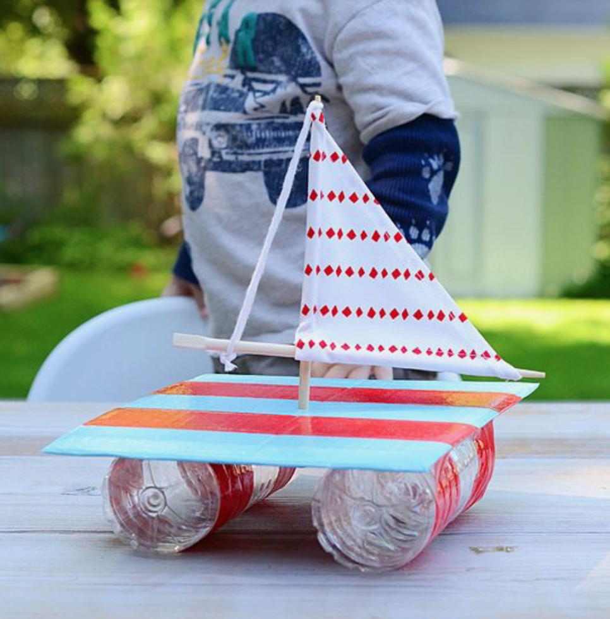
Tuesday 5th January 2021
Today we will build our own raft to try and save the troll from drowning. You can use a variety of materials when making your raft.
To build your raft you could use two plastic bottles, plastic container and some cellotape to hold it all together.
When you have finished making your raft you can test if it works. Does your raft float? Do you need to change your raft to make it float?

Slide 10
Date: Wednesday 6th January 2021
LO. To be able to complete the sentence describing the Troll.
Subject: English

Slide 11
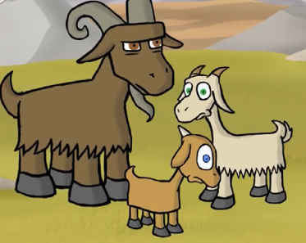
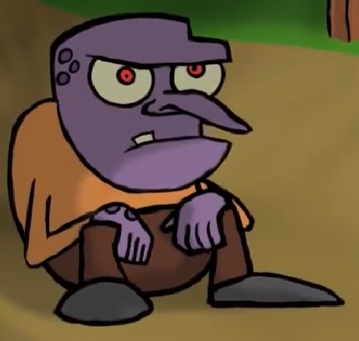
Can you remember our story from yesterday? See how much you can remember and tell it to your adult. Try to include as much detail as possible, re-watch the video if you need a reminder.
Here are some words Miss Hodge came up with to describe the characters in the story. Some of the words describe the goats and some describe the troll. Read the words with your adult, decide who they are describing and drag it to the correct box.
Goat | Troll
long nose
horns
purple
teeth
hooves
big
brave
little
angry
hungry
Add some more words to your list if your can think of other ways to describe the characters.

Slide 12
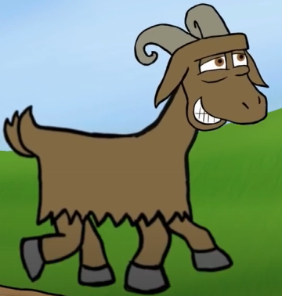
Here are some words to describe The Billy Goats Gruff…
little
brave
hungry
We are going to use the words to complete the following sentence.
The Billy Goat Gruff are…
Here are the sentence we created
The Billy Goat Gruff are little.
The Billy Goat Gruff are brave.
The Billy Goat Gruff are hungry.
On the next page it’s your turn to make some sentences.

Slide 13


Here are some words to describe the troll…
angry
purple
ugly
You are going to use the words to complete the following sentences.
The troll is _____________.
Write out 2 sentences below or on a piece of paper. You may need your adult to help you with this.

Slide 14

Can you read the sentences you made to your adult.
Did you remember your full stop? If not put it on now.
Well done for writing two super sentences. Here’s a little challenge for you…
The word troll starts with a ‘t’ sound, can you find three things in your house that start with the sound ‘t’?
Show your adult what they are. Great work!

Slide 15
Date: 6.1.2021
LO. To be able to identify the correct numerals 1 to 5.
Subject: Maths

Slide 16





Here you can see the numicon representations of the numbers 1 to 5. Can you match the numicom to the correct digit by drawing a line between the two?
1
3
5
2
4

Slide 17

Can you identify each digit and draw that number of circles into the five frame. Remember just one circle per box.
1
3
5
2
4

Slide 18
All of these 5 frames have 5 circles in them. Can you count how many red circles and how many blue circles are in each one. Remember when you add them all together the answer will always be 5.
1
4

Slide 19
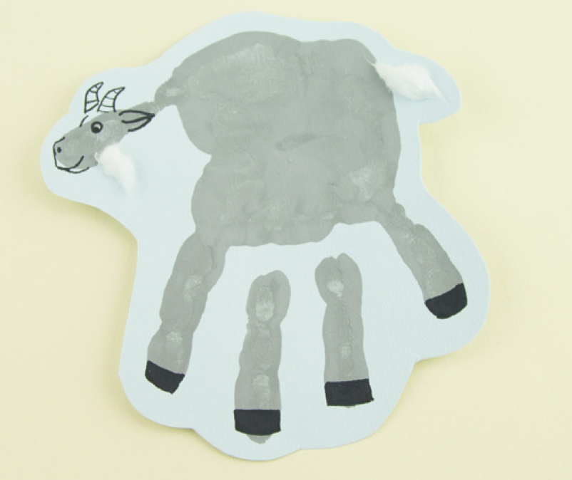
Wednesday 6th January 2021
Today we will be making our own handprint goat.
You will need the following equipment:
A4 paper
Paint
Paper plate
Paintbrush
Black pen
Scissors
Glue
Cotton wool

Slide 20
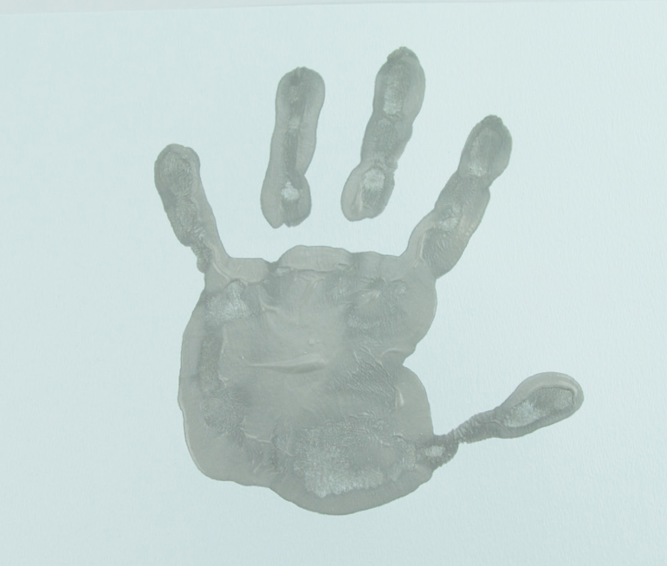
First, choose a paint colour for your goat and carefully press your hand into the paint. You may want to use a paintbrush to spread the paint all over your hand. Next, carefully press your hand onto the paper. Your thumb and fingers need to be spread out! Wash and dry your hands before proceeding onto the next step.
Once dry, you can draw some details onto your goat! Turn the print so that your fingers are at the bottom. Use the black pen to draw a face and ears onto your goat’s head.
Don’t forget to draw some horns!

Slide 21
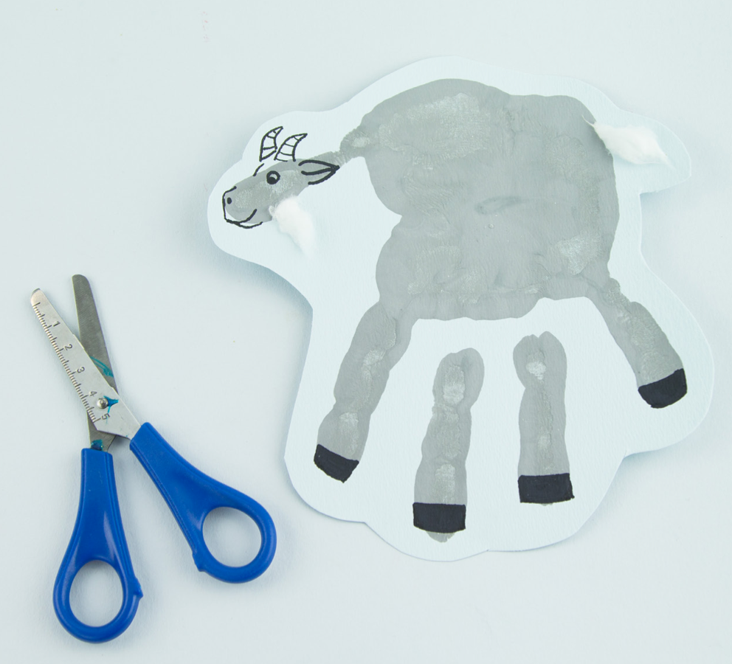
3. Then, stick a little cotton wool onto the opposite side from your thumbprint for the goat’s fluffy tail.
4. Next, stick a little cotton wool onto the goat’s chin for a fluffy beard!
5. Now, colour the remaining four fingertip prints back, for your goat’s hooves.
6. Finally, you may like to carefully cut around the outside of your goat, to make the shape of it stand out.

Slide 22
Date: Thursday 7th January 2021
LO. To be able to sequence a story.
Subject: English

Slide 23
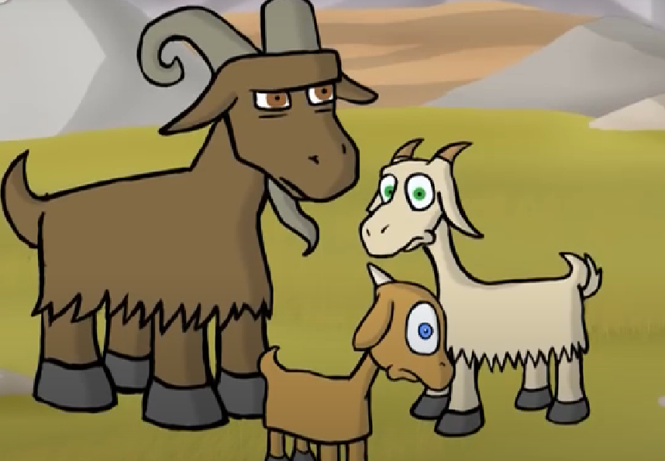
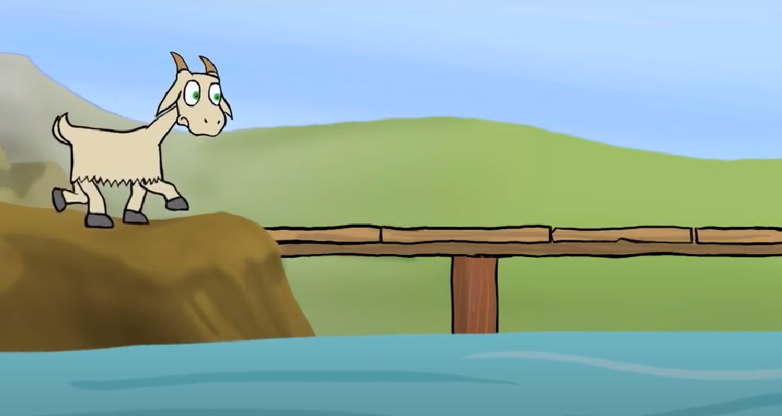
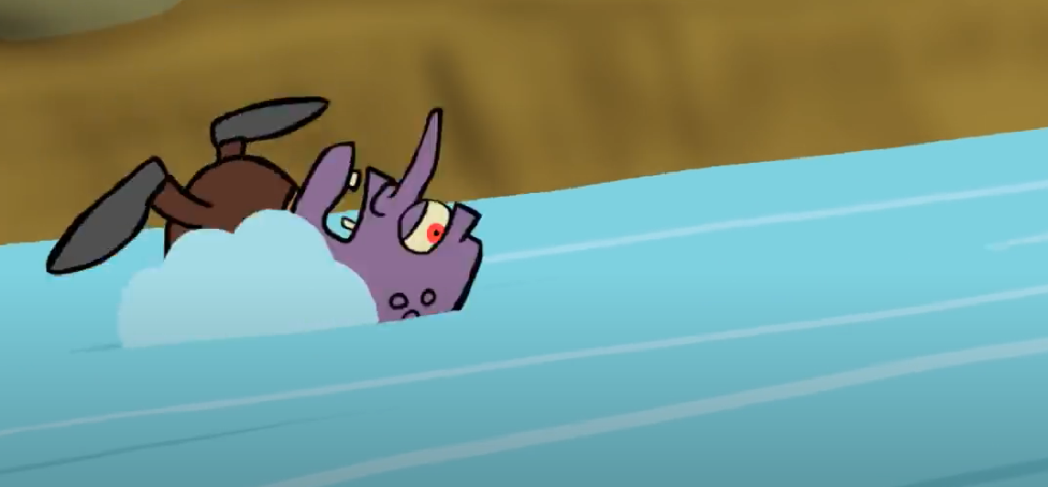
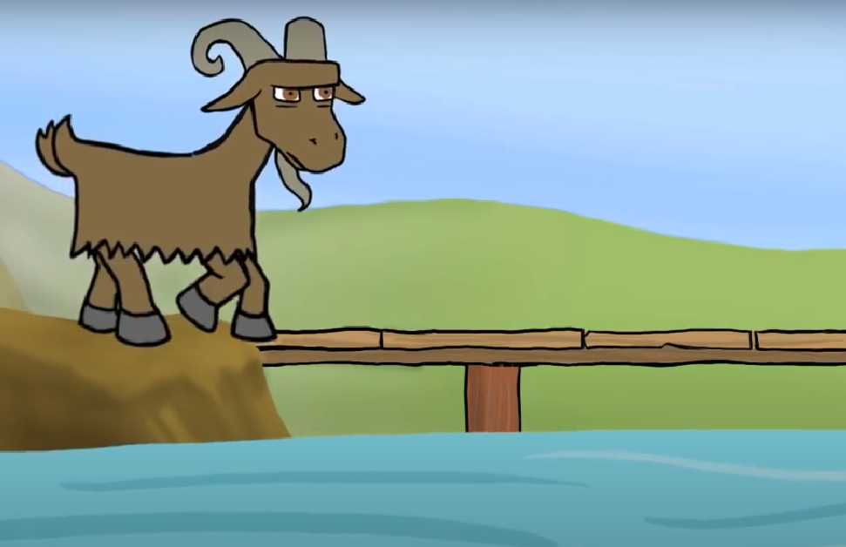
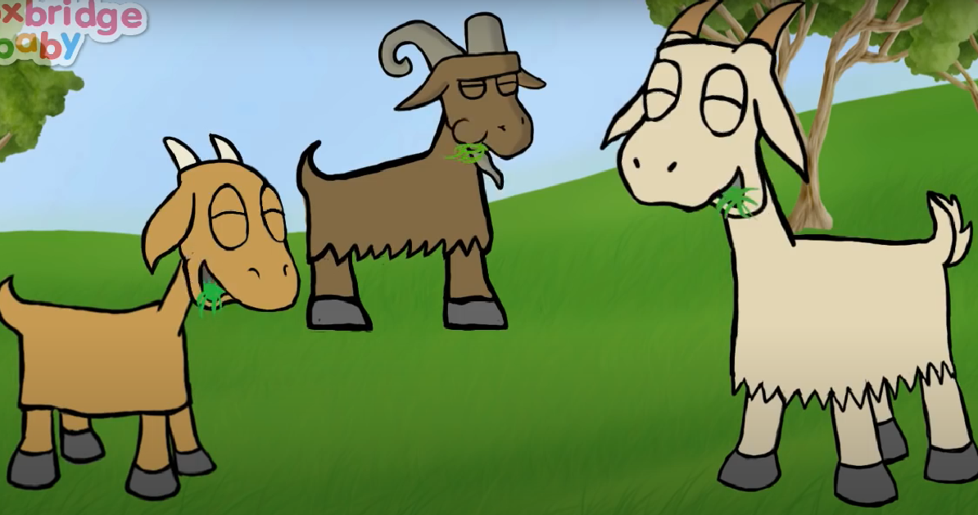
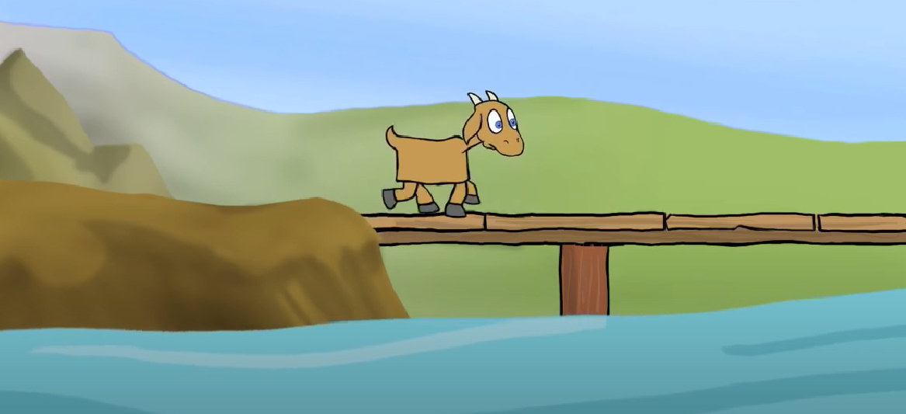
Here are some pictures from the story. Miss Hodge muddled them up while she was putting them onto the computer. Can you help her sort them out and put them into the right order? With your adult talk about what is happening in each photo as your sort them. Use the video from Mondays lesson if you are unsure.

Slide 24
Here is the story sequenced in the correct order. Two of the photos have been covered, can you think about which photos has been covered and draw your own picture in the boxes.
1.
2.
3.
4.
5.
6.

Slide 25
Choose your favourite picture from the story and write a simple sentence to describe what is happening. Your adult can help you with this.

Slide 26
Date: 7.1.2021
LO. To be able to partition numbers to 5.
Subject: Maths

Slide 27


Instructions
Each slide shows a part-whole model based on number bonds of 5.
Some parts of the model are missing.
Can you work out the missing number shapes?
Can you say the number bond of 5?
Choose the correct number shape to complete the part-whole model and make a number bond of 5.
5

Slide 28



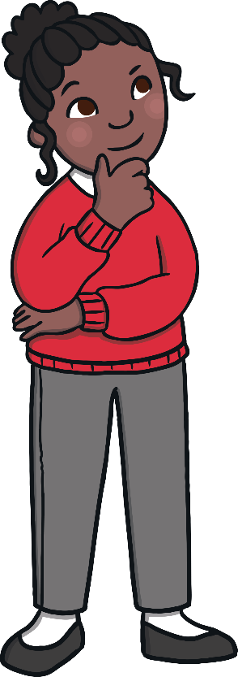
Complete the part-whole model.
5

Slide 29

Complete the part-whole model.
5

Slide 30

Complete the part-whole model.
5

Slide 31
Complete the part-whole model.
5

Slide 32
Complete the part-whole model.
5

Slide 33
Complete the part-whole model.
5

Slide 34
Thursday 7th January 2021
Today we will be doing a role play activity.
We will be doing a creative activity. We will be making a mask to represent a character from the story of the Three Billy Goats Gruff. You can use the two templates provided and decorate your mask once it has been cut out.
You might want to watch the video again to refresh your memory.

Slide 35
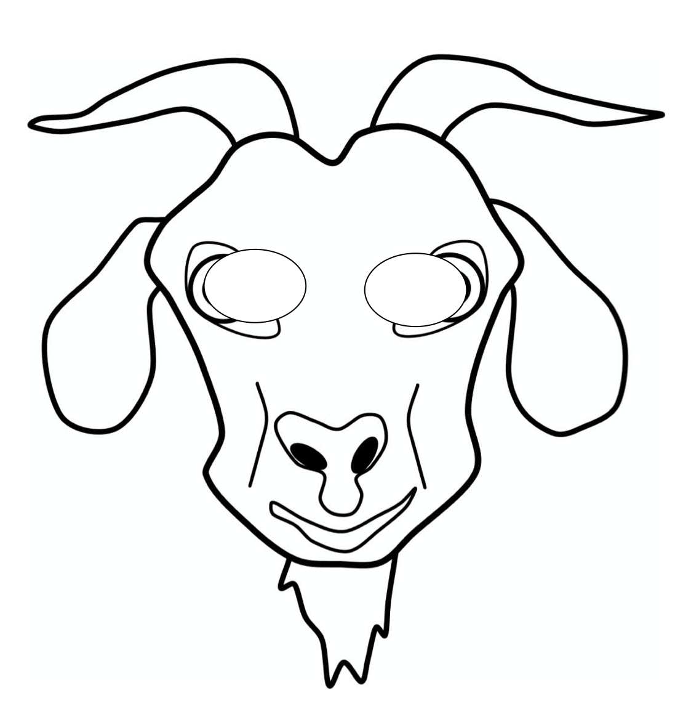

Slide 36
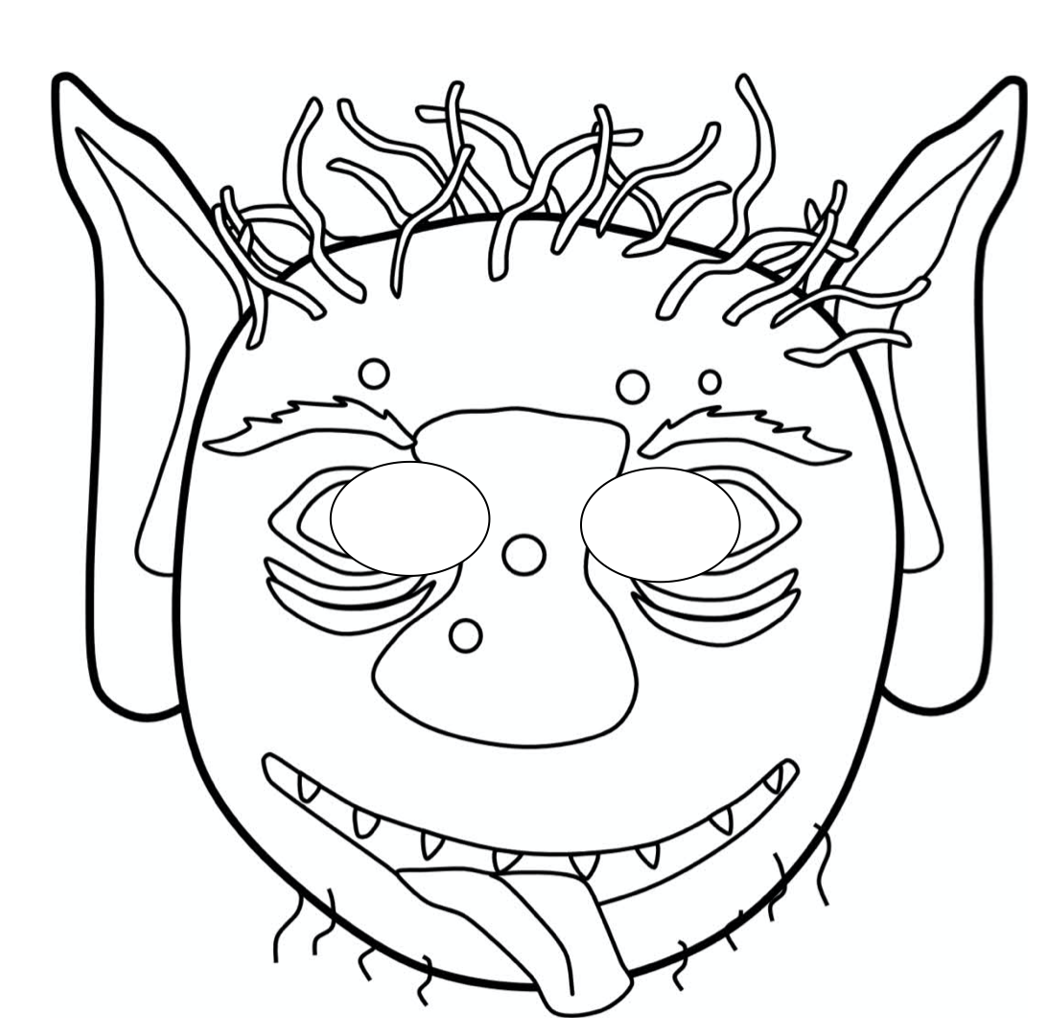

Slide 37
Date: Friday 8th January 2021
LO. To be able to retell a familiar tale.
Subject: English

Slide 38
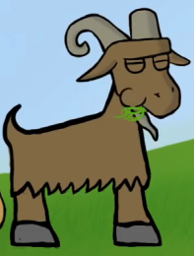
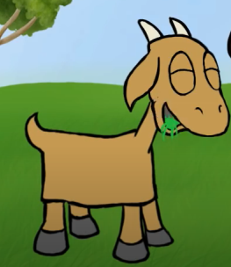
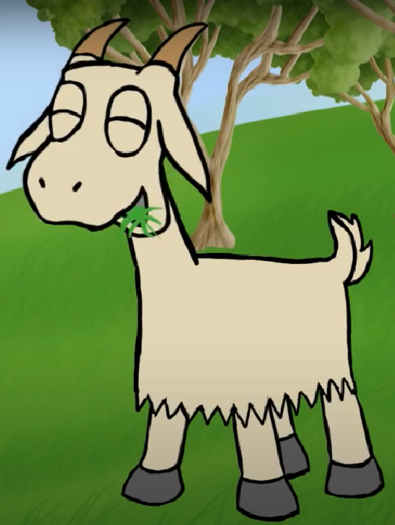
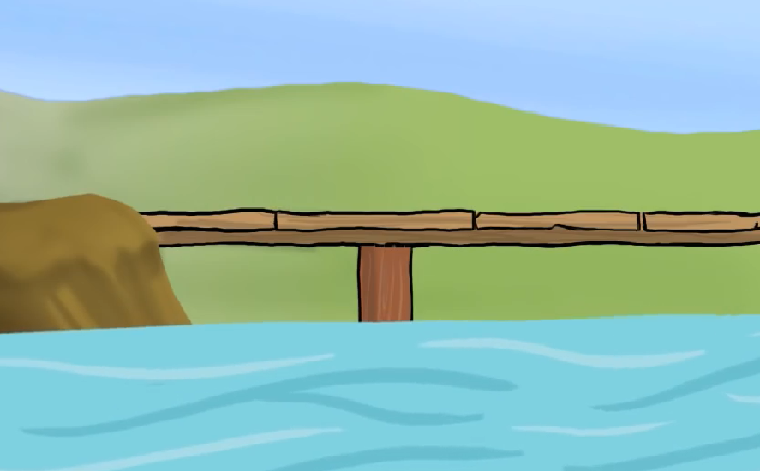
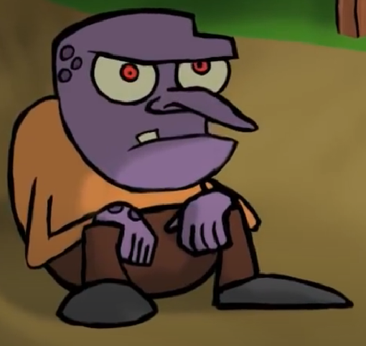

There are lots of different ways to retell a story. One of our favourite ways is to use puppets. Today we would like you to make your own puppets by printing out the pictures, cutting them out and sticking them onto different pencils to use as props to retell this weeks story.
If you don’t have access to a printer you could try drawing the pictures.
Remember to be careful while using the scissors!
Once your puppets are made, use them to retell the story to an audience. This could be your adult, your sister or even your cuddly toy.
You could ask your adult to record you telling the story and send it to us. Don’t forget to try to do all of the characters voices.

Slide 39
Friday 8th January 2021
Today we thought you might like to build your own bridge.
You can use anything that you may have at home to complete this activity.
Once you have completed your bridge make sure you take a picture and send us an email with your amazing work.
The Base staff have made their own bridge using things we have in school. Lets see who can make the best bridge, there will be a prize awarded for the best bridge.

Slide 40
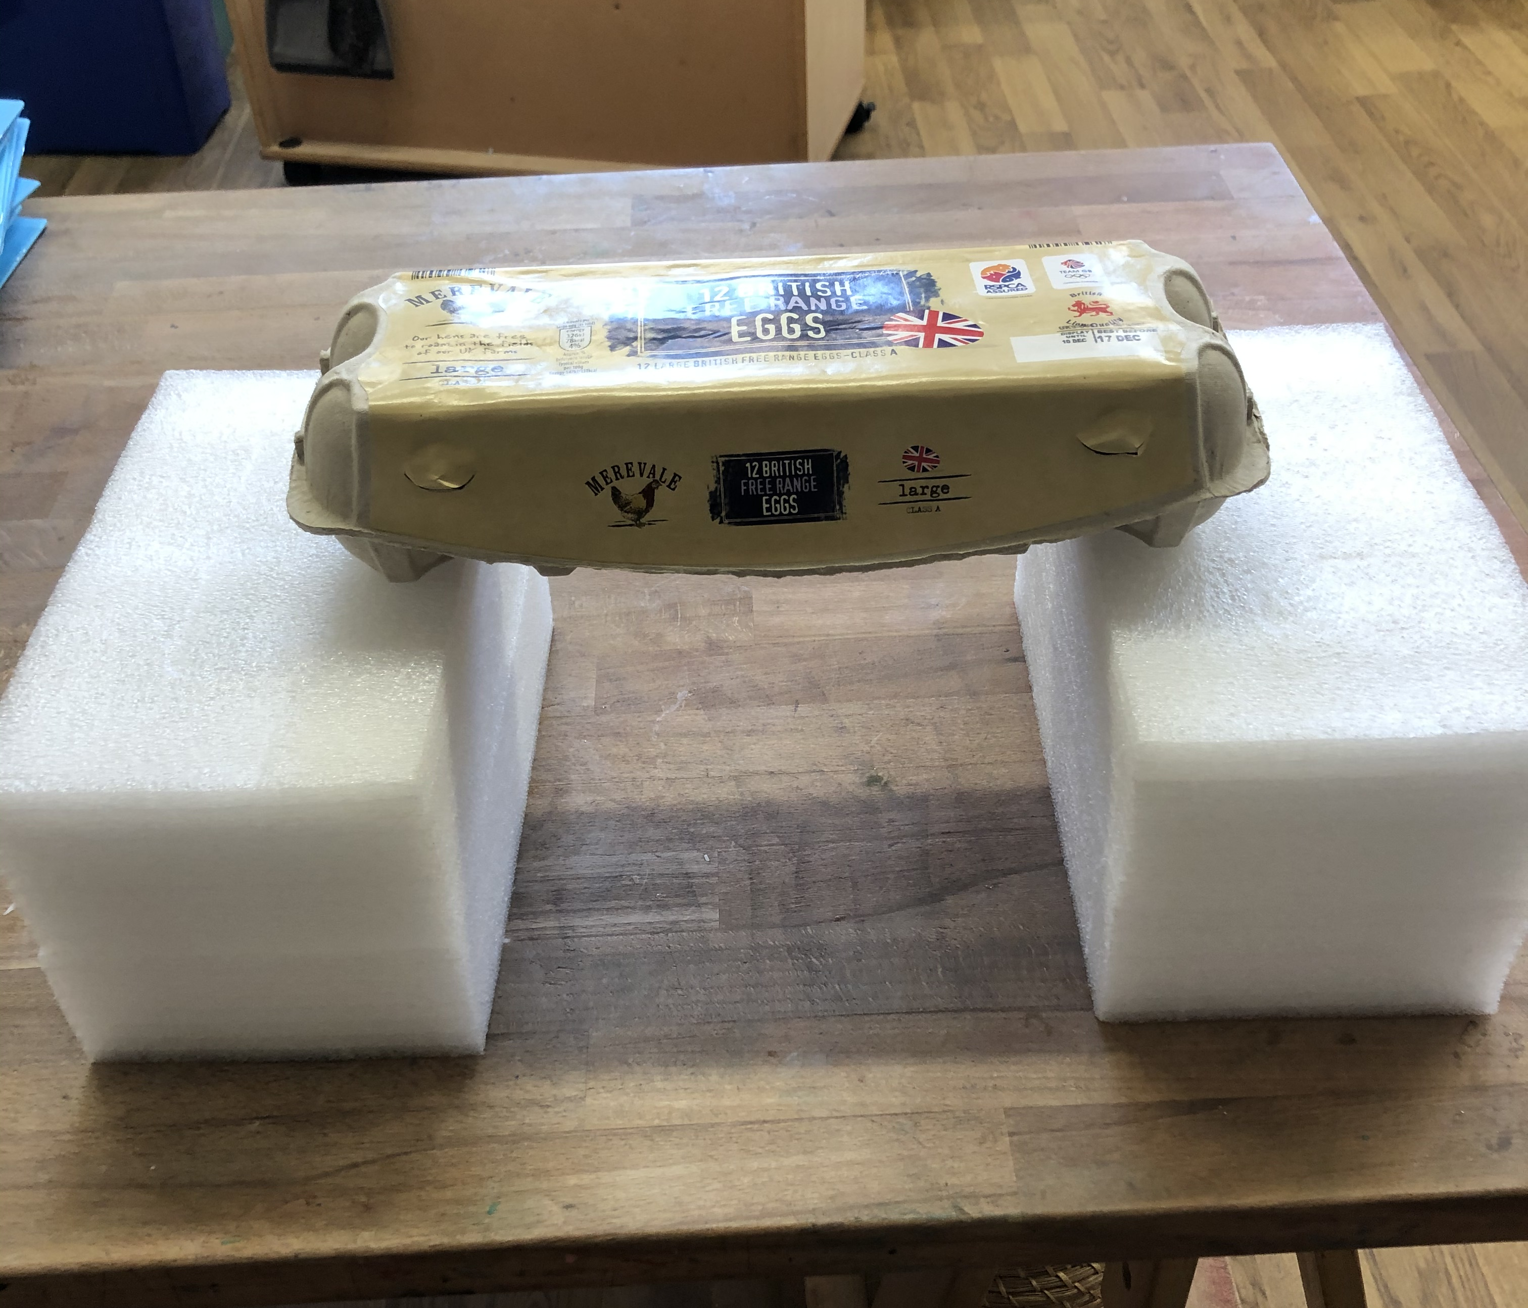
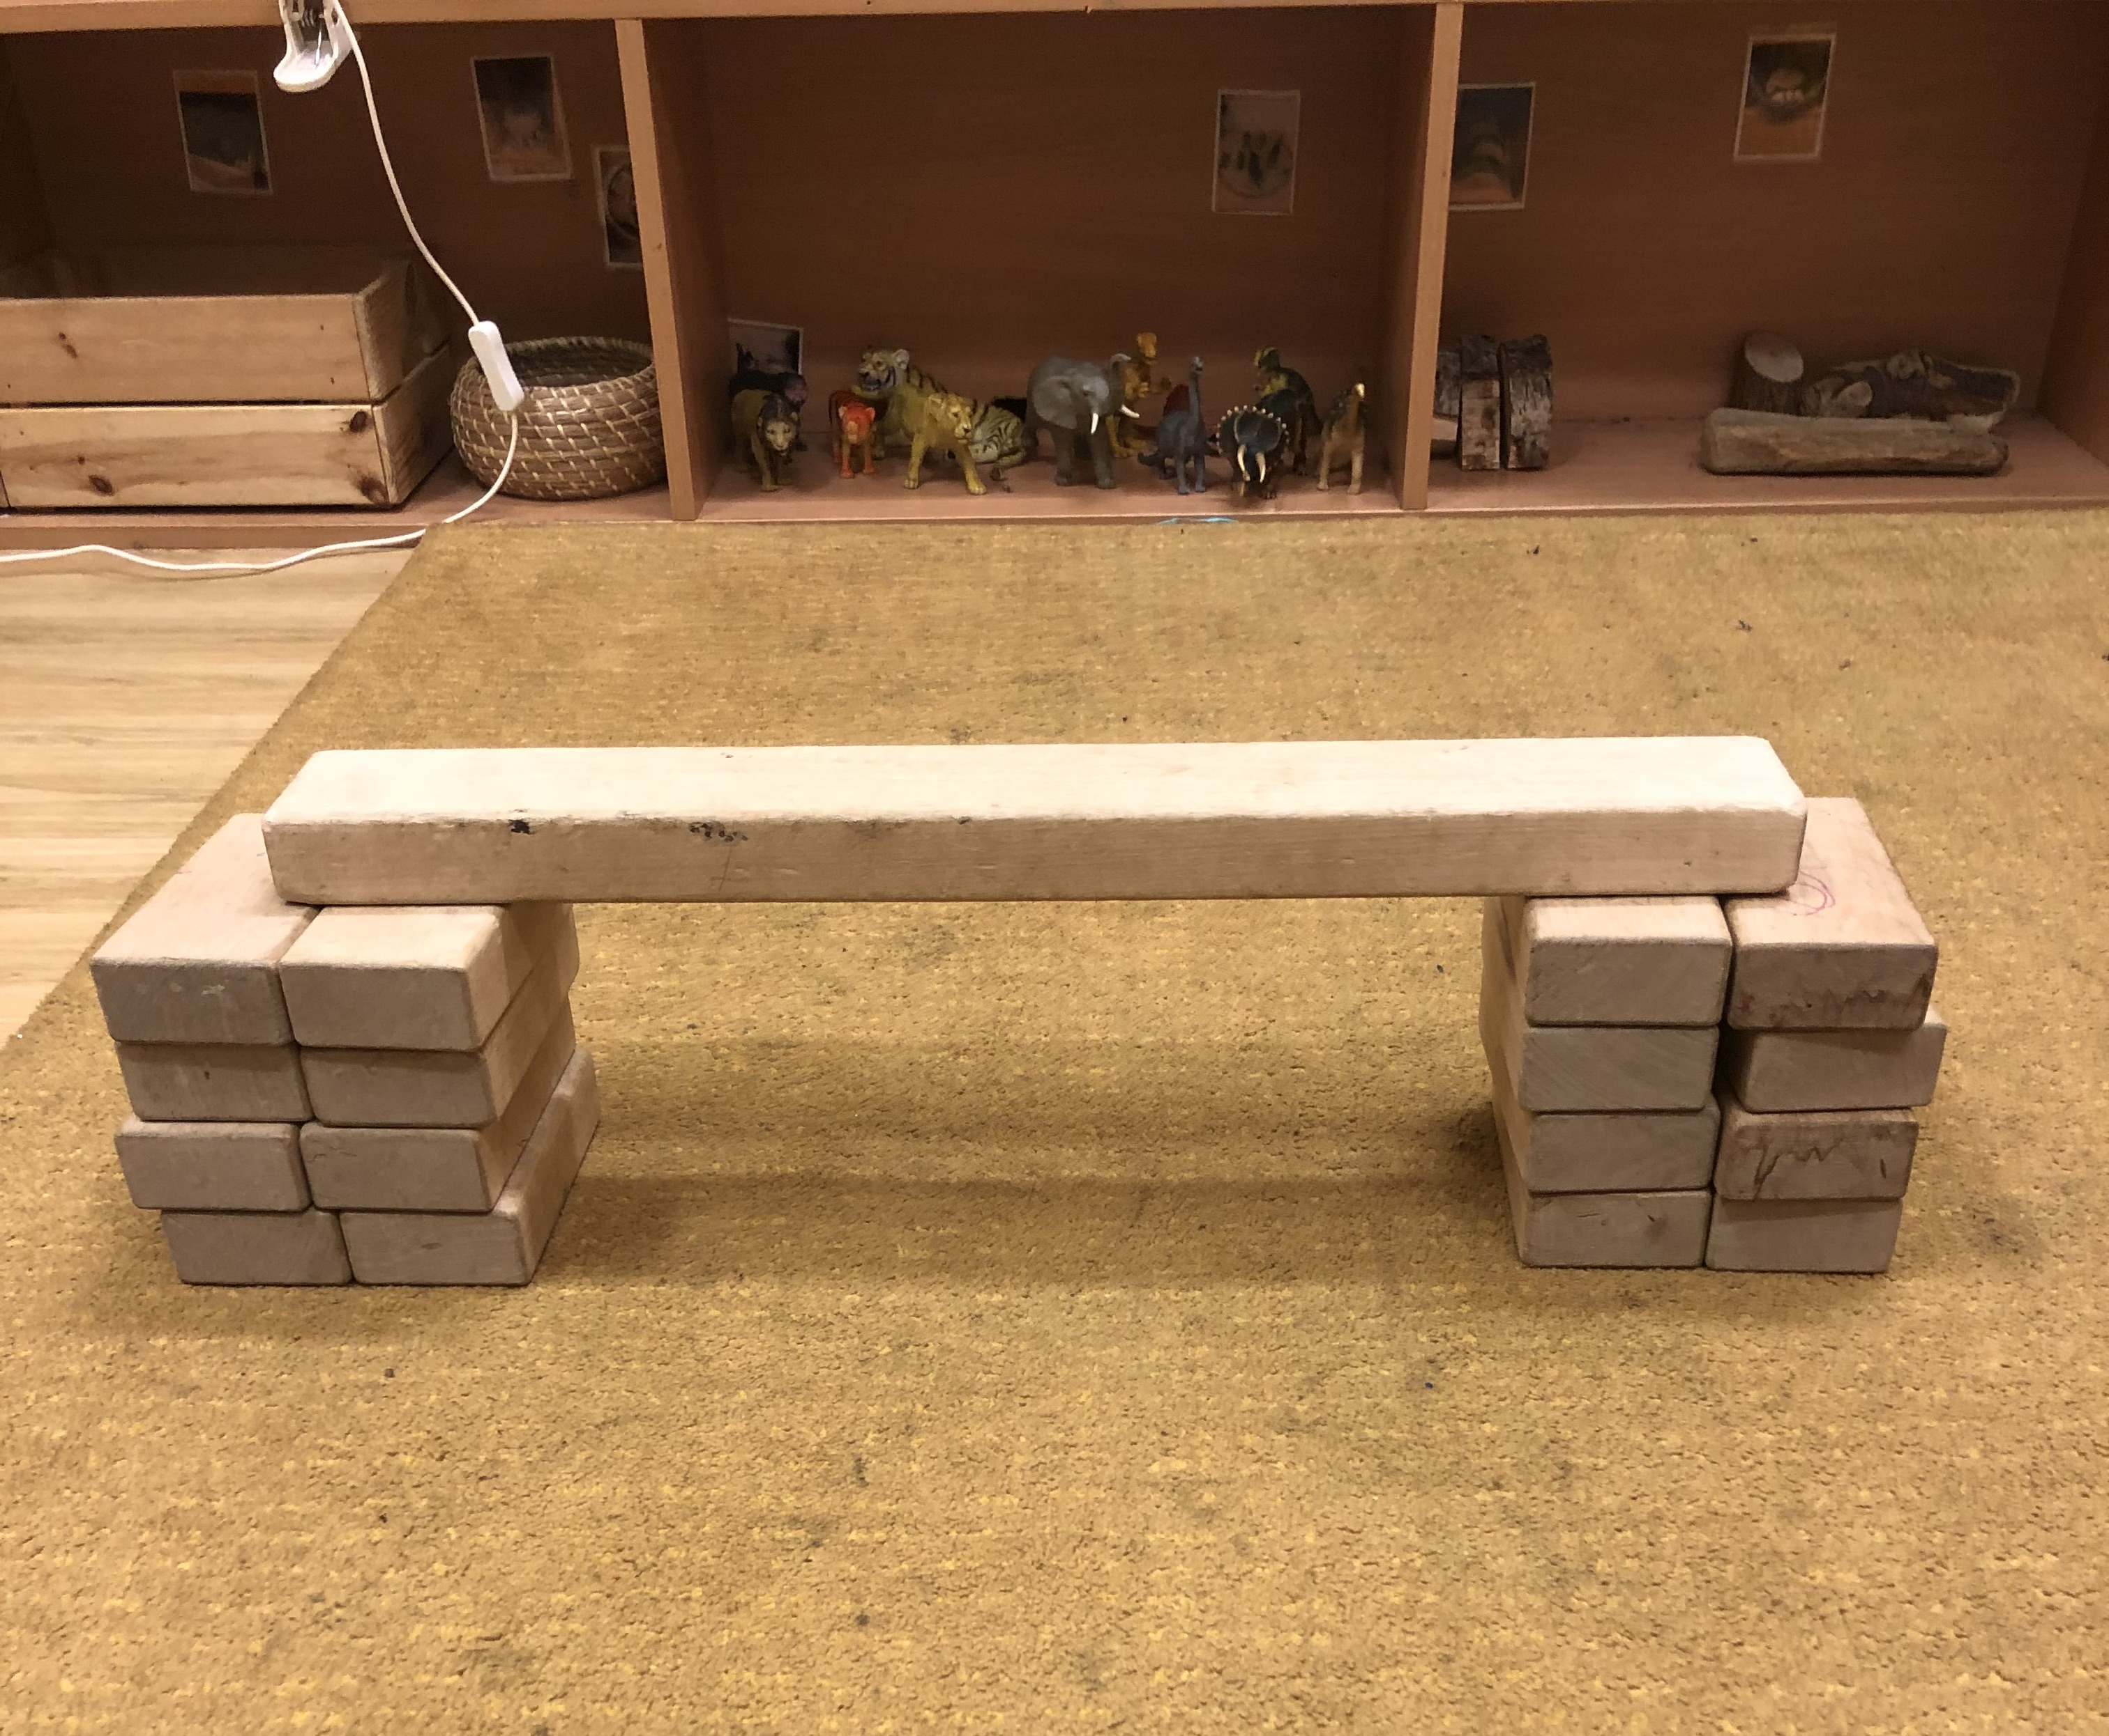
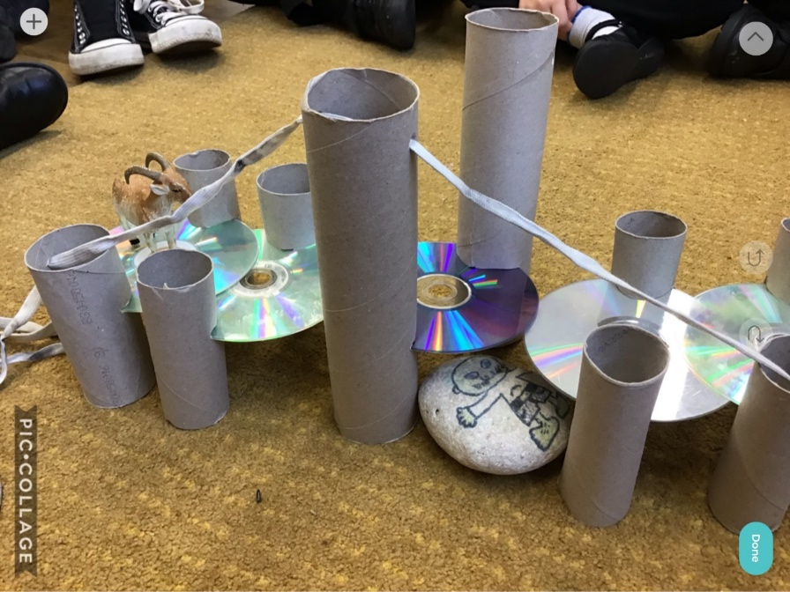
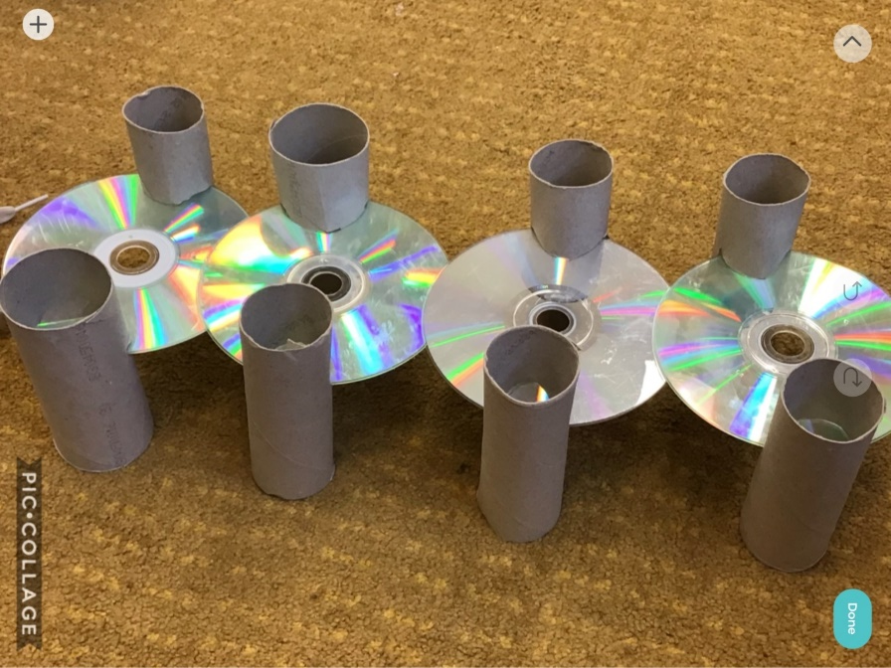
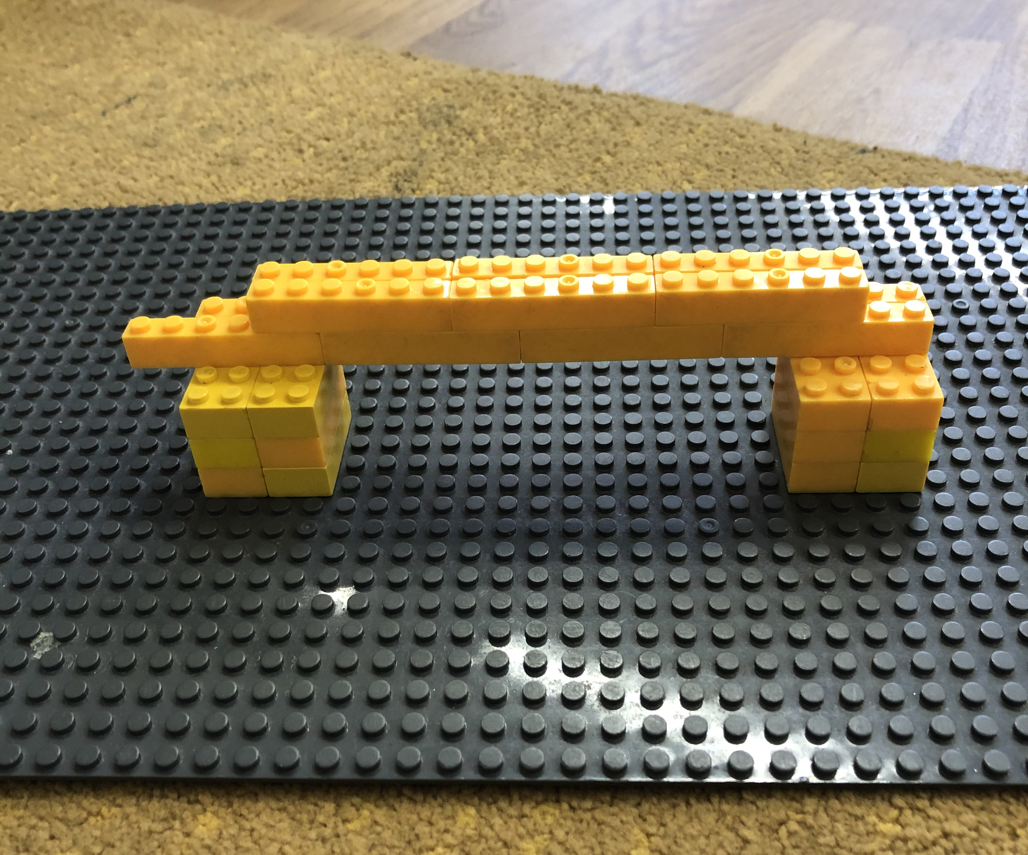
Here are some examples we have made for you to see what we are looking for.

