Slide 1


Subject: English
Pack: B

Slide 2


Date: Monday 8th February
LO To be able to write sentences using adjectives.
Subject: English

Slide 3

This is the story we are going to be focusing on this week.
Hope you enjoy it!
There's a Rang-Tan in my Bedroom - YouTube
Click on the link or copy and paste into the internet to listen to the story being read.
If you are unable to watch the video you will find pictures of each page of the book over the next two slides.

Slide 4
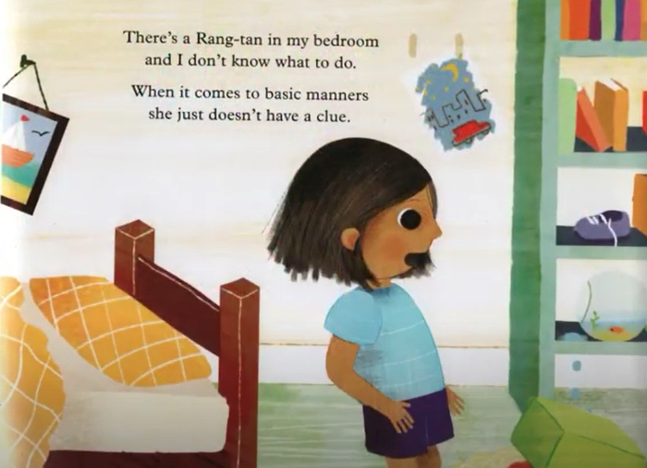
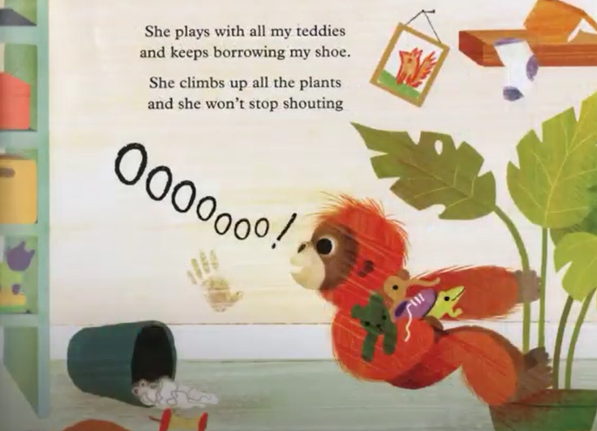
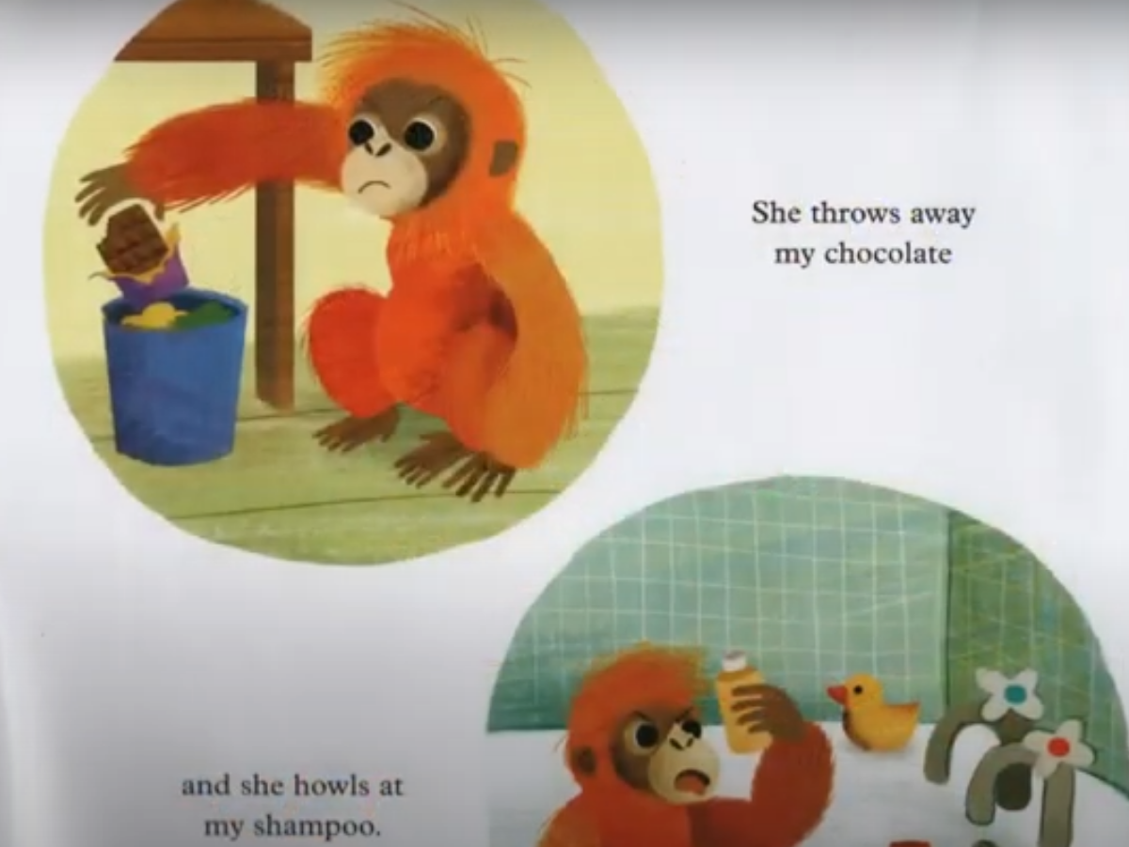
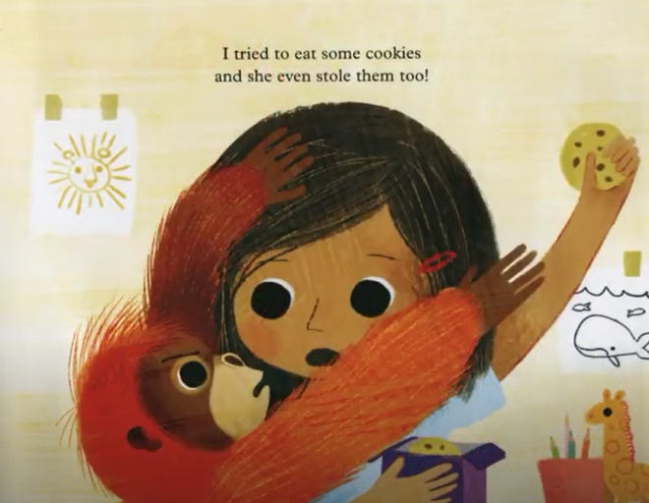
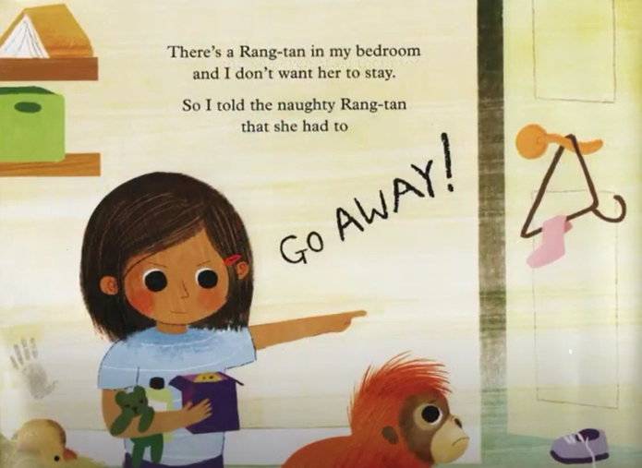
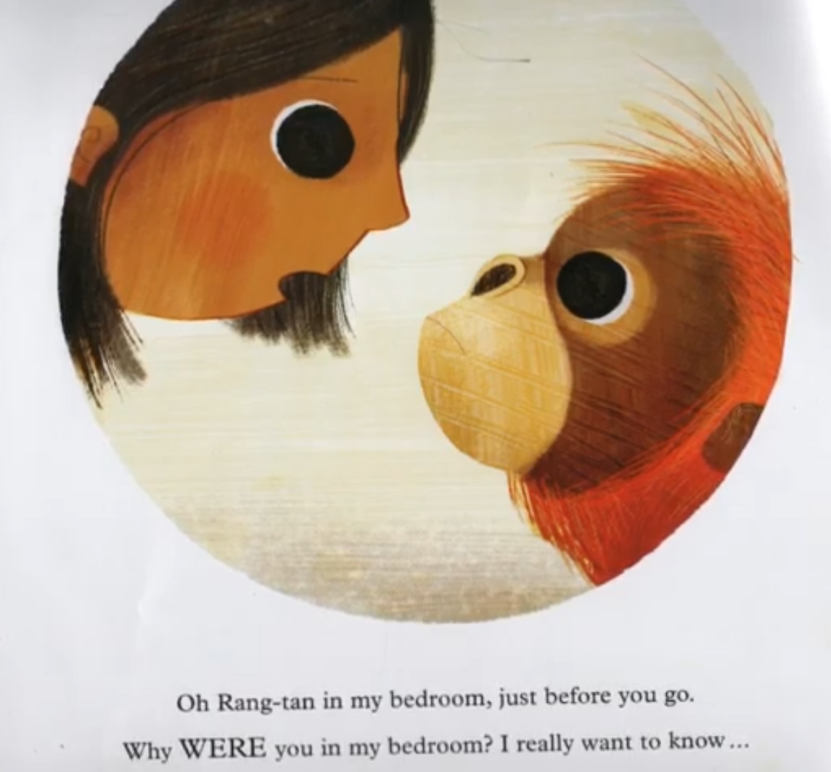
There’s a Rang-Tan in my bedroom …
Continued on the next slide

Slide 5
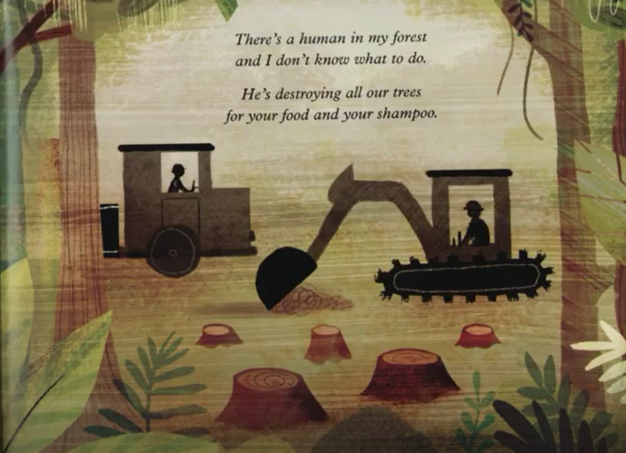
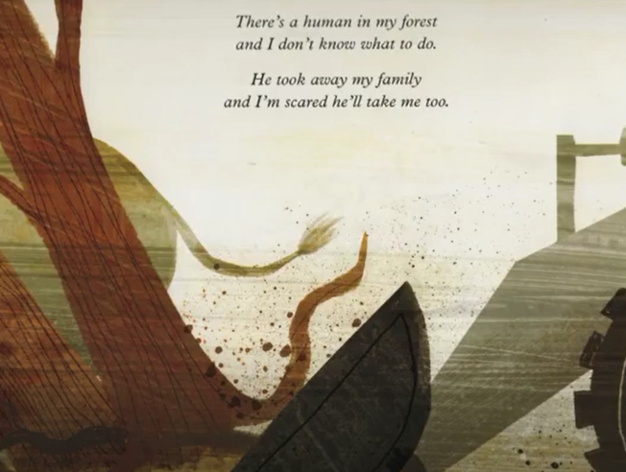
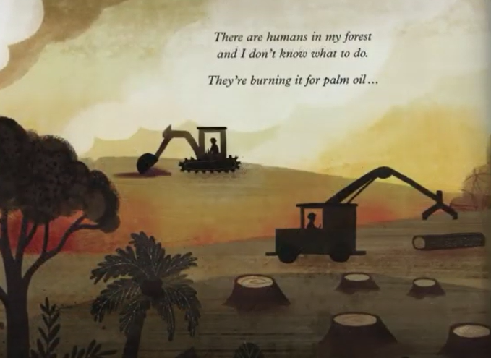
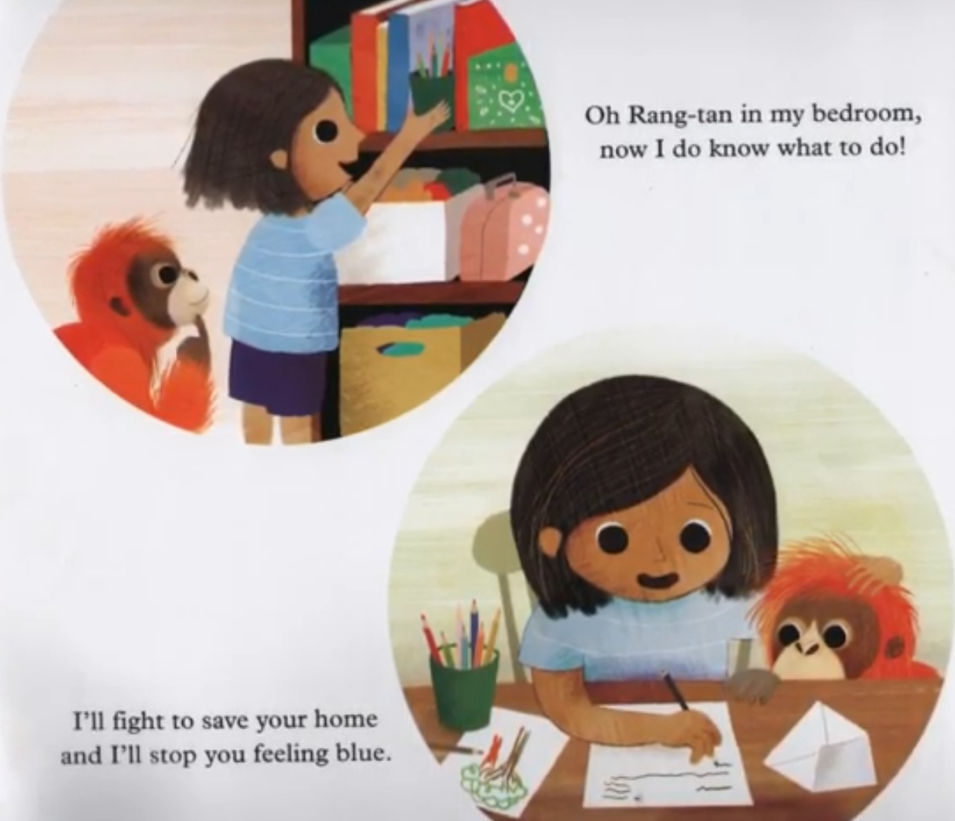
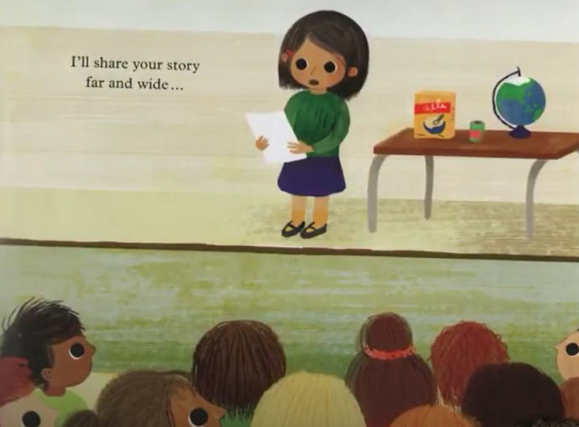
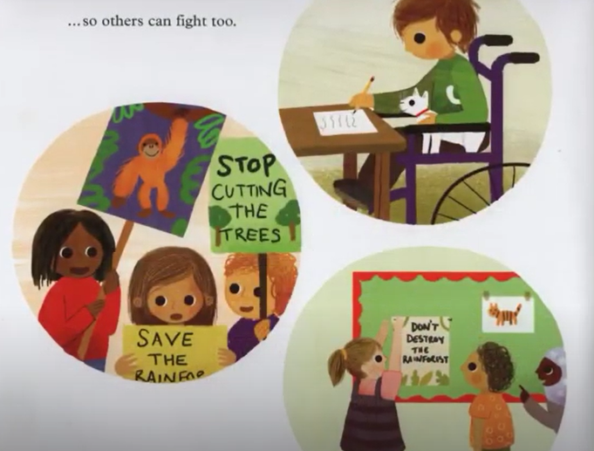
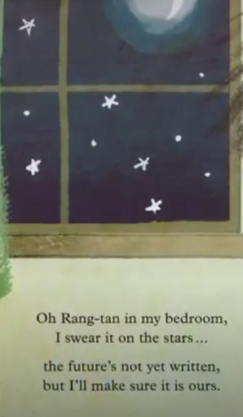
There’s a Rang-Tan in my bedroom …

Slide 6
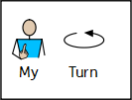
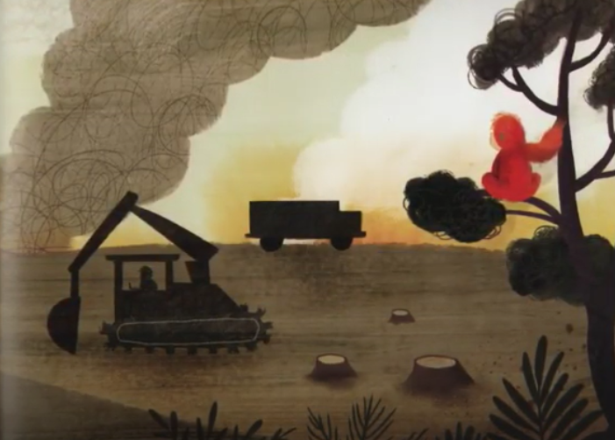
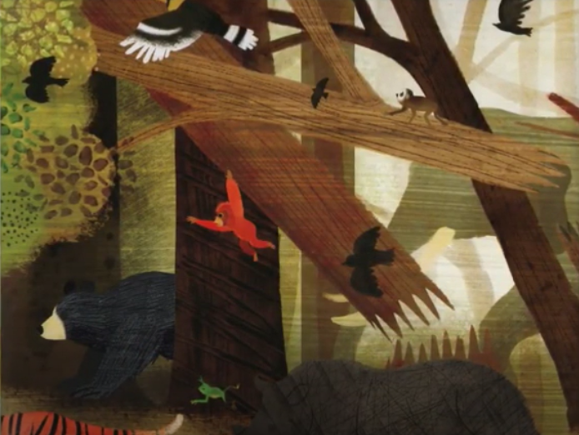
Recap on adjectives
An adjective is a describing word.
orange orangutan
grey smoke
broken branch
powerful digger
brown mud
grizzly bear
Can you think of any others?

Slide 7
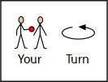
Adjectives are describing words.
Complete the noun phrases by
adding 1 adjective before the noun.
brown bear
broken branch
_____________ mud
_____________ digger
_____________ orangutan
_______________ smoke
_____________ bird
_____________ tree

Slide 8
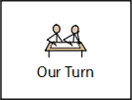
Example
Setting description
Read my description …
A scared orangutan was clinging onto a tall tree. The sky was filled with clouds of grey smoke. A powerful digger chopped down the trees one by one. The beautiful canopy started to disappear and turn into small tree stumps. The ground was covered in broken branches and dead leaves. The terrified animals squawked and howled as they searched franticly for a new home.

Slide 9
Read through the description again and highlight/underline the adjectives noun phrases.
Remember an adjective is a describing word.
A scared orangutan was clinging onto a tall tree. The sky was filled with clouds of grey smoke. A powerful digger chopped down the trees one by one. The beautiful canopy started to disappear and turn into small tree stumps. The ground was covered in broken branches and dead leaves. The terrified animals squawked and howled as they searched franticly for a new home.

Slide 10
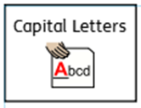
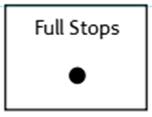


Sentences using adjectives…
Choose 4 of your noun phrases and turn them into full sentences.
Don’t forget:
If you are finding this task a bit tricky, you can have a go at the sentence building activity on the next few slides.
The sky was filled with grey smoke.

Slide 11




Sentence building
Read and order the cards to build the sentence. Remember the capital letter goes at the start of the sentence and the full stop goes at the end. Use the symbols to help you work out the word if you are finding it tricky to read.
You can cut and stick the pictures in the correct order or drag them into the correct boxes on your computer.

Slide 12
Sentence building
Read and order the cards to build the sentence. Remember the capital letter goes at the start of the sentence and the full stop goes at the end. Use the symbols to help you work out the word if you are finding it tricky to read.
You can cut and stick the pictures in the correct order or drag them into the correct boxes on your computer.
Once you have ordered the sentence cards, copy the words to write your sentence.
For example:
The sky was grey.

Slide 13



Sentence building
Read and order the cards to build the sentence. Remember the capital letter goes at the start of the sentence and the full stop goes at the end. Use the symbols to help you work out the word if you are finding it tricky to read.
You can cut and stick the pictures in the correct order or drag them into the correct boxes on your computer.

Slide 14



Sentence building
Read and order the cards to build the sentence. Remember the capital letter goes at the start of the sentence and the full stop goes at the end. Use the symbols to help you work out the word if you are finding it tricky to read.
You can cut and stick the pictures in the correct order or drag them into the correct boxes on your computer.

Slide 15


Sentence building
Read and order the cards to build the sentence. Remember the capital letter goes at the start of the sentence and the full stop goes at the end. Use the symbols to help you work out the word if you are finding it tricky to read.
You can cut and stick the pictures in the correct order or drag them into the correct boxes on your computer.

Slide 16
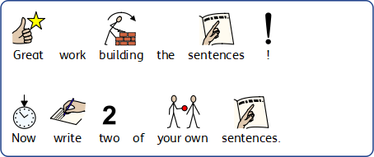
Sentence building
You can write your sentences neatly on a piece of paper or type them on the lines below.

Slide 17

Well done for all of your hard work! We can’t wait to see your completed work.
Could any completed work / photographic evidence of completed work please be sent to pioneerspupils@gmail.com
Thank you!

Slide 18
Date: Tuesday 9th February
LO To be able to write a setting description of the rainforest.
Subject: English

Slide 19
Lets re read my description to get it back in our head.
A scared orangutan was clinging onto a tall tree. The sky was filled with clouds of grey smoke. A powerful digger chopped down the trees one by one. The beautiful canopy started to disappear and turn into small tree stumps. The ground was covered in broken branches and dead leaves. The terrified animals squawked and howled as they searched franticly for a new home.

Slide 20
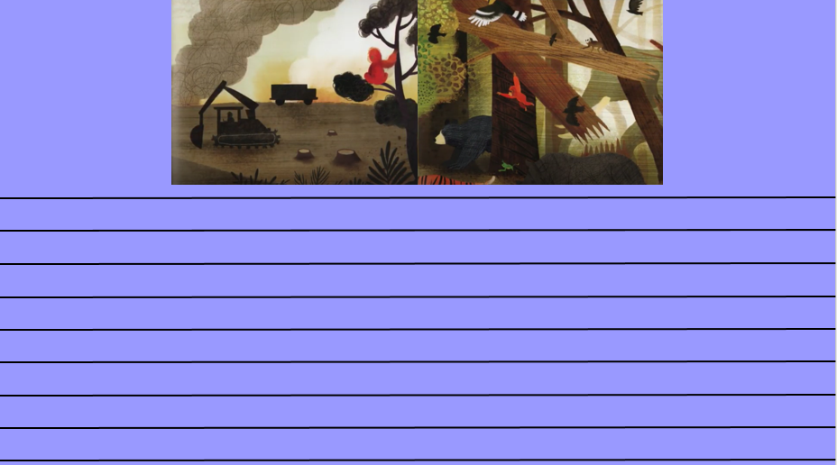
Write a setting description
Today you are going to write a setting description of the rainforest after people have cut down the trees.
Your description must include:
At least 6 sentences
At least 5 adjectives
You can use the blank lines on the next slide to type your description or you can write your description on paper.
If you are finding this task a bit tricky, you can have a go at the sentence building activity on the next few slides.
Don’t forget an adjective is
A describing word
This piece of writing should take approximately 45 minutes

Slide 22
Sentence building
Read and order the cards to build the sentence. Remember the capital letter goes at the start of the sentence and the full stop goes at the end. Use the symbols to help you work out the word if you are finding it tricky to read.
You can cut and stick the pictures in the correct order or drag them into the correct boxes on your computer.
Once you have ordered the sentence cards, copy the words to write your sentence.
For example:
The sky was grey.

Slide 23


Sentence building
Read and order the cards to build the sentence. Remember the capital letter goes at the start of the sentence and the full stop goes at the end. Use the symbols to help you work out the word if you are finding it tricky to read.
You can cut and stick the pictures in the correct order or drag them into the correct boxes on your computer.

Slide 24


Sentence building
Read and order the cards to build the sentence. Remember the capital letter goes at the start of the sentence and the full stop goes at the end. Use the symbols to help you work out the word if you are finding it tricky to read.
You can cut and stick the pictures in the correct order or drag them into the correct boxes on your computer.

Slide 25

Sentence building
Read and order the cards to build the sentence. Remember the capital letter goes at the start of the sentence and the full stop goes at the end. Use the symbols to help you work out the word if you are finding it tricky to read.
You can cut and stick the pictures in the correct order or drag them into the correct boxes on your computer.

Slide 26
Sentence building
You can write your sentences neatly on a piece of paper or type them on the lines below.

Slide 27
Well done for all of your hard work! We can’t wait to see your completed work.
Could any completed work / photographic evidence of completed work please be sent to pioneerspupils@gmail.com
Thank you!

Slide 28
Date: Wednesday 10th February
LO To be able to use ‘and’ to extend sentences.
Subject: English

Slide 29
and
We are going to use the word and to extend our sentences.
Can you say the word and?
Can you sound it out a n d?
Now can you practise writing the word and on a piece of paper?

Slide 30

The word ‘and’ can be used as a conjunction. Conjunctions join two sentences together …
The digger is big and powerful.
The and in this sentence is not used correctly
because it joins two words not two sentences.
There’s a human in my forest and I don’t know what to do.

Slide 31
Match the correct ending to the sentences
Sentence starters:
Ending:
There are humans in my forest and
damaging our homes.
They are burning down the trees and
I don’t know what to do.
Rang - Tan was scared and
howled at the shampoo.
Rang - Tan stole the cookies and
needed to find a new home.

Slide 32
Match the correct ending to the sentences – answers
Sentence starters:
Ending:
There are humans in my forest and
damaging our homes.
They are burning down the trees and
I don’t know what to do.
Rang - Tan was scared and
howled at the shampoo.
Rang - Tan stole the cookies and
needed to find a new home.

Slide 33
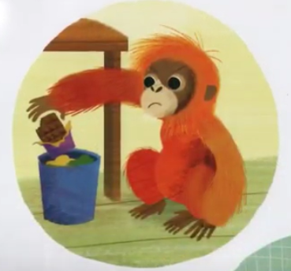
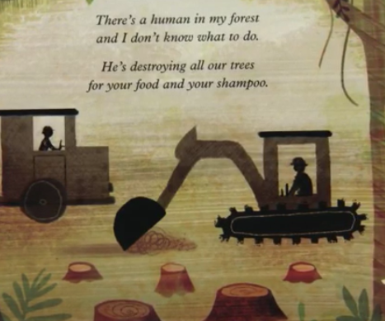
Complete my sentences:
There are human in my forest and ___________________________________________.
Rang - Tan was scared and ___________________________________________.
She threw away the chocolate and ___________________________________________.
The word ‘and’ is a …
Conjunction

Slide 34
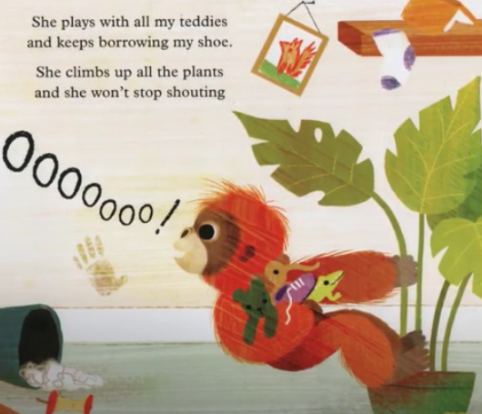
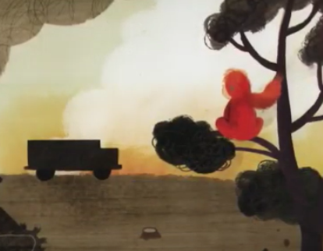
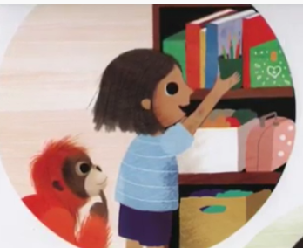

Your Sentences…
Write your own sentences about the story using the conjunction ‘and’ to extend your sentences
Don’t forget:
Use the pictures to help
If you are finding this task a bit tricky, you can have a go at the sentence building activity on the next few slides.

Slide 35
Sentence building
Read and order the cards to build the sentence. Remember the capital letter goes at the start of the sentence and the full stop goes at the end. Use the symbols to help you work out the word if you are finding it tricky to read.
You can cut and stick the pictures in the correct order or drag them into the correct boxes on your computer.
Once you have ordered the sentence cards, copy the words to write your sentence.
For example:
The sky was grey.

Slide 36


Sentence building
Read and order the cards to build the sentence. Remember the capital letter goes at the start of the sentence and the full stop goes at the end. Use the symbols to help you work out the word if you are finding it tricky to read.
You can cut and stick the pictures in the correct order or drag them into the correct boxes on your computer.

Slide 37


Sentence building
Read and order the cards to build the sentence. Remember the capital letter goes at the start of the sentence and the full stop goes at the end. Use the symbols to help you work out the word if you are finding it tricky to read.
You can cut and stick the pictures in the correct order or drag them into the correct boxes on your computer.

Slide 38


Sentence building
Read and order the cards to build the sentence. Remember the capital letter goes at the start of the sentence and the full stop goes at the end. Use the symbols to help you work out the word if you are finding it tricky to read.
You can cut and stick the pictures in the correct order or drag them into the correct boxes on your computer.

Slide 39
Sentence building
You can write your sentences neatly on a piece of paper or type them on the lines below.

Slide 40
Well done for all of your hard work! We can’t wait to see your completed work.
Could any completed work / photographic evidence of completed work please be sent to pioneerspupils@gmail.com
Thank you!

Slide 41
Date: Thursday 4th February
LO To be able to retell the story ‘There's a Rang-Tan in my bedroom’.
Subject: English

Slide 42
Lets read my version of the story
Retell of the story …
Many years ago, the world had beautiful rainforests filled with huge trees, gorgeous flowers and animals. Sadly, humans started to destroy the rainforests using powerful diggers to chop down the trees for palm oil. One day a furry orangutan was swinging through the trees when she heard a huge BANG! She thought it was thunder but she was wrong, very wrong.
Suddenly, she spotted grey clouds of smoke and fire spreading across the forest floor. She could see humans cutting viciously through the burning tree trunks and piling the remaining logs onto a massive lorry. The sound of animals squawking and howling with fear echoed through the rainforest. Rang - Tan wanted to stop the humans but she didn’t know how.
Rang - Tan was terrified. Her home had been destroyed and she couldn’t find her family. Rang - Tan knew she needed to find a new home but she didn’t know where to go. Rang - Tan loved the rainforest and didn’t want to leave but her safe warm house was gone and not safe anymore!
One day, Rang - Tan searched for a new home but all the trees were gone. She couldn’t find anywhere to live. Giant tears started to roll down her furry face. Then all of a sudden, in the distance, Rang - Tan spotted a house made from brown bricks. She saw a young girl with a room filled with toys and thought it would be good to live with her.
Rang - Tan played with the teddies and climbed up all the plants but somethings in the house made her feel quite mad. Rang - Tan didn’t like the chocolate, shampoo or the cookies because they all have palm oil in. Rang - Tan loved her new friend but wished she could go back to the rainforest with her family.

Slide 43
Now find the features
Retell of the story …
Many years ago, the world had beautiful rainforests filled with huge trees, gorgeous flowers and animals. Sadly, humans started to destroy the rainforests using powerful diggers to chop down the trees for palm oil. One day a furry orangutan was swinging through the trees when she heard a huge BANG! She thought it was thunder but she was wrong, very wrong.
Suddenly, she spotted grey clouds of smoke and fire spreading across the forest floor. She could see humans cutting viciously through the burning tree trunks and piling the remaining logs onto a massive lorry. The sound of animals squawking and howling with fear echoed through the rainforest. Rang - Tan wanted to stop the humans but she didn’t know how.
Rang - Tan was terrified. Her home had been destroyed and she couldn’t find her family. Rang - Tan knew she needed to find a new home but she didn’t know where to go. Rang - Tan loved the rainforest and didn’t want to leave but her safe warm house was gone and not safe anymore!
One day, Rang - Tan searched for a new home but all the trees were gone. She couldn’t find anywhere to live. Giant tears started to roll down her furry face. Then all of a sudden, in the distance, Rang - Tan spotted a house made from brown bricks. She saw a young girl with a room filled with toys and thought it would be good to live with her.
Rang - Tan played with the teddies and climbed up all the plants but somethings in the house made her feel quite mad. Rang - Tan didn’t like the chocolate, shampoo or the cookies because they all have palm oil in. Rang - Tan loved her new friend but wished she could go back to the rainforest with her family.
Use the key to highlight/ underline the key features in the correct colour
capital letters
and
exclamation marks
Remember an adjective is a describing word
full stops
adjectives

Slide 44
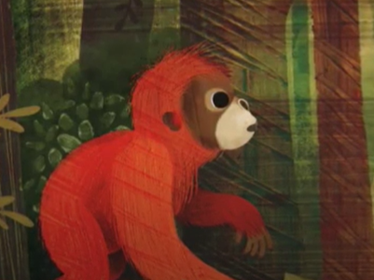
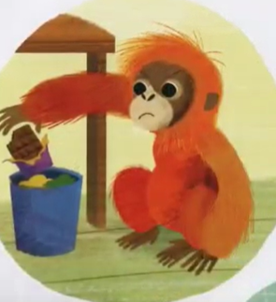
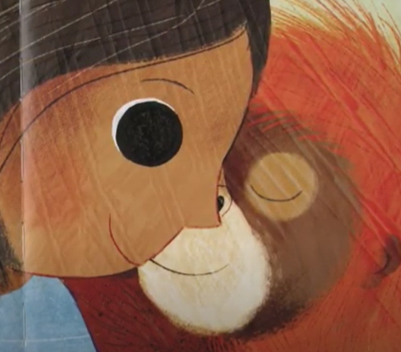
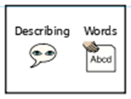
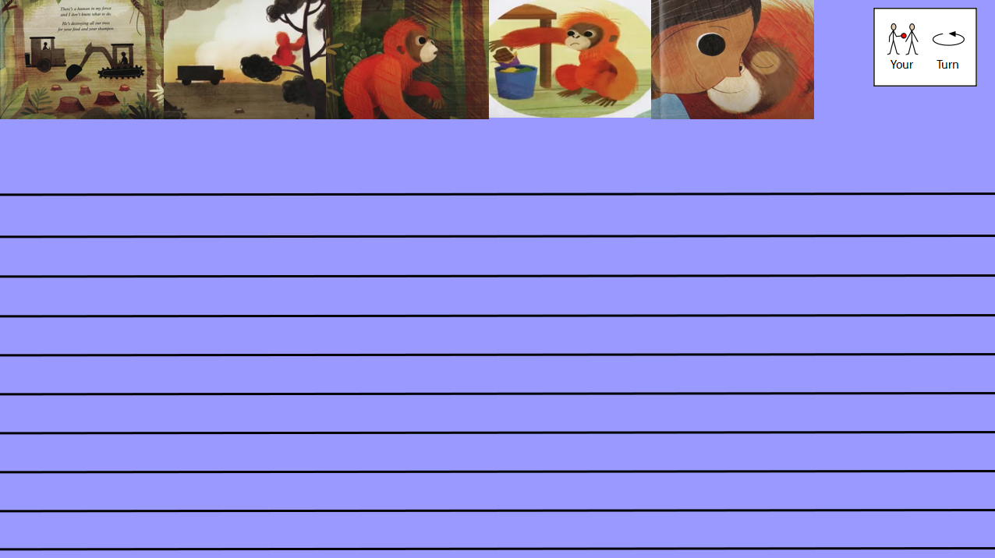
Retell of the story …
Today you are going to retell the story ‘There’s a Rang - Tan in my bedroom’.
If you are finding this task a bit tricky, you can have a go at the sentence building activity on the next few slides.
Your story must include:
At least 6 sentences
Adjectives (at least 5)
The conjunction ‘and’ to extended sentences (used at least 2 times)
Use the pictures to help you
You can use the blank lines on the next slide to type your story or you can write your story on paper.
This piece of writing should take approximately 45 minutes

Slide 46
Sentence building
Read and order the cards to build the sentence. Remember the capital letter goes at the start of the sentence and the full stop goes at the end. Use the symbols to help you work out the word if you are finding it tricky to read.
You can cut and stick the pictures in the correct order or drag them into the correct boxes on your computer.
Once you have ordered the sentence cards, copy the words to write your sentence.
For example:
The sky was grey.

Slide 47



Sentence building
Read and order the cards to build the sentence. Remember the capital letter goes at the start of the sentence and the full stop goes at the end. Use the symbols to help you work out the word if you are finding it tricky to read.
You can cut and stick the pictures in the correct order or drag them into the correct boxes on your computer.

Slide 48


Sentence building
Read and order the cards to build the sentence. Remember the capital letter goes at the start of the sentence and the full stop goes at the end. Use the symbols to help you work out the word if you are finding it tricky to read.
You can cut and stick the pictures in the correct order or drag them into the correct boxes on your computer.

Slide 49

Sentence building
Read and order the cards to build the sentence. Remember the capital letter goes at the start of the sentence and the full stop goes at the end. Use the symbols to help you work out the word if you are finding it tricky to read.
You can cut and stick the pictures in the correct order or drag them into the correct boxes on your computer.

Slide 50
Sentence building
You can write your sentences neatly on a piece of paper or type them on the lines below.

Slide 51
Well done for all of your hard work! We can’t wait to see your completed work.
Could any completed work / photographic evidence of completed work please be sent to pioneerspupils@gmail.com
Thank you!

Slide 52
Date: Friday 12th February
LO To be able to read and spell words with the ‘ir’ sound.
Subject: English

Slide 53

ir
The sound we are focusing on today is ir.
The ir sound is used at the end of words or in the middle of words.
Click on the links or copy and paste the links into your internet browser to watch the phonics videos.
Phonics 'ir' sound (complete RWI Phonics lesson) – YouTube
The IR Sound | Phase 5 | Phonics – YouTube
The /ir/ spelling pattern - Mr Thorne Does Phonics – YouTube

Slide 54
Read the ‘ir’ words
fir
stir
girl
sir
bird
dirt
swirl
firm
hire
shirt
first
skirt
Now write the words on a piece of paper and underline the ‘ir’ sound.

Slide 55

Real or Alien words?
Read the words and decide if they are real words or alien words.
Real words
fir
Alien words
eir
bird
lird
fird
skirt
girl
wirg
sir
shirt
qirt
Remember alien words are made up words!

Slide 56
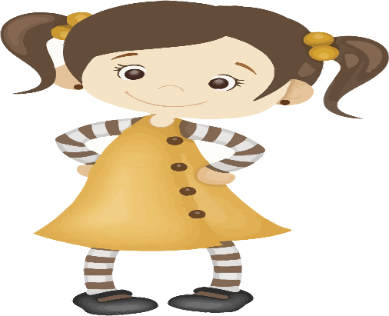
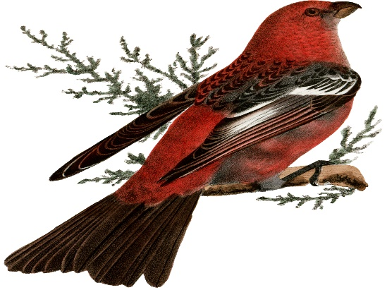
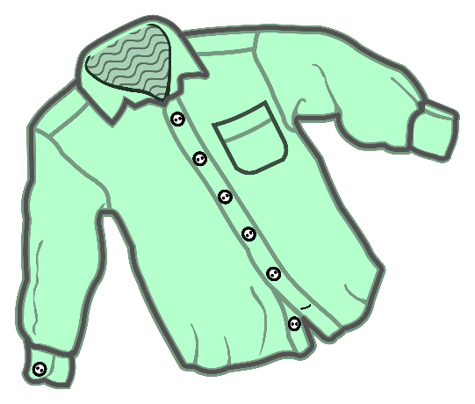


Match the picture to the correct word
shirt
bird
stir
girl
first

Slide 57
Match the picture to the correct word- answers
shirt
bird
stir
girl
first

Slide 58

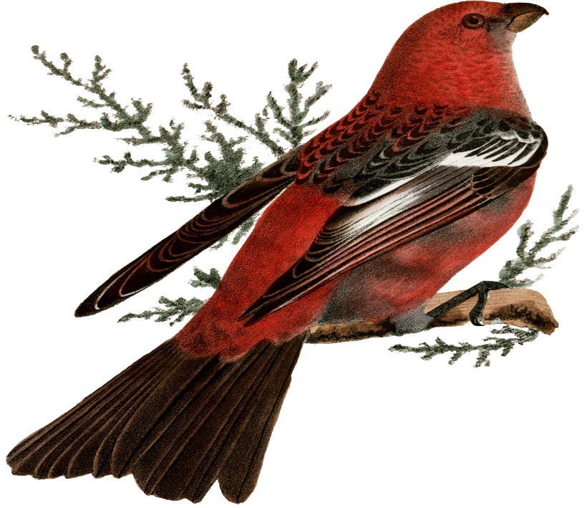

Write the word under the picture

Slide 59
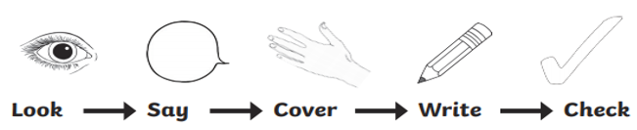
word | 1st try | 2nd try | 3rd try
sir
girl
dirt
bird
stir
first
skirt
shirt
Practice writing the words on a piece of paper or type into the table on your computer.

Slide 60
‘ir’ sound
Now pick 3 ‘ir’ words and write a sentence including each word.
girl
stir
shirt
dirt
fir
bird
first
skirt
sir

Slide 61
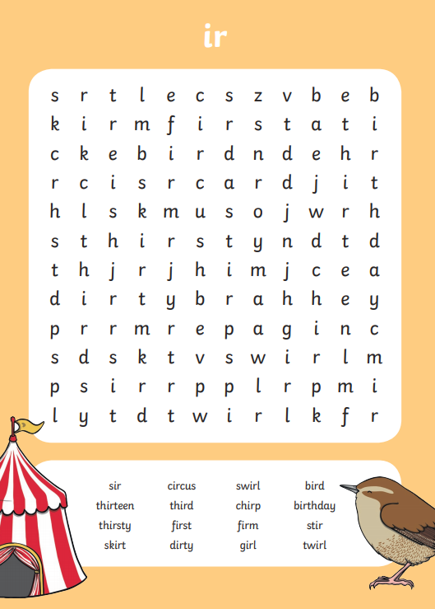
Word search

Slide 62
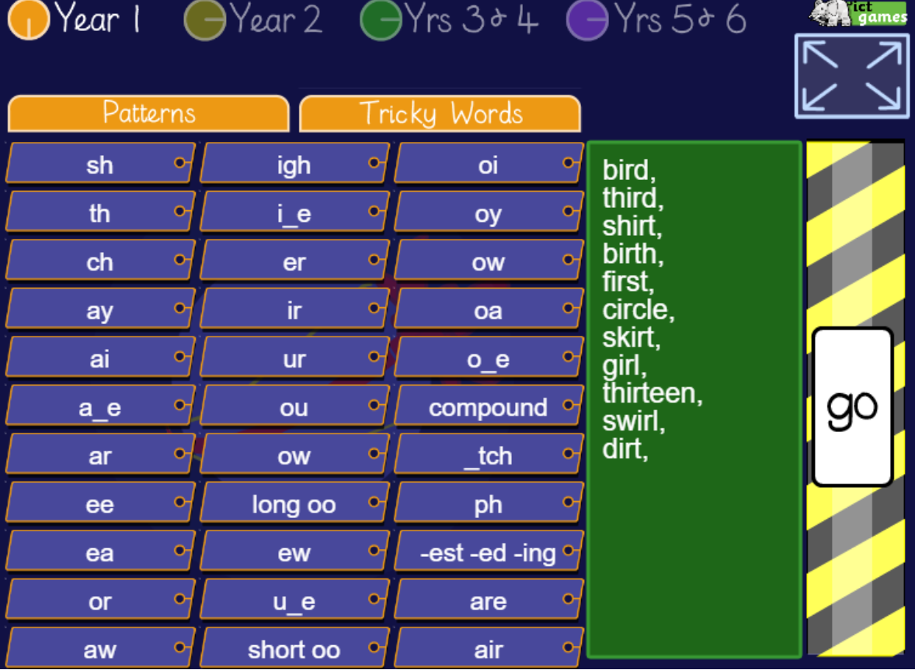
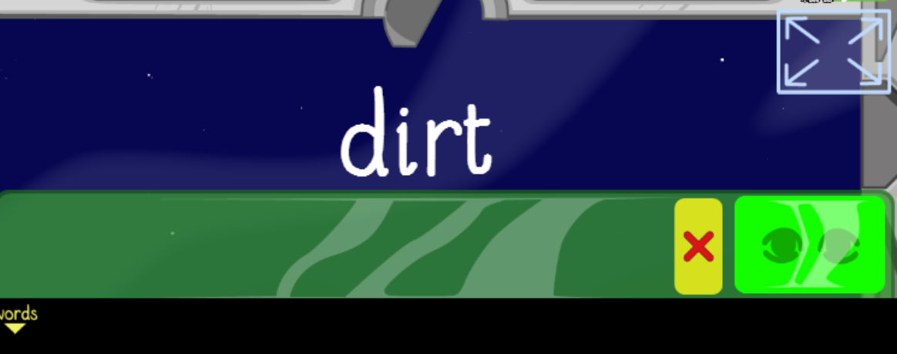
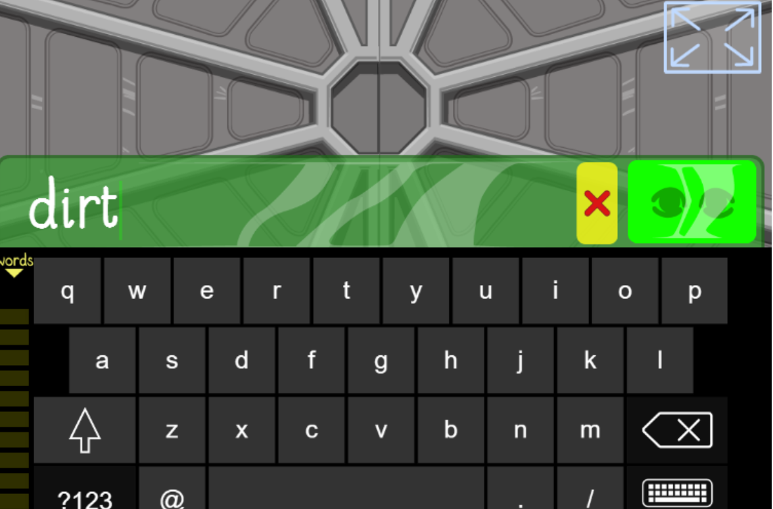
Spelling game!
Use the link to play the game and practice spelling the ‘ir’ words
Look, Cover, Write, Check- mobile friendly (ictgames.com)

Slide 63
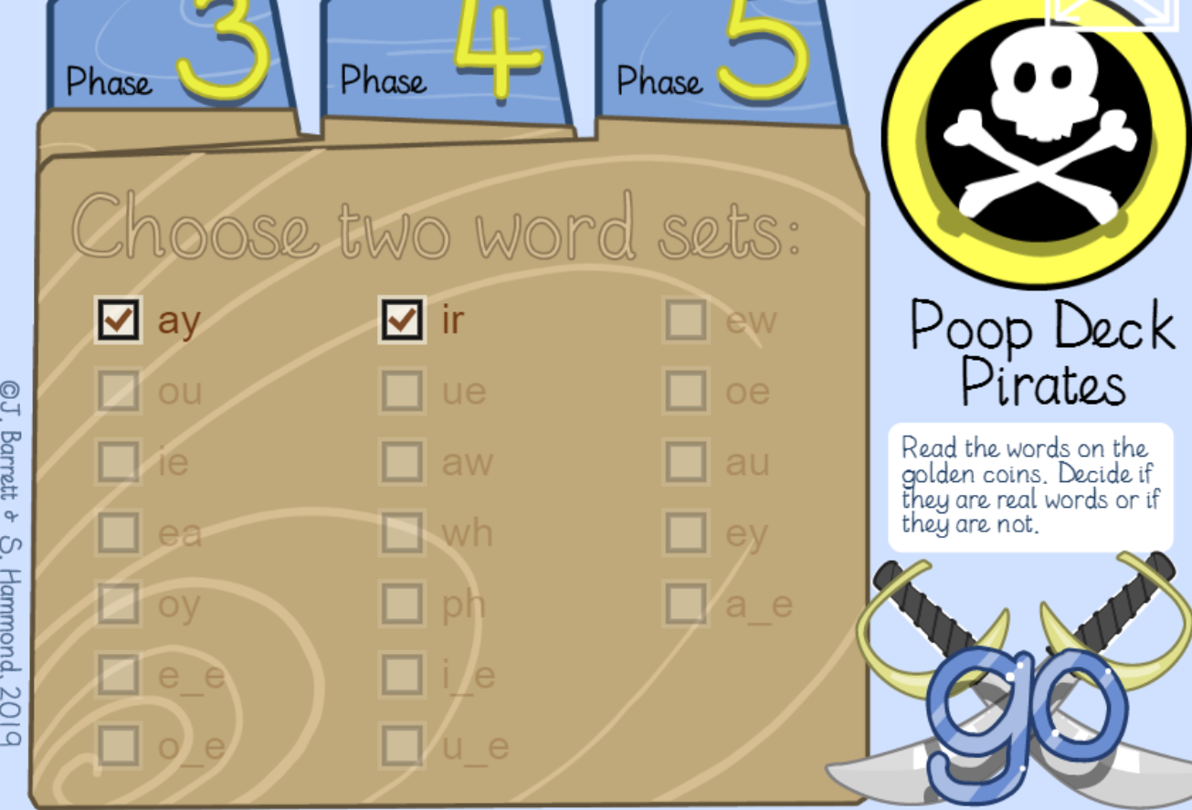
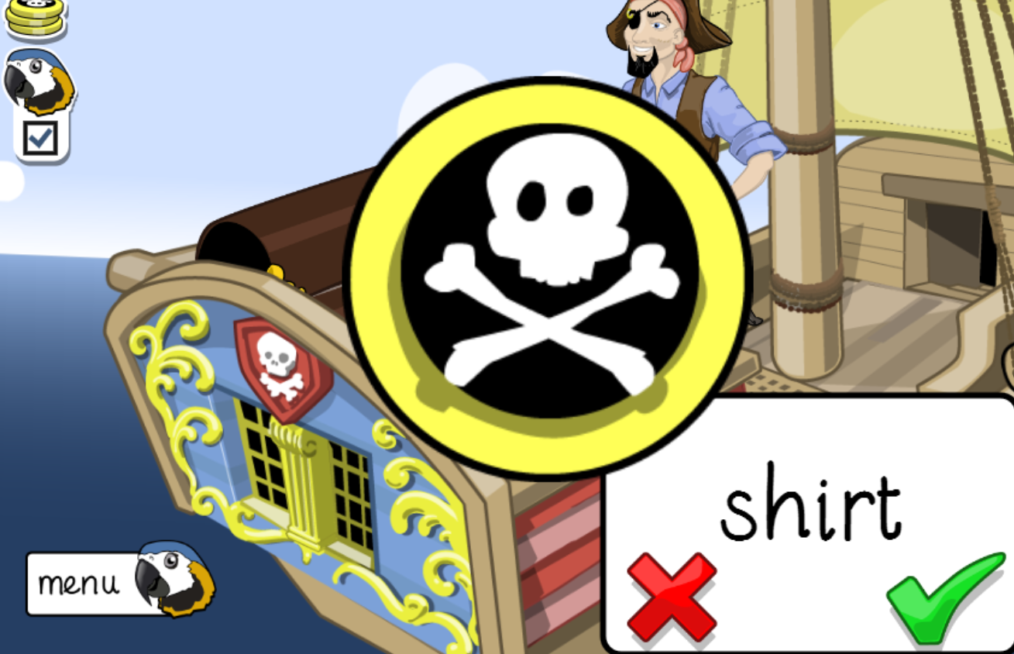
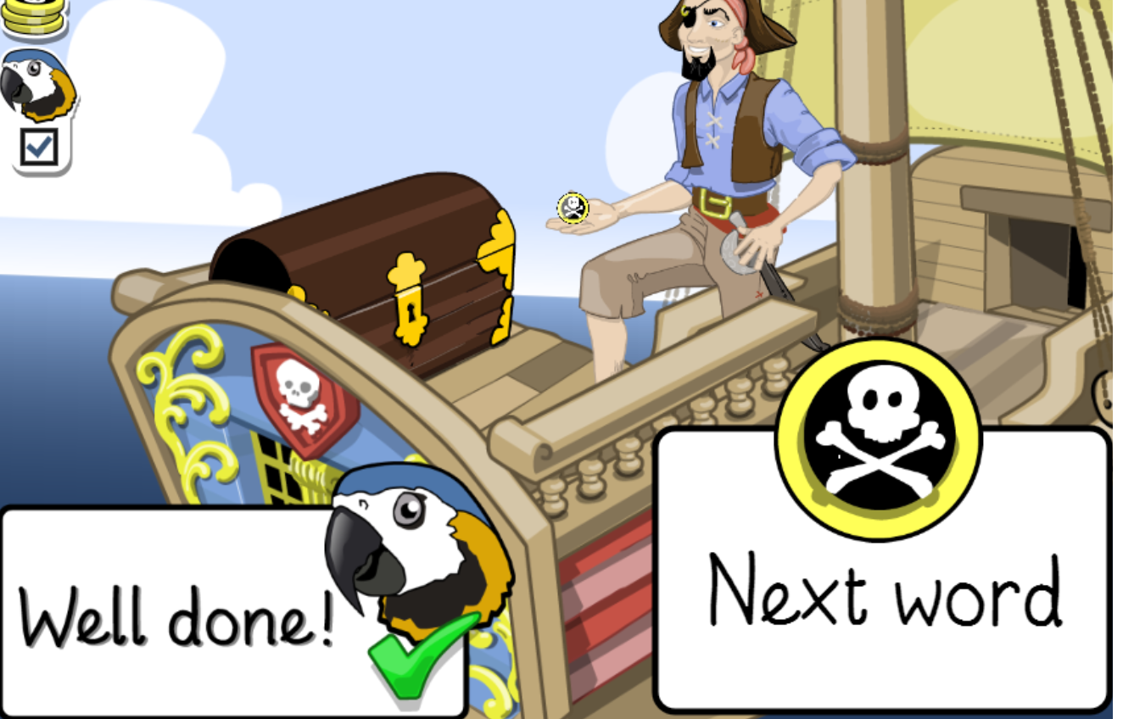
Spelling game!
Use the link to play the game and practice spelling the ‘ir’ words
Poop Deck Pirates - mobile friendly (ictgames.com)

Slide 64
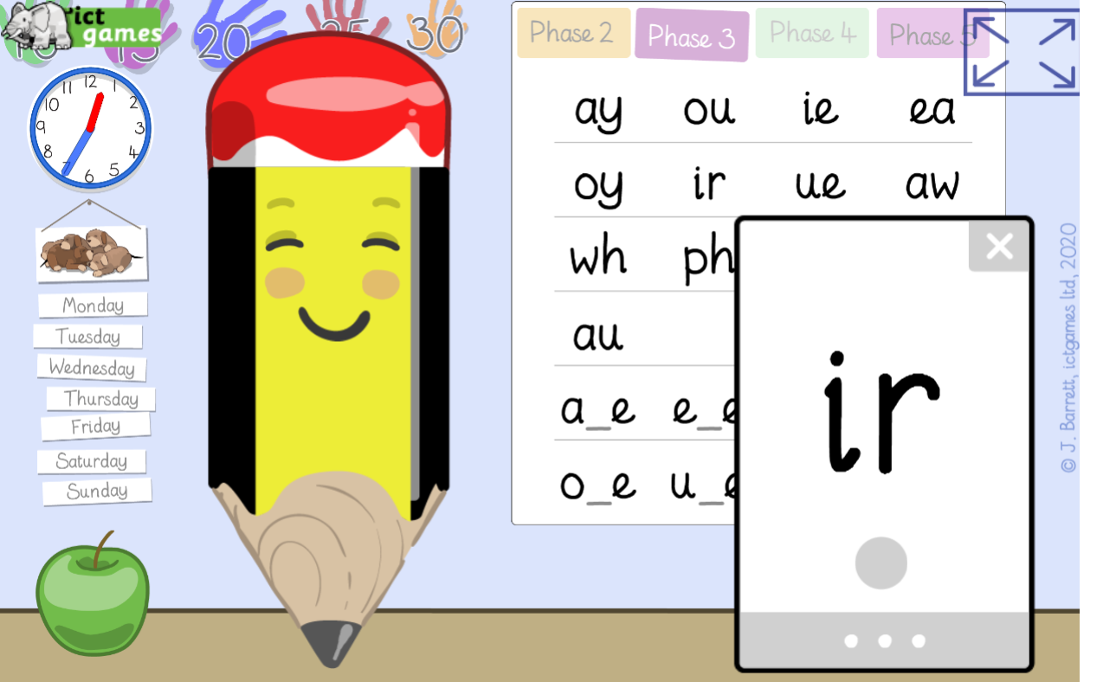

Spelling game!
Use the link to play the game and practice reading the ‘ir’ words
Sound Sayer (ictgames.com)

Slide 65
Well done for all of your hard work! We can’t wait to see your completed work.
Could any completed work / photographic evidence of completed work please be sent to pioneerspupils@gmail.com
Thank you!

