Slide 1



Date: Monday 28th June 2021
LO
LO.
Subject: P.E

Slide 2


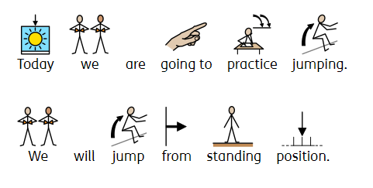

Jumping

Slide 3
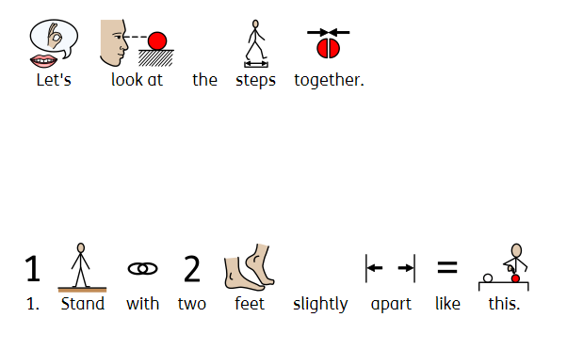

Jumping

Slide 4
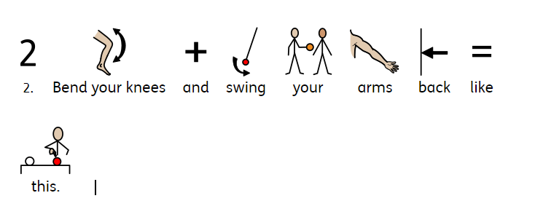

Jumping

Slide 5

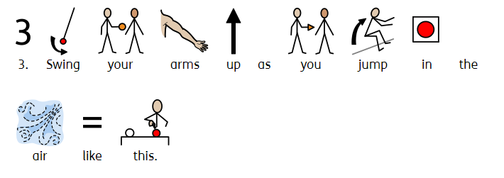
Jumping

Slide 6




Jumping
Click on the link to watch the music video.
jumping song

Slide 7

Date: Tuesday 29th June 2021
LO
LO.
Subject: Science

Slide 8
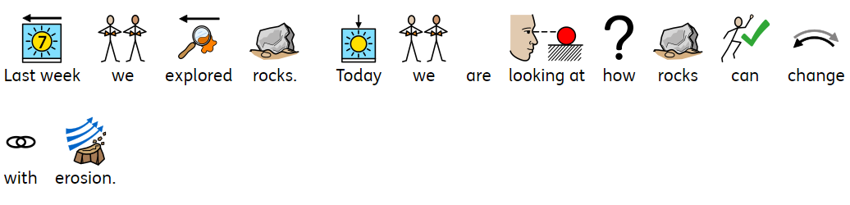
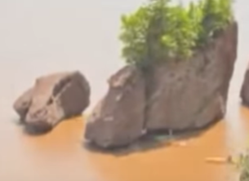
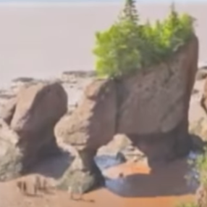

Rock erosion

Slide 9

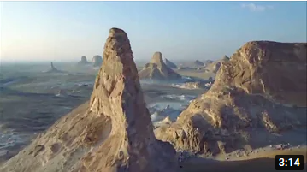
Rock erosion
.
rock erosion

Slide 10

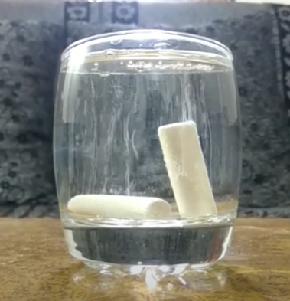

Rock erosion.
chalk in water

Slide 11


Rock erosion

Slide 12

Date: Wednesday 30th June 2021
LO
LO.
Subject: Science

Slide 13

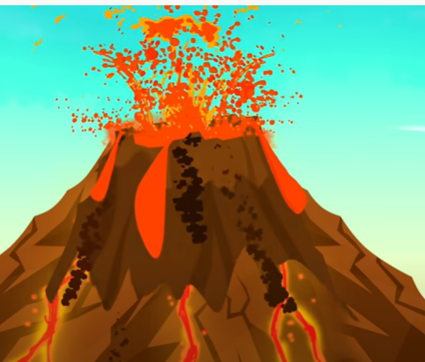
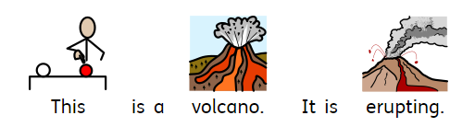
Volcanoes.

Slide 14
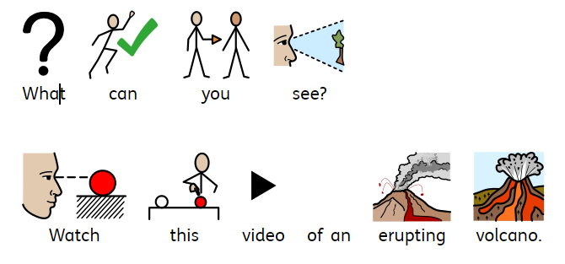
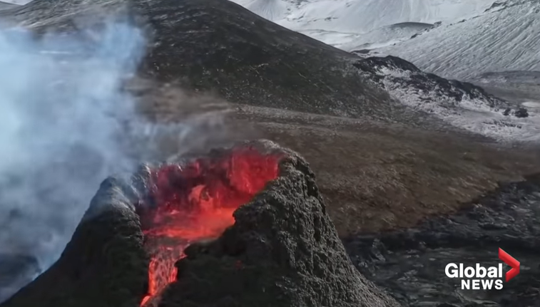
Volcanoes
Iceland volcano: Drone footage captures stunning up-close view of eruption - YouTube

Slide 15

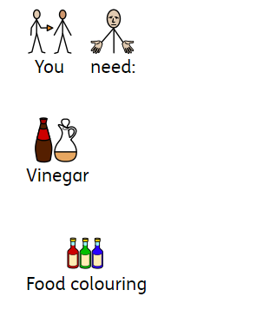
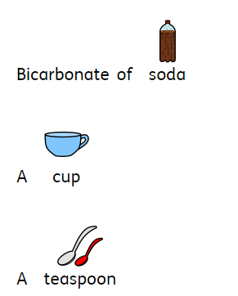
Volcanoes

Slide 16
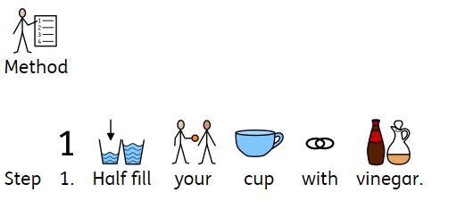


Volcano

Slide 17
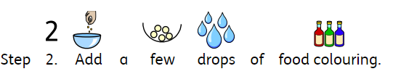
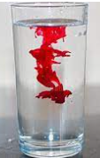
Volcano

Slide 18
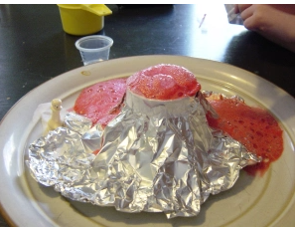
Volcano

Slide 19

Volcano

Slide 20

Date: Thursday 1st July 2021
LO
LO.
Subject: Science

Slide 21

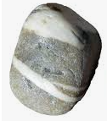


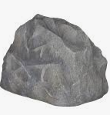
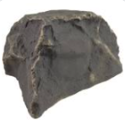


Rocks.

Slide 22




Rocks.

Slide 23



Rocks.

Slide 24

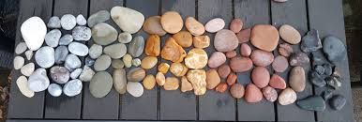
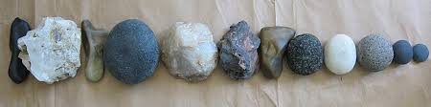
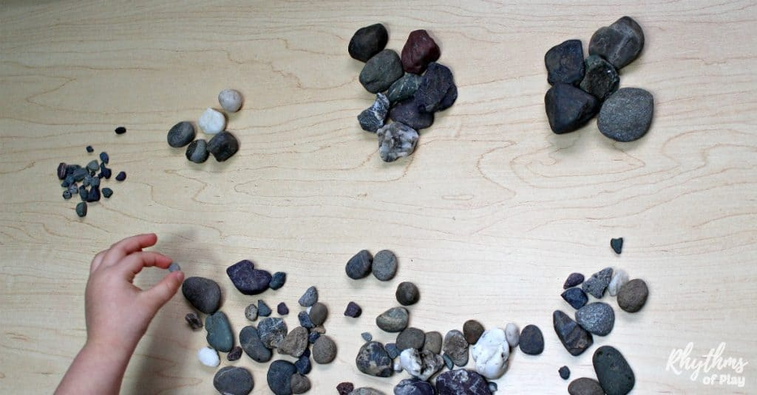
Rocks.

Slide 25

Date: Friday 2nd July 2021
LO
LO.
Subject: Science

Slide 26
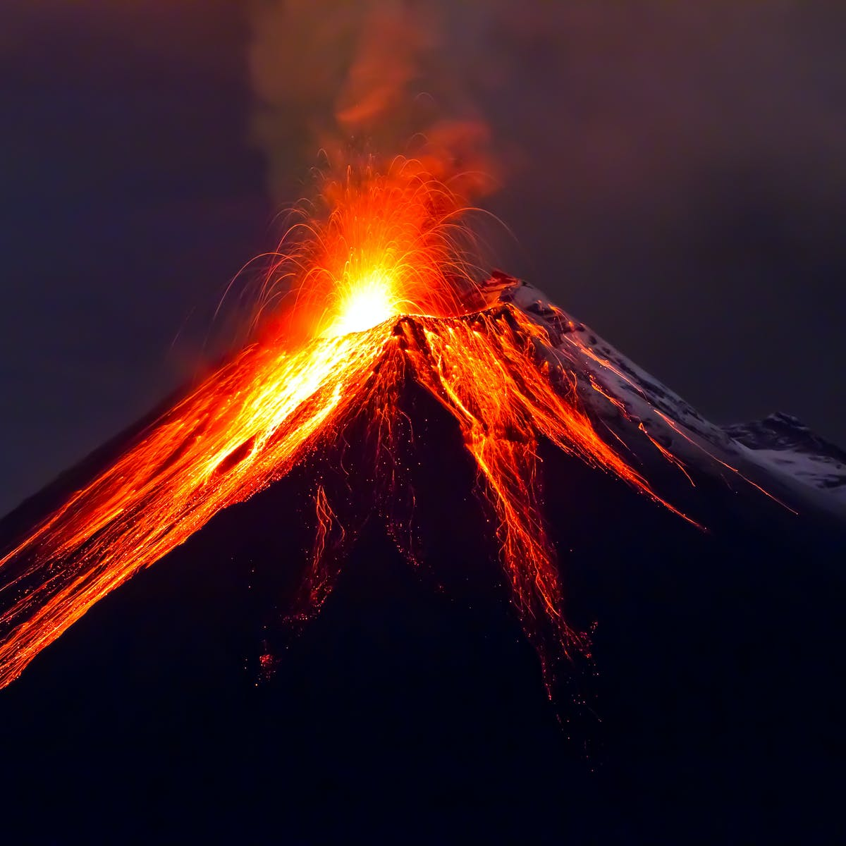
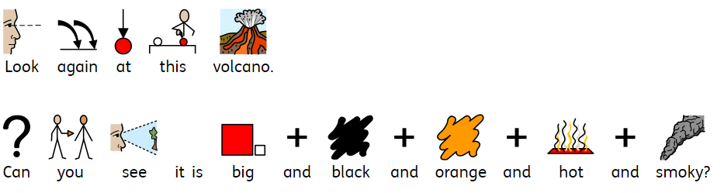
Volcanoes.

Slide 27


Volcanoes.
Big
smoky
hot
black
orange

Slide 28
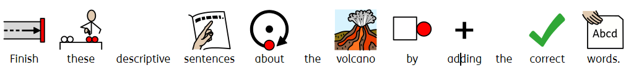




Volcanoes.

Slide 29
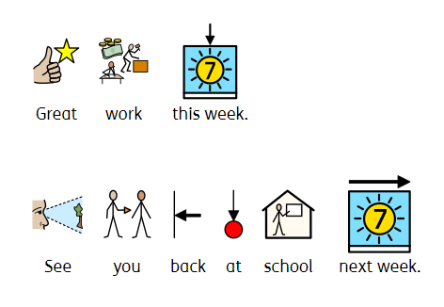
Finished.

