Slide 1
Date: Tuesday 5th January
LO To be able to use pencil to draw a koala.
Subject: Art & Design

Slide 2
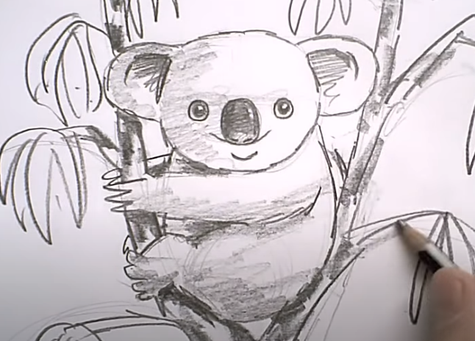
Tutorial
Follow the YouTube video to draw your own koala:
https://www.youtube.com/watch?v=tZ8moHK1-eQ
Copy and paste the link

Slide 3
Date: Wednesday 6th January
LO To be able to use pencil to draw an emu.
Subject: Art & Design

Slide 4
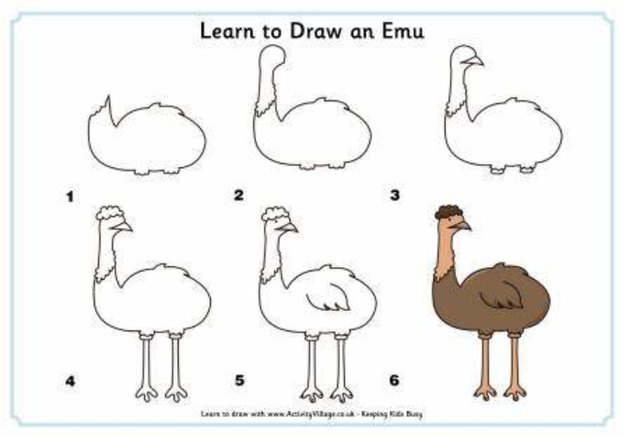
Tutorial
Draw an emu following the step-by-step diagrams...
But don’t colour it in yet!

Slide 5
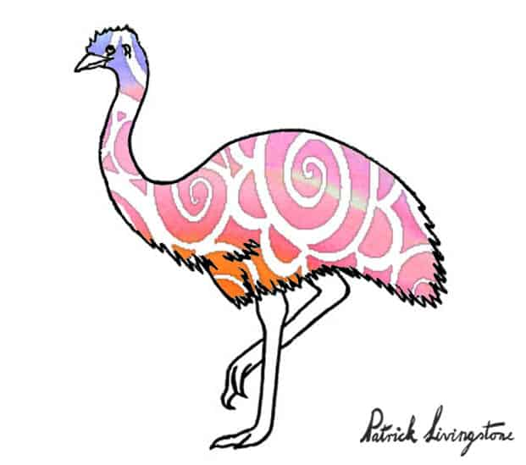
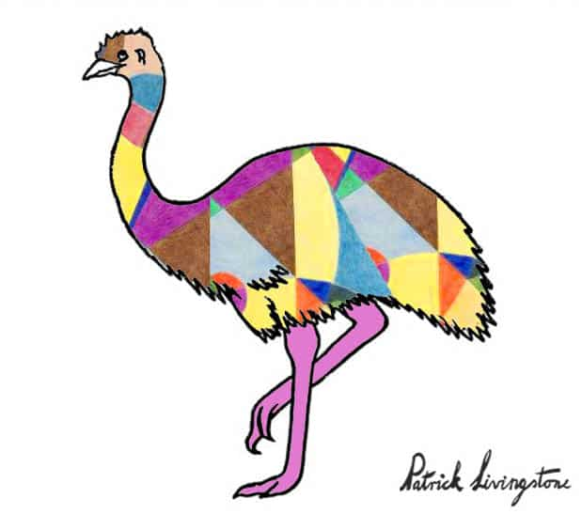
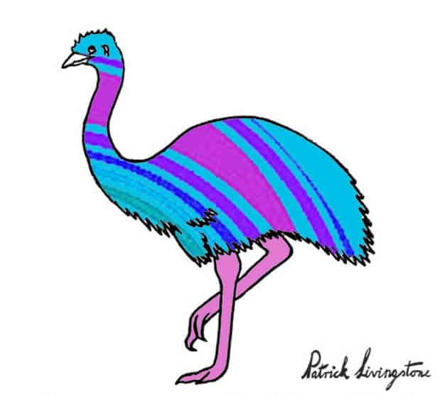
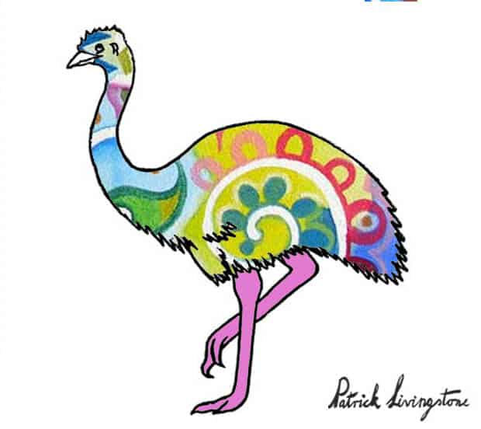
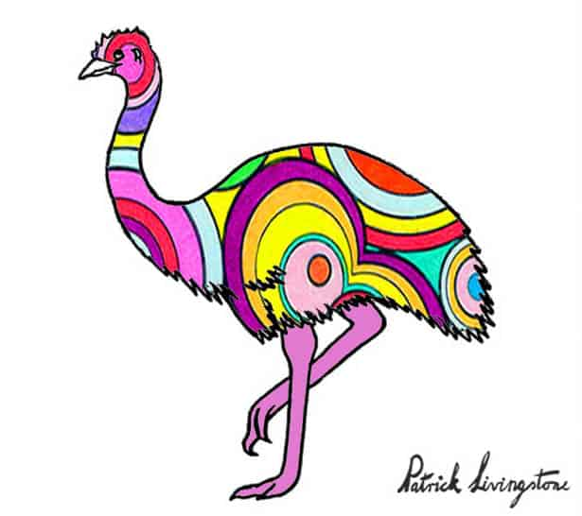
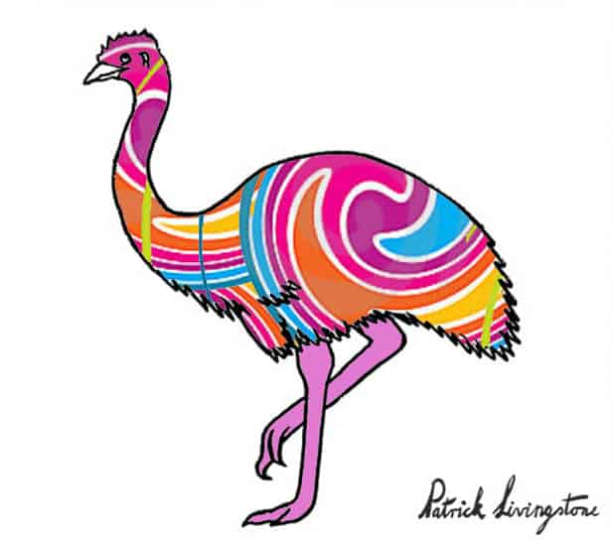
Patrick Livingstone
Which is your favourite?

Slide 6
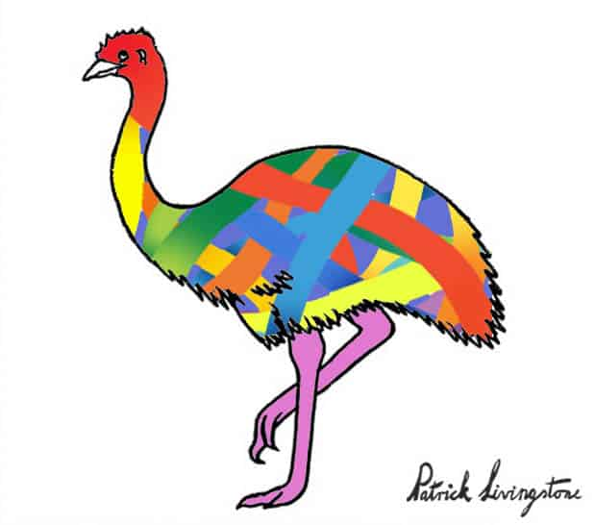
Colour
Decorate your emu in the style of Patrick Livingstone!
Look back at his work for inspiration.

Slide 7
Date: Thursday 7th January
LO To be able to use pencil to draw a kangaroo.
Subject: Art & Design

Slide 8
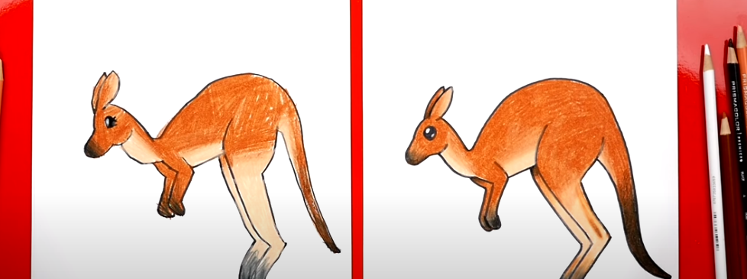
Tutorial
https://www.youtube.com/watch?v=FZLFACI54aY
Follow the YouTube video to draw your own kangaroo:

Slide 9
Date: Friday 8th January
LO To be able to draw a picture of the Australian Outback.
Subject: Art & Design

Slide 10
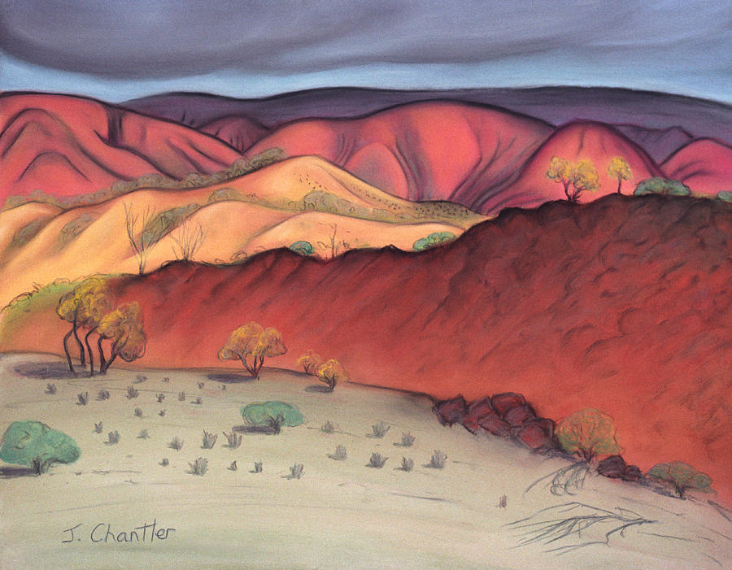
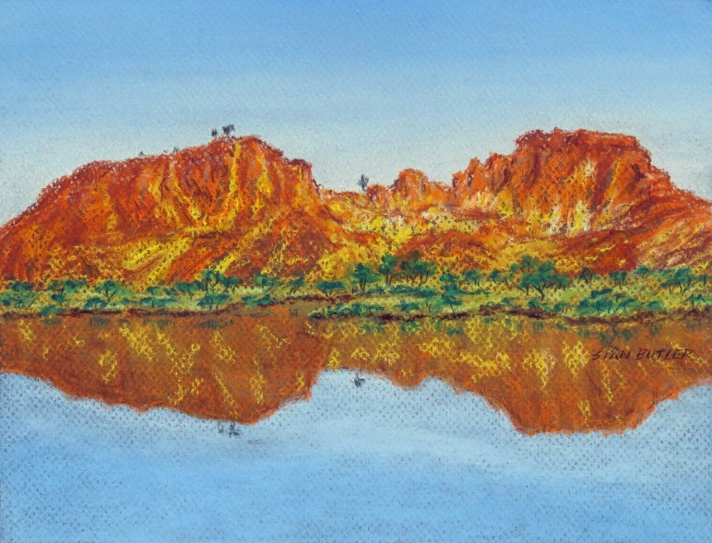
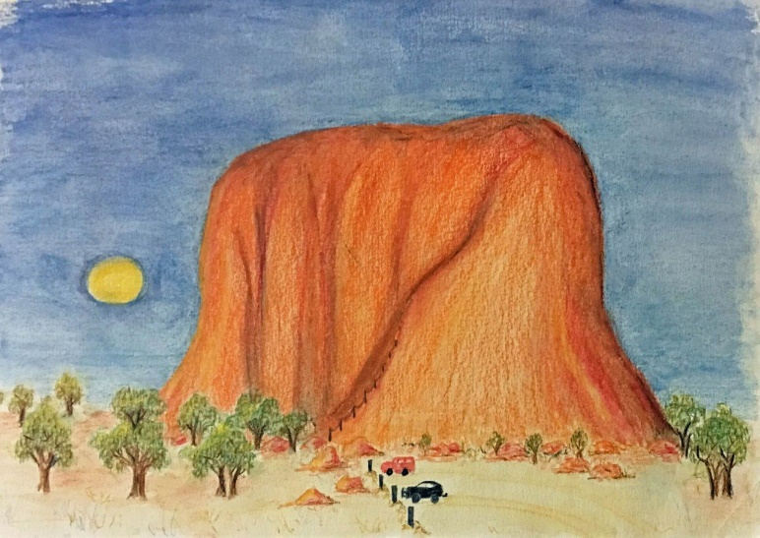
Outback Drawing Examples
Outback Drawing Examples

Slide 11
Draw the Outback …
Draw the Outback …
Using the examples as inspiration, draw your own picture of the Outback.
Challenge!
Can you include the animals you’ve drawn earlier this week in your art work?
Colour it in neatly using coloured pencils …
Challenge!
Can you shade with your coloured pencils to show the darker and lighter areas in your art?
Either send a photograph of your art work by email or bring your artwork into class when we are back at school – I can’t wait to see it!

